Slide 1
Indonesian music
Composers discover the Balinese Gamelan

Slide 2
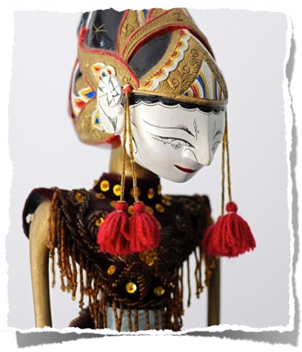
Balinese culture
Banjar - village - basic unit of Balinese political and social organization
Hindu culture - many holidays, all celebrated by music, dance and affiliated arts
Clubs take responsibility for music & dance

Slide 3
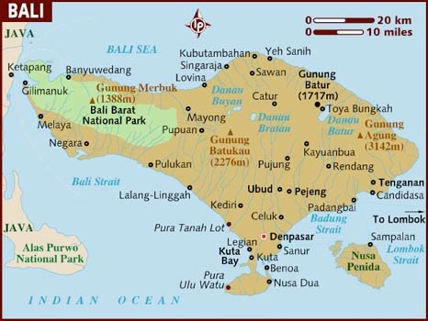
Bali has a great diversity of Gamelan instruments and musical styles. The most common are bronze orchestras and instruments of bamboo.

Slide 4
musical traits unique to Bali
Kotekan:
the sharing of a musical line through interlocking parts
The Angsel:
a break in an otherwise continuous line, often used to highlight a dance movement
Paired tuning:
instruments are nearly always paired and detuned to create a shimmering or beating effect

Slide 5
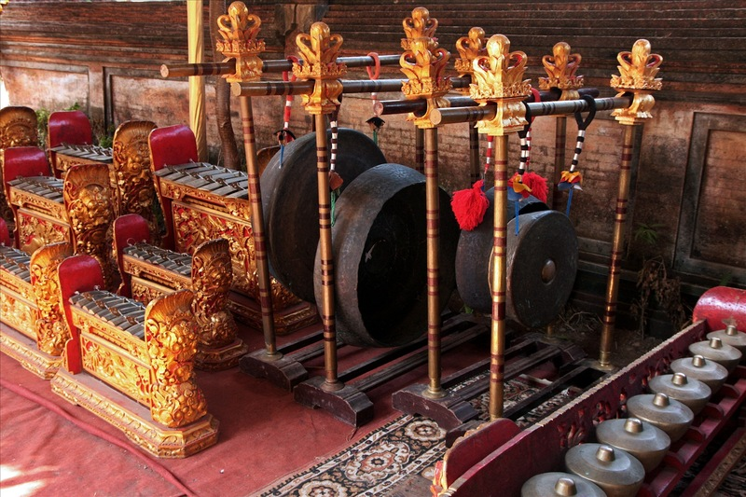
Gamelan gong kebyar

Slide 6
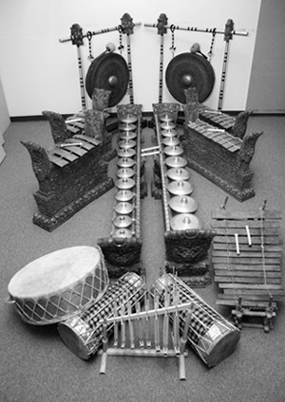
Categories of Instruments
knobbed gong instruments
metallophones
suling - bamboo flute
drums

Slide 7
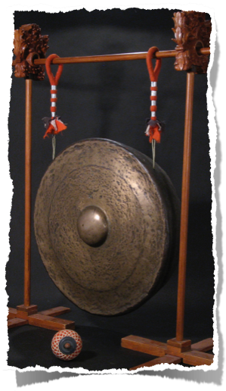
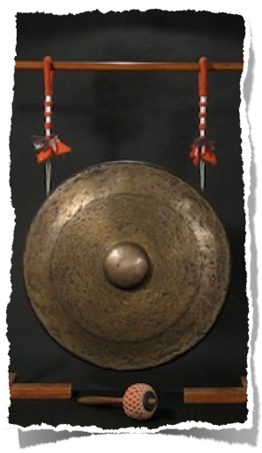
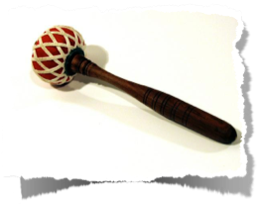
Gong
Knobbed Gong Instruments

Slide 8
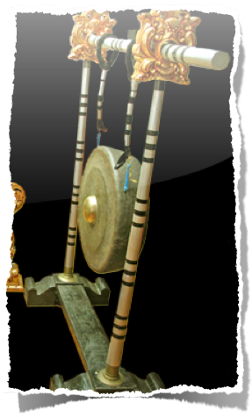
Kempur
Knobbed Gong Instruments

Slide 9
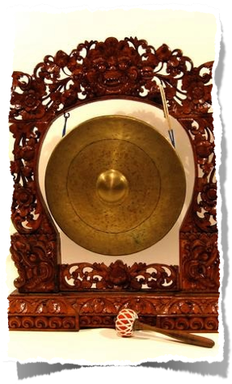
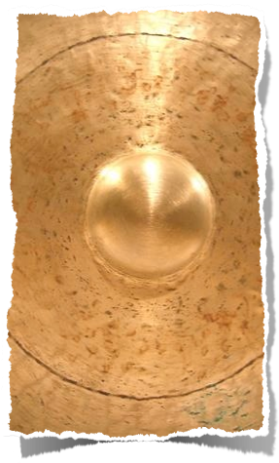
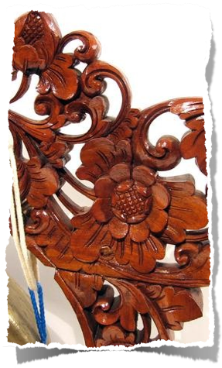
Kemong
Knobbed Gong Instruments

Slide 10
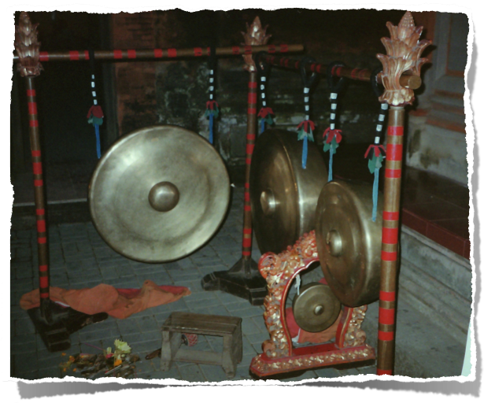
Gongs play the basic structure

Slide 11
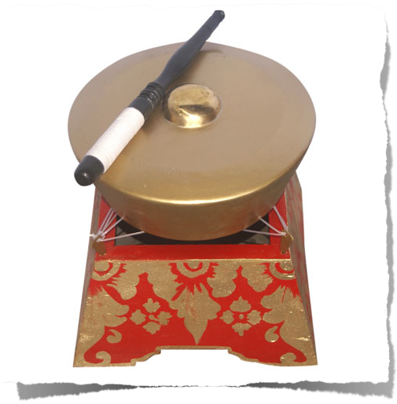
kempli
Knobbed Gong Instruments

Slide 12
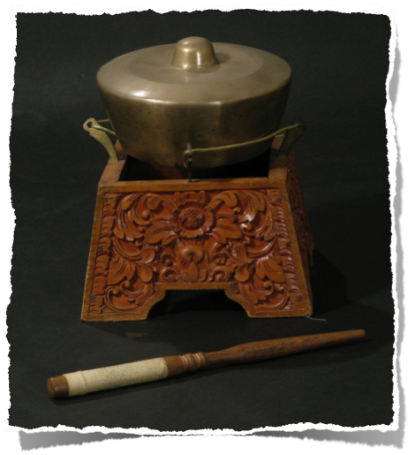
kemjar or kethuk
Knobbed Gong Instruments

Slide 13
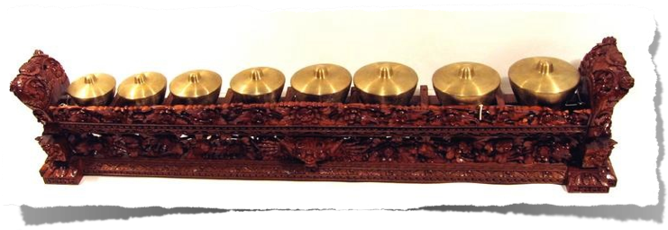
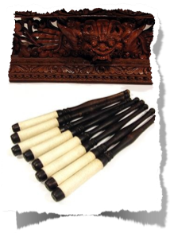
Reyong
Knobbed Gong Instruments

Slide 14
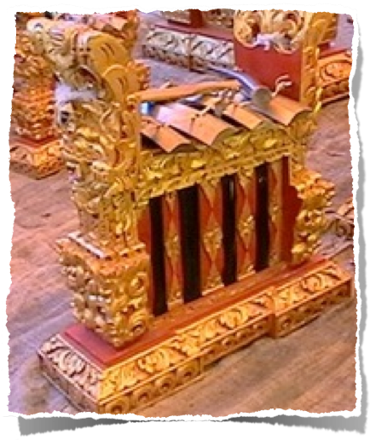
jegogan
Gangsa family (Metallophones)

Slide 15
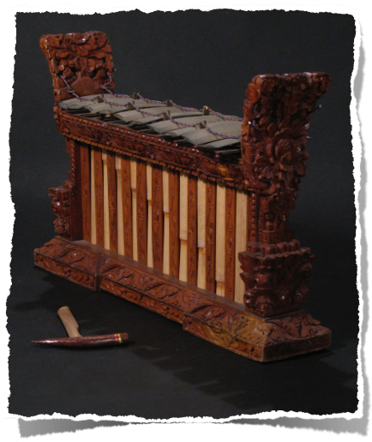
calung/ugal
Gangsa family (Metallophones)

Slide 16
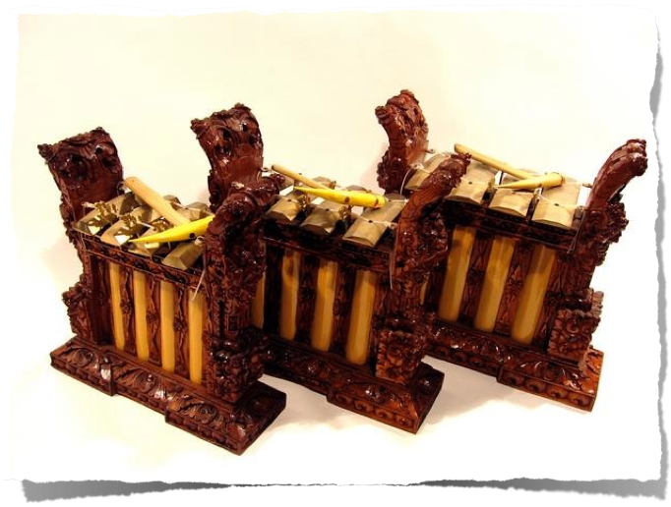
pemade
Gangsa family (Metallophones)

Slide 17
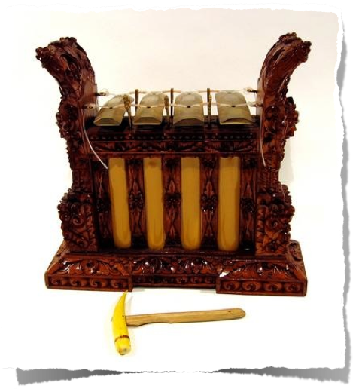
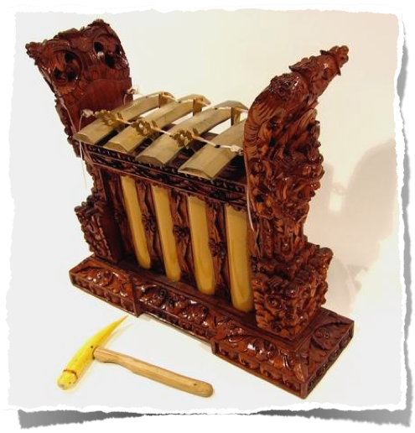
kantilan
Gangsa family (Metallophones)

Slide 18
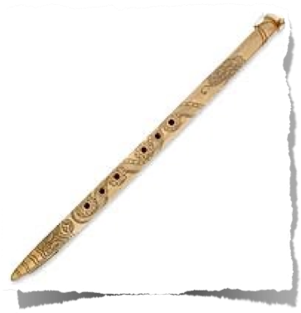
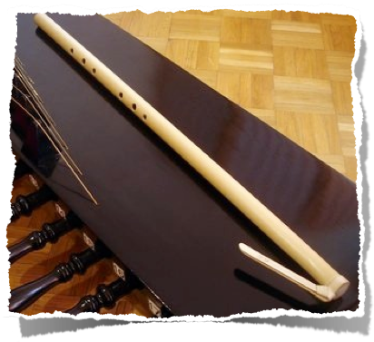
suling (bamboo flute)
melodic Instruments

Slide 19
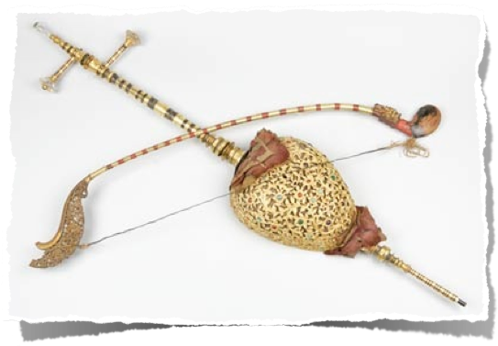
rebab
melodic Instruments

Slide 20
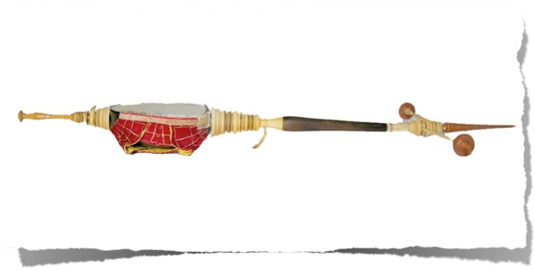
rebab
melodic Instruments

Slide 21
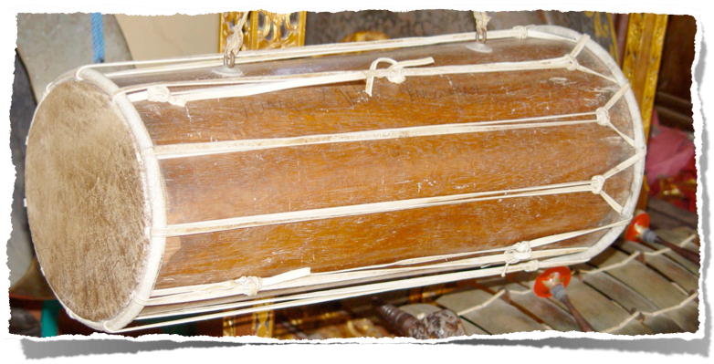
kendang
drums

Slide 22
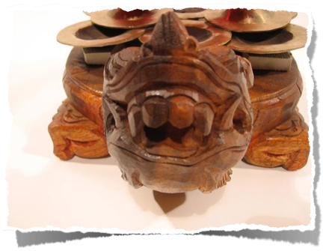
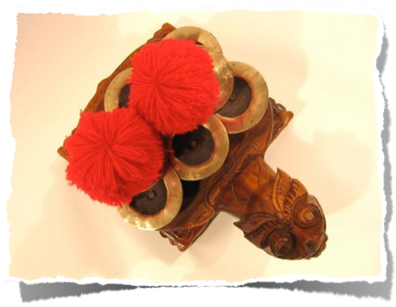
ceng-ceng
play with drums

Slide 23
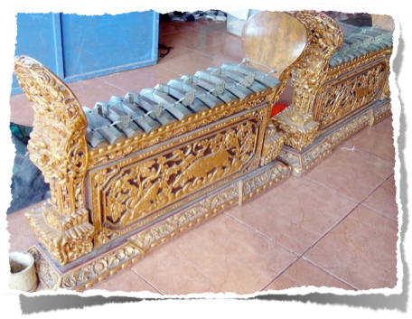
Gamelan gong keybar vs. pegulingan
gong kebyar loudest and most modern
gamelan pegulingan (or pelogongan) the “love” ensemble, lighter
both play in pelog (7 tone scale)

