Slide 1
Indonesian music
Javanese Gamelan

Slide 2
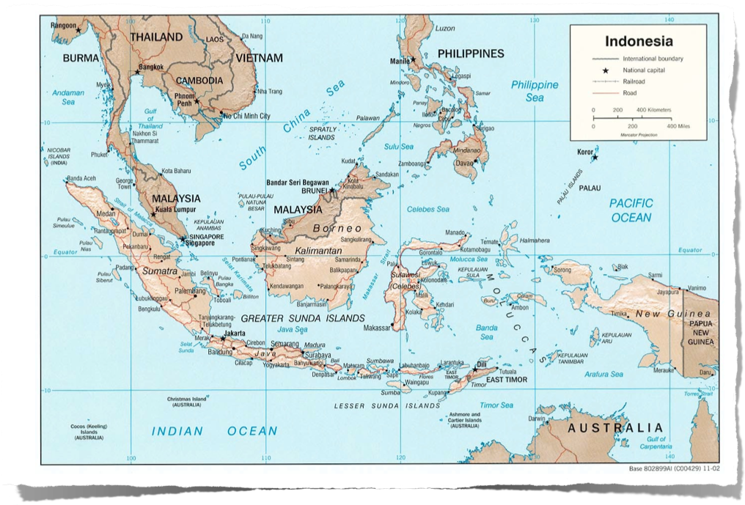
Where is Indonesia?

Slide 3
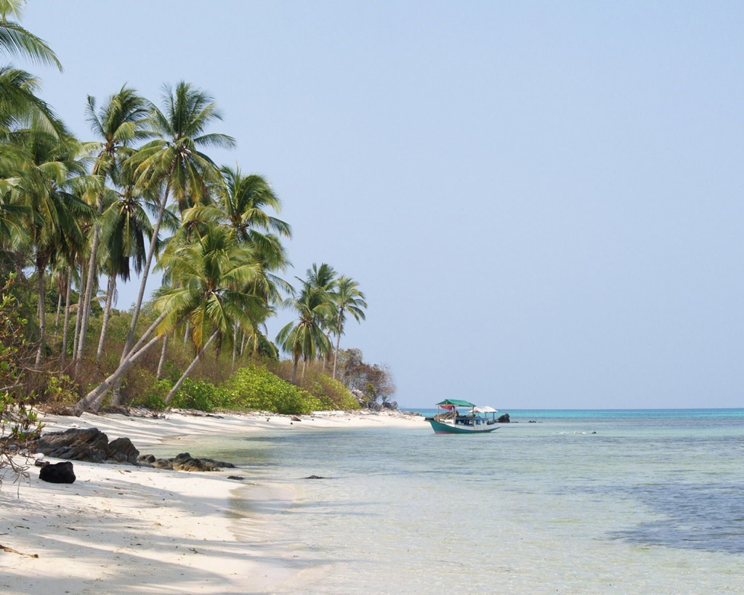
What led to the unification and independence of Indonesia in 1949?
Formerly known as the Dutch East Indies
European colonial domination imposed geographical borders and a single rule over diverse peoples living throughout a vast archipelago.

Slide 4
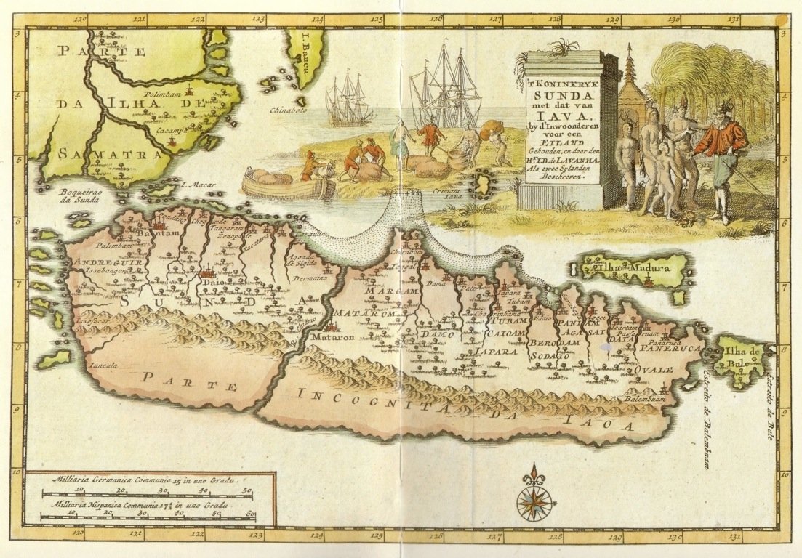
Unification occurred with the
adoption of a national language,
revolution against the Dutch (1945-1949) and
Indonesia’s independence.

Slide 5
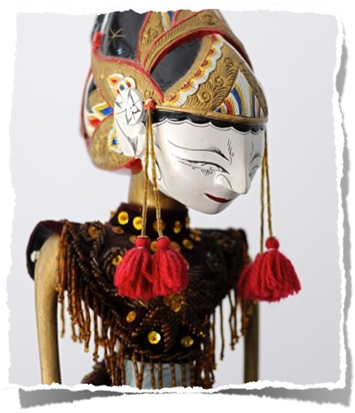
Indonesian culture
Regional diversity makes speaking of a single “Indonesian” culture problematic.
Many different kinds of music exist side-by side.

Slide 6
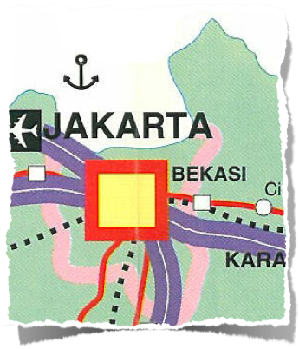
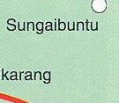
kinds of music you might find in Jakarta, capital of Indonesia
Western-style rock/pop in nightclubs/discos
gamelan (percussion ensemble)
music used to accompany wayang orang (elaborate dance-drama from central Java);
gambang-kromong
and much more!

Slide 7
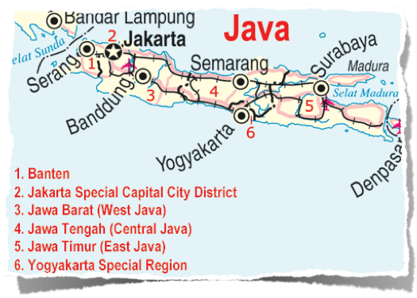
Indonesia’s population
about 238 million (the 4th largest);
Java’s is ca. 135 million

Slide 8
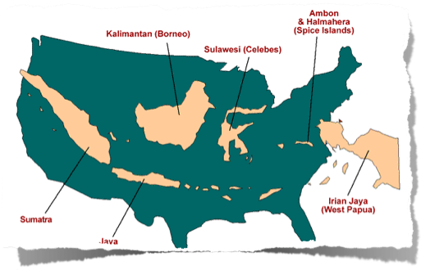
The Javanese are the largest ethnic group
The Sundanese live in the western third of Java
Most Javanese are Muslim, but it is a syncretic fusion of Islam with Hinduism, Buddhism, ancestor worship

Slide 9
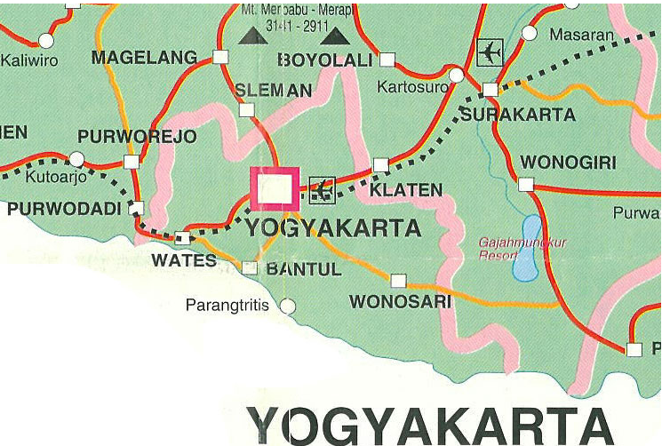
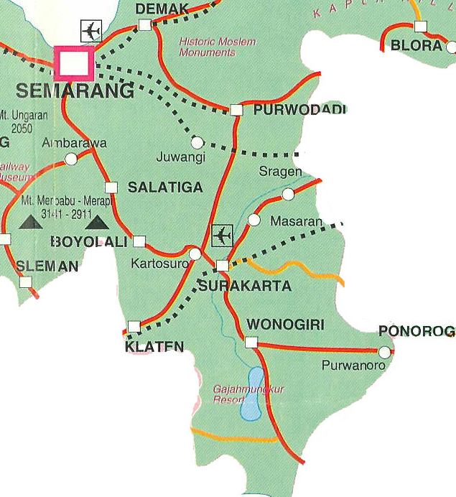
Name the 2 court cities in Java
Yogyakarta = Yogya
home of the sultan
Surakarta = Solo
home of the arts

Slide 10
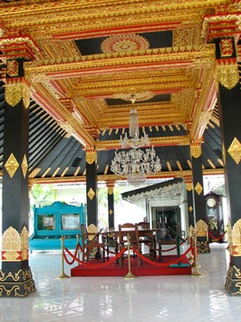
cultural centers
Courts
private individuals
national radio station
schools/colleges,
rural villages

Slide 11
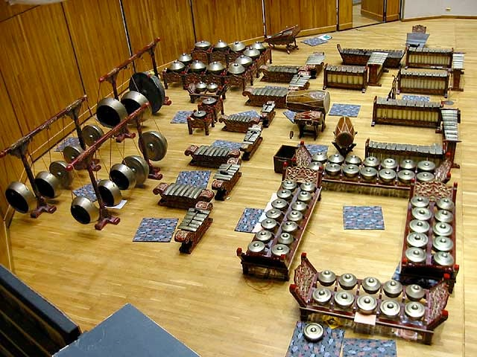
Javanese Gamelan

Slide 12
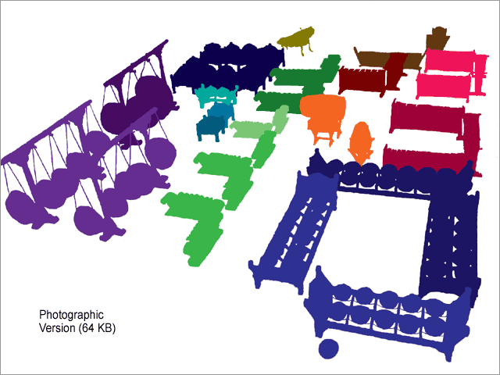
Categories of Instruments
knobbed gong instruments
metal keyed instruments (metallophones)
other melodic instruments
drums

Slide 13
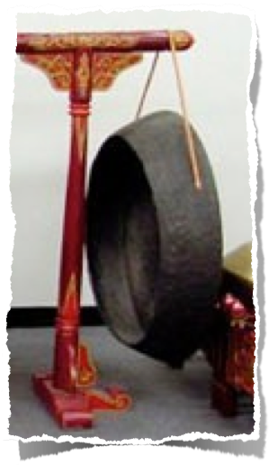
Gong ageng
Knobbed Gong Instruments

Slide 14
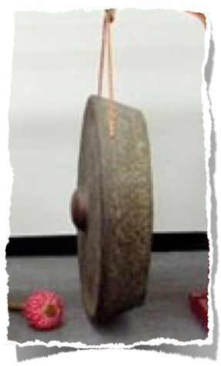
Gong siyem
Knobbed Gong Instruments

Slide 15
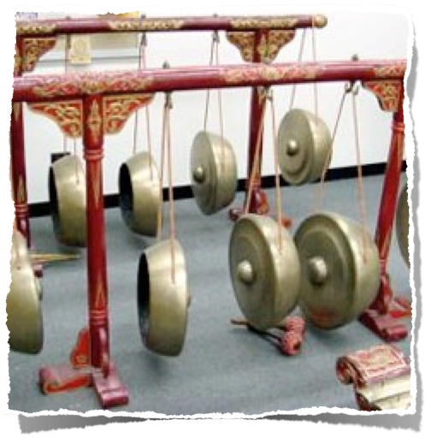
kempul
Knobbed Gong Instruments

Slide 16
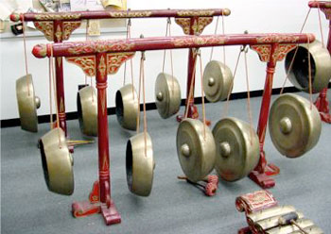
kempul
Knobbed Gong Instruments

Slide 17
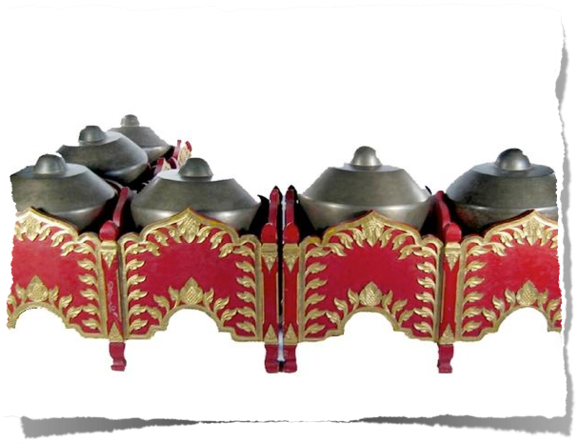
kenong
Knobbed Gong Instruments

Slide 18
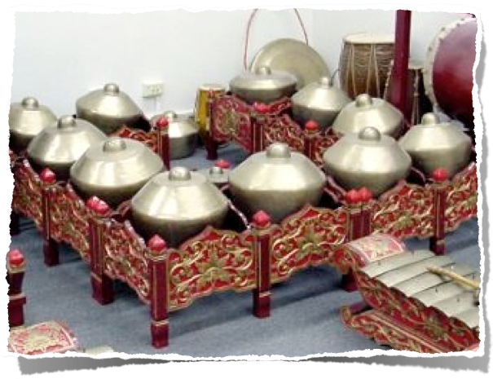
kenong
Knobbed Gong Instruments

Slide 19
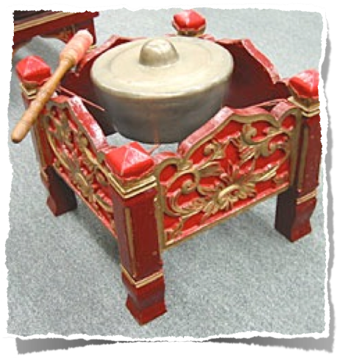
kethuk
Knobbed Gong Instruments

Slide 20
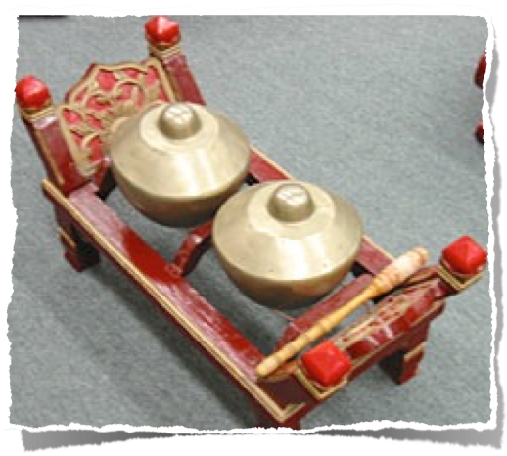
kempyang
Knobbed Gong Instruments

Slide 21
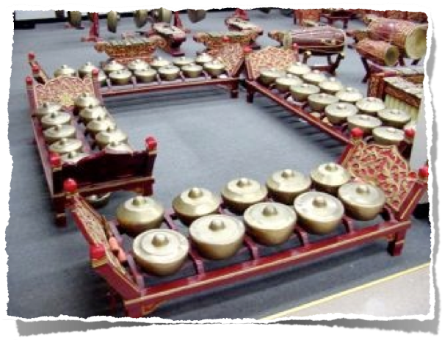
bonang barung
Knobbed Gong Instruments

Slide 22
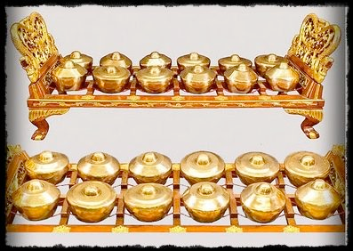
bonang barung
Knobbed Gong Instruments

Slide 23
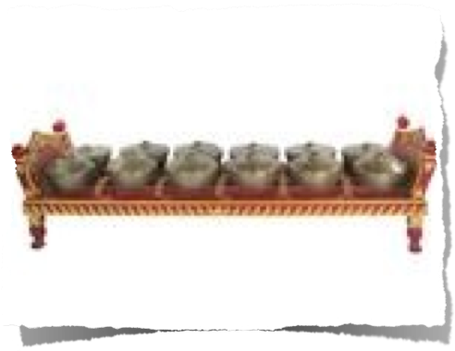
bonang panerus
Knobbed Gong Instruments

Slide 24
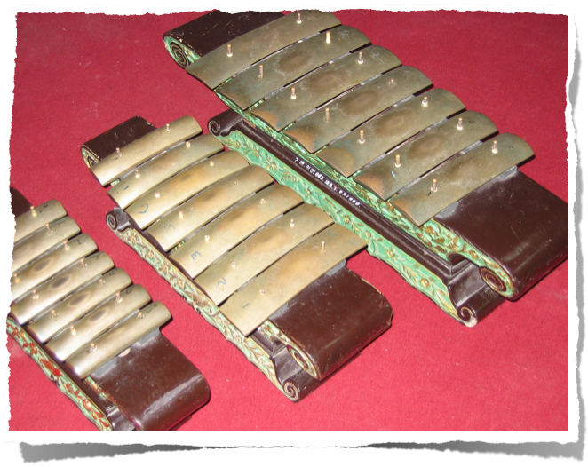
saron
metal keyed Instruments (Metallophones)

Slide 25
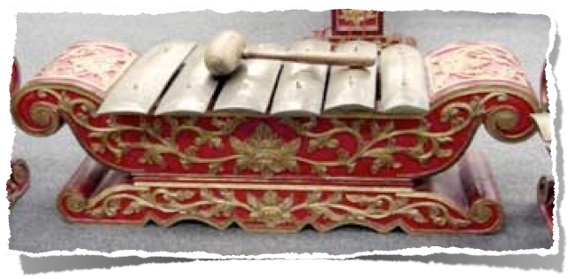
saron demung
metal keyed Instruments (Metallophones)

Slide 26
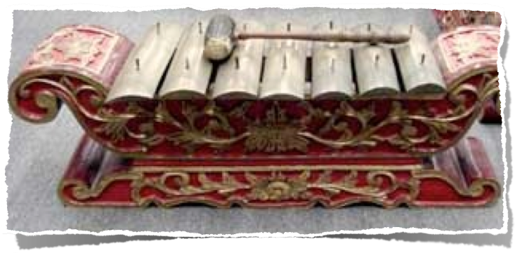
saron barung
metal keyed Instruments (Metallophones)

Slide 27
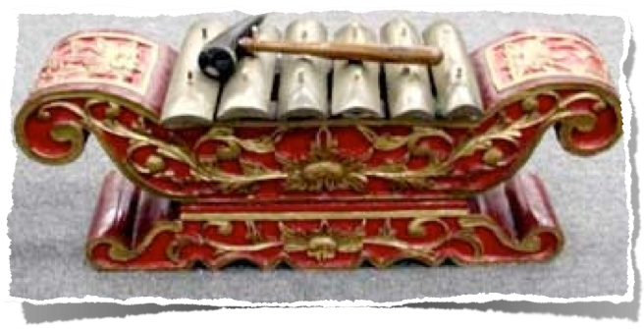
saron peking
metal keyed Instruments (Metallophones)

Slide 28
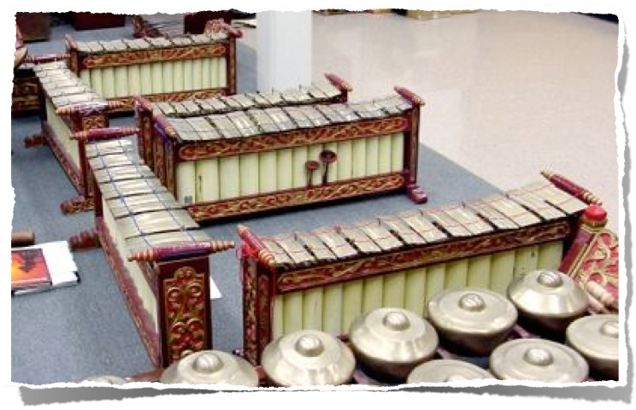
gendèr
metal keyed Instruments (Metallophones)

Slide 29
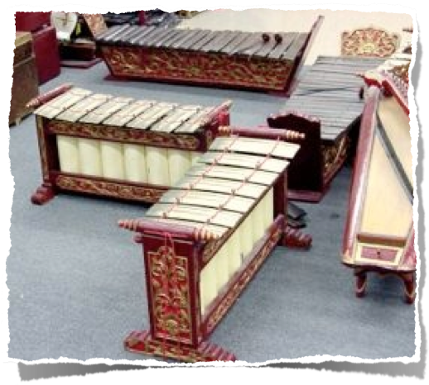
gendèr
metal keyed Instruments (Metallophones)

Slide 30
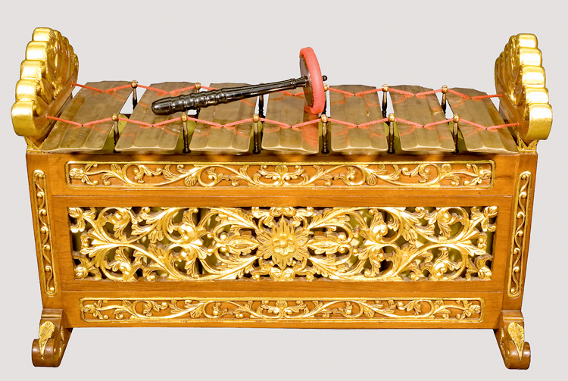
gendèr slenthem
metal keyed Instruments (Metallophones)

Slide 31
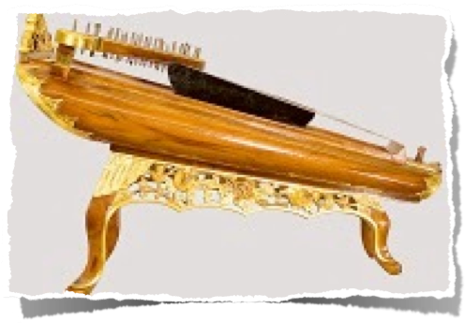
siter (zither)
melodic Instruments

Slide 32
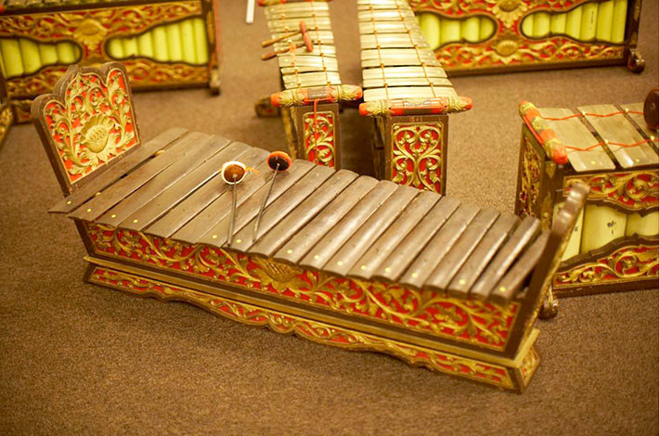
gambang
melodic Instruments

Slide 33
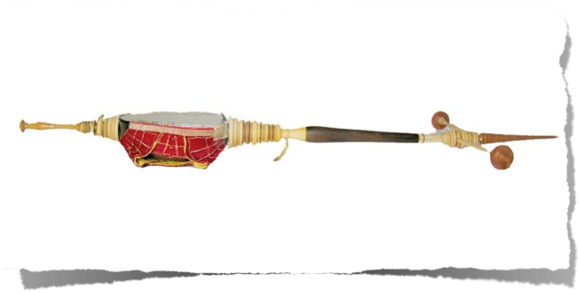
rebab
melodic Instruments

Slide 34
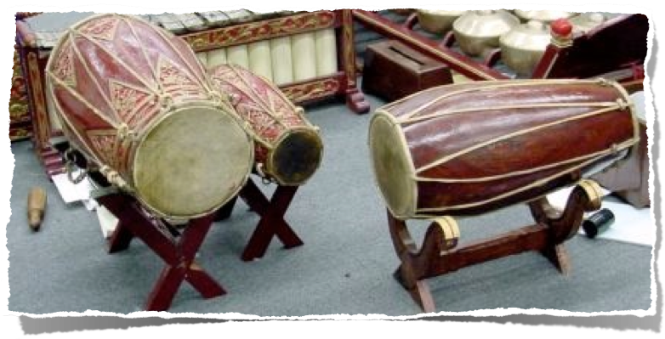
kendhang
drums

Slide 35
loud and soft-playing
loud-playing for outdoors
only drums and louder metal instruments
no voice
soft-playing indoors
singing and melodic instruments featured: gendèr, rebab, siter
loud-playing instruments still play, but softly

Slide 36
loud and soft-playing
Identified with Yogyakarta (Yogya)
Identified with Surakarta (Solo)

Slide 37
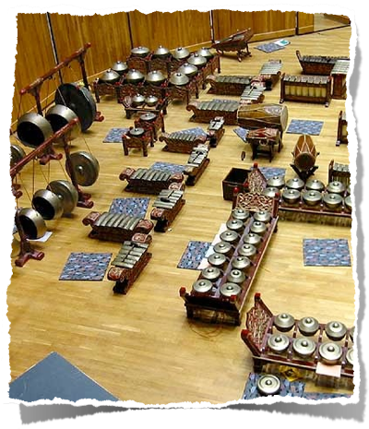
gamelan construction
Bronze preferred
brass and iron as well, but they are less sonorous
labor-intensive

Slide 38
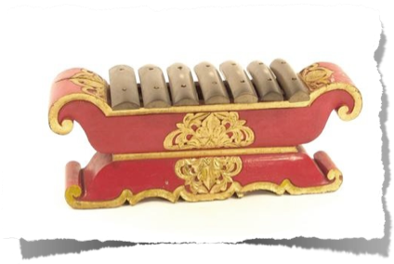
gamelan identity
although pélog (7 notes) and slendro (5 notes) are standard scales, the tuning of each individual gamelan is unique
bronze gamelans must be tuned regularly

Slide 39
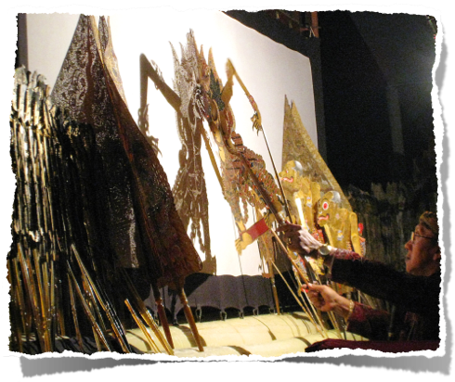
performance contexts
Javanese music related to other aspects of life
as entertainment
for ritual purposes at weddings, births, and so on
to accompany dance, shadow puppet theater (wayang kulit), etc.

Slide 41
Listening exercise
You will hear a short piece called Lancaran Kebogiro (crazy water buffalo) laras slendro pathet sanga
There is a short introduction (buka), followed by five16-beat sections that repeat twice
listen for the following 7 features

Slide 42
Kebogiro, cycles 1-3
Which instruments start (high, low, medium)?
On which cycle do the next instruments enter?
Which instrument is missing in cycle 1?
In which section do the drums enter in cycle 2?
In which section do the highest saron (peking) enter in cycle 2?
In which section in cycle 3 does it slow down?
What happens at the very end of the piece?

Slide 43
Listening exercise

Slide 44
Kebogiro, cycles 1-3
Which instruments start?
low (slenthem & gongs)
On which cycle do the next instruments enter?
B1
Which instrument is missing in cycle 1?
bonang (medium kettle gongs)
In which section do the drums enter in cycle 2?
C

Slide 45
Kebogiro, cycles 1-3
In which section do the highest saron (peking) enter in cycle 2?
B1
In which section in cycle 3 does it slow down?
C
What happens at the very end of the piece?
There is a pause, then everyone plays one note in unison

Slide 46
A Javanese Gendhing (composition)
in Performance
Bubaran “Kembang Pacar” (“Red Flower”) pélog pathet nem
Bubaran = sixteen beats per major phrase, four kenong beats per major phrase.
“Kembang Pacar” (a kind of red flower) is the name of a particular melody.
pélog is the scale system used in the modal category of pathet nem.

Slide 47
A Javanese Gendhing (composition)
in Performance
Central Javanese gamelan music in loud-playing style
This gendhing uses pélog scale tones 1, 2, 3, 5, and 6 with an occasional 4, but no 7.
The drummer conducts, controlling the tempo and the dynamics using sound signals.
The recording presents 4 phrases (gongan A-D) which comprise the Main Melody (balungan)

Slide 48
What to listen for
Patterns of repetition in the melody
when the percussion instruments enter
how the parts interlock
Irama level: when the beat subdivisions change

Slide 49
