Slide 1
How a Raga “Grows”
A raga’s growth in performance is described in terms of its barhat, or growth.
Like a growing seed containing all of the directions to become a plant, a raga contains rules for creating a self-contained musical world.
Unlike a Western piece of music, a raga is a template for musical action developed through many years of study and practice.

Slide 2
Form in Raga Performance
Generally speaking, raga performances start with slow and abstract motion and become progressively faster and more metrical, ultimately accelerating to a very fast conclusion.
This process of increasing speed is symbolic of the growth process (barhat) common to much Indian music.
There are several successive formal sections that occur without pauses between them: alap, jor, gat, and jhala.

Slide 3
The alap is the slow, abstract, improvised introduction. It explores the raga’s melodic essence and range, and there is no drumming or meter. The alap is the true test of the improvisatory skill of the performer.
Imrat Khan, surbahar, Rag Miyan ki malhar Aaroha (ascent): S M\R/P ’ M P N D N Ṡ Avaroha (descent): Ṡ D N P M P ^{M}\ G R S

Slide 4
The jor is an intermediary section that bridges the alap and the gat. The solo melodic instrument becomes more rhythmic and energetic, but there is not yet a metric cycle (tala) or drumming.
Rag Miyan ki malhar, 15’19” – 16’19”

Slide 5
Jor, Rag Miyan ki malhar, 20’48” – 21’55”

Slide 6
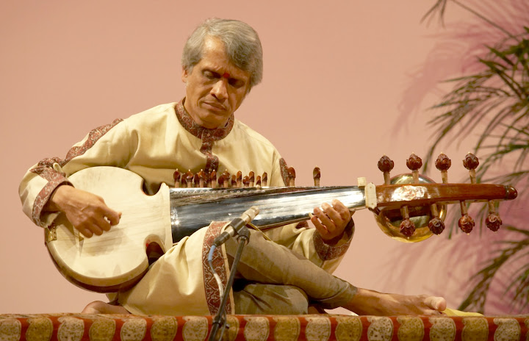
The gat begins when the drums enter. The drumming establishes the tala, which serves as the foundation for the remainder of the performance. As the gat proceeds, there is a gradual increase in tempo and patterns/sections become increasingly complex.
K. Sridhar, sarod, and K. Shivkumar, violin (rare Hindustani/Carnatic crossover), G.S. Sabra, tabla (Shringar, Real World, 1999)
Vilambit (slow) Gat, dadra tal (3+3), Rag Bhairavi S (R) G (M) P D N Ṡ Ṡ N D P M G R S

Slide 7
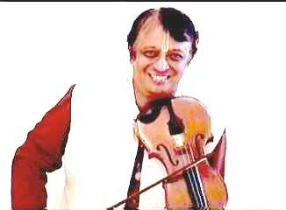
The jhala drives the performance to an exciting conclusion. It often begins with an upward jump in tempo and energy, and continues to accelerate until the end.
End of jhala: return of phrase from gat, instruments “trade fours,” then twice as fast, etc.
tintal (4+4+4+4), Rag Bhairavi S (R) G (M) P D N Ṡ Ṡ N D P M G R S

Slide 8
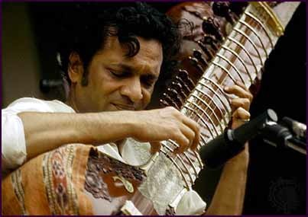
Insights and Perspectives
Two Kinds of Time

Slide 9
In addition to the dimension of time’s passing represented by the gradual and continuous growth of a raga in performance, there is a second type of time, cyclic time, that is represented by the continual recurrence of the tala cycle (i.e., in the gat and the jhala, not the alap or jor).
As the raga progresses, time thus becomes manifest in two dimensions: progressive and cyclic.

Slide 10
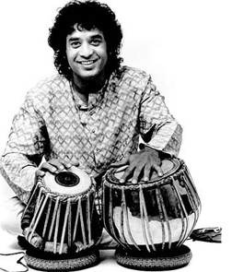
Tala review
The metric cycle has specific patterns of stronger and weaker beats.
The basic, “skeletal” drumming pattern that defines the tala is called the theka.

Slide 11
Tintal Counting Pattern
1 | 2 | 3 | 4 | 5 | 6 | 7 | 8 | 9 | 10 | 11 | 12 | 13 | 14 | 15 | 16
X | - | - | - | x | - | - | - | O | - | - | - | x | - | - | -
X : claps
O : wave
- : finger touches

Slide 12
Tihai

Slide 13
The rhythmic pattern of the tihai is irregular, which creates a syncopated effect and a sense of rhythmic “dislocation.”
This forms a growing tension that is finally resolved when all comes together on the final note of the performance.
Musicians carefully control the length of the tihai to ensure it lands where it is supposed to.

Slide 14
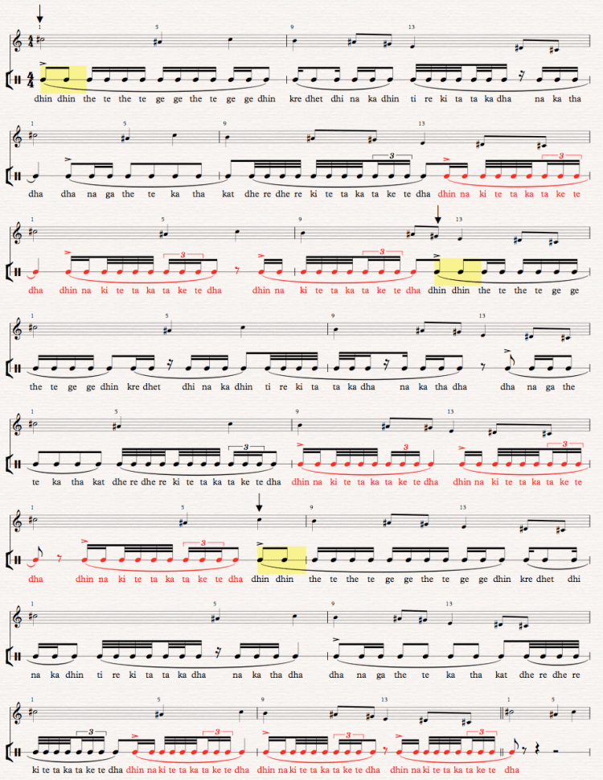
Dinuk Wijeratne’s transcriptionof a chadrakhar tihai by Zakir Hussain

