Slide 1
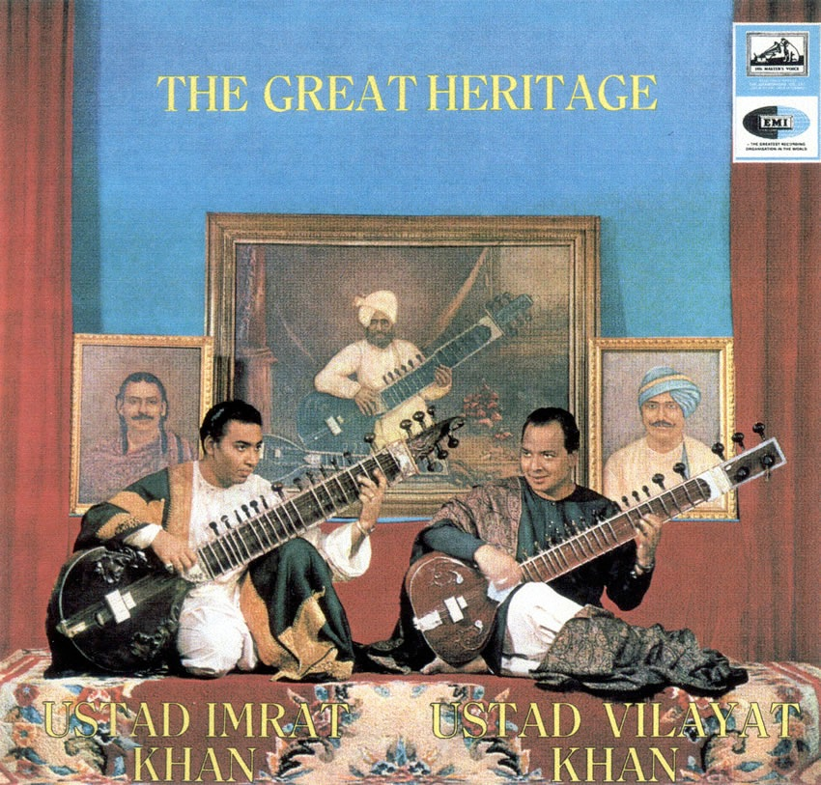
Intro to the Indian Classical Tradition

Slide 2
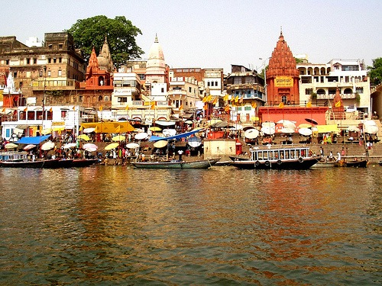
Culture & History
A few facts:
More than a billion people
World’s largest democracy
15 major languages: 200+ all together, 1600 dialects
Indo-European language family

Slide 3
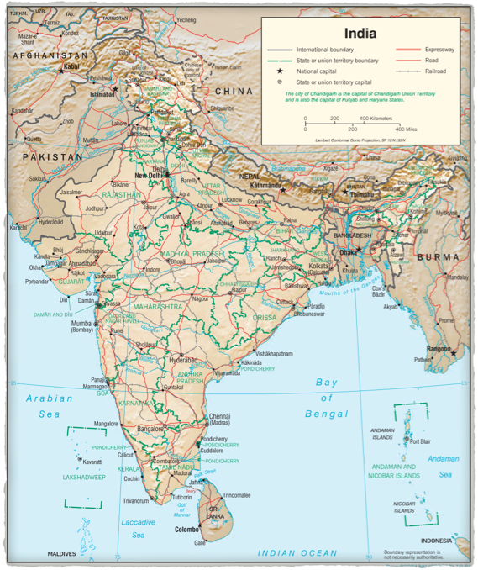

Slide 4
In 1500 BCE, the indigenous population was pushed south.
This may be the root of the north/south division (Hindustani/Karnatak (Carnatic)).
Indian classical music and the Hindu religion have close ties, as in the bhajan devotional songs and hymns.
In the 5th c. BCE, Buddhism and Jainism originated in India.
Islam was introduced in the 8th c. CE.

Slide 5
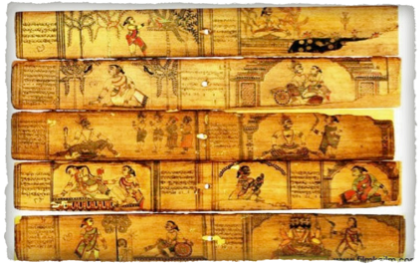
Natya Sastra
Ancient treatise, 36 chapters on theater, music and dance (probably 200 BCE and 200 CE)
Indian music theory has a long history
Songs preserved as poetry
Ramayana and Mahabharata

Slide 6
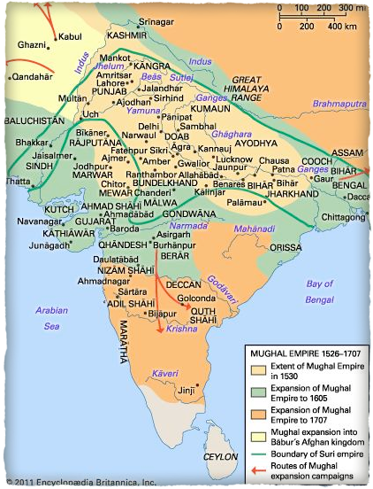
Moghul dynasty
From 1528 centered in Delhi and Agra
Great patrons of the arts and court musicians
Northern tradition mixes Persian elements with existing Indian culture
Raga system related to use of modes in Turkish and Arabic music as well
Cultural division between Islamic north and Hindustani south

Slide 7
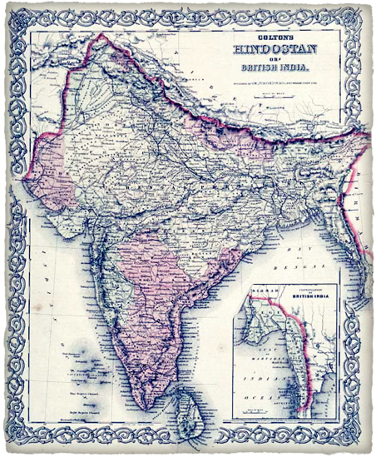
British colonization
1600–1947
European influence on India began in the 15th century when the Portuguese, French, Dutch, and English arrived for spice trade.
Christianity was imported with limited success.
1855

Slide 8
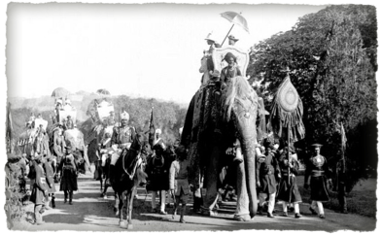
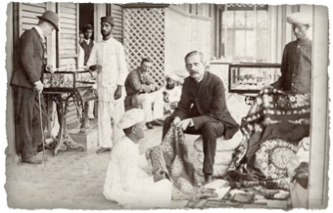
Responsible for transportation and administrative infrastructure, widespread adoption of English as second language
Although British not active patrons of the arts, music flourished under their rule
Golden age of Carnatic music ca. 1700–1900

Slide 9
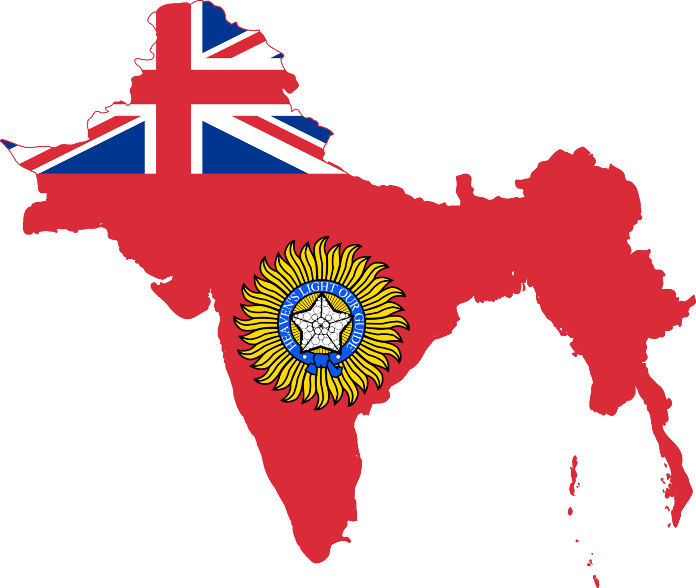
British colonization
1600–1947
Britain became the dominant colonial power in 1858.
Golden age of Carnatic music ca. 1700–1900
Recording industry took off in 1920s
European instruments adapted: violin, harmonium, clarinet, banjo

Slide 10
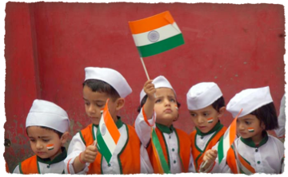
Modern India
India independence 1947, Sri Lanka 1948
After much bloodshed, two largely Muslim areas in the north became Pakistan and East Pakistan.
India is officially secular, but over 80% of the population is Hindu.

Slide 11
Modern India
Modernization picks up speed in the 1980s
Today about 1/10 of the country is Muslim
Indian arts now global phenomena
Government support, status of music

Slide 12
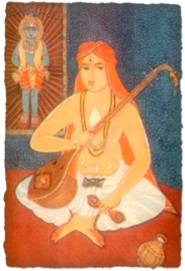
Karnataka sangeeta
An ancient but oral tradition, so we aren’t sure what it sounded like
Many dance traditions, but bharata natyam most well known
Carnatic tradition built around repertoire of devotional songs
There is an audible difference in the “busyness” of the textures, and confined nature of improv

Slide 13
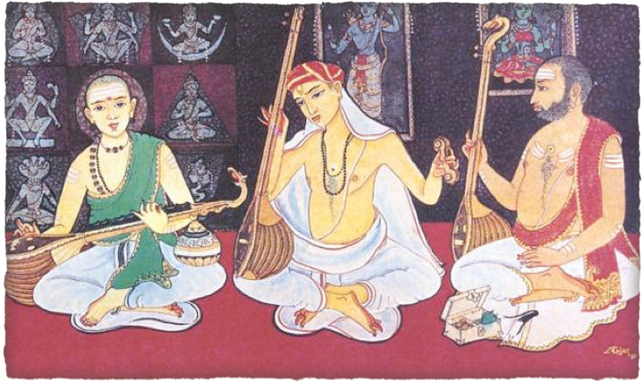
The Big 3 from the Golden Age

Slide 14
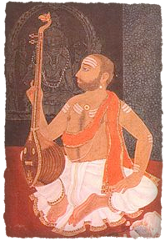
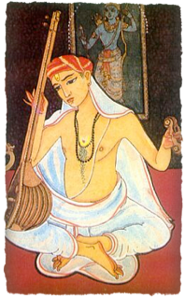
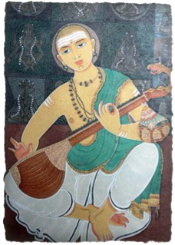
Syama Sastri (1762–1827)
Tyagaraja (1767–1847)
Muttuswamy Dikshitar (1776–1836)
Tyagaraja the most beloved, performed

Slide 15
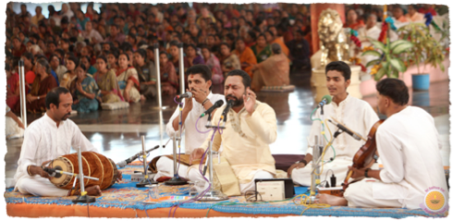
concert life
Sabha clubs sponsor early evening concerts, day long festivals
More informal than Western concerts
Works performed may depend on mood of performers, audiences, but will include well-known songs and ragas

Slide 16
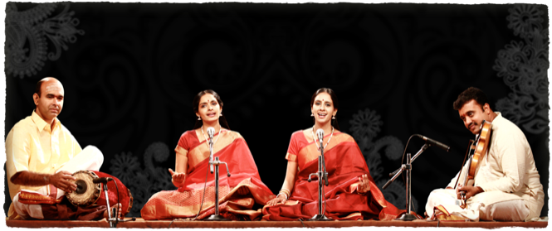
Structure of performance
Always three layers: melodic instrument, drone and drum
A singer most of the time, but not always

Slide 17
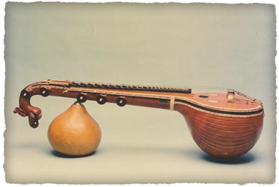
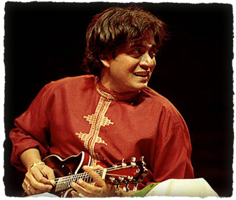
Veena, violin, mandolin, bamboo flute, sax, guitar all feature as solo instruments
Often a melodic accompanist (violin if voice, often two violins, violin/veena, two veenas if instrumental)

Slide 18
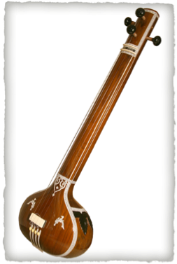
Function of secondary instruments
Melodic
Follow notes of soloist
Echo and support alapana improv
“Trade fours” during climactic improv
Drone
tambura or sruti-box (bellows or increasingly electronic)

Slide 19
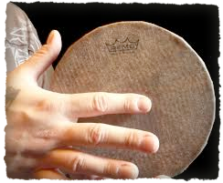
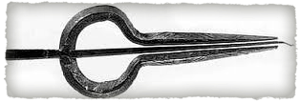
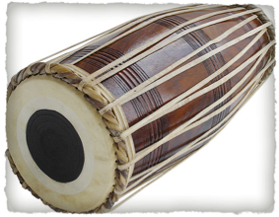
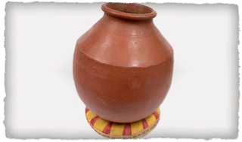
Rhythm
mrdangam most common, also ghatam, kanjira, morsang

Slide 20
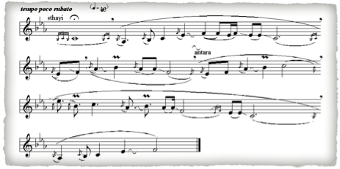
Raga system
From word for coloring, partly technical, but also associated with mood or rasa
Will include notion
parent scale,
ornamentation,
intonation,
rules for ascent and descent, and
different motion through the raga at different points in the improv/composition

Slide 21
Melakarta system
Parent scale with 7 notes
solfege: Sa, ri, ma, ga, pa, da, ni
Sa and Pa (tonic/dom) most important
72-possible scales, but many more ragas available through
omitting notes
zigzagging in ascent/descent
adding non-scale tones
ornamentation

Slide 22
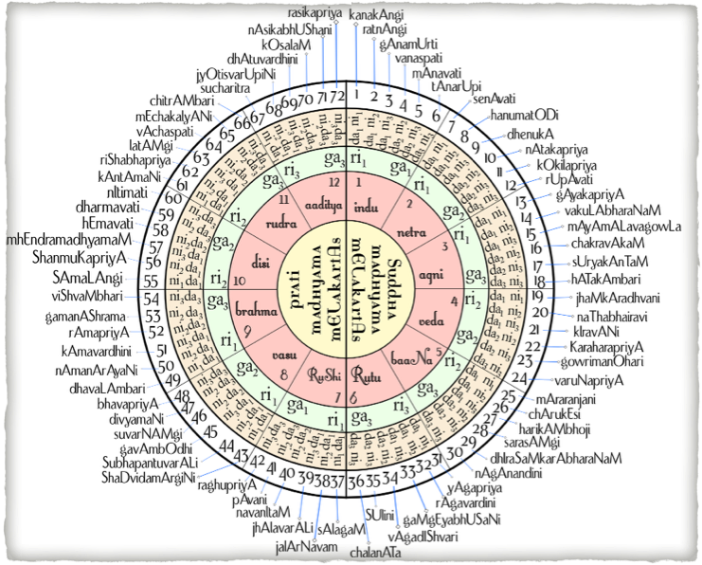
By Basavarajtalwar - Own work, CC BY-SA 3.0, https://commons.wikimedia.org/w/index.php?curid=8057036

Slide 23
Raga system
Hundreds available, but not that many used in practice
Major (“heavy” with implication) and minor
Some old, some newly-imported
A janya (derivation) of a melakarta
Sampurna - 7 note scale
Shadava - 6 notes
Audava - 5 notes
Svarantara - 4 notes

Slide 24
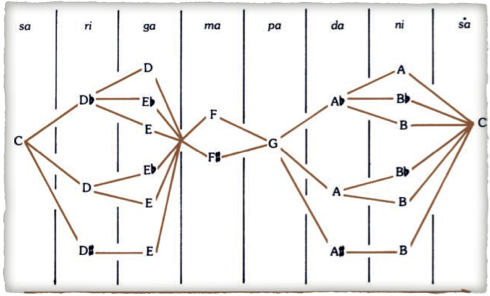
Melakarta possibilites

Slide 25
Other associations
Rasas:
Love, anger, sadness, fear, disgust, wonder, heroism, laughter, religious devotion (peacefulness)
Time of day
Animals and deities
Seasons
Auspicious properties

Slide 26
Tala/Tal
Beats grouped in cycles: talas
Hundreds of talas, but four primary ones in modern practice
Adi (most common) and rupaka can be fast, medium or slow
(Khanda) chapu and misra chapu usually fast
Slow tempos subdivide beat

Slide 27
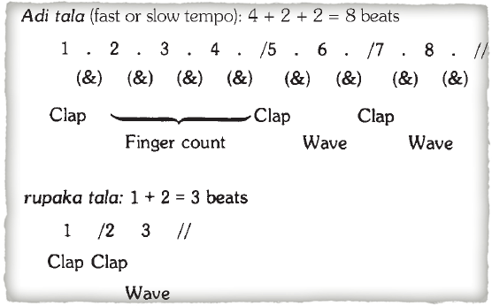
Adi and Rupaka tala

Slide 28
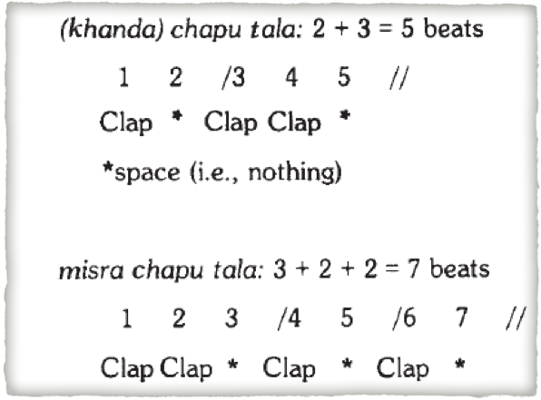
Khandu and Misra chapu tala

Slide 29
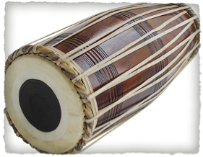
Drummer’s art
Improvisatory based on hundreds of patterns and strokes
Sollukatu drum solfege (bol)
Mora (korvai): three-fold repetition at cadences
Will traverse cycle to end after three two more reps on sam

Slide 30
Improv in the Carnatic composition
Improv without tala begins in the opening, and establishes the principal degrees
the soloist will extend downward and upward to the degree midway between the principal degree and its upper octave, producing notes with inflections and ornaments appropriate to the raga
the medial degree is established, followed by a return to the principal degrees, then the medial degree and the upper octave of the principal degrees, then a return to the upper octave of the principal degrees.

Slide 31
Exposition: Alapana
Sustained pitches alternated with other scale degrees prolonged in vigorous shakes
The last section brings the pitch and intensity level down gradually through melodic motifs of the upper and lower octaves, and concludes with a few phrases below the system tonic before resting on the tonic.
Traditionally the full alapana of a major raga is presented in connection with ragam-tanam-pallavi, although these days a kriti sometimes stars.

Slide 32
Ragam-Tanam-Pallavi
Pallavi in general in south India means the opening, recurring refrain section of of a multi-section composition, or any form.
In this context, however, a single line of text, often set in a complex time-cycle, used as a composition to be subjected to the “breaking up” improv technique.
Improv styles:
no pulse: no tala: alapana
with pulse: no tala: tanam
with tala: niraval, kalpana svara
anuloma/pratiloma (in pallavi exposition)

Slide 33
Ragam
In alapana occasional sustained pitches are alternated with other scale degrees prolonged in wide and vigorous shake
The last section of the alapana brings the pitch and intensity level down gradually before resting on the tonic.

Slide 34
Tanam
Close to Hindustani nom-tom: the syllables are ta nam, ta ka nam, etc
Separate sections of tanam are built in successively higher registral levels; each concludes with a short unpulsed passage of alapana
Improv with tala is of two kinds:
“Back to the beginning”: each passage leads back to the opening motif
Bhanjani--“Breaking up (a phrase)” singing the words of one line or the whole composition in different ways.
Niraval = “filling up”: a single line of text sung repeatedly with the original rhythmic distribution of text, but with melodies appropriate to the raga
Kalpana svara: improv on solfege

Slide 35
Pallavi
The pallavi itself is one line of composed melody (traditional, new or from a kriti).
Accompanists reproduce the soloist’s pallavi after one hearing.
One to six cycles long, and constructed so that the point of principal rhythmic weight is the halfway point in the tala cycle.
After sung or played several times, the pallavi is subjected first to niraval then with its time values reduced to a half (double speed), a third (triple speed), and a quarter of their original length (quadruple speed).
This allows the composition to be sung through 2, 3, and 4x in the same time cycle as the original, called anuloma (with the current).
In pratiloma (against the current) the composition at a fixed tempo and the time cycle is speeded up, or the composition is sung more slowly to a constant cycle.

