Slide 1
Diminutions & Counterpoint

Slide 2
Counterpoint in Composition

Slide 4
Counterpoint in Composition

Slide 6
10
6
6
10
8
6-5
10
8 5
10
6- 5
8

Slide 7
4-3
7-6
7-6
4-3
7-5
7-6
7- 6
4-3
ant
7- 6

Slide 8
Evaluate these analyses

Slide 9
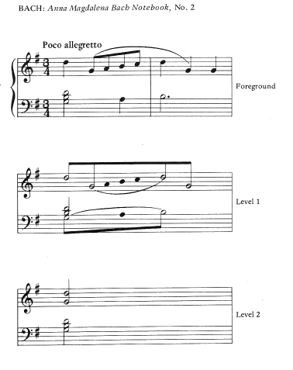
translate into Schenkerian
notation

Slide 10
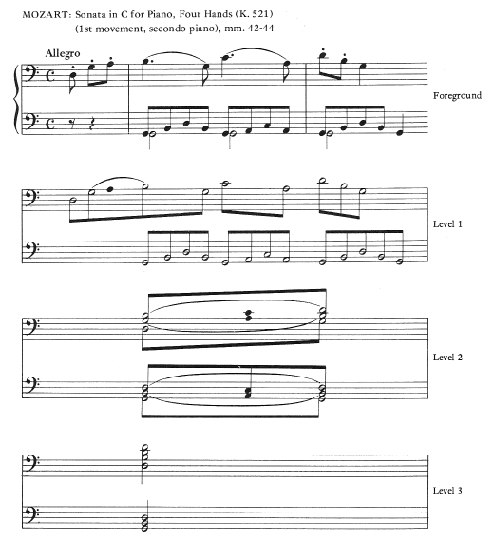

Slide 11
