Slide 1
Diatonic Sequences
Triadic root movement by
5th, 2nd and 3rd

Slide 2
Root movement by descending 5th

Slide 3
Triads in Descending 5th sequences
Harmonic intervals form stepwise succession of 6ths/10ths
Stepwise descending motion with end on ˆ5 or ˆ1
Soprano lines move by alternating 2nds/3rds or 4ths/5ths

Slide 4
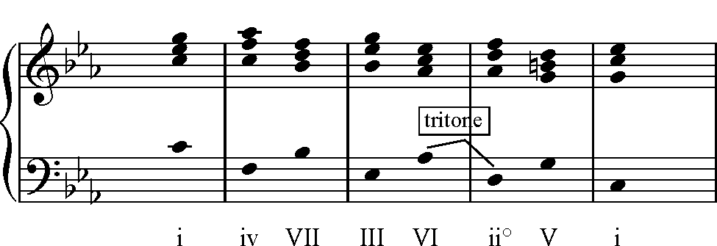
Descending 5ths ˆ1-ˆ7-ˆ6-ˆ5

Slide 5
Parallel 10ths ˆ1-ˆ7-ˆ6-ˆ5

Slide 6
Voice-leading ˆ1-ˆ7-ˆ6-ˆ5

Slide 7
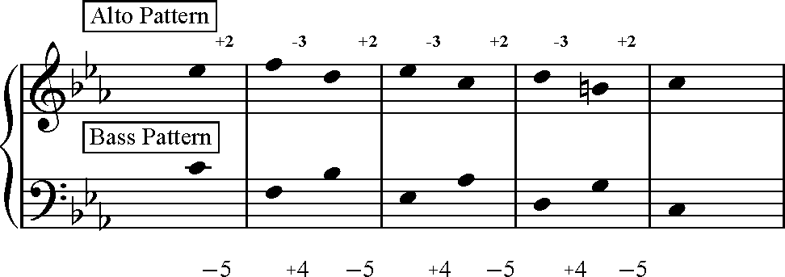
Voice-leading ˆ1-ˆ7-ˆ6-ˆ5

Slide 8
Voice-leading ˆ1-ˆ7-ˆ6-ˆ5

Slide 9
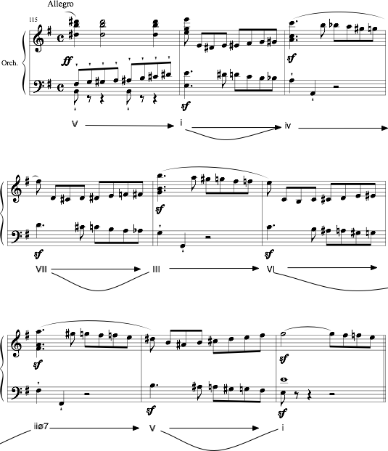
William Tell Overture

Slide 10
William Tell Overture reduction

Slide 11
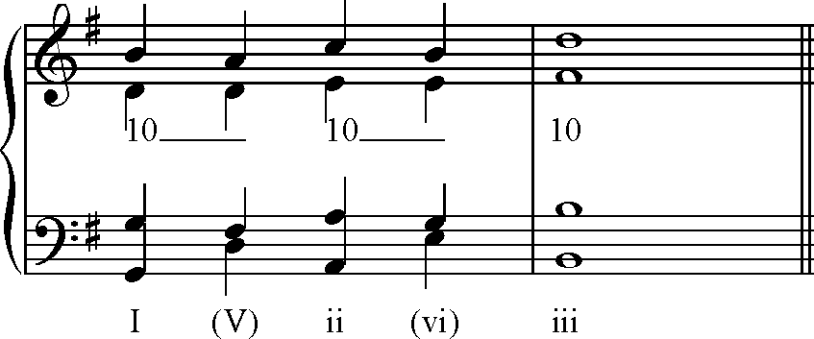
Triads in Ascending 5th sequences

Slide 12
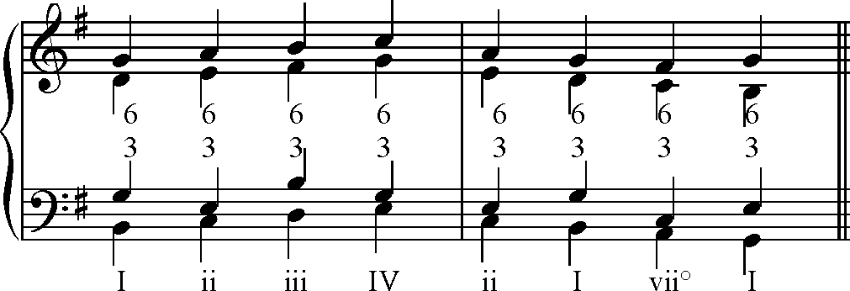
Root movement by 2nd: 1st inversion chords

Slide 13
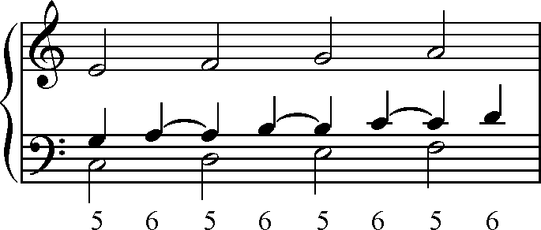
Root position triads in stepwise motion: the 5-6 sequence

Slide 14
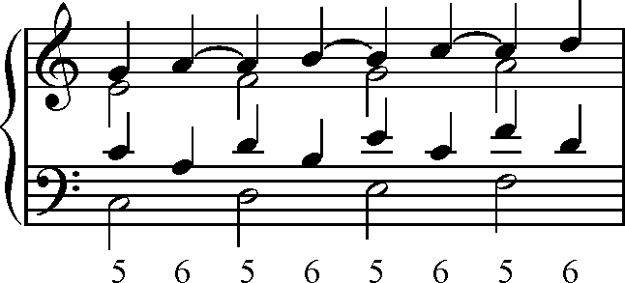
Root position triads in stepwise motion: the 5-6 sequence

Slide 15
Root movement by descending 3rd/ descending 5th
I vi ii vii° iii I IV ii
C-A-
D-B-
E-D-
F-D

Slide 16
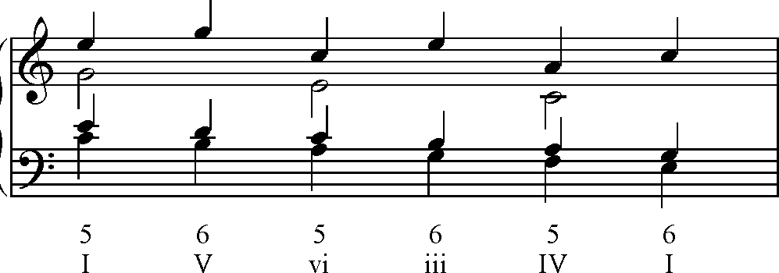
Root movement by Descending 3rd

Slide 17
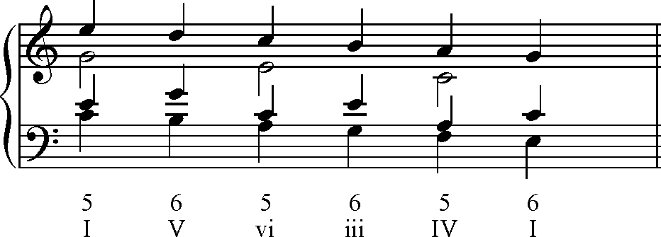
Root movement by Ascending 3rd

Slide 18
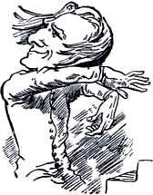
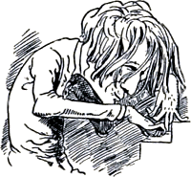
Root-position 7th Chords Descending by 5th
root motion = falling fifth
outer voice = parallel 10ths
inner voice = 7-6 sus

Slide 19
Root-position 7th Chords Descending by 5th
root motion = falling fifth
outer voice = 10ths - 7ths
inner voice = 7th resolves to 3rd of next chord

Slide 20
Root-position 7th Chords Descending by 5th
If all chords are in root position,
then every other one is incomplete

Slide 21
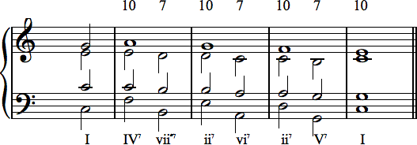
Root-position 7th Chords Descending by 5th
This is most clearly illustrated by SATB voicing.

Slide 22
Use of Secondary Dominants in Harmonic Sequences
Every other chord may receive a secondary dominant, to intensify the approach to diatonic chords and create a two-chord sequential pattern

Slide 23
Use of Secondary Dominants in Harmonic Sequences
This example can be expanded to travel twice around the circle of 5ths

