Slide 1
Phrase Structure and Grouping

Slide 2
Phrase length
In Classic period, usually multiples of 2 and 4 mm.
If tempo is faster, phrases are longer and v.v.
Strength of cadence determines end of phrase

Slide 3
Larger groupings: Periods
The first phrase an antecedent, the second a consequent
(often open/close pattern)

Slide 4
Classifying periods
harmonic scheme
thematic relationships

Slide 5
Question/Answer structure
I V HC
I V-I AC
I V || V I
If both phrases end with AC, then
I IAC I PAC

Slide 6
Parallel or Contrasting
If both phrases begin with the same melody, they are parallel
If not, contrasting (nonparallel) – use letter names to indicate this
A
A’
A
B

Slide 7
Parallel phrases
HC/PAC

Slide 8
Contrasting phrases
HC/PAC

Slide 9
Parallel phrases
HC/PAC

Slide 10
Sentence
A single phrase comprised of unequal groups
cadence only at the end;
that is, one phrase with subphrases.

Slide 11
Sentence
HC/PAC

Slide 12
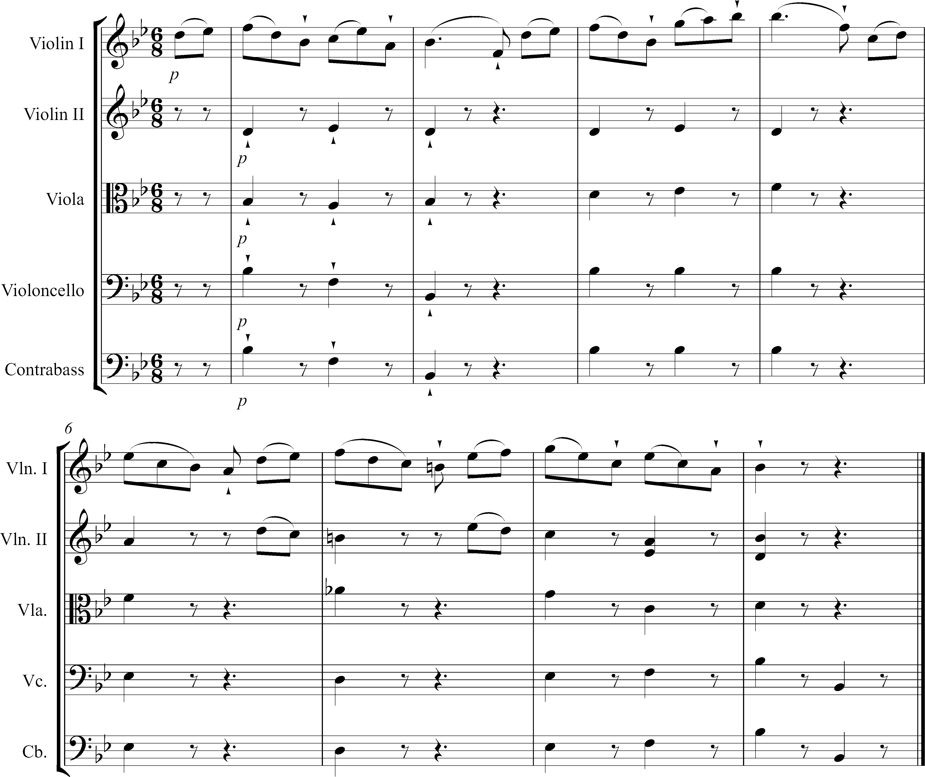
Notes:
Haydn Sym 84, ii tk 13

Slide 14
Sentence
one PAC

Slide 15
Phrase Groups
Two or more phrases
Double Period - two in a row

Slide 16
Phrase Periodicity
regular alternation of same phrase length
notion of hypermeter = 1 m. = 1 beat, as though a bar were a beat

Slide 17
Beethoven, Symphony No. 5 in C minor, Op. 67, i; mm. 6-21

Slide 18
Phrase Extension,
Contraction, Elision
1. cadential extension
2. internal extension
3. contraction, truncation (deletion)
4. phrase elision (overlap)

