Slide 1
Ode to the Perfect
Part-writing Exercise

Slide 2
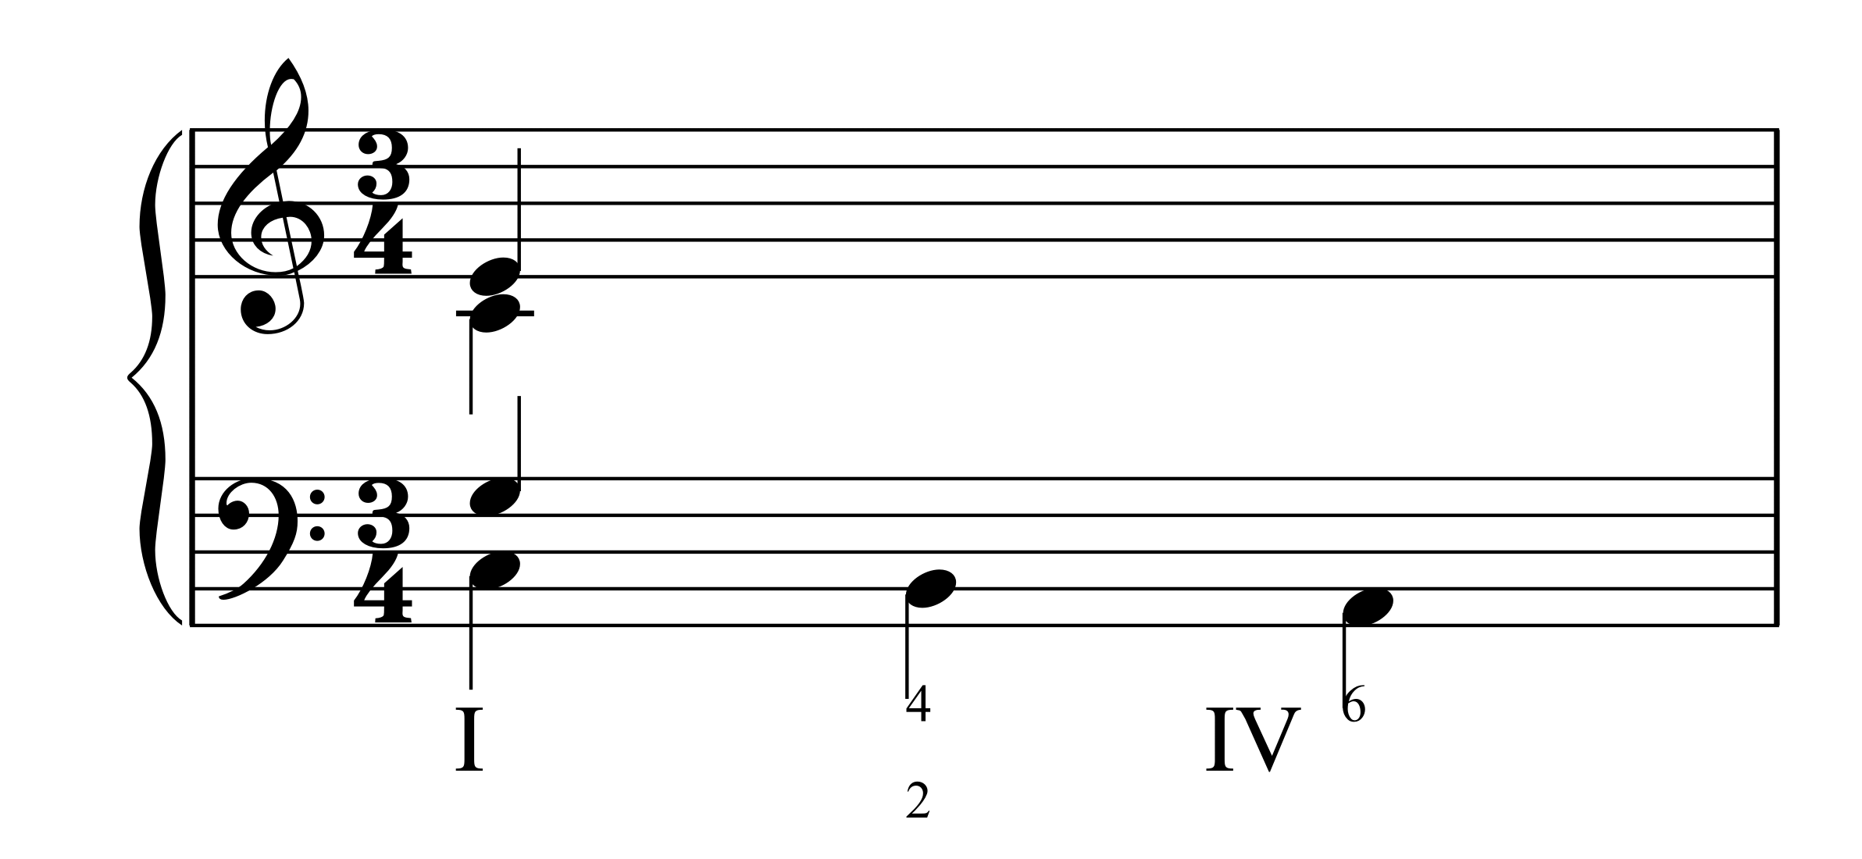
One who'd compose four equal voices
Already knows they have few choices;

Slide 3
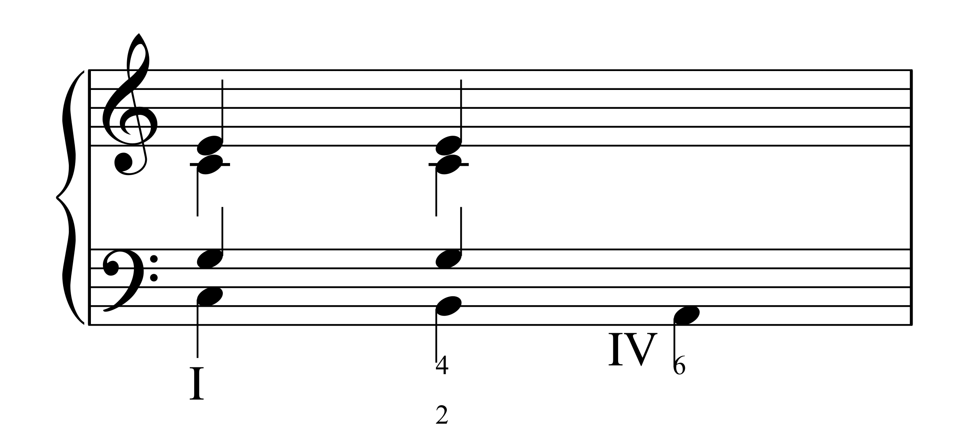
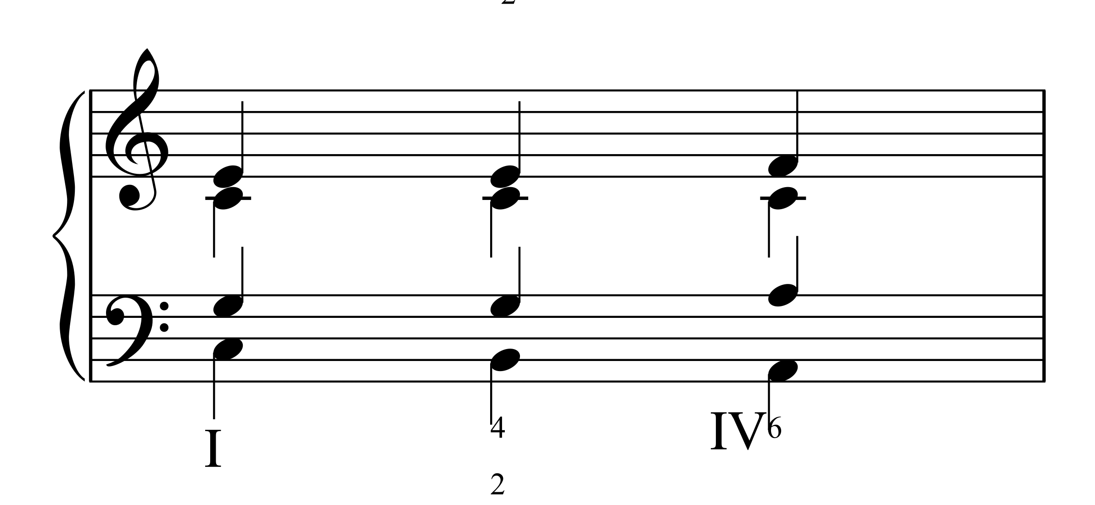
If you can hold a note, please do!
Or move it but a step or two.

Slide 4
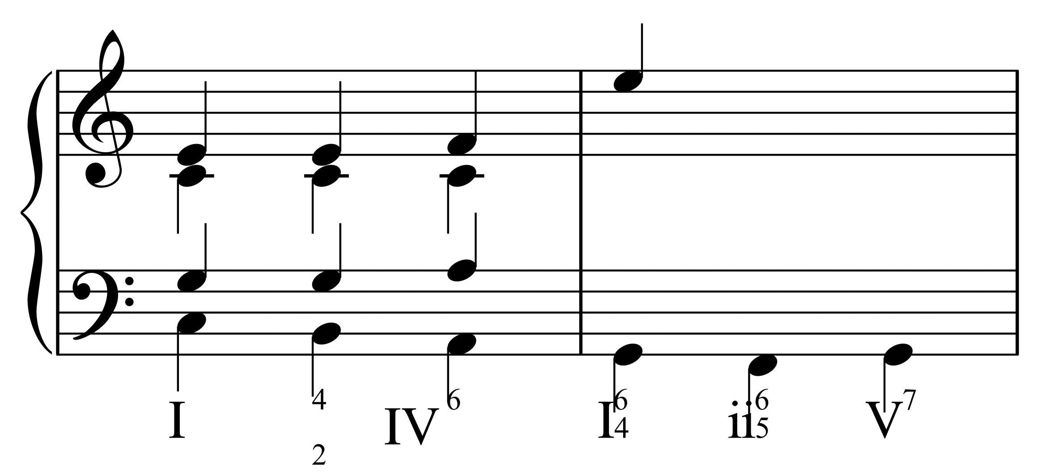
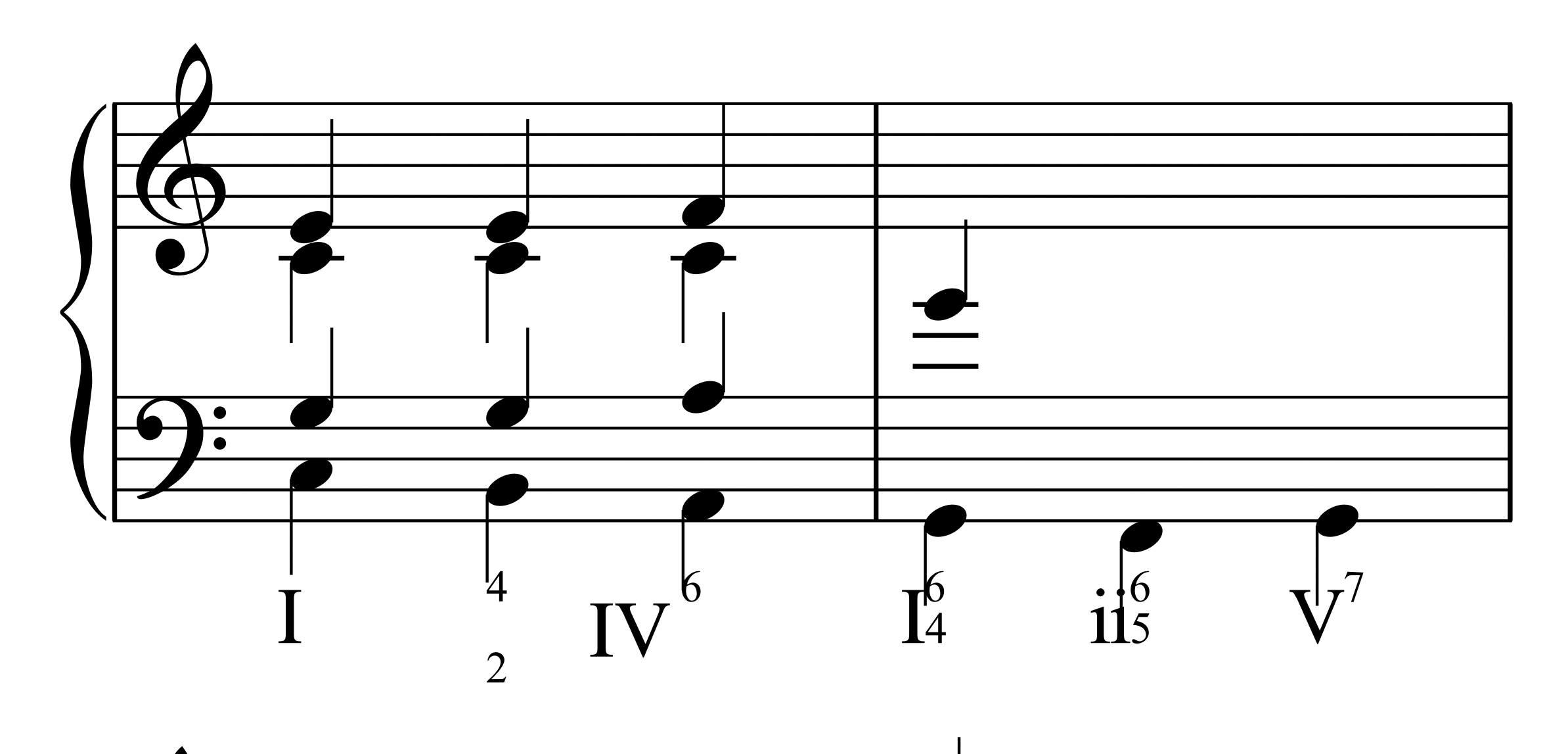
Or by an interval that strains;
Never jump outside your range

Slide 5
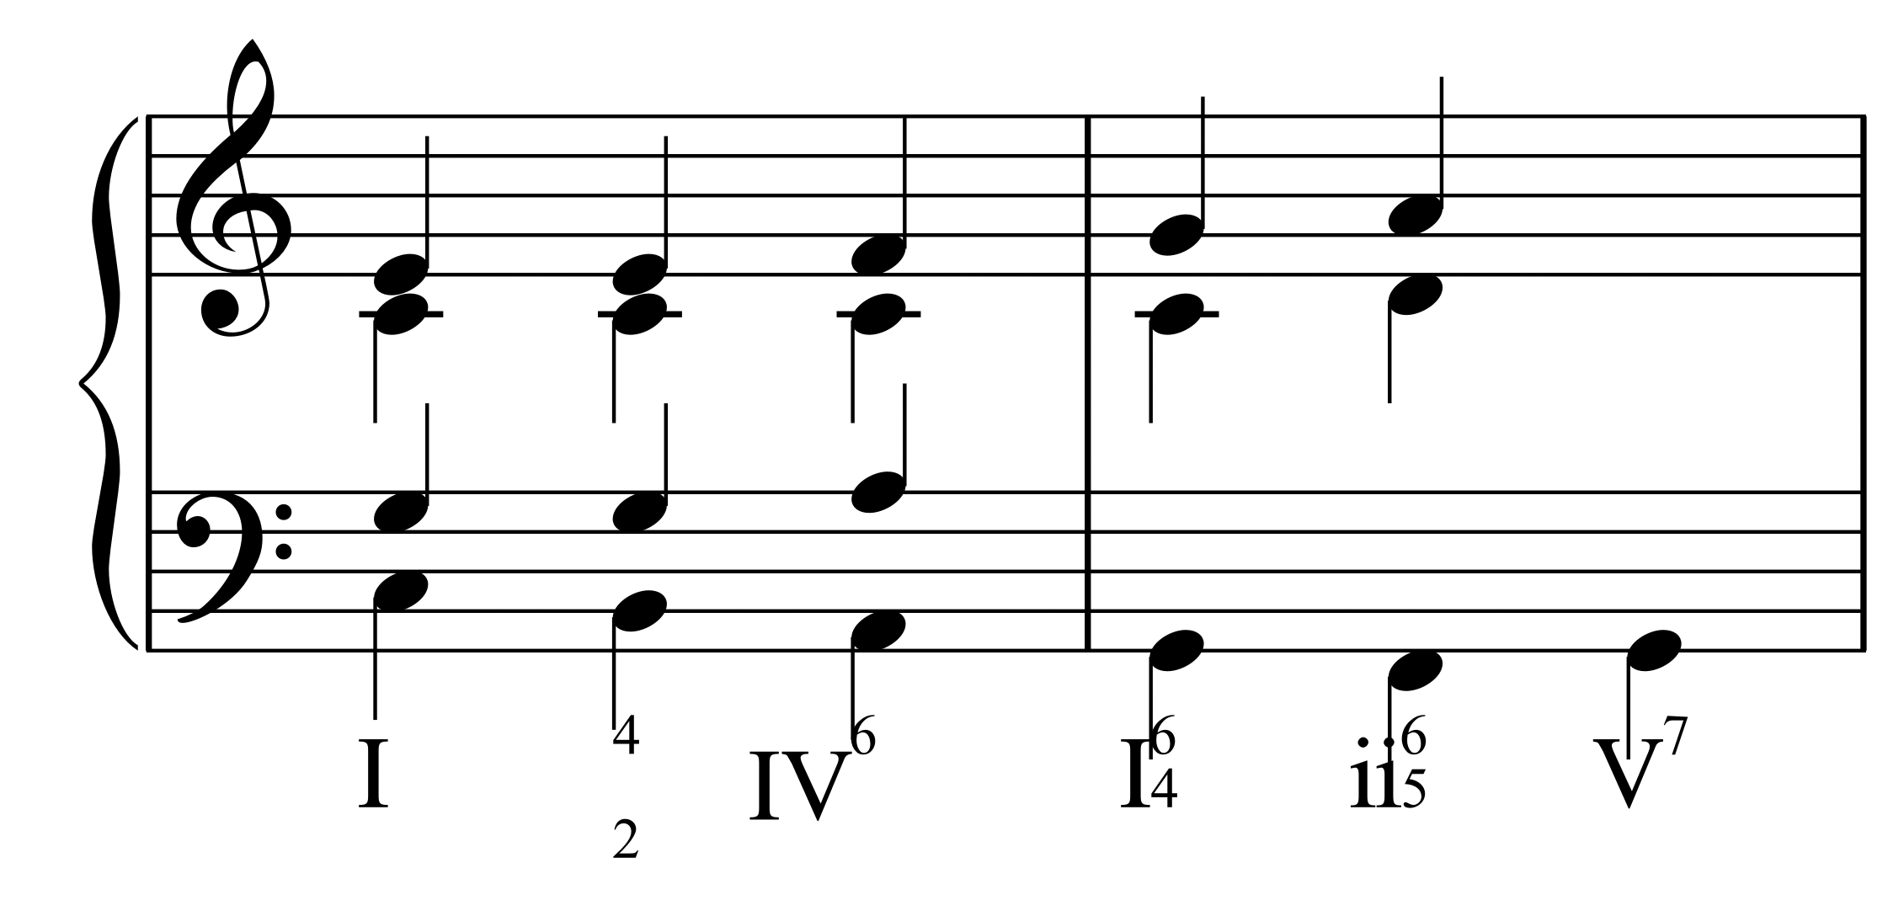
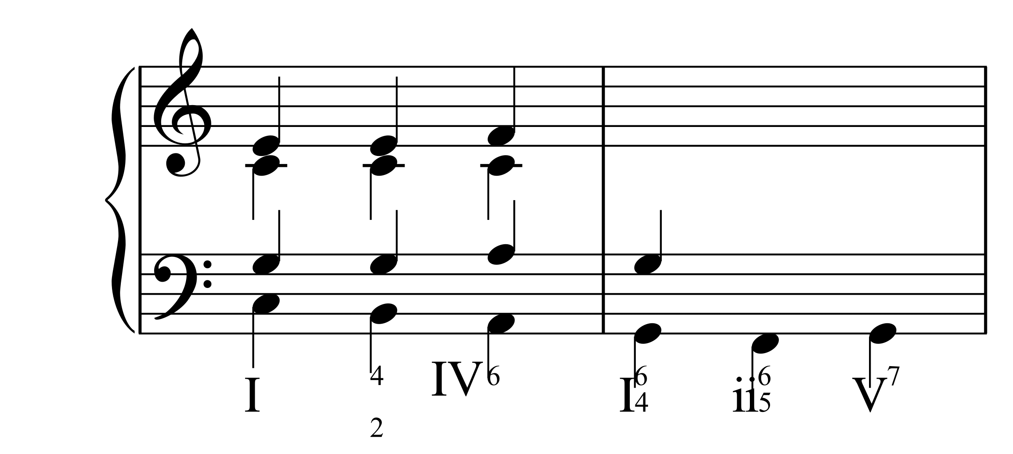
I'm sure you all avoid as well
Octaves and fifths in parallel

Slide 6
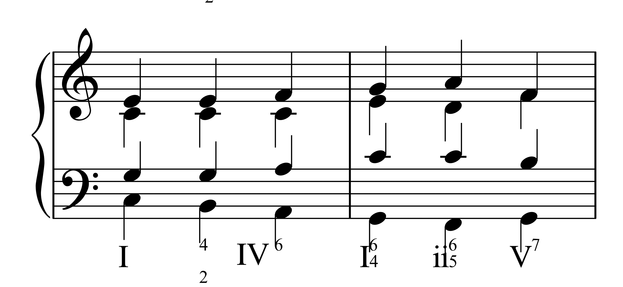
I won't tell you which note to double,
But if its a 7th, then you're in trouble!

Slide 7
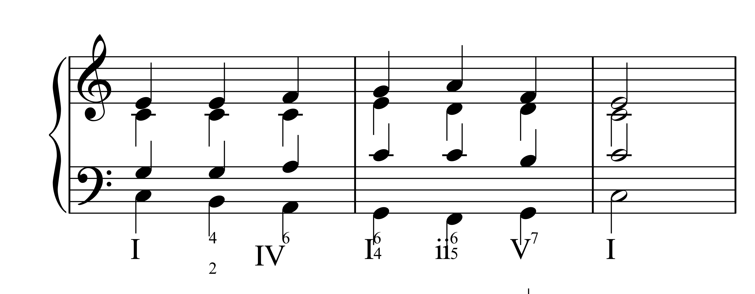
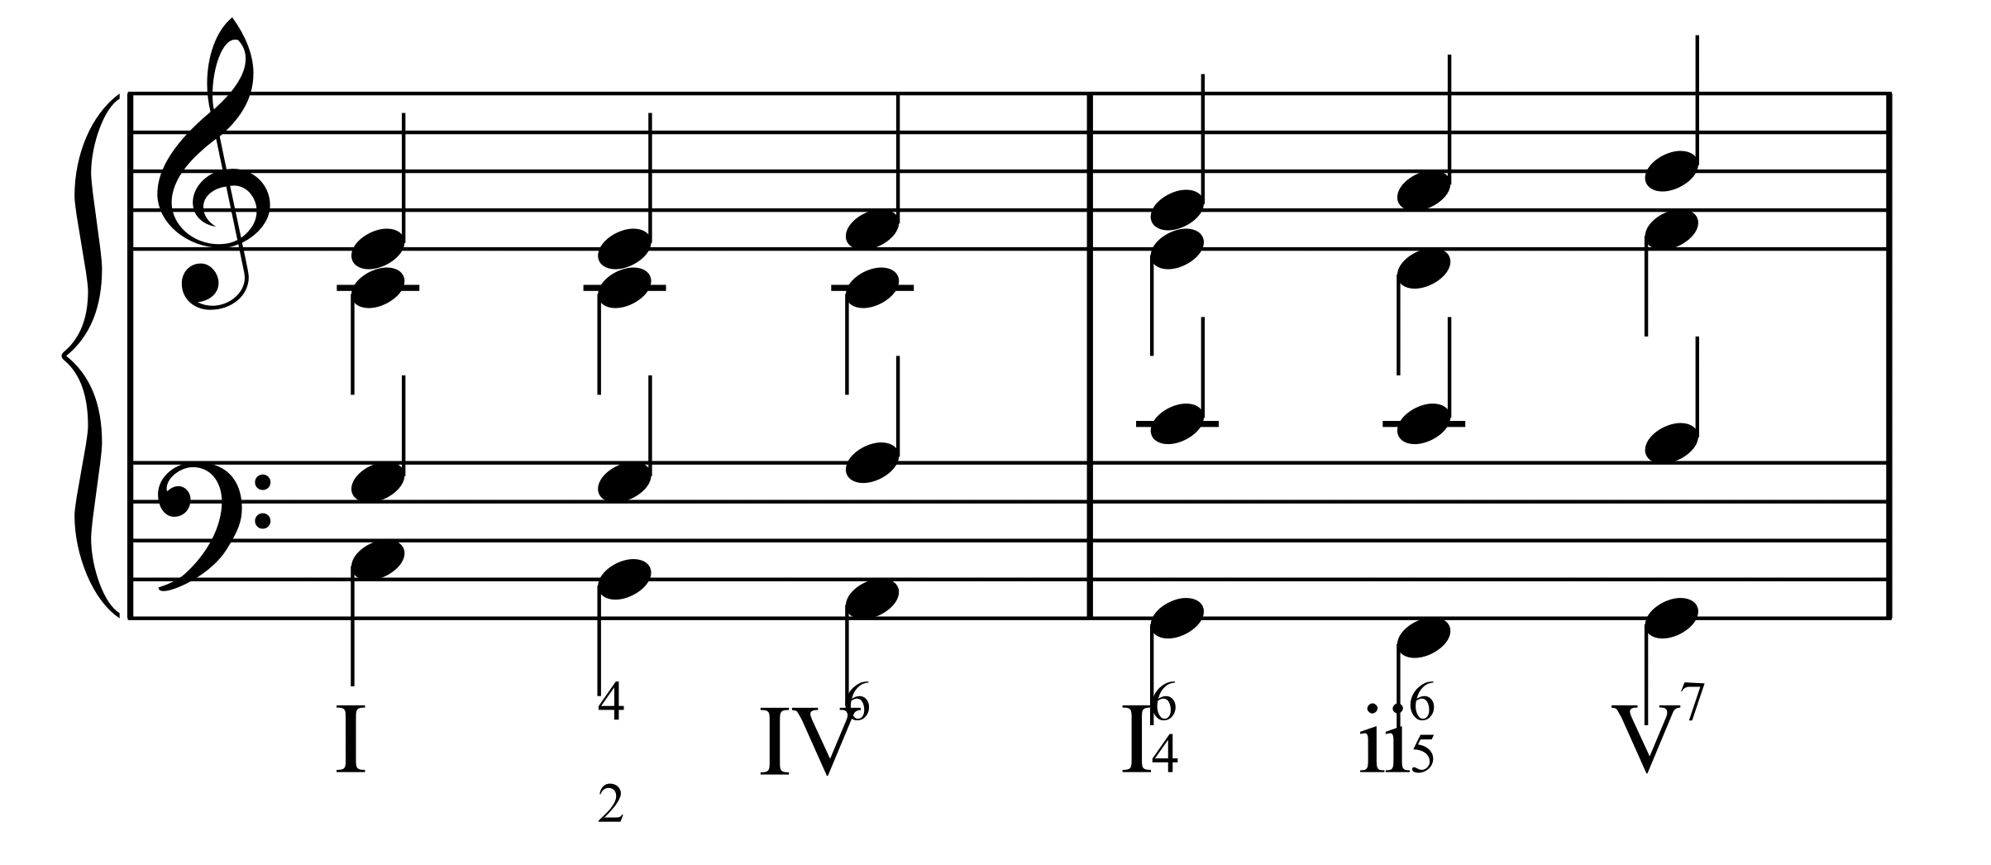
Some cool things here.
Some cool things here.
That holds as well for the leading-tone
Which goes to 1 or 5 alone.

Slide 8
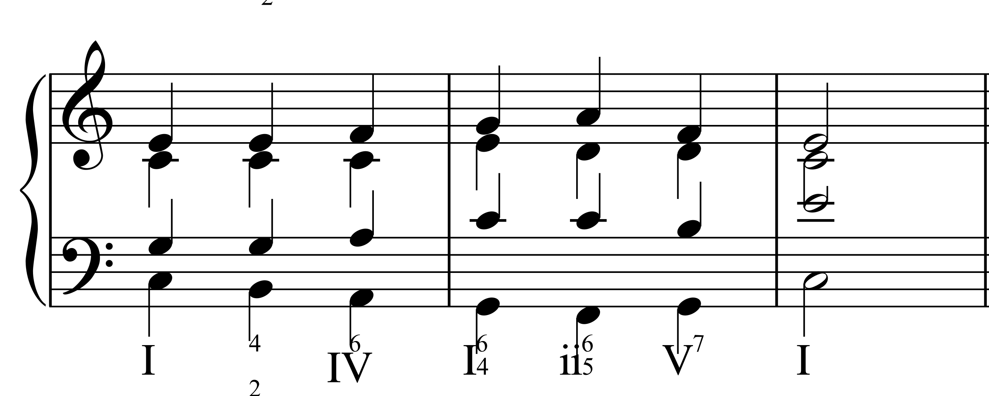
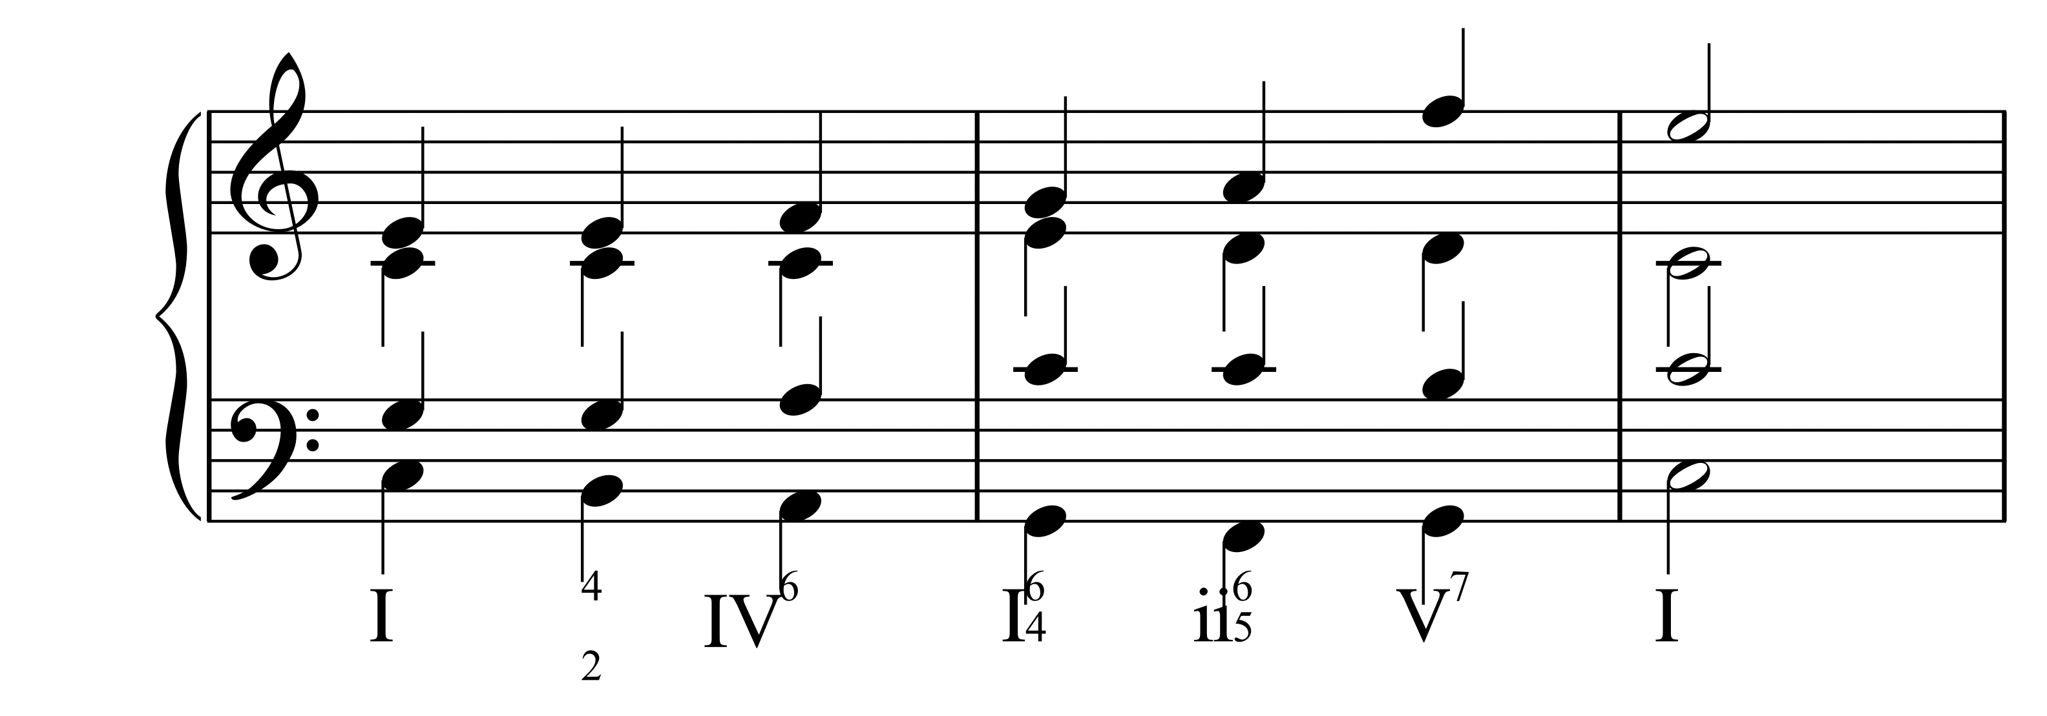
Some cool things here.
Some cool things here.
Watch spacing in and between staves
And don't let voices cross their paths.

Slide 9
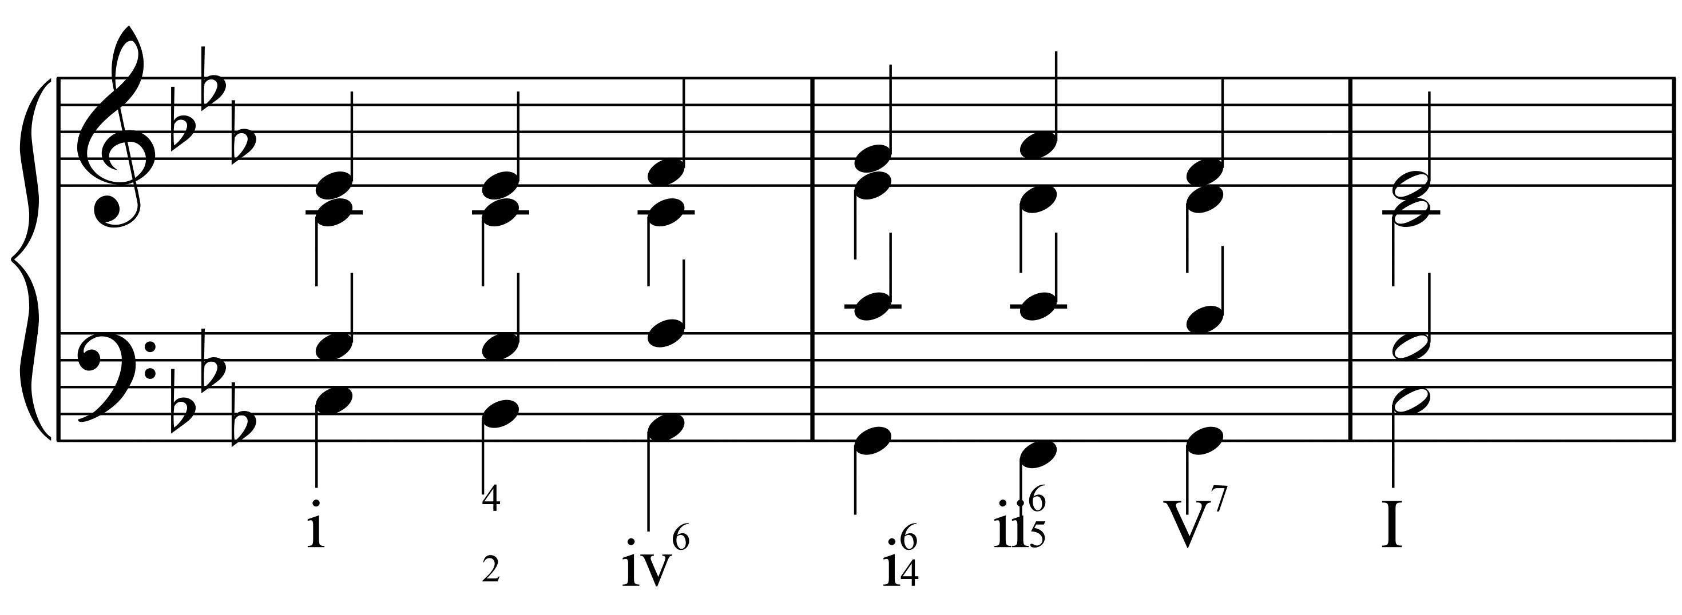
And, at the risk of sounding like a whiner;

Slide 10
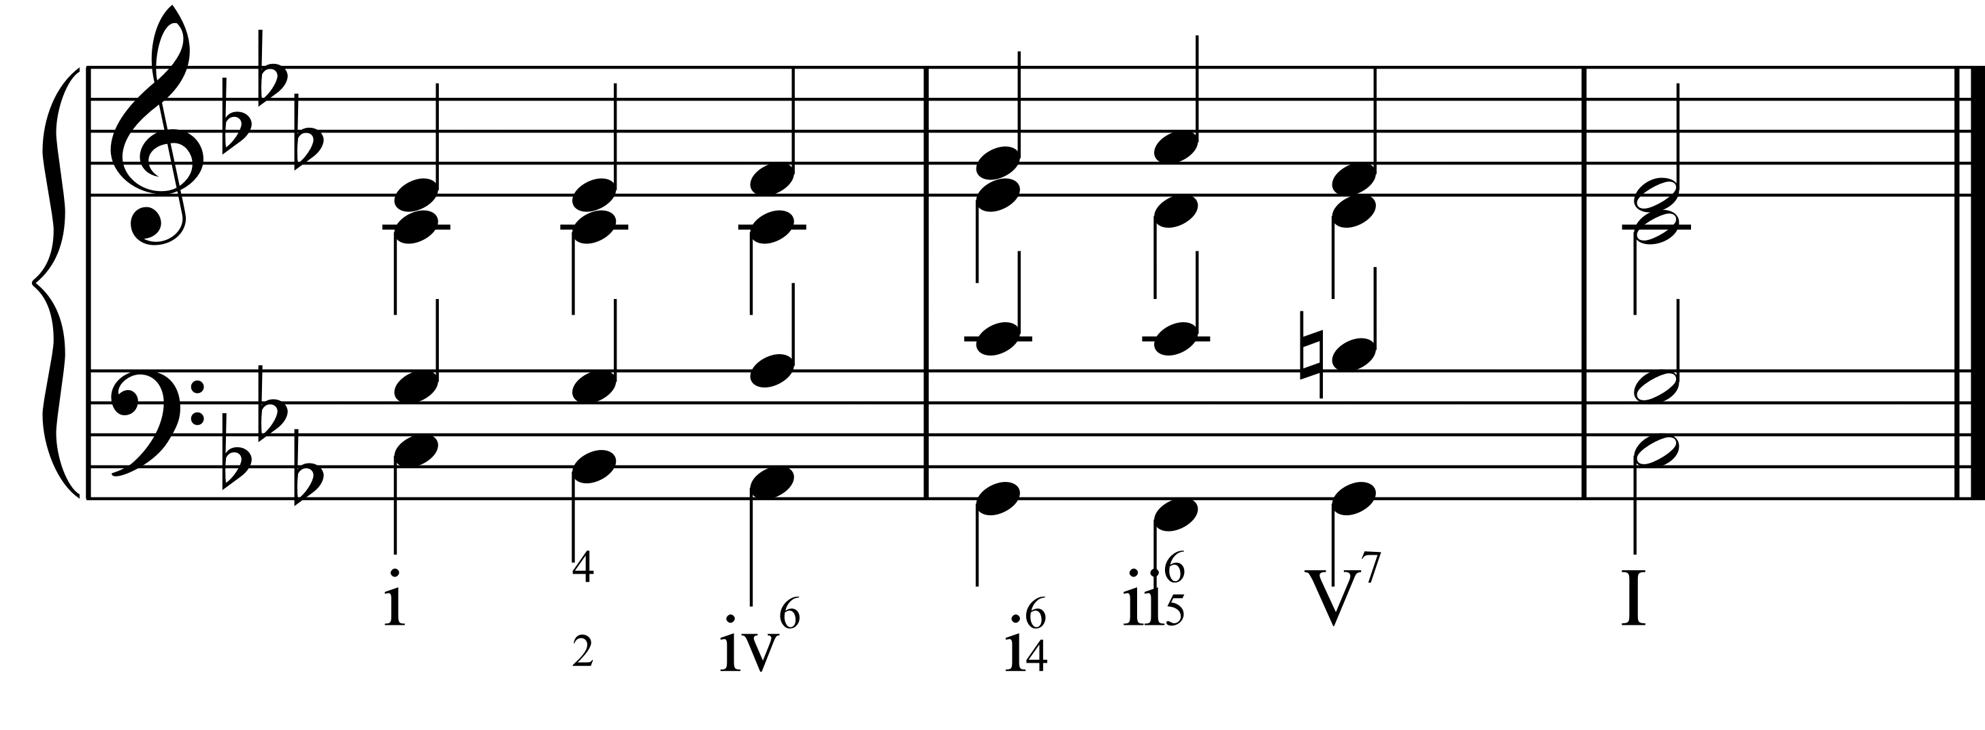
Please sharp that 7 when you're in minor!

