Slide 1
Chromatic Approaches to V
The Neapolitan Sixth

Slide 2
In several of the works we’ve encountered we’ve seen altered chords than feature ^{b}6-> 5, but which do not constitute mixture.
They are normally found in minor keys but may also appear in major.
The Neapolitan Sixth and the Augmented Sixths both appear as chromatic predominant chords that intensify harmonic motion to V.

Slide 3
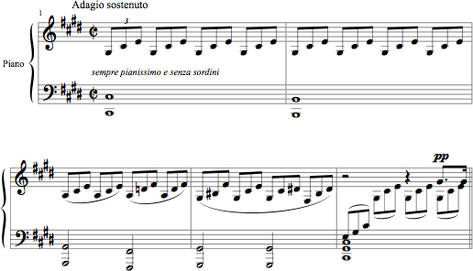
The opening of Beethoven’s Moonlight Sonata features the Neapolitan sixth.

Slide 4
What do the accidentals signify? Which scale degrees are altered?

Slide 5
If we reduce the Beethoven to block chords we can look at the voice-leading more carefully.

Slide 6
The Neapolitan sixth is most frequently found in the form of a major triad in first inversion built on lowered ^{b}2.
Its usual goal is V⁽⁷⁾, at a cadence, where it appears as the only predominant.
It may be separated from V by a passing chord built on #4, and the V is often expanded with a ⁶₄.

Slide 7
The contrapuntal origin of the lowered second scale degree is as either a chromatic neighbor embellishing the tonic scale degree or a chromatic passing tone connecting scale degree 2 to scale degree 1.
In fact, ^{b}II6 often functions as a neighbor chord prolonging the tonic.

Slide 8
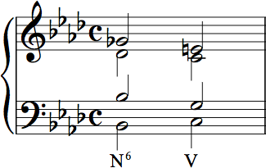
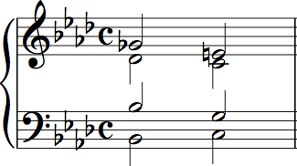
Voice-leading from N⁶->V
^{b}2 to #7
Double the bass (4) if you can.

Slide 9
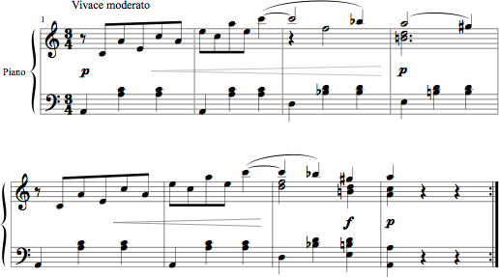
Beethoven Bagatelle, Op. 119, No. 9

Slide 10
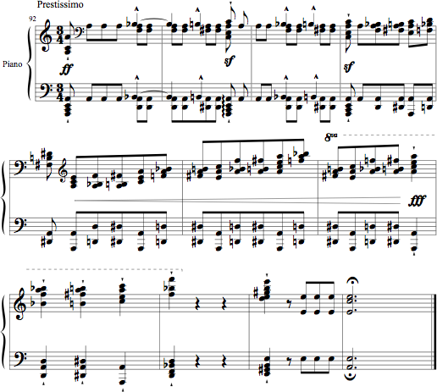
Liszt Transcendental Etude no. 2, mm. 92-end
i N⁶ (ped A) V⁶₅

Slide 11
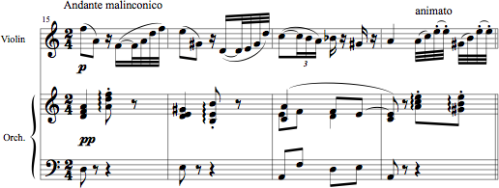
Where else can you use ^{b}II⁶?
In minor any chord that can go to ii°⁶ can go to ^{b}II⁶ (as in a sequence).

Slide 12
Saint-Saens, Introduction and Rondo Capriccioso
VI⁶ ⁵3 N⁶ V

Slide 13
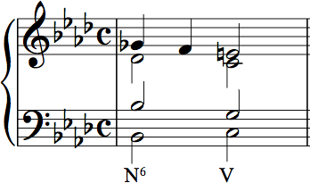
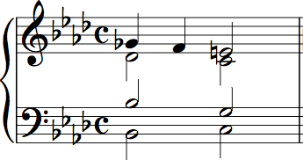
Voice-leading from N6->V
^{b}2-1-#7.
Double the bass (3rd of the chord) if you can.

Slide 14
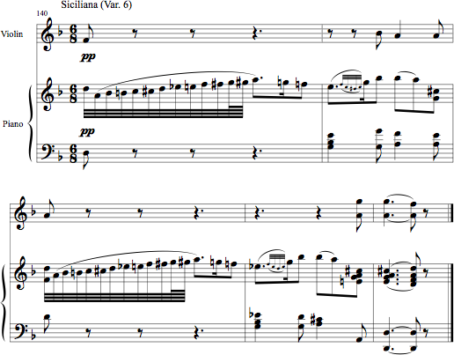
Mozart, Violin Sonata in F, K. 377, ii

Slide 15
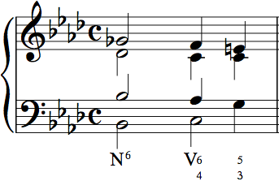
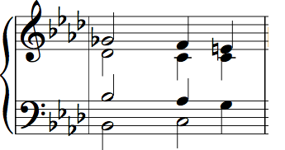
Voice-leading from N⁶->V
^{b}2-1-#7.

Slide 16
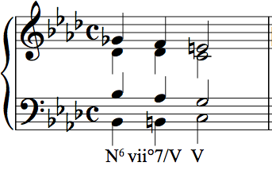
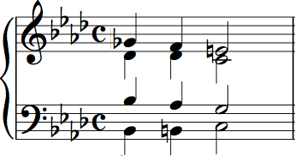
Voice-leading from N⁶->V
^{b}2-1-#7.

Slide 17
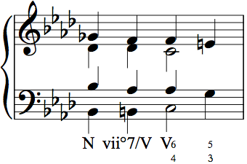
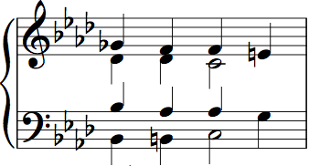
Voice-leading from N⁶->V
^{b}2-1-#7.

Slide 18
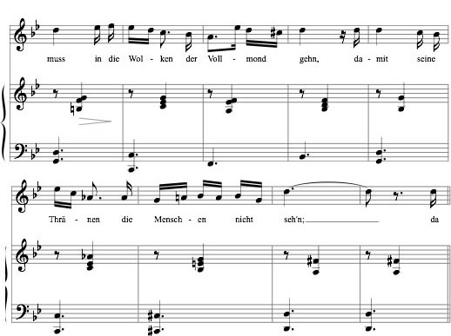
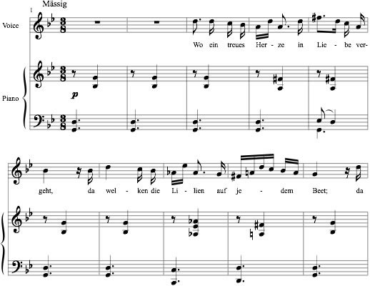
V⁷/iv iv V⁷/III III i
N⁶ vii°⁷/V V
N⁶ V i
Notes:
Mullerin 1

Slide 19
Part-write this Neapolitan progression
There are three different ways to set the first note in this example, but only two are functional. What are they?
A iii chord isn’t functional, but both I and VI would work.

Slide 20
Let’s begin with i, and write a bass line.
We have i - N⁶ - V - i

Slide 21
Now add the alto voice
The smoothest voice-leading from N->V moves ^{b}6->5
I doubled the bass of i in the first chord to avoid . . . What?

Slide 22
Now add the tenor voice
The smoothest tenor moves 5->4->3, with 4 becoming the 7 over V⁷
Let’s try the same soprano in a different key . . . .

Slide 23
This time begin on VI
3 - ^{b}2 - #7 - 1
VI - ^{b}II - V⁽⁷⁾ - i

Slide 24
Now add alto and tenor voices
3 - ^{b}2 - #7 - 1
VI - ^{b}II - V⁽⁷⁾ - i

Slide 25
Why did I double the fifth in VI?
To avoid parallel fifths
between bass and alto

