Slide 1
Beyond the N⁶
The Neapolitan in wider contexts

Slide 2
Other contexts for ^{b}II
If you don’t cadence, you can go to inversions of V or vii°⁷.
V ⁴₂
vii° ⁴₃

Slide 3
Can you use it in major?
Yes, but you might want to back it up with a ^{b}VI or I^{6.}

Slide 4
E: V/^{b}III G: I IV I ii/IV V/IV
Here’s an example of the N in major (anyone recognize this chromatic mediant modulation?)

Slide 5
Lennon/McCartney, You’re Going to Lose that Girl
E: V/^{b}III G: I IV I ii/IV V/IV
IV
E: ^{b}VI or V/^{b}II ^{b}II I iii ii⁷ V

Slide 6
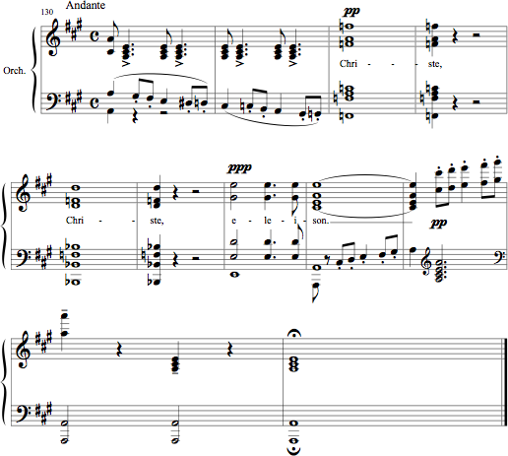
Verdi,
Requiem,
Kyrie
A: I ^{b}VI (V/N)
N V I

Slide 7
Nice examples but
You might have noticed something else about the Neapolitan in the last two examples.
The Beatles and Verdi used it in root position!

Slide 8
Hey, doesn’t it have to be in first inversion?
N ( i ) V i
No, but watch that dim. 5 between the ^{b}2 and scale degree 5!
Here Paganini uses a passing 1 to finesse the bass motion to V.

Slide 9
Of course if you’re Chopin, you may not mind that dissonant tritone

Slide 10
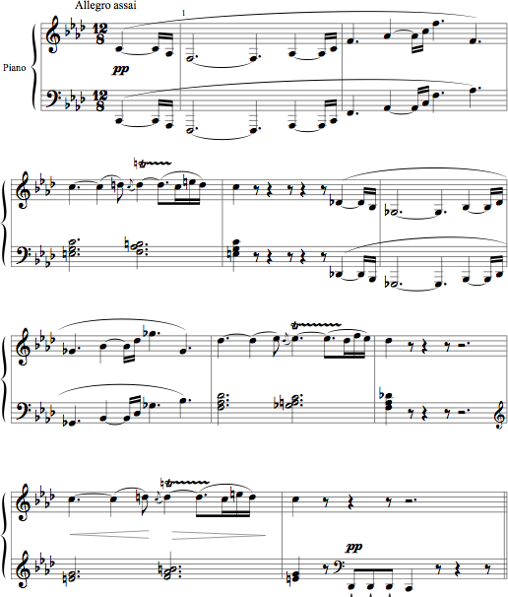
N⁶ makes a great pivot chord
. . in a chromatic modulation,
and it works well in sequences
Notes:
Beethoven op. 57

Slide 11
Analyze the first four bars of Beethoven’s Op. 57 in f minor.
What happens in mm. 5-8?
The first four mm. are sequenced a half-step higher.
V⁶ vii°⁴₃/V V⁶

Slide 12
As the initial entrance on 5/C tonicized f minor, so the entrance on 5/D^{b} tonicizes G^{b}.
Beethoven actually modulates to ^{b}II, but moves back to I: D^{b}, which becomes the ^{b}VI of f!
Gb: V⁶ vii°⁴₃/V V⁶

Slide 13
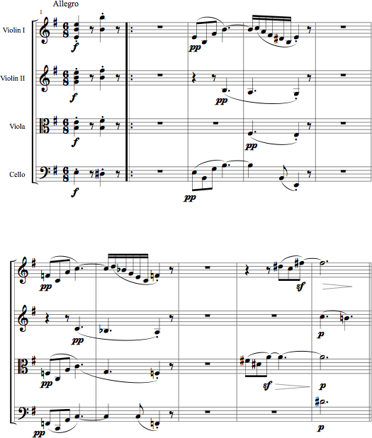
i V⁶ i V⁷ i
^{b}II V⁷/^{b}II ^{b}II vii°⁷ V⁶₅
Beethoven, String Quartet, op. 59 no. 2, mvt. 1, mm. 1-10

Slide 14
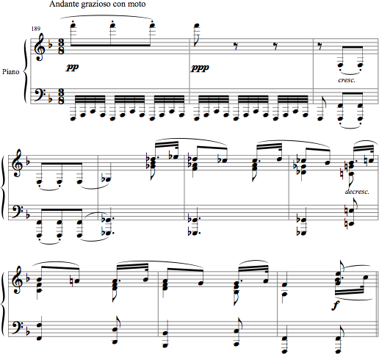
I
^{b}II V⁶₅
I vi IV V⁷ I
Beethoven, Andante Favori, mm. 189-98
Notes:
N6w

Slide 15
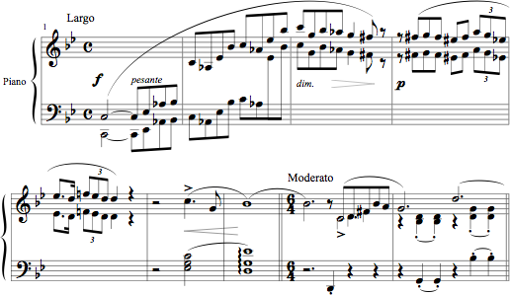
?
^{b}II⁶ V⁶₅ —————
————— iv⁶ VI⁴₂ V⁷ i
Chopin, Introduction to Ballade in g minor, mm.1 - 9

Slide 16
Setting a bass line with N⁶ chords
Where could you use Neapolitan sixth chords while figuring this bass?

Slide 17
Setting a bass line with N⁶ chords
T———————P———D——T——P————D—————T
What is the fundamental progression outlined by this bass line?

Slide 18
T--------------------P------D---T-----P---------D------------------T
i ? ? N⁶ ? ? N⁶ ? V V i
Use N6 for your first and second predominant, and use root position chords
to express i and V at the beginning and at the final cadence.
How would you set those chords not in root position, but still express
T and D functions? How would you set the chromatic tone?

Slide 19
i vii°⁶ i⁶
N⁶ V⁴₂ i⁶
N⁶ V⁶/V V⁶₄ ⁵₃ i
A tonic prolongation with vii°6 would work well within the first bar.
The first N6 could move to a dominant in third inversion, which resolves to i6.
The second N6 moves to the structural dominant through a secondary chord to V (either vii°/vii°⁷ or V⁶), and then to a cadential ⁶₄.

Slide 20
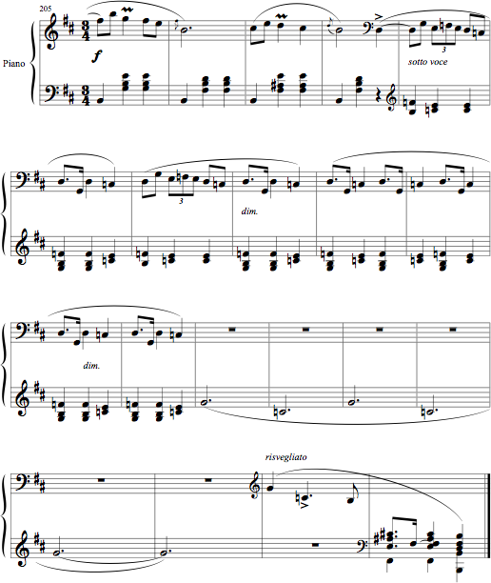
iv⁶₄ i V^{7/ped.} i ^{b}II: V⁶₅ I
V ⁷ i
Chopin, Mazurka in b minor, op. 33 no. 4, mm. 205-end

Slide 21
Add Chromatic (Mode mixture, ^{b}II or secondary chords) at each *

Slide 22
Schubert Waltz Analysis
i ⁶ ^{b}II⁶ ⁶₄ ⁵_{3 i}
V
i V ^{b}II V⁷ i
^{b}II
The Original

Slide 23
Questions: The Waltz is in F major, but
What key is tonicized in mm. 3-4?
How does Schubert get from F to this key and back to F?

Slide 24
Answers:
bIII is tonicized in mm. 3-4
Mode mix serves as a pivot (m. 2), while the g° chord (which can also be heard as part of a vii°⁷) pivots back to F

Slide 25
Where can you locate melodic sequence?

