Slide 1
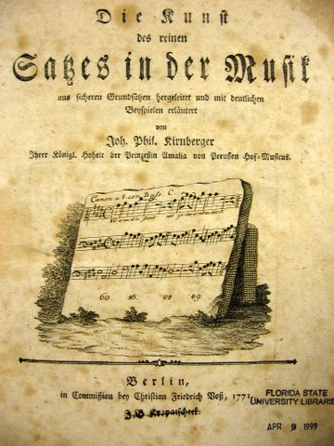
The Contrapuntal ⁶₄

Slide 2
Second inversion triads are rarely used as substitutes for root position triads
The ⁶₄ chord may look like a triad, it may feel like a triad, but it rarely ever functions or sounds like a triad.

Slide 3
For hundreds of years the perfect fourth between the bass note and the root of the triad was considered a dissonance used sparingly if at all, in which case it was prepared and resolved by stepwise motion (unless the fourth occurred in inner voices, or between soprano and an inner voice).

Slide 4
How does it function?
But the ⁶₄ Chord has many important functions, all of them prolongational.
The ⁶₄ functions essentially as a contrapuntal linear chord.

Slide 5
How does it function?
It has four primary uses:
an accented cadential ⁶₄ chord;
an unaccented passing ⁶₄ chord
a sustained or pedal ⁶₄ chord and
an arpeggiated ⁶₄ chord.

Slide 6
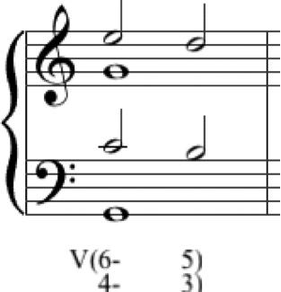
cadential ⁶₄
a standard cadential formula in which the I⁶₄ chord enters on a strong beat, and the 6 and 4 resolve to 5 and 3 over the same bass to form a root position V.

Slide 7
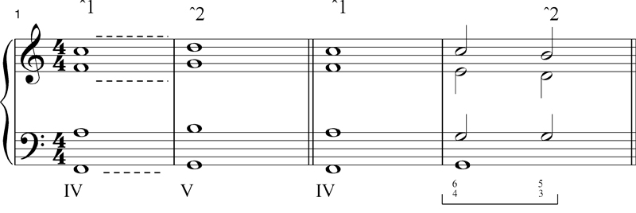
cadential ⁶₄
The I⁶₄ helps avoid parallel fifths when the soprano ˆ1 moves to ˆ2

Slide 8
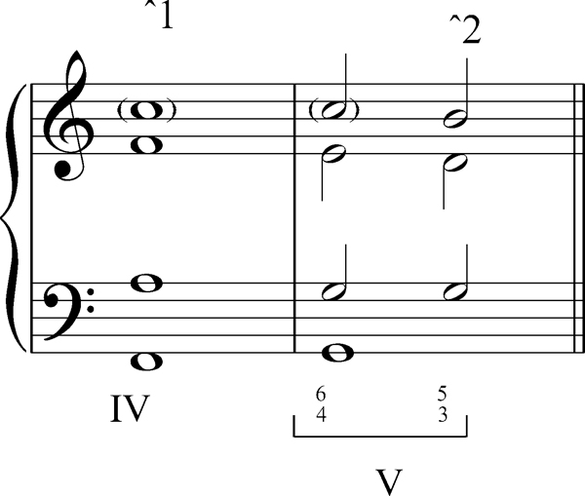
When moving to I⁶₄ from IV, treat ˆ1 as a common tone, so that the 4->3 sounds like a suspension.

Slide 9
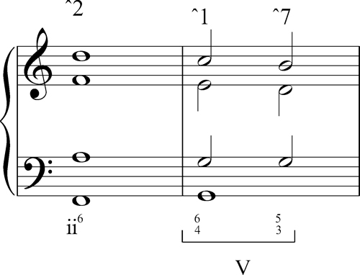
When moving to I⁶₄ from ii⁶, treat ˆ1 as a passing tone.

Slide 10
cadential ⁶₄
Always double the bass: ˆ5.

Slide 11
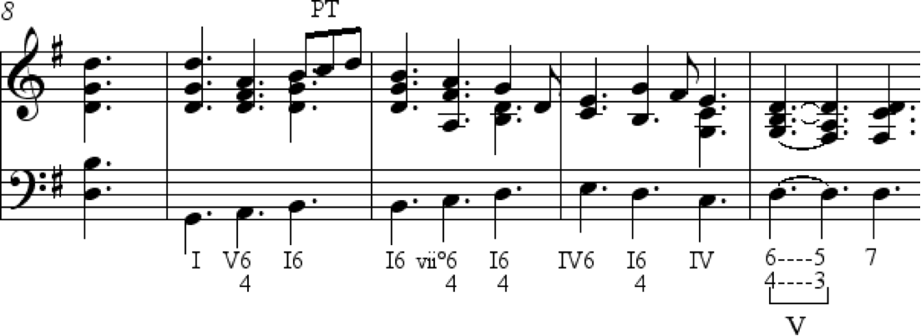
passing ⁶₄
The unaccented passing ⁶₄ moves stepwise between two bass notes related by third (as with sixth chords, in I-vii°⁶-I⁶, but it works just as well with ⁶₄ chords)

Slide 12
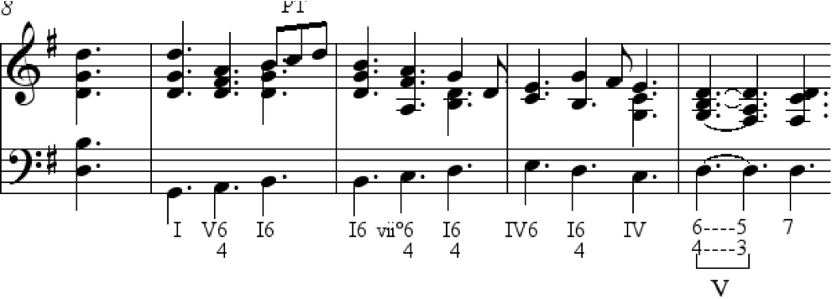
passing ⁶₄
most often links a root position chord to a first inversion or v.v.
The V⁶₄ or V⁴₃ and the I⁶₄ are the most common passing chords

Slide 13
pedal ⁶₄
The pedal ⁶₄ (also called the neighbor six-four) is basically a linear elaboration of a root position chord, essentially functioning as neighbor tones over a root position ⁵₃ chord, where the interval 6->5 and 4->3

Slide 14
pedal ⁶₄
Amazing Grace harmonized with neighbor six-four chords

Slide 15
arpeggiated ⁶₄
The arpeggiated ⁶₄ chord is an expansion of root position.
It often appears as part of a bass arpeggiation moving through each member of a triad (e.g. root-third-fifth), or as an “oompah” root-fifth motion oscillation.

Slide 16
Amazing Grace harmonized with arpeggiated and pedal six-four chords

Slide 17
Other treatments of the cadential ⁶₄ chord
The ⁶₄ may act like an appoggiatura chord.

Slide 18
The greatest expansion of the cadential ⁶₄ chord
During the cadenza of a concerto, the soloist plays over the root position chord, before a trill on ˆ2 that brings the soloist to a root position V under a fermata, whereupon the orchestra brings back the tonic.

Slide 19
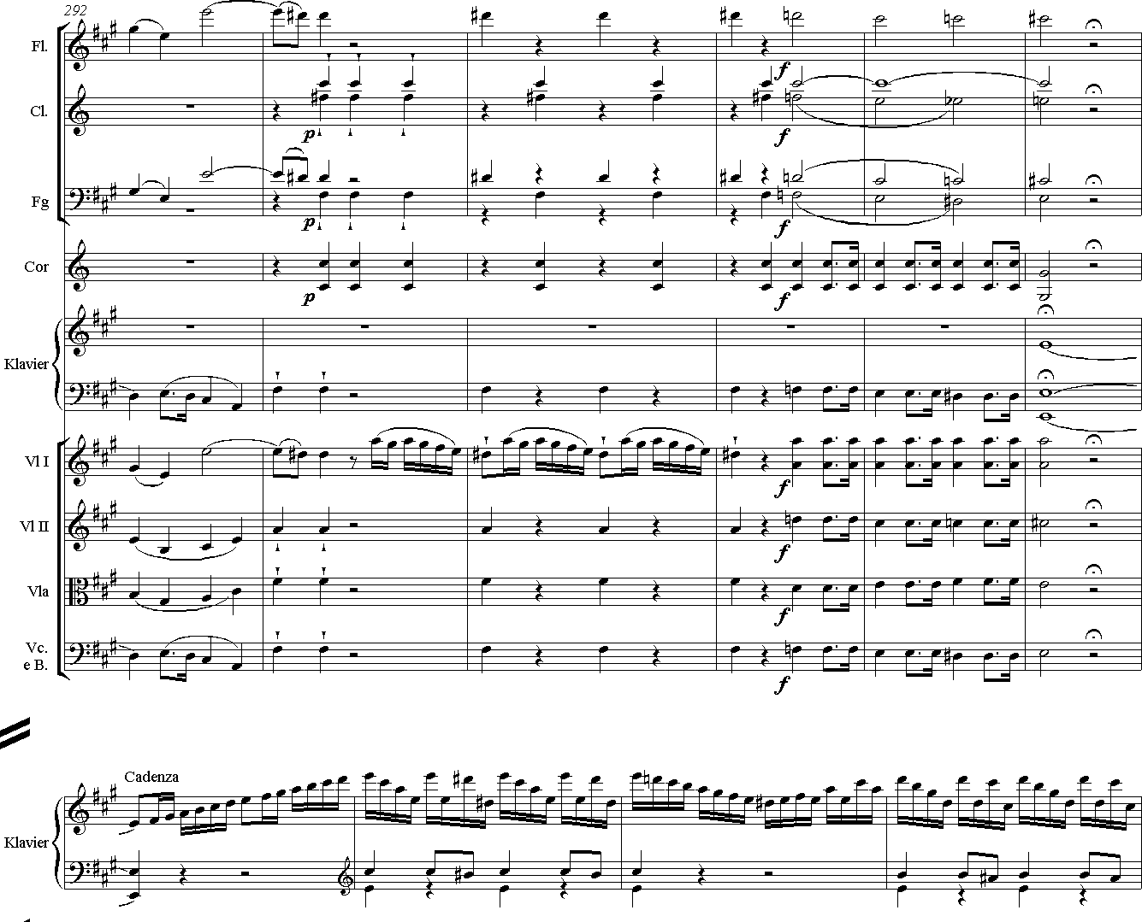

Slide 20
Compound Melody:
two or more lines in different registers
Bach, Cello Sonata 1
4 - 3
I
(IV⁶4)
I

Slide 21
(I⁶4)
V
I
V
(I⁶4)
(vii°⁶)
⁶4-⁵3
V
How would you “connect the dots” in this arpeggiated melody by Corelli?
Where are the implied six-four chords?

Slide 22
Part-writing: 99% of the time
99% of the time double the bass (=fifth)!
if you aren’t arpeggiating the bass, move by step; try to move inner voices as smoothly as possible (this is not the place to get inventive with inner-voice motion!)
if you leap towards or away from that bare fourth between the bass and the root, it sounds funky (in a bad way).

Slide 23
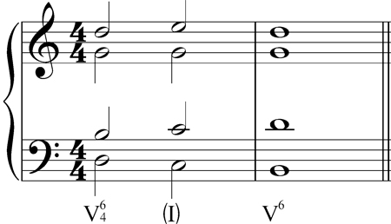
Other Diatonic linear chords
The consonant passing I chord:
V⁶₄-I-V⁶

Slide 24
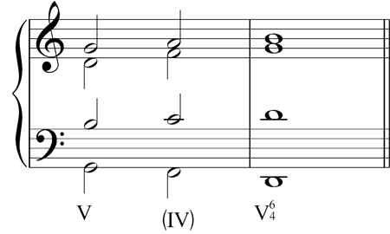
Other Diatonic linear chords
The retrogressive V-IV progression, in which IV functions as a passing chord (even if the bass is a leaping tone rather than a PT)

Slide 25
Other Diatonic linear chords
Apparent 7th chords that don’t function as T, P or D, but move in sequence.

Slide 26
Schumann
Other Diatonic linear chords
If a chord just doesn’t make sense as a tonic, predominant or dominant in context, it is probably embellishing one of those functions.
arpp
p

Slide 27
Lennon/McCartney
?

Slide 28
passing
cadential
I
(V⁶)
I
(V⁴3-⁶5 )
I
IV⁶
(I⁶4)
IV
I⁶
(vii°)
I
⁶4-⁵3
HC
V
⁶4-⁵3
I
(V⁶)
I
(V⁴3-⁶5 )
I
IV⁶
(I⁶4)
IV
I
PAC
V

Slide 29
Brahms, Variations on a Theme by Haydn, op. 56a, mm. 1-10
⁶4
⁶4
⁶4
⁶4

Slide 30
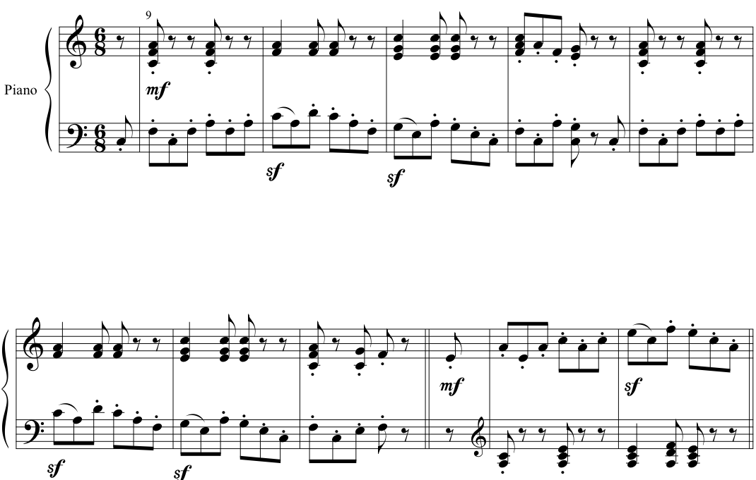
Schumann, Album for the Young, op. 68 no. 8, "Wilder Reiter
⁶4
⁶4
⁶4
⁶4
⁶4

Slide 31
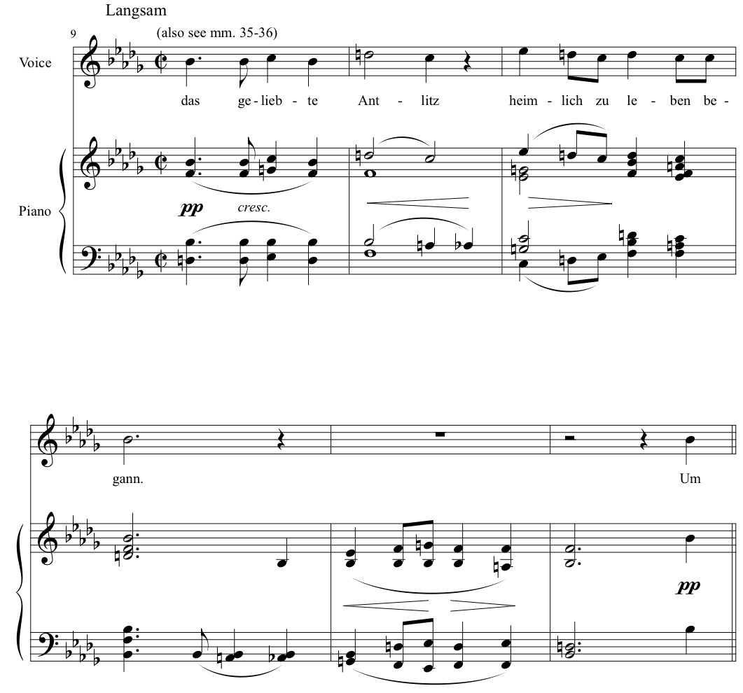
Schubert, Schwanengesang no. 9, "Ihr Bild", mm. 9-14
⁶4
⁶4
⁶4

Slide 32
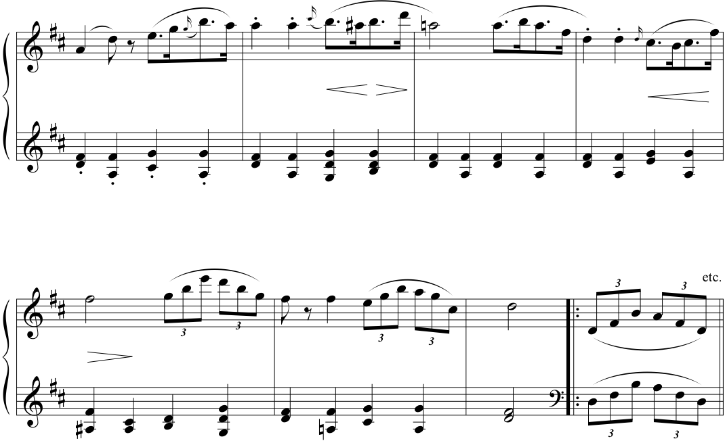
Schubert, Piano Sonata D. 850, iv
⁶4
⁶4
⁶4
⁶4

Slide 33
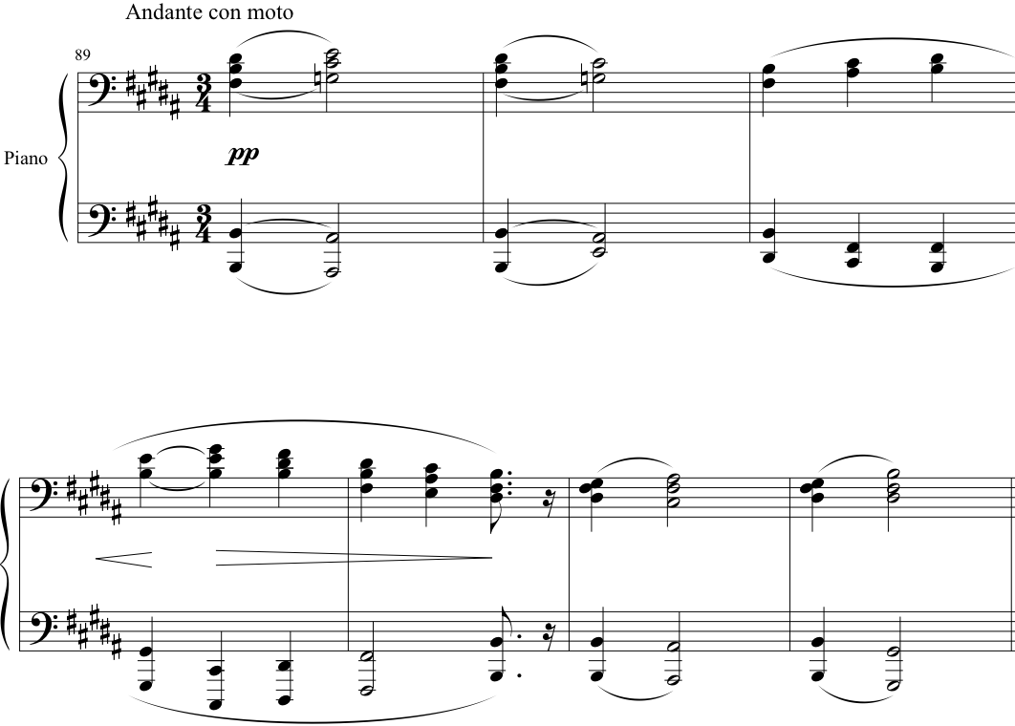
Brahms, Ballade, Op. 10, No. 4
⁴3
⁶4
⁶4
⁶4

