Slide 1
1st week Review
16C 2022

Slide 2
Secondary Dominants
V⁶5 of ii in A^{b} Major

Slide 3
Secondary Dominants
vii°⁷ of V in A Minor

Slide 4
Secondary Dominants
vii°⁴2 of III in C Minor

Slide 5
Secondary Dominants
vii°⁶5 of iv in G# Minor

Slide 6
Secondary Dominants
vii°⁴3 of ii in A Major

Slide 7
Harmonization

Slide 10
Circle 4 part-writing, and
1 chord-spelling, problems
//5, T & A
//8, A & S
Aug 2nd, T
7th not prepared or resolved in V7
no 3rd in final tonic

Slide 11
Circle 5 part-writing problems
//5, T & A
unres. 7th, T
// 8, A & S
Aug 2nd, B
Unequal 5s, B & T

Slide 12
Where can you find a harmonization error?
i
(iv6
V65)
i
(ii°)
i6
i
(V65)
iv6
V

Slide 13
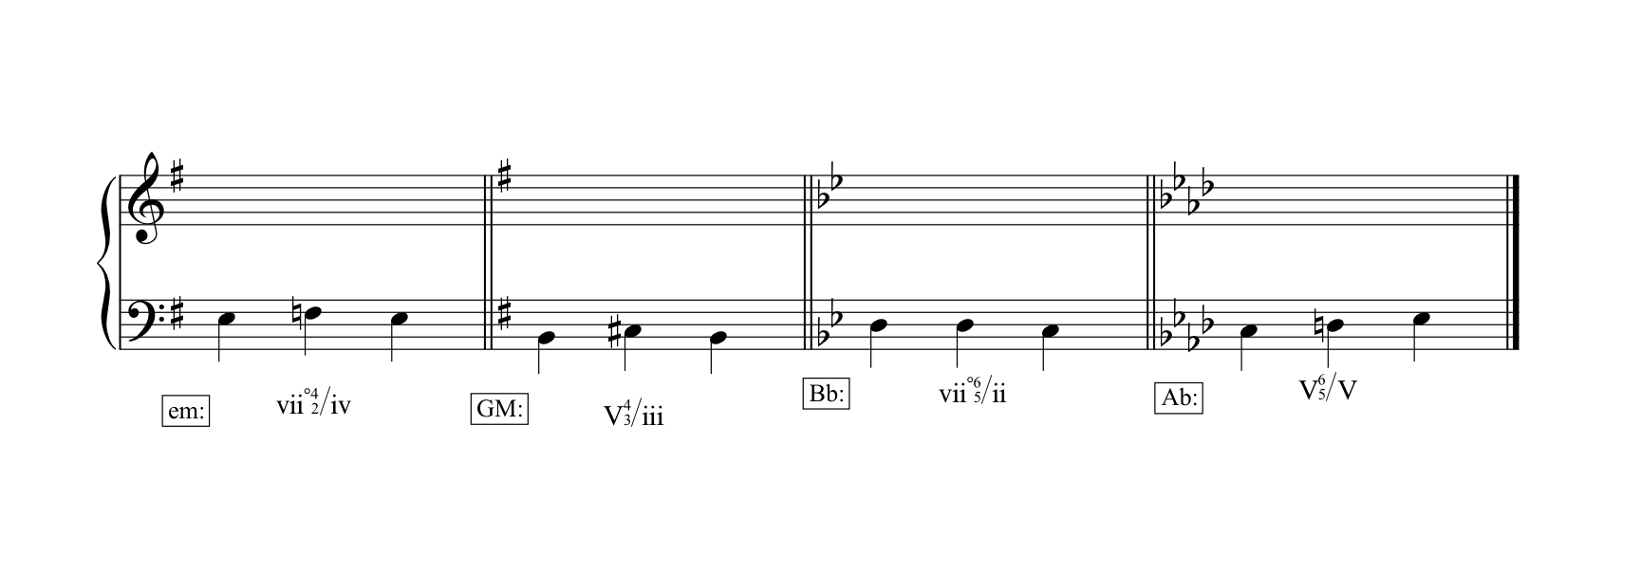
Part-Writing

Slide 14
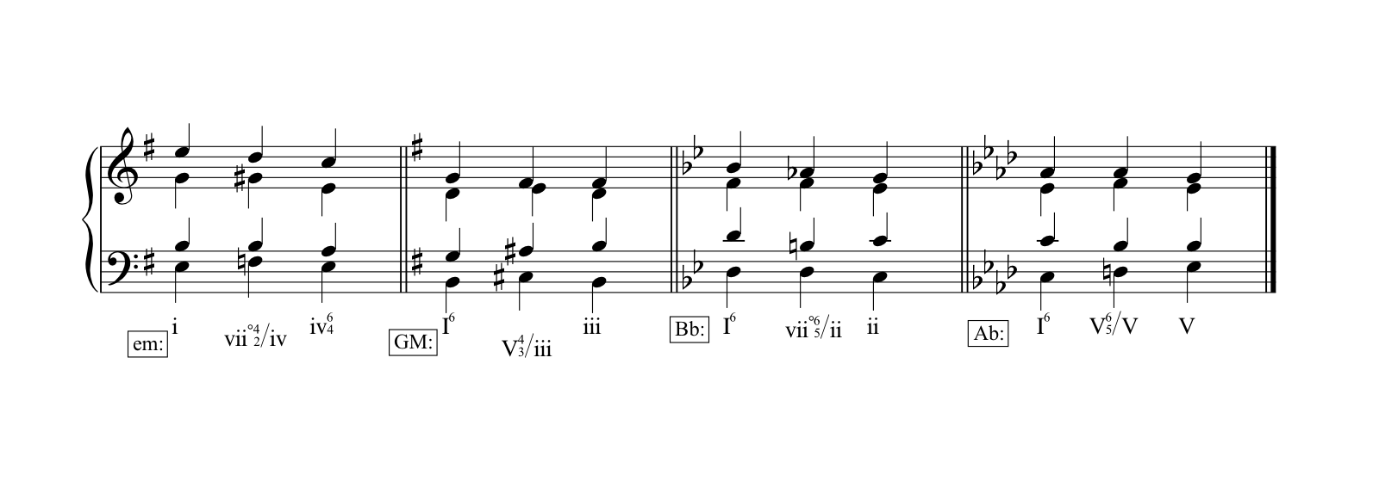
Part-Writing

