Slide 1
Basic Concepts and Techniques of
SPECTRAL MUSIC 2

Slide 2
Derivation of pitch aggregates
from spectral models
instrumental spectra
relative amplitudes of partials within instrumental spectra
formants
spectral envelopes
attack transients
non-harmonic spectra
artificial (harmonic) spectra
distorted harmonic spectra
frequency shifted spectra

Slide 3
instrumental spectra
Western instruments have spectra which are close to pure harmonic spectra for clarity
But sounds are never completely harmonic.
noise
stretching & compression
relative amplitudes of partials
presence or absence of partials
formants
envelopes
attack transients

Slide 4
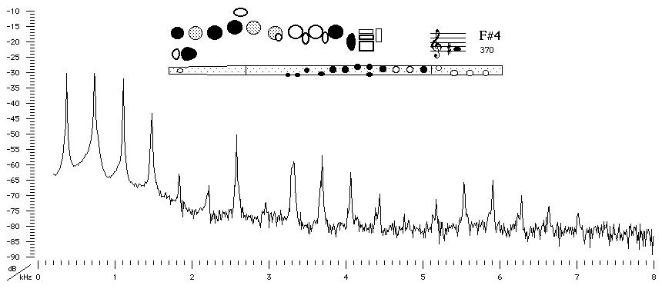
relative amplitudes of partials within instrumental spectra
examples
the flute's weak fundamental tone (in comparison in its to its second partial) in its low register makes it difficult to hear at a distance

Slide 5
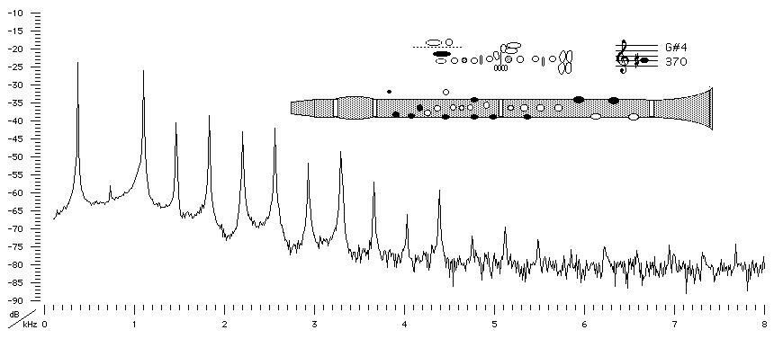
relative amplitudes of partials within instrumental spectra
examples
the clarinet spectrum emphasizes only odd numbered partials

Slide 6
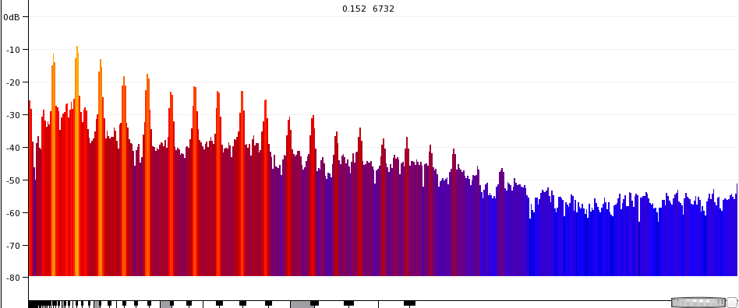
relative amplitudes of partials within instrumental spectra
examples
ff brass instruments have dissonant upper partials (7th or the 9th) as the loudest components ( “brassiness”)

Slide 7
relative amplitudes of partials within instrumental spectra
higher part of instrument's range has fewer partials than lower part

Slide 8
formants
vibrating physical bodies act as filters, emphasizing bands of frequencies and attenuating others
as a fixed part of construction, particular frequency regions are highlighted or masked regardless of pitch
formants are a clue to source, marking different registers as inflections of the same instrument

Slide 9
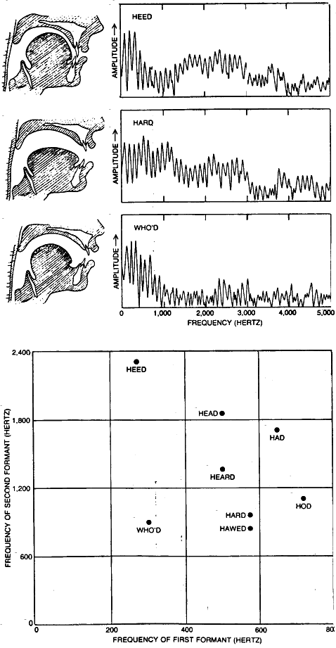
The human voice creates different types of formants, as with vowels
a soprano singing ‘e’ has formants at 350, 2000, 2800, 3600 and 4950 Hz, etc.

Slide 10
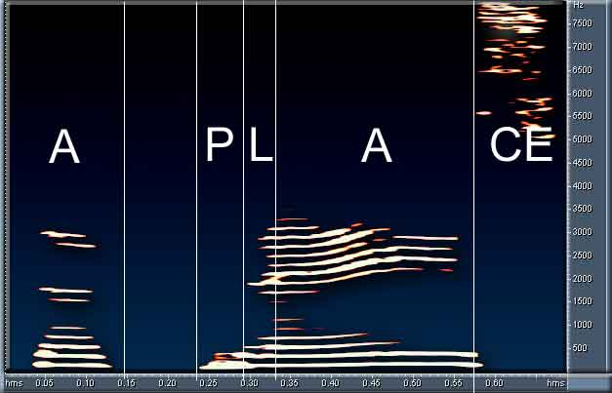
formants

Slide 11
formants
The lack of formant cues prevents us from understanding high vowel sounds
timbral hearing thus more widely and finely developed than pitch and interval hearing
flute example

Slide 12
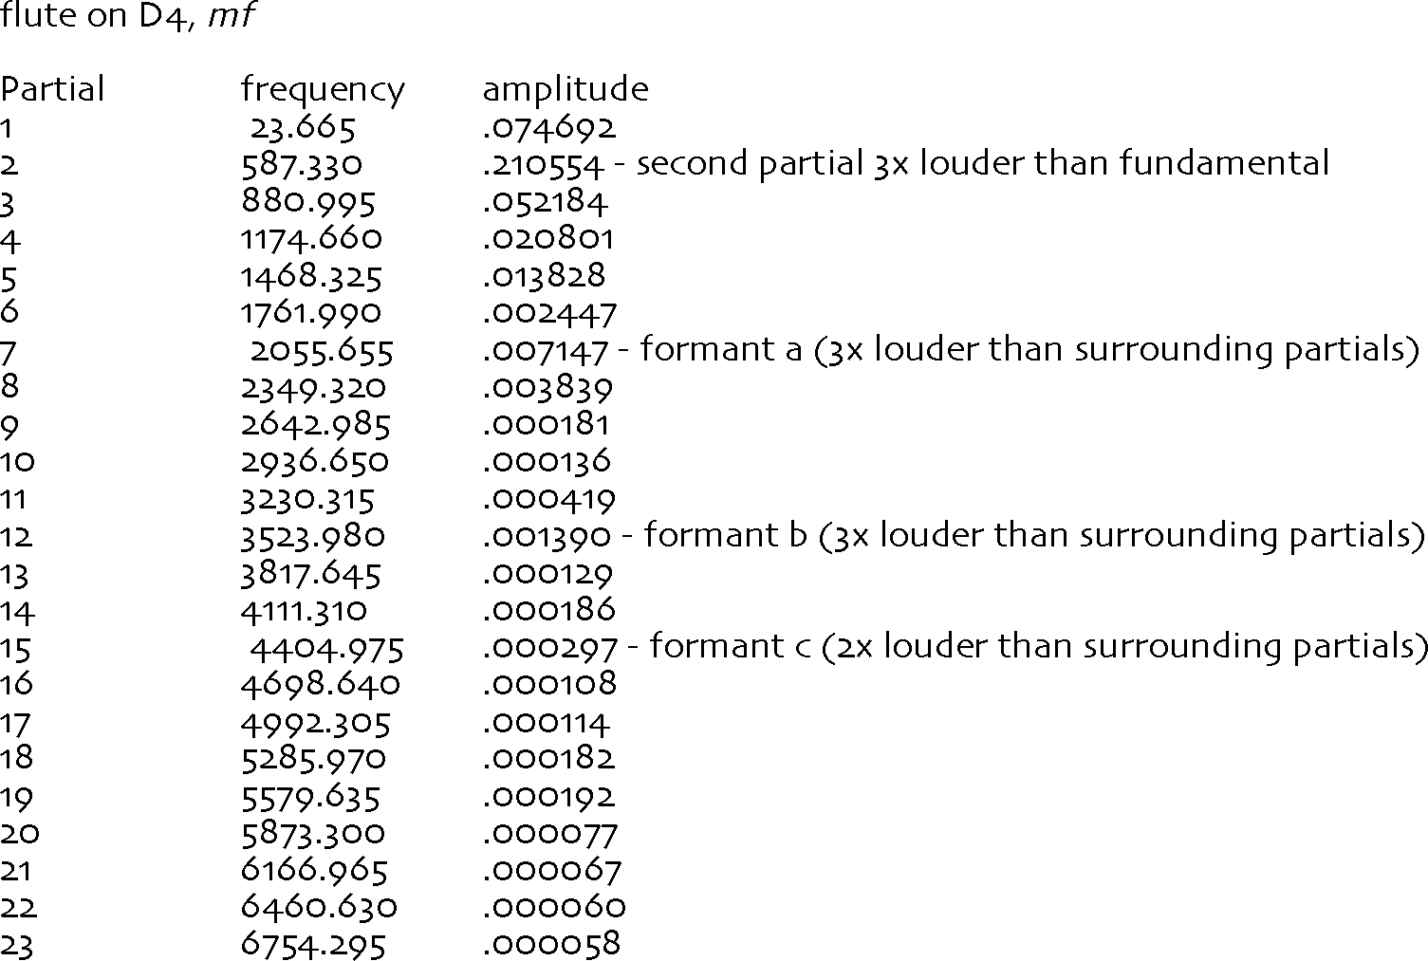

Slide 13
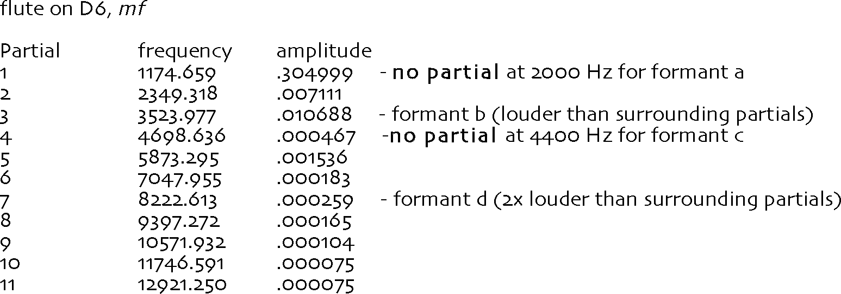
formant analysis of other instruments

Slide 14
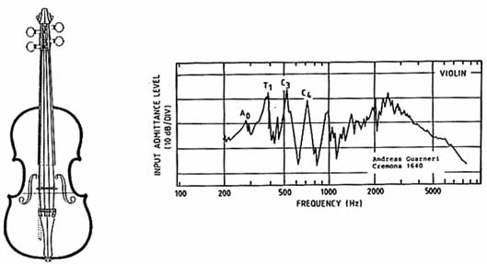
spectral envelopes
changes in overall amplitude and relative changes of partials critical to impression of timbre
complex and difficult to model

Slide 15
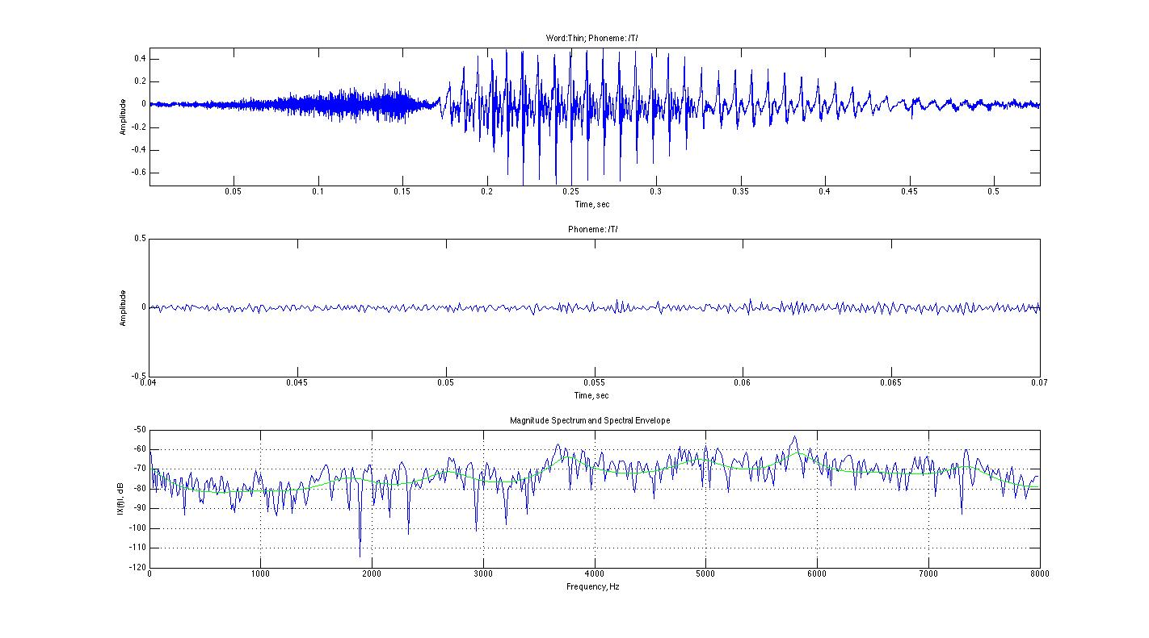
spectral envelopes
The most basic aspect of an envelope its global amplitude motion.

Slide 16
spectral envelopes
spectral envelope determines
appearance,
disappearance and
changing relative amplitudes of partials
spectral flux = variation within a sound during its evolution and sustain
why many electronic sounds seem “artificial”

Slide 17
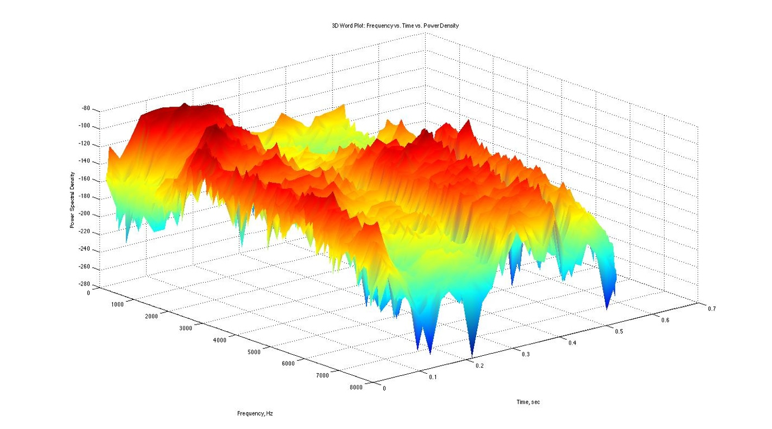

Slide 18
attack transients
a coloring of the spectrum present only in the first part of the sound
generally noise-like
often caused by the physical production of the sound
extremely important to the perception of timbre

Slide 19
attack transients
for modeling purposes, the exact frequency content seems less important than its presence
central to perception: amplitude of the transient relative to
harmonic portion of spectrum and
envelope

Slide 20
attack transients
(a) The waveform of an attack transient.
(b) Amplitudes of the first five harmonics of the attack transient of a 110 Hz. diapason organ pipe.

Slide 21
non-harmonic spectra
classes of spectra
colored noise (guiro, maracas, blowing through a flute
modeled as a resonant/band-pass filter applied to white noise
instrumental multiphonics / bells
multiple superposed harmonic spectra and beats
sounds in which spectral stretching or compression interfere with ear's perception of a fused, pitch producing, timbre

Slide 22
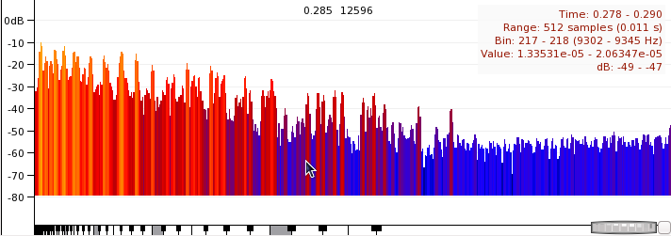
non-harmonic spectra
non-harmonic spectra do not produce a clear sense of spectral fusion or well-defined pitch

Slide 23
non-harmonic spectrum of a cow-bell (approximated to nearest quarter-tone)
large number of weak (low amplitude)
upper partials when first struck

Slide 24
highest partials disappear almost immediately, leaving spectrum of medium complexity

Slide 25
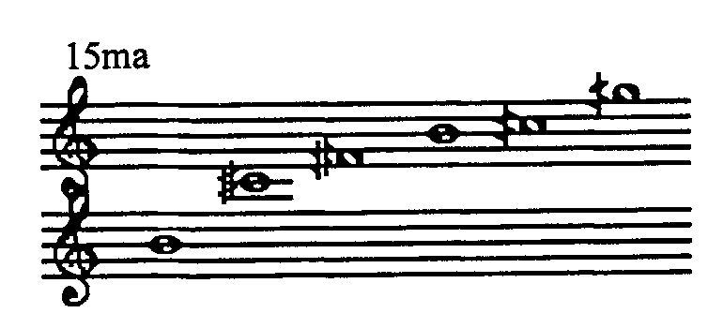
Note that due to the effects of beating and modulation between partials, some notes change pitch slightly during the sonic evolution
The upper partials of this spectrum continue to fade, leaving only the most significant partials to resonate:

Slide 26
artifical (harmonic) spectra
composers took simple mathematical expression of harmonic series and used it to create abstract spectra
any combo of harmonic partials on same fundamental share certain acoustic properties
new, artificial sounds based on frequency = rank * fundamental sound natural, resonant

Slide 27
distorted harmonic spectra
many instrumental spectra are slightly stretched or compressed
To model this effect an exponent added to the equation for harmonic partials:
frequency = rank * fundamental raised to the x power;

Slide 28
distorted harmonic spectra
frequency = rank * fundamental raised to the x power;
If the exponent x < 1 the spectrum is compressed
If the exponent x > 1 t it is stretched
If the exponent x = 1 t it is harmonic
Another distortion technique is to change the highest and/or lowest notes of the spectrum and then re-scale the interior notes so as to preserve the relative spacing between the frequencies.

Slide 29
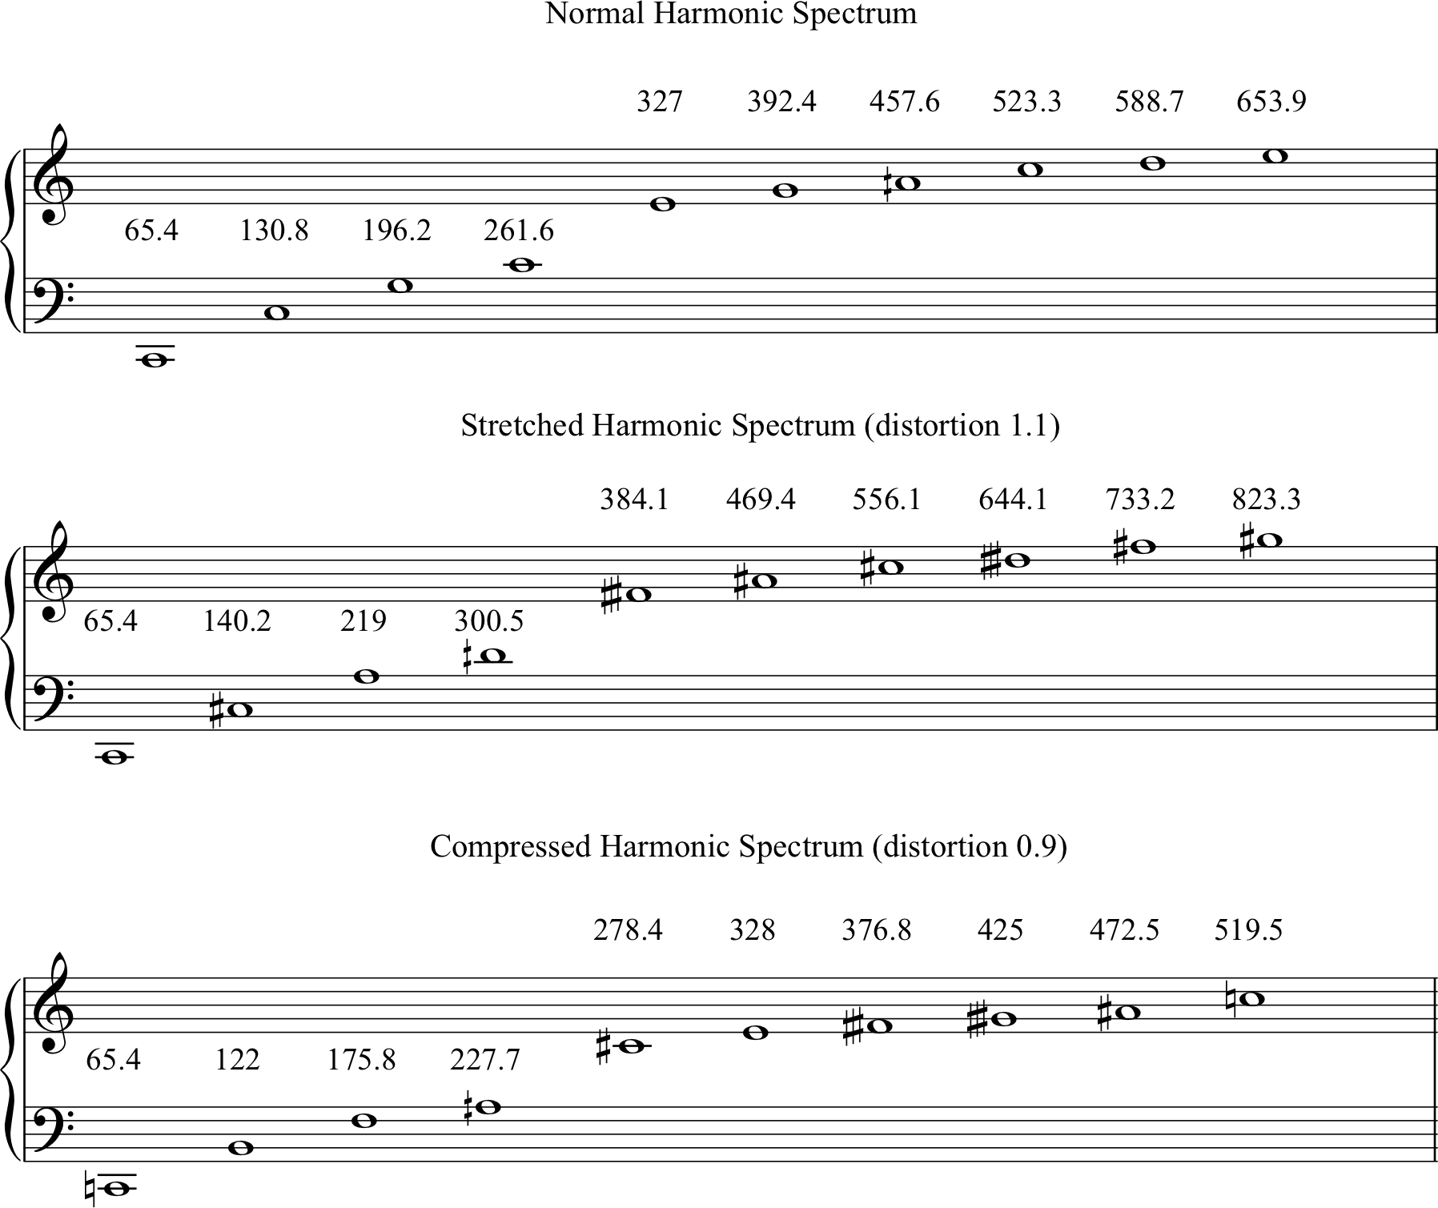

Slide 30
frequency shifted spectra
instead of creating a distortion which gets ever larger as frequencies increase, a constant value (in Hz) added to all the partials.
frequency = rank * fundamental + shift-value
The effect of this distortion becomes less significant as frequencies increase, as % of distortion decreases.

Slide 31
