Slide 1
Rock’n’roll erupts
Society and the Music Business

Slide 2
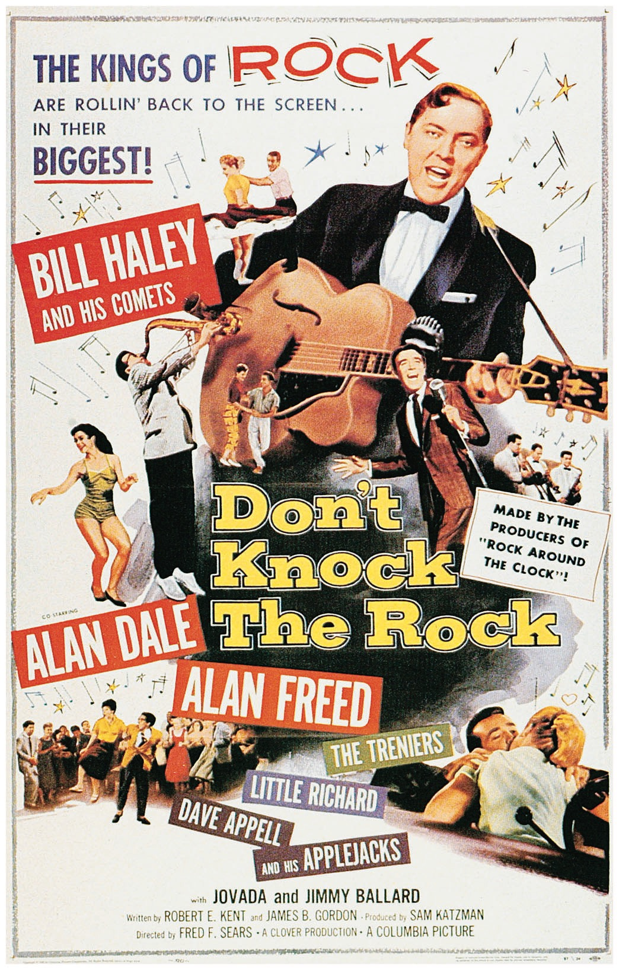
Civic reaction
Abel Green and Milton Bracker readings
Business reaction and Marketing
Small labels and two case studies
How do the big labels cash in?
White idols singing Black music
Alan Freed
Rise and fall of Mr. Rock ’n’ Roll
Scandal!?
Payola was legal, then illegal, mirroring contemporary relations between large corporations and entrepreneurs

Slide 3
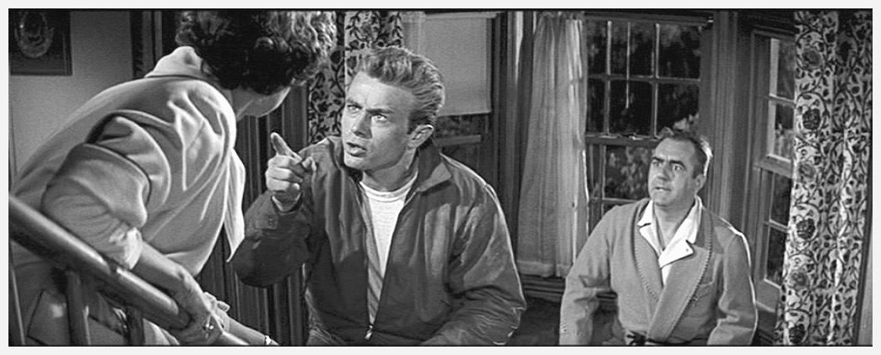
Civic Reaction
Rock is…
unwholesome and obscene
morally corrupting
encourages racial integration
“a sign of depersonalization of the individual, of ecstatic veneration of mental decline and passivity.” (Dr. Meerloo)
James Dean in Rebel Without a Cause

Slide 4
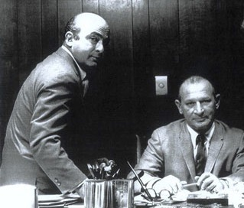
Independent labels: chess
Leonard & Phil Chess emigrated from Poland in 1928.
By the early 1940's, they owned several bars and nightclubs in the South Side of Chicago.
In 1947 the Chess brothers started signing local artists like Muddy Waters to Aristocrat Records (predecessor to Chess records)
The great Willie Dixon produced seminal R&B from the late ‘40s through the ‘60s.
They later tried doo-wop and soul, but sold the company in 1969 to GRT.
Leonard’s son Marshall went on to manage Rolling Stones Records during a decadent time in their history.

Slide 5
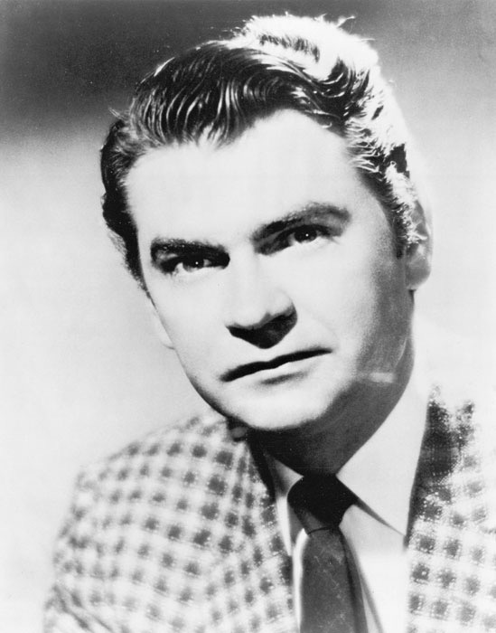
Independent labels: Sun
Sam Phillips got into music in the late ‘40s when black musicians in the South had nowhere to record.
Started as Memphis Recording Service in 1950, and launched Sun Records label in 1952.
Memphis was a hotbed of blues activity. Sun recorded artists such as B. B. King, Ike Turner, Howlin’ Wolf, Bobby Bland, Little Junior Parker, and the Prisionaires
At the beginning a blues label, but Frustrated by lack of airplay, he wanted to find a white performer who sounded black.
Phillips discovered Elvis Presley in 1954, who cut 5 blues, and 5 country tunes for Sun, all with the same feel.
Philips sold Presley’s contract to RCA in order to have enough money to continue the label.

Slide 6
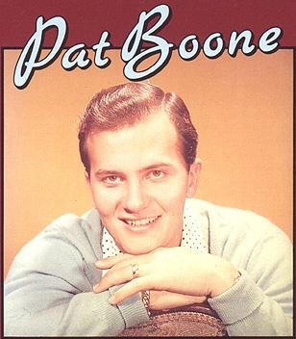
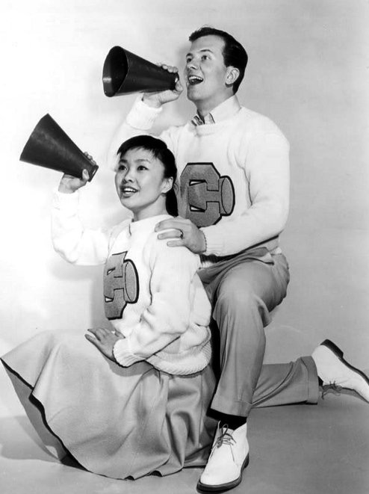
Reaction from major record labels
How do we cash in on this and make it acceptable to white America?
Cover versions of rock and roll hits
Take advantage of weaknesses of small labels
Create teen idols
Hire songwriters to pen “rock n’ roll songs”
Create dance crazes for the kids

Slide 7
White Stars:
Bill Haley, Teen Idols & Covers

Slide 8
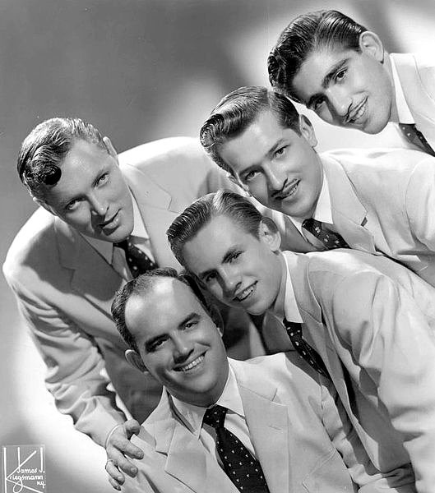
Bill Haley and the Comets
Haley from Western swing tradition
Stripped down instrumentation: 2-3 horns + percussion section
Blues shouter
Some success with cover of Rocket 88
Renamed band “the Comets”
Starts performing R&B covers
Hits with “Rock Around the Clock”

Slide 9
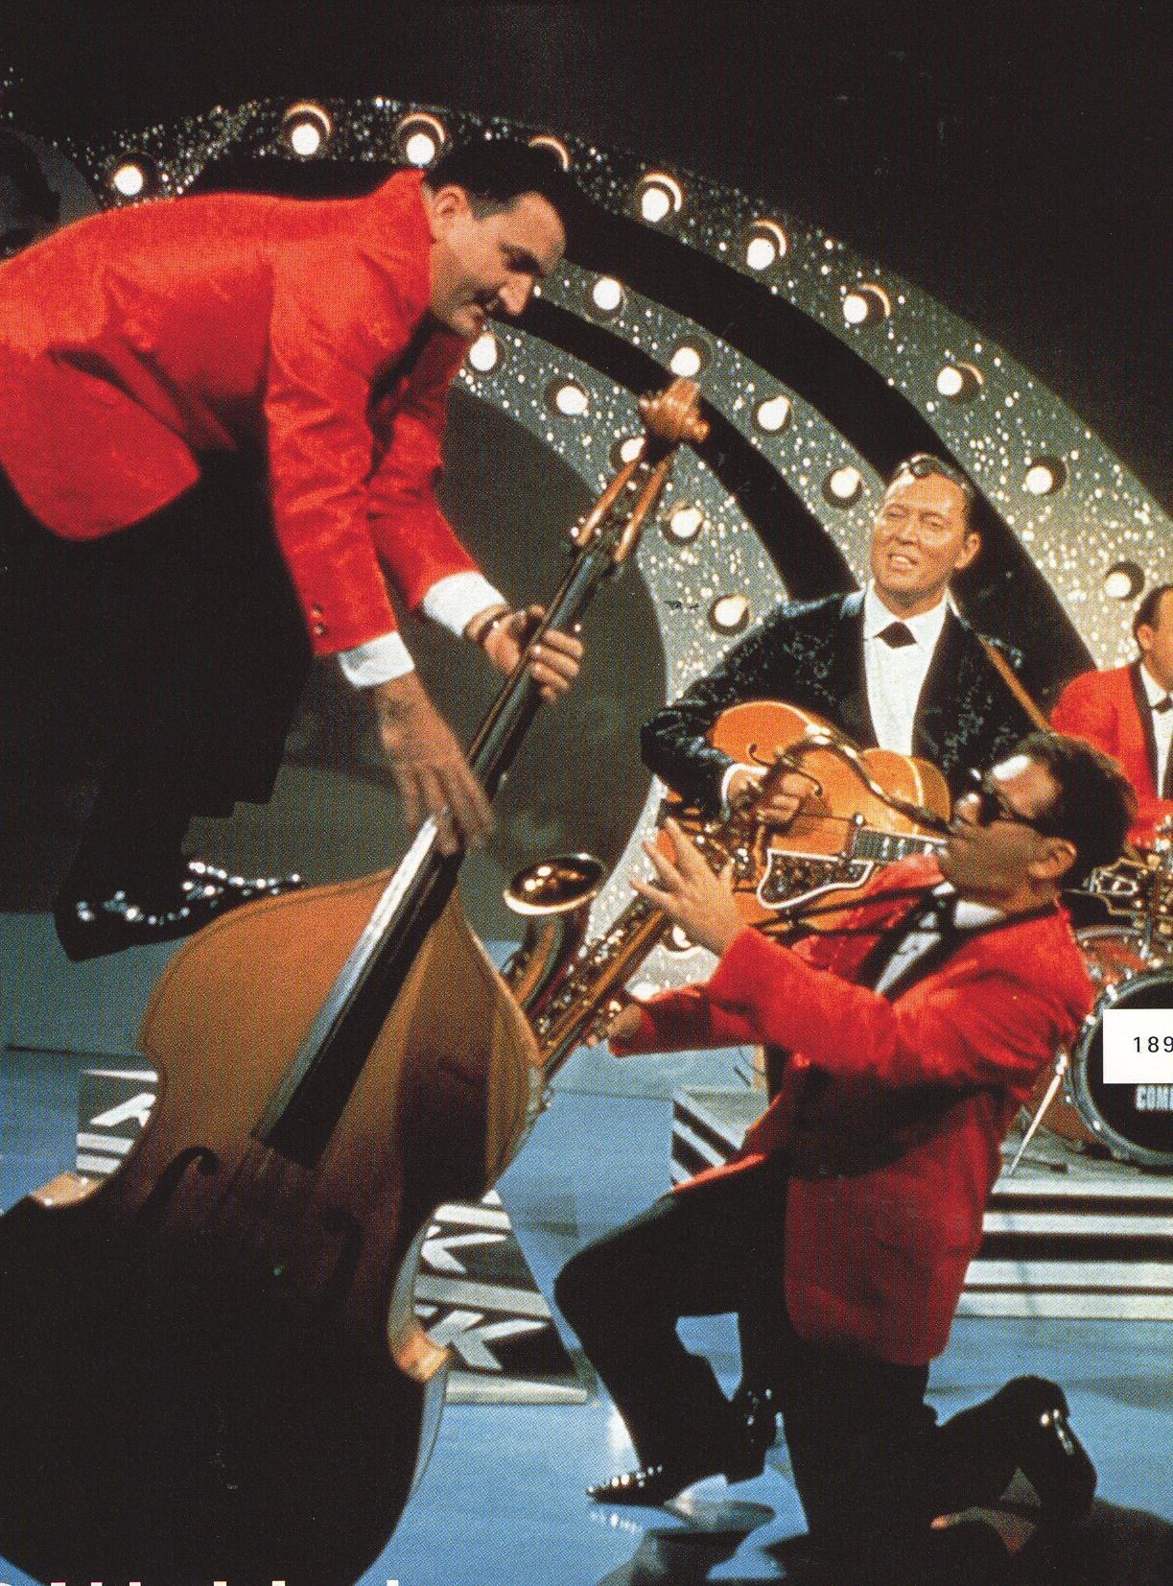
Rock Around the clock
1 rock ’n’ roll hit in 1955
12-bar blues
For most of song, fast shuffle rhythm
Occasionally beat even out, esp. during guitar solos
Made Haley huge in the U.K.

Slide 10
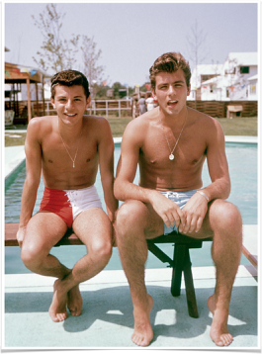
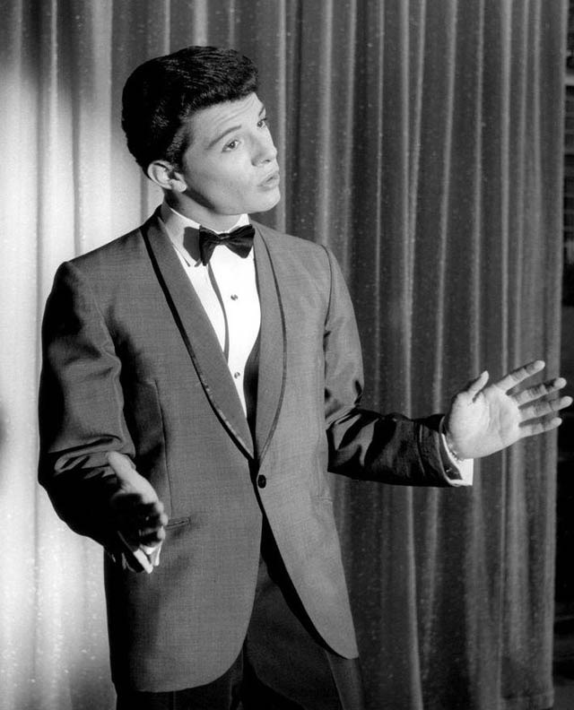
Mission: Create Teen Idols
White, clean-cut, non-threatening teen idols created by record labels and Hollywood to provide safe (and profitable) alternatives to R&B and Rockabilly idols White, good looking, teen idol types
Fabian (Fabian Forte, 1943- )
Frankie Avalon (1940- )
Bobby Rydell (1942- )
Pop music with rock and roll flavoring

Slide 11
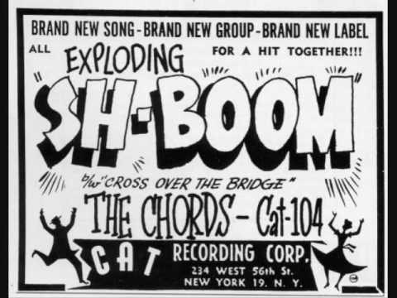
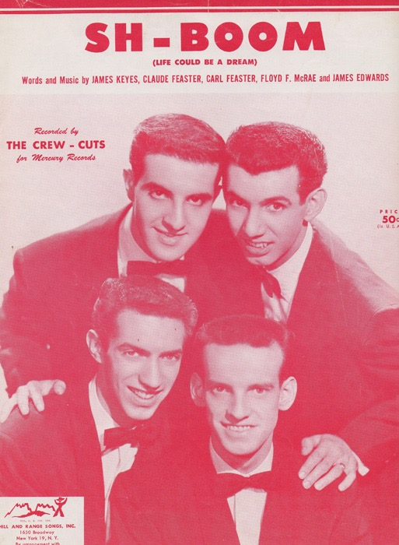
Cover versions redux
Original version:
African-American artist
Independent record label
R&B charts only
Cover version:
White artist
Major record label (Decca, Columbia, RCA Victor, Capitol)
Usually more successful than the original

Slide 12
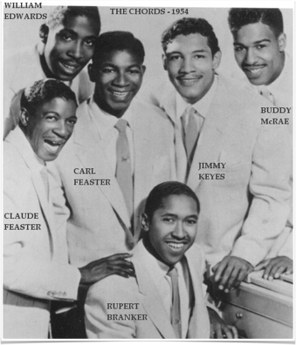
Case study: the chords “Sh-Boom” (1954)
Often cited as the first rock ’n’ roll record
AABA love ballad
A cappella introduction and scat singing

Slide 13
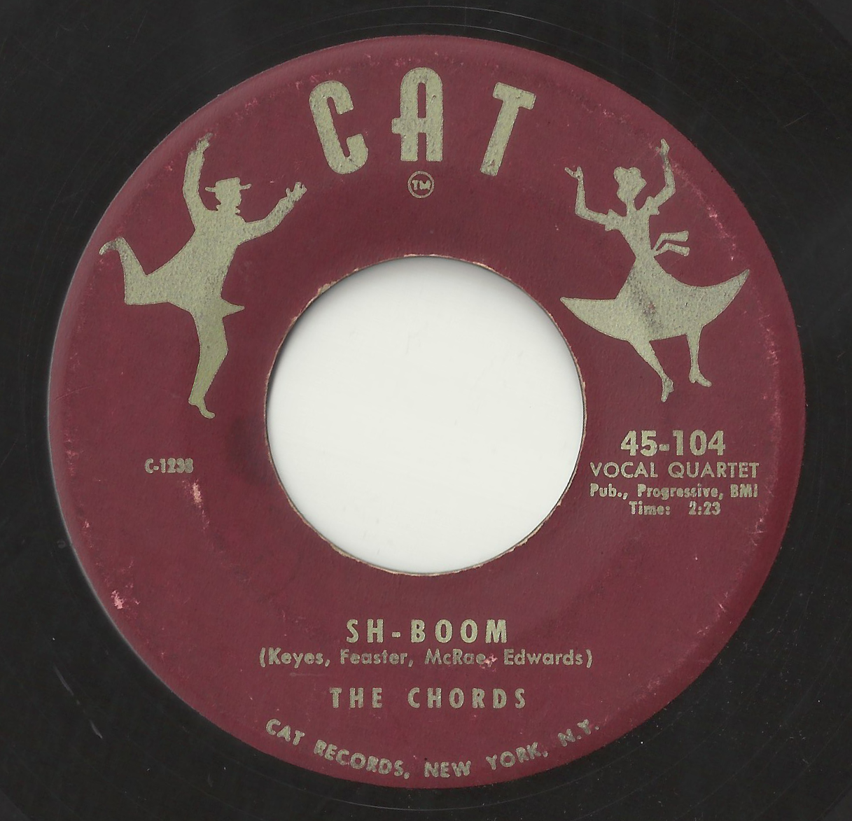

Slide 14
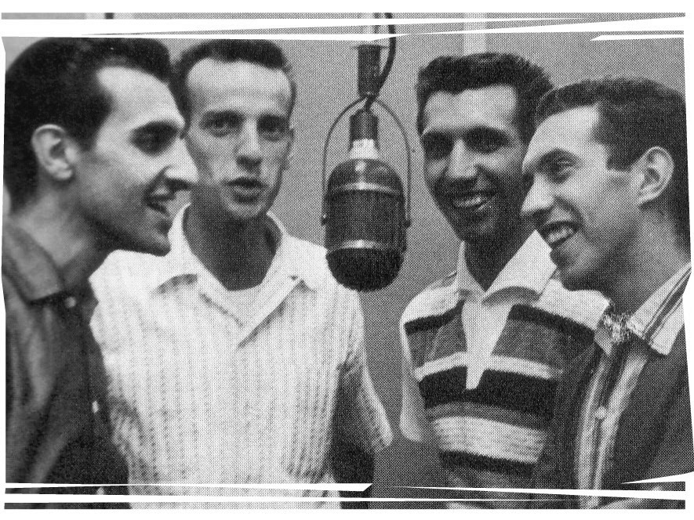
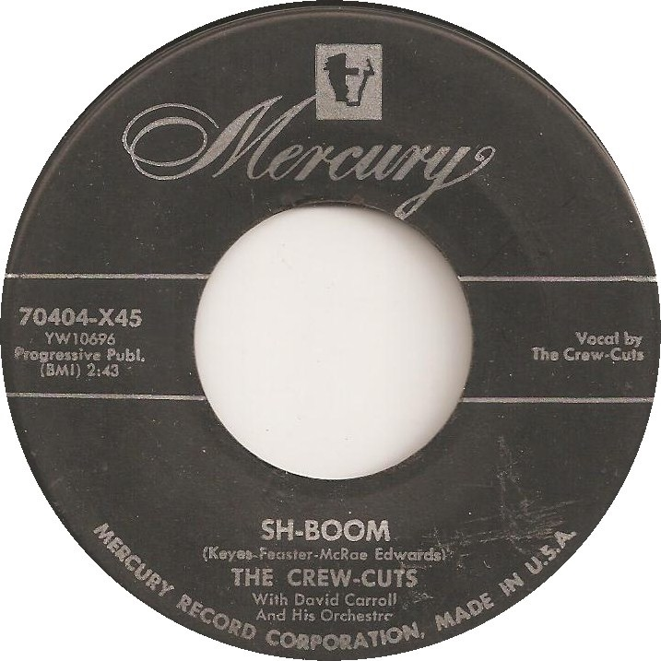
Case study: The Crew Cuts “Sh-Boom” (1954)
Scat singing intro and group singing in the middle
Two “false” endings
Use of the kettle drum (tympani)
Crooning vocal style

Slide 15
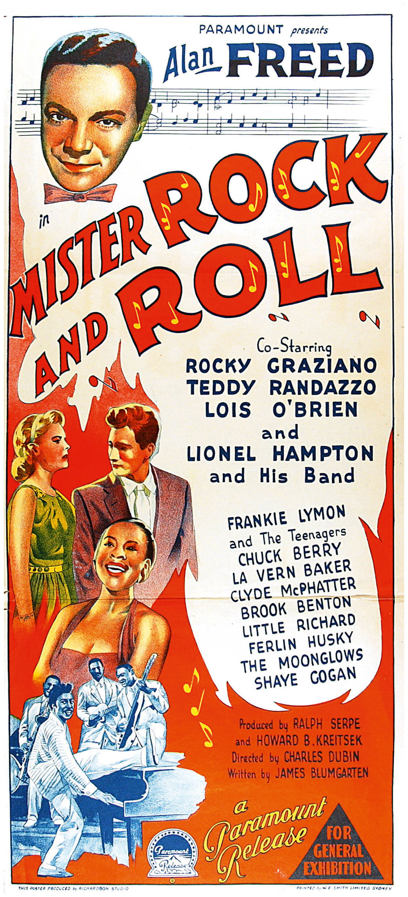
Alan Freed & American Bandstand
Mr. Rock ’n’ Roll & America’s Oldest Teenager

Slide 16
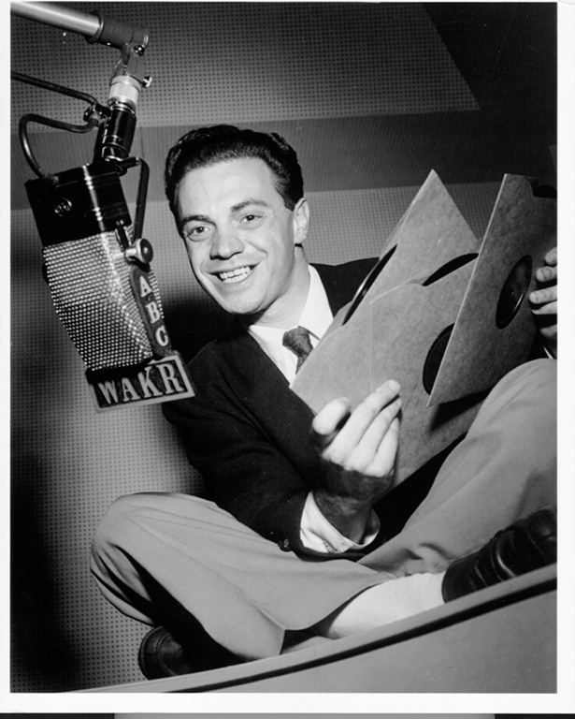
Who first called it Rock ’n’Roll?
Alan Freed
Had a radio program called the Moondog’s Rock’n’Roll party (1951)
Noticed that white kids were listening to R&B; gave it a new name to avoid racial stigma
The program a huge hit
Promoted concerts by black artists played to integrated audiences

Slide 17
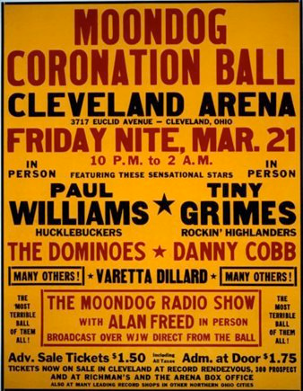
the rise …
The Moonday Coronation Ball at the Cleveland Arena in 1952 caused the first rock’n’roll riot when 15,000 more people showed up than the hall could hold
He moved to New York and continued to promote concerts that broke box office records, taped shows for stations all over the country, attracted 4,000 fan clubs, and even formed his own band!
Freed promoted certain records that went on to sell thousands of copies, and often received song-writing credit.
After a Boston riot after a concert in May, 1958, rock ’n’ roll was banned in several states. Subsequent legal fees resulting from his arrest left him bankrupt

Slide 18
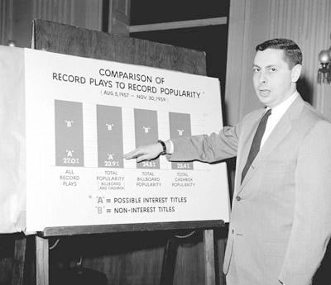
… and fall of alan freed
A probe into rigged television quiz shows expanded to include payola: the illegal practice of accepting bribes in exchange for heavy airplay
Freed defiantly tells a Congressional committee that Washington calls this “lobbying”; Freed would move West and died at 43
Indeed, the “payola scandal” was used to force indie labels out of business, and attack rock as a genre

Slide 19
Freed was in many ways an ambivalent figure, for as well as promoting rock ’n' roll he made a small fortune out of it; many artists received a considerable reduction of their due royalties because Freed's name appeared on songwriting credits, but on the other hand, his sponsorship helped the records succeed. … [But] Freed deserves to be remembered for his adventurous – even imprudent – efforts on behalf of the music he loved. … Whatever Freed's personal frailties, he did far more than most whites to popularize black music.
-Bill Millar

Slide 20
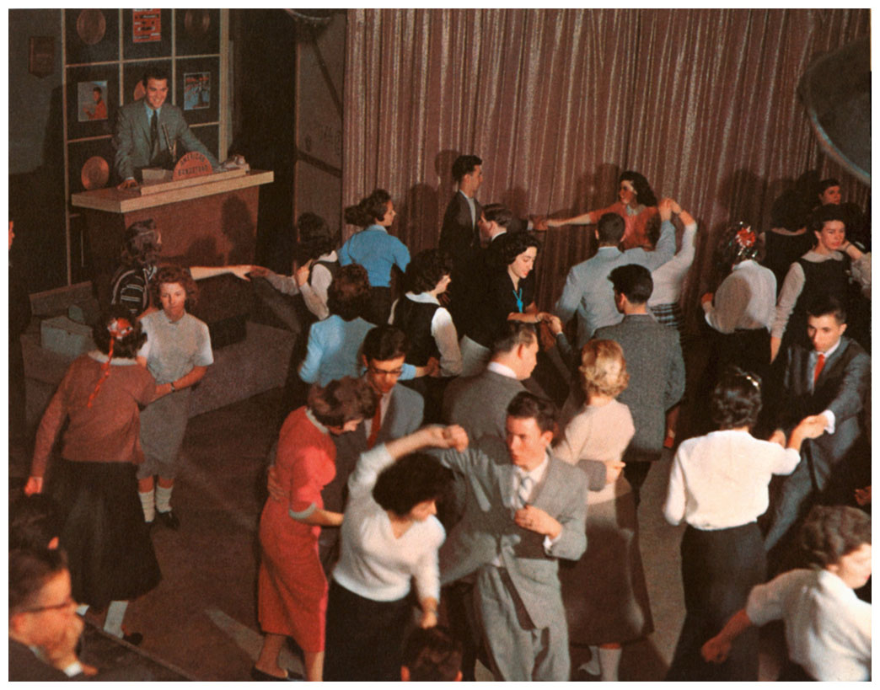
American Bandstand
Began broadcasting from Philadelphia in 1957
Projected clean-cut, safe, mostly white image of rock and roll
Launched careers of teen idols
Created & promoted dance crazes

Slide 21
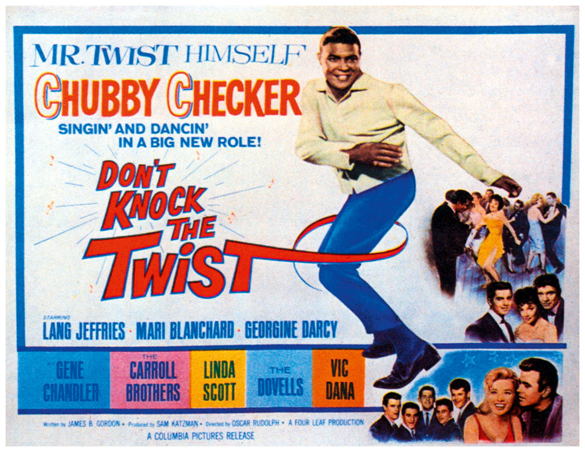
Mission: Create dance crazes
Dances created to go with popular songs
Often include instructions for dance
Manufactured by Brill Building (or other professional) writers
Many recorded by Chubby Checker

Slide 22
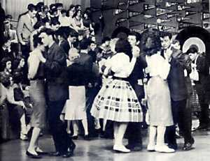
The sound of Dance records
All similar in style
Rely on 12-bar blues as verse or refrain
Straight rock ensemble, with backing vocals
Not heavily produced
Strong beat
Help to remove stigma of rock
Ex. The Twist

