Slide 1
Bo Diddley
The Big Beat

Slide 2
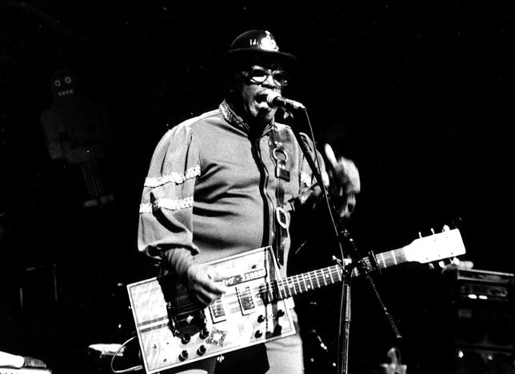
Bo Diddley (Elis McDaniel)
From Mississippi but grew up in Chicago, where he was influenced by all kinds of music, especially electric blues
Recorded over 20 albums for Chess
Huge influence on the British scene, and late ‘60s West Coast bands

Slide 3
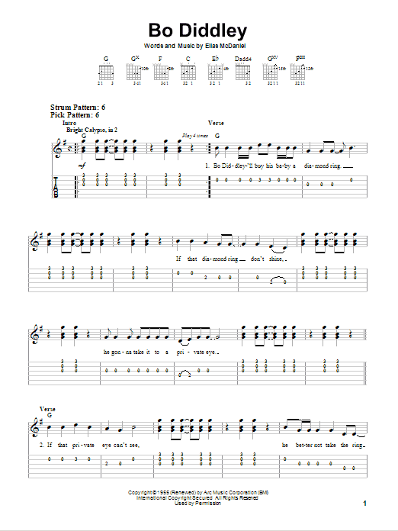
Bo Diddley BEAT
Trademark ‘Bo Diddley beat’ on tom-toms and maracas
essentially a 3-2 clave rhythm
similar to a folk tradition called "hambone," used by street performers who play out the beat by slapping and patting their arms, legs, chest, and cheeks while chanting rhymes
If each beat has four subdivisions—1 e & a 2 e & a, etc.—red attacks show the rhythm: 1 e & a 2 e & a 3 e & a 4 e & a

Slide 5
Little Richard
Wild Man of Rock ’n’ Roll

Slide 6
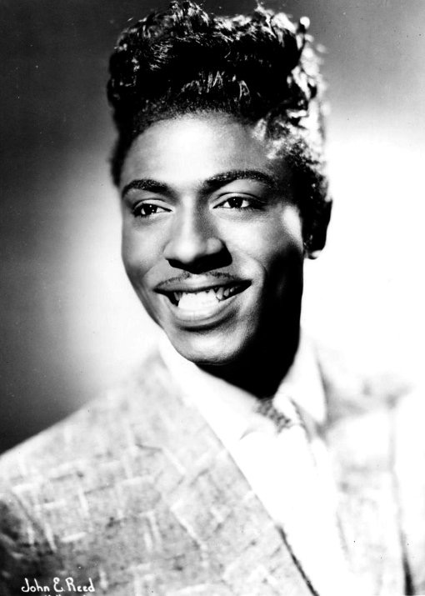
Little Richard (Richard Penniman, 1932- )
Born Macon, Georgia
At age 14 traveled with medicine shows, blues bands, and other traveling musical acts
Masters pop, blues, R&B, gospel styles
1952 becomes affiliated with Specialty Records
Producer Bumps Blackwell looking for gospel singer who could sing the blues

Slide 7
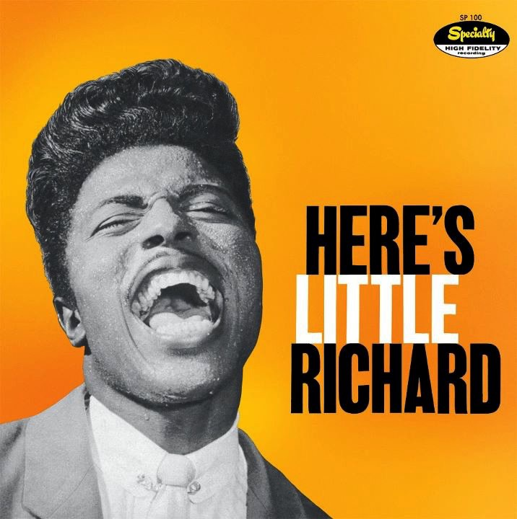
Little Richard - Elements of Style
Wild, uninhibited vocal style
Blues shouter
Incorporated high falsetto singing
Outrageous performing style
High energy of gospel
Percussive piano style that combines boogie-woogie and blues
Speeds up boogie-woogie until shuffle rhythms break down
Lucille (1957) foreshadows 1960s rock: baseline, slower, 8-beat feel

Slide 8
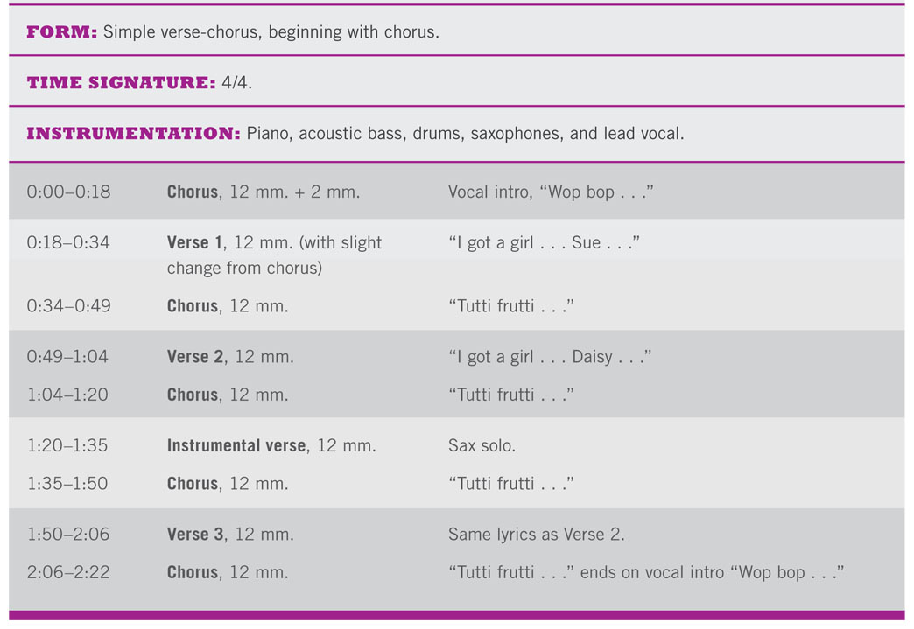
Tutti Frutti (1956)
As a way of talking back to his employers without offending them, he came up with the famous nonsense syllables “Wop bop a loo bop ..”
First major hit, recorded in New Orleans with the same musicians as Fats Domino.
Covered by Pat Boone

Slide 9
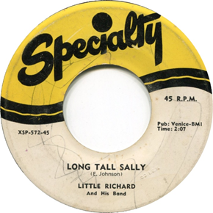
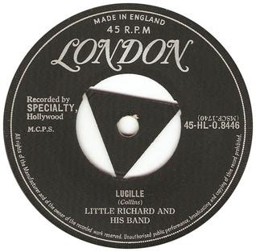
“Long Tall Sally” (1956), Bumps Blackwell, Enotris Johnson, and Little Richard
Specialty’s best-selling record
Built on the twelve-bar blues adapted to reflect verse-chorus structure format
Drummer Earl Palmer plays fast shuffle, while Richard plays 8th-notes (two per beat)
Suggestive lyrics

