Slide 1
Rock’n’Roll Begins

Slide 2
Almost by accident [rock] sprang out of an industry that was only beginning to discover itself, and as a result it grew up free and unencumbered, its success not only uninstructive but actually counter to good business methods.
-Peter Guralnick

Slide 3
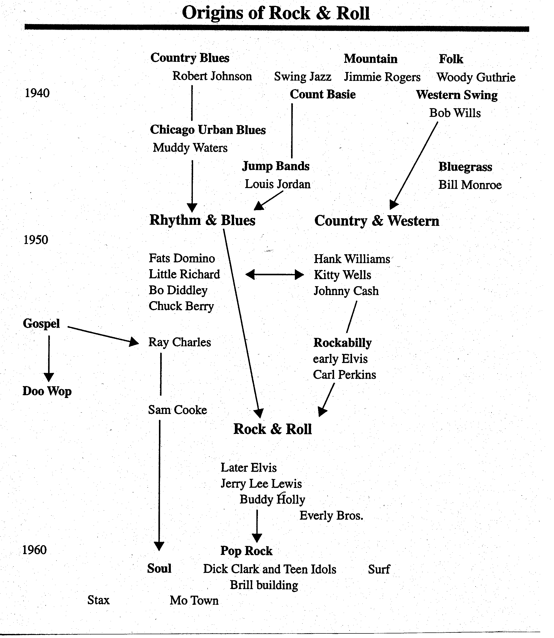

Slide 4
Birth of Multitrack Recording
Les Paul singlehandedly invented a way to overdub records and avoid sound degradation.
He plugged his guitar directly into the recording console.
Previous experiments involved a disc-cutting lathe; after 1948 he used a tape recorder.
In 1950 he and his wife Mary Ford dubbed 12 tracks onto “How High the Moon,” a huge hit in 1951

Slide 5
Birth of Multitrack Recording
Zak Albin stresses the oral nature of Paul’s practice, which relied on memory and improvisation
This was the beginning of the recording as a compositional process
This took awhile to filter down to rock, which was still captured live in the studio, even if 45 records drove the business

Slide 6
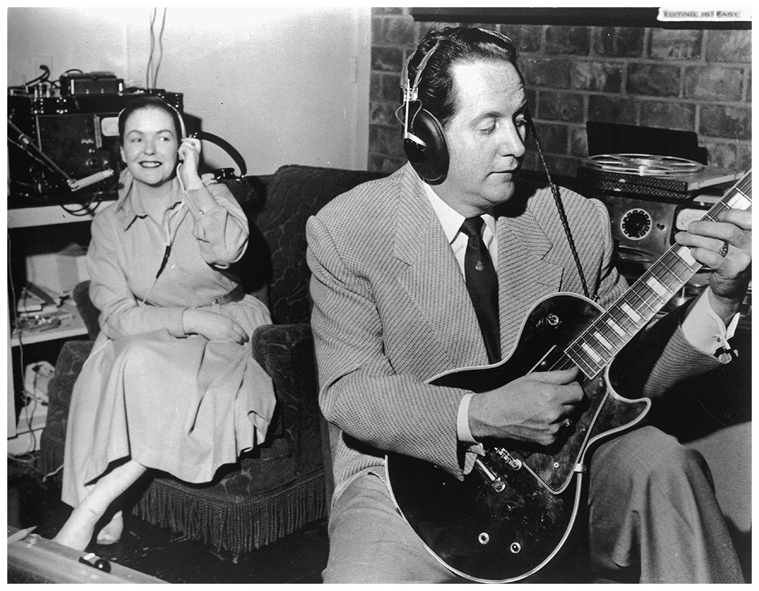

Slide 7
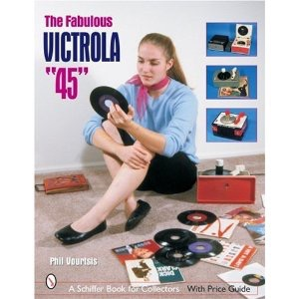
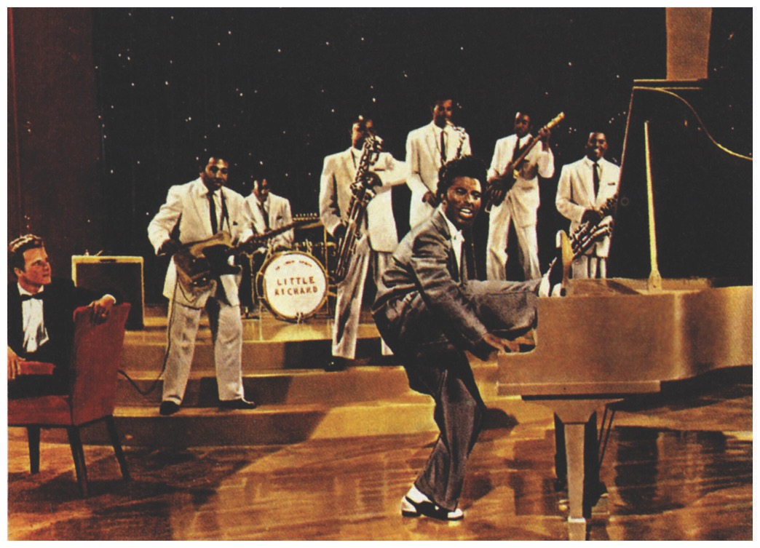
The sound of the singer/band on tape determined whether they would be recorded
But the goal of recording was simulated spontaneity: the sound of a live performance

Slide 8
jerry Leiber and Mike Stoller
Songwriters and producers, brought wit and satire to rock ’n’ roll
They wanted to be involved in black culture; controversy on whether they succeeded
After meeting in LA, they started peddling songs in 1951 to bluesmen and bands

Slide 9
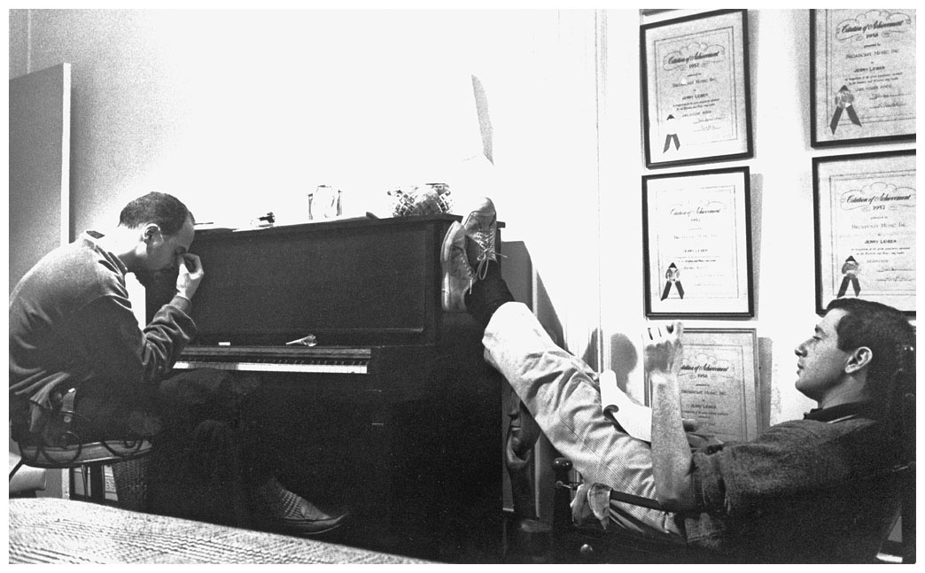

Slide 10
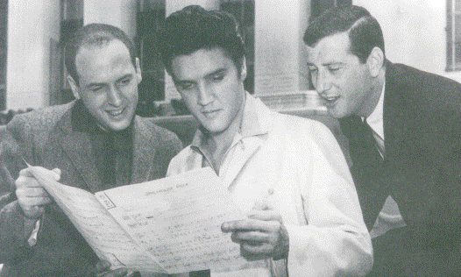
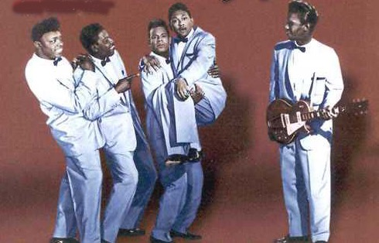
The Coasters
Mike Leiber and Jerry Stoller wrote and produced hits for Elvis Presley and The Coasters in the late ‘50s
The Coasters: popular vocal harmony group in late 1950s and early 1960s
Playlets: scenes from teenage life distilled into brilliantly funny records
“Yakety Yak” (1958)
seven weeks as #1 on the R&B charts and a week as number one on the Top 100 pop list.

