Slide 1
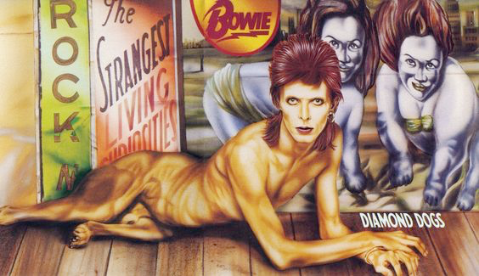
Progressive Rock/Glam Rock/Art Rock

Slide 2
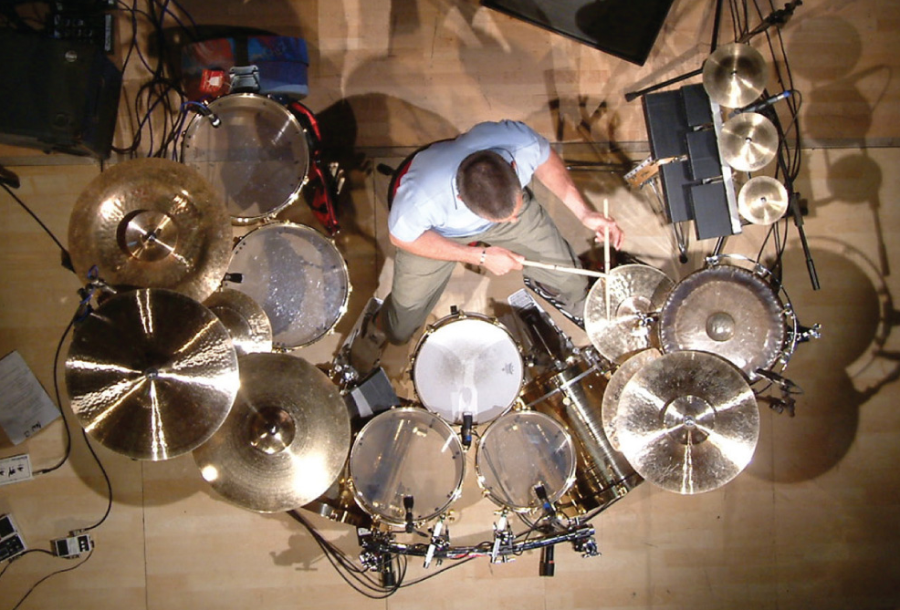
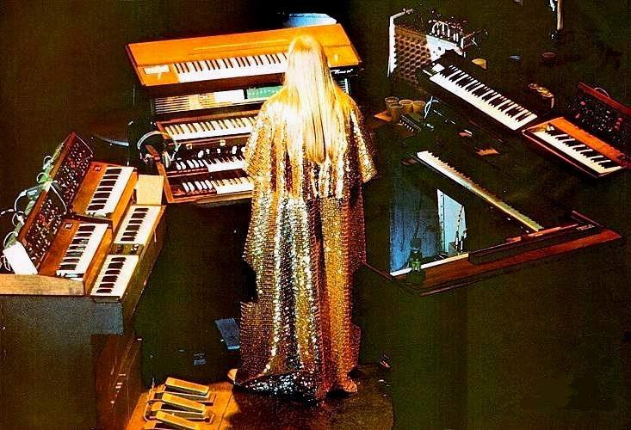
Prog (Progressive) Rock Late ‘60s and beyond
Adopts not only techniques, but also forms and stature of Classical music
Experiments with form, concept albums, electronic instruments
Genesis (early)
Emerson, Lake, and Palmer
King Crimson
Yes
Pink Floyd
Carl Palmer of Emerson, Lake and Palmer
Rick Wakeman of Yes

Slide 3
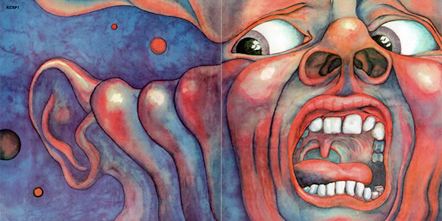
king crimson (1968)
One of the first prog rock bands; still in existence, but 21 members have come and gone
Core is still experimental guitarist and producer Robert Fripp
In the Court of the Crimson King (1969)includes elements of jazz, classical, and experimental music, and complex song structures.
Other notable ups include Larks' Tongues in Aspic (1973), Starless and Bible Black (1974), and Red (1974)

Slide 4
Glam (glitter) Rock (1971–76)
British Rock movement—theater and spectacle after the serious late ‘60s
Bands, but primarily singers, assume persona on stage, in studio
Mark Bolan & T. Rex (“Get it on (Bang a Gong),” ‘71)
Mott the Hoople (“All the Young Dudes,” ‘72)
Gary Glitter (“Rock and Roll, parts 1 & 2,” ‘72)
Slade (“Mama Weer All Crazee Now,” ‘72)
The Sweet (“The Ballroom Blitz,” ‘73)
American
New York Dolls
Alice Cooper
Lou Reed
Noddy Holder of Slade, 1973

Slide 5
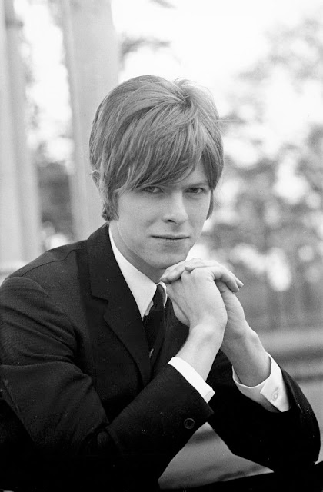
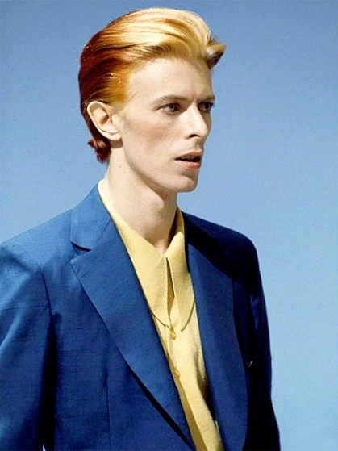
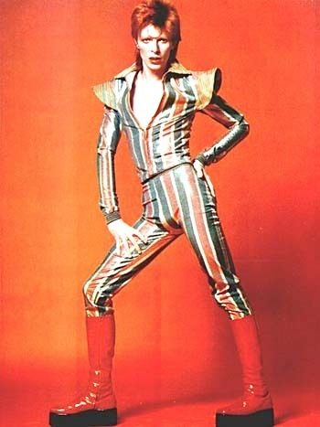
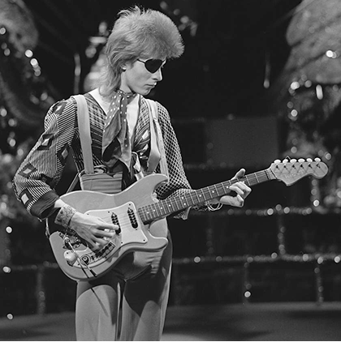
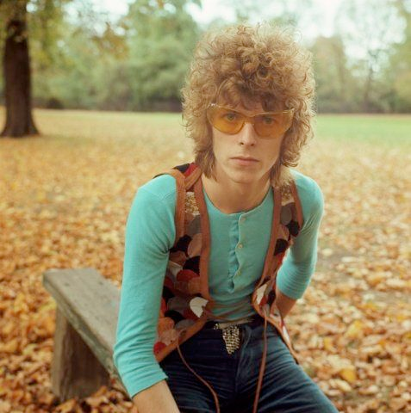
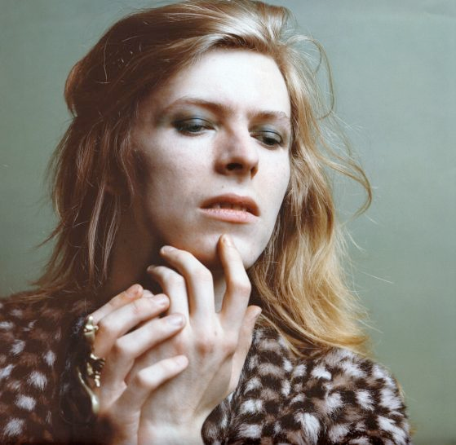
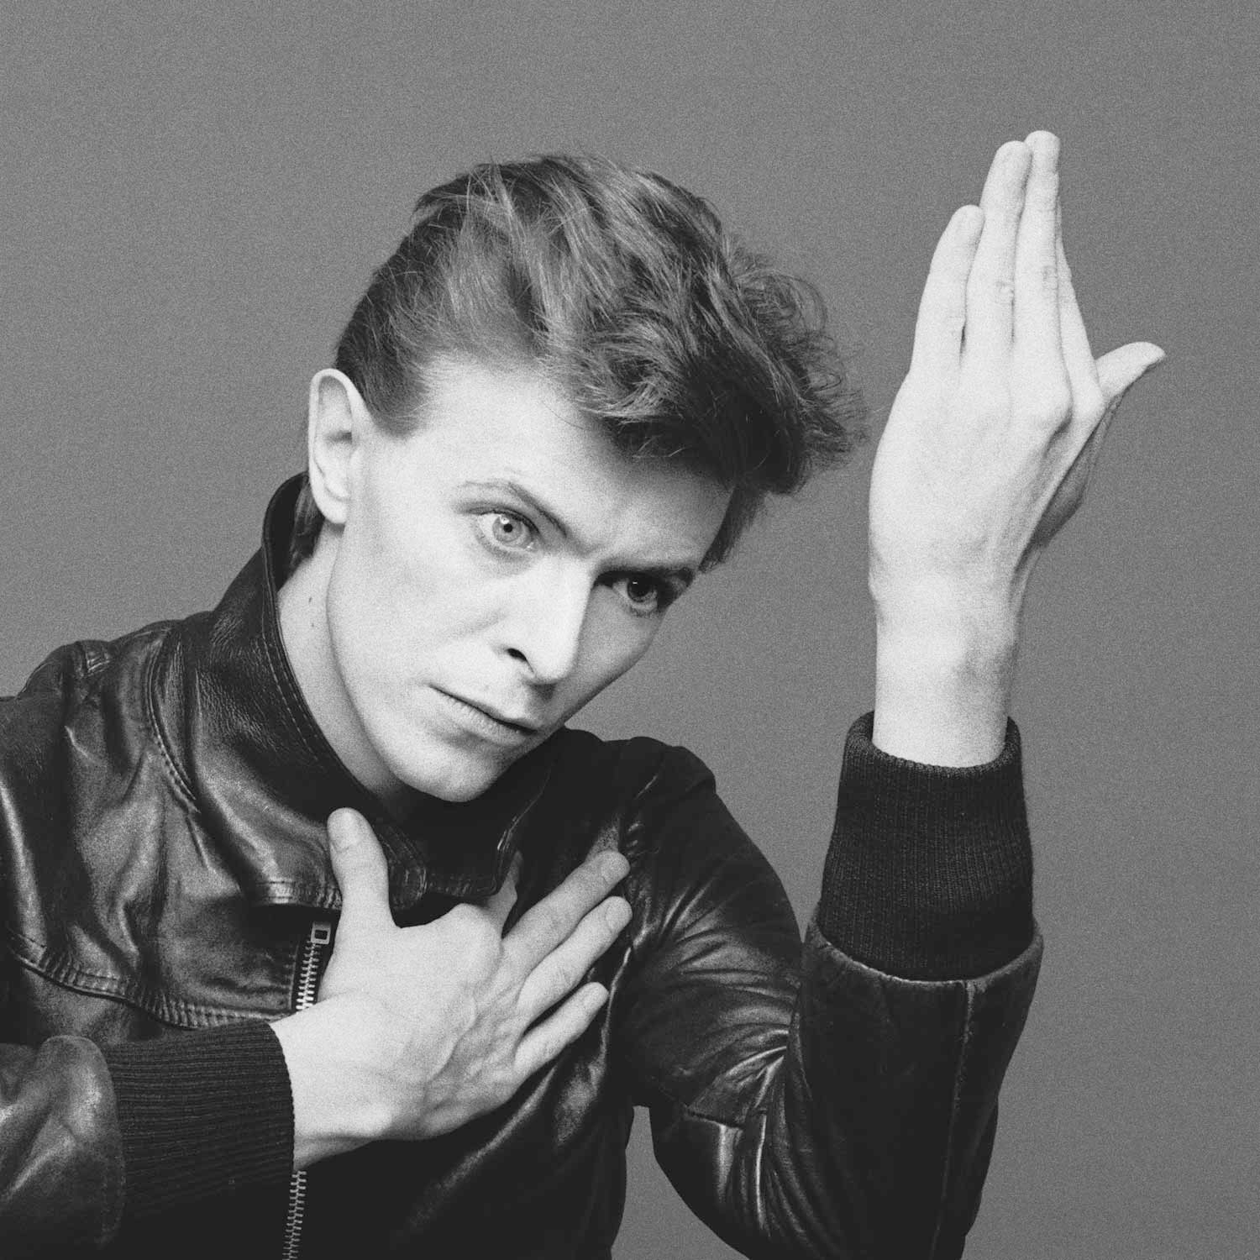
david bowie (David Robert Jones, 1947–2016)
During early career, assumed different persona for nearly every album;
Mod 1967
Folksinger 1968–69
Space Oddity folk, 1971
Ziggy Stardust, 1972–4 (Glam)
Diamond Dogs, 1974
Thin White Duke, 1975–6 (“plastic soul”)
Berlin dandy, 1976–80

Slide 6
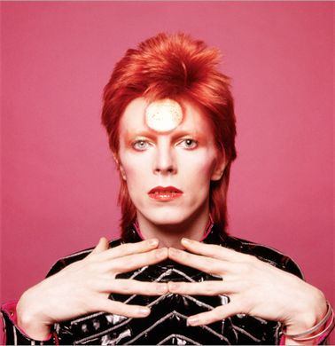
“Suffragette city,” the rise and fall of Ziggy Stardust and the spiders from mars (1972)
Concept album featuring most enduring Bowie character, Ziggy Stardust
Introduced glam rock to the masses, along with sexual and social commentary in sci-fi guise (the earth has but 5 years left)
The character is promiscuous, takes drugs, and preaches peace, but is destroyed by his addictions and the adulation of fans (rock allegory)
“Suffragette City” originally a b-side with Little Richard influences, later released as a single

Slide 7
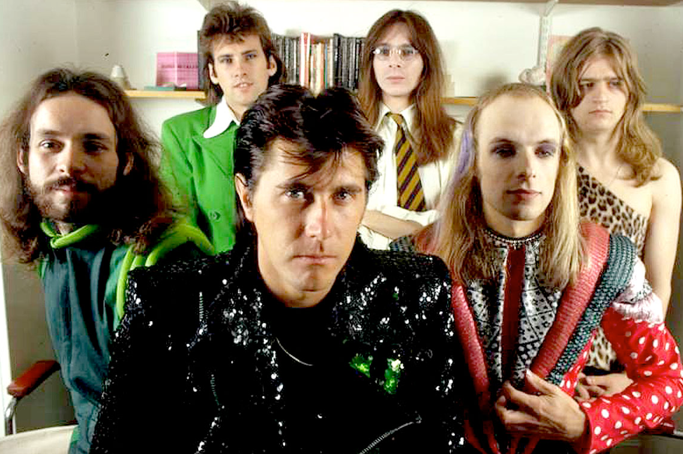
Roxy music (1971–82)
Glam art rock, most members from an art school background
(founder Brian Ferry, Brian Eno, Andy Mackay)
Mixed music, electronica, pop art and fashion
A more sophisticated, arty version of glam that influenced punk
• Roxy Music (1972)
• For Your Pleasure (1973)
• Stranded (1973)
• Country Life (1974)
• Siren (1975)
• Manifesto (1979)
• Flesh and Blood (1980)
• Avalon (1982)
Ferry a successful solo artist
Eno to become both a solo artist and one of the most famous rock producers

Slide 8
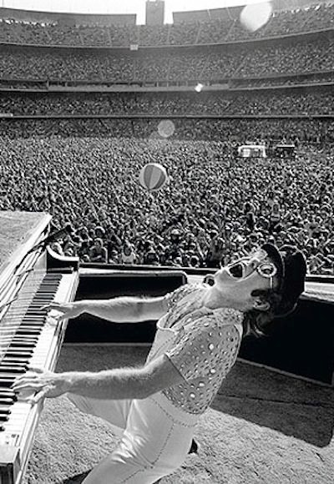
Glam singer/songwriter, icon of the 1970s Elton John (1947–)
Sir Elton Hercules John, CBE, (b. Reginald Kenneth Dwight) British singer, pianist, and composer.
Has worked with lyricist Bernie Taupin since 1967; they have collaborated on more than 30 albums
Has sold more than 300 million records, and more than fifty Top 40 hits, including seven consecutive No. 1 US albums
From 1970–2000 he had at least one song in the Billboard Hot 100.
Composed for Broadway and film (The Lion King, Aida, Billy Elliot the Musical)
Seventh studio album Goodbye Yellow Brick Road (1973), although double, became his best-selling album to date
"Goodbye Yellow Brick Road" the song uses Wizard of Oz imagery to talk about getting back to one’s roots.

