Slide 1
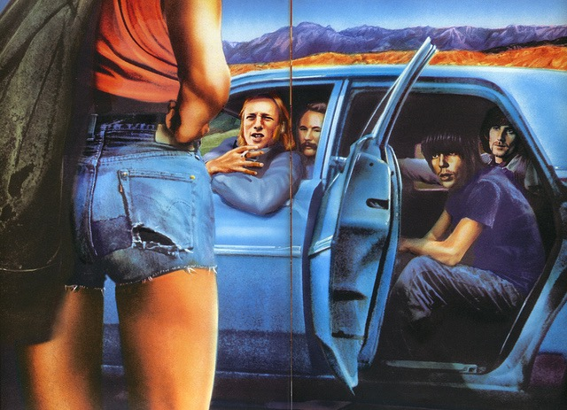
1970 and beyond

Slide 2
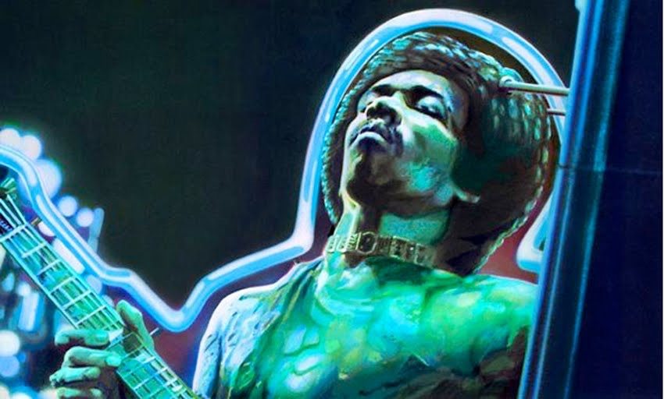
The 1970s
Death of 1960s musical counterculture icons
Jimi Hendix (1970)
Janis Joplin (1970)
Jim Morrison of the Doors (1971)
Breakup of the Beatles (1970)
Consolidation of the record industry
Six corporations responsible for 80 percent of record sales in the United States
Profits from recorded music reached new levels
Popularity of prerecorded tapes (cassette and eight-track)

Slide 3
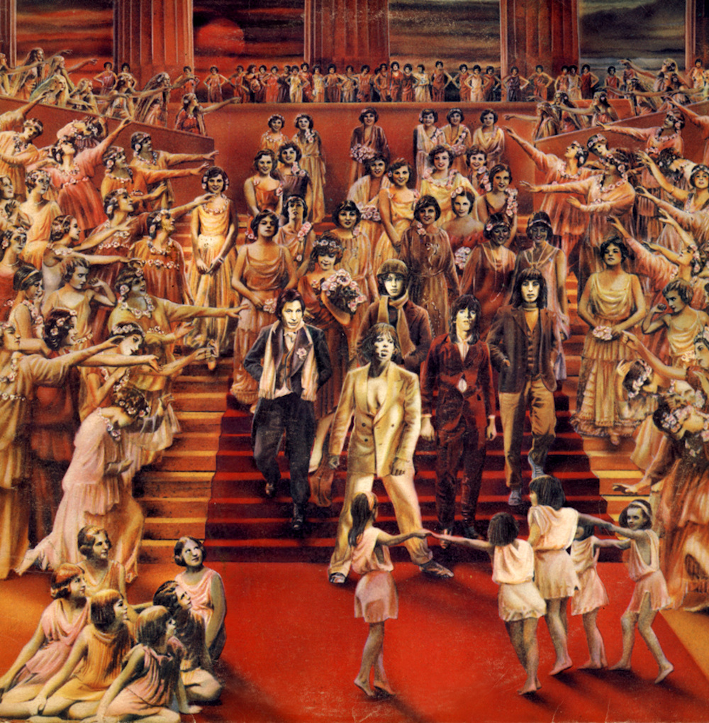
Rock Comes of Age
Progressive rock musicians saw themselves as artists
Industry co-opted the appeal of rock, creating hybrid genres
Guy Peellaert’s cover for the Rolling Stones It’s Only Rock’n’Roll (1974)
Musicians favored the album format over singles
FM radio developed niche marketing targeting specific listeners
AOR radio format became more popular
Wealth as a goal,the idea of a “rock star”
Rock became suitable for large venues, rather than the clubs and ballrooms of the 1960s

Slide 4
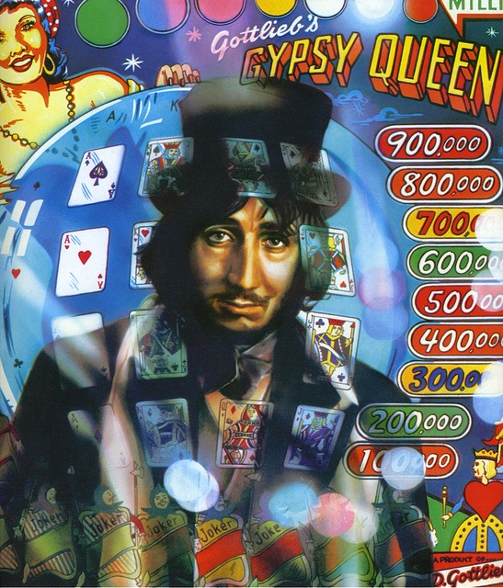
The Rock Album
Idea of “the record album as a thematically and aesthetically unified work”
Examples: Sgt. Pepper’s Lonely Hearts Club Band, Tommy (The Who), and Pet Sounds
Musicians treated the time span of an LP as a total entity
Songs linked together in particular sequences, creating an overall flow
First two singles usually the first song on each side
Often experimented with studio technology
Sound sources could be shifted in space (stereo gives way to quadrophonic listening)
Electronic instruments like the Arp and Moog synthesizer and Mellotron (based on tape loops)
Multitracking allowed musicians to play all instruments on a track

Slide 5
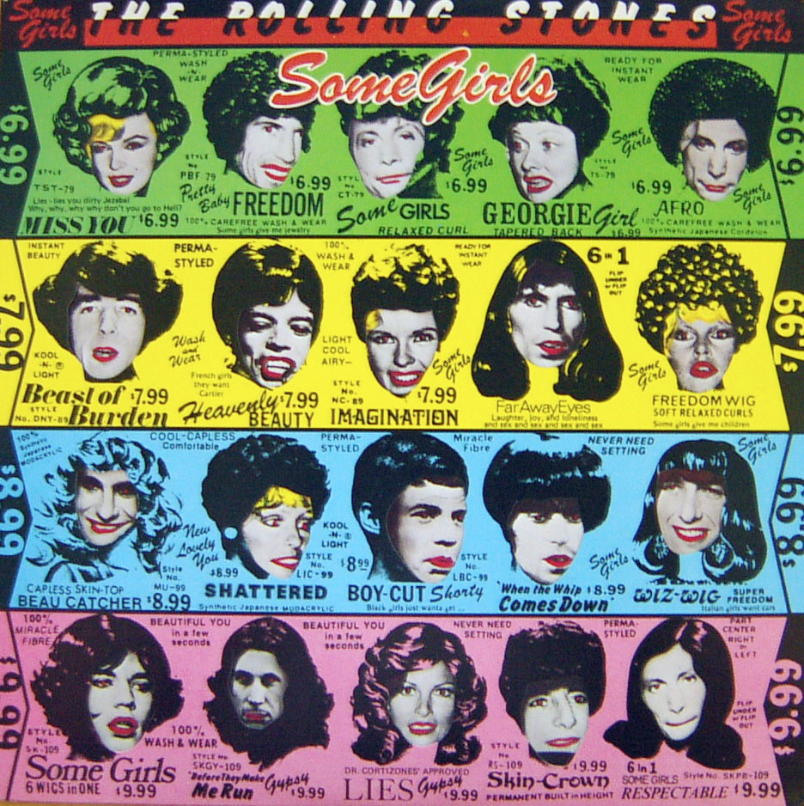
Album Art
LP often treated as an art object
Album covers often spoke to a group’s aesthetic aims and personality
Sexuality, politics, mythology/mystery
Dustjacket often included visual analogs to the music inside
Included a minimalist approach
Example: The Beatles’ monochromatic White Album

Slide 6
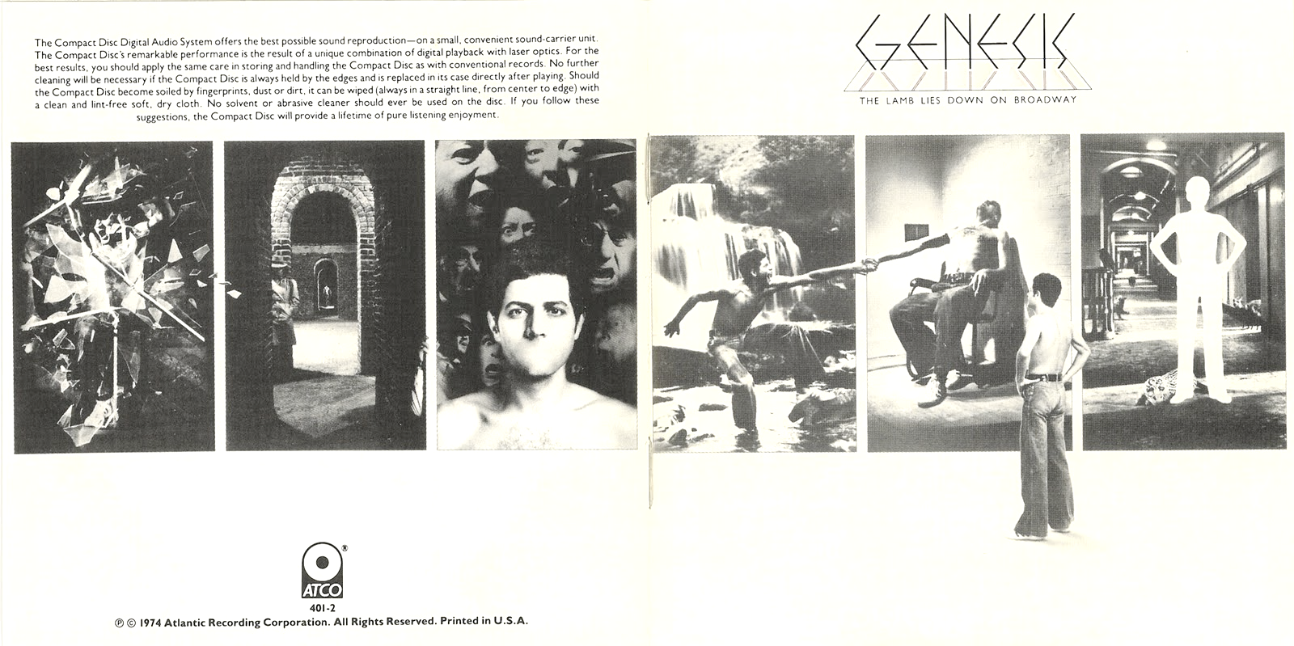
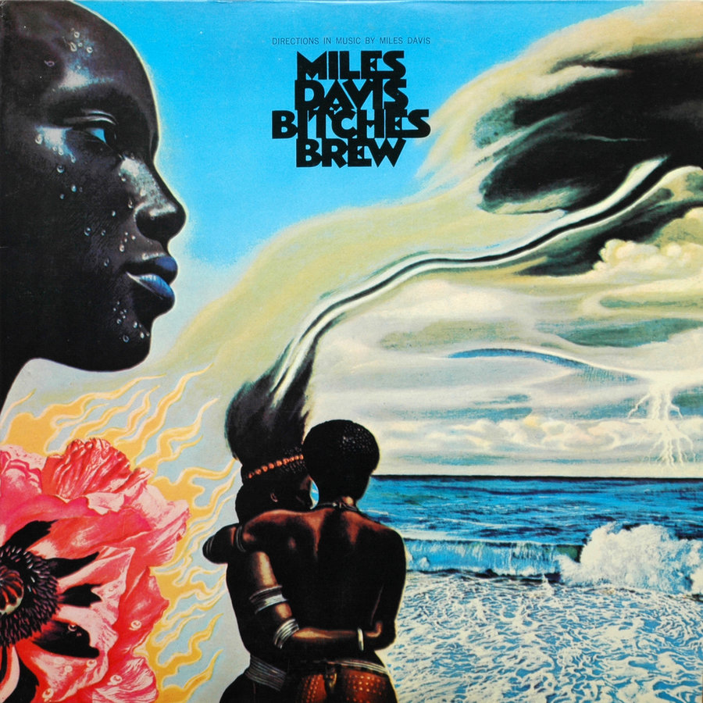
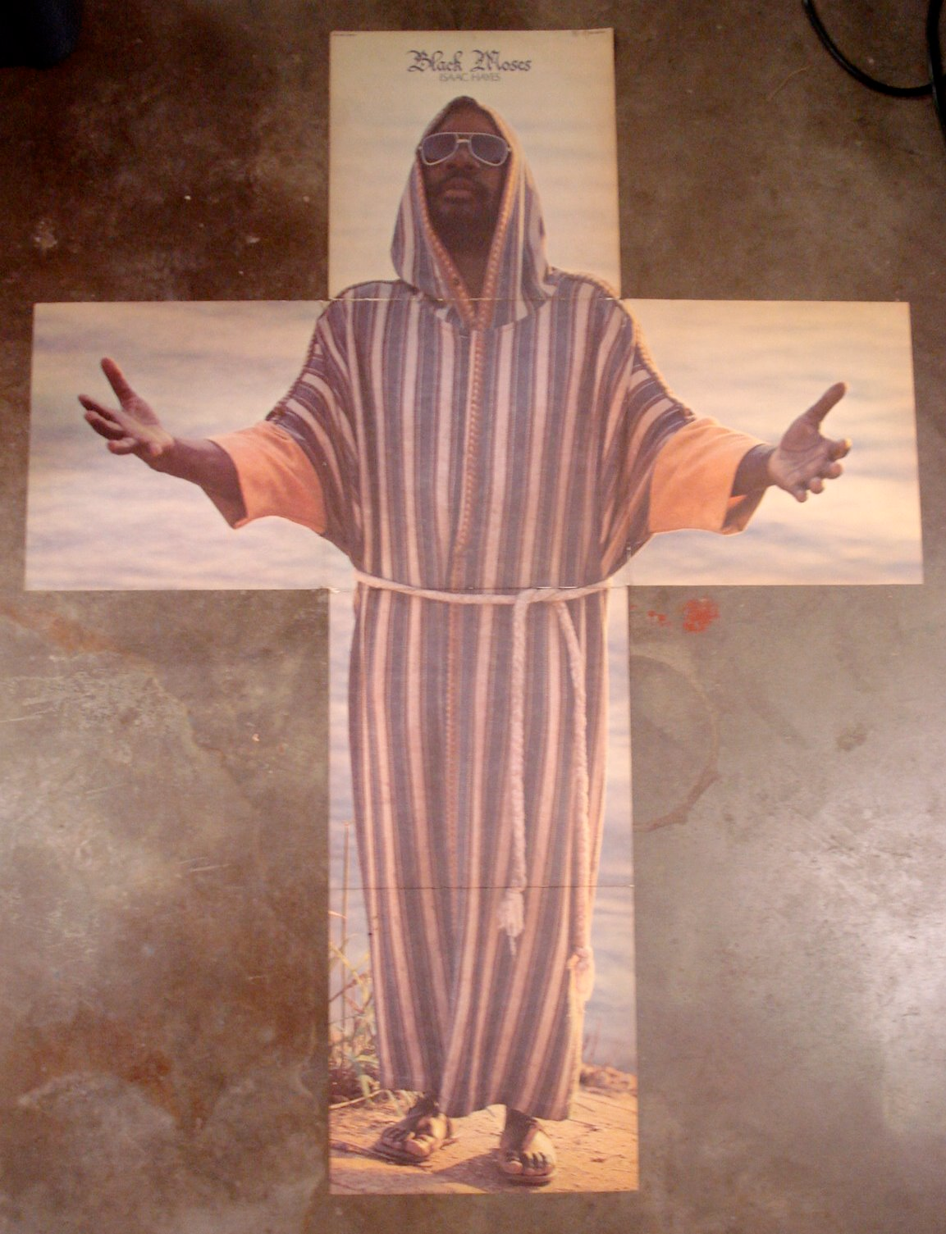
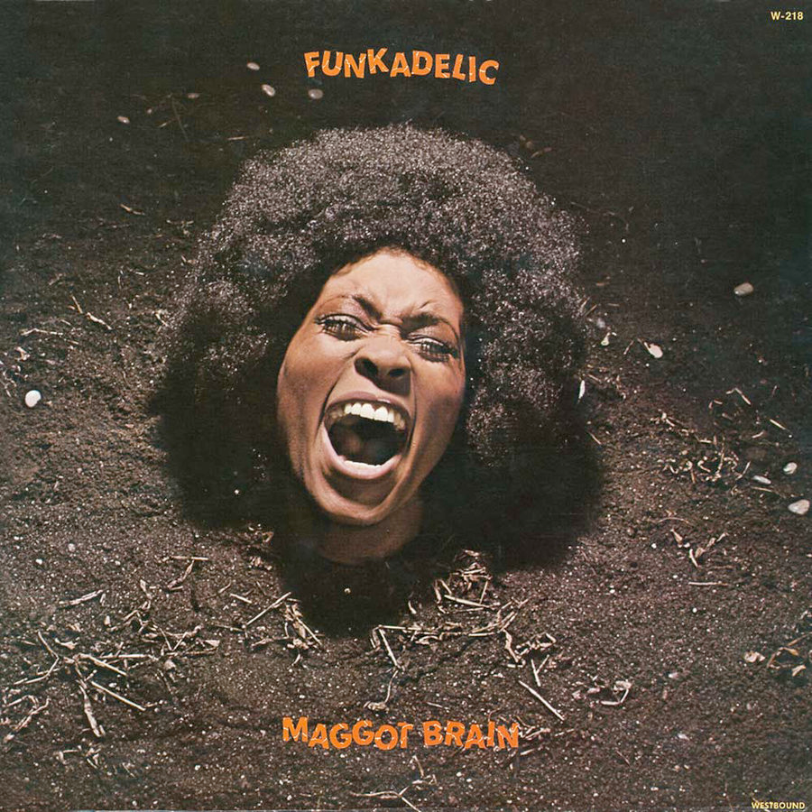
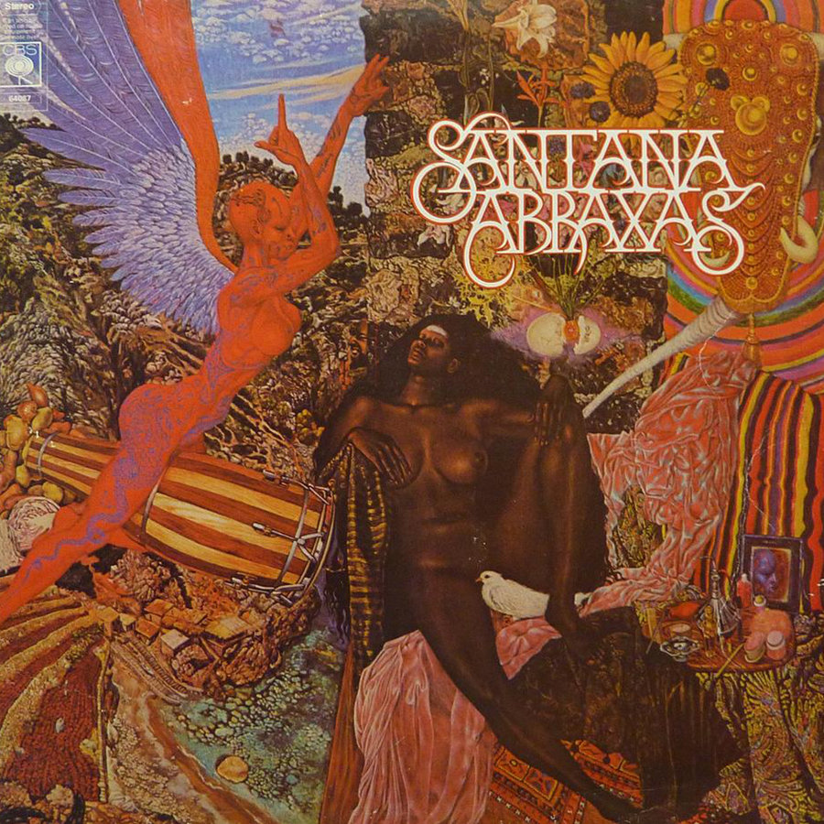
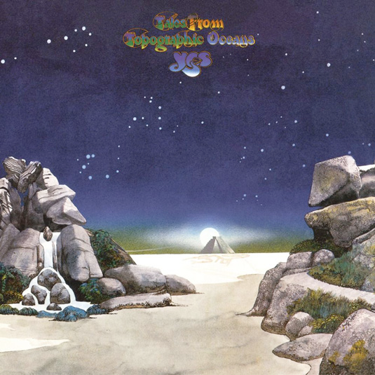
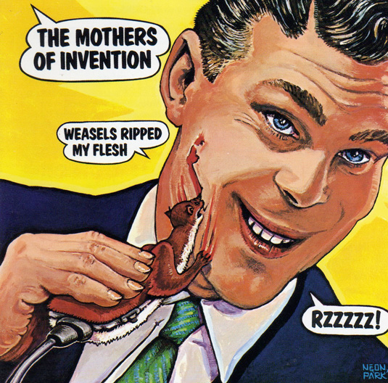
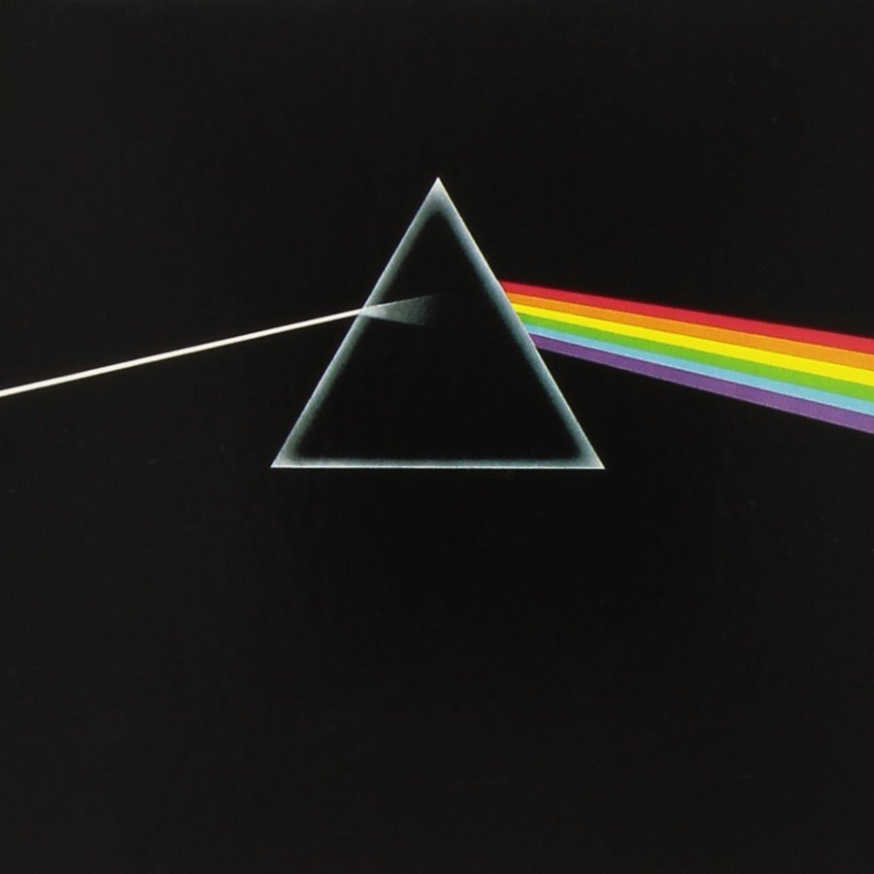
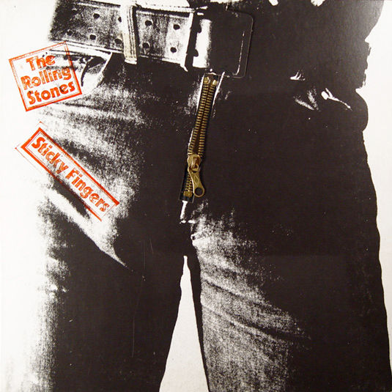
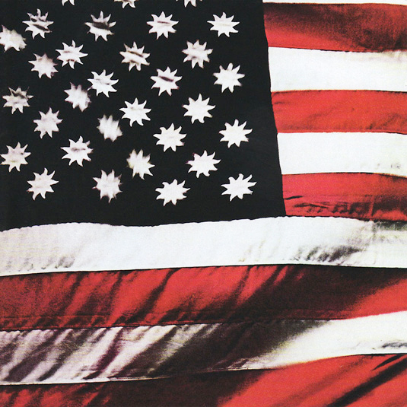
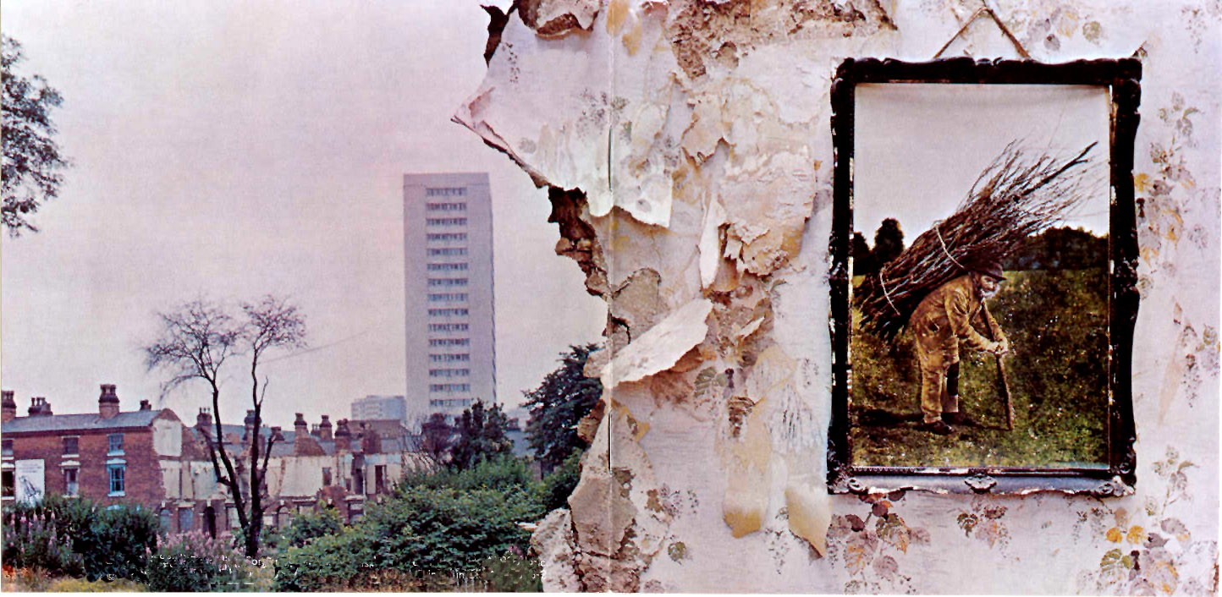
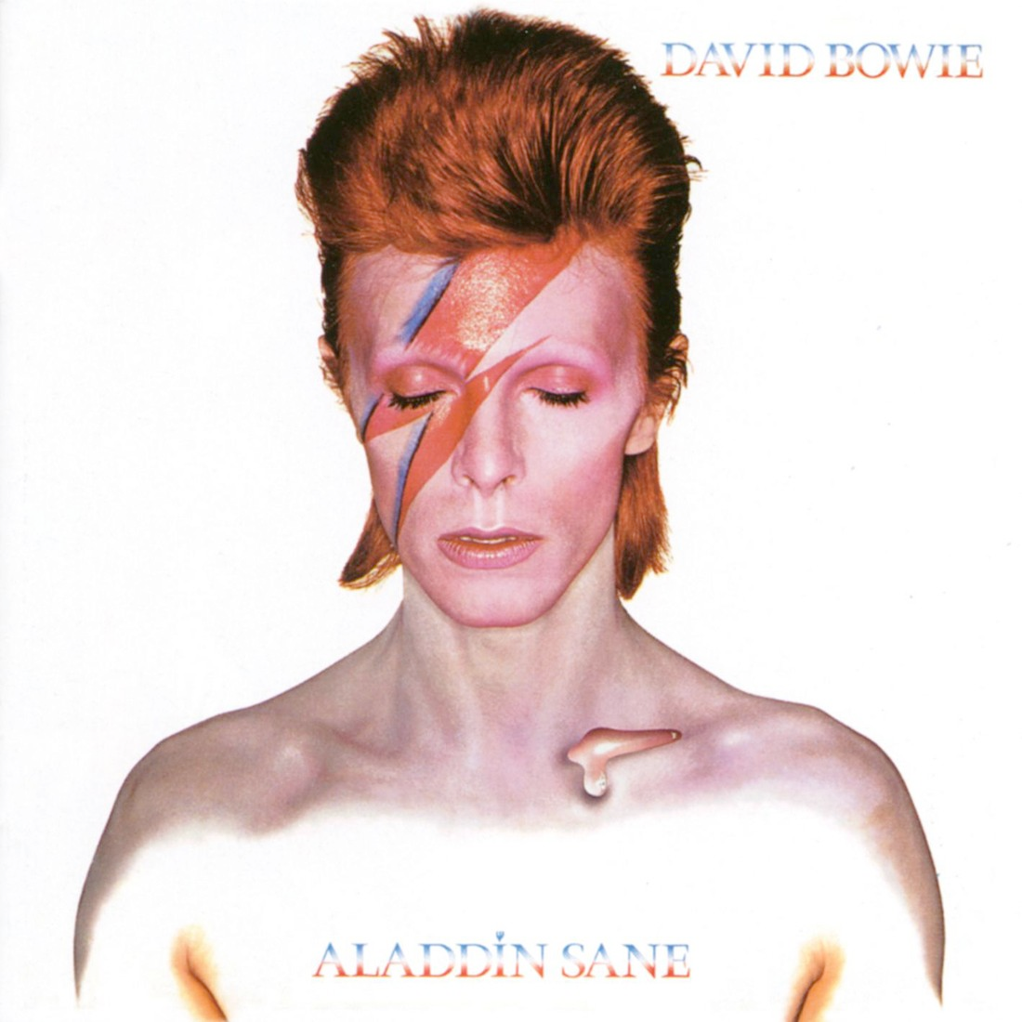
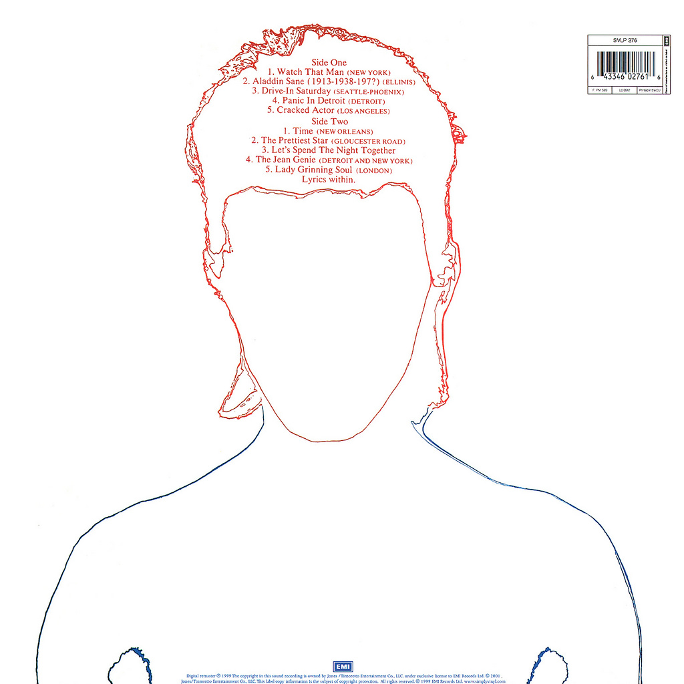
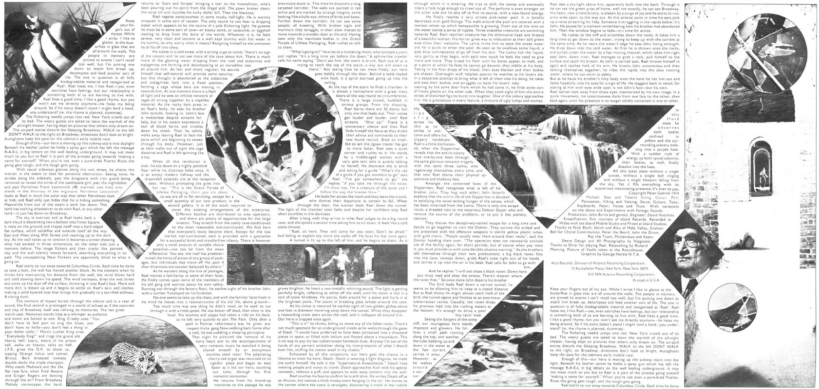
miles davis, Bitches brew, 1969
pink floyd, dark side of the moon, 1973
david bowie, aladdin sane, 1973
Led Zeppelin IV, 1971
Funkadelic, maggot brain, 1971
yes, tales from topographic oceans, 1972
santana, abraxas, 1970
sly and the family stone, there’s a riot goin’ on, 1971
the Rolling stones, sticky fingers, 1971
genesis, the lamb lies down on broadway, 1974
isaac hayes, Black Moses, 1970
the mothers of invention, weasels ripped my flesh, 1970
“Peaches en Regalia,” Frank Zappa and the Mothers, Filmore East 1971
“Peaches en Regalia,” Frank Zappa and the Mothers, Filmore East 1971

Slide 7
Singer/Songwriters of the ‘70s

Slide 8
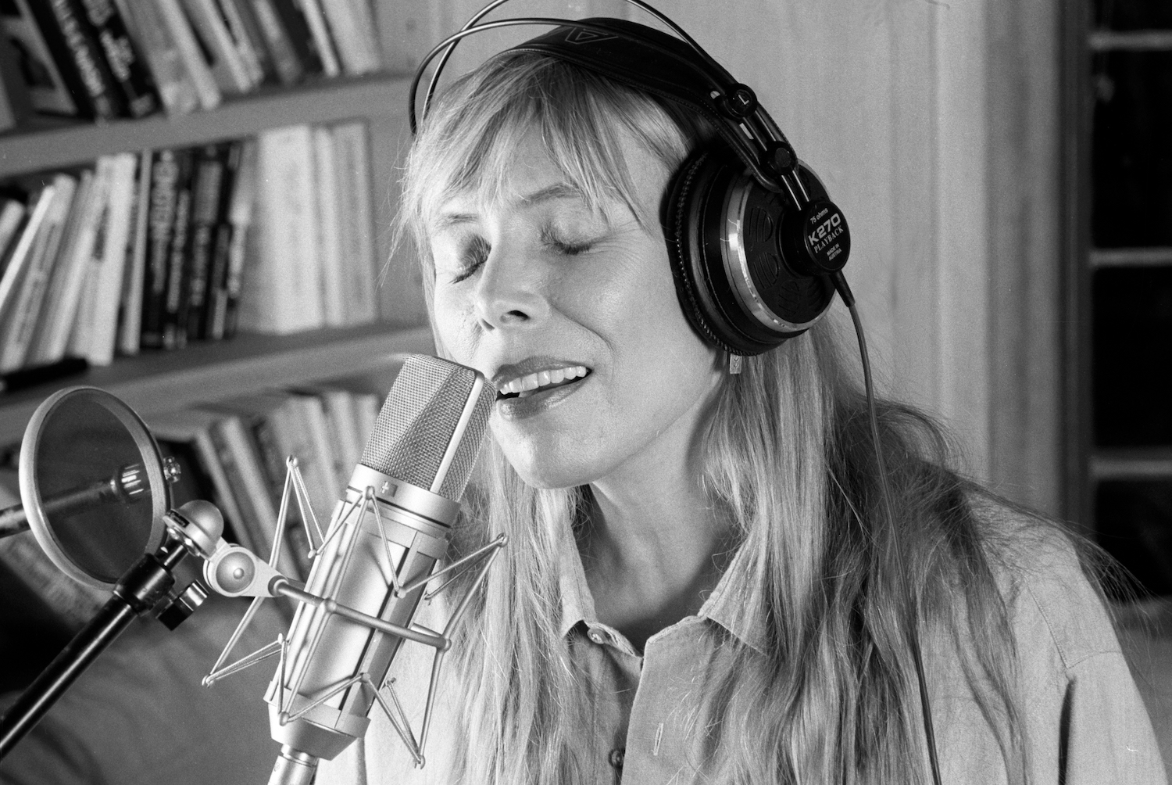
Singer/Songwriters
Catchall term to describe primarily acoustic music of early-mid 1970s by musicians who write their own material
Joni Mitchell recording at home
Extension of folk rock, with many other additional influences
Emphasis on vocal ability, songwriting
Not oriented toward pop mainstream
Generally introspective, self-oriented lyrics
Vocalist usually plays guitar or piano
Contrasts with hard rock, R&B/soul, and mainstream rock
Usually solo act, but some groups (CSNY) fit this model

Slide 9
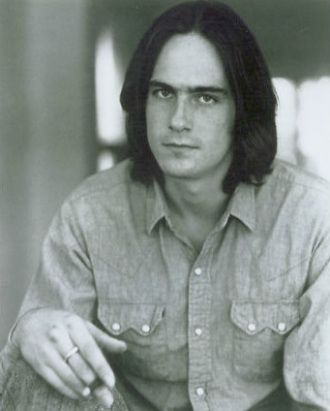
James Taylor (1948- )
Started as folk artist in NYC coffee houses
Signed to Apple Records in 1967
During 1968 he underwent treatment and had a motorcycle accident in which he broke both hands, so he couldn’t tour
Left Apple for Warner Bros. and had his first successful album Sweet Baby James (1970)
Painful, introspective lyrics
One of the best-selling solo artists of all time

Slide 10
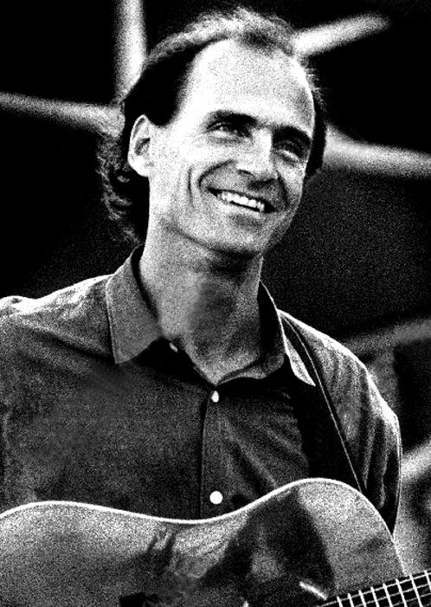
Fire and Rain (1970)
Clear folk rock orientation
Lyrical content personal, alluding to suicide of friend, and problems with depression and addiction
but friendly pop elements kept the song light
Acoustic guitar by Taylor, piano by Carole King, brushes (rather thank sticks) on drum, double bass rather than electric
Fair amount of production
Builds in intensity throughout (end-weighted)

Slide 11
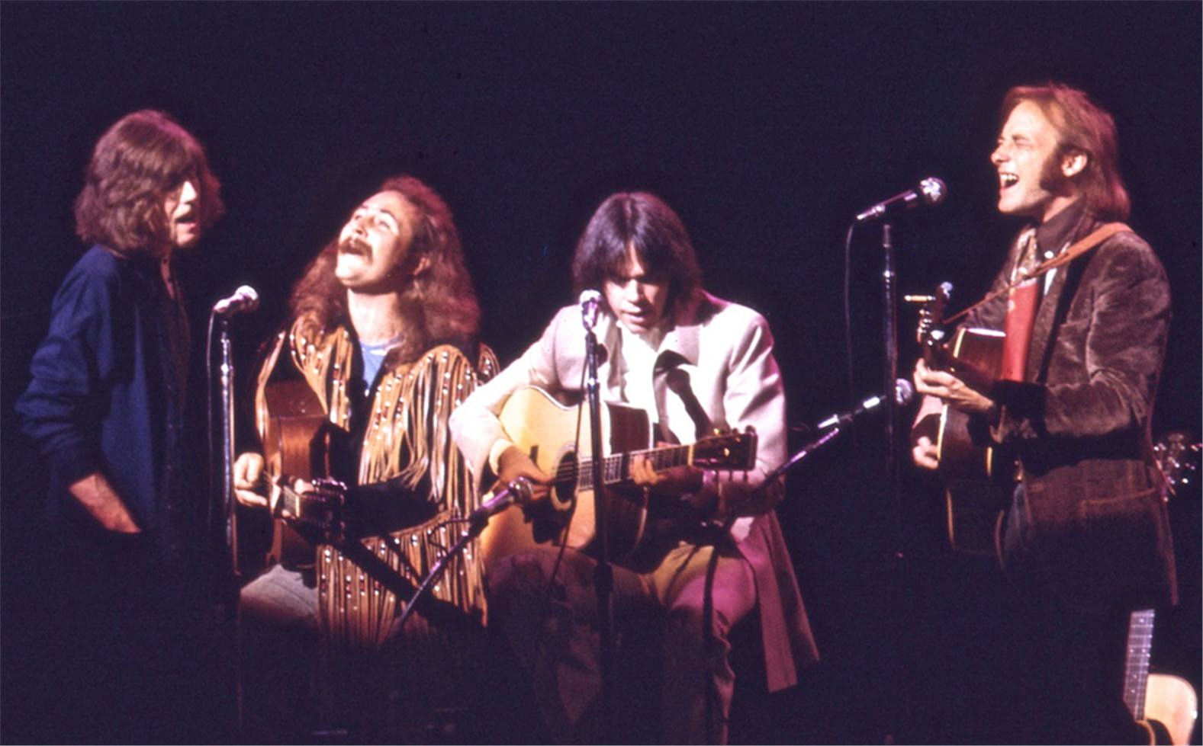
Crosby, Stills, Nash, and Young (1969)
One of the first Supergroups
David Crosby from The Byrds
Stephen Stills & Neil Young from Buffalo Springfield
Graham Nash from The Hollies
Acid-country-folk rock; similar to Byrds but more folk-oriented
Ex. “For What It’s Worth”
Crosby, Stills, Nash came together 1968, Ask Young to join early ‘69
Expands tight vocal harmonies of Everly Brothers to four parts
Tight harmonically, but no high end
Four songwriters - character of songs were different depending on author

Slide 12
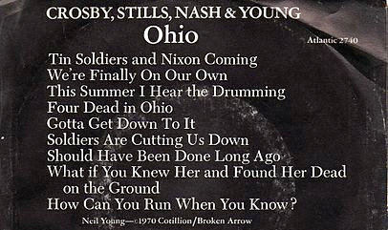
“Ohio” (1970)
Songwriter = Neil Young, but evinced the political activism that characterized the group as a whole
Lyrics about Kent State massacre (1970)
Riff-based
Distorted electric guitar
No harmonies at beginning - significant
Particularly tight harmonies for rest - adds tension
B-Side by Stephen Stills “Find the Cost of Freedom”

Slide 13
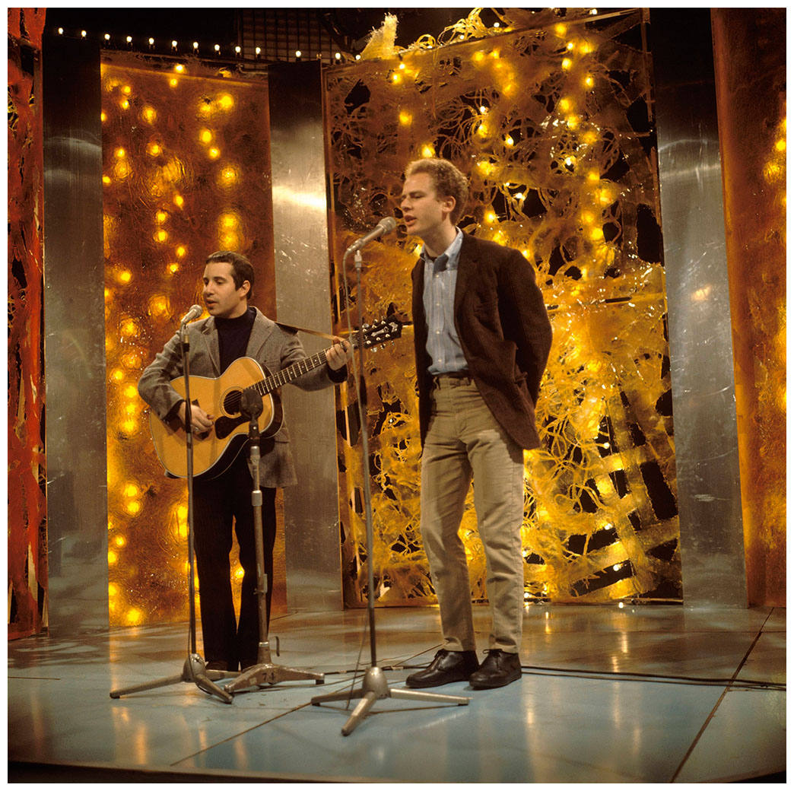
Paul Simon (1941–) and Art Garfunkel (1941–)
Heavily influenced by Everly Brothers
1957 hit “Hey Schoolgirl” (as Tom and Jerry) near copy of Everly Brothers style
Also Brill Building
Enjoyed their biggest success with “Bridge Over Troubled Water,”after which they broke up.

Slide 14
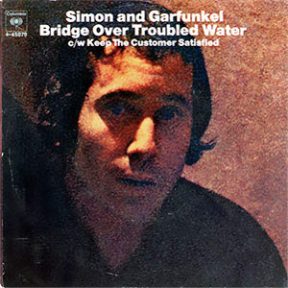
“Sound of Silence” and “Bridge Over Troubled Water”
“Sound of Silence” (1964) originally issued acoustically – flops
Re-released with studio production, rock band- #1 hit
Dark imagery, but framed as pop song
“Bridge Over Troubled Water” (1969; released 1970) from their fifth album with the same name (1970)
a straight-ahead, piano-based gospel song
wrecking crew musicians used for a “wall of sound” affect

Slide 15
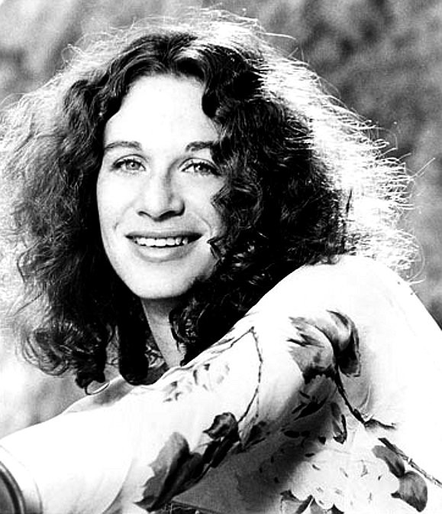
Carole King (1942–) and Tapestry (1971)
Brill Building songwriter (with ex-husband Gerry Goffin) who goes solo in 1970
First album fails, but Tapestry (1971) one of the best-selling albums of all time (over 25 million sold)
Most successful female songwriter of the latter half of the 20th c. in both US and UK, many awards (Gershwin Prize, Kennedy Center)
“It’s Too Late/I Feel the Earth Move” the biggest single
“(You Make Me Feel Like) A Natural Woman” had already been a huge hit for Aretha Franklin, while “You’ve Got a Friend” would be a huge hit for James Taylor

