Slide 1
British Folk Rock & Celtic Soul
Fairport Convention and Van Morrison

Slide 2
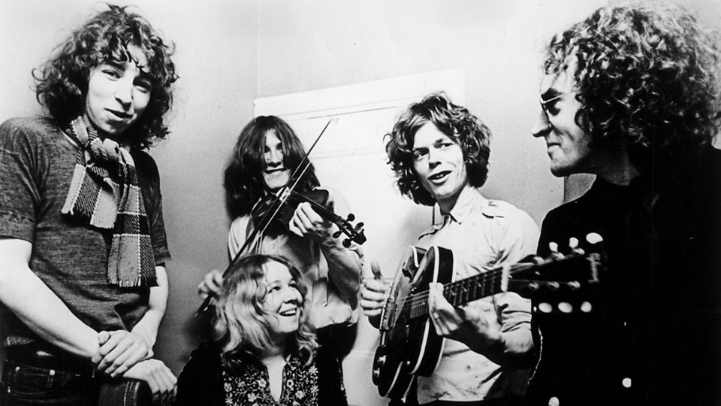
Fairport Convention (1967-79)
Formed in 1967 by Richard Thompson (guitar, vocals), Simon Nicol (guitar, vocals), Ahley Hutchings (bass) and later Martin Lamble (drums)
Influenced by American folk rock, but introduction of Sandy Denny as lead singer in 1968 steers them toward traditional British music.
Sandy Denny began singing in London’s folk clubs in the mid-1960s, became famous for her powerful vocals and songs. Contributed to the LPs What We Did on Our Holidays and Unhalfbricking (both 1969),
Part of a movement that included Steeleye Span, Fotheringray and the Albion Band, among others.

Slide 3
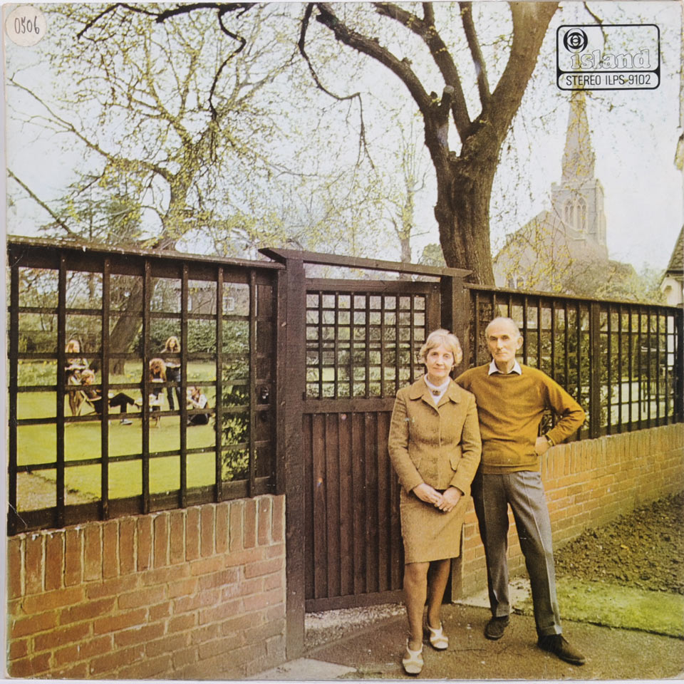
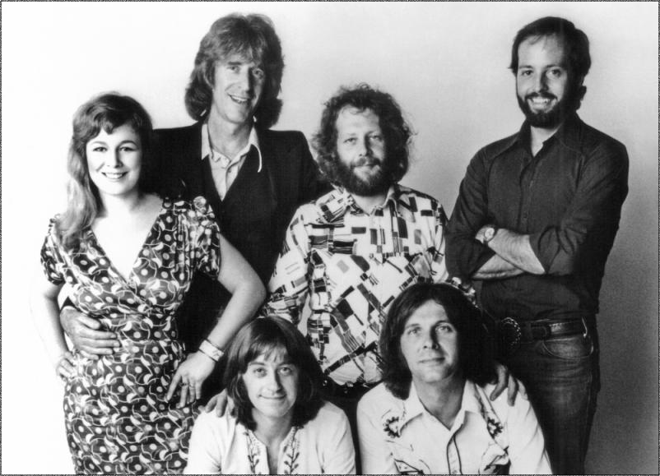
“Who Knows Where the Time Goes?”
Sandy Denny wrote “Who Knows Where the Time Goes?” at 19
It was recorded by American folk singer Judy Collins before Denny’s version was released.
But the definitive version was with Fairport Convention on their third album, Unhalfbricking.

Slide 4
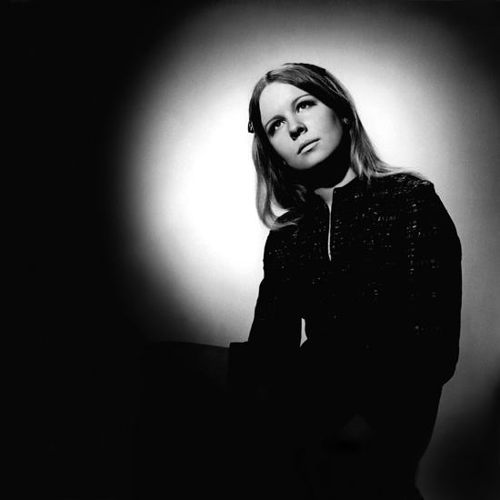
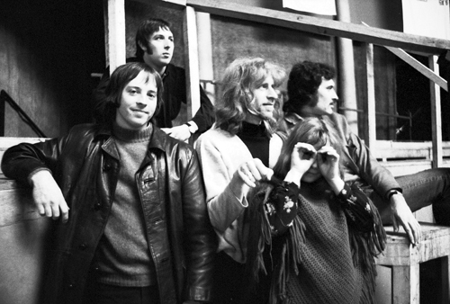
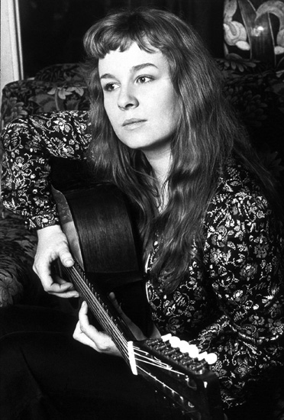
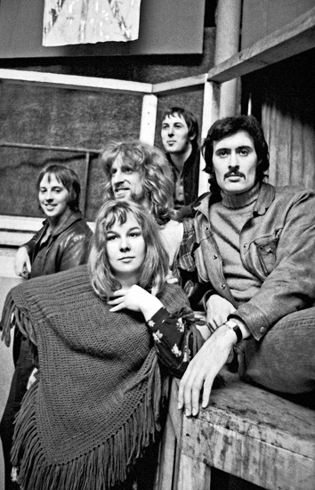
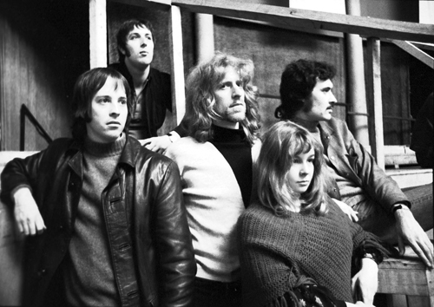
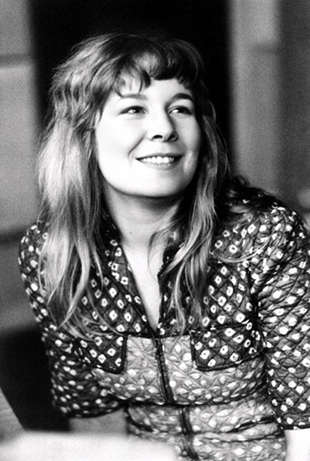
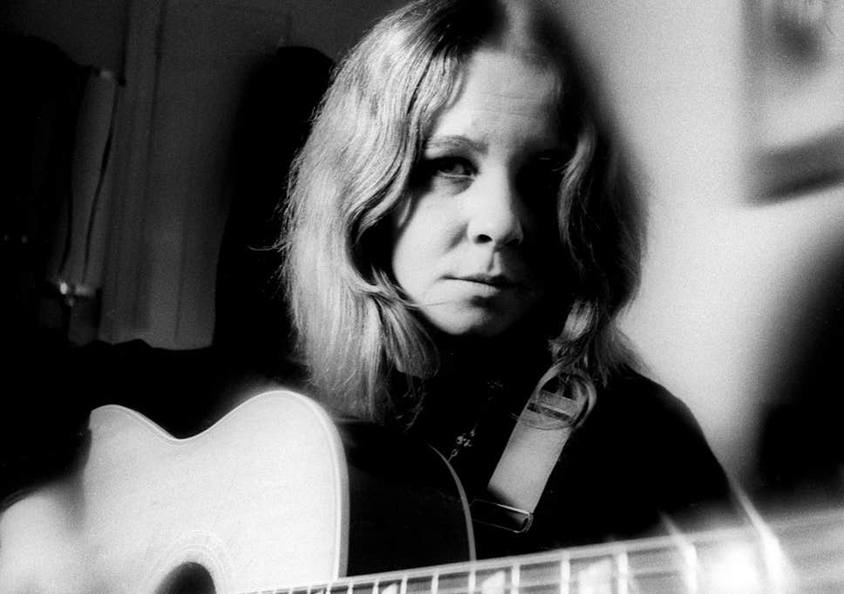
Who Knows Where the Time Goes?
Across the evening sky, all the birds are leaving
But how can they know it's time for them to go?
Before the winter fire, I will still be dreaming
I have no thought of time
For who knows where the time goes?
Who knows where the time goes?
Sad, deserted shore, your fickle friends are leaving
Ah, but then you know it's time for them to go
But I will still be here, I have no thought of leaving
I do not count the time
For who knows where the time goes?
Who knows where the time goes?
And I am not alone while my love is near me
I know it will be so until it's time to go
So come the storms of winter and then the birds in spring again
I have no fear of time
For who knows how my love grows?
And who knows where the time goes?.

Slide 5
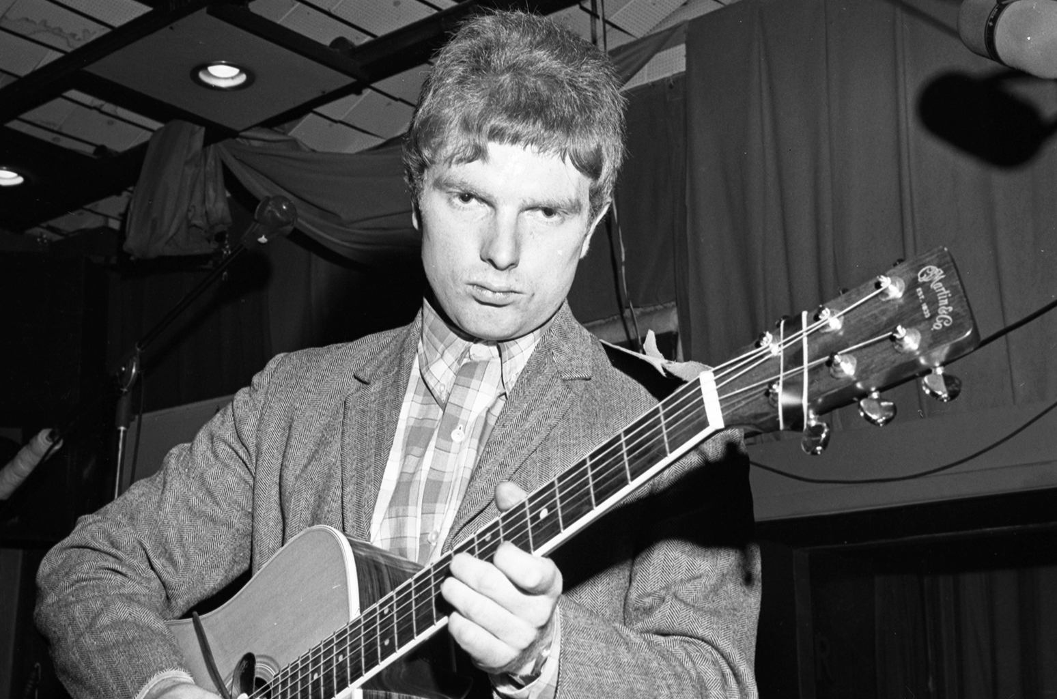
Van Morrison (1945-)
Sir George Ivan "Van" Morrison a North Ireland singer who began singing and playing in bass as a teen.
The lead singer of Them, for which he recorded the garage rock classic “Gloria.”
Went solo with “Brown-Eyed Girl” in 1967.
His breakthrough came with the critially-acclaimed album Astral Weeks (1968), influenced by folk, jazz, blues and classical music, followed bt Moondance (1970)
Soul singer in the Amreican R&B tradition, with Celtic and jazz influences, sometimes called “Celtic soul”

