Slide 1
Pre-punk in NYC
and the motor city

Slide 2
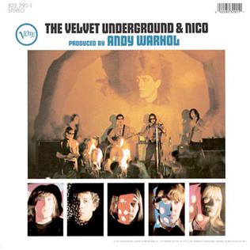
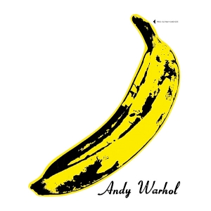
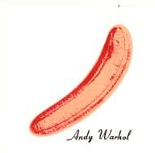
the velvet underground
with German model/chanteuse Nico, 1965–67
Lou Reed, vocals, guitar; John Cale, viola, bass and keyboards, Sterling Morrison, guitar, Maureen Tucker, drums.
At the height of the flower-power generation, the Velvet Underground wrote songs about alienation, drug addiction, and sado-masochism.
During the early part of their career, they came under the wing of artist Andy Warhol (1930-1987) who promoted them and designed the cover for their first album: the famous banana which could be peeled.
The Velvet Underground
& Nico, 1967
front and back

Slide 3
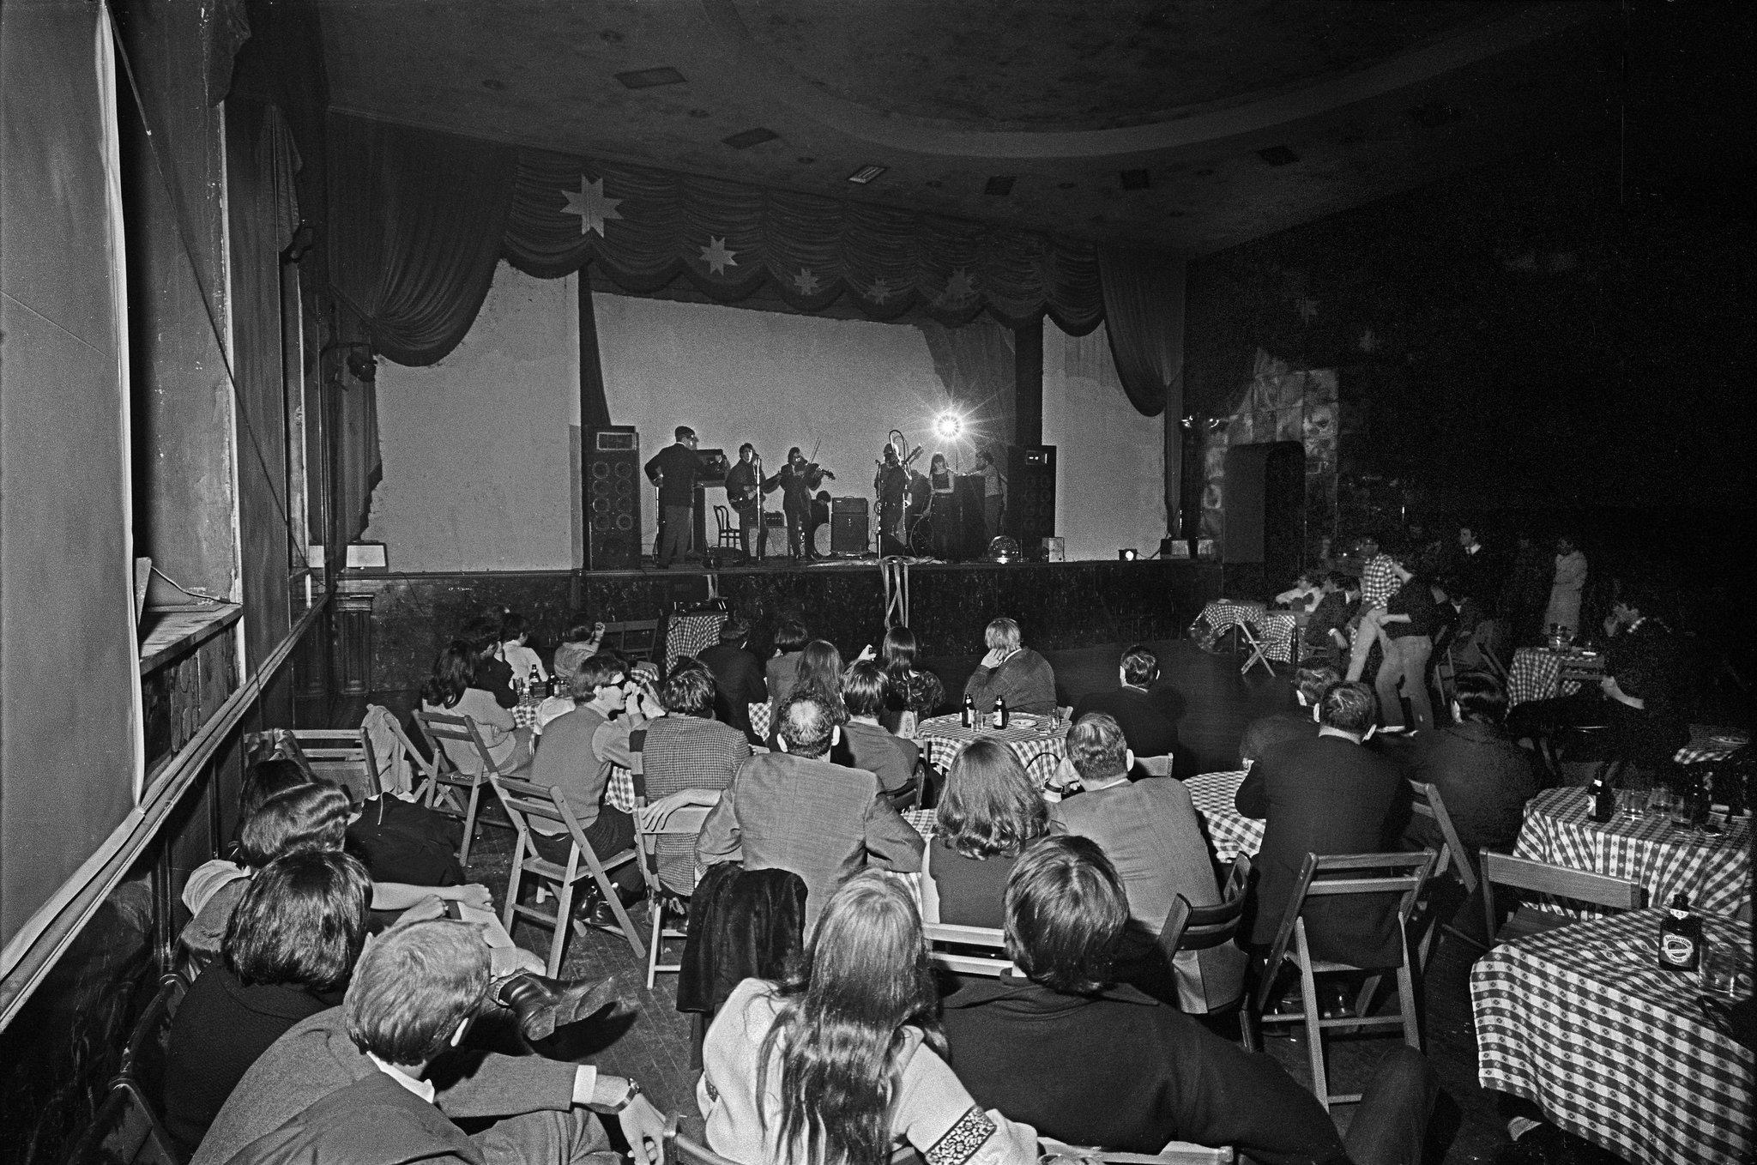
The Velvets toured with Warlhol's Exploding Plastic Inevitable (1966-1967) traveling mixed media show. Although the Velvet Underground had no major hits nor achieved commercial success before they broke up, their cult hits include “Heroin”, “Venus In Furs”, “I’m Waiting for My Man," and “Femme Fatale,” and in 1970 the enduring hits "Rock and Roll" and "Sweet Jane."

Slide 4
Detroit is burning: The MC5
By the 1960s Detroit was the most industrial US city
Alongside Motown, a ferocious rock'n'roll became the voice of Detroit's blue-collar workers

Slide 5
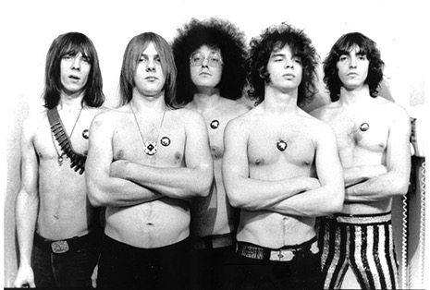
Detroit is burning: The MC5 1966
MC5, influenced by White Panther leader John Sinclair and led by guitarist Wayne Kramer, represented the revolutionary wing of the student riots and used rock as an agit-prop device.
Their live shows were known for their wild fury, and their first album Kick Out The Jams (1969) was perhaps the most visceral albums released to that date: acid-rock taken to an extreme that would later be known as punk.
Later lps lacked the power of this call to arms, but the remaining members are touring in a 50-year tribute to Kick Out The Jams, hoping to revive its politics.

Slide 6
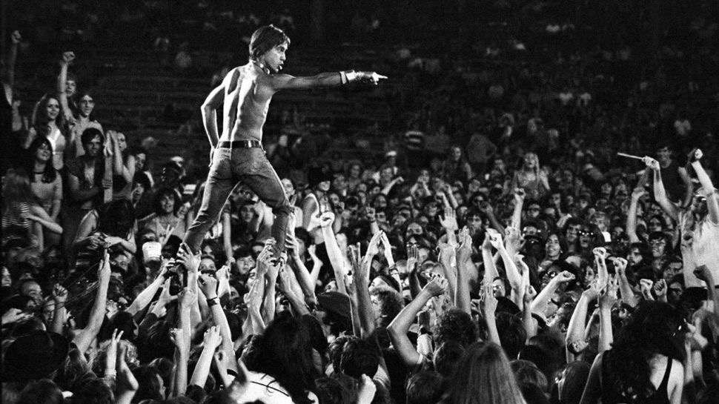
Iggy and the stooges ((Ann arbor 1967)
Iggy Pop (James Osterberg) and the Stooges came up alongside the MC5. Their music borrowed ideas from Chuck Berry, the Rolling Stones, the Velvet Underground and the Doors, but also pushed them to the limit.

Slide 7
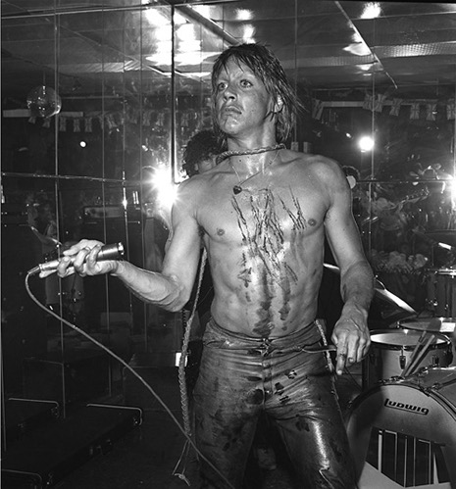
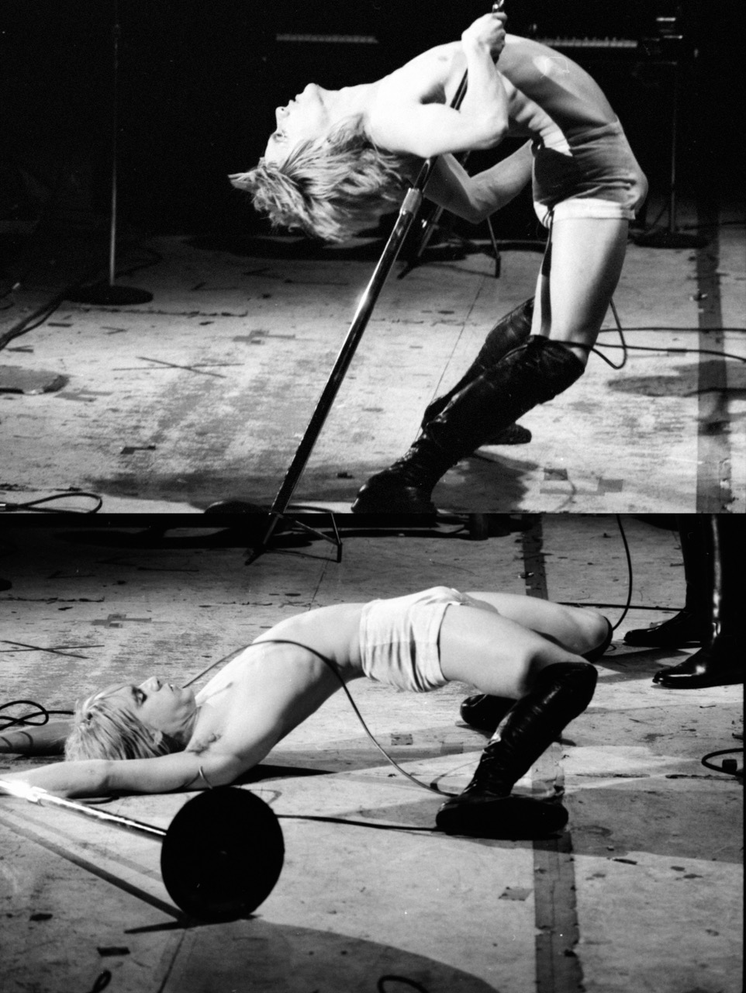
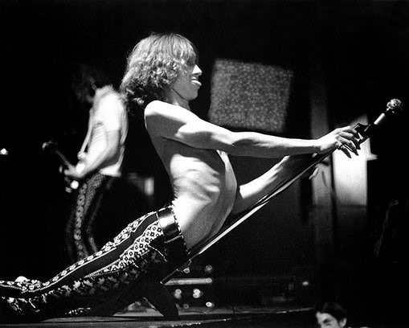
Considered the grandfather of punk, Iggy gave his first Stooges concert on Halloween 1967.
His act included rubbing raw steak over his body, gouging his skin with broken glass, and diving into the audience.

Slide 8
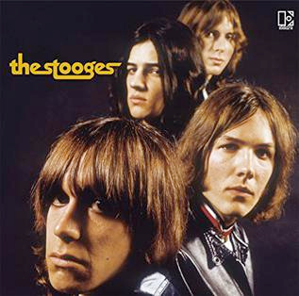
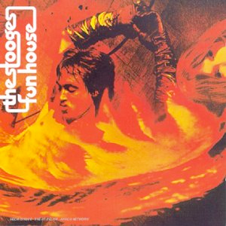
The songs "1969," "No Fun" and "I Wanna Be Your Dog" exemplified their "degenerate," apolitical appeal, compared to the MC5.
Raw Power (1973): seminal to the UK punk movement, with “Raw Power,” “Gimme Danger,” and “Search and Destroy”
The Stooges (1969): “1969,” “No Fun,” “I Wanna Be Your Dog”
Fun House (1970): “TV Eye,” “Funhouse,” “1970”

