Slide 1
From Blues to Rock 2
Cream, Led Zeppelin, and the Birth of Hard Rock

Slide 2
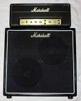
Clapton and the blues rock “sound”
Most influential of the British guitarists emerging in the 1960s
Influenced by Robert Johnson and B. B. King
Exerted a major influence on early heavy metal
Adopts Gibson Les Paul
Combined with Marshall stack
Guitar amplifier
Speaker cabinet containing four square speakers x 2
Uses feedback in studio recordings

Slide 3
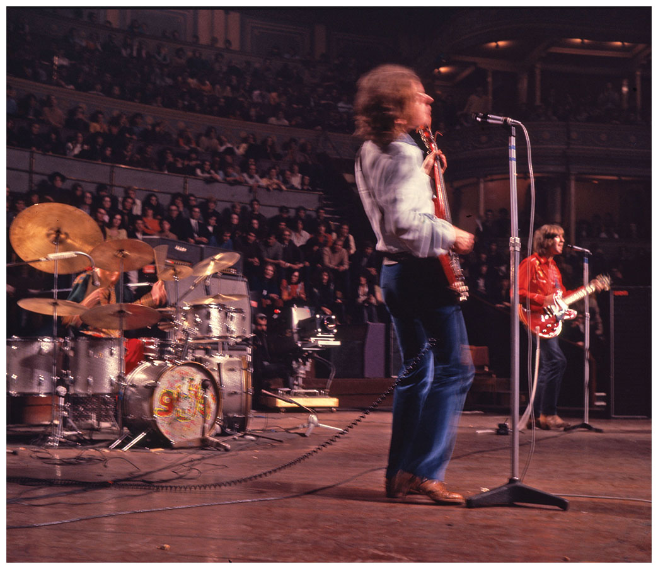
Cream (or The Cream, 1966–68)
Jack Bruce, Ginger Baker, Eric Clapton
First “power trio”
Lead guitar, bass, drums
No chording instrument (rhythm guitar or piano)
Also first super group – Members from other successful bands
Replicated blues such as “Crossroads”
Albums Fresh Cream (1966), Disraeli Gears (1967), Wheels of Fire (rare double LP, 1968)
“Sunshine of Your Love” verse structured around a double 12-bar blues pattern

Slide 4
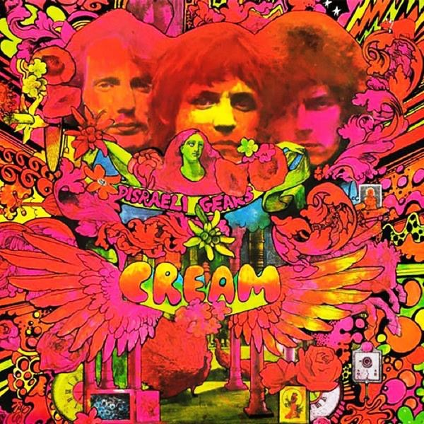
“Sunshine of your love” from Disraeli gears (1968)

Slide 6
Heavy Metal Music
Counter-culture writer William S. Burroughs
1962 novel The Soft Machine: Uranian Willy, the Heavy Metal Kid
1964 novel Nova Express: heavy metal becomes a metaphor for addictive drugs
Rock critic about Jimi Hendrix in 1967
His music was “like heavy metal falling from the sky”
1968 Steppenwolf song, “Born to be Wild”
“I like smoke and lightningHeavy metal thunder”
Besides Cream, early metal includes Vanilla Fudge and Iron Butterfly’s 17 minute “In-A-Gadda-Da-Vida”

Slide 7
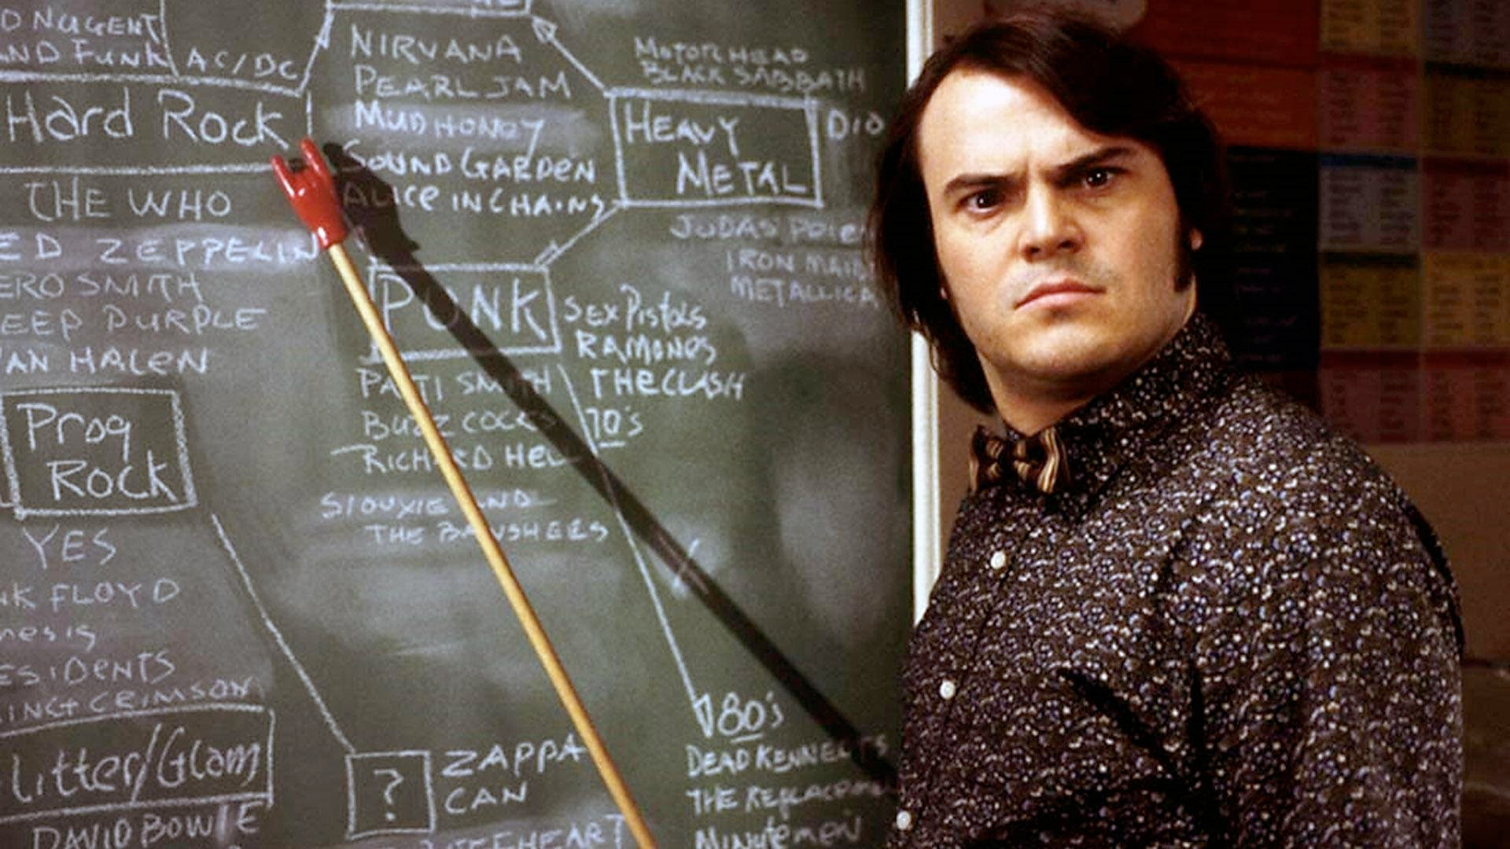
Hard Rock & Heavy Metal
Blues-influenced guitar
Guitar & bass frequently play same line
High, harsh, dramatic blues-edged vocals
Highly engineered sound – reverb, echo, feedback, noise
Built from mostly power chords, riff-based
Modal harmonies
Extended improvisations, including drum solos
LOUD

Slide 8
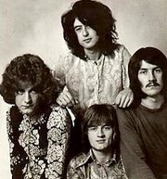
Led Zeppelin (1968)
Often called first heavy metal band
Most important band in the development of hard rock
Influence on almost every metal or hard rock band of the 1970s and 80s and beyond
Impact on business of rock
Jimmy Page, (guitar, 1944–), John Paul Jones [John Baldwin] (bass & keyboards, 1946 -), Robert Plant (vocals & lyrics, 1948–), John Bonham (drums, 1948-1980)

Slide 9
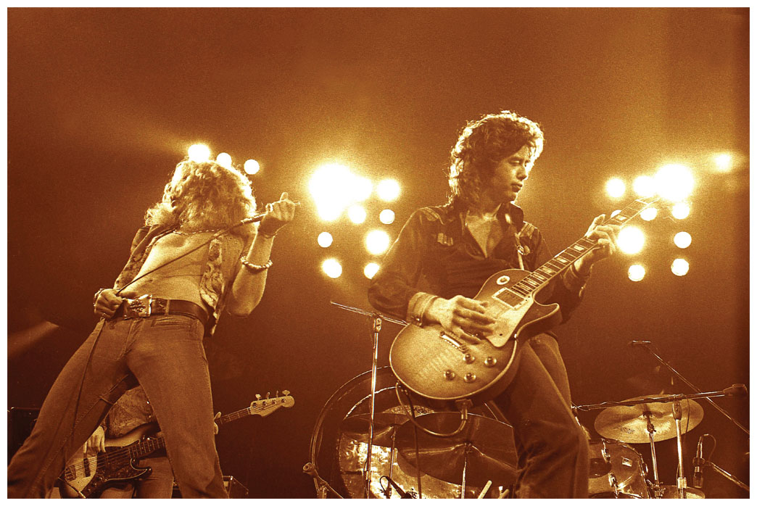
Led Zeppelin - Style
Virtuosic guitar-focused rock steeped in the blues, with influences from the San Francisco psychedelic scene and British Isles folk music.
Heavy but varied textures and extremely loud.
Riff-based, often in bass
Other influences include Indian classical and Arabic music, Reggae, Country music and bluegrass
Like Stones, front man (Plant) and guitar god (Page)
Loud, active drumming, Bonham’s drum solos set a new standard
Mixed or additive meters, or irregular accent patterns
Long improvisations, and exchanges between Page and Plant

Slide 10
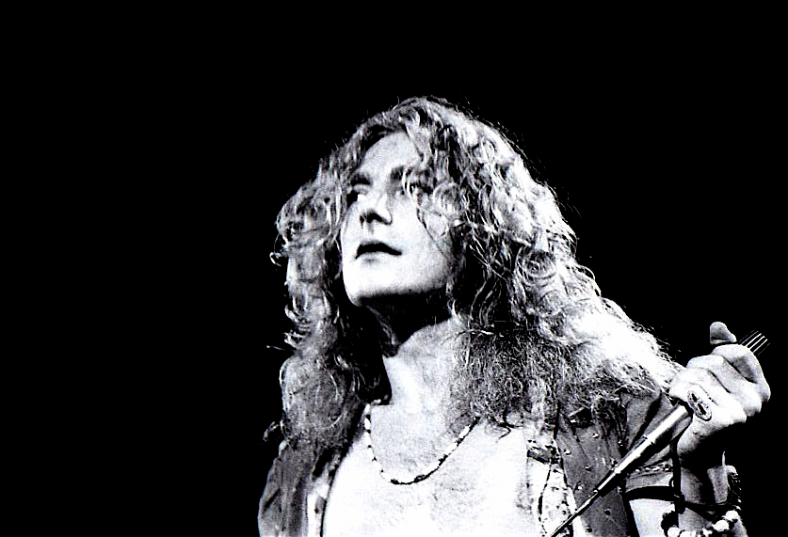
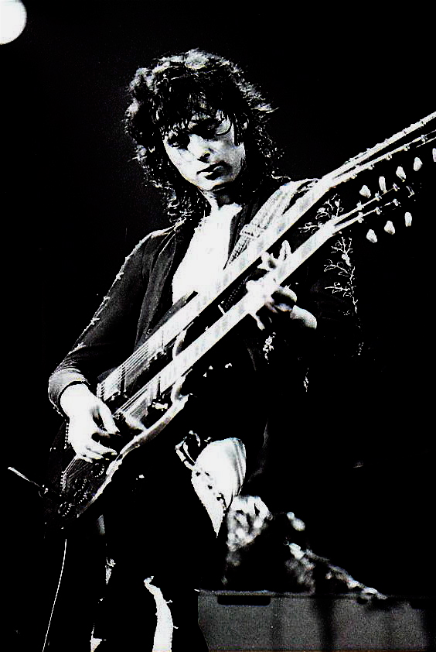
Jimmy Page & Robert Plant
Page one of the most popular studio musicians in UK
Joins Yardbirds 1966; retains name, roster of tour dates when band breaks up in 1968
Along with Jimi Hendrix, founder of metal guitar style
Avoids clean sound
Prefers distortion, thick texture
Frequently employs pedal effects, feedback
Sound more important than notes
Plant influenced by blues shouters
Extremely high voice for rock singer
Changes tone color and texture like guitarist
Adds shrieks, moans, vocalizations

Slide 11
Influence
Hard rock vocal and guitar styles
Shatter 4 minute barrier for songs
Fix importance of AOR radio
Establish new expectations for concert performance
Duration
Increase band’s % of profits from tickets
Change in concert circuit, and way business was done
Establish importance of the album as primary revenue generator

Slide 12
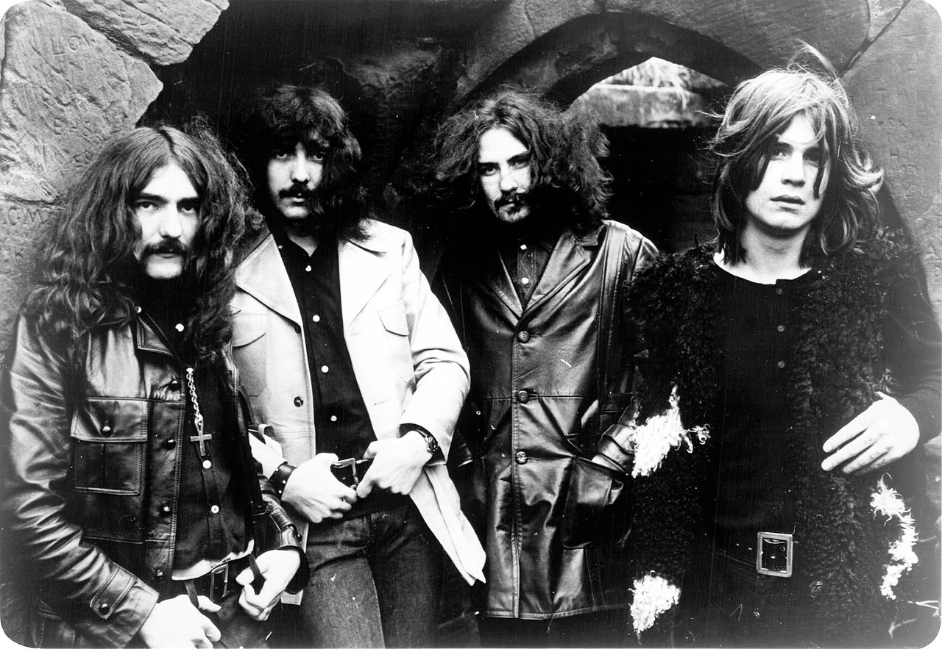
Black Sabbath (1968)
Aggressive reaction to psychedelic culture of San Francisco and Woodstock
Formed as a blues band in Birmingham by guitarist/songwriter Tony Iommi, bassist Beezer Butler, singer Ozzy Osbourne, and drummer Bill Ward
Began incorporating occult themes, drugs, dark imagery, and political corruption, tuning down their guitars, and playing faster
Sabbath pioneered metal with their first three albums Black Sabbath (1970), Paranoid (1970) and Master of Reality (1971)

Slide 13
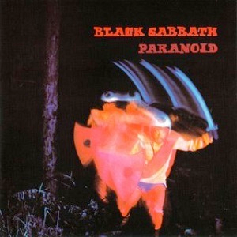
Black Sabbath – Paranoid (1970)
2nd LP, topped the UK chart
Hard-driving eight-beat rock rhythm
Power chords in bass & guitar
High, aggressive vocals
LOUD
Dark subject matter
Riff-driven
Modal guitar solos
Notable songs:
“Paranoid,” “War Pigs,” “Iron Man”

