Slide 1
Late 1960s in Los Angeles
The Byrds, The Doors,

Slide 2
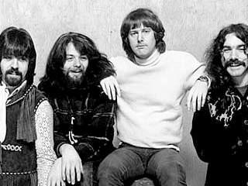
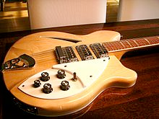
The Byrds (1964)
First folk and country rock band to hit big
Led by singers Roger McGuinn and David Crosby
Popularized folk songs like Pete Seeger’s “Turn, Turn, Turn” and Dylan’s “Mr. Tambourine Man,” which they took to #1
Part of CA music scene, along with Mamas and the Papas
Vocal harmonies a maturation of Everly Brothers style
David Crosby makes second part a “composite” of 3rds, 4ths, and 5ths
Help to popularize “jangly” Rickenbacker 12 string guitar sound

Slide 3
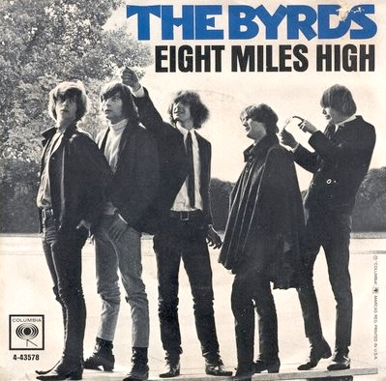
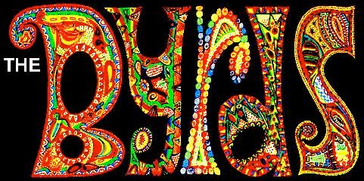
Eight Miles High (1966)
One of the first “psychedelic” hits
Thick, dense texture
Heavy reverb on all, especially guitar
Static quality
Riff-based
Droning, directionless guitar solos
Hallucinatory lyrics about a flight to London (but perceived to be about drugs) caused song to be banned on some stations.

Slide 4
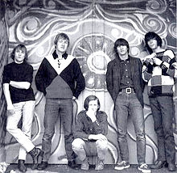
Folk to Country Rock
Buffalo Springfield
Mixture of country, rock, folk, and blues influences
Same ingredients as rockabilly, but informed by all rock styles of ’60s
Heavy doses of folk music as well, and British Invasion influence
The Byrds’ Sweetheart of the Rodeo (1968) was the first serious exploration of country and western music by rock musicians
Buffalo Springfield, formed in LA in 1966, launched careers of Stephen Stills and Neil Young
# 1 hit with “For What It’s Worth (Stop, Hey, What’s That Sound?)”
Flying Burrito Brothers also blended psychedelic rock and honky-tonk, simultaneously with, and partly in opposition to, acid rock
Important members included Gram Parsons and Chris Hillman
Distinguished ‘American’ sound as opposed to ‘British’ sound in Rock and Roll

Slide 5
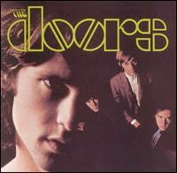
Jim Morrison and The Doors (1966)
Morrison (1943-1971) formed The Doors with guitarist Robby Krieger, Drummer John Densmore, and keyboardist Ray Manzarek
Manzarek played bass on a Fender Rhodes Piano bass
Among the more controversial bands of the 1960s
Morrison first rock artist arrested onstage in New Haven, CIT, 1967
In 1969 cited for indecency when a drunk Morrison started stripping
Sound dominated by sinuous organ, Morrison’s voice, and his obscure, “poetic” lyrics

Slide 6
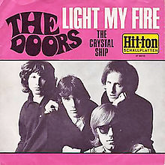
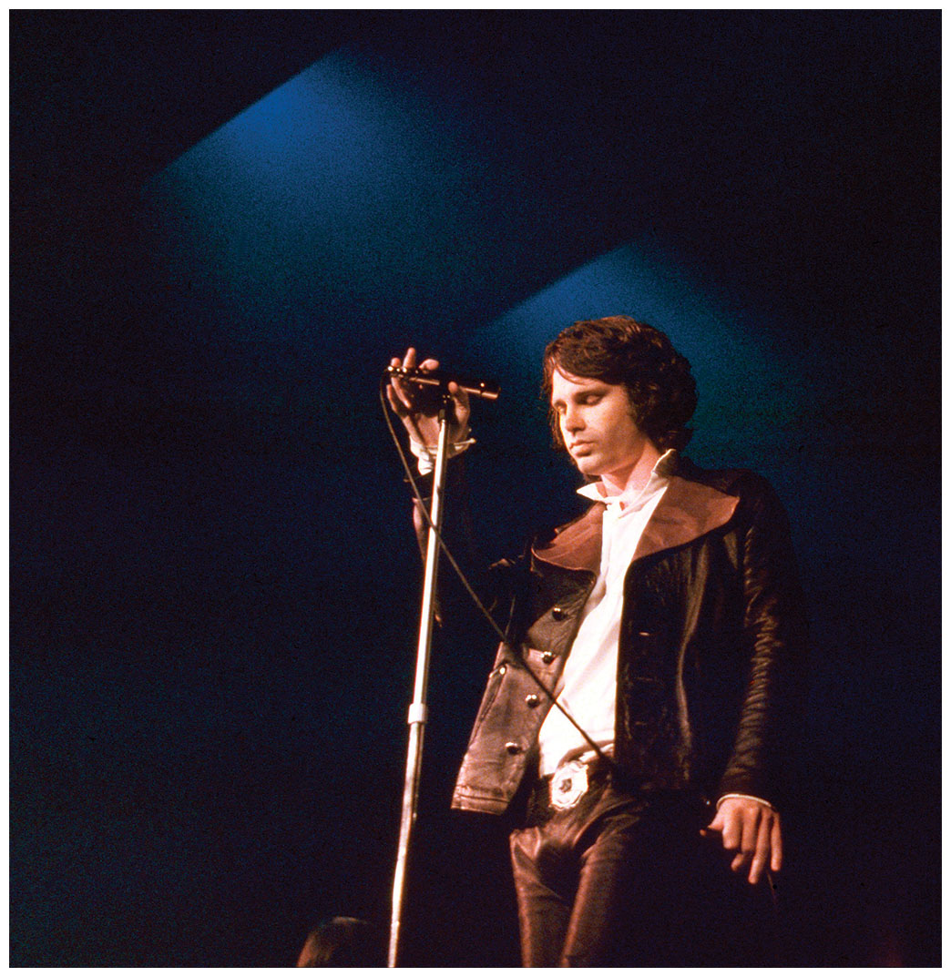
“Light my fire” (1967)
Their debut album, The Doors (1967), included “Light My Fire” and “Break on Through” and peaked at #2 behind Sgt. Pepper.
Other hit singles include “Hello, I Love You” (1968) and “Riders on the Storm” (1971).
Popularity of truncated single, which spend three weeks at #1, led to the popularity of the album version of the song
Became successful despite being almost seven minutes long!
This encouraged record companies to promote albums on emerging FM radio

Slide 7
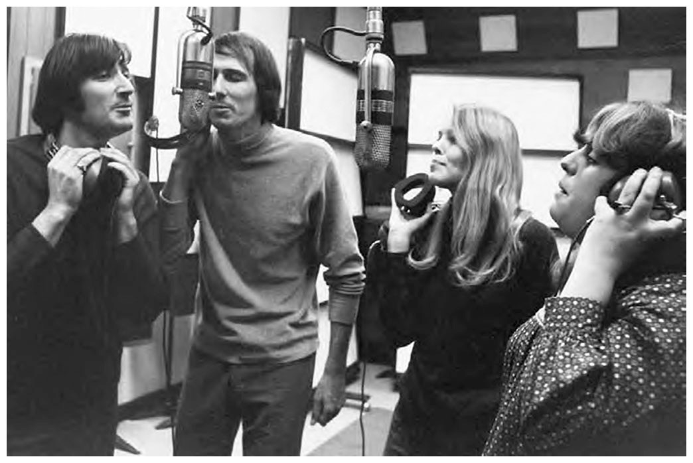
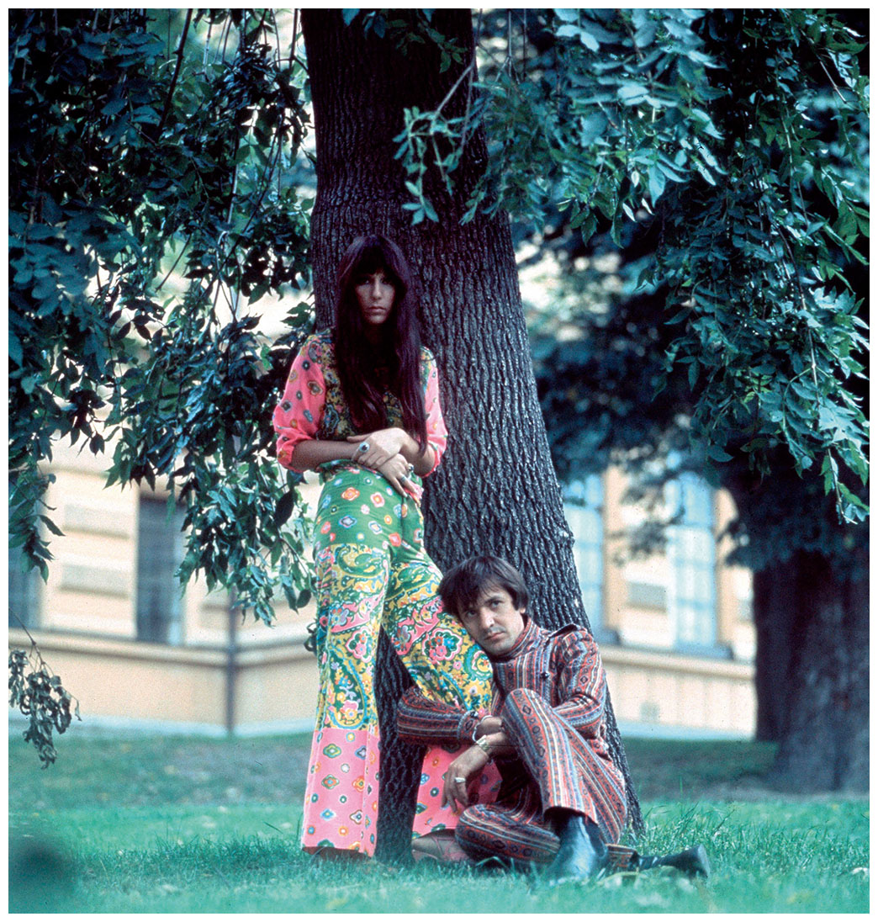
The Mamas and the Papas (1965) & Sonny & Cher (1965)
Mamas and the Papas: John Phillips, Denny Doherty, Cass Elliot and Michelle Phillips
Folk rock group organized around John Phillips’s arrangements and songs, which took them from the early ‘60s folk sound into the swinging ‘60s
Five audio albums and seventeen singles: “California Dreamin’” 1965
Sonny & Cher: Sonny & Cher Bono, husband and wife singing team
Former backup singers for Phil Spector
Hit songs in 1965: “Baby Don’t Go” and “I Got You Babe” on Atlantic
Hugely successful television variety series in the 1970s

Slide 8
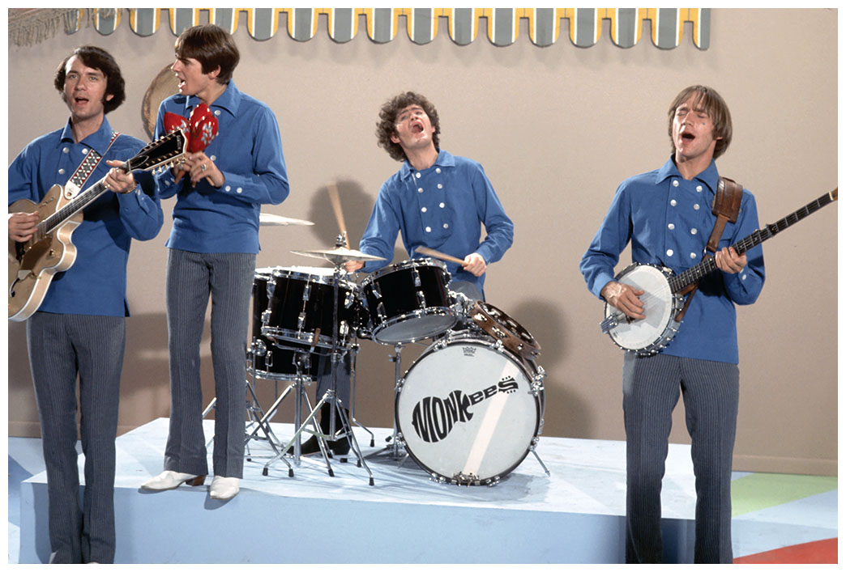
The Monkees (1965)
Mickey Dolenz, Michael Nesmith, Peter Tork and Davy Jones
Manufactured in LA as an ersatz Beatles, for the television series The Monkees, which aired fro 1966–68
Only nominally musicians with studio performers backing them at first, they grew into an actual band that lasted until 1971
A return to Brill Building system: great songs, and high production values.
Hugely successful, as they seemed to represent the “old” British Invasion Beatles

Slide 9
“Last Train to Clarksville,” Tommy Boyce & Bobby hart (1966)
Listen for 2-beat, almost country feel, Beatles guitar licks

