Slide 1
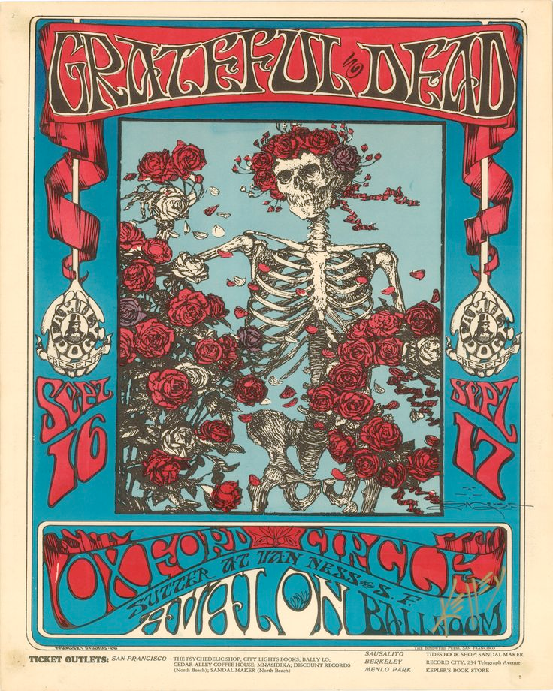
Psychedelic Rock
San Francisco and Beyond

Slide 2
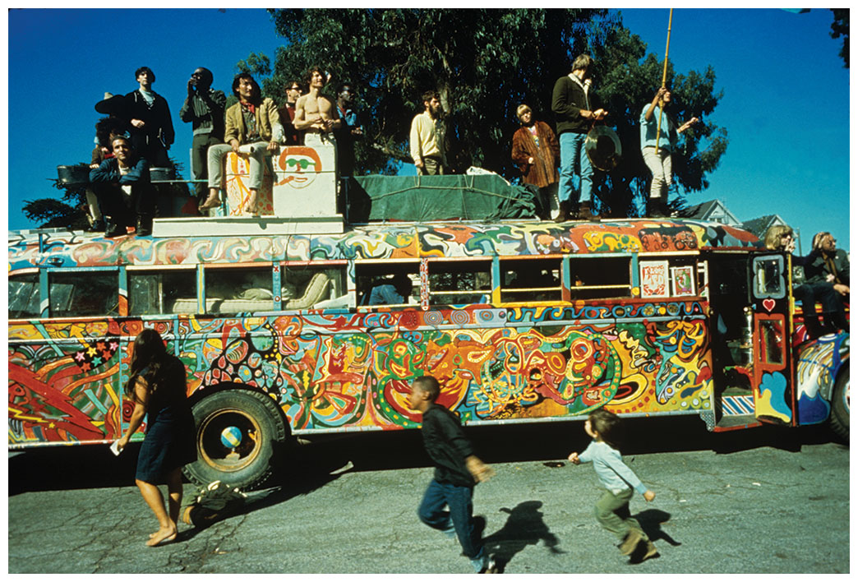
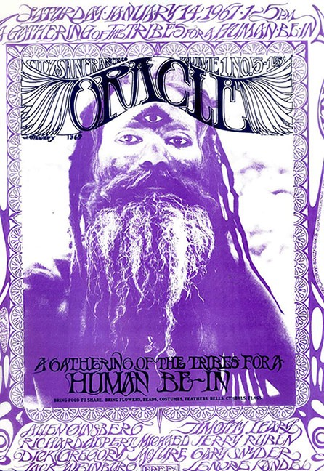
Psychedelic period
Huge cultural changes by 1965
Civil Rights movement
Free speech movements
Early protests of Vietnam war
LSD beginning to filter through country
Creates new artistic and cultural movements
Centered on the West Coast
The Magic Bus with Ken Kesey and his Merry Pranksters

Slide 3
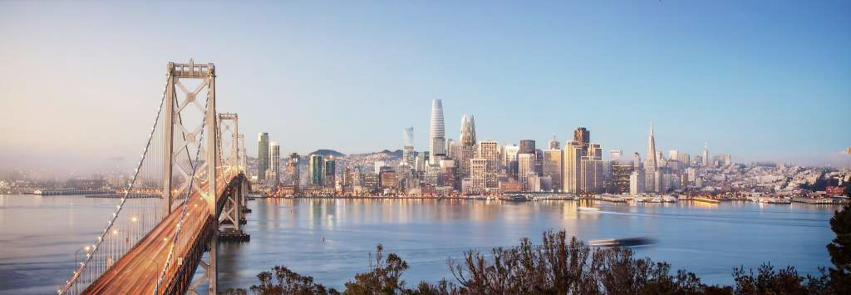
San Francisco 60s Scene
During the 1960s, a number of radical, avant-garde movements converged in the San Francisco Bay Area.
These included the student “free speech movement” at Berkeley, “Beat” poets and writers, and the “hippies” who began to crowd into the Haight-Ashbury neighborhood.
Bands and songs included: Country Joe and the Fish (“I Feel Like I’m Fixin’ to Die Rag”), Quicksilver Messenger Service, Big Brother and the Holding Company (with Janis Joplin), and the Jefferson Airplane (“Volunteers”).
Promoted by Bill Graham and Chet Helm, who rented out inexpensive ballrooms for concerts
The “scene” was more important than any particular musician

Slide 4
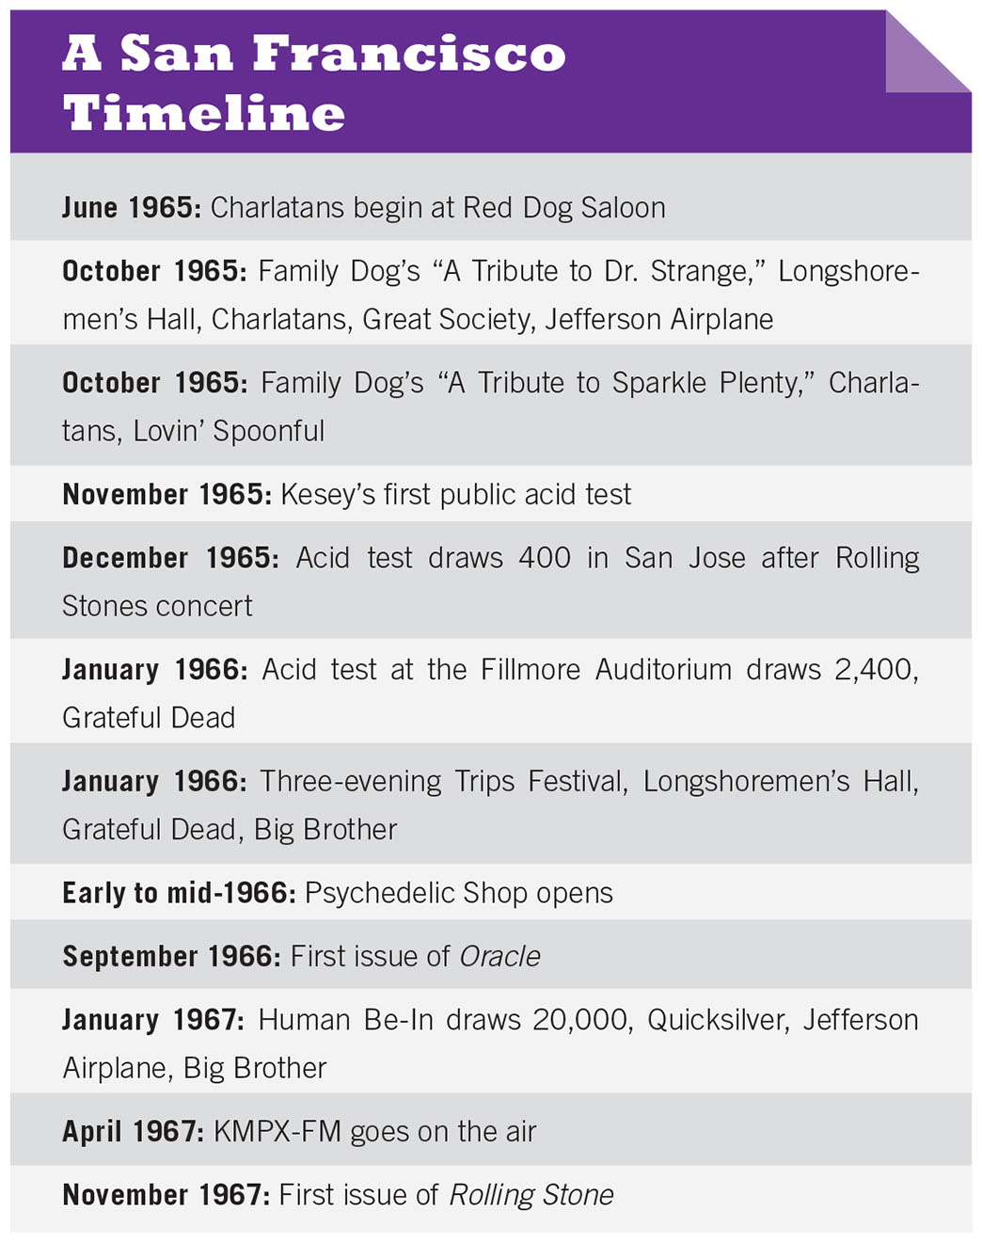

Slide 5
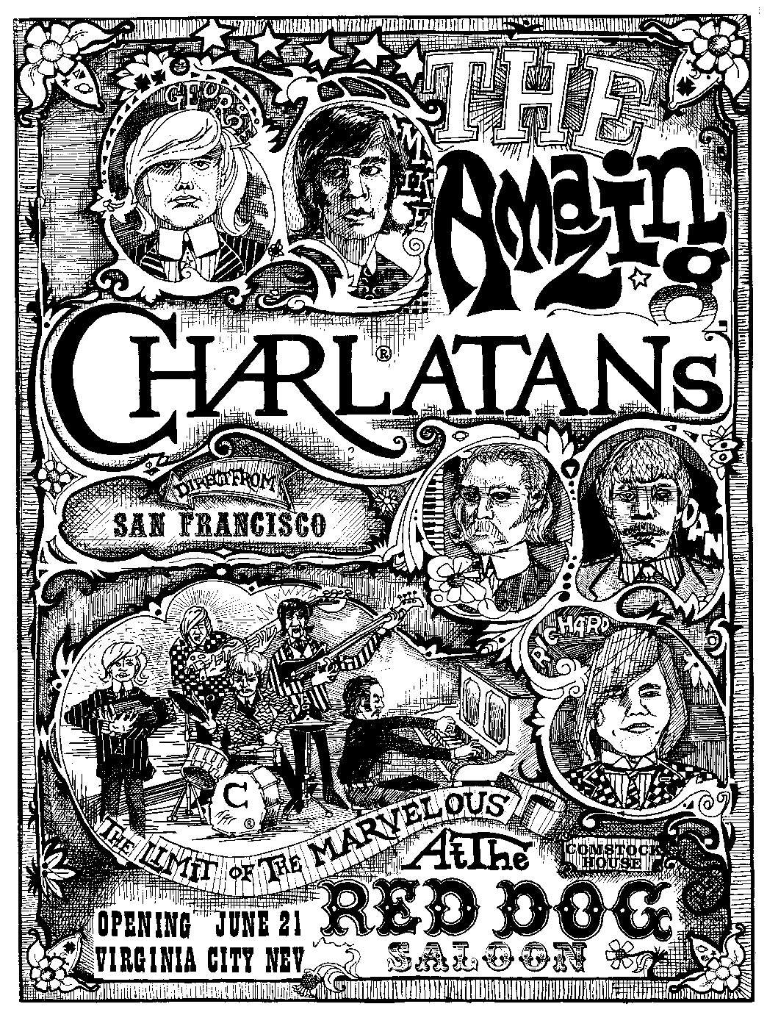
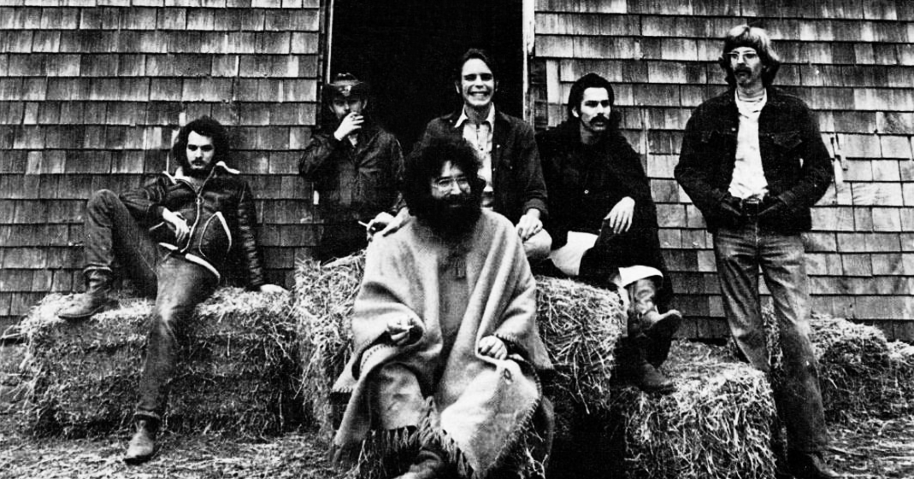
San Francisco Sound
Rejection of slick professionalism
Extended instrumental improvisations, often involve minimalist development
Electronic experimentation
Feedback and distortion
Other avant-garde effects
Many San Francisco bands not acid rock, but mixed folk, country music, R&B, and blues styles: American roots music
Emphasis on light shows, psychedelic art
The Grateful Dead, 1969

Slide 6
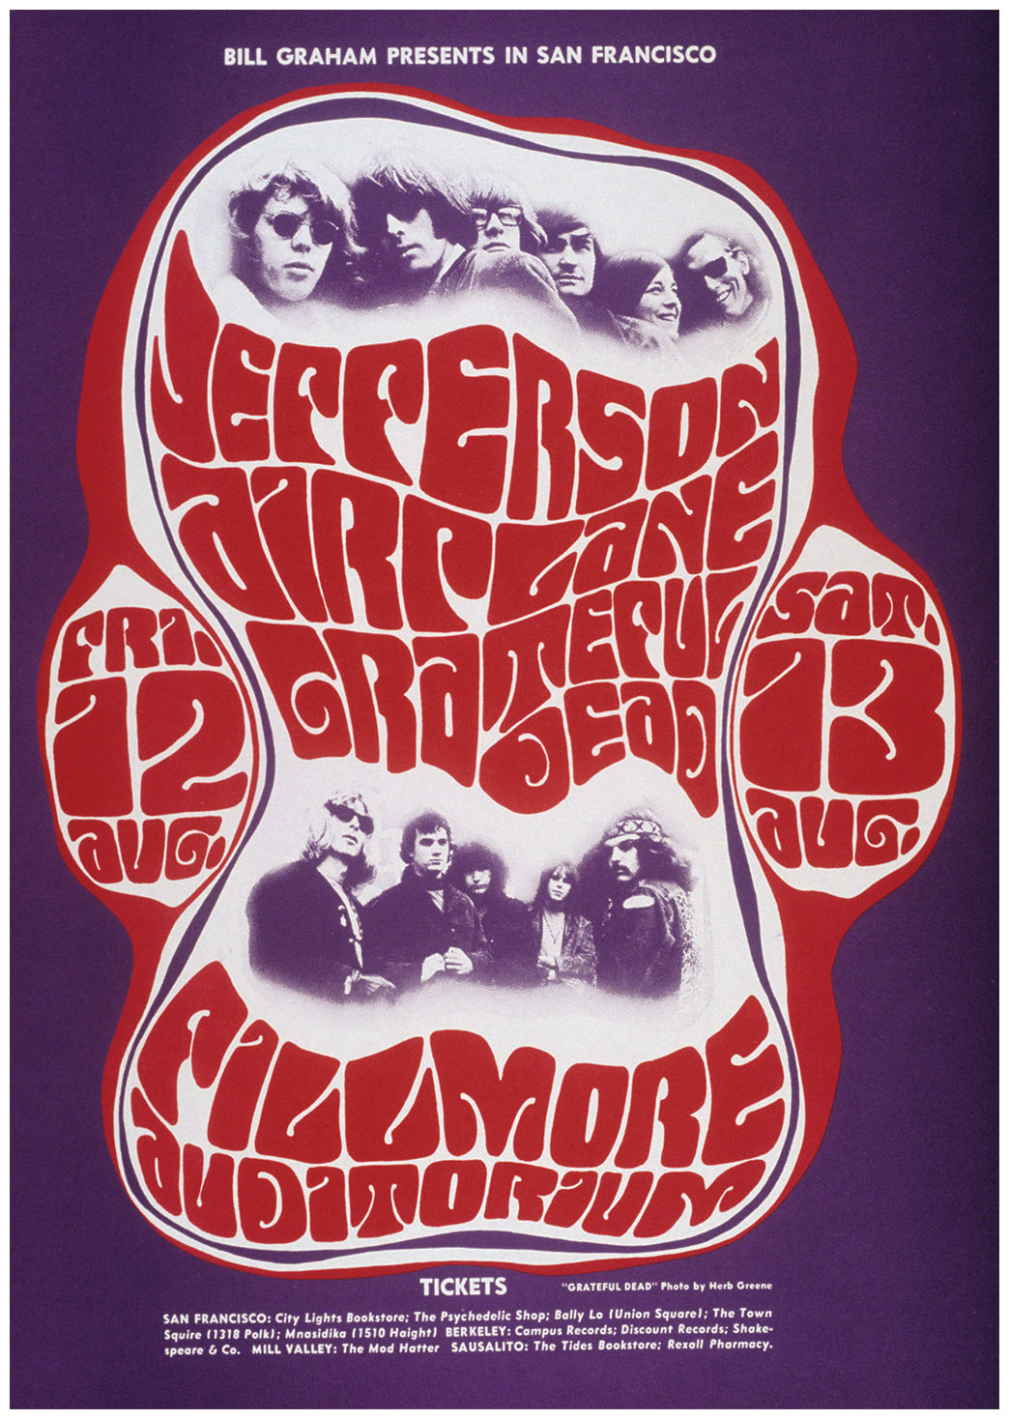
but what did “acid rock” mean?
Modally-based harmonies = lack of harmonic drive
Drone: sustained note underneath entire texture, borrowed from Indian classical music
Often lacks definitive beat
Free-form, often obscure lyrics
Thick, dense textures

Slide 7
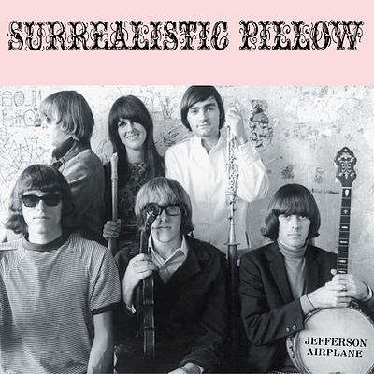
Jefferson Airplane (1965)
First band to emerge nationally from San Francisco and achieve commercial success
With Quicksilver Messenger and the Grateful Dead were the original triumvirate of San Francisco acid rock bands
Second LP (first with Slick) Surrealistic Pillow (1967) big hit
Biggest celebrity in the band was Grace Slick, who had formally been with The Great Society
Introduced to a national audience with “Somebody to Love” in 1966 and “White Rabbit” in 1967

Slide 8
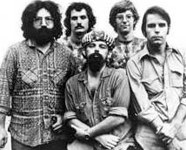
Grateful Dead (1965)
Led by country and jazz-influenced guitarist Jerry Garcia (1942-1995), with Ron “Pigpen” McKernan, Phil Lesh, Mickey Hart (drums), Bill Kreutzmann, and Bob Weir (guitar)
Pioneered transition from urban folk to folk rock to acid rock
Members from diverse backgrounds
Garcia: country/folk music
Lesh: Classical, avant-garde electronic music
Hart: world music, percussion
McKernan: blues
The Dead, 1971

Slide 9
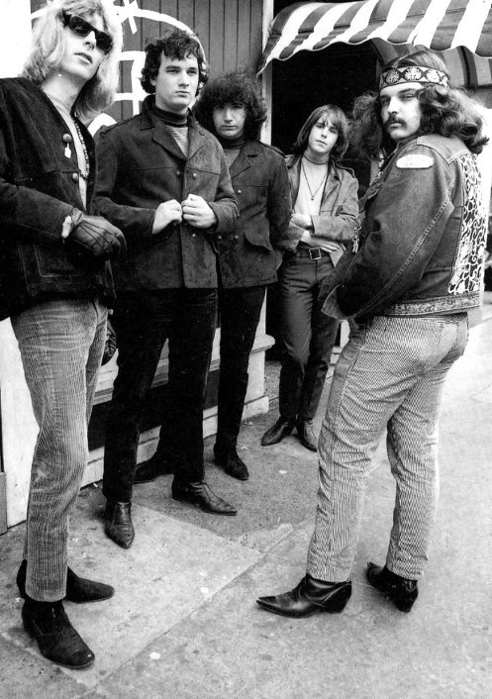
Deadheads and the Jam Band Aesthetic
During the 60s, the band lived in an old Victorian house near the corner of Haight and Ashbury and often played live, spontaneous jams in Golden Gate Park.
Their best album of the period, Workingman’s Dead (1970) featured folk and country style ballads
Known for live performances and long jams
Became a unique musical institution with devoted fans, known as Deadheads, who followed them and recorded every concert
Their fans would make them the most popular live act in the history of rock and roll.
In honor of their longevity, the following video splices together seven videos of live performances of “Truckin’” from 1972–1991

Slide 10
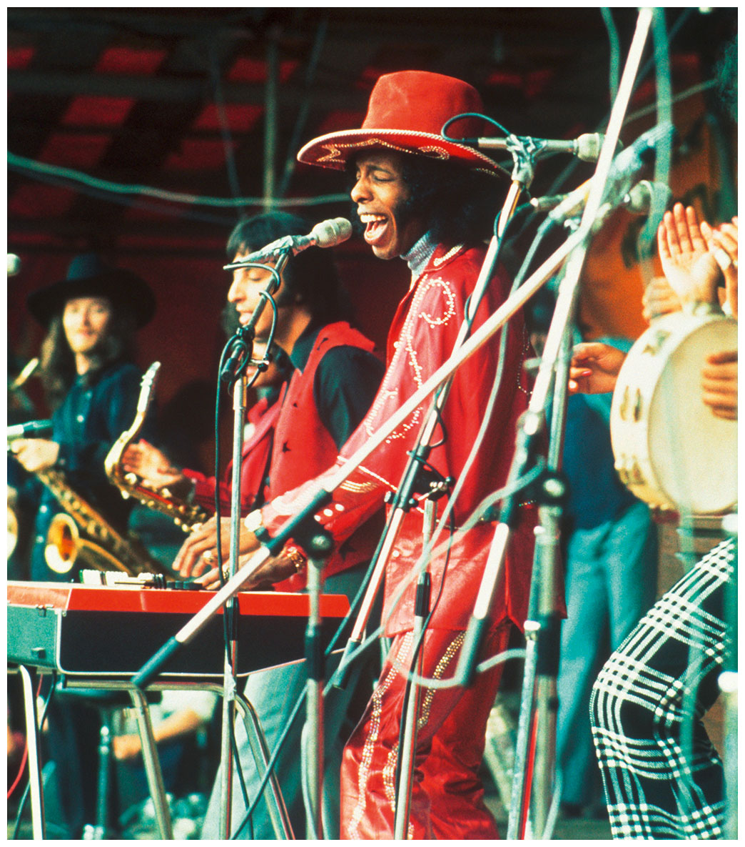
Sly and the Family Stone (1968–83)
Sly Stone (born Stewart) began his career at the age of four as a gospel singer, becoming a San Francisco DJ in 1964
Studied trumpet, music theory, and composition in college
Formed the Stoners, which became the Family Stone (included 2 siblings), multi-racial, blending jazz, soul, psychedelia, and folk rock
“Everyday People” first #1 hit, from 4th album Stand! (1969)
Recorded a series of his albums and songs between 1968 and 1971 with Sly and the Family Stone

Slide 11
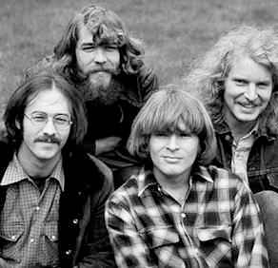
Creedence Clearwater Revival (1968)
Led by John Fogerty from El Cerrito, who joined with his brother Tom and two high school friends,; after band name and personnel changes became CCR in 1968
Most popular rock band in America 1969-70, first widely-successful “root” rock’n’roll band (deliberately old-fashioned)
String of top 10 hits (one of the great singles bands):
Bad Moon Rising
Down on the Corner
Proud Mary (famous cover by Tina Turner)
Fortunate Son (about the draft)
Positioned themselves as southern rock stylists despite Bay Area origins
Rock music flavored with country/rockabilly guitar fills
Country-influenced lyrics, but blues rock vocal style
Often two-beat style beat, like honky-tonk

