Slide 1
Atlantic Records, STAX, FAME
Rise of Soul

Slide 2
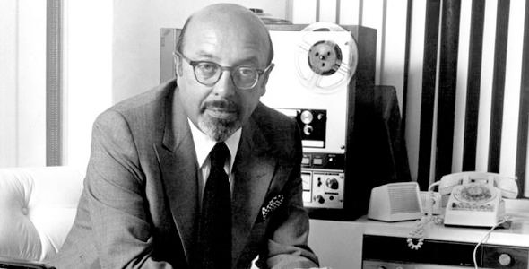
Founding of Atlantic Records
One of the most consistently successful companies in music
Founded by Ahmet Ertegun and his original partner Herb Abramson , later producer Jerry Wexler as a third partner
Ertegun, son of the Turkish Ambassador to the United States, set u Atlantic in 1947, started releasing jazz records in 1948.
Stick McGhee's 'Drinkin' Wine Spo-De-O-Dee' in 1949, a major R&B hit, which launched Atlantic into R&B
Hard to record blues in New York City in the late 1940's, but jump blues emerged

Slide 3
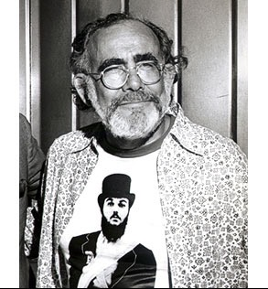
Atlantic in the 1950s
Ray Charles came aboard in 1952
Wexler and Ertegun co-produced practically all the records from '53 to about '58 or '59
Contracted in 1956, Jerry Leiber and Mike Stoller brought the Coasters
In 1956, Ahmet's brother Nesuhi joined the company to explore LPs and handle jazz.
Between 1956 and 1960, Atlantic had 84 hits in the Hot 100.

Slide 4
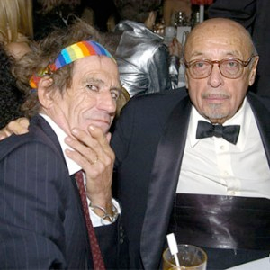
Atlantic in the 1960s
Developed a working relationship with Memphis’s Stax Records and Muscle Shoals, Alabama's Fame Records, sending Wilson Pickett and Aretha Franklin there to record.
Atlantic started signing rock acts in the 1960s, including Sonny and Cher (1965), Cream, the Bee Gees, Led Zeppelin and Buffalo Springfield
Ertegun offered the Rolling Stones a production and distribution deal for their own label.
The principals at Atlantic sold the company to Warner/Seven Arts in 1972.
But little else changed at Atlantic in the seventies

Slide 5
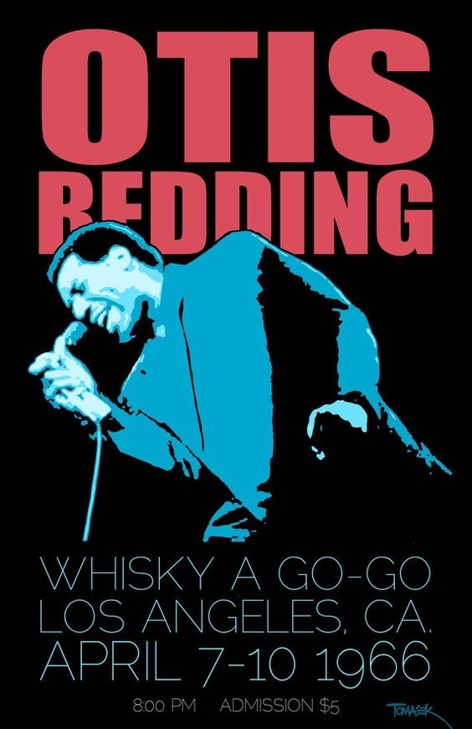
Soul Music
Replaced term R&B in the mid 1960s
Soul equated with African-American pride
Continuation of R&B styles of the 1950s
Strong ties to gospel traditions
Big Names:
Ray Charles
Wilson Pickett
Otis Redding
Aretha Franklin
James Brown

Slide 6
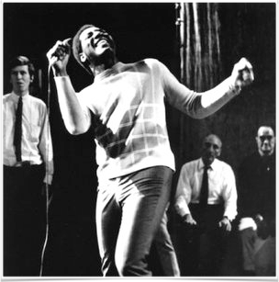
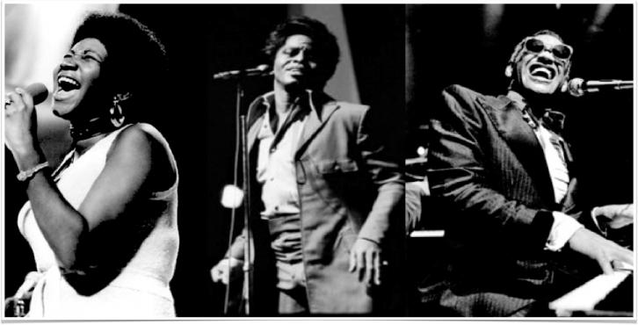
Soul Southern style
Heavily influenced by blues and gospel
Retains elements of R&B
Horn section
Tendency toward shuffle rhythms
Emotional, “attitude” songs
Otis Redding
Rougher, blues/gospel singing style of most performers
Aretha Franklin James Brown Ray Charles

Slide 7
Ray Charles (1930-2004)
Lost his sight at age of 7 but became the “Genius of soul,” the first important soul artist
First established his career in Seattle
Many R&B hits in 1950s, but no cross-over success until 1959 (“What’d I Say,” No. 6 on pop charts)
Roots in Gospel music and preaching style
Often just changed words to change a gospel song to an R&B song (This Little Light of Mine/This Little Girl of Mine)
Combined many different styles
R&B, Soul, Country, Tin Pan Alley, Blues, etc.
Full R&B band with horn section

Slide 8
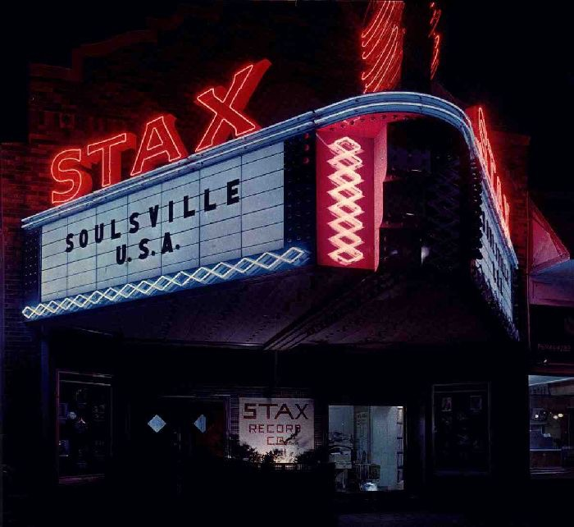
Stax/volt Records, Memphis TN
Stax Records was the birthplace of soul music in the 1960’s. Founded by brother and sister Jim STewart and Estelle AXton, Stax captured the southern soul market.
Distributed by Atlantic Records, recorded numerous Atlantic artists
House band: Booker T. and the MGs
Racially integrated rhythm section
Wilson Pickett
Midnight Hour
Otis Redding: The King of Soul
(Sitting on the) Dock of the Bay

Slide 9
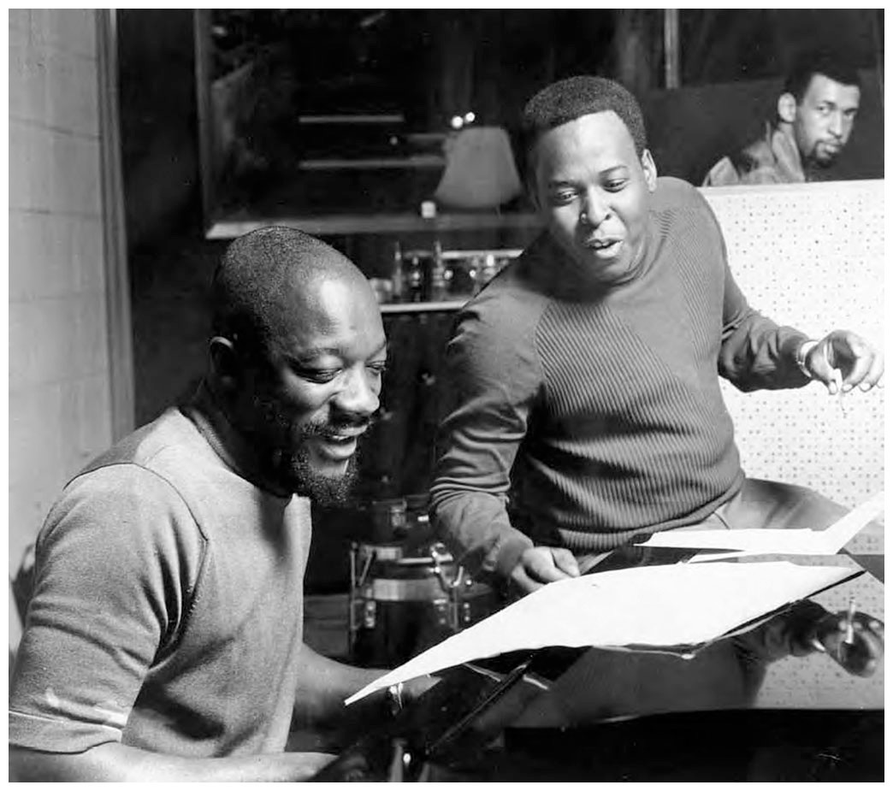
Soulsville, U.S.A.
House writers included the duo Isaac Hayes and David Porter Isaac Hayes became an extremely successful solo artist in the 1970s
Unlike Motown’s written-down arrangements, the Stax house band, Booker T and the MG’s used head arrangements (skeletal outlines with only chords and melody).
Co-owner Al Bell shepherded STAX after Atlantic Records dumped them, took the company to the top in the late 1960s/early 1970s, before it went bankrupt in 1975.

Slide 10
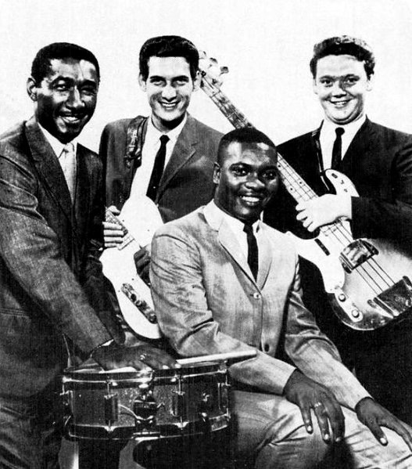
Booker T. and the MGs
Integrated band
Booker T. Jones (keyboards), African-American
Al Jackson (drums) African-American
Donald “Duck” Dunn (bass)
Steve Cropper (guitar) white
Memphis Horns - all white
Stressed electric guitar, active bass lines, horn lines
Heavy use of the delayed back-beat and honking horns became a STAX signature.

Slide 11
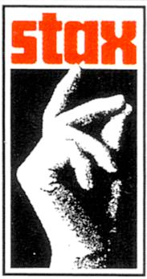
Comparison Between Motown and Stax
“Hitsville”
Black owned
All black performers
Aimed at white audience
Top-down decisions
Songs by professional songwriters, prepared arrangements
“Soulsville”
White owned (at first)
Integrated
Aimed at R&B audience
Collaborative
Songs by performers and songwriters, arranged during sessions

Slide 12
Producer/composer most important
Smooth, refined pop sound
Complex textures
Wall of Sound
Often straight 4 rhythm
Clean, crisp rhythms
Orchestral instrument backing
Performer most important
Rawer, blues-gospel sound
Simpler textures
Horn/rhythm sections
Pulsating “funky” rhythms
Songs have an improvised feel

Slide 13
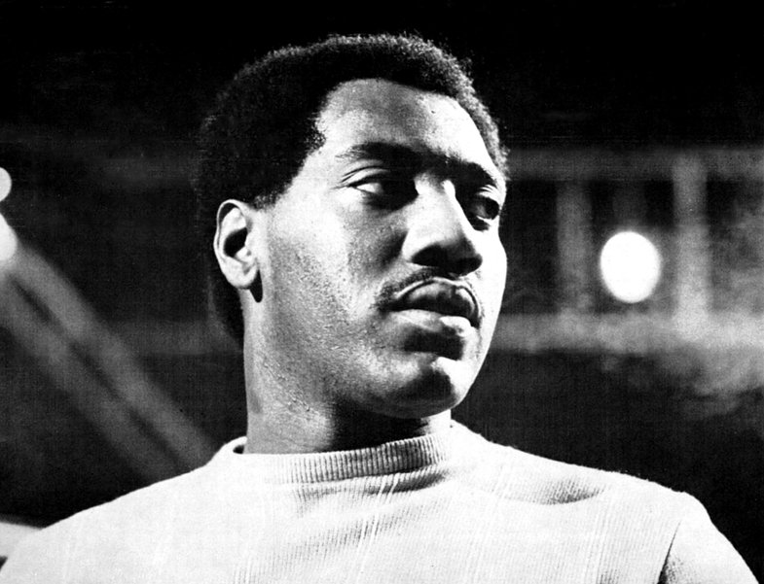
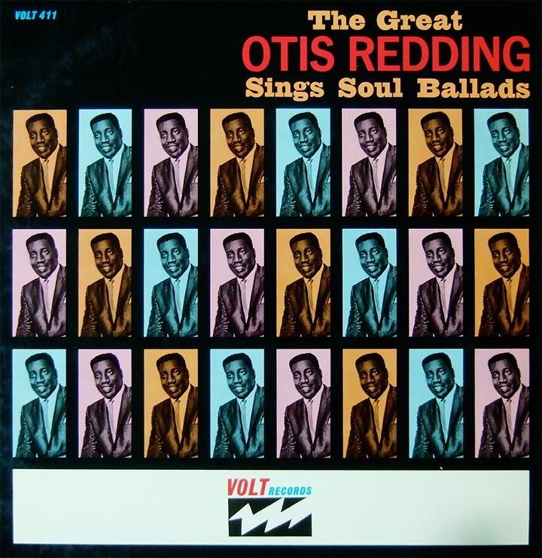
Otis Redding (1941-1967)
Started career as backup singer for Little Richard
Commanded wide variety of styles
Soulful ballads like Percy Sledge
Blues/gospel fusion
Gritty tone
Impassioned style
Breakout performance at Monterey Pop
Killed in plane crash later that year
Posthumously “Sitting on the Dock of the Bay” becomes a huge crossover hit

Slide 14
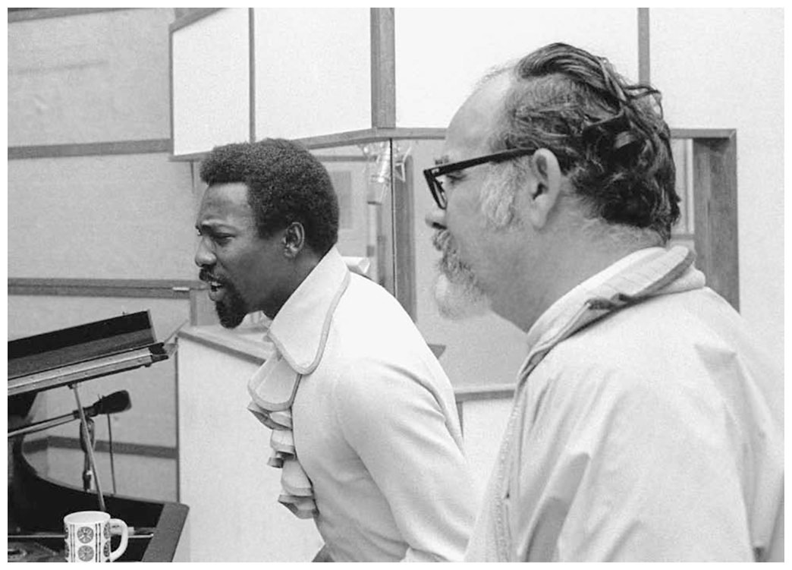
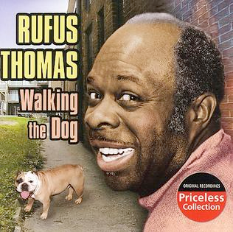
Other Major Stax Artists
Isaac Hayes
Songwriter/producer for Stax
Theme from Shaft won Grammy, Oscar for best song
Wilson Pickett - “In The Midnight Hour,” also records at Fame in Muscle Shoals
Sam and Dave (Sam Moore and Dave Prater)
Rufus Thomas, “Walking the Dog”

Slide 15
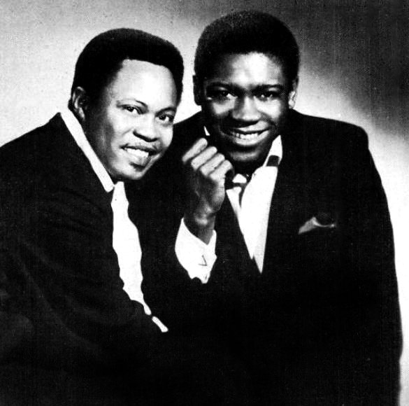
SAM AND DAVE “SOUL MAN”, HAYES & PORTER
Certain similarities to Motown sound
Riff-based, verse and refrain, end-weighted
Differences
More gospel-influenced vocal
Not a “story song” - about attitude
Groove
eight beat rock rhythm in bass line
back beat in tambourine (refrain) or drums (verse)
horn riffs
double time guitar riff

Slide 16
Fame Studio, Muscle Shoals, AL
Rick Hall founder
Muscle Shoals Sound Rhythm Section
All White group
Recorded several artists for Atlantic Records
Etta James
Percy Sledge
“When A Man Loves a Woman”
Wilson Pickett
“Mustang Sally”
Aretha Franklin
“Respect”

