Slide 1
From Blues to Rock
The British Blues Revival and the Rolling Stones

Slide 2
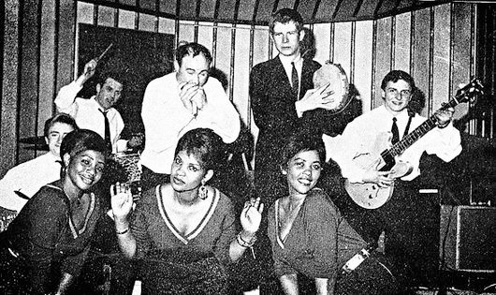
British Blues Revival
Bands and musicians include
Cyril Davies and Alexis Korner, Blues Incorporated
The Rolling Stones
Long John Baldry
Ginger Baker and Jack Bruce (later Cream)
John Mayall and the Bluesbreakers
Yardbirds
Manfred Mann
Pretty Things
Spencer Davis Group
Eric Burdon and the Animals
Fleetwood Mac
Savoy Brown
Ten Year After
Led Zeppelin
Skiffle & Trad players attracted to “deep blues” (country and country-influenced blues); R&B
Blues clubs open throughout England
British bands begin focusing on blues repertoire
Begin with relatively straight cover versions of Chicago blues
Eventually yields new rock styles: hard rock, blues rock, heavy metal
Cyril Davies and Alexis Korner,
Godfathers of the British blues scene

Slide 3
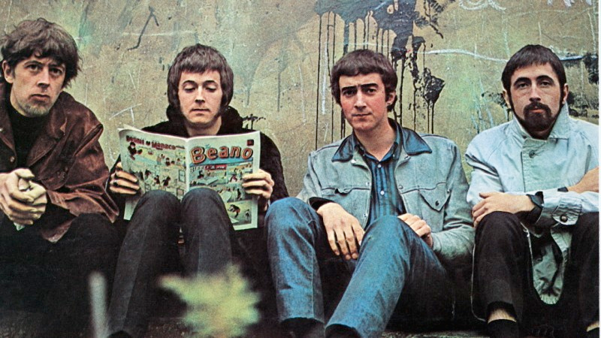
Blues Influence on hard rock
Primacy of the guitar
Guitar tone colors and techniques expand
Overdriven guitar = “snarling” hard rock sound
Improvisation
Extended, improvised solos become important part of rock
Vocal style
Rough, harsh growl of blues singers
Using entire voice, not just refined “singing” voice
Blue notes, groans, moans, and shouts
John Mayall’s Bluesbreakers
with Eric Clapton

Slide 4
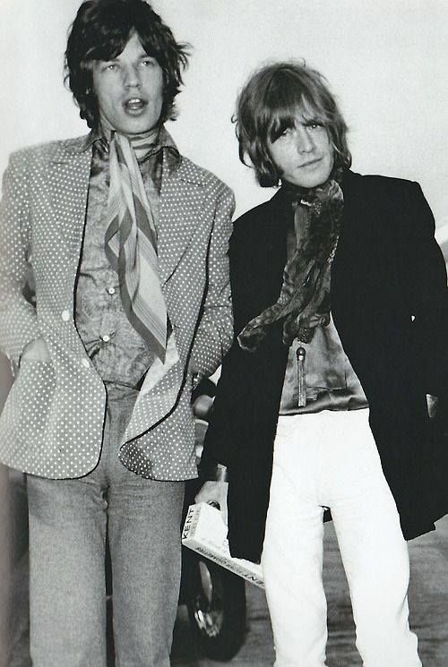
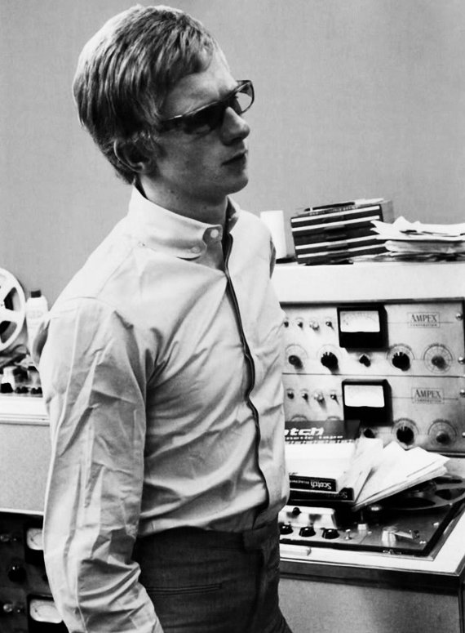
The Rolling Stones (1962)
Keith Richard, guitar, Charlie Watts, drums, Brian Jones, guitar, sitar, etc., Bill Wyman, bass, and Mick Jagger, vocals
Keith and Mick childhood friends who reconnected in college
Left original band Blue Boys to join up with Brian Jones’ band
Name from Muddy Waters song
Original intent: blues band with some Chuck Berry and Bo Diddley
Hook up with Bill Wyman in ’62, Charlie Watts in ’63
Seminal gig at the Crawdaddy Club in Richmond part of the swinging London scene
Manager Andrew Loog Oldham shapes into “anti-Beatles”
non-conforming rebels, “scruffy,” aggressive manner
Mick Jagger and Brian Jones
Andrew Loog Oldham

Slide 5
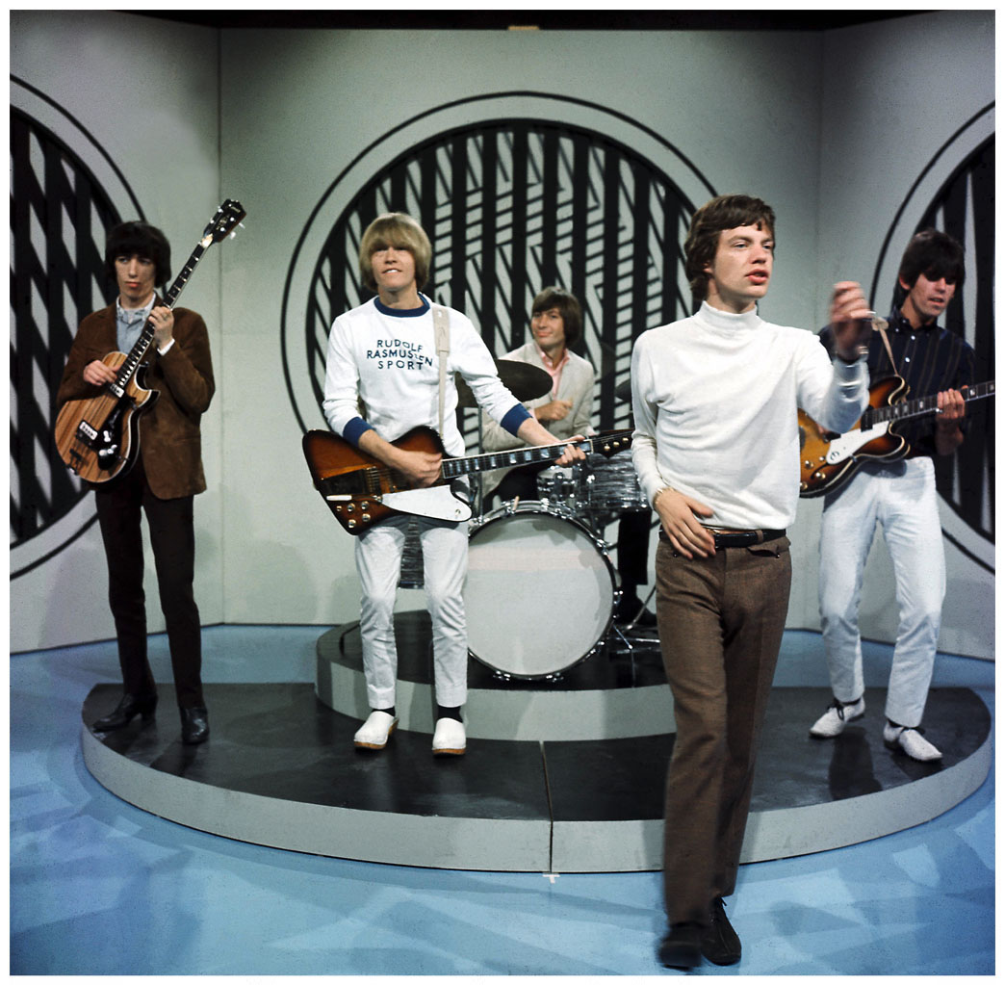
Rolling Stones - early style
Dense textures, low registers in all instruments
Hard, yet precise, drumming
Riff-based style, laden with power chords
Prominent, often distorted guitar
Majority of songs based on altered 12-bar blues progressions
First hit in England - cover of Chuck Berry's “Come On”
Second - “I Wanna Be Your Man,” by Lennon/McCartney

Slide 6
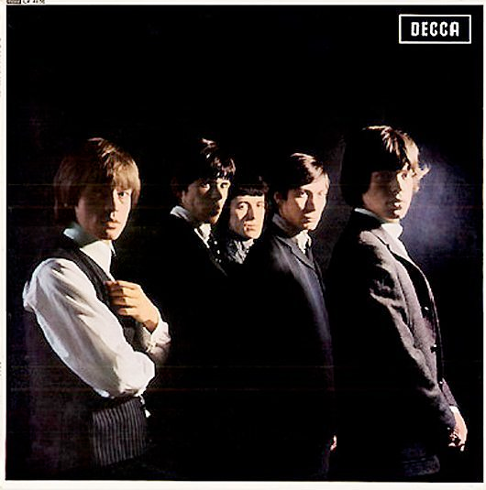
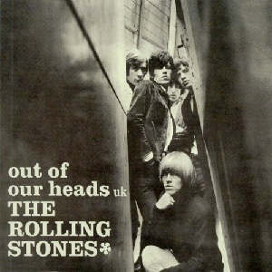
1964–1965
Three record deal with Decca, great terms
First record The Rolling Stones: England's Newest Hit Makers 1964 mostly covers;
only one Jagger/Richards original
“Route 66” (Pop Standard)
“I Just Want to Make Love to You” (Willie Dixon, Chicago Blues)
“Honest I Do” (Jimmy Reed, Chicago Blues)
“Mona (I Need You Baby)” (Bo Diddley)
“Now I've Got a Witness,” Nanker Phelge*
“Little by Little,” Nanker Phelge*
“I'm a King Bee” (Slim Harpo, Chicago Blues)
“Carol “(Chuck Berry)
“Tell Me (You're Coming Back)” Jagger/Richards Original
“Can I Get a Witness” (Holland-Dozier-Holland, Motown)
“You Can Make It If You Try” (Ted Jarrett, Rhythm and Blues)
“Walking the Dog” (Rufus Thomas, Rhythm and Blues)
(Nanker Phelge*) was a collective pseudonym used in 1963–
1965 for group compositions.
More LPs released in the US than UK; each release had a few more Jagger/Richards originals
The Rolling Stones No. 2 (UK, 1965), 12x5 (US, 1965)
The Rolling Stones Now! (US, 1965)
Out of Our Heads (1965); only US had “Satisfaction” (4 Jagger/Richards originals)

Slide 7
(I Can’t Get No) Satisfaction (1965), first US #1
Circular feel
Avoids tonic pitch in riff, vocals
Hook – word “Satisfaction,” largely avoided
Replaced with riff or drum break
“Endless loop”
Regular but irregular form
Verse and refrain, but not really a refrain
Verses same length, but phrases within verses of different lengths

Slide 8
(I Can’t Get No) Satisfaction
Fuzztone riff – distorted sound achieved by cutting through speaker cone
Interesting syncopation
X X X X X____ X X X X X
1 2 3 4 1 2 3 4
“Shuffle” eighth of riff against rock beat of bass, drum

Slide 9
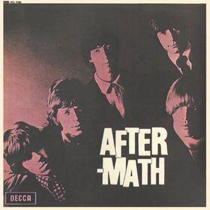
Aftermath (1966)
“Paint It Black,” “Stupid Girl,” “Lady Jane,” “Under My Thumb,” “Doncha Bother Me,” “Think,” “Flight 505,” “High And Dry,” “Its Not Easy,” “I Am Waiting, Going Home”
The first LP to consist entirely of Jagger/Richards compositions
Still blues-based, but forays into folk rock (Lady Jane)
Brian Jones plays sitar, dulcimer, koto, marimba
recorded entirely at RCA in California
One of the longest pop LPS to date

Slide 10
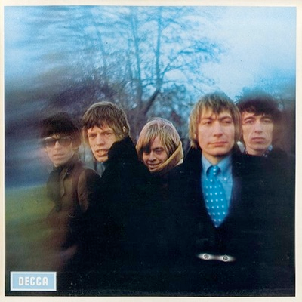
between the buttons (1967)
“Lets Spend The Night Together,” “Yesterday's Papers,” “Ruby Tuesday,” “Connection,” “She Smiled Sweetly,” “Cool Calm & Collected,” “All Sold Out,” “My Obsession,” “Who's Been Sleeping Here,” “Complicated,” “Miss Amanda Jones,” “Something Happened To Me Yesterday”
Beginnings of the Stones brief flirtation with psychedelia
Again recorded at RCA in Los Angeles during their American Tour, but finished in London
Pop Rock, folk rock, blues rock

Slide 11
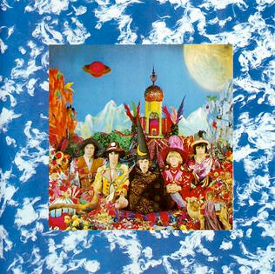
Their Satanic Majesties Request (1967)
The Stones’ attempt at a psychedelic answer to the Beatles Sgt. Pepper, but rather haphazard, put together in the midst of personal troubles
Widely reviled at the time, it looks better in retrospect
“Sing This All Together,” “Citadel,” “In Another Land,” “2000 Man,” “Sing This All Together,” “She's A Rainbow,” “The Lantern,” “Gomper, “2000 Light Years From Home,” “On With The Show”
jumping jack flash (single, 1968)
Widely praised as a return to blues roots, with a hard rock edge
Acoustic guitars in different tunings, but miked closely for distorted sound

Slide 12
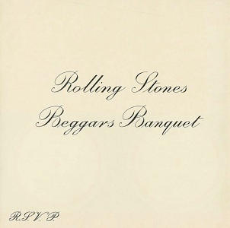
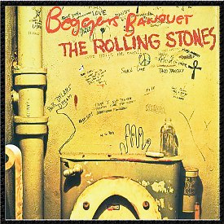
beggar’s banquet (1968)
“Sympathy For The Devil,” “No Expectations,” “Dear Doctor,” “Parachute Woman,” “Jig-Saw Puzzle,” “Street Fighting Man,” “Prodigal Son,” “Stray Cat Blues,” “Factory Girl,” “Salt of The Earth”
Brilliant roots-based music, great production
“Sympathy For The Devil” based on The Master and Margarita by Mikhail Bulgarov
Production of album captured by director Jean-Luc-Godard for film One plus One (released as Sympathy for the Devil)
Brian Jones second-to-last album
Original, banned cover

Slide 13
“Sympathy for the devil”
Section 3 – 25 bars
a I watched with glee Background vocals added While your kings and queens Fought for ten decades For the gods they made (woo woo, woo woo)
a I shouted out, "Who killed the Kennedys?" When after all It was you and me (who who, who who)
a Let me please introduce myself I'm a man of wealth and taste
a And I laid traps for troubadours Who get killed before they reached Bombay (woo woo, who who)
b Pleased to meet you ….
b
Intro – 10 bars
Section 1 – 25 bars
a Please allow me to introduce myself 4 bars Accompaniment: congas, I'm a man of wealth and taste maracas, piano, bass
a I've been around for a long, long years 4 bars Stole many a man's soul and faith
a And I was 'round when Jesus Christ 4 bars Bass line becomes more Had his moment of doubt and pain active
a Made damn sure that Pilate 5 bars Washed his hands and sealed his fate
+ one measure
b Pleased to meet you 4 bars Hope you guess my name
b But what's puzzling you 4 bars Is the nature of my game
Section 4 – 25 bars
Guitar solo – a a a a form, 17 measures long Full accompaniment
b Pleased to meet you Hope you guessed my name, oh yeah
b But what's confusing you Is just the nature of my game (woo woo, who who)
Section 5 – 25 Bars
a Just as every cop is a criminal Bass, piano at most active And all the sinners saints - Implied 16 beat rhythm
a As heads is tails + background vocals Just call me Lucifer 'Cause I'm in need of some restraint (who who, who who)
Section 2 – 25 bars
I stuck around St. Petersburg Bass and piano lines more
When I saw it was a time for a change active
Killed the czar and his ministers
Anastasia screamed in vain
I rode a tank
Held a general's rank
When the blitzkrieg raged
And the bodies stank + 1 bar
Pleased to meet you
Hope you guess my name, oh yeah
Ah, what's puzzling you
Is the nature of my game, oh yeah (woo woo, woo woo)
a So if you meet me Have some courtesy Have some sympathy, and some taste (woo woo)
a Use all your well-learned politesse Or I'll lay your soul to waste, um yeah (woo woo, woo woo)
b Pleased to meet you …….
What's my name Tell me, baby, what's my name Tell me, sweetie, what's my name
Outro
Woo, who
Oh yeah, get on down Oh yeah Oh yeah! (woo woo) Tell me baby, what's my name Tell me honey, can ya guess my name Tell me baby, what's my name I tell you one time, you're to blame Oh, who woo, woo ….. What's my name Tell me, baby, what's my name Tell me, sweetie, what's my name

Slide 14
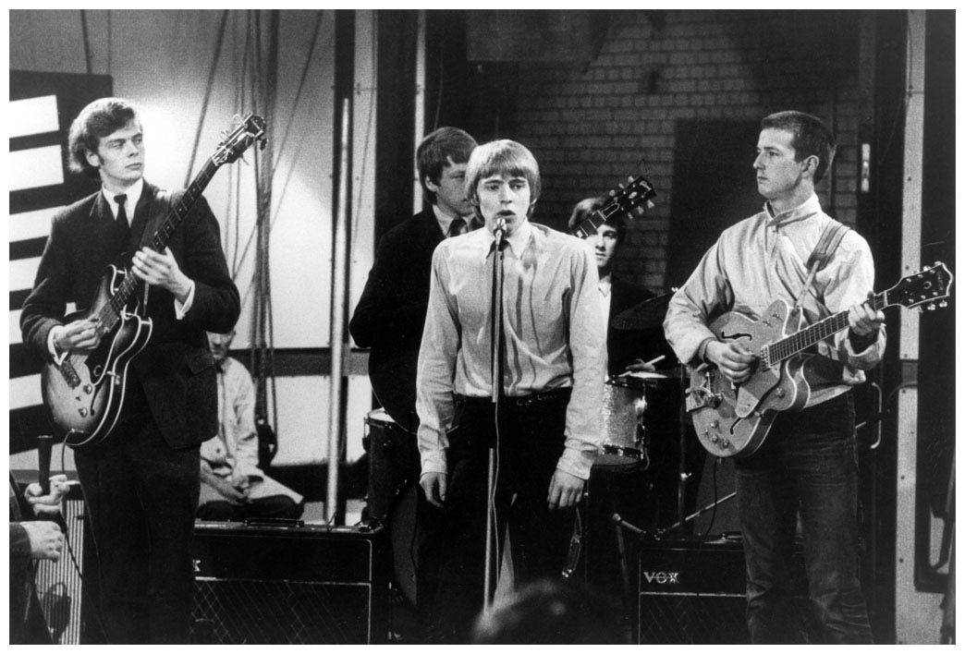
The Yardbirds (1963)
One of premiere blues-based bands
Hit single “For Your Love” moves toward psychedelic rock
Lead guitar player - Eric Clapton (b. 1945)
Replaced by Jeff Beck (1965-6), Jimmy Page (1966-8; briefly overlapped with Beck)
1965 Clapton leaves to join John Mayall and Blues Breakers
Soon becomes famous for his solos, “Clapton is God” meme
Other famous personnel include Mick Taylor (Brian Jones’ replacement in the Stones), Jack Bruce (Cream), John McVies & Mick Fleetwood (Fleetwood Mac)
Blues styled solos create “sound” of blues rock

Slide 15
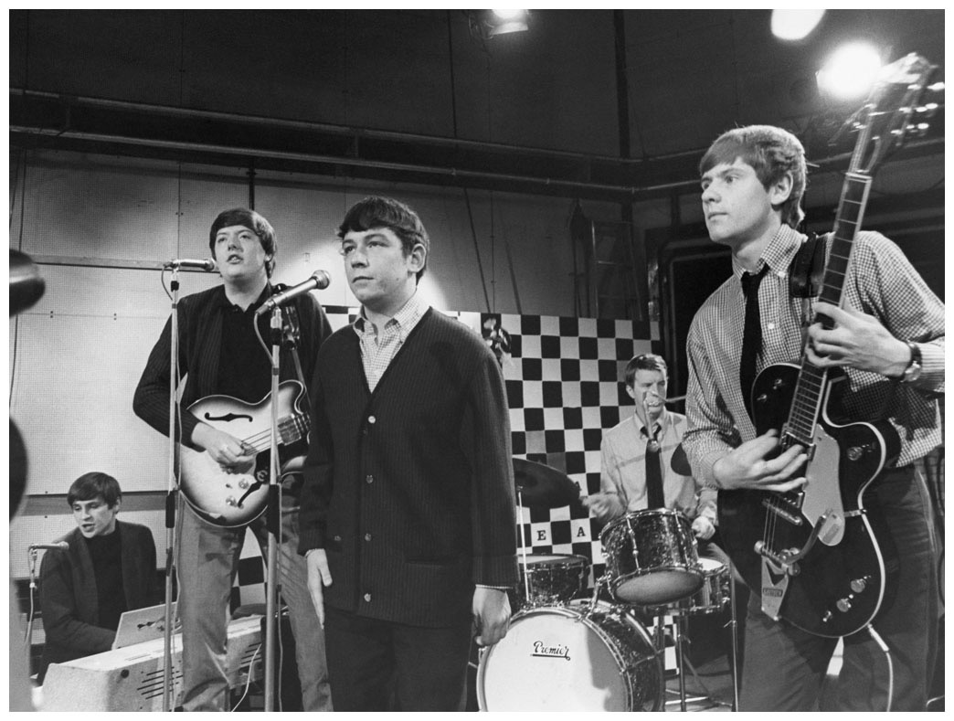
The Animals (1963?)
Blues-based, wrote originals in the style of traditional blues
Headed by organist and songwriter Alan Price, and featuring lead singer Eric Burdon, who had a deep, bluesy voice.
In 1964, had their biggest hit, “House of the Rising Sun”; other hits “We Gotta Get out of This Place,” “It's My Life,” “I'm Crying” and “Don't Let Me Be Misunderstood”
First lp The Animals (1964); many subsequent personnel changes

