Slide 1
“Beatlemania” 1963–65
Height of fame in England, conquest of U.S.
Albums
Please, Please Me (1st)
With the Beatles
Hard Days’ Night
Beatles for Sale
Help!
Singles
Please, Please Me
I Wanna Hold Your Hand
Love Me Do
Can’t Buy Me Love
Hard Days’ Night
Eight Days a Week

Slide 2
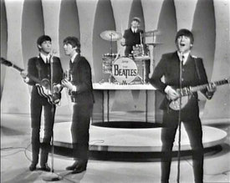
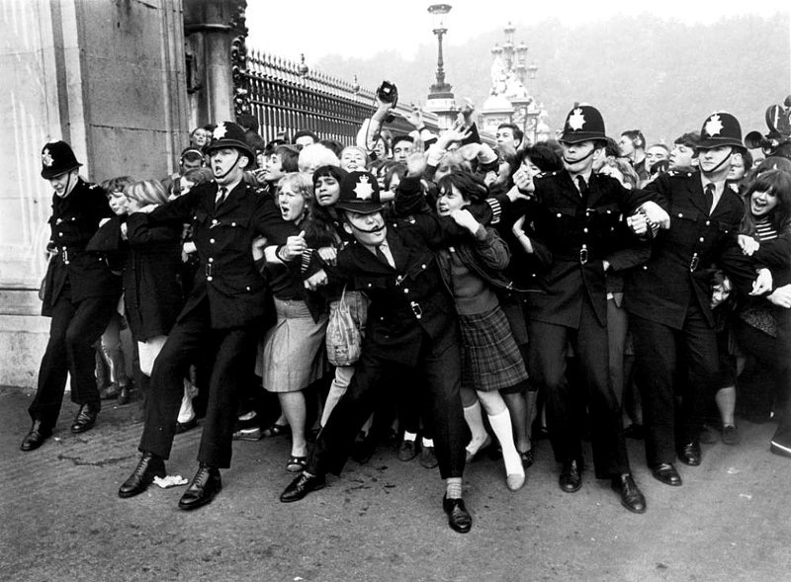
beatlemania
Beatles were already established stars in Europe by 1964 when they toured the United States
Mass adulation surrounding the group unique
American Beatlemania: The first time extreme adulation was bestowed on nonnative rock musicians
Beatles were the first important “group”
Each member of equal importance
Each member played at least one instrument and wrote songs

Slide 3
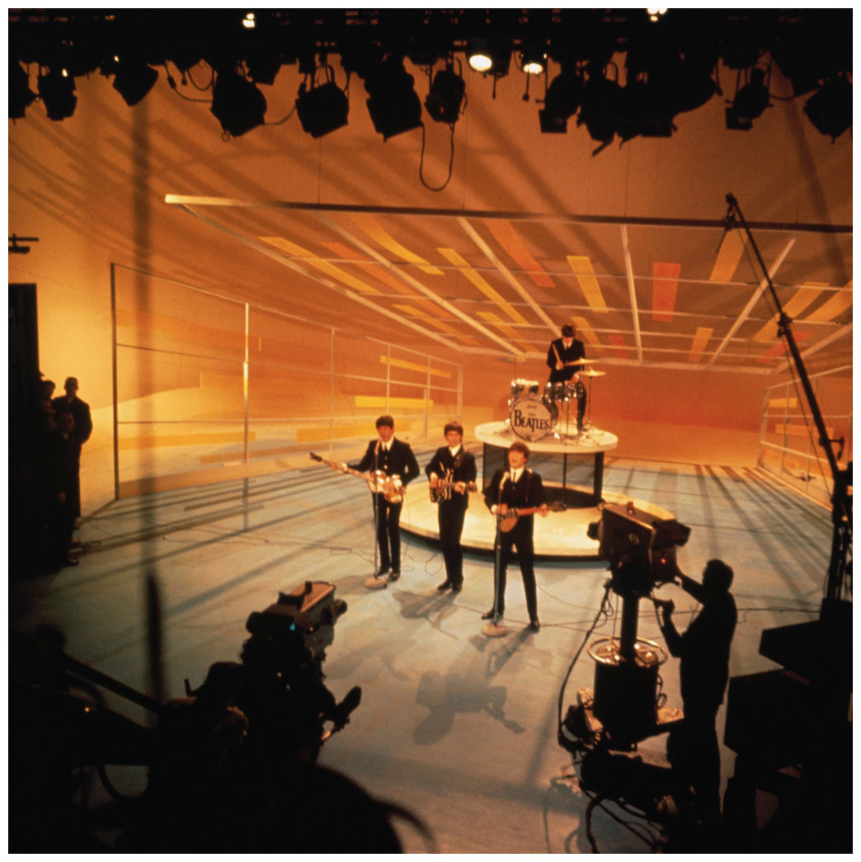
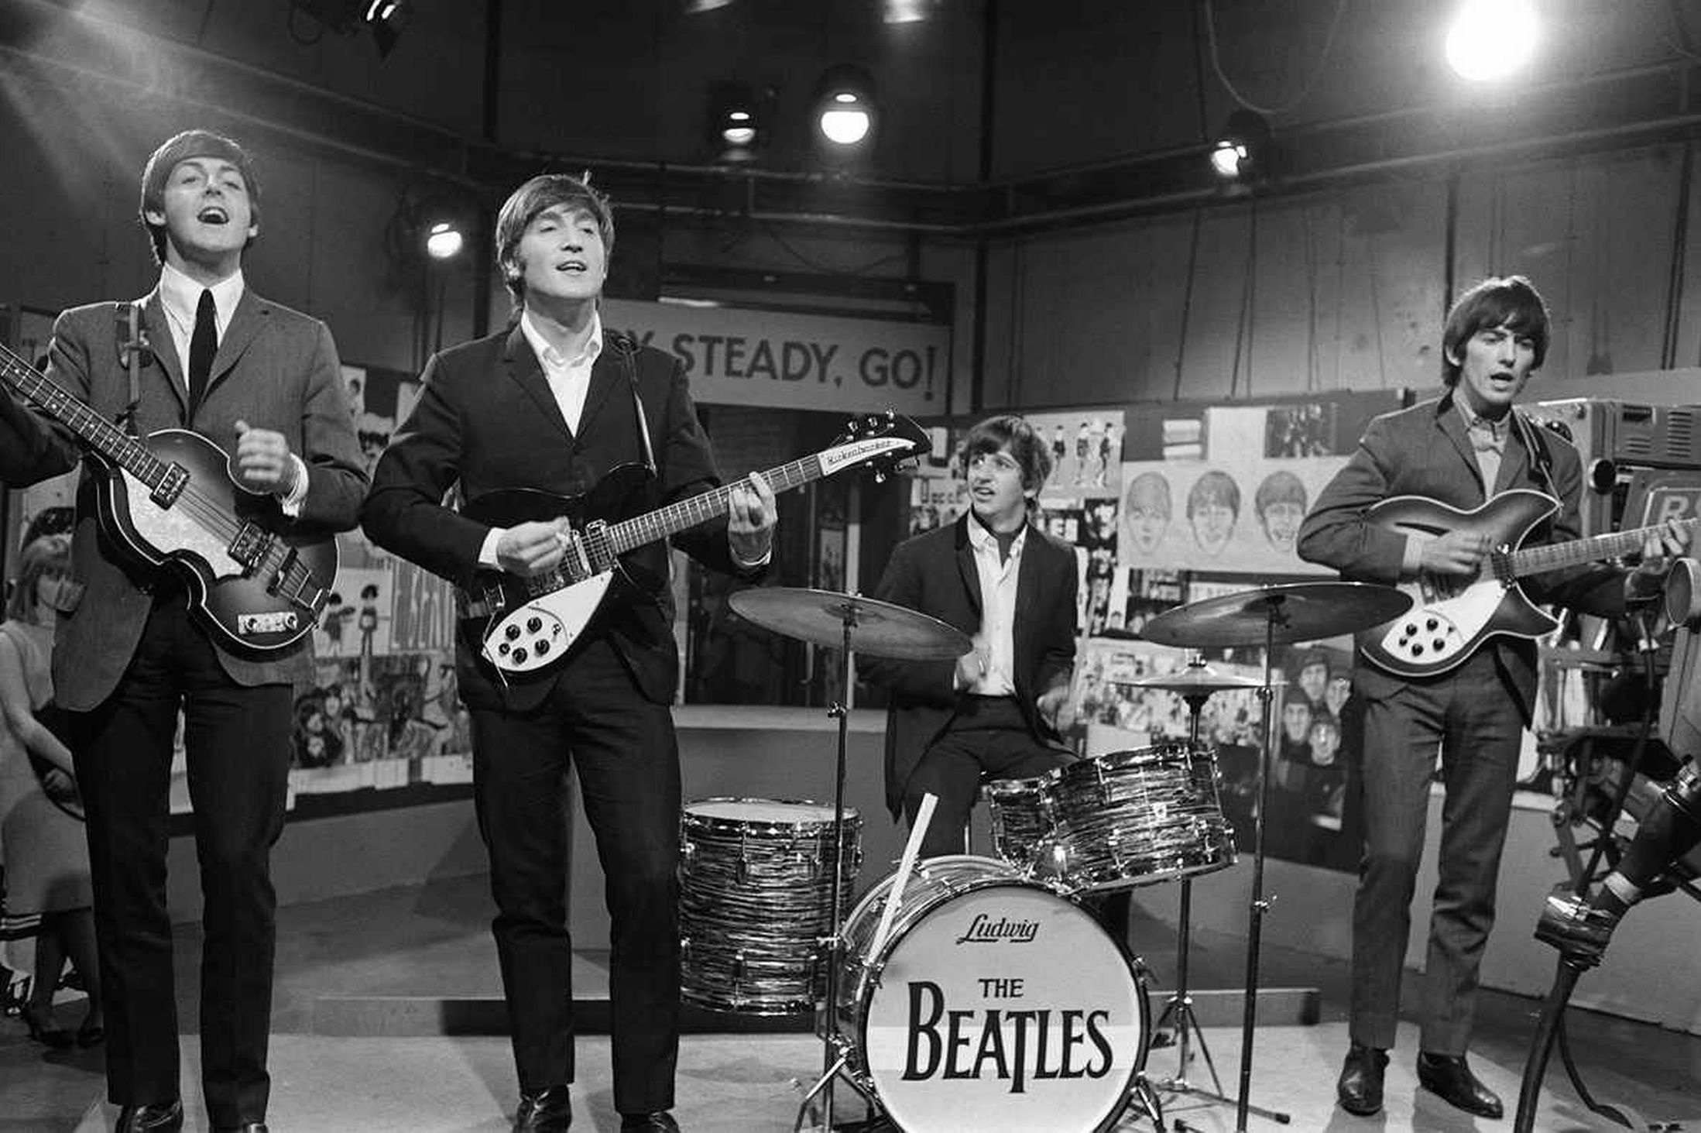
“Hard Day’s Night” (1964)
Title song from the Beatles’ first movie
Title demonstrates clever wordplay
AABA form with references to blues form
Lyrics and form express themes of dissonance resolving to consonance

Slide 4
1965
The Beatles’ film debut, A Hard Day’s Night was a “complete success.”
The soundtrack to Help! (1965) also reached the top of the charts.
Rubber Soul, their first album of all original material established Lennon and McCartney as the preeminent songwriting team of their generation.

Slide 5
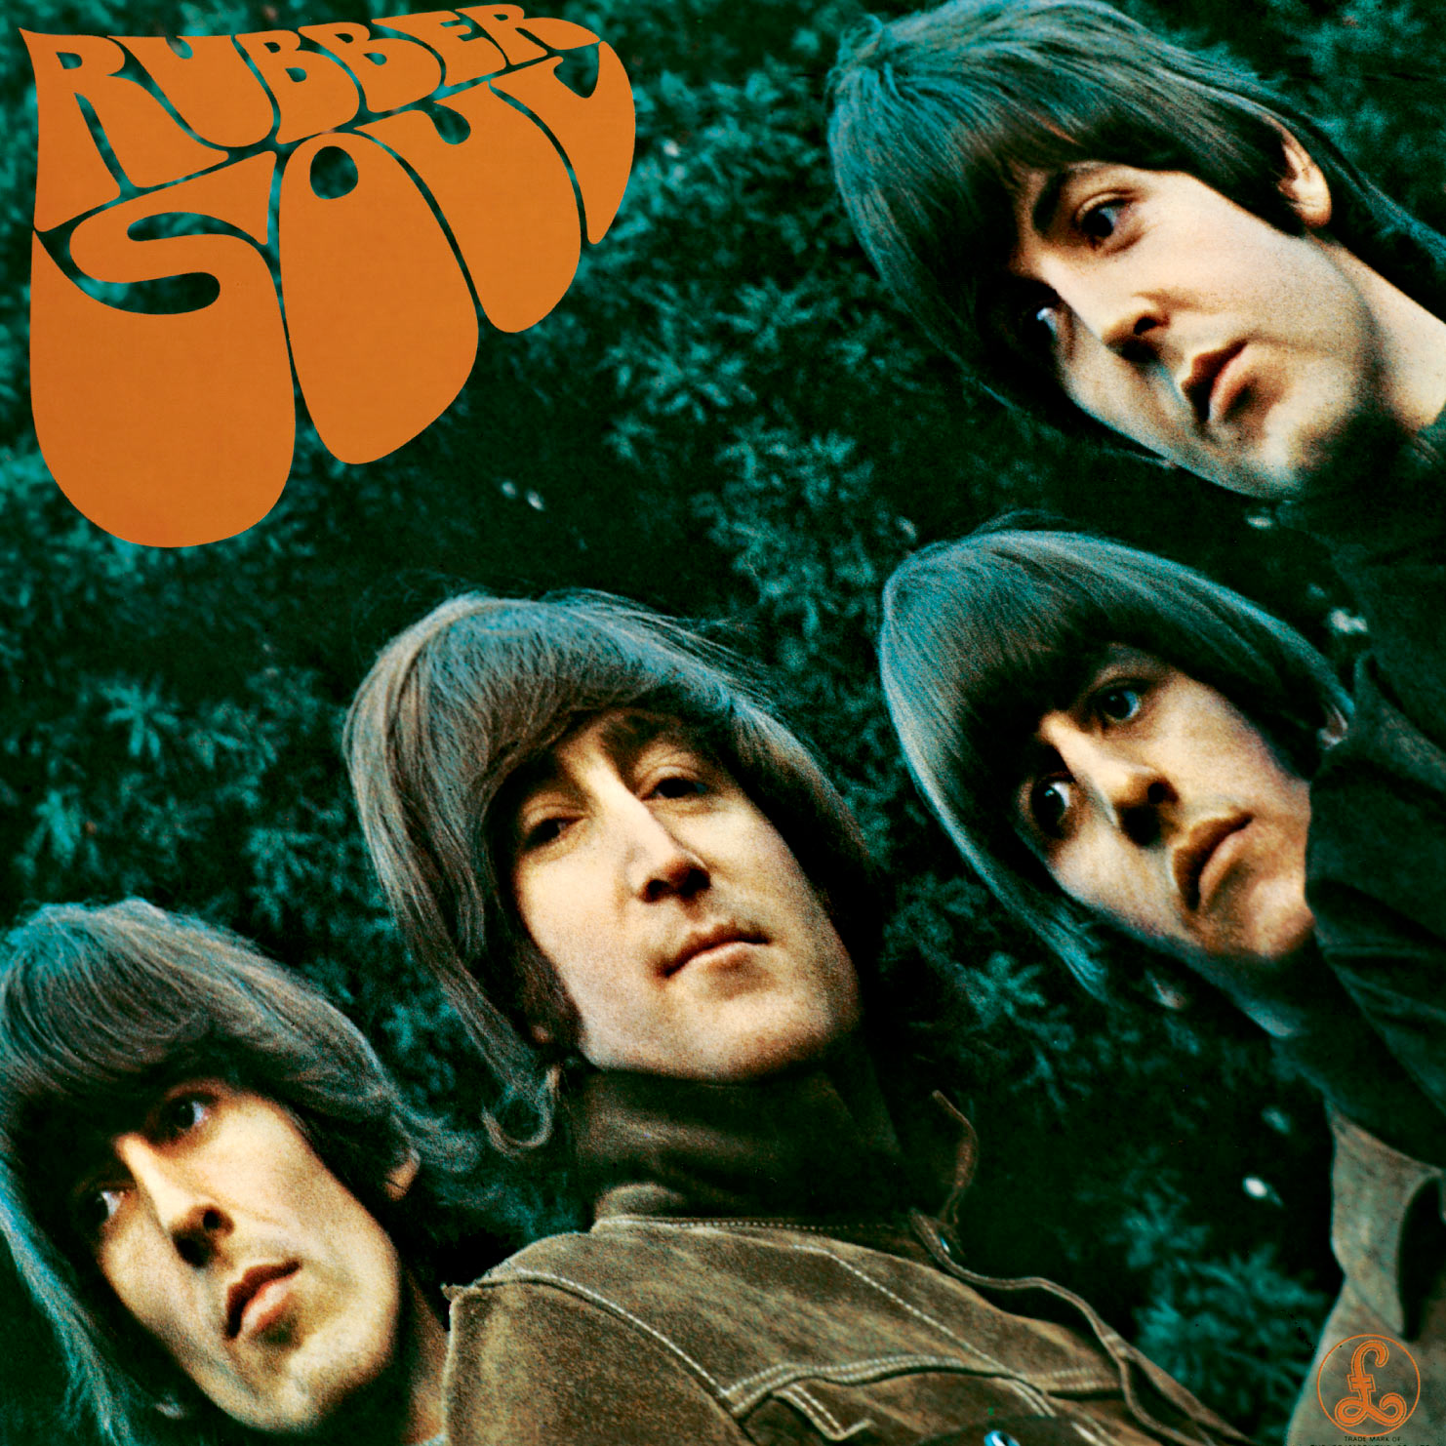
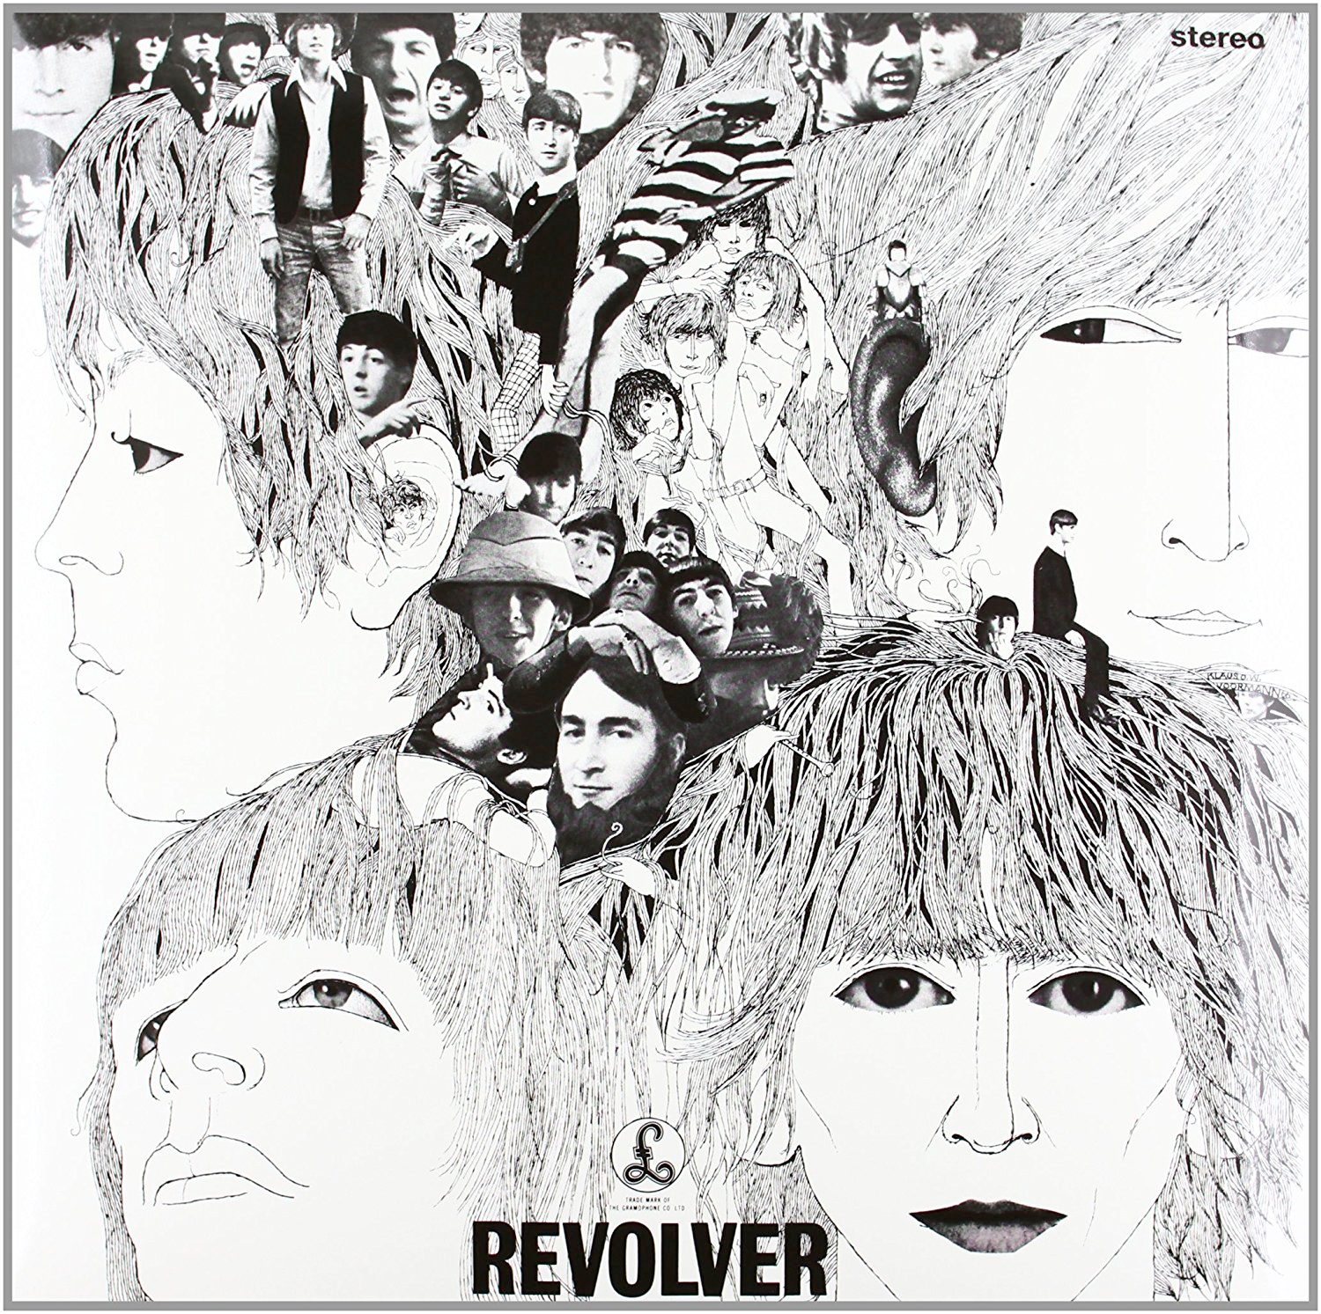
Dylan-inspired seriousness (or Mature period) 1965-66
Albums
Rubber Soul
Revolver
Singles
“We Can Work It Out”
“Day Tripper”
“Paperback writer”
“Yellow Submarine”
“Eleanor Rigby”
Lyrics more personal, literary, some veiled political commentary
Drug-influenced songs, lyrics
Greater familiarity with American culture
Expanded palate of tone colors
Sitar, orchestral instruments
Different guitars used for different effects
Willingness to depart from traditional rock ensemble
More complex harmonically

Slide 6
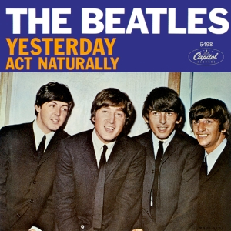
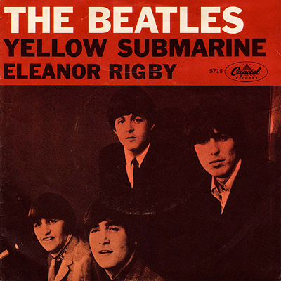
“Yesterday” (1965)
Wide-ranging and enduringly popular
Evokes Tin Pan Alley models
AABA form
Theme of broken romance
Distinctive and expressive melody
Influence of crooning on McCartney’s singing
“Eleanor Rigby” (1966)
Accompanied by a string quartet
Alternates between unrelated major and minor chords
Philosophical look at loneliness
Verse/chorus form suggests the influence of folk ballads
Incorporates uneven phrase lengths reflecting the theme of incompleteness

Slide 7
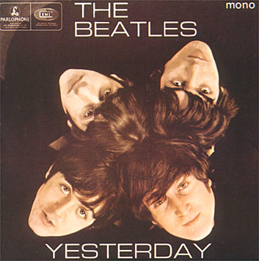
“drive my car” Rubber soul, oct. 1965
Bass-heavy sound an influence of American R&B
McCartney’s solo in a rock vein
Two-chord funk riff in the verse
Chorus contains piano-driven jazz-style key modulations.
Very syncopated intro
Form:
Intro | Verse | Refrain | Verse (solo) | Refrain | Verse | Refrain | Outro (fade-out)

Slide 8
“drive my car” Rubber soul: D major or G major?
Intro
Verse
Refrain
Verse (solo)
Refrain
Verse
Refrain
Outro (fade-out)
------ 2X -------
|b |G |
G: iii I
|b |e A |D G |A |
iii vi
D: ii V I IV V
------ 2X -------
|b |G |
G: iii I
|b |e A |D G |A |
iii vi
D: ii V I IV V
& |1 & 2 & 3 & 4 & |1 & 2 & 3 & 4 & ||Verse ...
» »
Guitar: A |C D C A F - C D |- D C - C - D - ||
Bass: | A C D D | ||D ...
Drums:| | Fill ---- Cymbals!
------ 3X -------
|D |G |a |- D |
D: I IV ii I
G: V
------ 2X -------
|b |G |
G: iii I
|b |e A |D G |A |
iii vi
D: ii V I IV V
------ 3X -------
|D |G |a |- D |
D: I IV ii I
G: V
------ 3X -------
|D |G |a |- D |
D: I IV ii I
G: V
Asked a girl what she wanted to be
She said baby, "Can't you see
I wanna be famous, a star on the screen
But you can do something in between"
Baby you can drive my car
Yes I'm gonna be a star
Baby you can drive my car
And maybe I love you
Beep beep-m beep beep yeah
I told a girl that my prospects were good
And she said baby, it's understood
Working for peanuts is all very fine
But I can show you a better time
I told a girl I can start right away
And she said listen babe I got something to say
I got no car and it's breaking my heart
But I've found a driver and that's a start
Baby you can drive my car
Yes I'm gonna be a star
Baby you can drive my car
And maybe I love you
Beep beep-m beep beep yeah
Baby you can drive my car
Yes I'm gonna be a star
Baby you can drive my car
And maybe I love you
Beep beep-m beep beep yeah

Slide 9
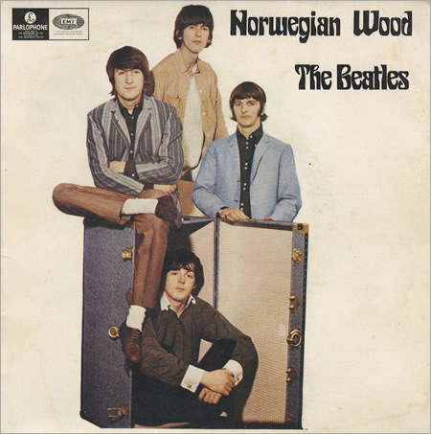
Norwegian Wood, rubber soul
Slow waltz – 3 beats per measure
Pop vocal style
Folk-like
Thin texture
Sitar joins guitar
Modal, not tonal, orientation
Different pattern of half and whole steps
Lacks harmonic direction, drive of blues

Slide 10
Norwegian Wood
A Instrumental – guitar
A Instrumental – sitar + guitar
A I once had a girl, or should I say, she once had me.
A She showed me her room, isn't it good Norwegian wood?
B She asked me to stay and she told me to sit anywhere,
B’ So I looked around and I noticed there wasn't a chair.
A I sat on a rug, biding my time, drinking her wine.
A We talked until two and then she said, "It's time for
bed".
A Sitar + guitar
A Sitar + guitar
B She told me she worked in the morning and started to laugh.
B I told her I didn't and crawled off to sleep in the bath.
A And when I awoke I was alone, this bird had flown.
A So I lit a fire, isn't it good, Norwegian wood.
A Sitar + guitar

Slide 12
1966-1969
Controversy & Sgt. Pepper

Slide 13
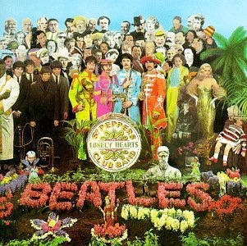
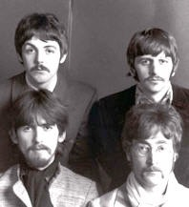
Retire from live performance
Controversy surrounding Lennon’s statement “Christianity will go … We’re more popular than Jesus now…” (1966)
The Beatles in 1967
July 1967 Sgt. Pepper’s Lonely Hearts Club Band, one of the most influential albums of the decade.
Influenced by Beach Boys, Pet Sounds
Result of Brian Wilson’s focus on song writing, producing
Beatles decide to devote their energy to recording.
In 1968 their manager Brian Epstein, who had held the group together as a creative unit, died

Slide 14
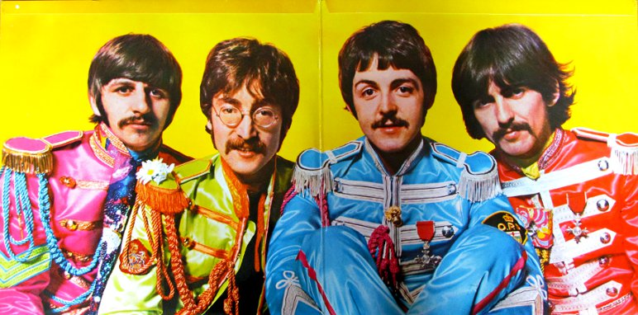
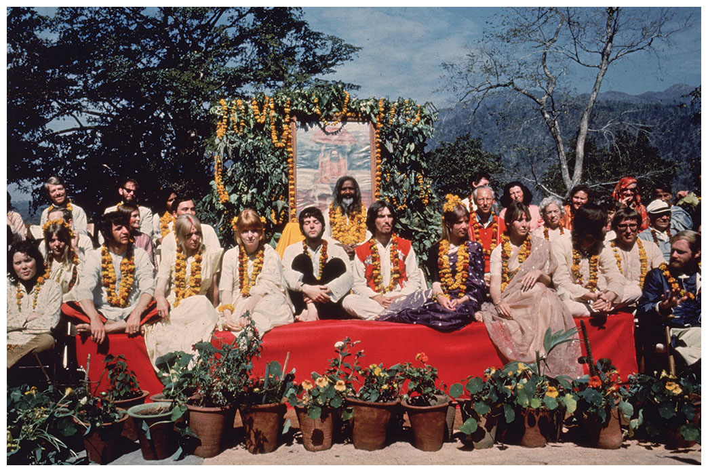
Beatles’ Psychedelic style
Experimentalism
Creating new sounds, effects
New styles, forms, methods of composition
Surrealistic/psychedelic lyrics, often from impersonal sources
Album takes precedence over singles
Singles viewed as separate entities
Abandonment of traditional roles in band
“concept album” – songs arranged around central concept or story
“Frame” created by song Sgt. Pepper’s Lonely Hearts Club band and reprise (melody, with different words, recurs)
Highly produced

Slide 15
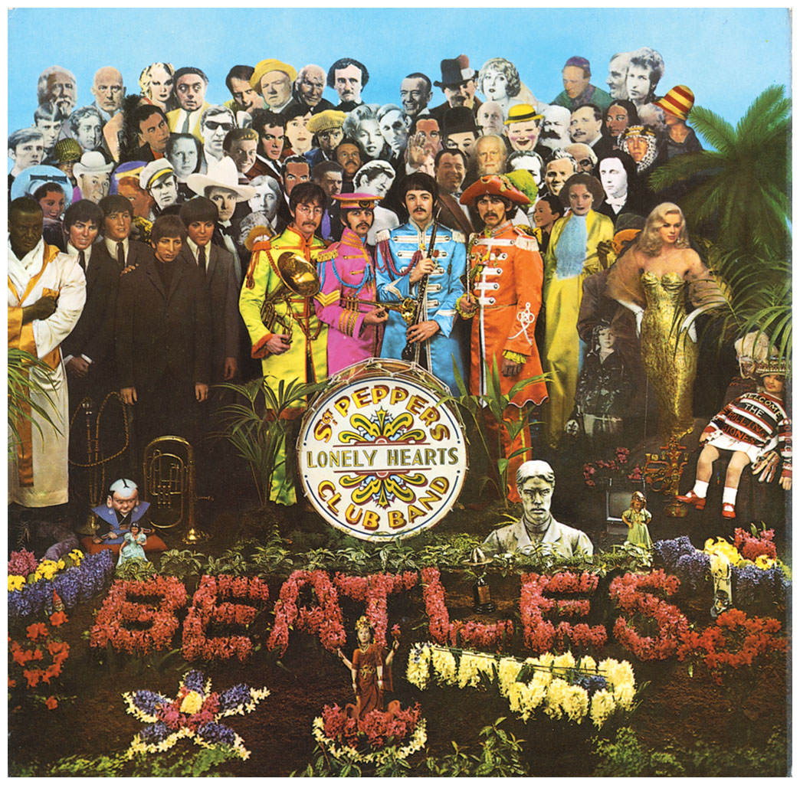
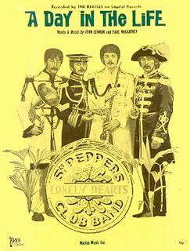
“A day in the life”, sgt. Pepper
First take: Lennon—piano, McCartney—Hammond organ, Harrison–acoustic guitar, Starr—congas
At the end of the second verse, "I'd love to turn you on", a 24-bar bridge.
Assistant Mal Evans' voice counting out the bars was treated with echo, and ended with the sound of an alarm clock to kick off McCartney's 8-bar section "Woke up, fell out of bed."
Orchestral parts influenced by avant-garde composers such as Karlheinz Stockhausen (on cover).
An extended, atonal crescendo over the bridge encouraged 40-piece orchestra to improvise within the bare bones score.
This semi-improvised segment recorded four times, on a separate four-track tape machine, and then overdubbed into a single massive crescendo.
The Beatles hosted the orchestral session as a 1960s-style happening, with famous guests
Orchestra players were asked to wear formal dress and then given fake noses, etc. to contrast (this was filmed but never released)
The song ends with one of the most famous final chords in music history, played on three different pianos and harmonium
The chord was made to ring out for over 40" by increasing the sound level as the vibration faded out.

Slide 16
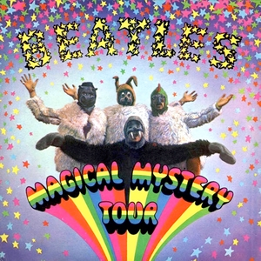
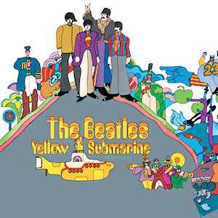
Beatles – Psychedelic period
Albums
Sgt. Pepper’s Lonely Hearts Club Band
Magical Mystery Tour (1967)
Yellow Submarine (released 1969, but characteristic of earlier period)
Singles
All You Need Is Love
Hello/Goodbye
I Am The Walrus
Strawberry Fields Forever
Penny Lane

Slide 17
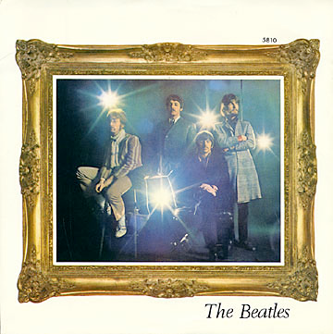
“penny lane,” magical mystery tour
Folk-Like with classical elements, but harder rocking than “Eleanor Rigby”
Pet Sounds-like orchestration
Piccolo trumpet both Bach-like and ironic
Matter-of-fact recitations and ominous bass notes rescue it from being overly-sweet
| Verse | Verse | Refrain |
| Verse | Verse (solo) | Refrain |
| Verse | Verse | Refrain |
| Refrain / Outro (with complete ending)

Slide 18
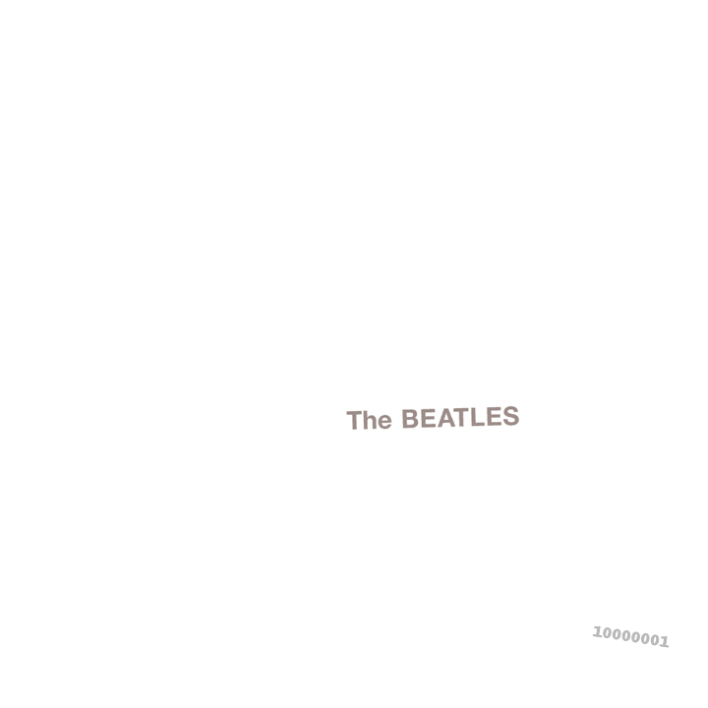
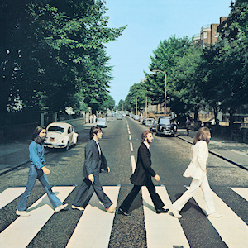
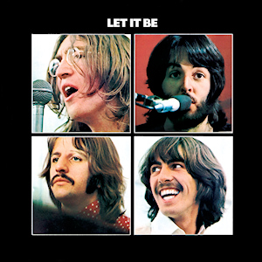
Return to Roots (1968-70)
Albums
The Beatles [aka The White Album, 1968]
Abbey Road (1969)
Let It Be (1970)
Singles
Revolution
Hey Jude
Get Back
Ballad of John and Yoko
Come Together
Lady Madonna
Something
The Long and Winding Road

