Slide 1
The British Invasion 2
From Mersey Beat to the Who

Slide 2
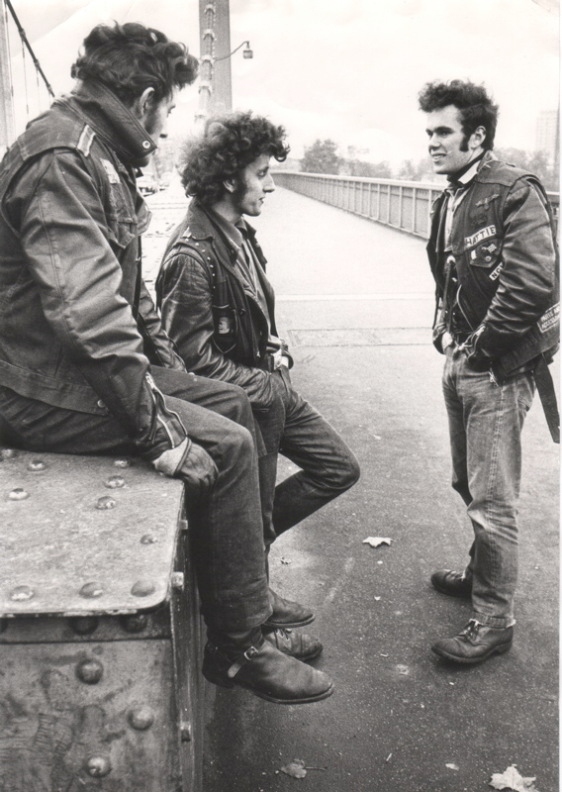
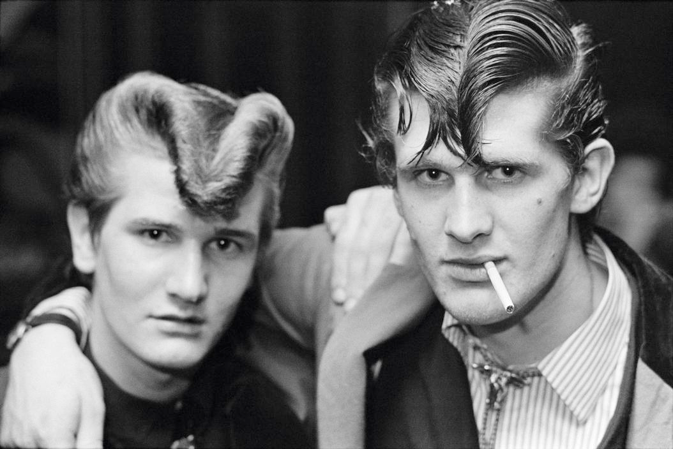
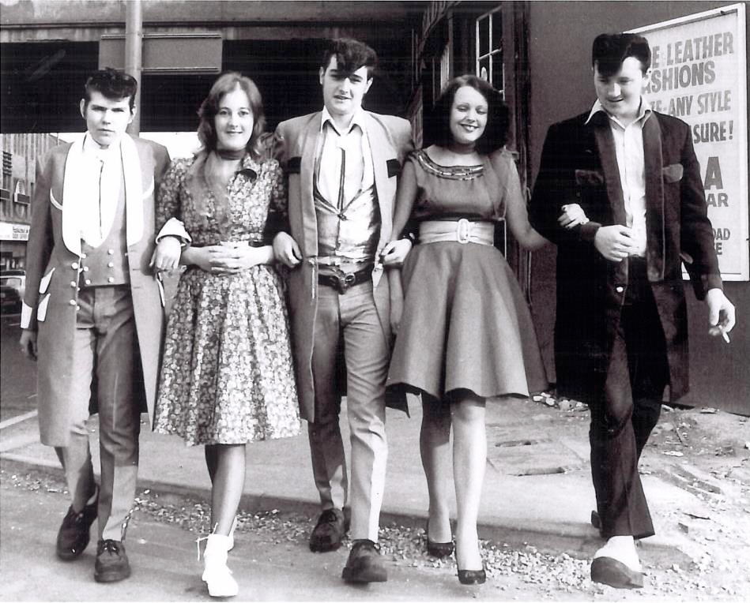
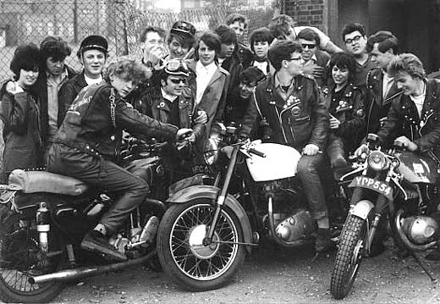
British Rock styles: Teddy boys
British Rock styles: Rockers
Rockers influenced by “Rebel without a Cause,” Marlon Brando: leather jackets, motorcycles, pompadour hair
Teddy Boys date before rock and roll to skiffle and jazz fans (ala Beatniks): “Neo-Edwardian” with fancy duck-tales

Slide 3
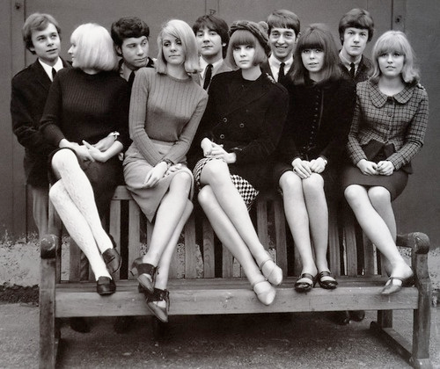
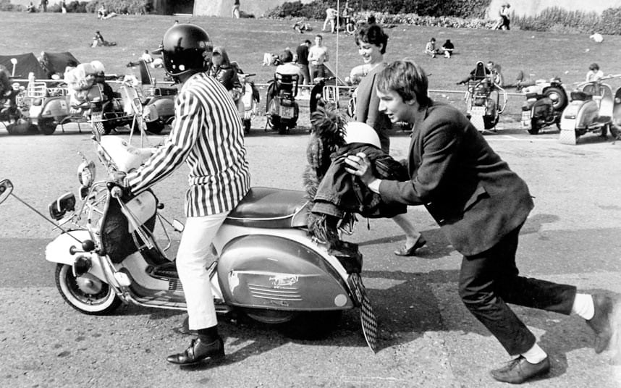
British Rock styles: mods
Opposed to Rockers: drove scooters, were into fashion and the latest bands, especially American soul music, wore suits
Various mods and rockers clashes caused a panic in 1964
Mods associated with London bands, especially the Who, who wrote their second rock opera about the mod lifestyle, Quadrophenia

Slide 4
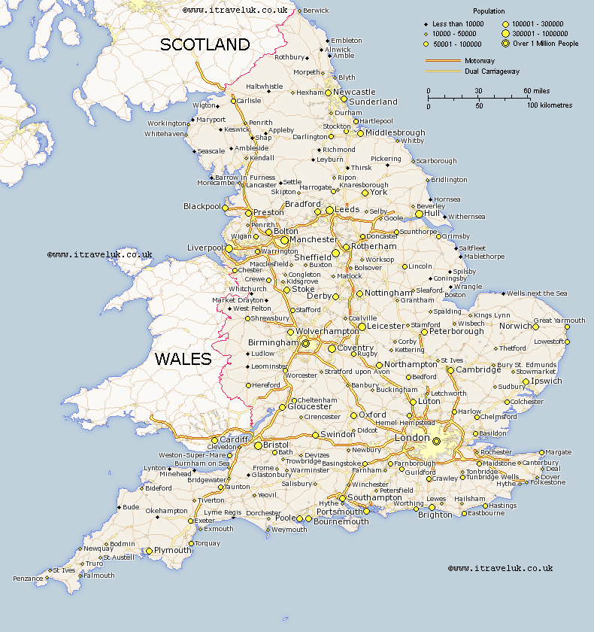
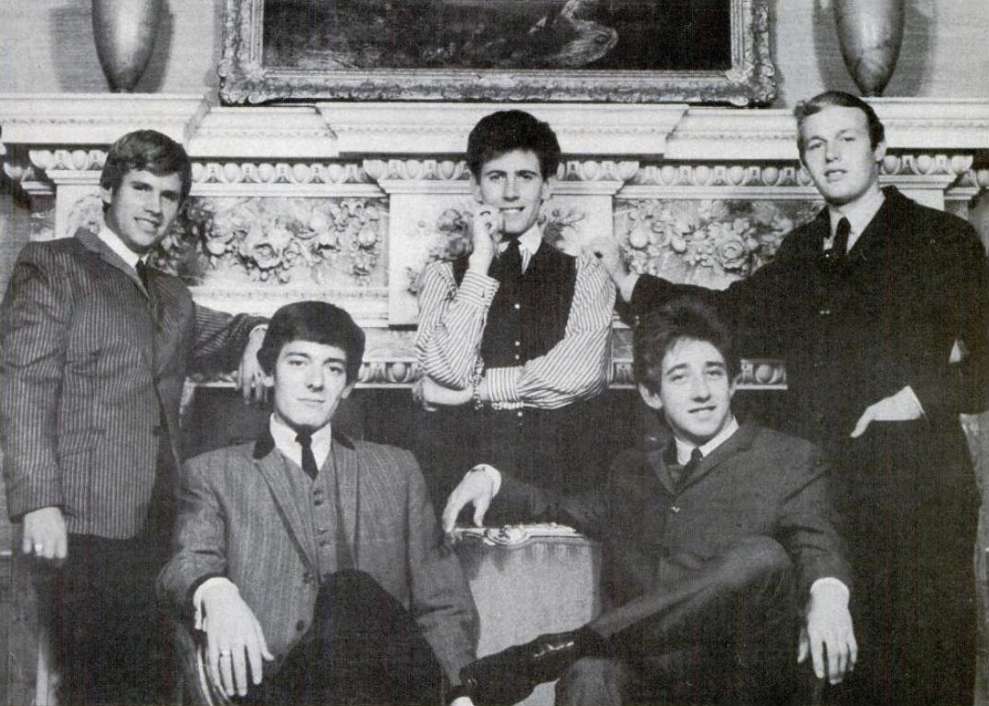
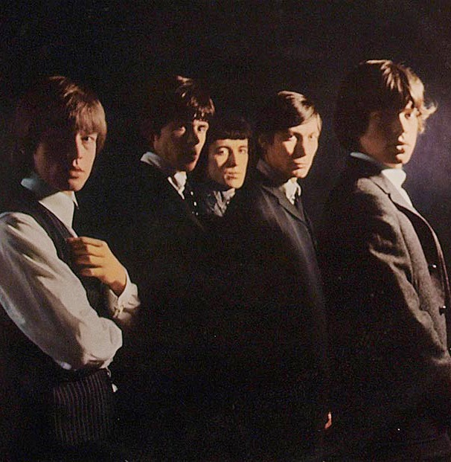
centers of U.K. rock in the 1960s
Van Morrison, Belfast,
Northern Ireland
The Hollies,
Manchester
The Beatles, Gerry and the Pacemakers,
Rory Storm and the Hurricanes, Peter and Gordon
Liverpool
The Rolling Stones, The Animals,
The Yardbirds, The Who
London

Slide 5
The Hollies (1962)
Known for their pioneering and distinctive
three-part vocal harmony style.
One of the leading British groups of the 1960s and into the mid 1970s.
Formed by Allan Clarke and Graham Nash in 1962 as a Merseybeat type music group in Manchester, Tony Hicks added banjo and other instruments
Graham Nash left the group in 1968 to form the supergroup Crosby, Stills & Nash.
“Bus Stop,” “Stop Stop Stop!” “Just One Look,” “Look Through Any Window,” “Carrie Anne,” “He Ain’t Heavy, He’s My Brother,” “Long Cool Woman in a Black Dress,” “The Air That I Breathe”

Slide 6
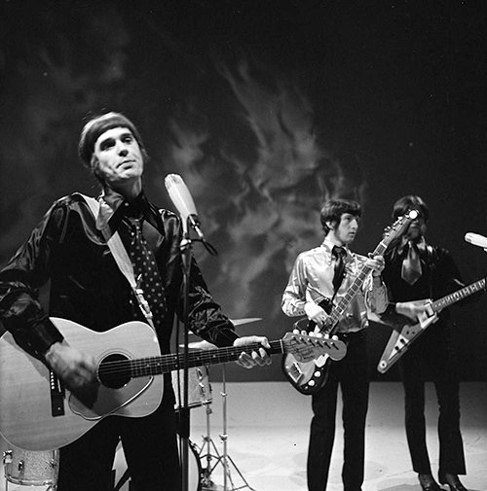
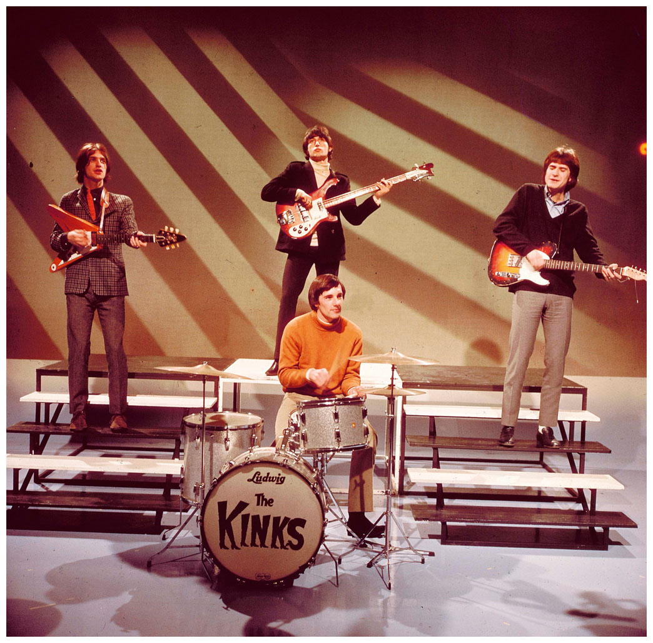
The kinks (1964)
Ray Davies, lead vocals and guitar; Dave Davies,
guitar, vocals; Peter Quaife, bass; Mick Amory, drums
At first one of the more aggressive of the London
bands. Angular guitar block chords, and blues inspired guitar solos, abrasive lead vocals, chant-like background vocals.
“You Really Got Me”, “All Day And All Of The Night”
Banned from touring the US in ’65, so didn’t hit here until the 1970s
Their music was influenced by a wide range of genres, including R&B, British music hall, folk and country. Many of their songs and concept albums reflected English culture and lifestyle, fuelled by Ray Davies' observational writing style
“Well-Respected Man”, “Sunny Afternoon”, ‘Waterlook Sunset,” and “Lola”

Slide 7
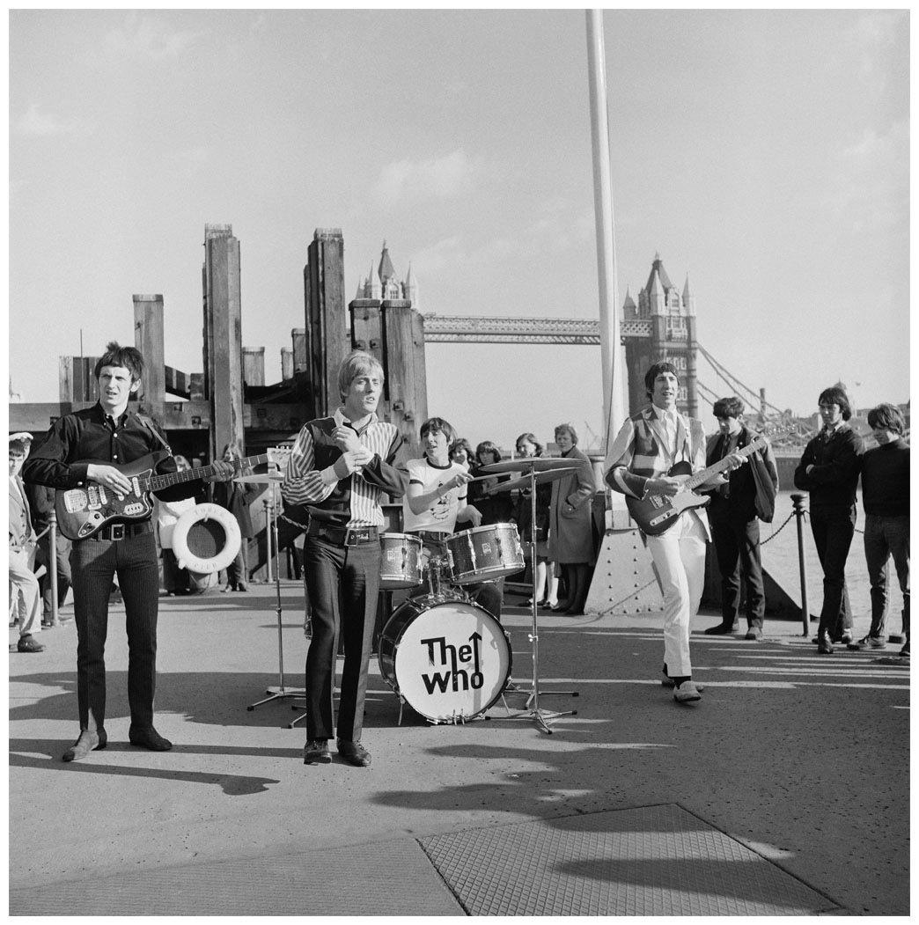
The who (1964)
Pete Townshend, guitar, vocals, Roger Daltrey, vocals, John Entwistle, bass; Keith Moon, drums
Led by Townshend and Daltry
The original Mod band, the Who were on the first groups to use “extramusical” means of creating stage excitement (trashing instruments, creating extreme feedback).
Pete Townshend experimented with his guitar, and with rock composition
Tommy, the first successful rock opera, was written in 1968.
Early hits include “My Generation”, “I Can’t Explain,” “Substitute”, “I Can See For Miles”

Slide 8
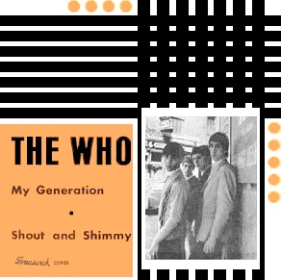
“My Generation,” pete townshend (1965)
Simple verse-refrain (4 bars repeated in later verses) Key keeps moving upward, from G–>A–>Bb–>C Stuttering mimics a frustrated kid, but also creates double-entendre “F-f-f-f-fade”
FORM:
Intro, 4 mm.
Verse and refrain, 20 mm.
Verse
Bass solo
Verse
Verse
Coda
People try to put us d-down (Talkin' 'bout my generation)
Just because we g-g-get around (Talkin' 'bout my generation)
Things they do look awful c-c-cold (Talkin' 'bout my generation)
I hope I die before I get old (Talkin' 'bout my generation baby)

