Slide 1
The Beatles
From Liverpool to the World

Slide 2
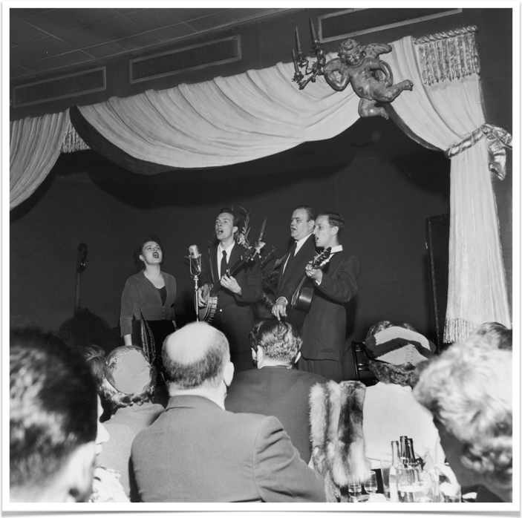
British Bands in the early 60s
Most English rock and roll stars manufactured idols like Cliff Richards
Teens (esp. guitarists) look to records of American blues, folk music
Merchant marines brought back American R&B, blues and rock’n’roll records
Sparks skiffle craze
Syncopated mixture of jazz, folk, and blues
Instrumentation cheap, easily accessible
Ex. Lonnie Donegan
Lonnie Donegan’s Skiffle group

Slide 3
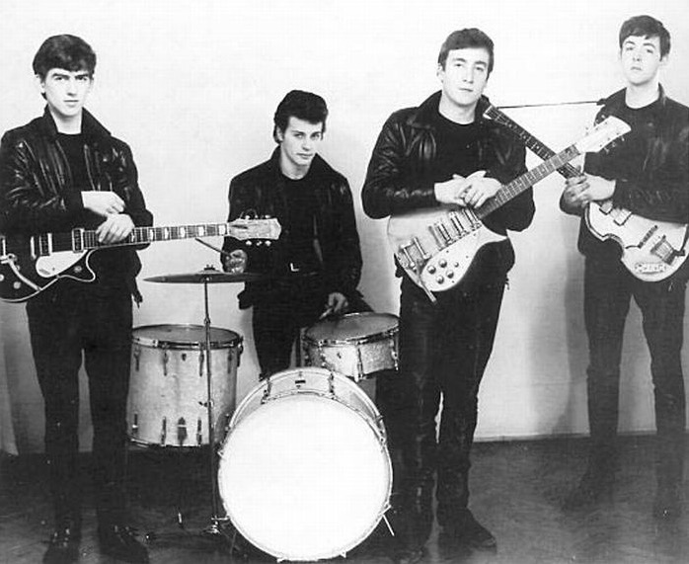
The Beatles and the British Invasion
Beatles audience identified with the band
Rock music became something performed by (not just for) middle-class youth
Represented not just a musical style but also a lifestyle
George Harrison, Pete Best, John
Lennon, Paul McCartney, 1961
Other British Invasion bands included the Who, the Rolling Stones, Gerry and the Pacemakers, Herman’s Hermits, Kinks, Peter and Gordon, the Animals, the Hollies, Manfred Mann, Petula Clark, Freddie and the Dreamers, Wayne Fontana and the Mindbenders,the Dave Clark Five, the Troggs, Donovan, Lulu, the Searchers, Billy J. Kramer, Chad & Jeremy, Them, Tom Jones,the Yardbirds, the Spencer Davis Group, and the Small Faces.
Success indicated accelerating American receptivity to international pop influences

Slide 4
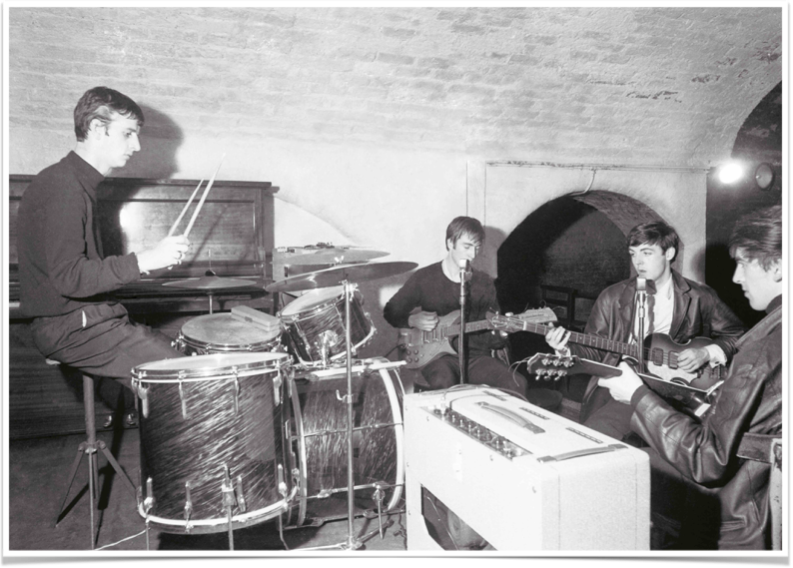
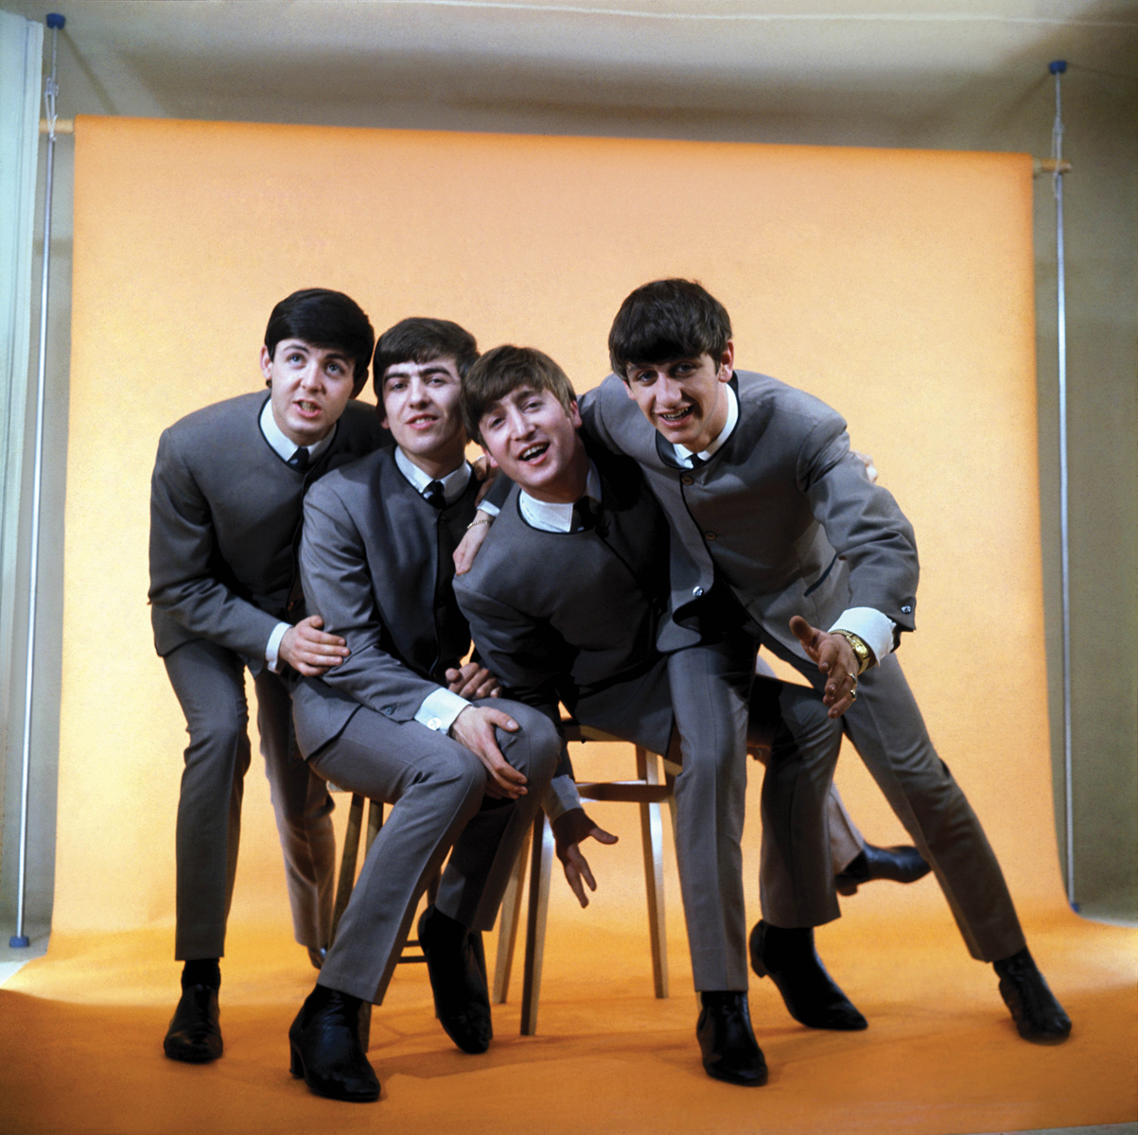
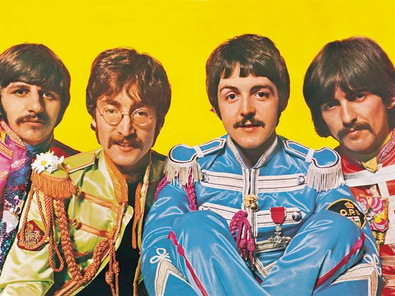
The Beatles – Style Periods
Early Career (1957-62)
“Beatlemania” (1962-64)
Dylan-inspired seriousness (1964-66)
Psychedelia (late 1966-1967)
Return to Roots (1968-1970)
The Beatles in Liverpool’s Cavern Club, 1962
St. Pepper’s Lonely Hearts Club Band, 1967
Photo shoot, 1964

Slide 5
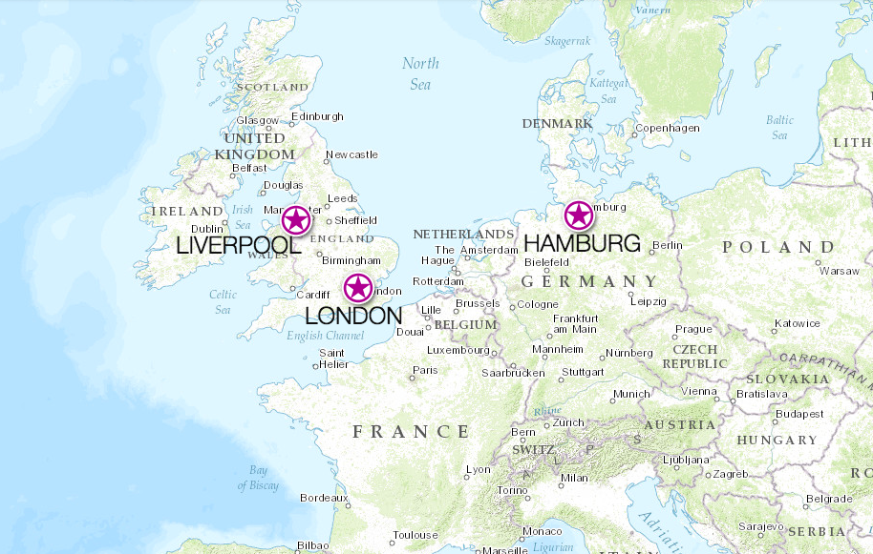
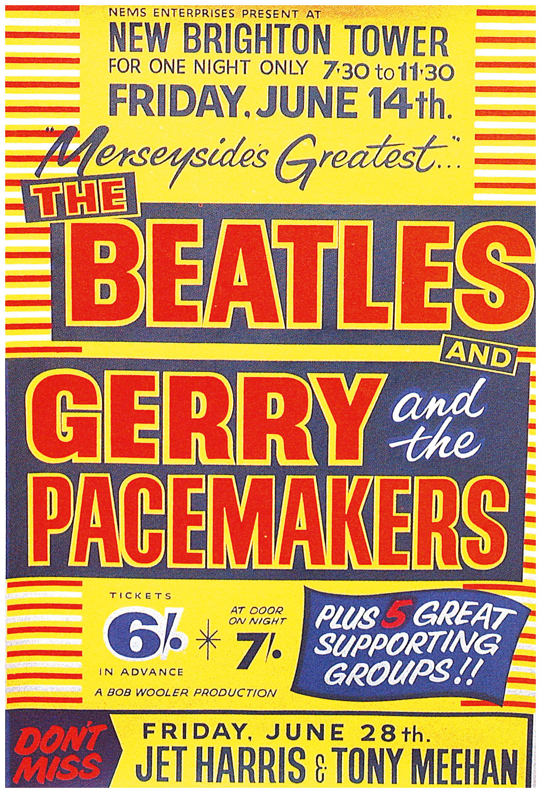
Early Career
Gigs in Liverpool
Modeled on Buddy Holly’s Crickets
House band at clubs in Hamburg, Germany
Performed covers by Chuck Berry, Carl Perkins, Little Richard, and Buddy Holly
6-7 hours a night, 6 nights a week
Learn to quickly absorb, adapt, and reproduce anything to fill time

Slide 6
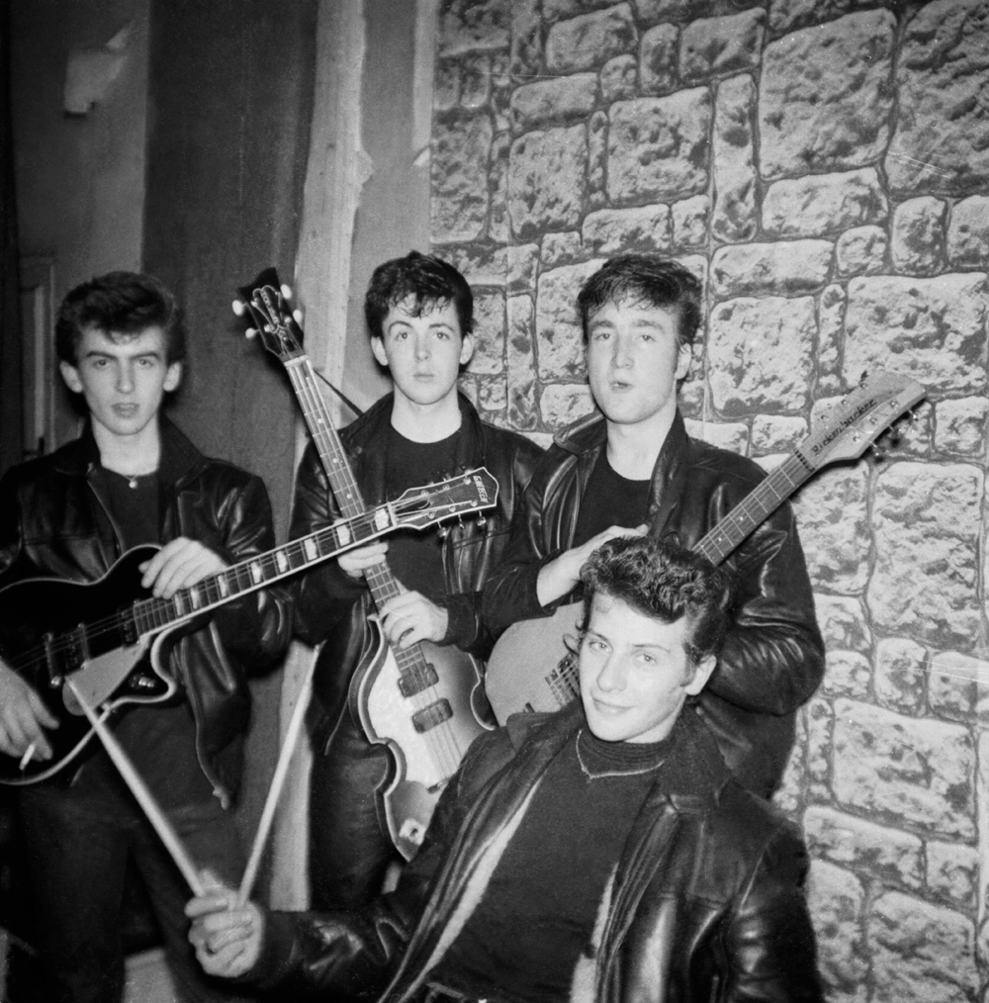
Quarrymen to beatles
The Quarrymen in 1958: John Lennon, Paul McCartney, George Harrison, Colin Hanton, and Duff Lowe, cut a shellac disc of two songs at a home studio in Liverpool including “That’ll be the Day.”
During the Beatles’ second stay in Hamburg, they were recruited to back fellow English performer Tony Sheridan and record “My Bonnie.”
Legend has it that on Oct. 28, 1961, a young man came into NEMS Music Store in Liverpool and asked Brian Epstein if they had “My Bonnie” by the Beatles.
By December Epstein was managing them.
His goal was to procure a recording contract from one of the four major record companies in England: EMI, Pye, Philips, and Decca.

Slide 7
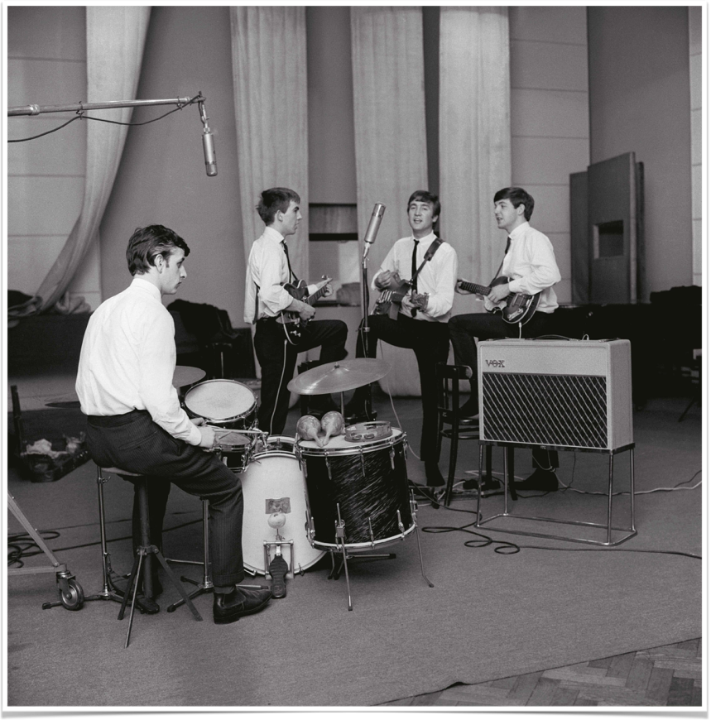
Auditions and first success
The Beatles covered a wide spectrum of material: R&B, rockabilly, standards, showtunes and rock and roll and Lennon-McCartney originals. 3 part vocal harmonies
Pete Best was still on drums.
Pye and Decca passed, but they passed the audition with George Martin and Parlophone, a small label.
In August 1962 drummer Ringo Starr (Richard Starkey) replaced Pete Best.
With Pete Best in the studio, 1962

Slide 8
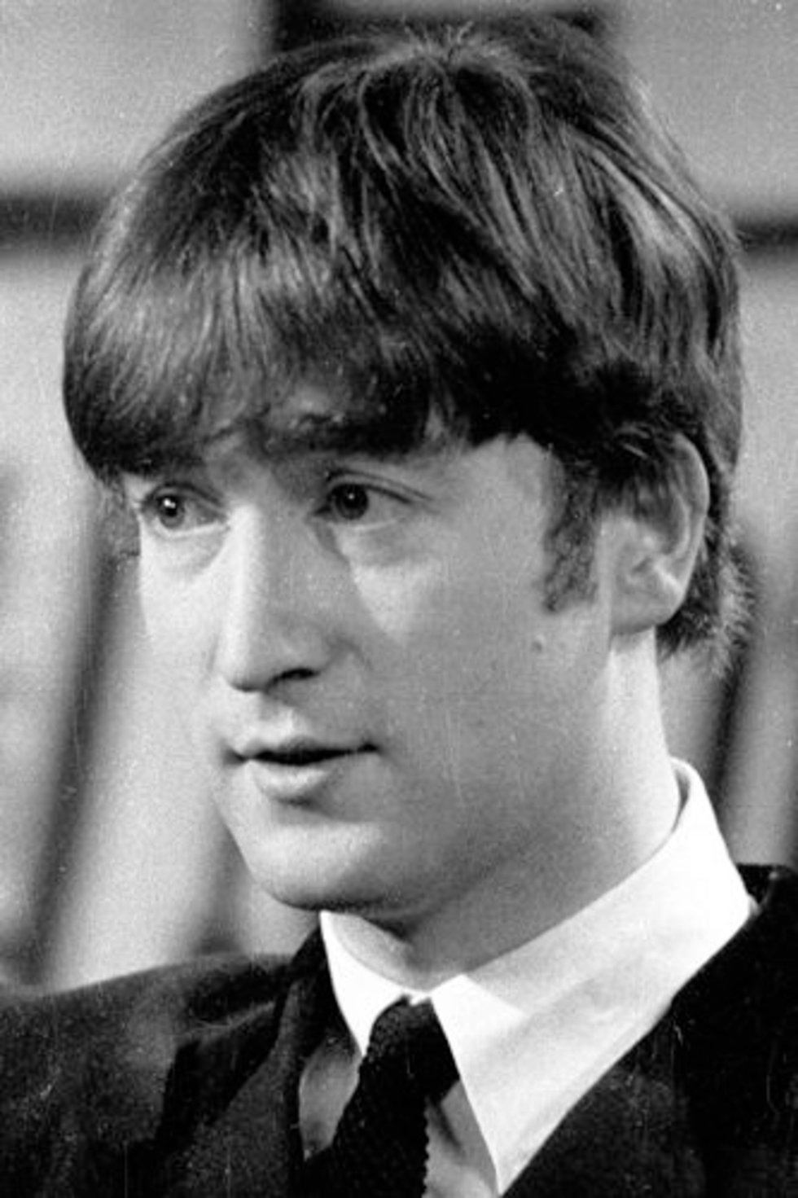
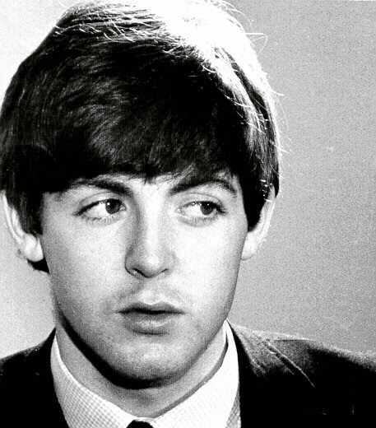
individual Influences
John Lennon (1940-1980)
Country blues
Trad (Dixieland) jazz
Rockabilly
Formed skiffle group, the Quarrymen, at age 17
Paul McCartney (1942-)
English popular music
Dance hall music
Trad jazz
Rock and roll, rockabilly, R&B
From musical family

Slide 9
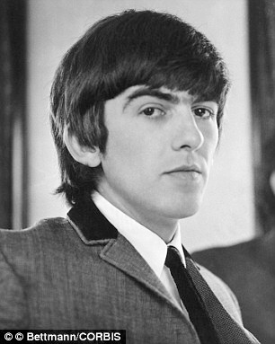
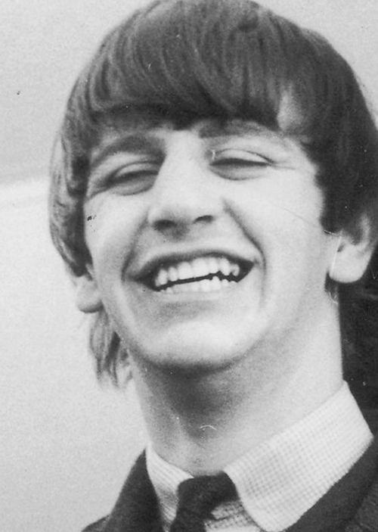
individual Influences
George Harrison (1943–2001)
Dance hall music
Jazz
American country music, esp. Jimmie Rodgers
Rock and roll, rockabilly
Also in skiffle group
Ringo Star (1940-)
American country, esp. Gene Autry
Swing jazz
Skiffle
English popular music
blues

Slide 10
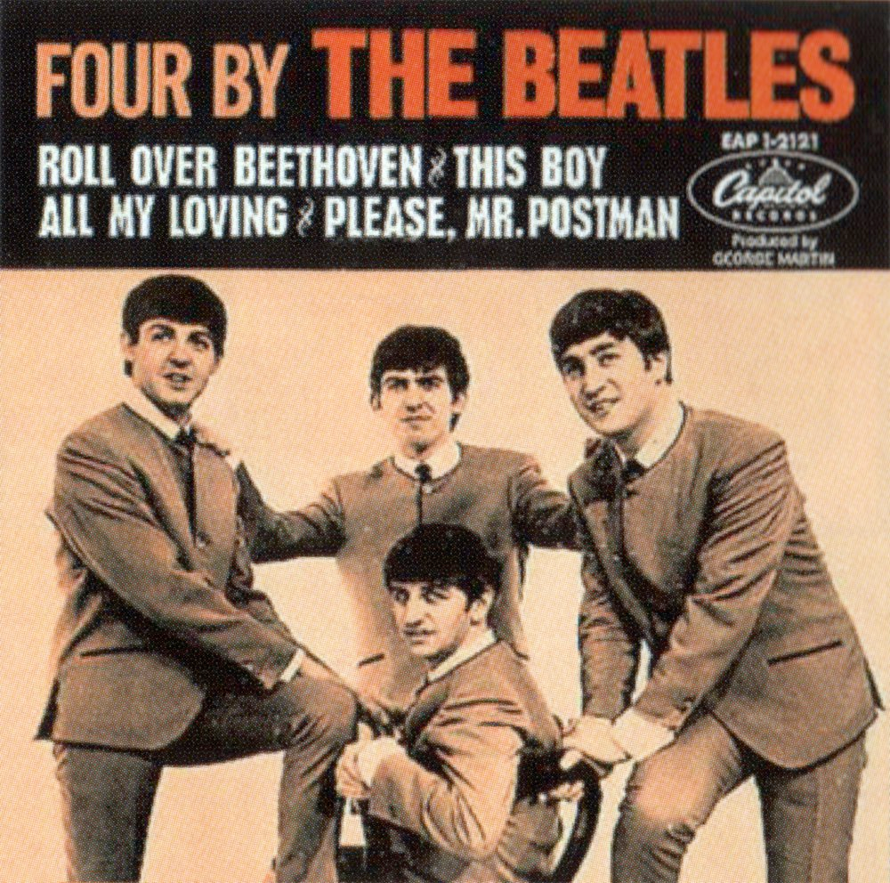
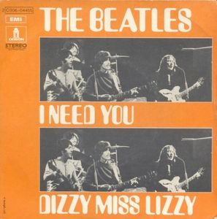
Covers by the Quarry Men and The Beatles before 1962, by artist, number, & artist style
Elvis Presley | 28 | Rockabilly
Chuck Berry | 14 | Rock and Roll
Buddy Holly | 14 | Rockabilly
Little Richard | 14 | R&B/Rock and Roll
Gene Vincent | 13 | Rockabilly
Carl Perkins | 12 | Rockabilly
Jerry Lee Lewis | 10 | Rockabilly/Rock and Roll
Lonnie Donegan | 8 | Skiffle
Larry Williams | 7 | R&B
Fats Domino | 6 | R&B/Rock and Roll
Duane Eddy | 6 | Surf
The Coasters | 5 | R&B
Eddie Cochran | 5 | Rockabilly
The Everly Brothers | 5 | Rockabilly/Rock and Roll
Sonny Terry & Brownie McGhee | 5 | Blues
The Vipers | 5 | Skiffle
Ray Charles | 2 | R&B
Les Paul and Mary Ford | 2 | Jazz (skiffle-like)
Peggy Lee | 2 | Pop
Big Joe Turner | 2 | R&B/Jump blues

Slide 11
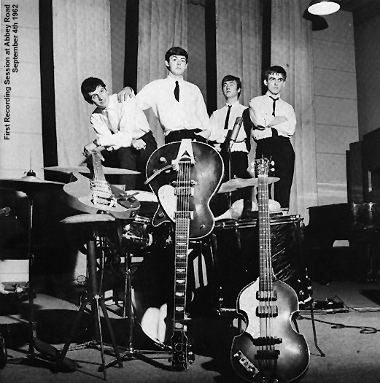
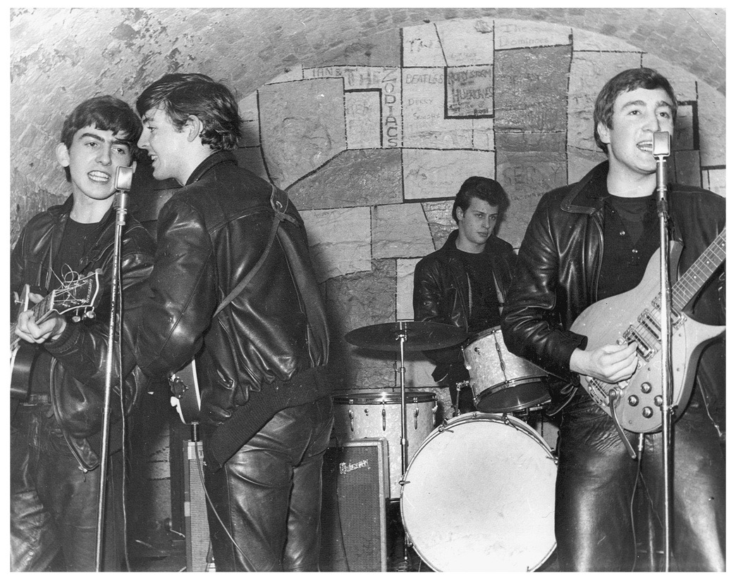
first serious recordings
“Love Me Do,” cut with Ringo Starr on drums, backed with “P.S. I Love You,” released October 5, 1962.
“Please Please Me” like a Roy Orbison ballad until George Martin brought up the tempo to produce the group’s first chart-topper.
The Beatles performed almost every day, often twice, and would for nearly four years.

Slide 12
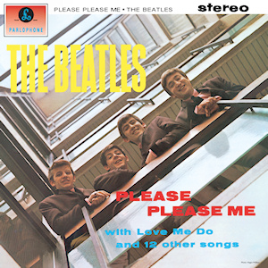
“Please Please Me” and the first lp (1962)
Before “Please Please Me” the record business model top-down: song, publisher, record company, and performer.
A song often had several competing versions
Artists were lucky to be paid at all.
Named lead singer with a backing band
Mark Lewisohn: “There can scarcely have been 585 more productive minutes in the history of recorded music.”
The Beatles cut thirteen songs, twelve of which became their entire first long-playing record.

Slide 13
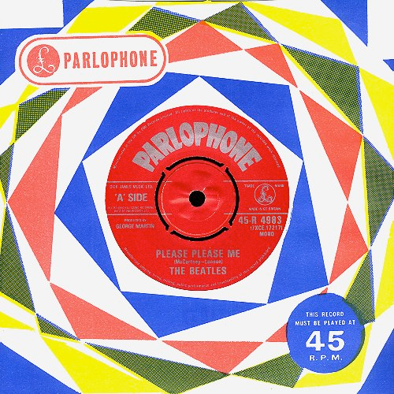
“Please Please Me” (1962)
Released in the first week of January 1963, “Please Please Me” promptly reached number one and remained in the album charts for seventy weeks.
Influences
Roy Orbison and Carl Perkins
Straightforward, up-tempo love song
AABA form
Intense B section
Some complex harmonic turns
Forceful drumming
Favorite Beatle sound – guitar lines in octaves
Leads Harrison to adopt 12-string Rickenbacker

Slide 14
“Beatlemania” begins
1962 June 6 Audition for EMI; signed by producer George Martin
Aug. 18 Ringo Starr replaces drummer Pete Best
Oct. 5 Love Me Do/P.S. I Love You released in U.K.
Dec. 18-31 Final Hamburg performances 1963 Jan 11 Please Please Me/Ask Me Why released in U.K.
Late Feb. Please Please Me hits #1 on British charts
Mar. 22 Please Please Me, first Beatles LP, released in U.K. #1 30 weeks
Oct. 13 First outbreak of “Beatlemania”
Nov. 4 Capitol Records signs The Beatles for U.S. recordings
Dec. 26 I Want to Hold Your Hand/I Saw Her Standing There released US

Slide 15
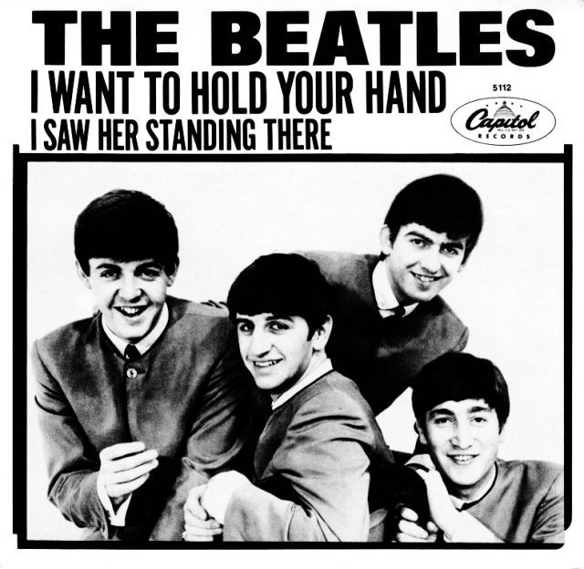
I Want to Hold Your Hand
Verse/refrain form with “middle 8”
Everly Brothers influence
Vocal style
Rising at end of verse into falsetto
Melismas
Hints of blues shouter voice
Note: no guitar solos
this early sound characteristic of fact they had no drummer until ‘61
I saw her standing there
Could be Little Richard Song
Shows their hard-driving Hamburg rock roots

