Slide 1
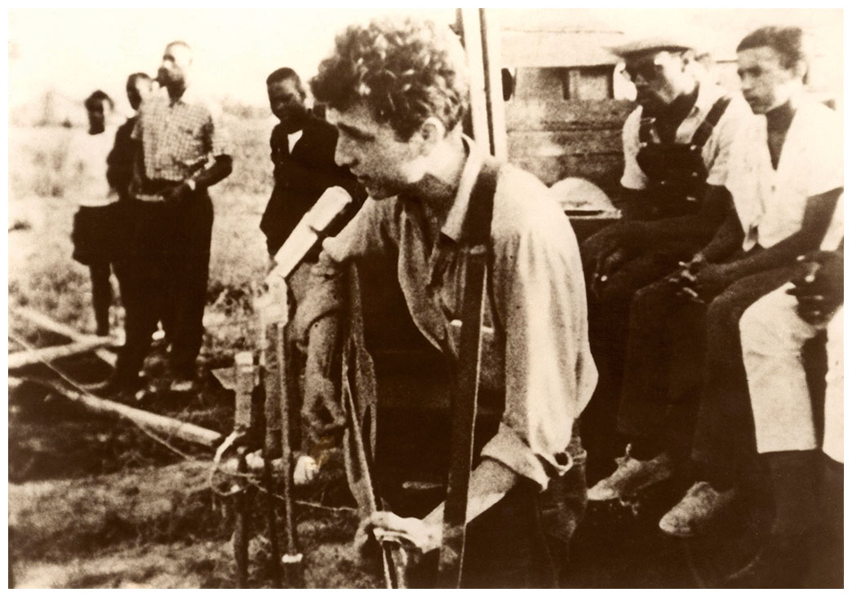
Bob Dylan
Transcending the Folk Scene

Slide 2
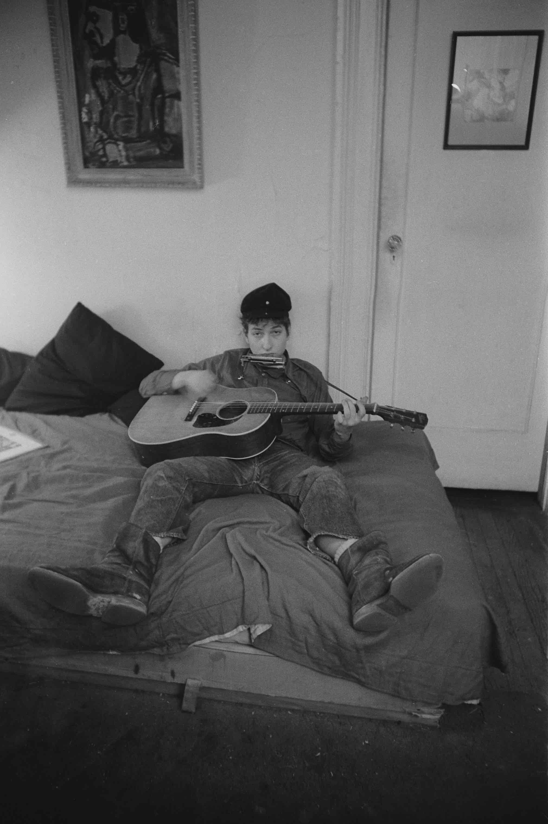
Late ‘50s/early ‘60s American folk revival
Begins in 1930s when John and Alan Lomax, Leadbelly, Pete Seeger, Woody Guthrie end up in NYC
NYC becomes center of folk music movement
Gains national attention in 1950s
Moe Asch - Folkways Records
The Weavers Good Night Irene a top 10 hit
Initially two different approaches
Rediscovery of musicians from older niche musics
Recreated folk music by contemporary musicians
Ex. Peter, Paul & Mary, “The Times They are A-Changing”
Dylan in New York

Slide 3
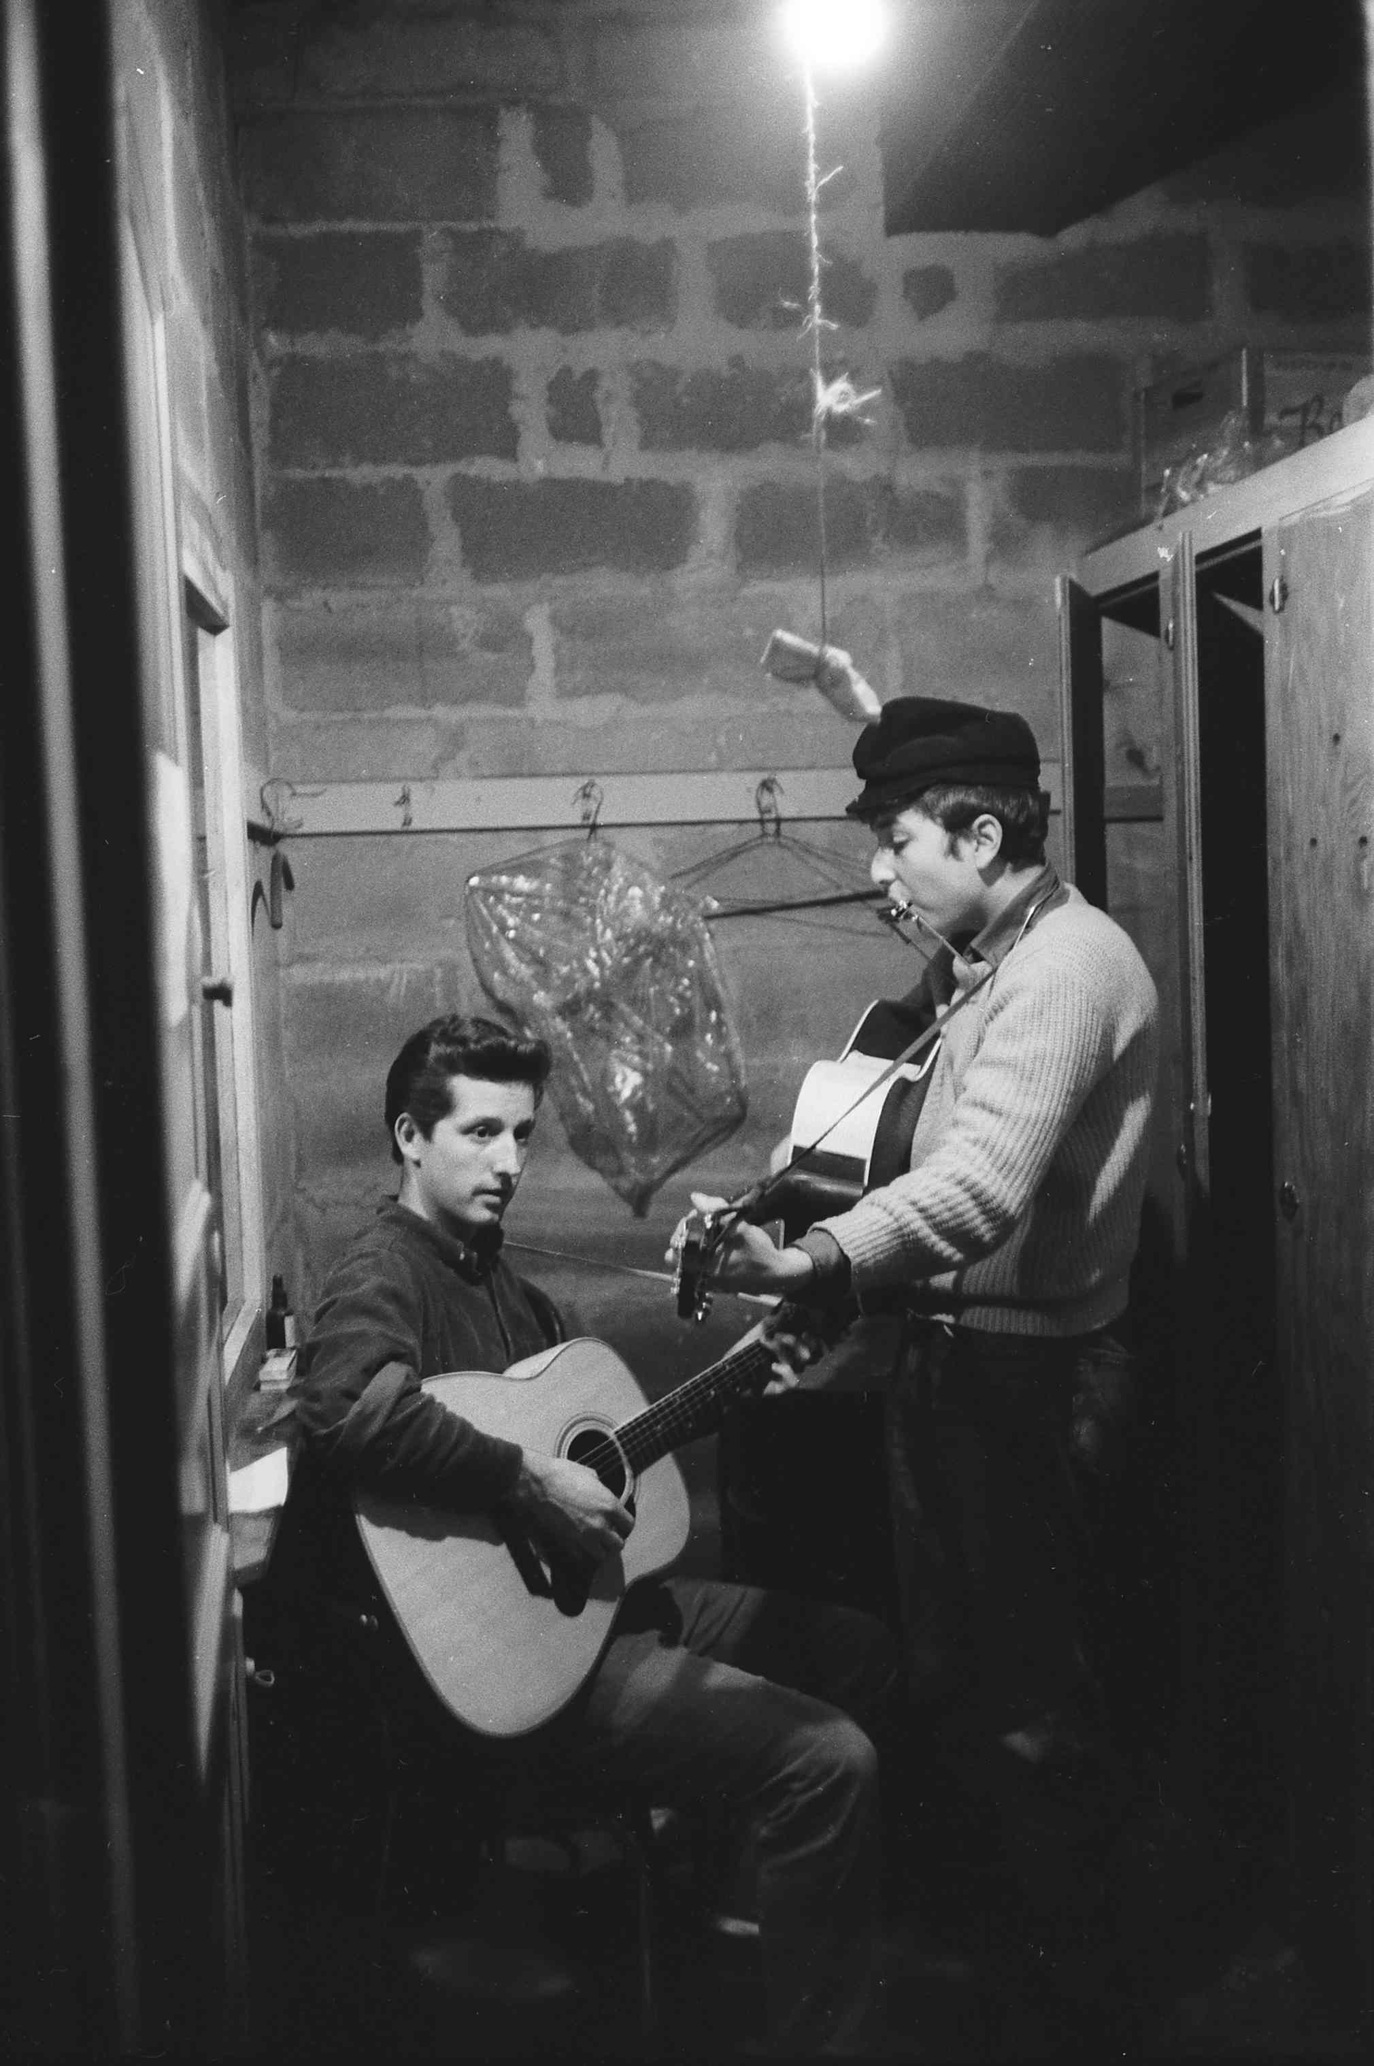
Urban Folk Music
Singer-songwriters begin writing own songs in the folk style
Joan Baez
Odetta
Ritchie Havens
Ramblin’ Jack Elliot
Simple accompaniments, acoustic guitar
focus on melody, audible lyrics
often narrow ranges, highly repetitiveAssociated with working-class, rural southerners
Concerned with political and social issues
Perceived by fans as “authentic” and often scholarly
Gerde’s Folk City, NYC

Slide 4
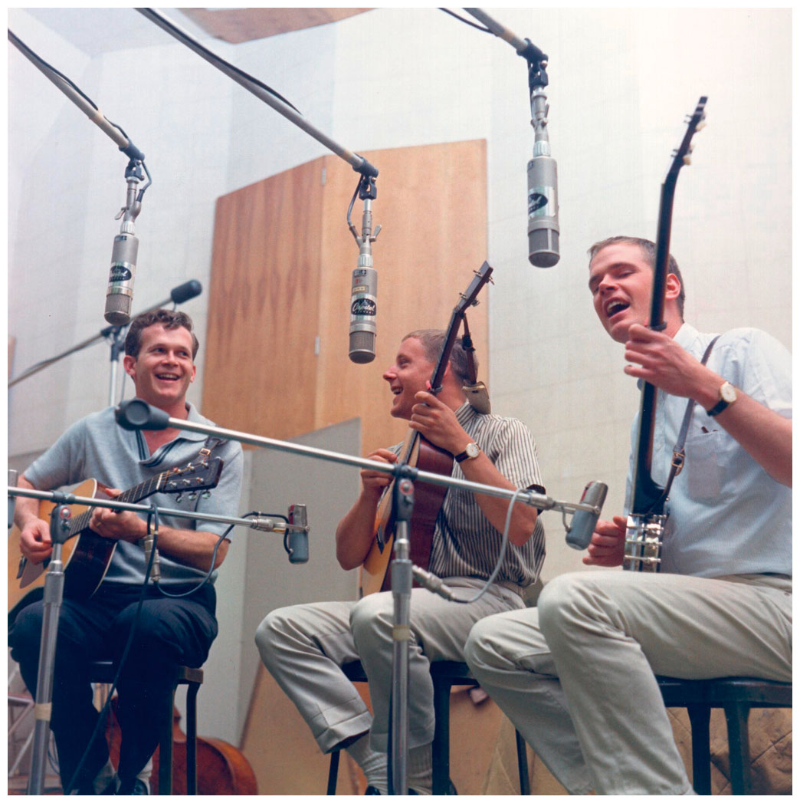
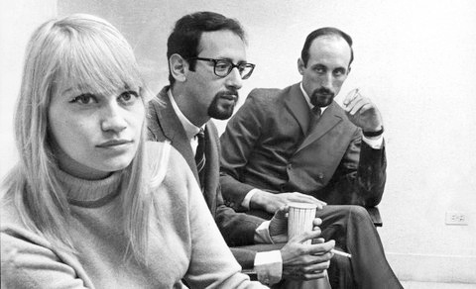
Peter, Paul and Mary
A group aimed not for small coffeehouses, but for larger concert halls. Their music was more polished than that of many folk artists, but die-hard folkniks embraced the group—in part because of their passionate involvement in the civil rights movement.
(from left) Bob Shane, Nick Reynolds, and Dave Guard
The Kingston Trio
The most popular ensemble of the “folk revival” of the late ’50s and early ’60s. Their first album, The Kingston Trio (1958), stayed on the pop-album charts for 195 weeks.
(from left) Mary Travers, Peter Yarrow and Paul Stookey
Notes:
The Kingston Trio—(from left) Bob Shane, Nick Reynolds, and Dave Guard—at a recording session. The group was the most popular of the “folk revival” of the late ’50s and early ’60s. Their first album, The Kingston Trio (1958), stayed on the pop-album charts for 195 weeks.
Photo credit: Michael Ochs Archives/Getty Images

Slide 5
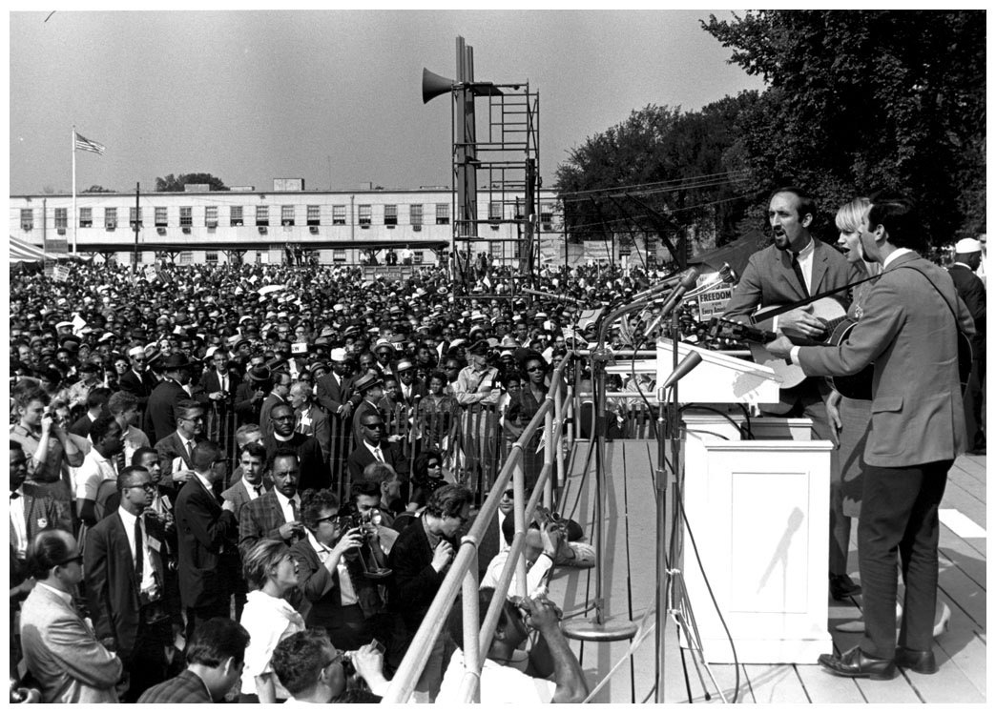
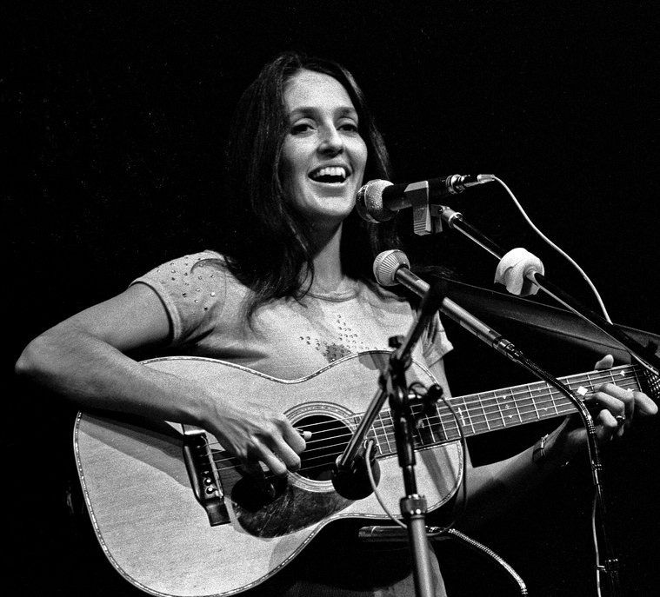
Backlash against Folk
House Unamerican Activities Committee went after folk singers because of associations with unions and left-wing causes
Weavers, Woody Guthrie, some older folk musicians blacklisted
Younger, apolitical musicians lead movement
Joan Baez
Peter, Paul & Mary at the March on Washington for Jobs and Freedom, 1963

Slide 6
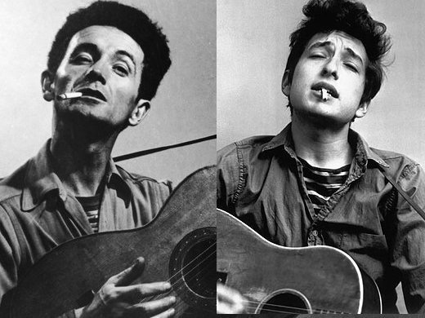
Bob Dylan (Robert Zimmerman, 1941- )
Gets into folk music in college after hearing Woody Guthrie
1960 goes to NYC to meet Guthrie
Gets work singing in coffee houses in the city
Often incorporated traditional melodies
Comes to be seen as the embodiment of the folk movement
Stood out for the originality and intensity of his songs
Idiosyncratic performance style a barrier to pop marketability
His songs were often covered by more pop-friendly artists
Woody Guthrie/Bob Dylan

Slide 7
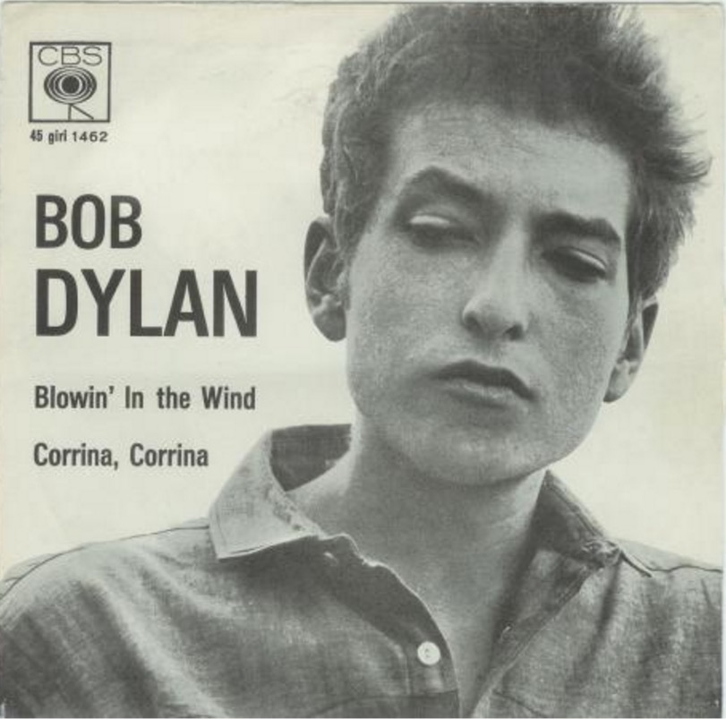
Dylan’s profile rises
After short time in NYC, writes songs that explore social and political themes
“Blowin’ in the Wind” (1962)
Highly repetitive melody, in claustrophobically narrow range
Strophic form – three verses, each with three phrases
Simple, chordal accompaniment with slow harmonic rhythm
Focus on lyrics
Refrain as tag: “The answer my friend, is blowin’ in the wind, the answer is blowin’ in the wind”
Compare to Peter, Paul and Mary

Slide 8
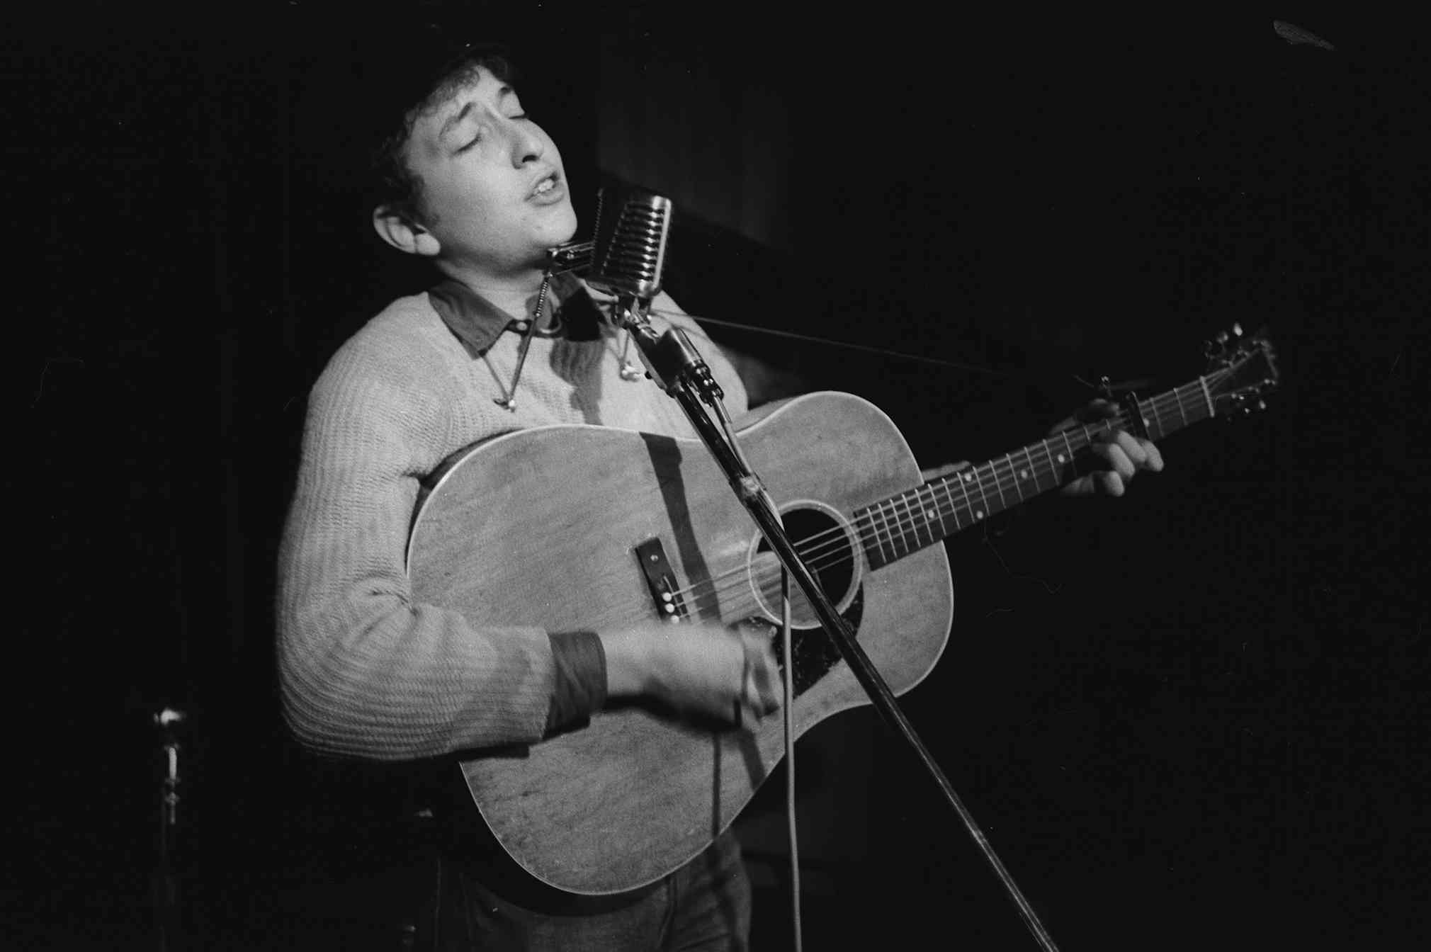
Talkin’ John Birch Paranoid Blues (1962)
Political commentary on HUAC and anti-communist organizations
Typical Dylan vocal delivery
weak vocals
full of humor, sarcasm
Conversational style
Guitar strumming, harmonica combo from country blues
Completion of vocal phrases by instrument
Now we all agree with Hitler’s views
Although he killed six million Jews
It don’t matter too much that he was a Fascist
At least you can’t say he was a Communist!
That’s to say like if you got a cold you take a shot of malaria
Well, I wus lookin’ everywhere for them gol-darned Reds
I got up in the mornin’ ’n’ looked under my bed
Looked in the sink, behind the door
Looked in the glove compartment of my car
Couldn’t find ’em . . .

Slide 9
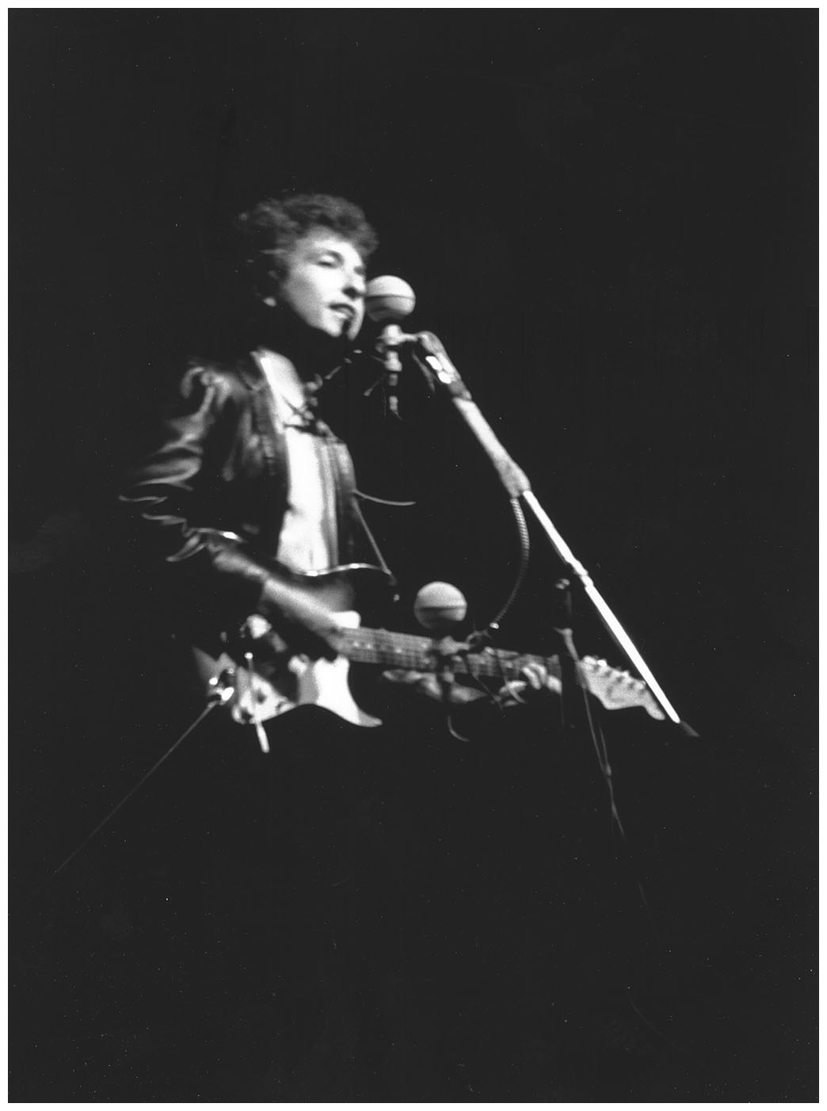
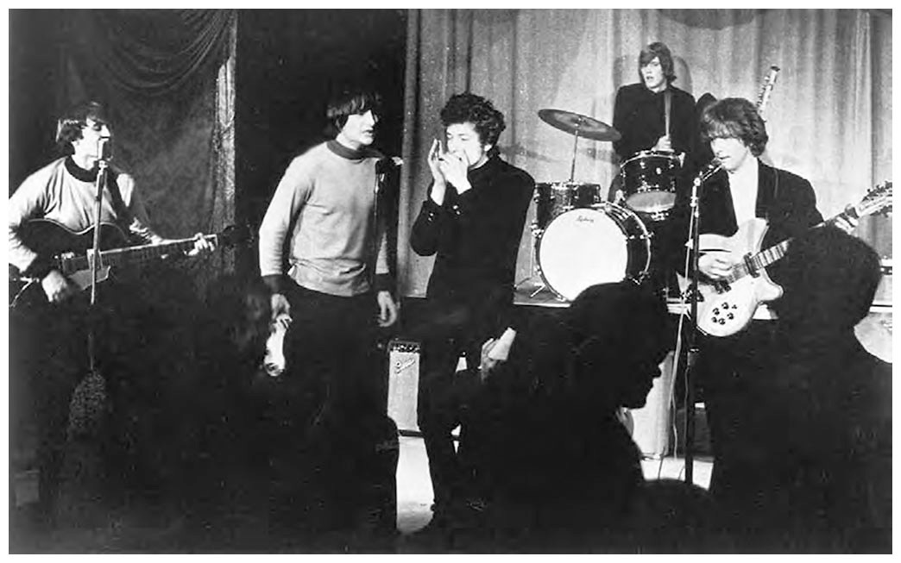
Dylan goes electric
Transformed into a rock ’n’ roll musician at the 1965 Newport Folk Festival
Perceived by the folk community as a betrayal
Possibly influenced by the Byrds’ successful cover (audio)
Folk Rock is born as a genre
Dylan’s career largely sustained by albums, not singles
Recorded in a wide variety of genres
Raised the possibility of rock ’n’ roll as “art”
the field of Dylanology includes many tomes on his lyrics and life
As if his career needed any more of a boost, was awarded Nobel prize for literature in 2016 “for having created new poetic expressions within the great American song tradition”

Slide 10
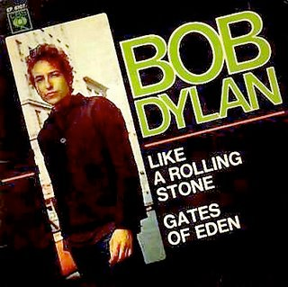
Like a Rolling Stone (1965)
Ended restrictions on length, subject matter, and poetic diction
Dense sound dominated by organ and piano,
also drums, electric guitar, harmonica
Featured an “in your face” vocal style
Incorporated surreal images and blunt realism
Strophic form with very long strophes
8-beat rock backbeat, Electric guitar fill marks transition between sections
Change in lyrical content
Less overtly political
Deals with more personal reflections

Slide 11
like a rolling stone (1965)
Electric guitar fill leads to
Interlude: harmonica fill, based on organ riff
organ, electric piano, guitar, drums, piano, guitar, drums accomp.
Intro
Once upon a time you dressed so fine
You threw the bums a dime in your prime, didn't you?
People'd call, say, "Beware doll, you're bound to fall"
You thought they were all kiddin' you
You used to laugh about Everybody that was hangin' out
Now you don't talk so loud
Now you don't seem so proud
About having to be scrounging for your next meal.
How does it feel (x2)
To be without a home
Like a complete unknown
Like a rolling stone?
a
Same fill bridges to
As above + organ
a
You've gone to the finest school all right, Miss Lonely
But you know you only used to get juiced in it
And nobody has ever taught you how to live on the street
And now you find out you're gonna have to get used to it
You said you'd never compromise
With the mystery tramp, but now you realize
He's not selling any alibis
As you stare into the vacuum of his eyes
And ask him do you want to make a deal?
How does it feel
How does it feel
To be on your own
With no direction home
Like a complete unknown
Like a rolling stone?
a
a
b
organ enters with long, sustained chords
b
syncopated descending bass line, faster harmonic rhythm
more active piano part
c
Electric guitar fill leads to
Organ riff

