Slide 1
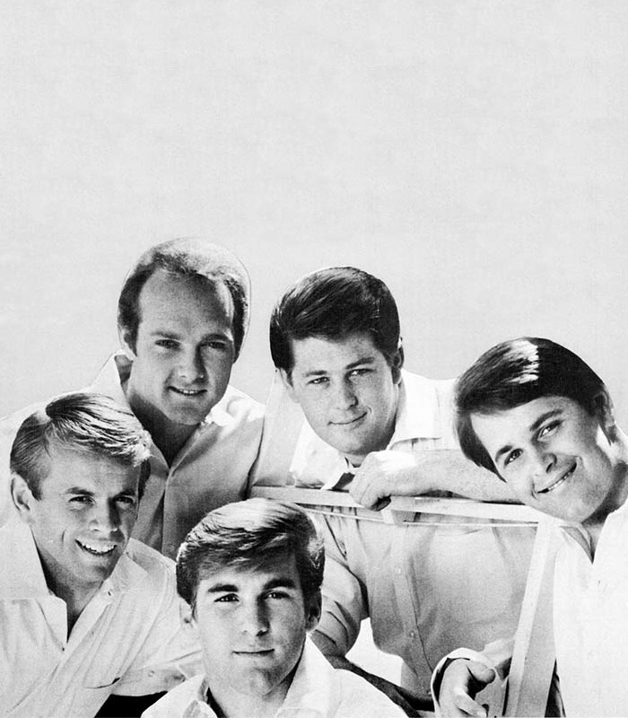
Surf Rock
SoCal birthes a new genre

Slide 2
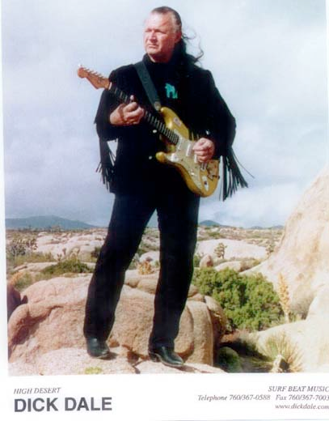
Dick Dale and the birth of surf
Little influence from rockabilly
exists in instrumental and vocal forms
Instrumental surf originated with Dick Dale “King of the Surf Guitar “and his Deltones
Exploits possibilities of Fender Stratocaster
1961: Rendezvous Ballroom in Balboa, CA and “Let’s Go Trippin’”
1963: appeared in the movie Beach Party, became a California celebrity

Slide 3
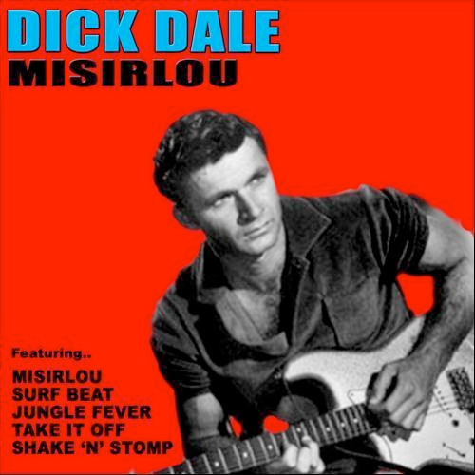
Dick Dale - Misirlou (1963)
Distinctive sound clear with fuzz distortion
Introduces Tremolo and Glissando (slide between notes)
Based on Middle Eastern stringed instrument style
Adds Latin influences
Trumpet
Variant of clave rhythm
Heavy backbeat

Slide 4
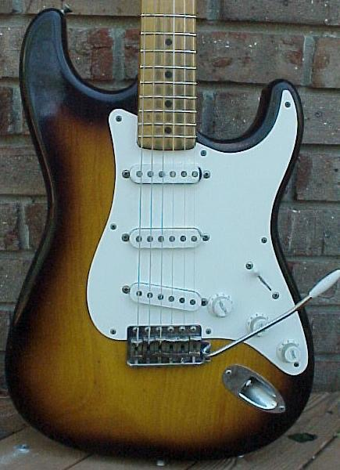
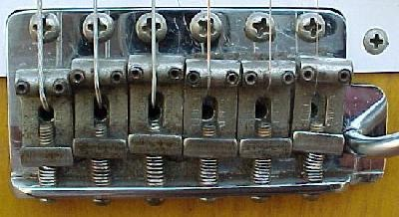
Leo Fender
California-based luthier
1950: first mass-produced solid-body electric guitar, with single pickup
1951: Telecaster
1954: Stratocaster
Tremolo lever (or whammy bar) moves all strings at once

Slide 5
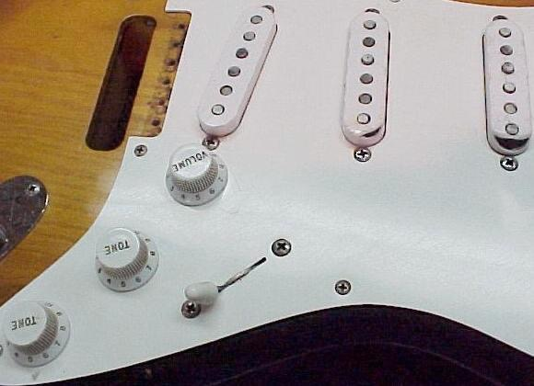
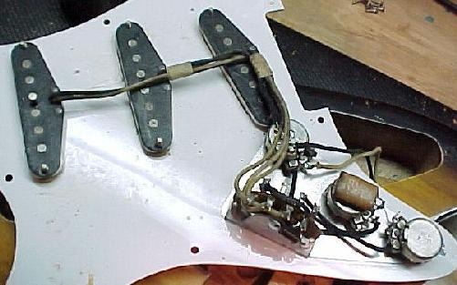
Fender Stratocaster
Three pickups
Volume knob
Two tone knobs
Lever selects which pickup projected through amp
Neck
Middle
Lead

Slide 6
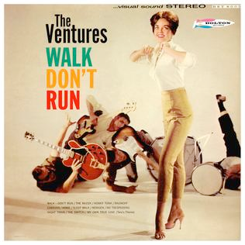
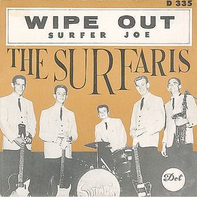
Surf guitar
Dale: distinctive sound clear with fuzz distortion
Introduces Tremolo and Glissando (slide between notes)
Other instrumental surf groups:
Chantay’s with “Pipeline” (1963)
Ventures (most successful) with “Walk, Don’t Run (1960), “Hawaii Five-O theme” (1969)
Surfaris with “Wipe Out” (1963)

Slide 7
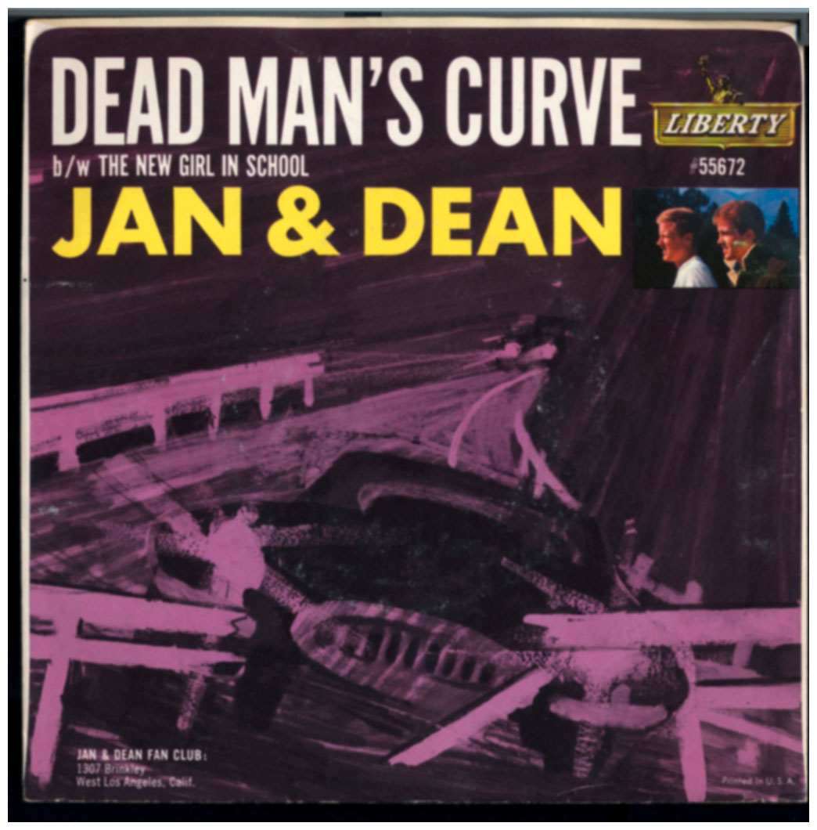
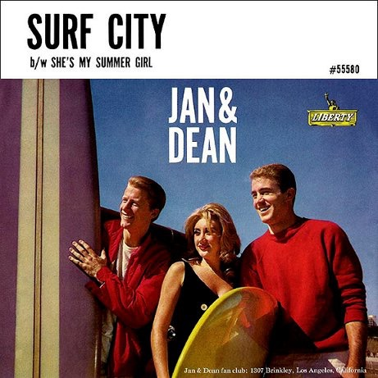
Jan and dean
brief career ca. 1959 to 1966
worked with Brian Wilson
“Surf City” (1963), “Little Old Lady From Pasadena,”“Dead Man's Curve,” “Sidewalk Surfin’” (all 1964)
produced by Lou Adler and Herb Alpert
Signed with Liberty Records
Jan Berry injured in car crash in 1966; Dean Torrence left music to become a graphic designer.

Slide 8
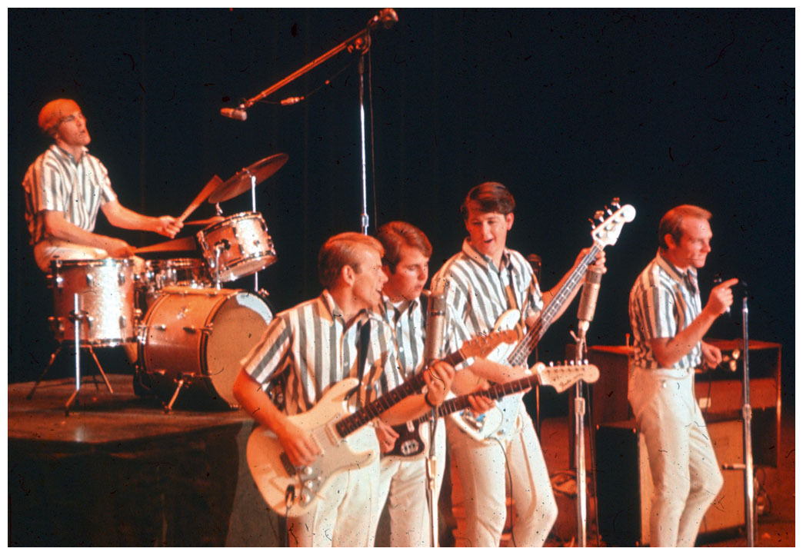
The Beach Boys
Brian, Carl and Dennis Wilson, Mike Love, Al Jardine
Brought Surf music to national prominence
1961: The Pendletones
First record: “Surfin’” No. 75 in 1961
1963, Capitol Records: 2nd LP Surfin’ U.S.A. reached No. 2 on the charts
Best-selling American rock group of the 1960s, perhaps the most celebrated

Slide 9
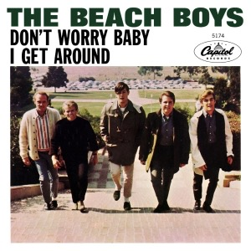
I Get Around (1964)
Heavily produced
Different character of verse, refrain
Wide variety of tone colors shape song
Bass with reverb - Dick Dale sound
crisp, almost delicate guitar
Hammond organ
Wide vocal harmonies
Falsetto obbligato (requisite high part)
Vocal riffs from doo-wop
Melody laid over top

Slide 10
California girls (1965), Brian Wilson, Capitol
#3 on the Billboard charts, fall ’65
“Happy Trails” cowboy shuffle rhythm
12-string guitar, organ, bass, drums, glockenspiel, horns, percussion
Form:
10-bar intro followed by 2-bar vamp
8 bar verse and chorus
solo lead vocals in first two verses
call-and-response in the harmony of the chorus
doo wop vocals in 3rd and 4th verses
short instrumental break and return of chorus

Slide 11
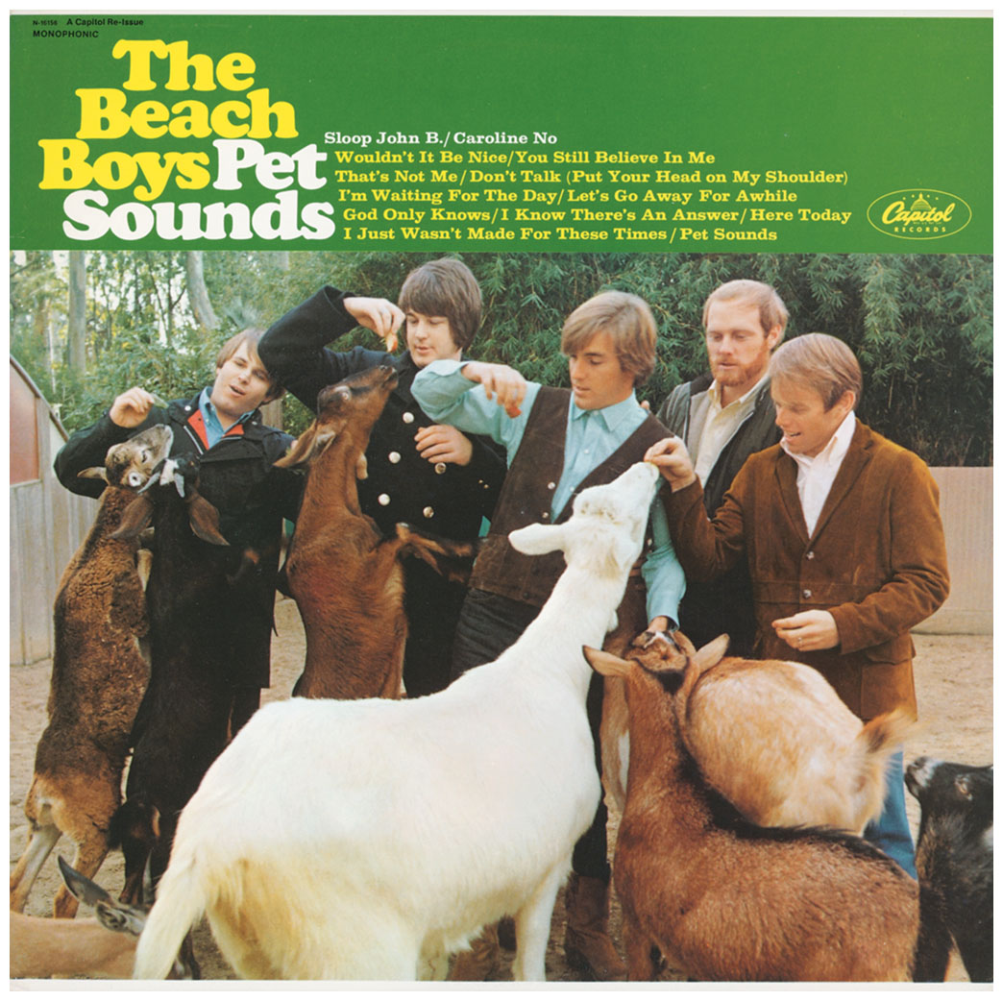
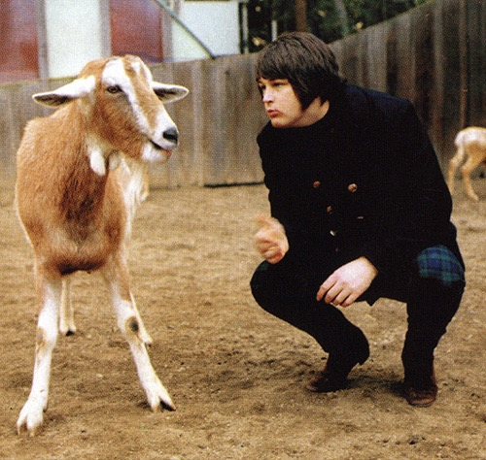
Pet Sounds (1966)
Inspired by the Beatles Rubber Soul (1966)
Often called the first concept album
Diverse and unusual instrumentation
Pet Sounds in turn influenced the Beatles’ St. Pepper’s Lonely Hearts Club Band (1967)
The opening track “Wouldn't It Be Nice,” by Brian Wilson, Tony Asher, and Mike Love, was released as a single.
It includes accordions and a detuned twelve-string guitar.
The music sometimes appears in two keys at once, and slows down for effect.
After recording the instrumental track, the Beach Boys overdubbed their voices to Wilson's exact specifications.

Slide 12
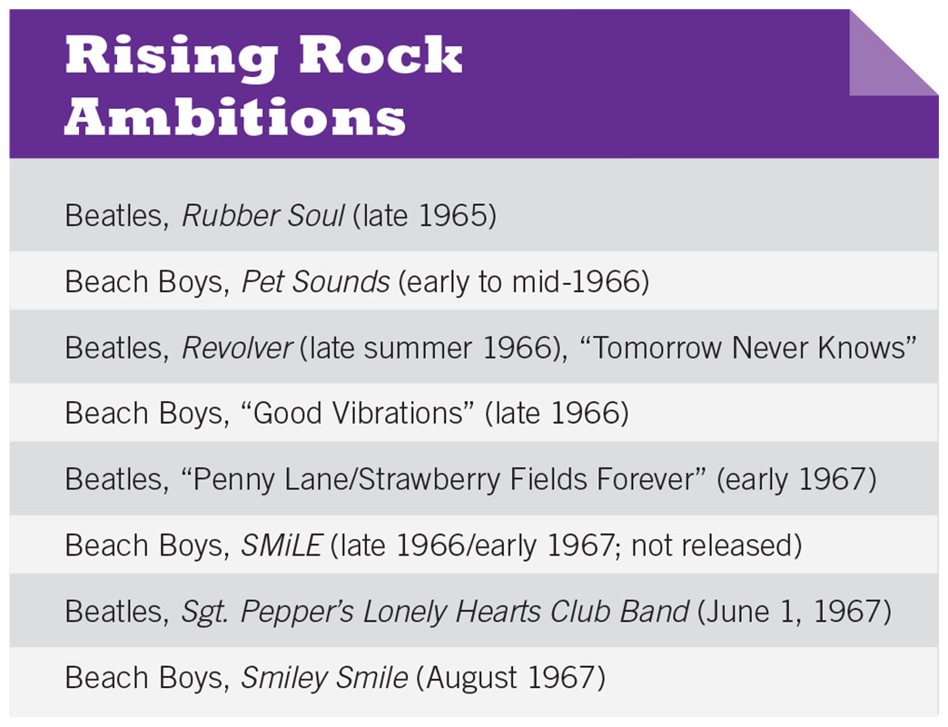

Slide 13
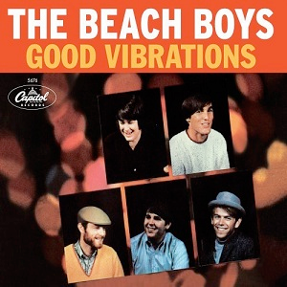
“Good vibrations” (1966)
4 Studios, 17 sessions, $50,000 to $75,000 to produce
Uses wrecking crew and many unusual instruments
organ flute, cello, theremin
Most famous song, huge hit, and considered one of the most important songs every produced
Succeeded by Smile, a stunning and unprecedented project
Abandoned in 1967, at which time Smiley Smile was released instead
Finished in 2004

Slide 14
D Sustained organ, maracas; slower tempo
Gotta keep those lovin' good vibrations A happenin' with her Gotta keep those lovin' good vibrations A happenin' with her Gotta keep those lovin' good vibrations A happenin‘
E Return to original tempo
Ahhhhhhhh Begins with “Ahhhh” of C section, but Good good good good vibrations then same as 2nd part of B section (Oom bop bop)…..
(Good good good good vibrations (Oom bop bop) She's na na . . . Na na na na na Bass, high vocals with heavy echo Na na na Joined by second melody, then third - Na na na na na polyphonic texture (several lines) Na na na Do do do do do Do do do Do do do do do Do do do Heavy bass triplets and theremin to end
Good Vibrations
Basic tempo: 152 beats/minute (fast) with 4 beats to the bar
Slows considerably in D section, but returns to original tempo at end
B
A Close my eyes` As in first A She's somehow closer now Softly smile, I know she must be kind When I look in her eyes She goes with me to a blossom world
B I'm pickin' up good vibrations As in first B She's giving me excitations I'm pickin' up good vibrations (Oom bop bop good vibrations)……
C Instrumental – 8 bars Barroom sounding piano
(Ahhhhhhh) Alternates beats with bass (Ah my my what elation) Vocals on vowel sounds with heavy echo don't know where but she sends me there
(Ah my my what a sensation) (Ah my my what elations) (Ah my my what)
I'm pickin' up good vibrations Low voice + theremin She's giving me excitations I'm pickin' up good vibrations Backing vocals enter + tambourine
(Oom bop bop good vibrations)
She's giving me excitations Fast triplets in cellos (Oom bop bop excitations) Good good good good vibrations Second, higher layer of
(Oom bop bop) background vocals added
She's giving me excitations (Oom bop bop excitations) Good good good good vibrations (Oom bop bop) She's giving me excitations (Oom bop bop excitations)
A I, I love the colorful clothes she wears
And the way the sunlight plays upon her hair
I hear the sound of a gentle word
On the wind that lifts her perfume through the air
Vocal (heavy echo) accomp. by short organ chords, bass Drum, tambourine added Four even drum shots lead into…

