Slide 1
Phil Spector and the LA scene

Slide 2

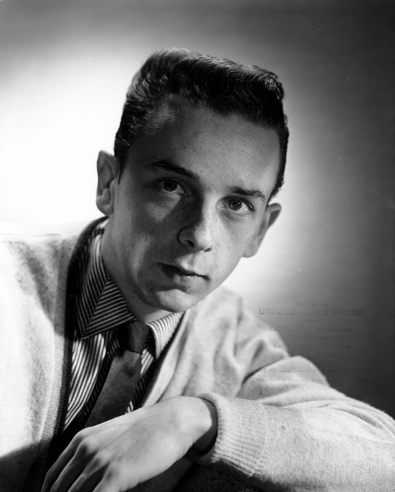
Phil Spector (1940- )
The “Tycoon of Teen,” Phil Spector is something of an enigma: by nineteen, he was a Brill Building producer; at thirty, a semi-retired recluse.
In between those years he was known as one of the most creative, innovative producers in the history of pop music.
He worked at Goldstar Studios in Los Angeles where he wrote, arranged, and produced for The Crystals, The Blossoms, Bobby Soxx and the Bluejeans, Darlene Love, and the Ronettes.
He also produced cuts for the Righteous Brothers, Gene Pitney, Ike and Tina Turner, and Connie Francis.

Slide 3

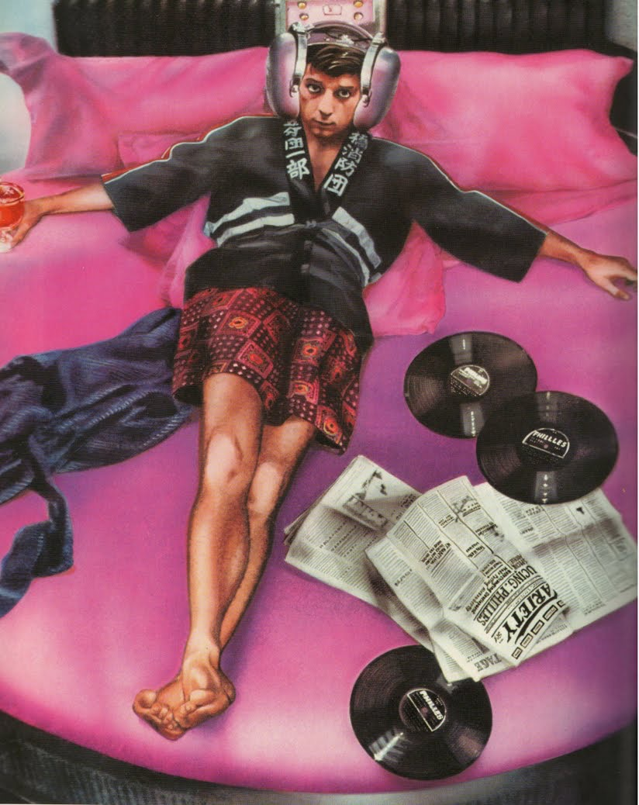
Phil Spector
  Began career as a performer with the Teddy Bears
  Apprenticed with Leiber and Stoller
  Co-founded Philles Records by the age of twenty-one
  Maintained a high level of involvement with all aspects of music-making
    Records he produced are more closely associated with him than are the performing artists
  Established a new production model: small volume, high percentage of hits
  Business model based upon Tin Pan Alley

Slide 4

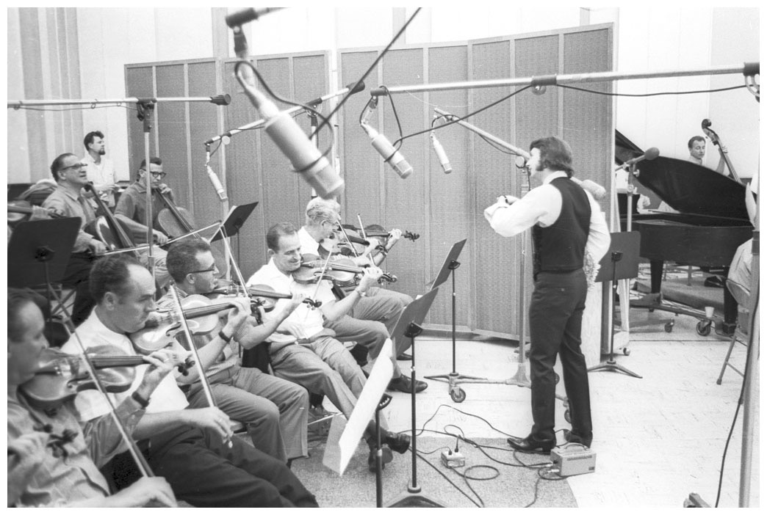
“Kiddie symphonies” & the wall of sound
  Thick, full textures created by overdubbing
  Large orchestra with lots of percussion
  Pre-recorded sounds
  Background vocals
  Rock ensemble
  doubling and tripling instruments for a very dense, orchestrated sound.
  He also made heavy use of echo and other production techniques.
The 1970’s found him working with the Beatles on the Let It Be Album, George Harrison’s All Things Must Pass, John Lennon’s Imagine, and the Ramones End of the Century album.

Slide 5

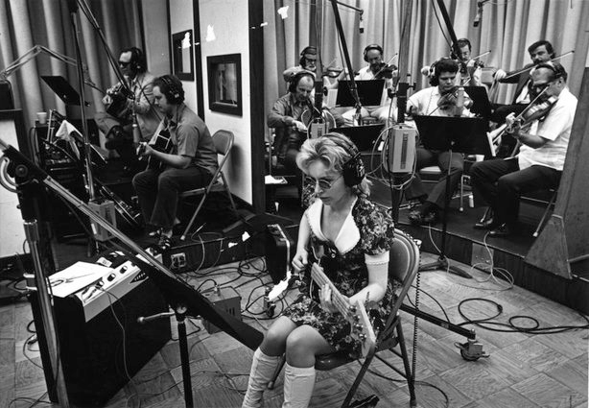
The Wrecking crew at gold star studios
Notable members included
  Carole Kaye bass,
    Possibly the most influential bassist in rock history
    Played with a plectrum (pick)
  Tommy Tedesco, Glen Campbell and Al Casey, guitar
  guitar,
  Hal Blaine and Earl Palmer, drums,
  Leon Russell piano
  Plas Johnson, sax

Slide 6
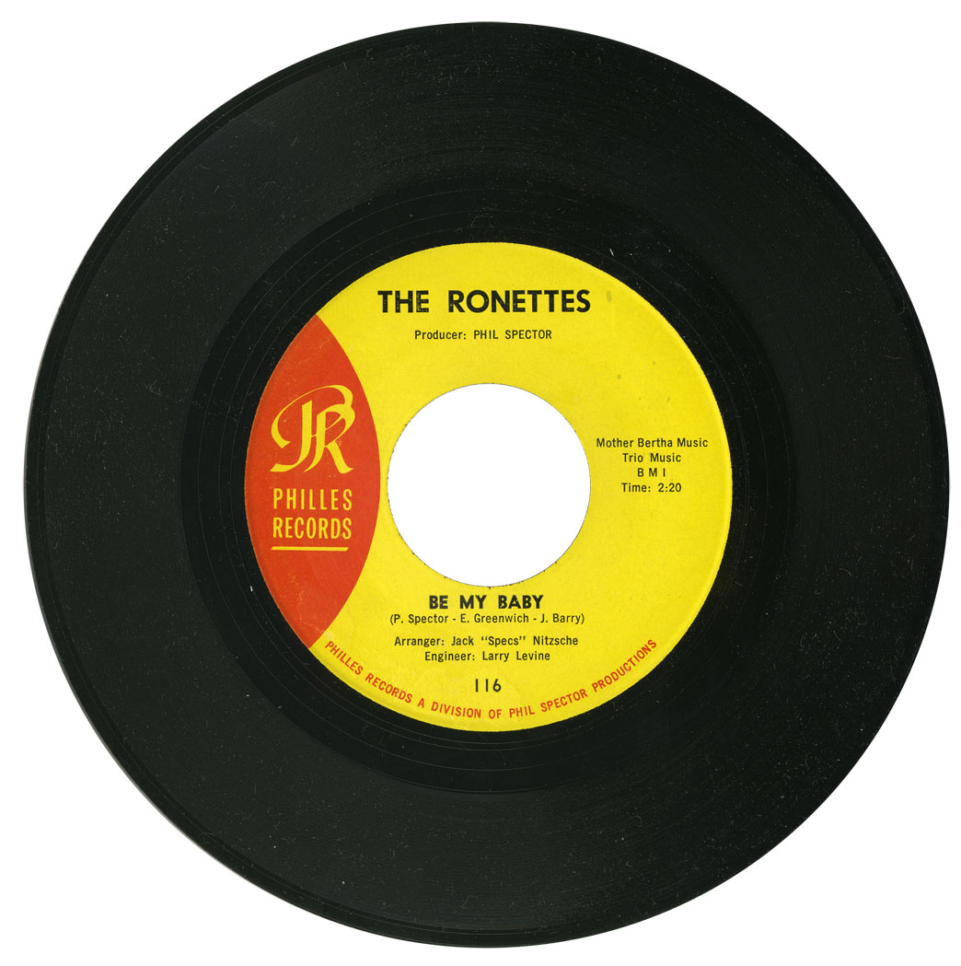
“Be My Baby,” by Phil spector, ellie greenwich and Jeff Barry, Philles
    Among Spector’s biggest hits: No. 2 on BillboardHot 100, #4 on R&B
    Uses rock instrumentation along with horns, orchestral strings and percussion
    Song begins with catchy hook in the drums, and uses handclaps and percussion to reinforce the beat
      The song builds from a lead vocal (8 bars) which adds backup vocals and saxes (8 bars), before all the instruments enter for the chorus, which is the hook.
      Verse 2 pulls back a bit, then builds again towards the chorus
      Strings have the melody in the instrumental break, which is only 8 bars, before chorus breaks in again
      The listener thinks it’s the end, but then the original drum hook returns, and a final chorus

Slide 7

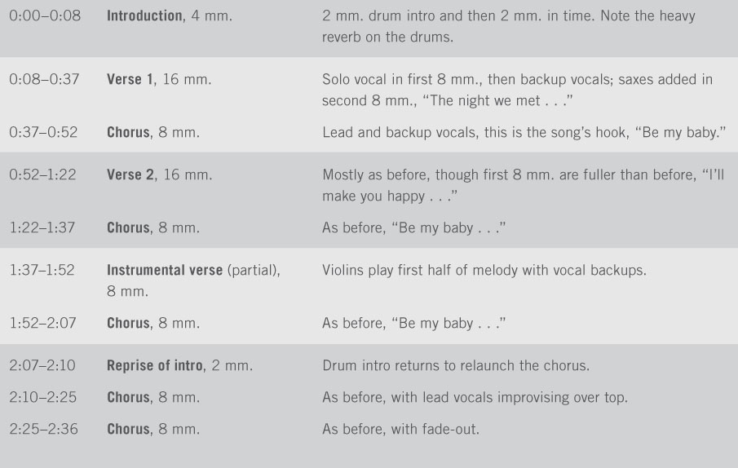
“Be My Baby”

Slide 8
“You've Lost That Lovin' Feelin’,” by Phil Spector, Barry Mann, and Cynthia Weil
First recorded by the Righteous Brothers in 1964
often called the ultimate expression and illustration of Spector's "Wall of Sound" recording technique, as well as “the ultimate pop record”
No. 1 in U.S. and U.K. in 1965
Between the original and its many covers, it became the most-played song on American radio and tv in the 20th c.
Righteous Brothers—Robert Hatfield from Anaheim and Bill Medley from Santa Ana—broke off from local male doo wop groups to form a duo

Slide 9

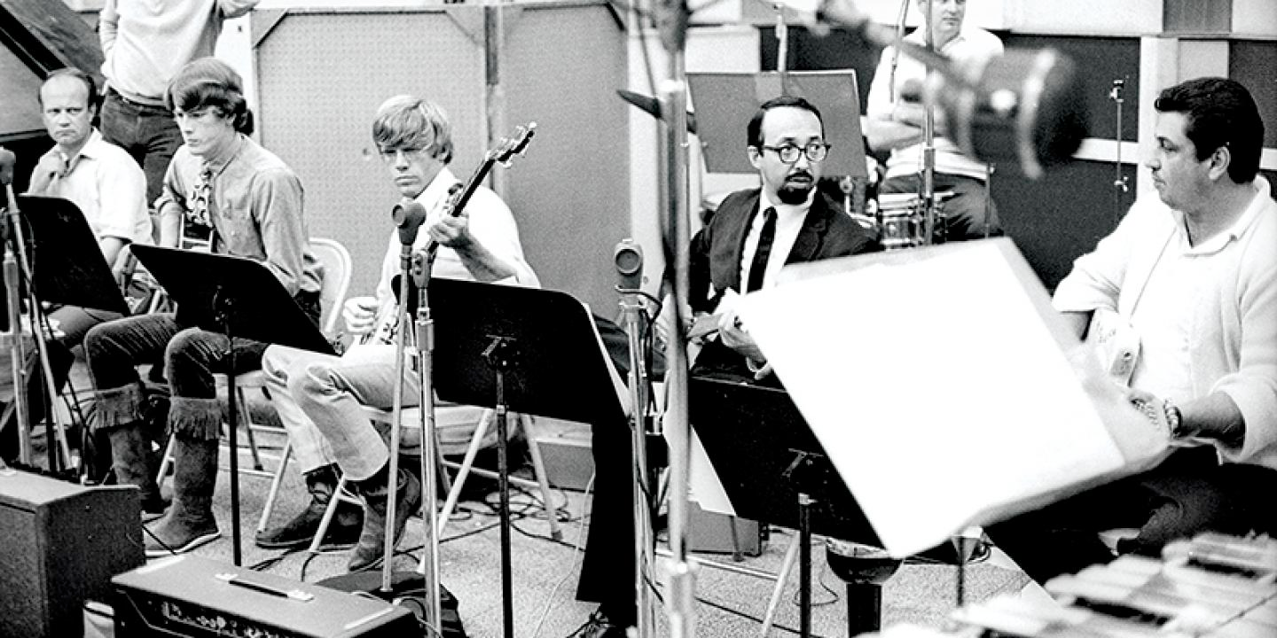
early ‘60s studio production
Jazz and pop musicians start recording rock and roll
Thicker orchestration (more of everything …)
Recording musicians separate from touring group
Many producers worked in a number of styles

Slide 10
Changes in studio production during the 1960s
Fewer instrumentalists needed
  rock groups record with their own members
  and multitracking eliminates need for doublers
Multitracking transforms the way records are made

