Slide 1
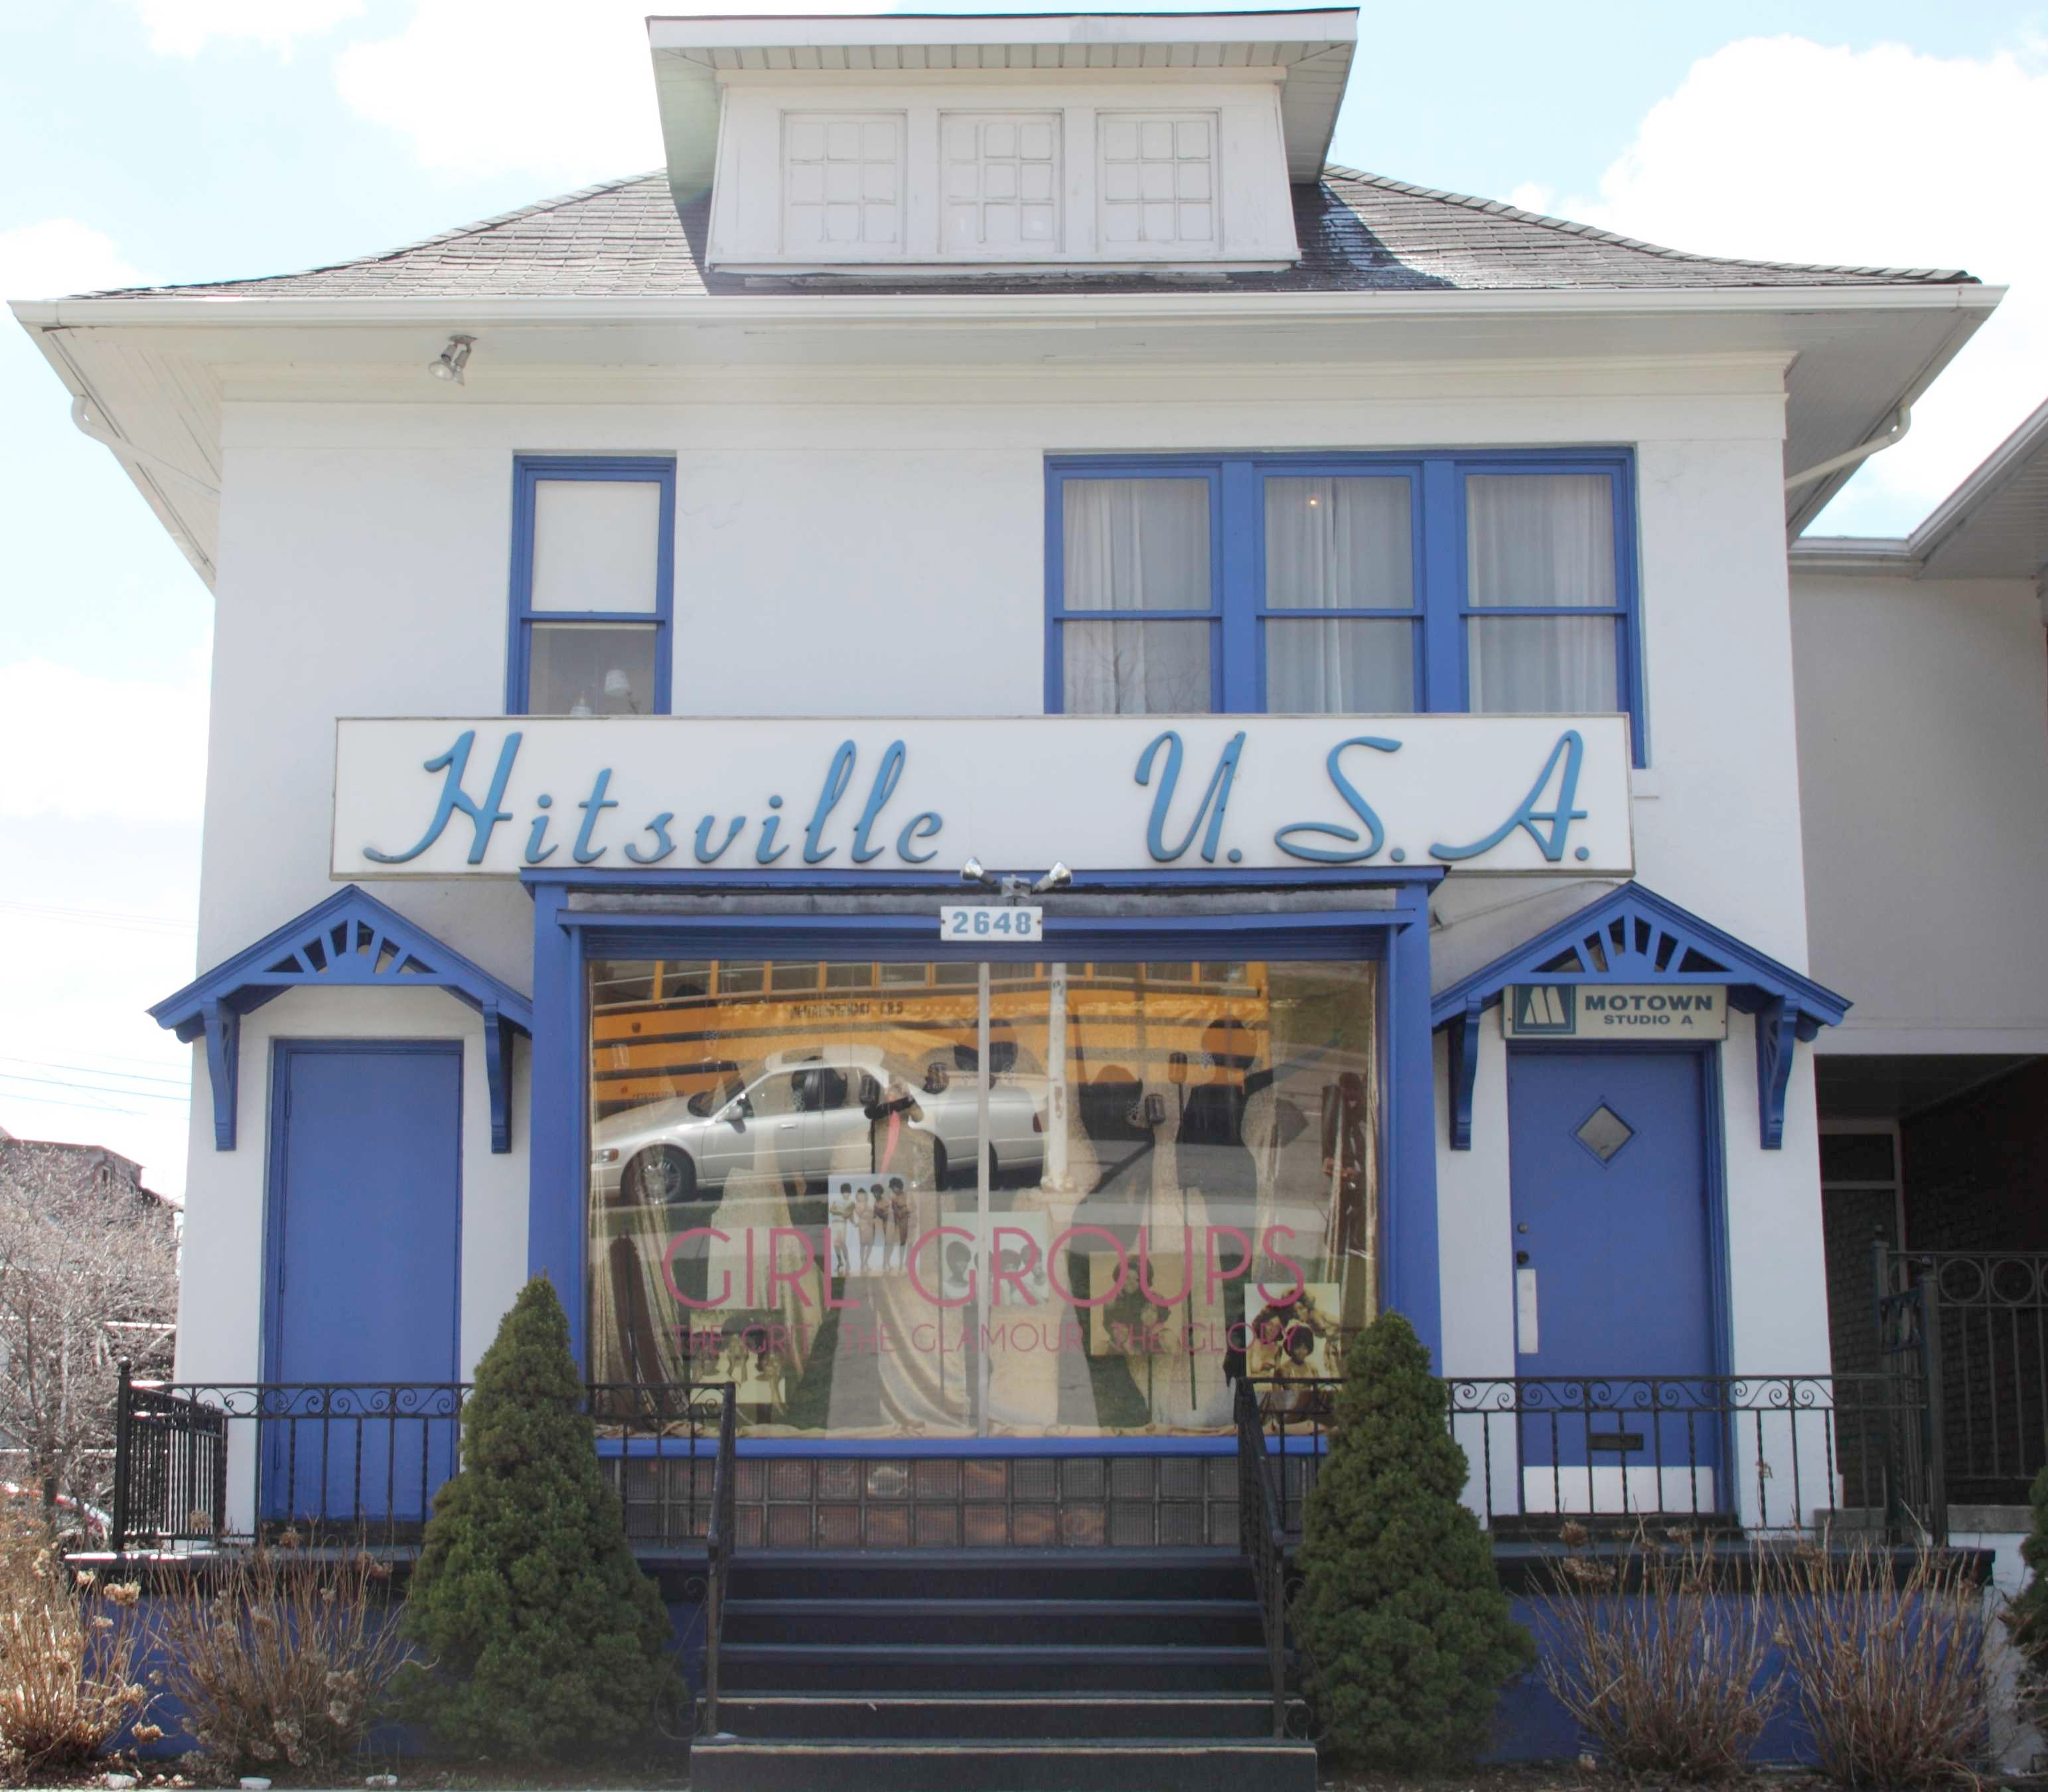
Berry Gordy and Motown Records

Slide 2
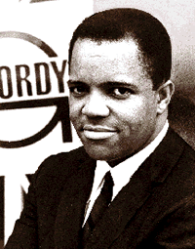
the business
Motown a stunning success story in the history of African American business.
Berry Gordy Jr. started as a songwriter for Jackie Wilson in the late 1950s, in 1959 co-wrote "Money (that’s what I want)," Motown’s first hit
In 1961 they had their first #1 on both Pop and R&B charts with the Marvelletes “Please Mr. Postman”

Slide 3
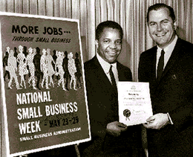
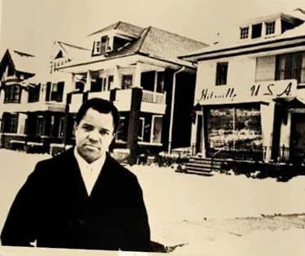
“The sound of young america”
Tight quality control and a shrewd marketing strategy.
Slogan cut across racial lines
A group of labels: Motown, R&B on Tamla, Gordy, and Soul, each with its own roster.

Slide 4
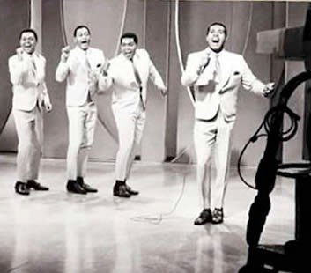
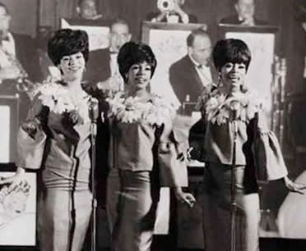
Artists schooled to be charismatic and sophisticated live performers.

Slide 5
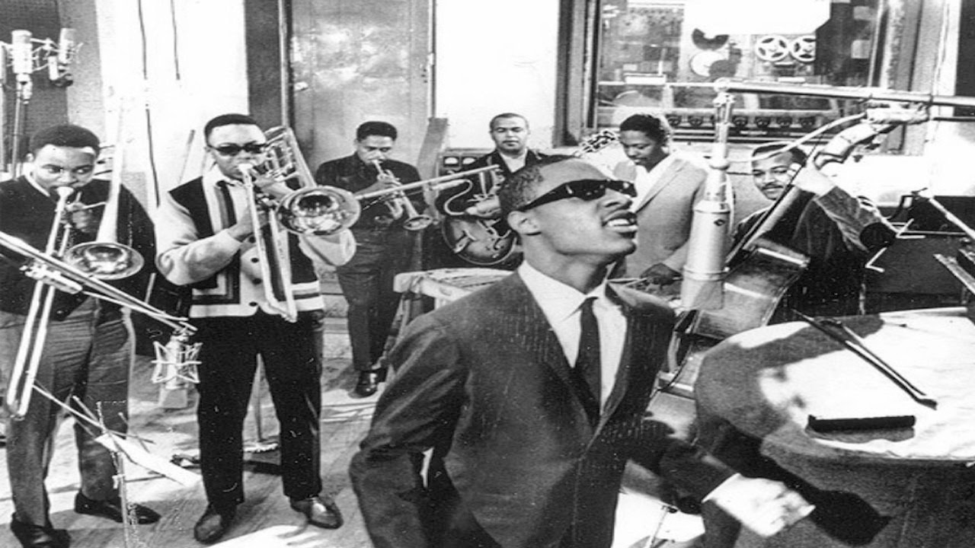
THE FUNK BROTHERS
Backing band formed from the cream of Detroit’s jazz and R&B musicians

Slide 6
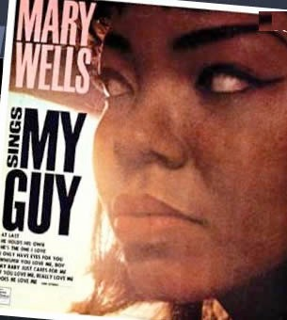
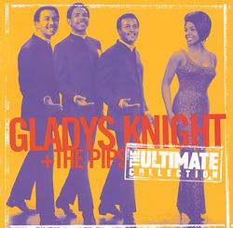
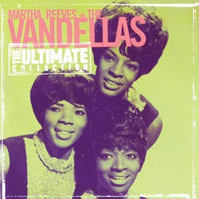
the music
Two distinct black pop sounds in the 1960s –Motown and STAX Memphis Soul.
Motown arrangements favored car radio.
Vocals, drums (backbeat on snare),
syncopated bass line high in the mix; "Heat Wave"

Slide 7
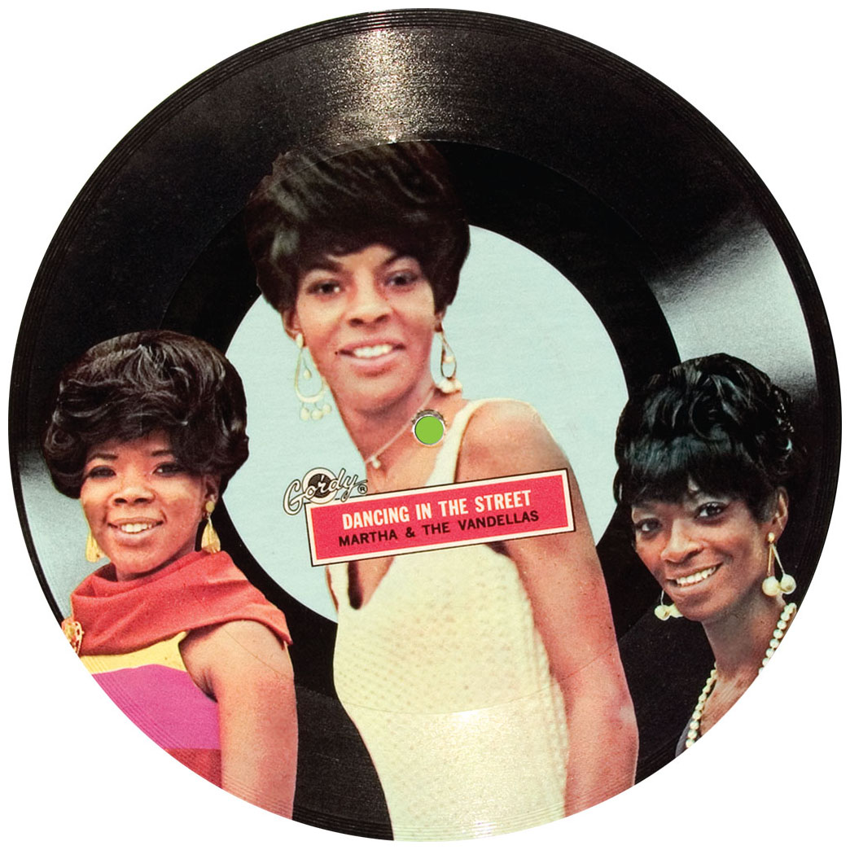
The Motown Sound
Thick, “wall-of-sound” textures
8-beat rock style beat
AABA, pop forms
Frequent appearance of hook - “in the first groove”
End-weighted
Tag line provides ending
Simple lyrics

Slide 8
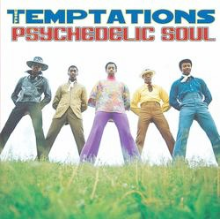
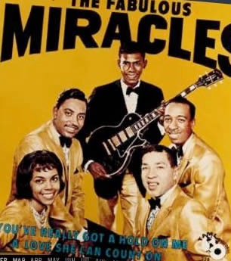
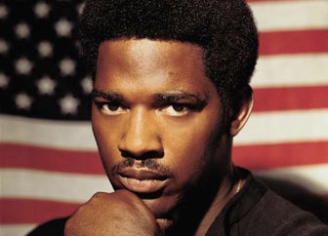
By 1965 a more complex, layered sound with backup singers, brass and strings.
“What Becomes of the Brokenhearted” Jimmy Ruffin, 1966
In the late ‘60s a ‘psychedelic soul’ sound, (“Cloud Nine”), which culminated in Marvin Gaye’s “What’s Goin’ On” 1971 and Edwin Starr’s “War.”

Slide 9
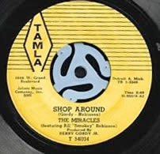
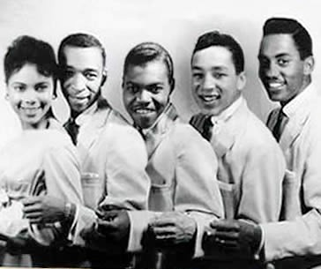
Motown’s history
In 1960 "Smokey”
Robinson convinced
Gordy to distribute own
records; shortly after
that "Shop Around" hit #2
on the charts.
By the mid-1960s, eight
record labels, a
management service, and
a publishing company
The Miracles

Slide 10
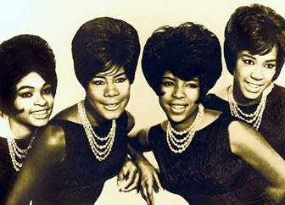
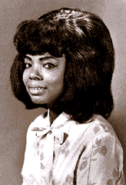
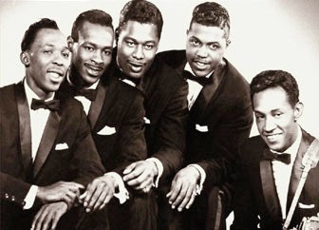
Marvelettes
Mary Wells
Consistent hits early with Smokey and girl groups. Mary Wells, the Marvelettes, the Contours, “Do you love me”
Motown a strong backer of Martin Luther King.
Contours

Slide 11
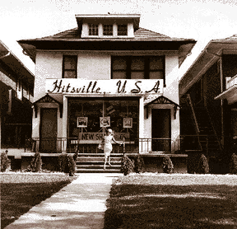
Motown from 1964 through 1967
14 #1 pop singles
20 #1 R & B singles
46 Top 15 pop singles
75 top 15 R & B records.
In 1967, Motown sold 70 % of its records to whites
In 1970 alone, 16 songs were in the Top 10
Motown had 1/3 of all #1 songs!

Slide 12
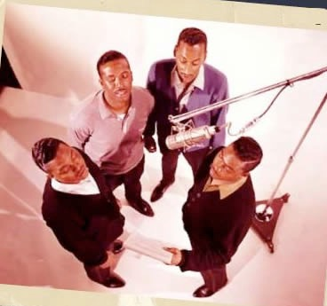
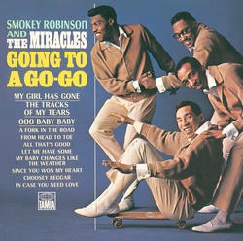
Gordy's organization increased its share of the hit market throughout the 1960s
in 1970 alone, 16 songs in the Top 10.
In 1967, the Motown empire began to suffer internal disputes.

Slide 13
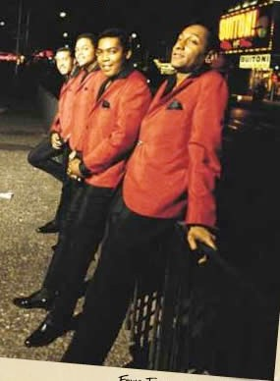
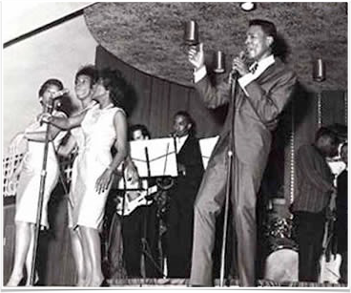
By 1969 Motown was one of USA top 5 record companies.
In 1971 Berry Gordy moved the Motown
headquarters to LA.

Slide 14
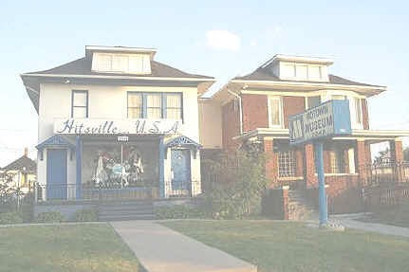
The Artists
Motown's headquarters ("Hitsville, USA") a magnet for talent

Slide 15
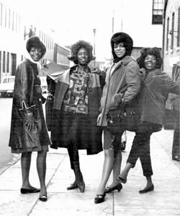
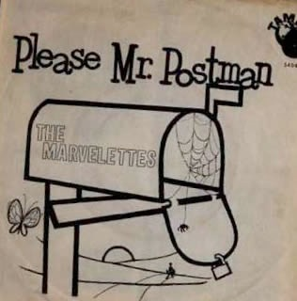
Vocal groups predominated
The early girl group with the Marvelettes hit “Please Mr. Postman” (1961)

Slide 16
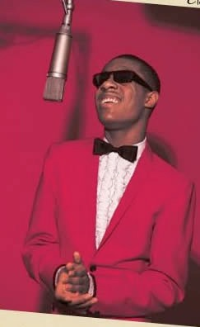
Important solo acts include Marvin Gaye, Mary Wells, and Stevie Wonder. Gaye signed in 1961, “How sweet it is (to be loved by you)”
Stevie Wonder
Marvin Gaye & Tammi Terrell

Slide 17
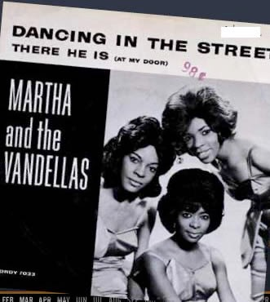
Martha Reeves a secretary who
convinced the company
to sign her group.
In 1963, Martha and
the Vandellas hit the
charts with the
million-selling
"Heat Wave" followed
by "Dancing in the Street."

Slide 18
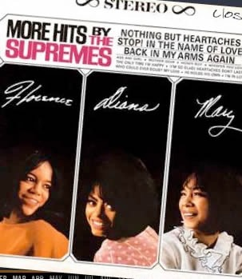
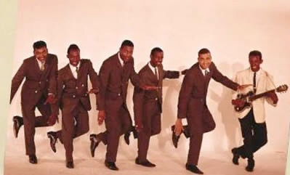
Gordy was not known for his warm attention to acts. Yet the Temptations, Smokey Robinson and Diana Ross forged successful long-term careers.

Slide 19
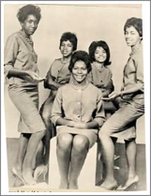
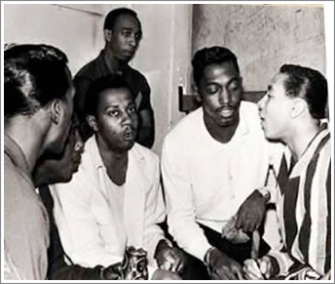
Smokey Robinson
unusual as both a
performer and
songwriter/producer;
also wrote for Mary Wells,
the Marvelettes, and the Temptations.
Track of My Tears(#16) 1965

Slide 20
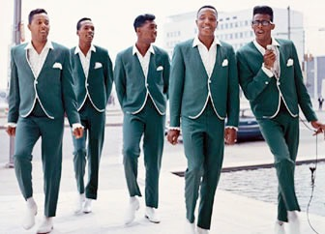
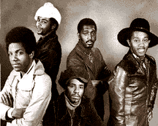
The Temptations were signed in 1960, and on the charts by 1964. They recorded Smokey Robinson’s "My Girl," and remained on the charts through the ‘60s with several hits including "Ain't Too Proud To Beg" and "(I Know) I'm Losing You."

Slide 21
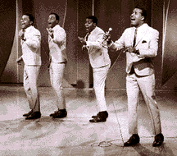
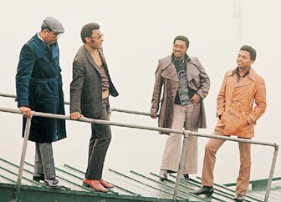
The Four Tops were originally signed to Chess in the 1956. After a string of failures on small labels, the Motown team revived their careers in 1963 and
paired them with Holland-Dozier-Holland,
who wrote "Baby I Need
Your Loving," "I Can't Help Myself," and "Reach Out I'll Be There.”
Their fortunes declined when H-D-H left, but their career continued in the 21st c.

Slide 22
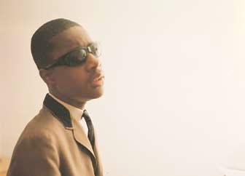
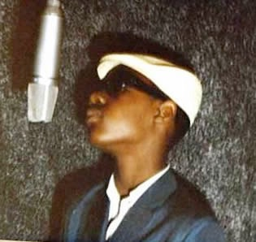
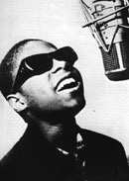
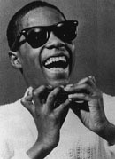
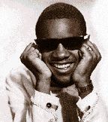
Stevie Wonder signed at age 11, had his 1st #1 hit in 1963 “fingertips part II,” worked in the Motown factory with everyone, “Uptight,”
“Signed sealed delivered I’m yours”

Slide 23
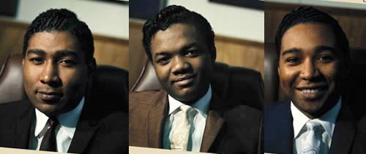
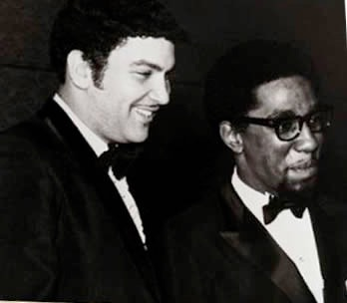
Songwriting and production talent competed for hot recording acts.
Among the most famous were
Holland-Dozier-Holland
(“Heat Wave"), Whitfield and Strong, and Ashford and Simpson.

Slide 24
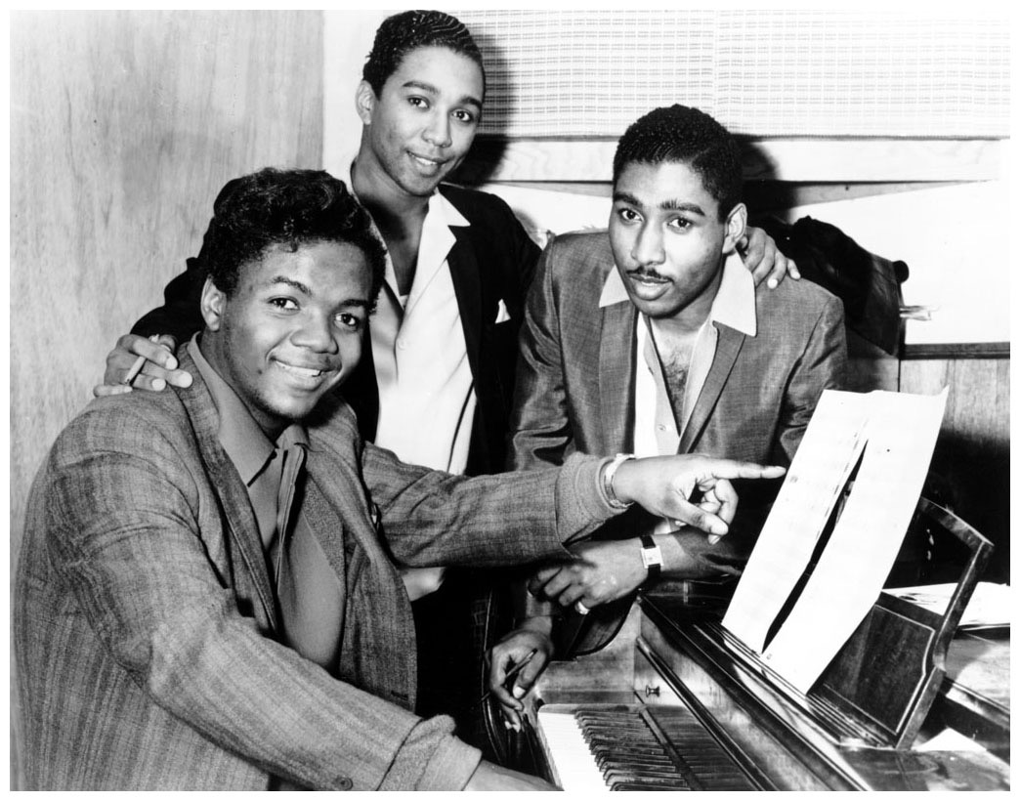
in-house songwriters hollanD-dozier-holland
Heat Wave
How Sweet It Is (Being Loved By You)
Baby, I Need Your Loving
I Can’t Help Myself
Reach Out, I’ll Be There
Standing In The Shadow Of Love
This Old Heart of Mine
Where Did Our Love Go
Baby Love
Come See About Me
Stop, In The Name Of Love
28 hits for the label,
17 for the Supremes alone
Back In His Arms Again
I Hear A Symphony
You Can’t Hurry Love
You Keep Me Hangin’ On

Slide 25
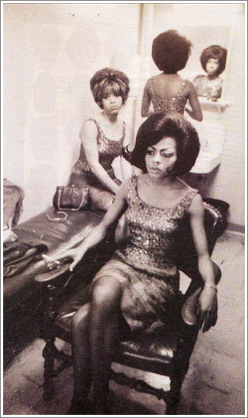
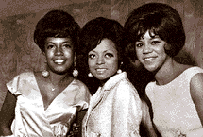
The Supremes were three black women from the projects put through Motown finishing school. A long road to success, from “Baby Love,” to the topical late 1960s “Love Child”

Slide 26
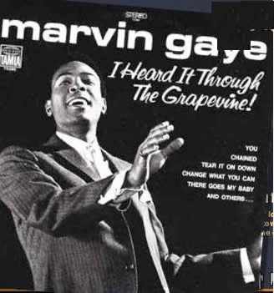
Marvin Gaye (1934–1984)
Hired by Motown as drummer
Then singer and arranger
Had a successful duet career with Tammi Terrell until the latter’s illness forced her to retire
Becomes biggest star of Motown label
Songs in the Motown style, but sound a little closer to the soul found on other labels
Later he breaks away from the Motown system and takes control of his production
Killed by his father 1984

Slide 27
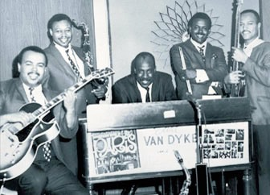
The Funk Brothers maintained a high level of musicianship. Bass player James Jamerson revolutionized pop bass.

Slide 28
Two Songs from the hottest period
"My Girl," composed and produced by Smokey Robinson and Ronald White, performed by the Temptations (#1, 1965)
"You Can't Hurry Love" Holland-Dozier-Holland, produced by Brian Holland and Lamont Dozier, performed by the Supremes (#1, 1966)

Slide 29
My Girl
Intro establishes rhythmic foundation
2 bar bass riff starts on “and” of 4
Guitar riff reinforces rock style beat
1 + 2 + 3 + 4 +
x x x x x x
snaps on backbeat
Lightly syncopated vocals
Hook: solo bass motive, lead guitar, drums and lead voice, background vocals; brass, strings.
Layering increases intensity. Brass response to lead.
An instrumental interlude before last verse, dominated by strings, with a new melodic figure.
Upward key change just before concluding verse and chorus

Slide 30
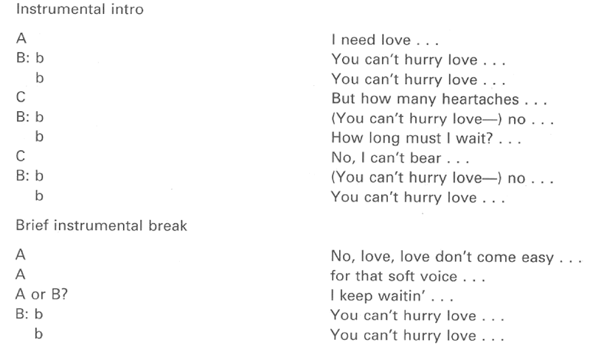
You Can't Hurry Love

Slide 31
70s Motown
“Super Freak” Rick James
Lionel Ritchie and the Commodores

Slide 32
The Jackson Five from Gary, Indiana, first recorded in 1969, when Michael was eleven: their 1st four hits all reached #1 in 1970, including “I want you back” and “I’ll be there”

Slide 33
Marvin Gaye - What’s Goin’ On (1971)
Ground breaking song/LP
Commentary on racism, Vietnam war new for Motown
Sixteen-beat rhythmic foundation
Clear jazz influences in sax solos, relaxed syncopation
Still has “Motown sound” - thick textures
But very topical, political lyrics

