Slide 1
Sam Cooke and the Girl Groups

Slide 2
The Rise of Soul (Ray Charles and Sam Cooke)
Both men crossed over from rhythm & blues to pop charts
Both came from the Deep South
Both were influenced by African American sacred music (gospel)
Both faced criticism from church leaders
Both were successful businessmen

Slide 3
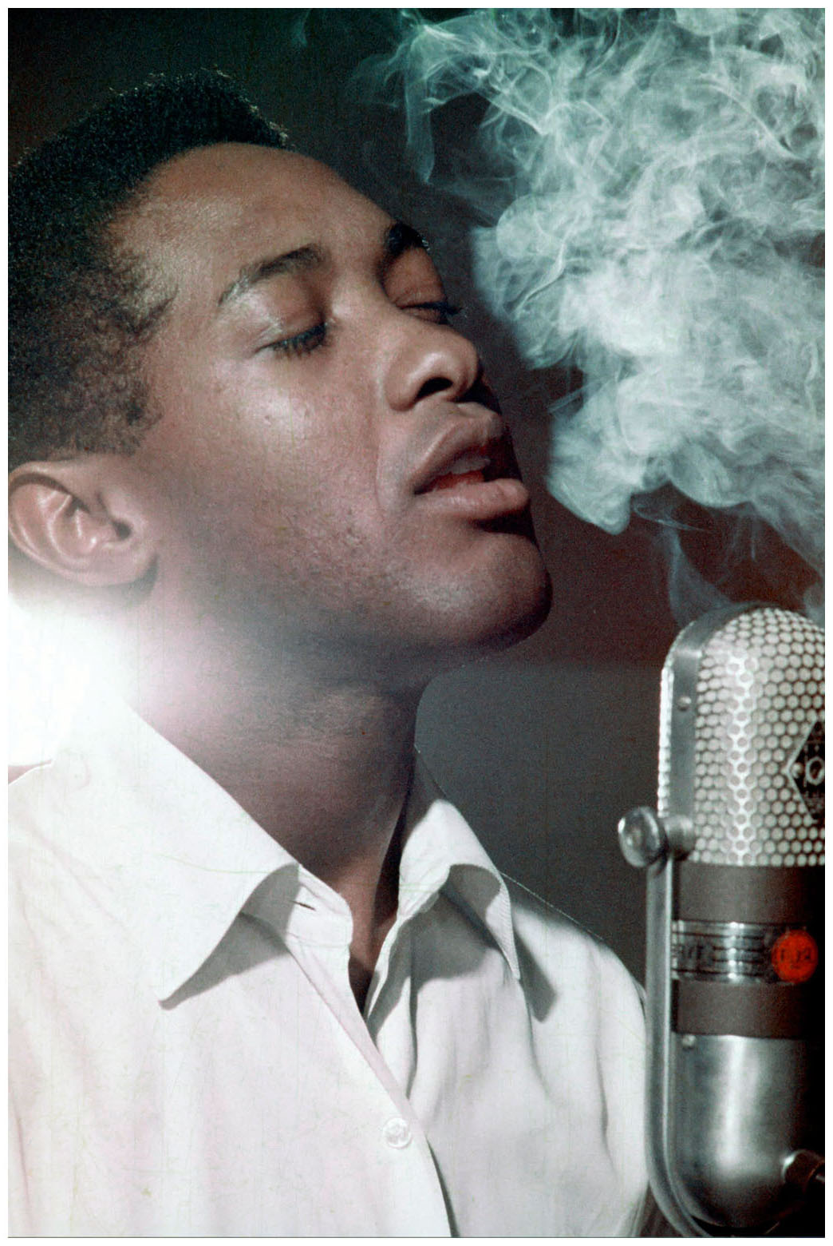
Sam Cooke (1931–64)
Established his career in Chicago
joined Gospel quartet the Soul Stirrers in 1951, who recorded for Specialty
Cooler vocal approach shaped by the influence of Nat “King” Cole
Embodied the tension between secular and gospel music
Gospel community never accepted him again after he sang nonreligious music under his own name
Politics resided more in his life than his music
Devotion to African American community
Commitment to black self-determination

Slide 4
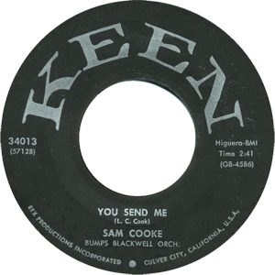
“You Send Me” (1955; released 1957)
Cooke's debut single was a massive commercial success: #1 on the Billboard R&B and Pop charts, beating Teresa Brewer’s cover version
Distinctive because of Cooke’s voice and personality
Makes use of melisma (a single word or syllable is stretched out over multiple pitches)
Considered a founding song of “Soul”
In 1960 signed with RCA and began recording gospel-inflected songs, later formed his own label & publishing company

Slide 5
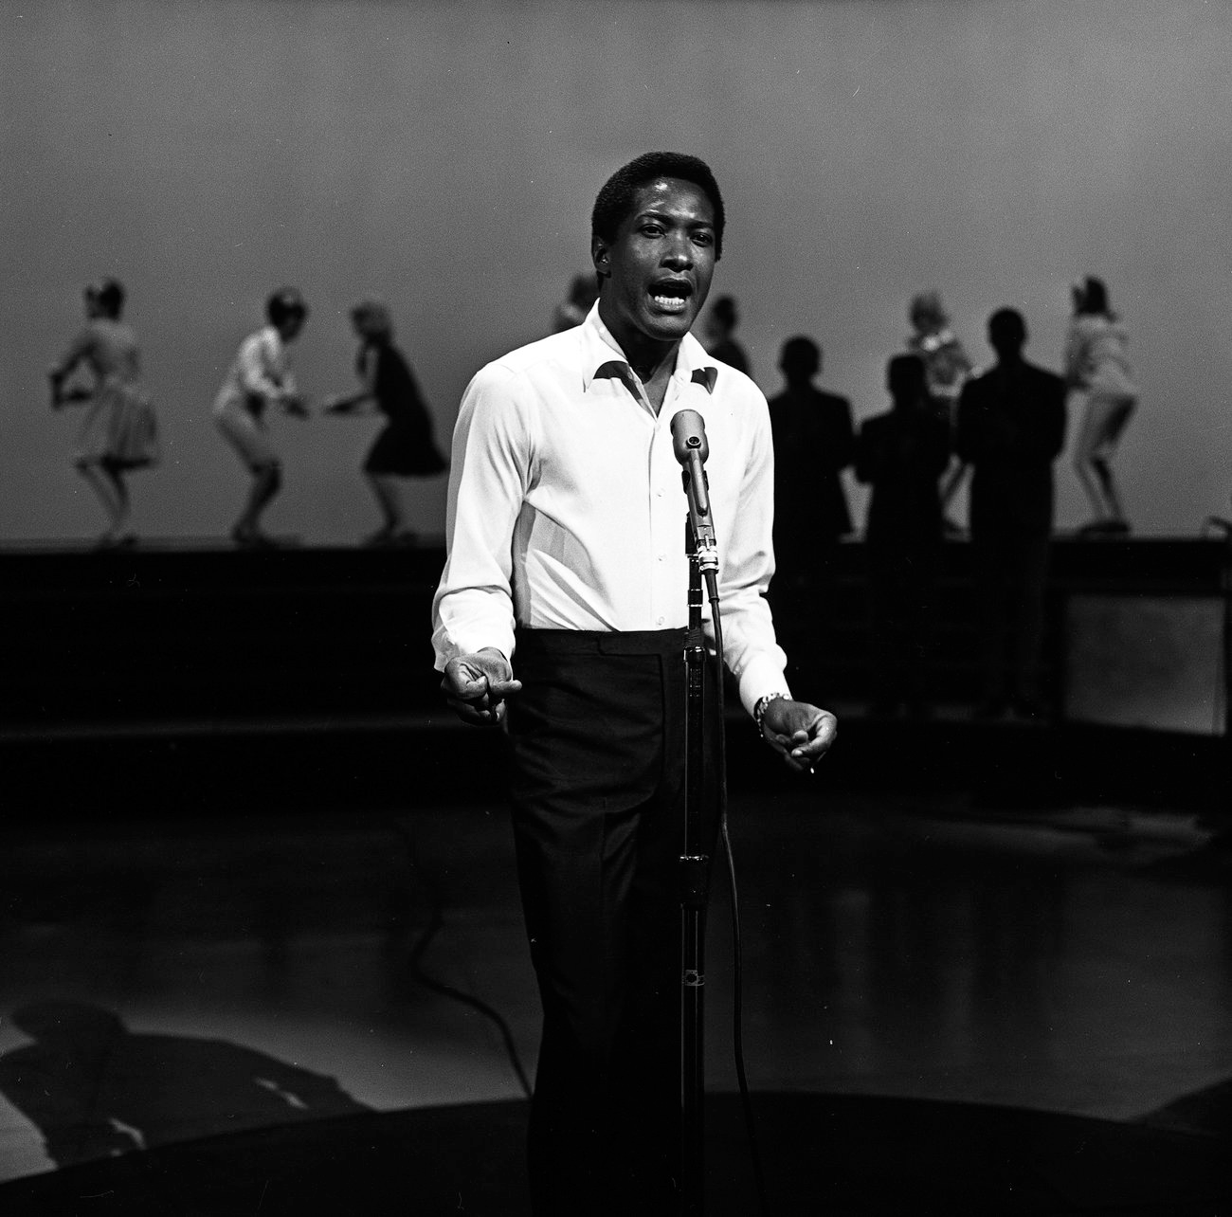
“A Change Is Gonna Come”
Adopted as an anthem of the civil rights movement
Major influence on rock
Many of his songs are covered by rock artists, vocal style very influential
Killed under mysterious circumstances in 1964
Well-known political song, “A Change Is Gonna Come” which was released posthumously in 1965
Inspired by Dylan’s “Blowin’ in the Wind” and Cooke’s experiences while on tour

Slide 6
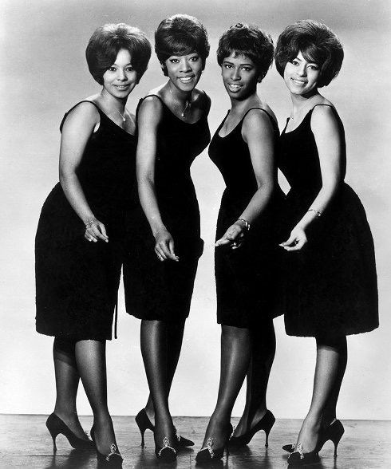
Girl Group Rock
Usually black, always urban, one distinctive lead singer and back-ups
Presented as if in high school, posed in their prom dresses
The Chiffons
A function of the producer’s sound.
Not R&B or soul but straight rock, aimed at Top 40.
The relationship with the producer made girl group records very personal.
From one point of view, about a girl’s wish to be free, from a male fantasy figure

Slide 7
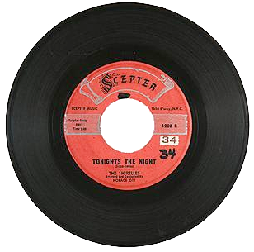
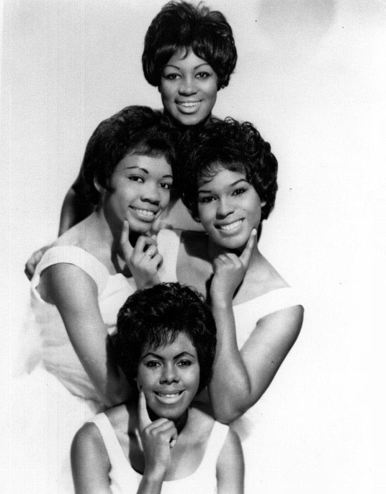
Tonight’s the night (1960) by Luther Dixon and Shirley Owens
Released in 1960; title and lead track from the Shirelle’s 1961 LP
Co-written by singer Shirley Owens
The song was shocking when it was released for its frank depiction of a woman’s desires
You said you're gonna meet me,
Tonight's the night.
You said you're gonna kiss me,
Tonight's the night,
Well I don't know,
Said I don't know right now
I might love you so.
You say you're gonna beg me,
Turn the lights down low
You said you're gonna make me
Feel all aglow.
Well I don't know,
Well I don't know right now
I might love you so.
I might love you so much.
You may break my heart.
I may want you so much
And all my dreams been torn apart.

Slide 8
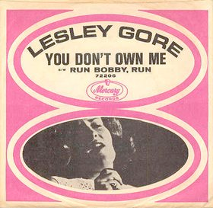
You don’t own me (1963) by John Madara and David White
Recorded by Lesley Gore when she was 17
An anthem for female independence
Second largest hit after “It’s My Party,” No. 1 in 1963
Both enlivened by the production of Quincy Jones
You don't own me
I'm not just one of your many toys
You don't own me
Don't say I can't go with other boys
And don't tell me what to do
Don't tell me what to say
And please, when I go out with you
Don't put me on display 'cause
You don't own me
Don't try to change me in any way
You don't own me
Don't tie me down 'cause I'd never stay
I don't tell you what to say
I don't tell you what to do
So just let me be myself
That's all I ask of you

