Slide 1
The Brill Building and Aldon music
Songwriters, producers, hit makers

Slide 2
Music Business/Trends
Rock ’n’ roll musicians participated more fully in business
Some musicians and fans embraced outsider status
Commercial possibilities included hybrid form
Tin Pan Alley business model
Rock ’n’ roll sound
Led to early 1960s often being described as a lackluster period

Slide 3
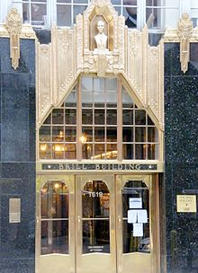
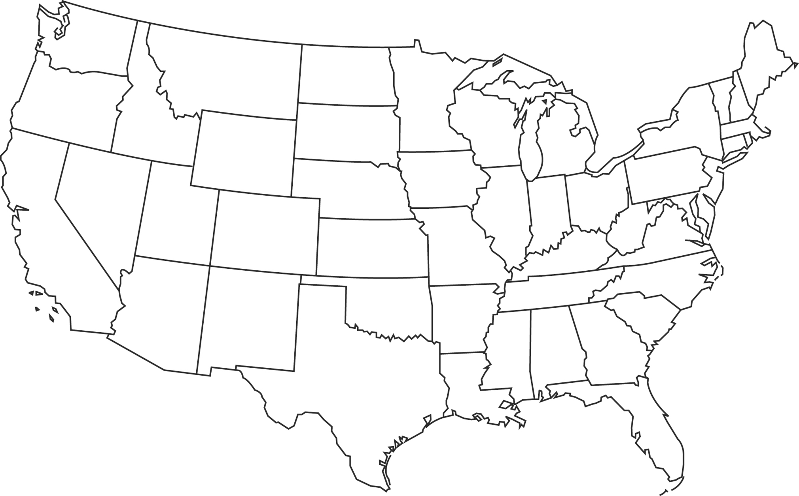
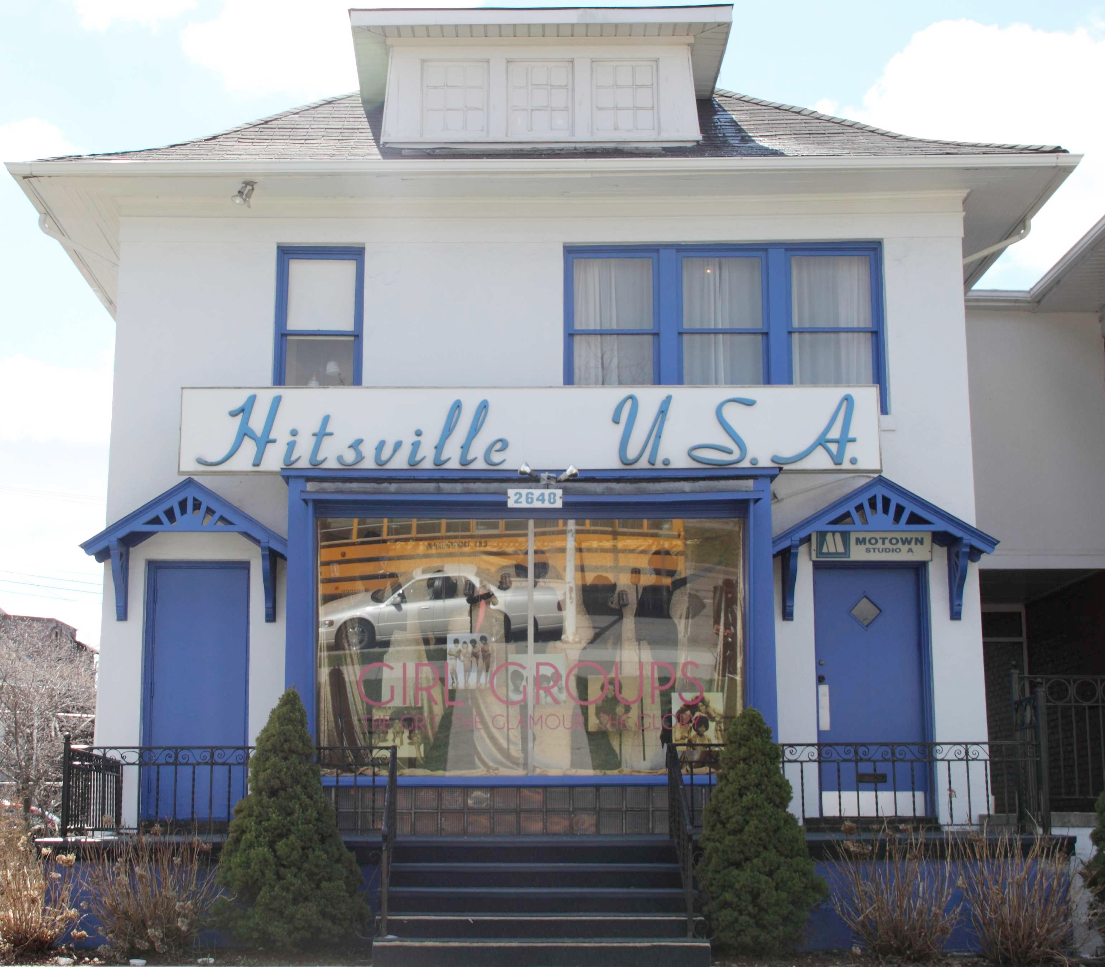
Early 1960s centers of Rock & major studios
Phil Spector & Surf Rock/Goldstar, Hollywood
Motown, Detroit
Brill Building pop and Atlantic records, NYC
Stax, Memphis (Soul, R&B)
Fame, Muscle Shoals, Alabama

Slide 4
Songwriters and Producers (1960s)
New emphasis on songwriting as a craft
Brill Building in NYC: where many top songwriters had offices
Record producers: responsible for the characteristic sound of the finished record
In 1960s, the producer and the songwriter were often the same person, with much power and influence

Slide 5
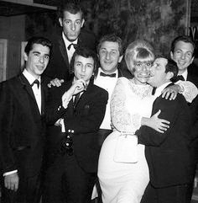
The Brill Building (1958 —1970s)
Located at 1619 Broadway in New York, once Tin Pan Alley.
Across the street at 1650 Broadway was Aldon Music Publishers owned by Al Nevins and Don Kirshner. With their guidance, Brill began collecting songwriters, arrangers and artists and producing music for rock and roll market.
Competition helped Brill composers and artists produce thousands of hits during this period.
In the early 1960’s there were over 160 music businesses: writers, publishers, music printers and promoters.

Slide 6
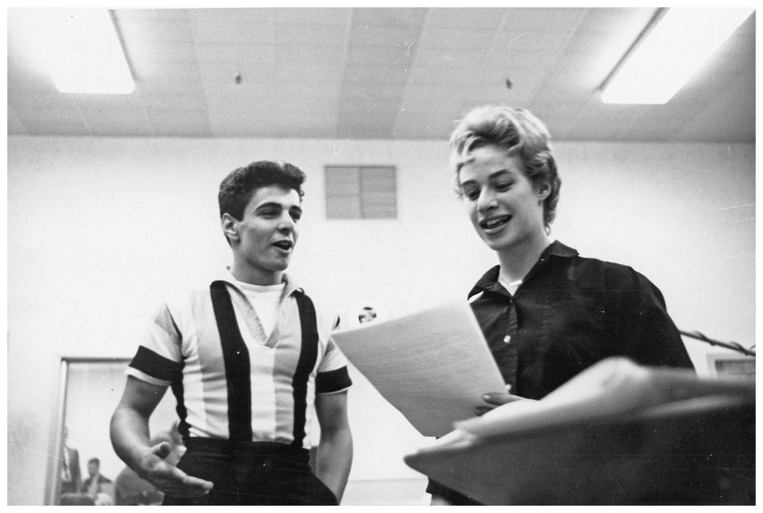
The Brill Building
These New York-based songwriters worked for mostly independent labels
Gerry Goffin and Carole King
Became like a vertical Tin Pan Alley
Some Brill Building songwriters also had performing careers
Neil Sedaka, Neil Diamond, Carole King

Slide 7
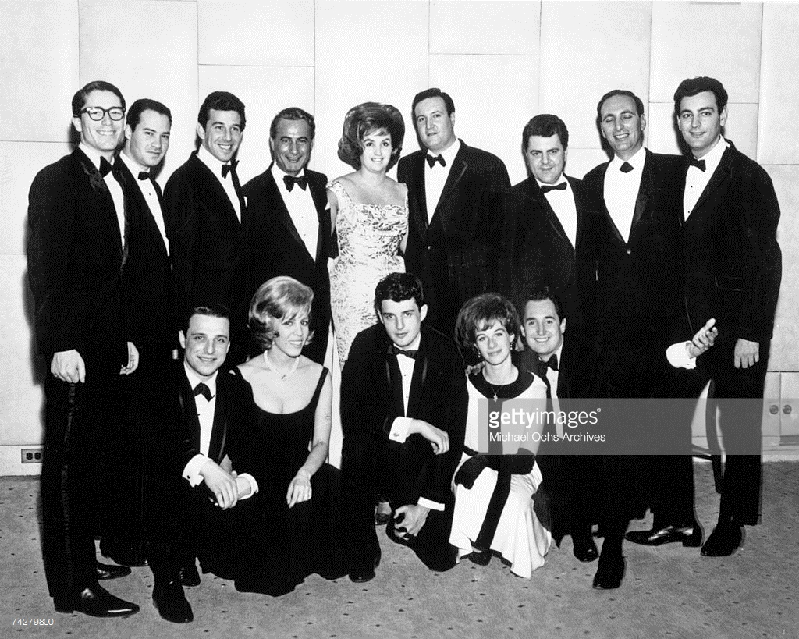
Brill Building Songwriters
Jerry Leiber and Michael Stoller
Hound Dog, Jailhouse Rock, Yakety Yak, Love Potion #9, Kansas City, Stand By Me
Gerry Goffin and Carole King
Will You Still Love Me Tomorrow, Take Good Care Of My Baby, Up On The Roof
Barry Mann and Cynthia Weil
You’ve Lost That Lovin’ Feeling, On Broadway
Ellie Greenwich and Jeff Barry
Be My Baby, Chapel Of Love, Do Wah Diddy Diddy, Leader of the Pack
Neil Sedaka
Calendar Girl, Breaking Up Is Hard To Do
Burt Bacharach and Hal David
These Magic Moments, Wishin' and Hopin’, Blue on Blue

Slide 8
Song forms
Tonight with words unspoken
You say that I'm the only one
But will my heart be broken
When the night meets the morning sun
Is this a lasting treasure
Or just a moment's pleasure
Can I believe the magic in your sighs
Will you still love me tomorrow
I'd like to know that your love
Is a love I can be sure of
So tell me now and I won't ask again
Will you still love me tomorrow
Tonight you're mine, completely
You give your love so sweetly
Tonight the light of love is in your eyes
But will you love me tomorrow
Optional introduction
A=Verse: usually 8 bars, sometimes 16 bars
A=Verse: same musical idea, different lyrics
B=Bridge/Chorus/Refrain/Middle 8: contrasting musical idea
A=Verse: first musical idea, different lyrics
Ending; fade endings common
Will you still love me tomorrow? by King and Goffin, sung by the Shirelles

Slide 9
Style features of brill and aldon pop
Song form (Verse-Verse-Chorus-Verse) rather than the blues
• Danceable
• Short: ca. 2 minutes, 30 seconds
• Well-produced, polished studio sound
• Violins and other orchestral instruments
• Simple, rhyming lyrics
• Backup vocals
• Insignificant back-beat
• No blues or rhythm and blues influence
• No twangy guitar, slap bass or honking horns
• No strong regional accents

Slide 10
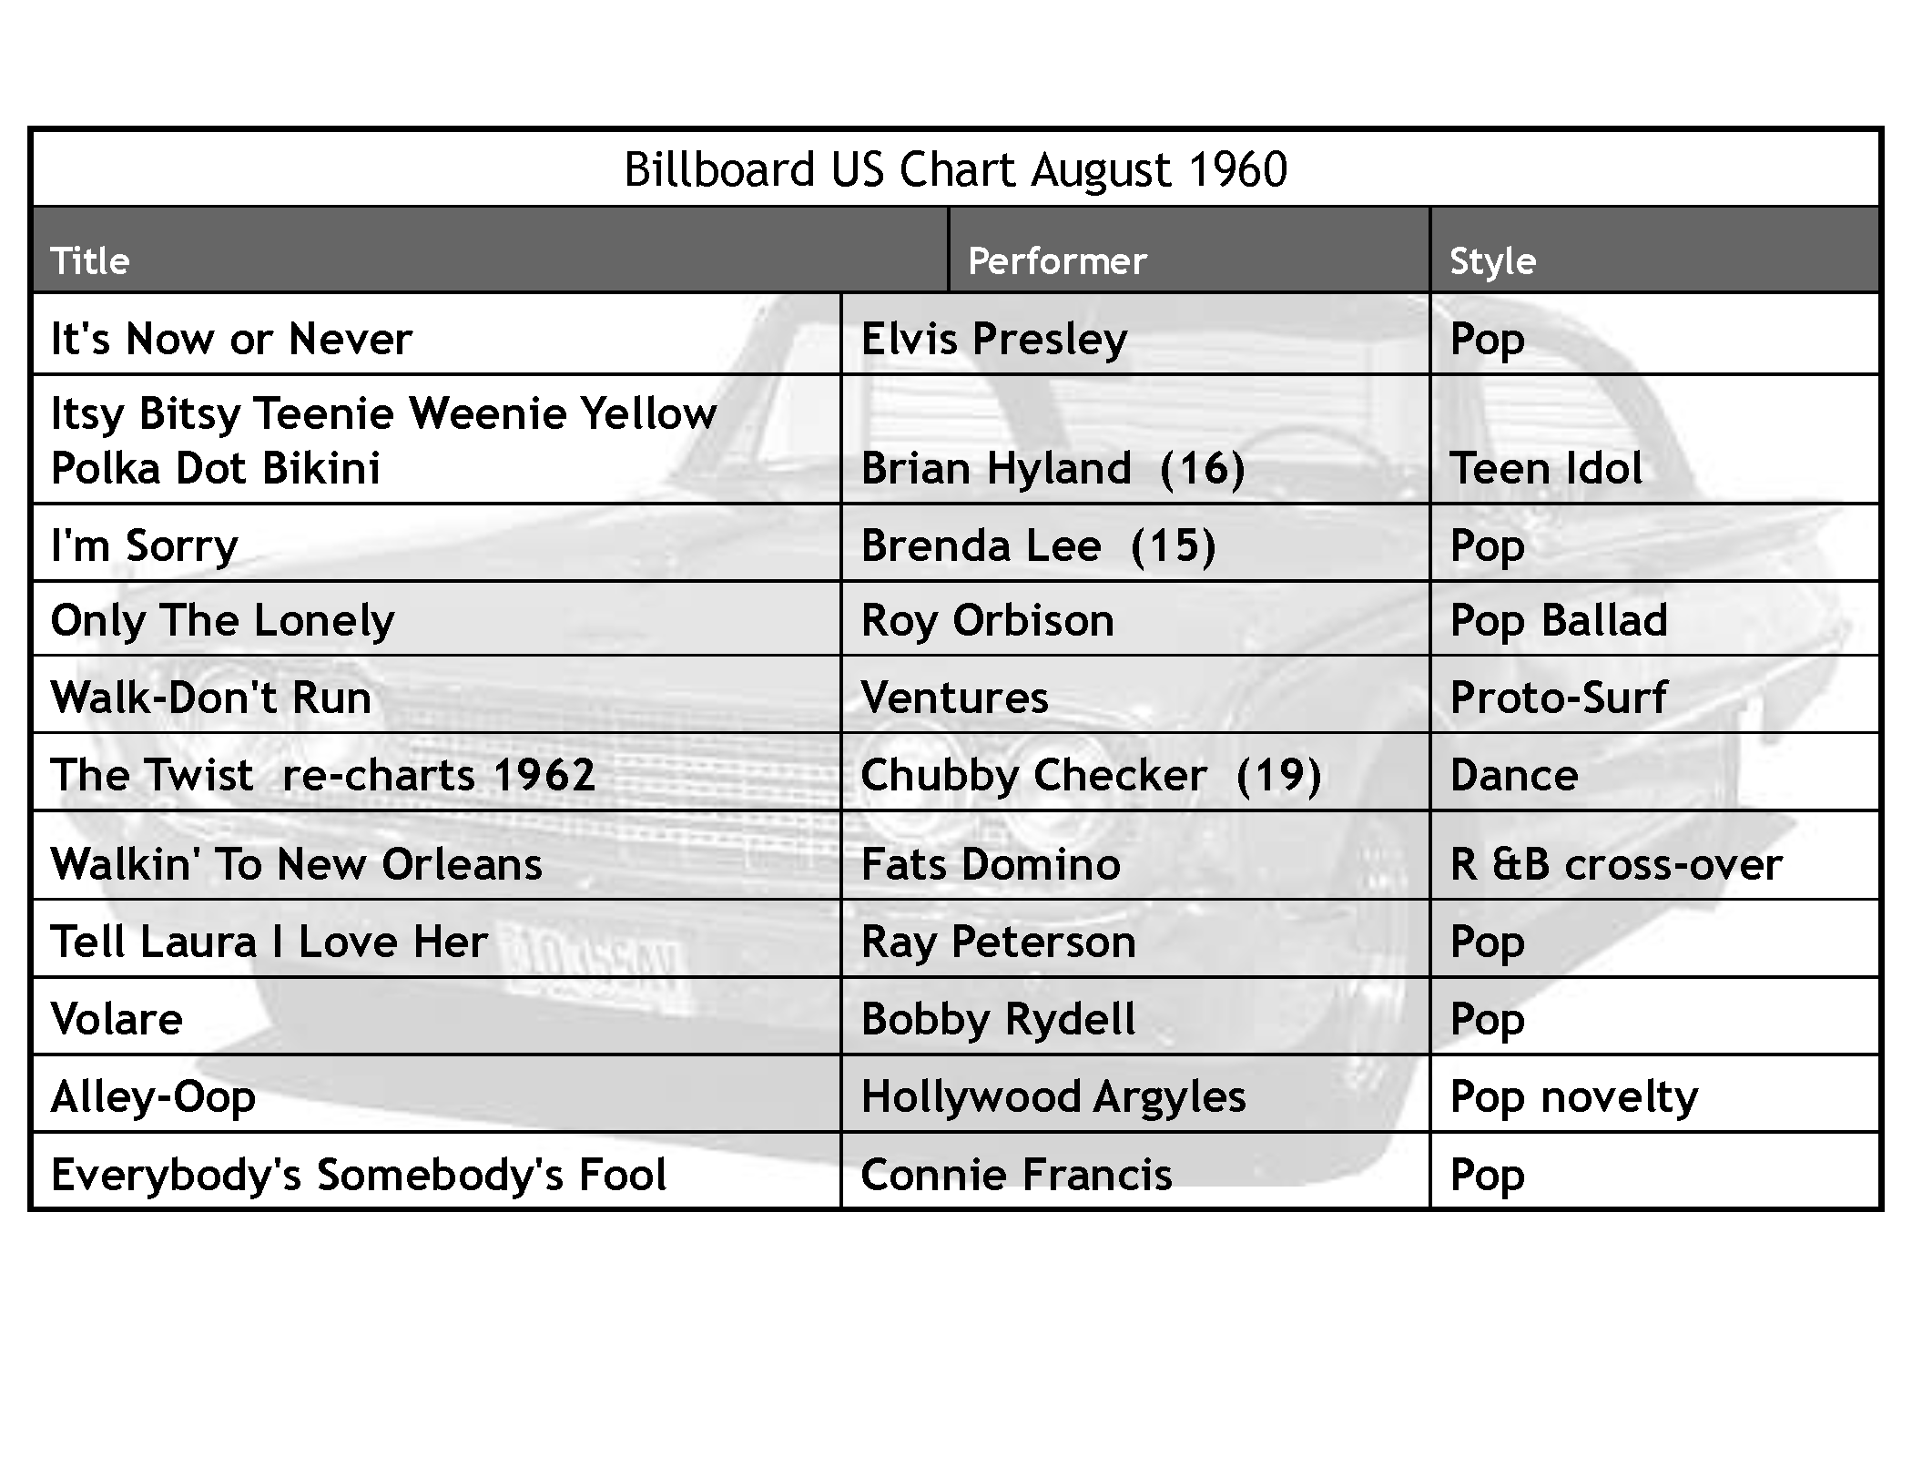

Slide 11
