Slide 1
Rockabilly and Sun Records 1
Sonny Burgess, Carl Perkins, Jerry Lee Lewis

Slide 2
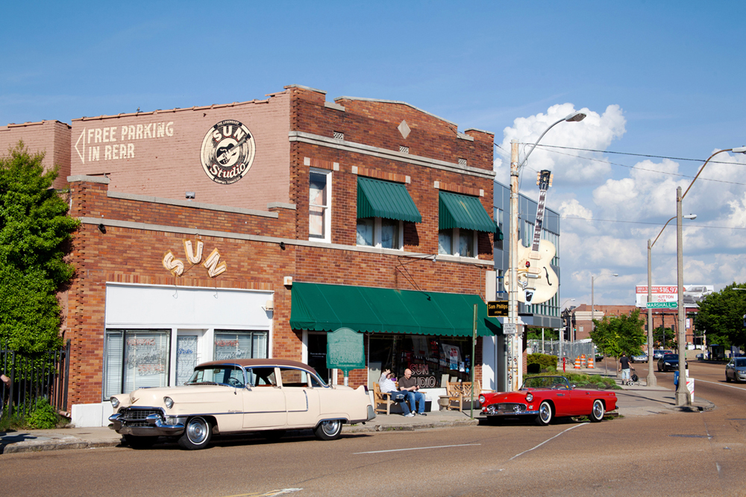
sun studios artists
Elvis Presley
The Prisonaires
Charlie Rich
Billy Lee Riley
Rufus Thomas, Jr.
Conway Twitty
Howlin’ Wolf
Sonny Burgess
Johnny Cash
The Dixie Cups
Roger Miller
Charlie Feathers
Roscoe Gordon
Merle Haggard
Jerry Lee Lewis
Roger Miller
Roy Orbison
Junior Parker
Carl Perkins
Rockabilly Country
Blues R&B
Pop Doo-wop

Slide 3
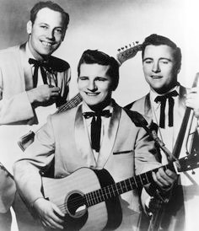
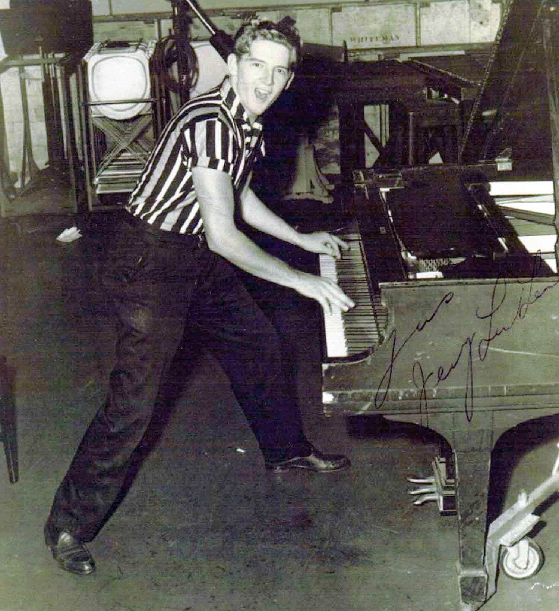
Rockabilly
Combination of country and R&B, but with more weight on the country elements
Less blues influence on vocal style than Berry, Little Richard
Rather, hiccups, stutters
vibrato (quavery) vocal effects
Fast, nervous tempos of bluegrass
Accented backbeat, but even beats of country music
The Burnette trio
Jerry Lee Lewis

Slide 4
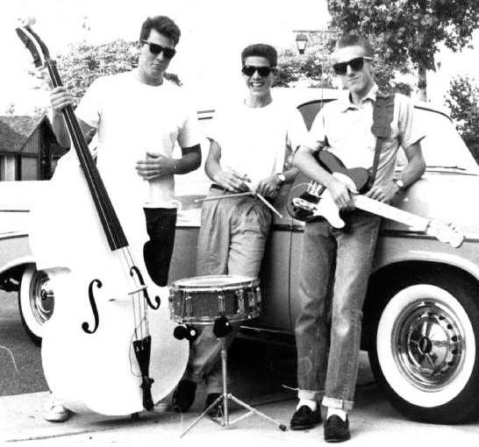
Rockabilly
“rock” or “honky-tonk” instrumentation
lead electric guitar
acoustic rhythm guitar
string bass
drums (sometimes just a snare)
songs from R&B repertoire, or in similar style

Slide 5
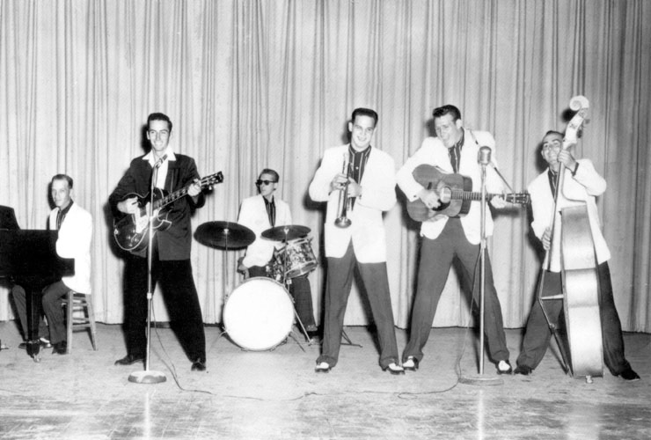
sonny burgess (1931-2017)
Began with a boogie woogie band in the early 1950s around Newport, Arkansas
Came back from the army in 1953 and re-formed the band, then expanded under Sam Philips tutelage to become the Pacers
First recording in 1956 considered the most raucous rock to date, produced his only hit “Red-headed Woman”
Still producing a weekly radio show and performing with members of the Pacers and other bands

Slide 6
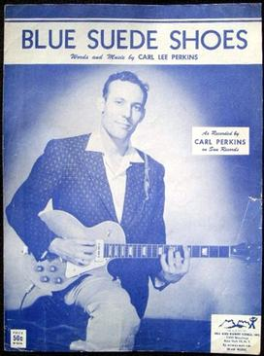
Carl Perkins (1932-1998)
Born rural Tennessee
Working as country singer when heard Elvis on radio
Decided to pattern style after Elvis
Auditioned for Sam Phillips
First record - “Blues Suede Shoes” - major hit
Country influences audible
But heavy doses of blues as well
Stop time
guitar style
riff-based

Slide 7
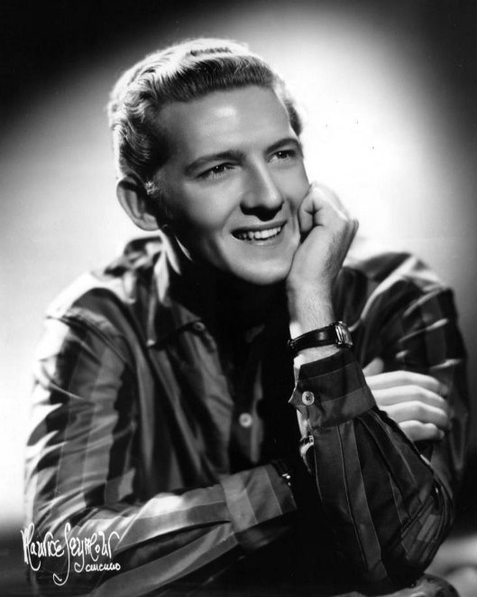
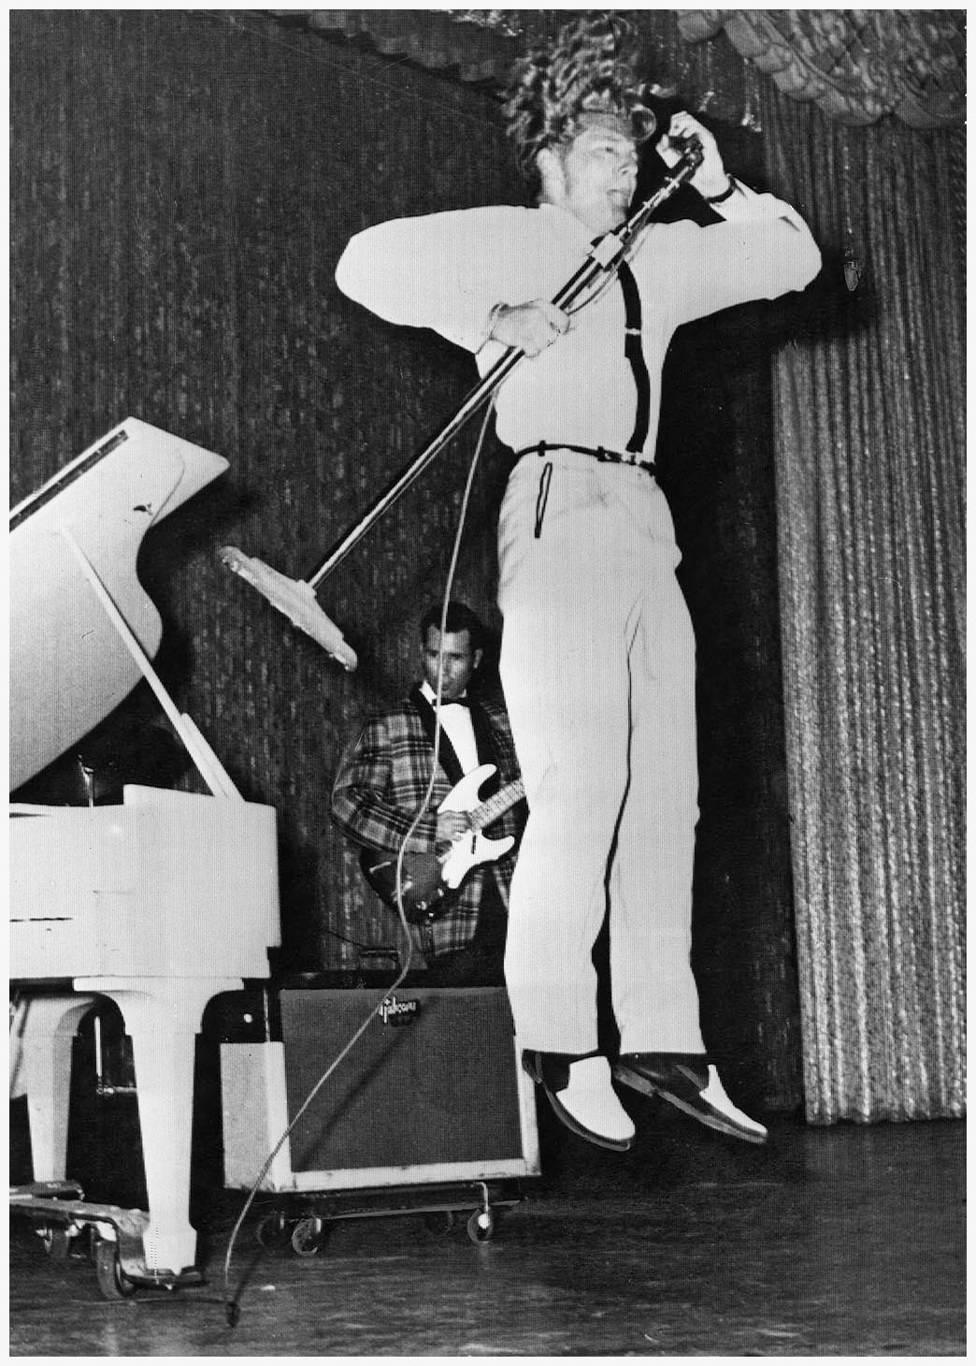
Jerry Lee Lewis (1935- )
Born Ferriday, Louisiana
Primary influences - boogie-woogie piano, New Orleans R&B style of Professor Longhair, Fats Domino, country barrelhouse
Rockabilly, but much in common with Little Richard
Known for his personality and performance style as much as his music
Nickname (“The Killer”) and songs reinforced his image as a wild man

Slide 8
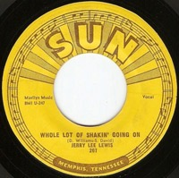
Whole Lotta SHakin’ going on
“Whole Lotta Shakin’ Going On” went to the top of the pop, r&b, and c&w charts, like Perkins’ “Blue Suede Shoes” and Elvis’ “Don’t Be Cruel” before it and nothing since. …
First recorded by Big Maybelle, but Lewis radically altered the original, adding boogie piano complemented by J.M. Van Eaton's drumming, Roland Janes' “muted” guitar and suggestive spoken asides.
Reached No. 3 on the Billboard pop chart, No. 1 on the R&B chart and No. 1 on the country charts.

Slide 9
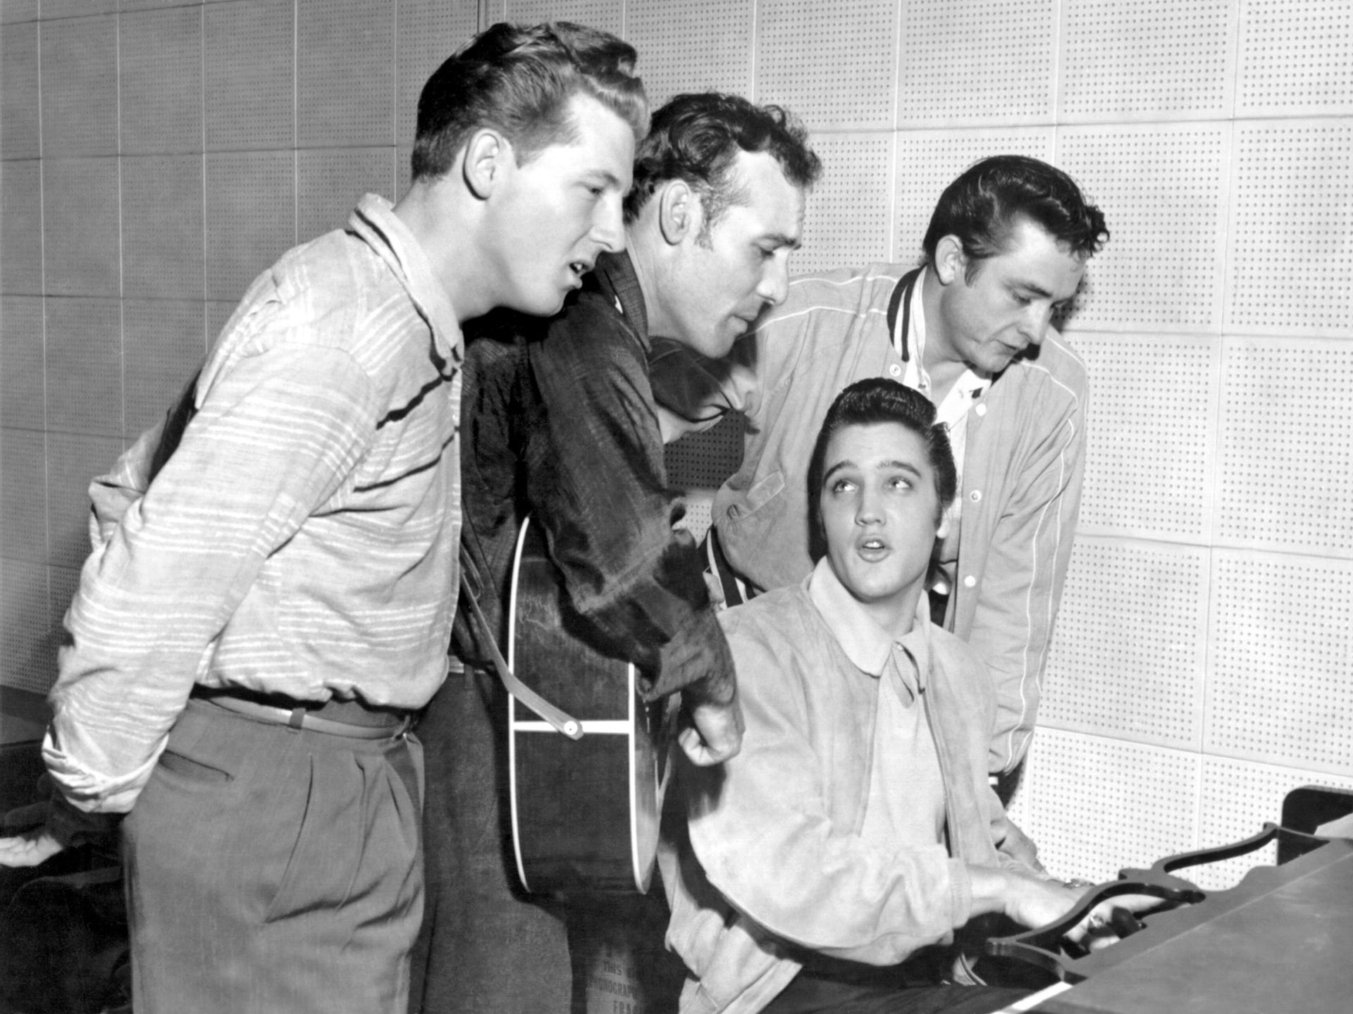
The “Million Dollar Quartet’”of Carl Perkins, Elvis Presley and Johnny Cash in 1956.

Slide 10
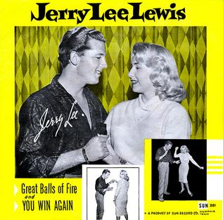
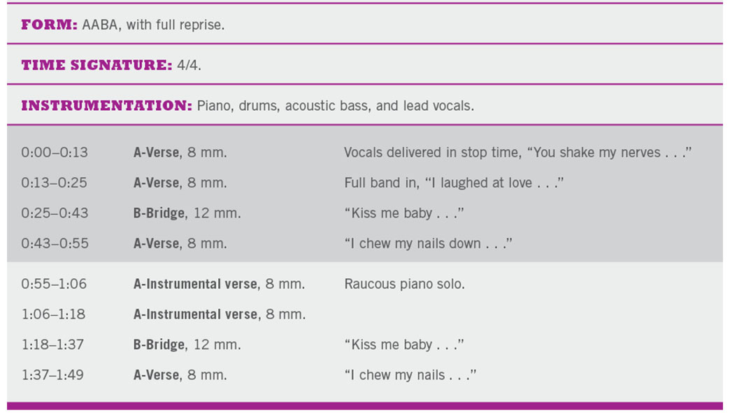
“Great Balls of Fire”was written in 1957 by Otis Blackwell and Jack Hammer. It sold one million copies in its first 10 days of release in the United States and sold over five million copies, making it one of the world's best-selling singles of all time. It reached No. 2 on the Billboard pop charts, No. 3 on the R&B charts, and No. 1 on the country charts

Slide 11
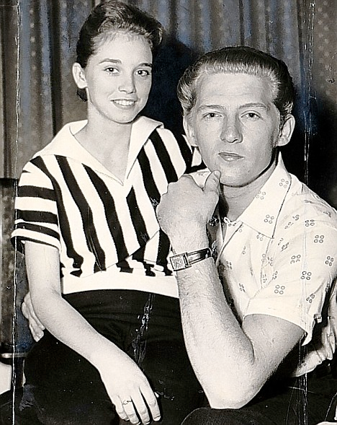
Decline of Jerry Lee Lewis
Career suffered when it became known that he married his thirteen-year-old second cousin Myra and took her on a tour of England in 1958
Became a country singer in the 1960s, with forays into Gospel and R&B

