Slide 1
Elvis and Rockabilly

Slide 2
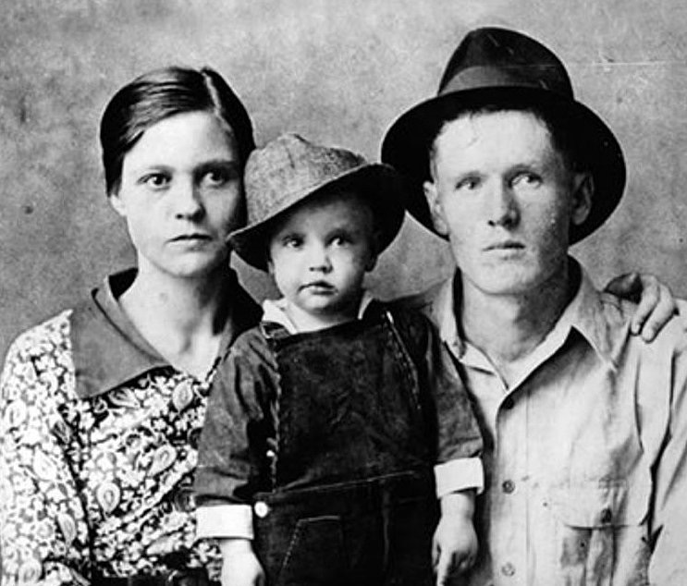
Elvis Presley (1935-1977)
Born Tupelo, Mississippi into poor family
Begins playing guitar age 10
Influences: Muddy Waters, Jimmie Rodgers, Southern Gospel
Family moves to Memphis 1948, absorbs blues, R&B scene

Slide 3
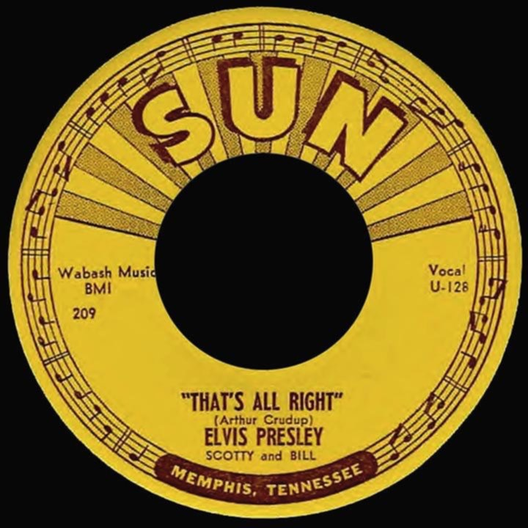
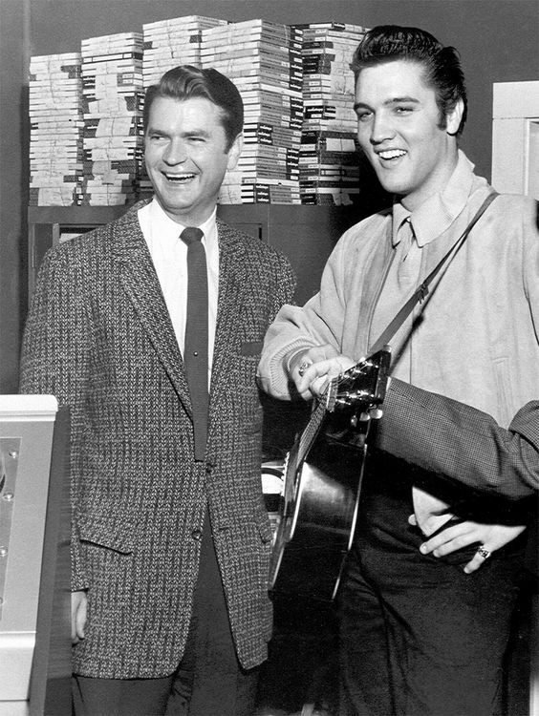
Elvis meets sam philips
Late 1953 goes into Sun studios to record demo, invited back in 1954
After recording some lackluster cuts, Elvis and guitarist Scotty Moore start playing the old blues song by Arthur Crudup, That’s All Right, Mama and Blue Moon of Kentucky
Memphis DJ Dewey Philips starts playing That’s All Right constantly: it’s a huge hit

Slide 4
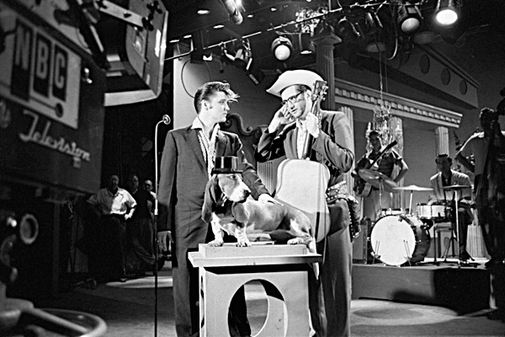
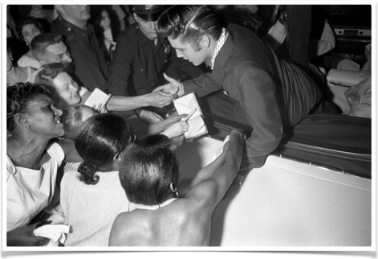
from memphis to the world
By August 1954 featured on Grand Old Opry, but Elvis doesn’t fit the Opry image
Finds a home at the Louisiana Hayride from 1954–1956; by that time he was a national figure
August 1956 TV appearances on the Milton Berle and Ed Sullivan shows are a sensation
Elvis on the Steve Allen show, 1956

Slide 5
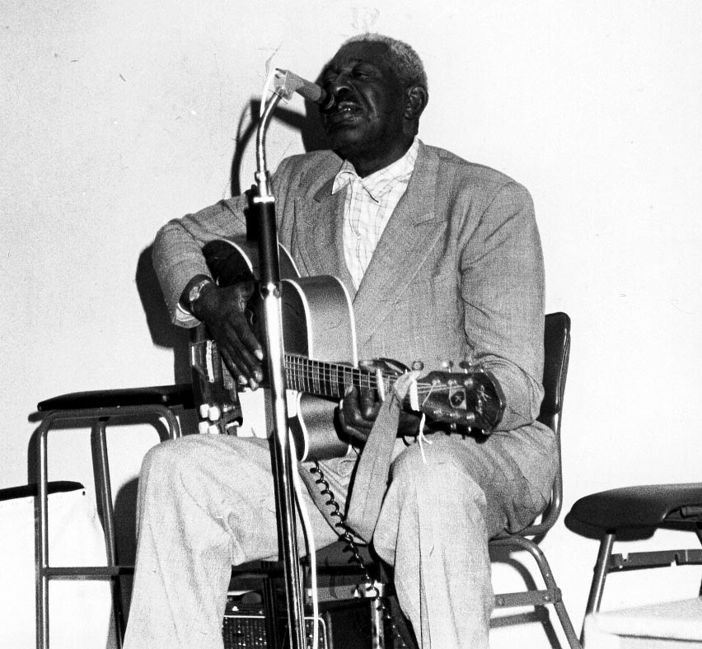
arthur crudup's original “That’s All Right, Mama”

Slide 6
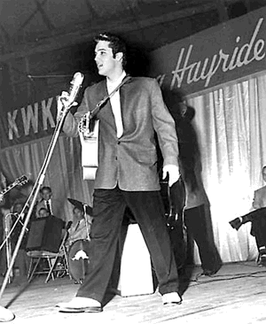
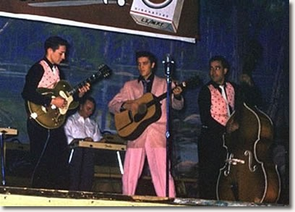
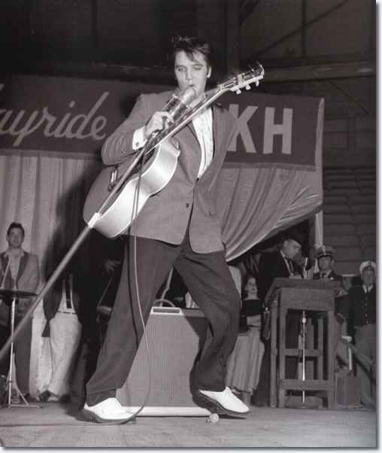
1954 on the louisiana hayride
1954
1955
1956

Slide 7
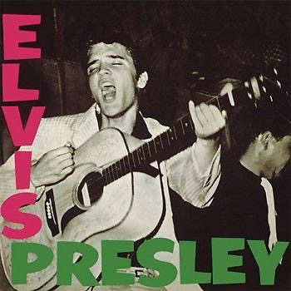
Elvis - Major Influences
Brings huge number of vocal styles into rock and roll
Persona in which country and R&B, black and white cultures mesh
Style combination of honky-tonk, Western swing, R&B, with unique vocal style
Creates sub-genre of rock and roll = rockabilly
Became the biggest-selling solo artist of any period until the early twenty-first century
Popularity established rock ’n’ roll as a mass-market phenomenon

Slide 8
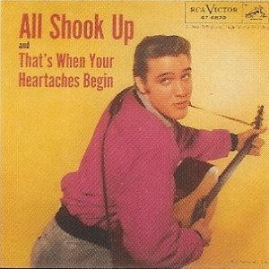
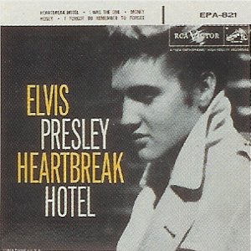
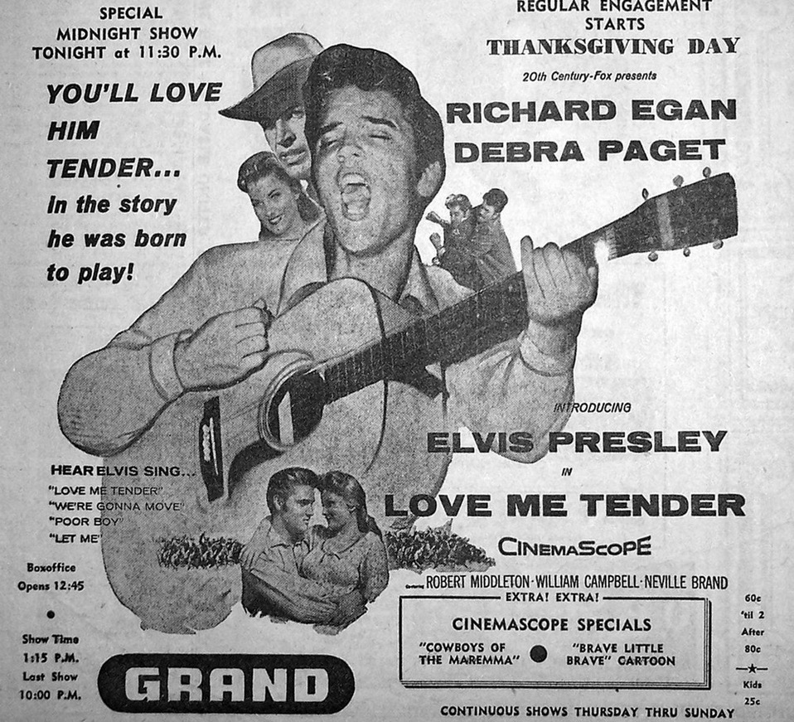
post-sun career
Moved to RCA Victor in late 1955
TV and film appearances managed by Colonel Thomas Parker
Pop-friendly sound produced by Chet Atkins
Appeared in dozens of bad movies from 1956 through the mid-1960s

Slide 9
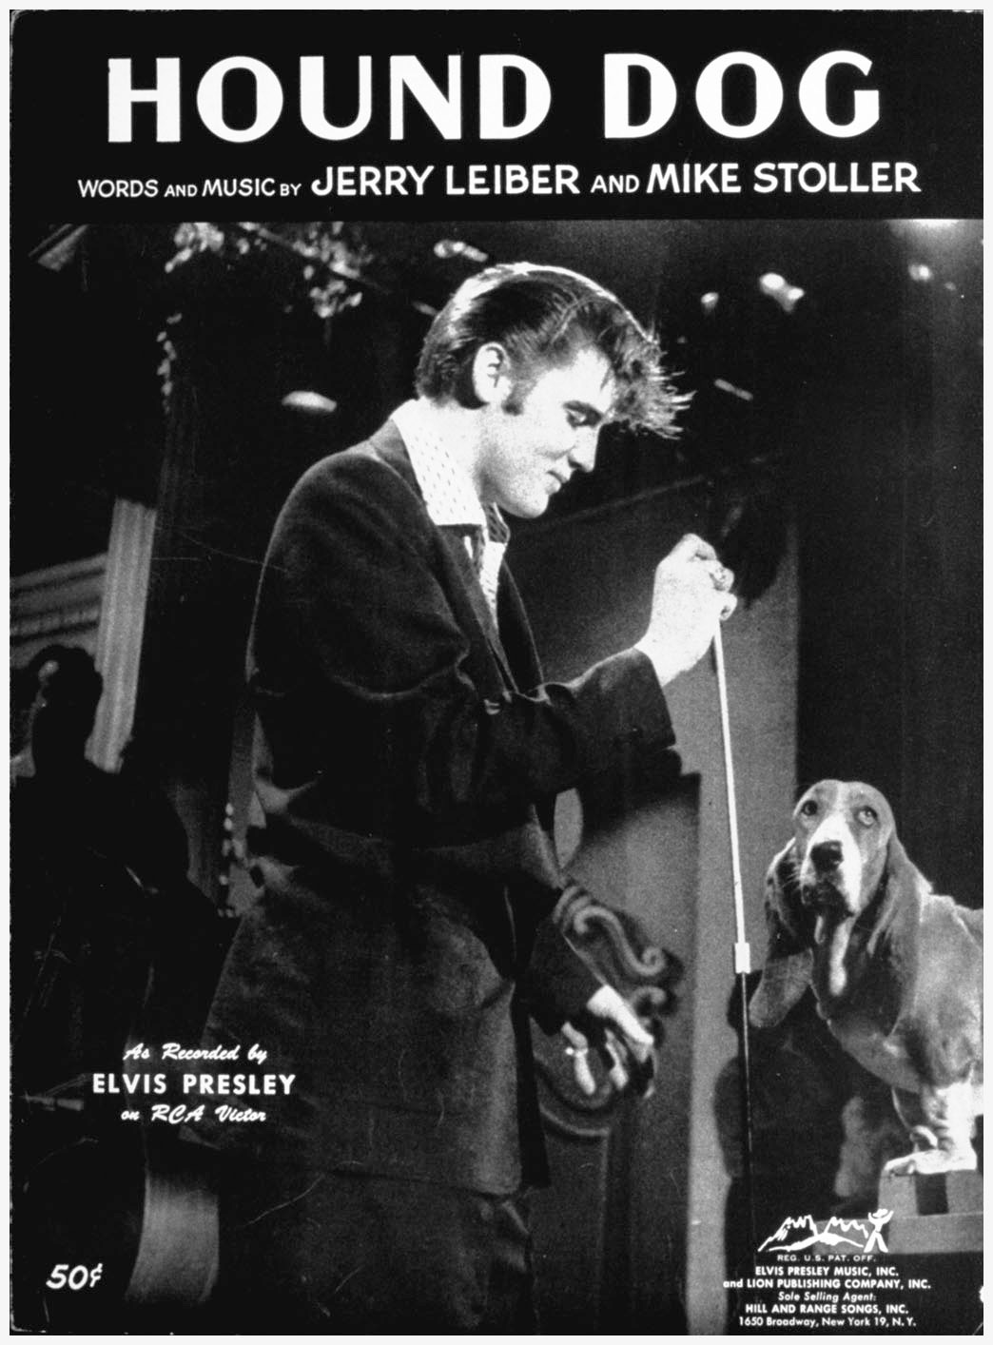
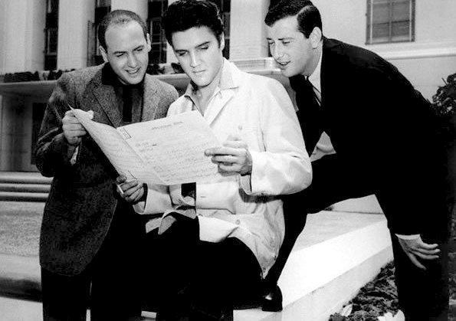
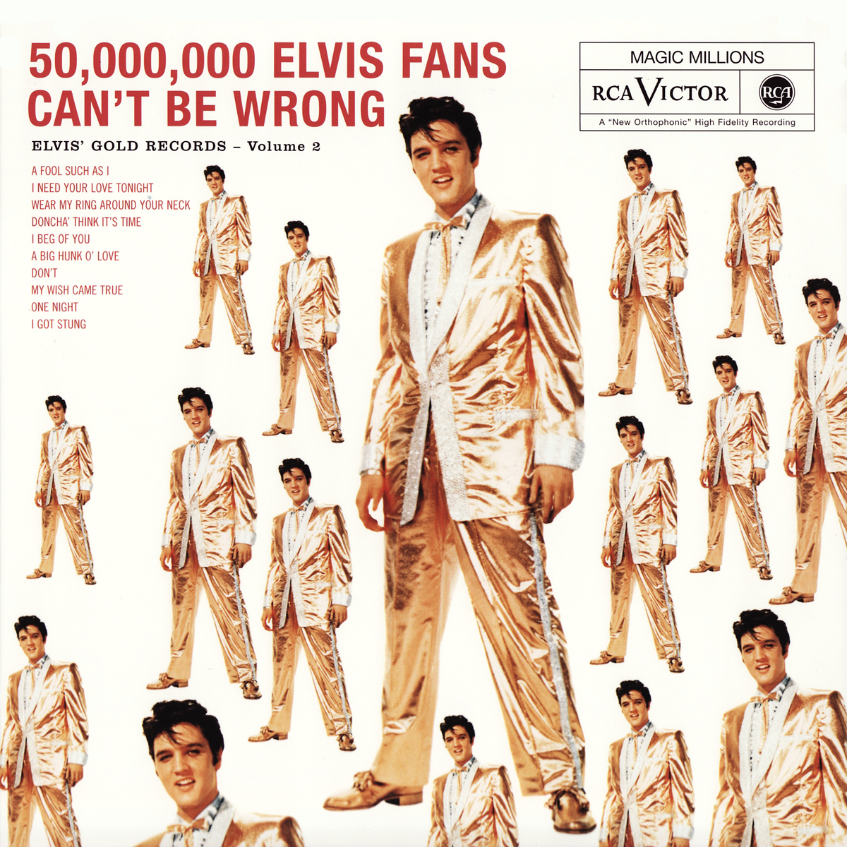
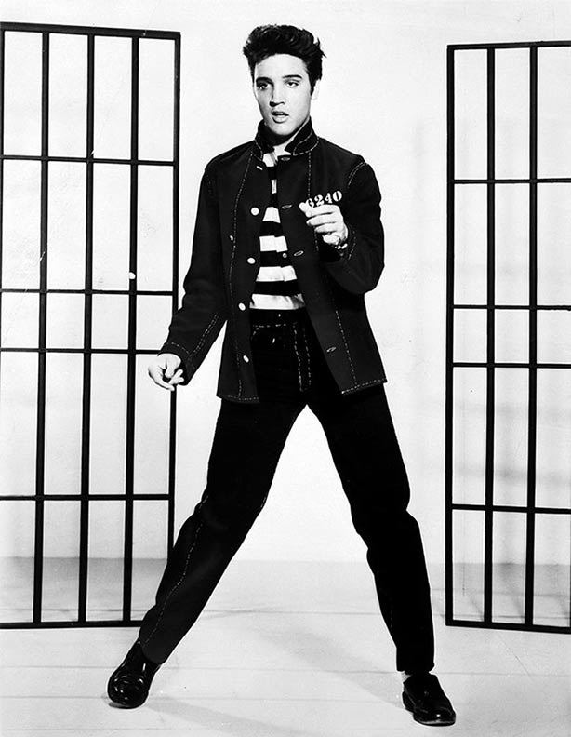
milestones
Working with Leiber & Stoller (responsible for Hound Dog, Jailhouse Rock, and many others), 1957
1956
Gold Records, vol. 2, 1959
Jailhouse Rock, 1957

Slide 10
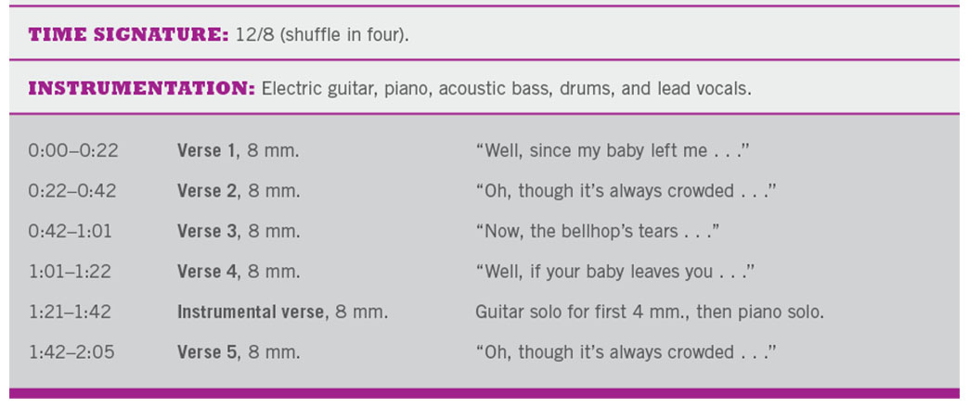
“Heartbreak Hotel” Presley's first single on his new record label RCA Victor, was released on January 27, 1956. It was written by Tommy Durden, Mae Boren Axton, and Elvis Presley. Presley recorded it in a session with his band, the Blue Moon Boys, the guitarist Chet Atkins, and the pianist Floyd Cramer.
Presley's first million-seller, it achieved unheard of feats, reaching the top 5 of Country and Western, pop, and Rhythm 'n' Blues charts simultaneously.

Slide 11
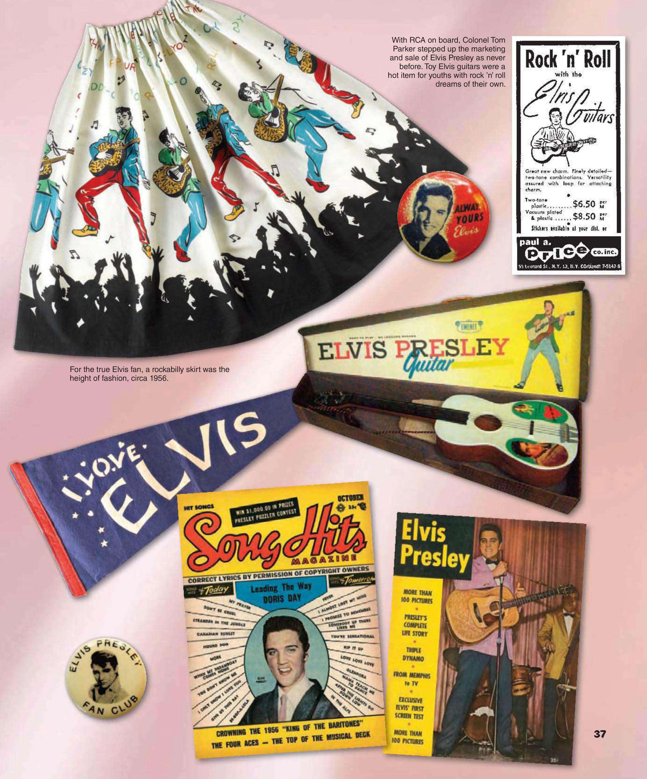

Slide 12
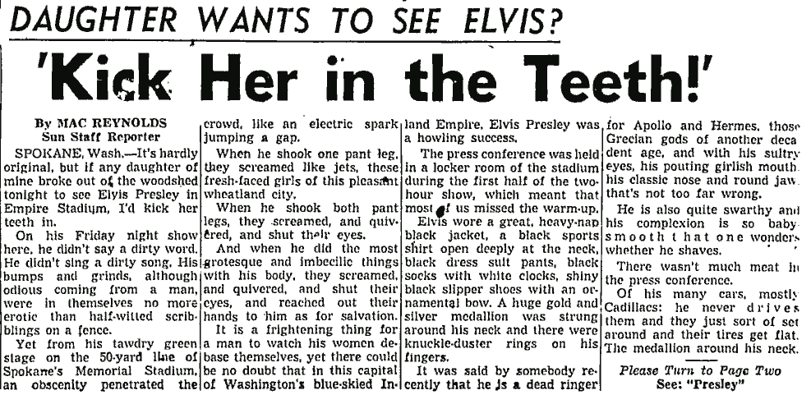
He didn’t sings a dirty song. His bumps and grinds, although odious coming from a man, were in themselves no more erotic than half-witted scribblings on a fence. Yet from his tawdry green state … an obscenity penetrated the crowd …
It was said by somebody recently that he is a dead ringer for Apollo and Hermes, those Grecian gods of another decadent age …He is also quite swarthy and his complexion is so baby smooth that one wonders whether he shaves …
It is a frightening thing for a man to watch his women debase themselves …

Slide 13
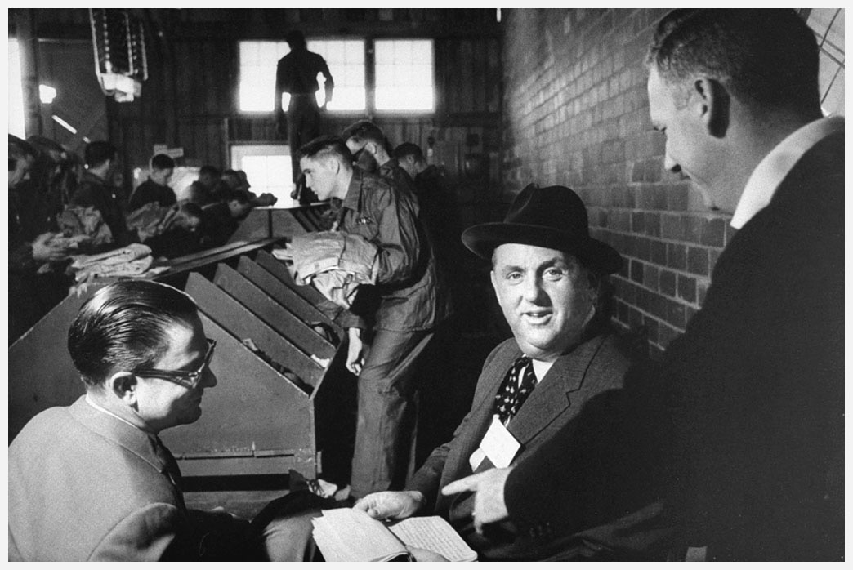
elvis joins the military

