Slide 1
Anton Webern (1883–1945)
Atonal miniatuarist

Slide 2
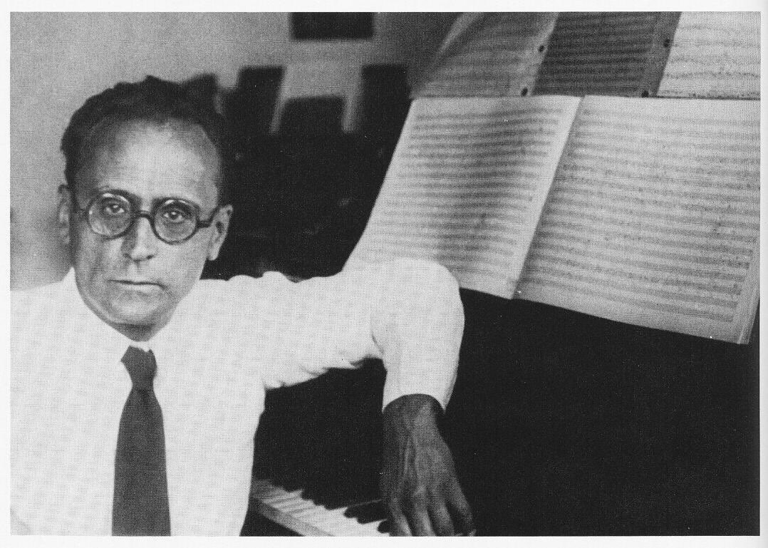
His unity of language (no popular tunes here!) and lack of tonal reference made him a major father figure to modernists after WWII (the Darmstadt School)
Webern was in some ways the most “modern” composer in the Second Viennese school, but also more delicate and rarefied
He wrote only some 31/2 hours of music in 31 works
chromatic
semitone-m3
whole-tone
Webern at work, 1930
Three pieces for cello and piano, Op. 11, No. 3 Äussert ruhig

Slide 3
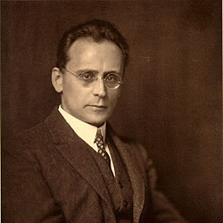
Five Movements, op. 5, for string quartet (1909)
Webern pursued a style of abstraction, brevity, and an almost mathematical precision of structure.
He is known for his lightly orchestrated, almost pointillist textures. Like pinpoints of sound, that “ping” from disparate points, his works are aphoristic and brief almost to an extreme.
Counterpoint is everywhere: invertible, canonic, retrograde, every technique from the golden age of counterpoint, the sixteenth through the eighteenth centuries. (His doctoral dissertation was on early 16th-century polyphonic sacred vocal music.)
The five movements average no more than about two minutes in length and display the composer’s gift for instrumental tone color, using for example, the wood of the bow, harmonics, playing near the instrument’s bridge, and pizzicato.

Slide 4
A typically neat, painstaking, and heavily annotated Webern manuscript, for the Five Pieces for String Quartet, Op. 5.
Movement I is the longest.

Slide 5
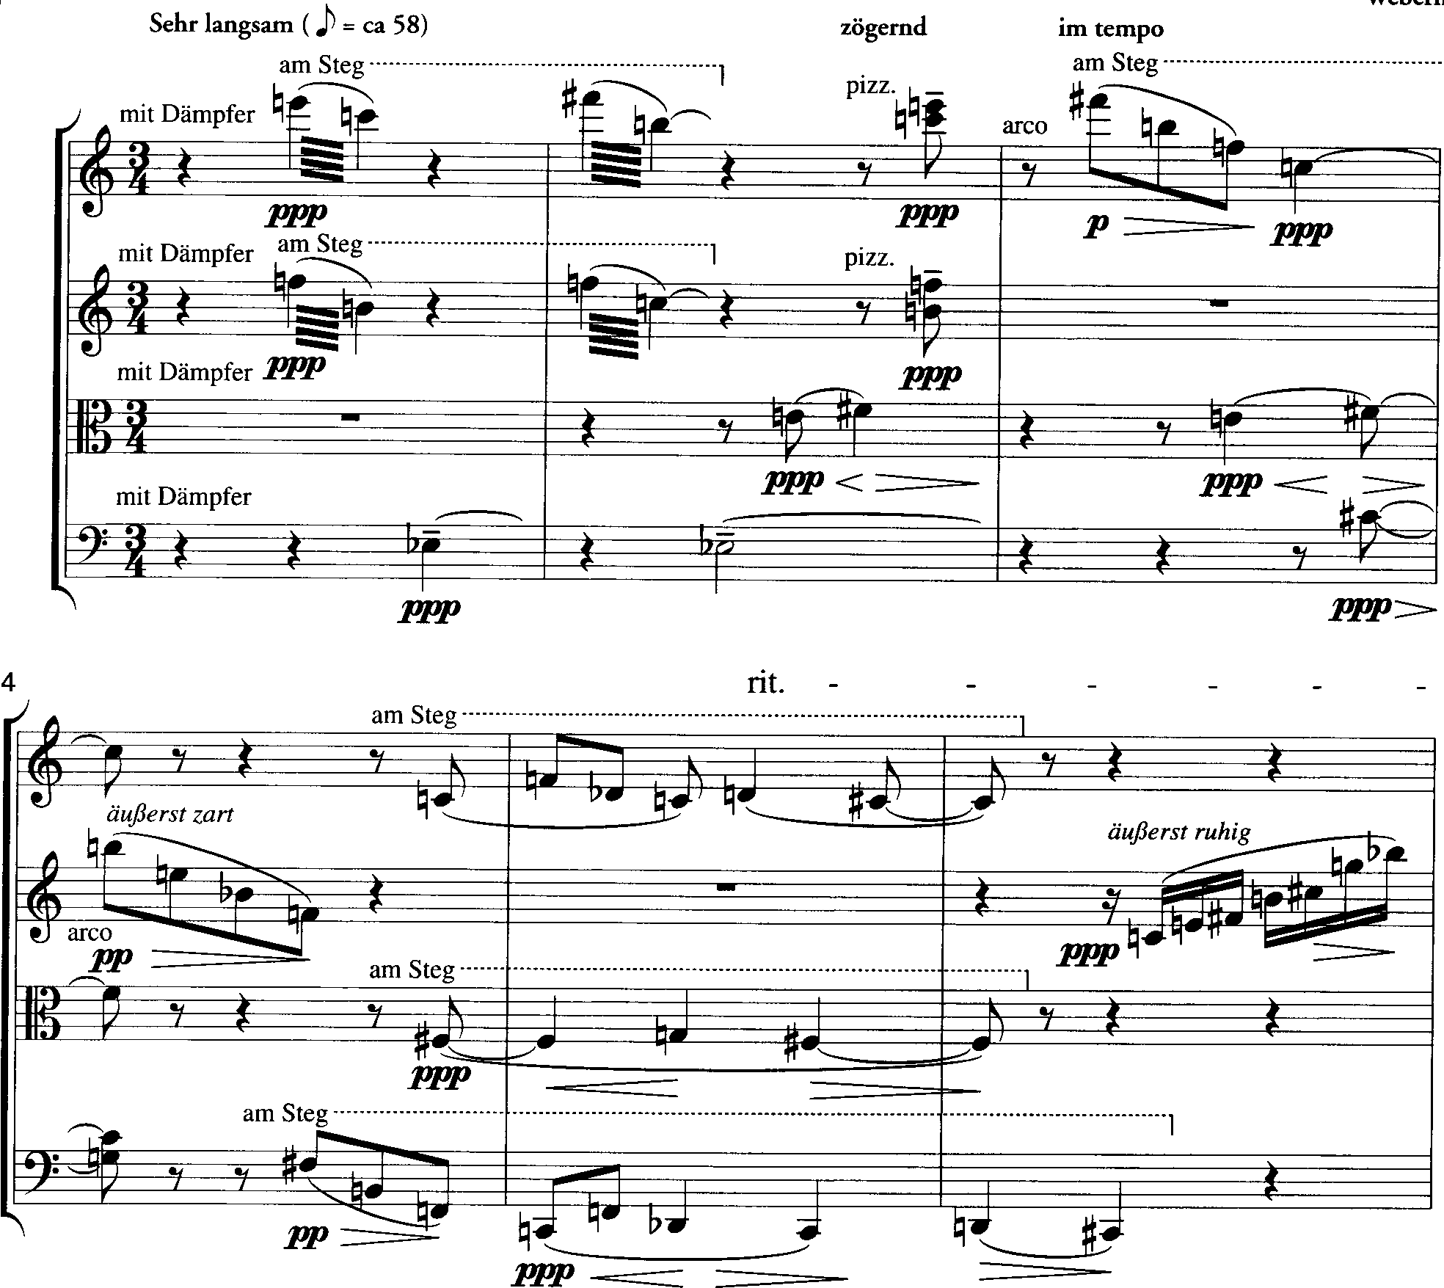
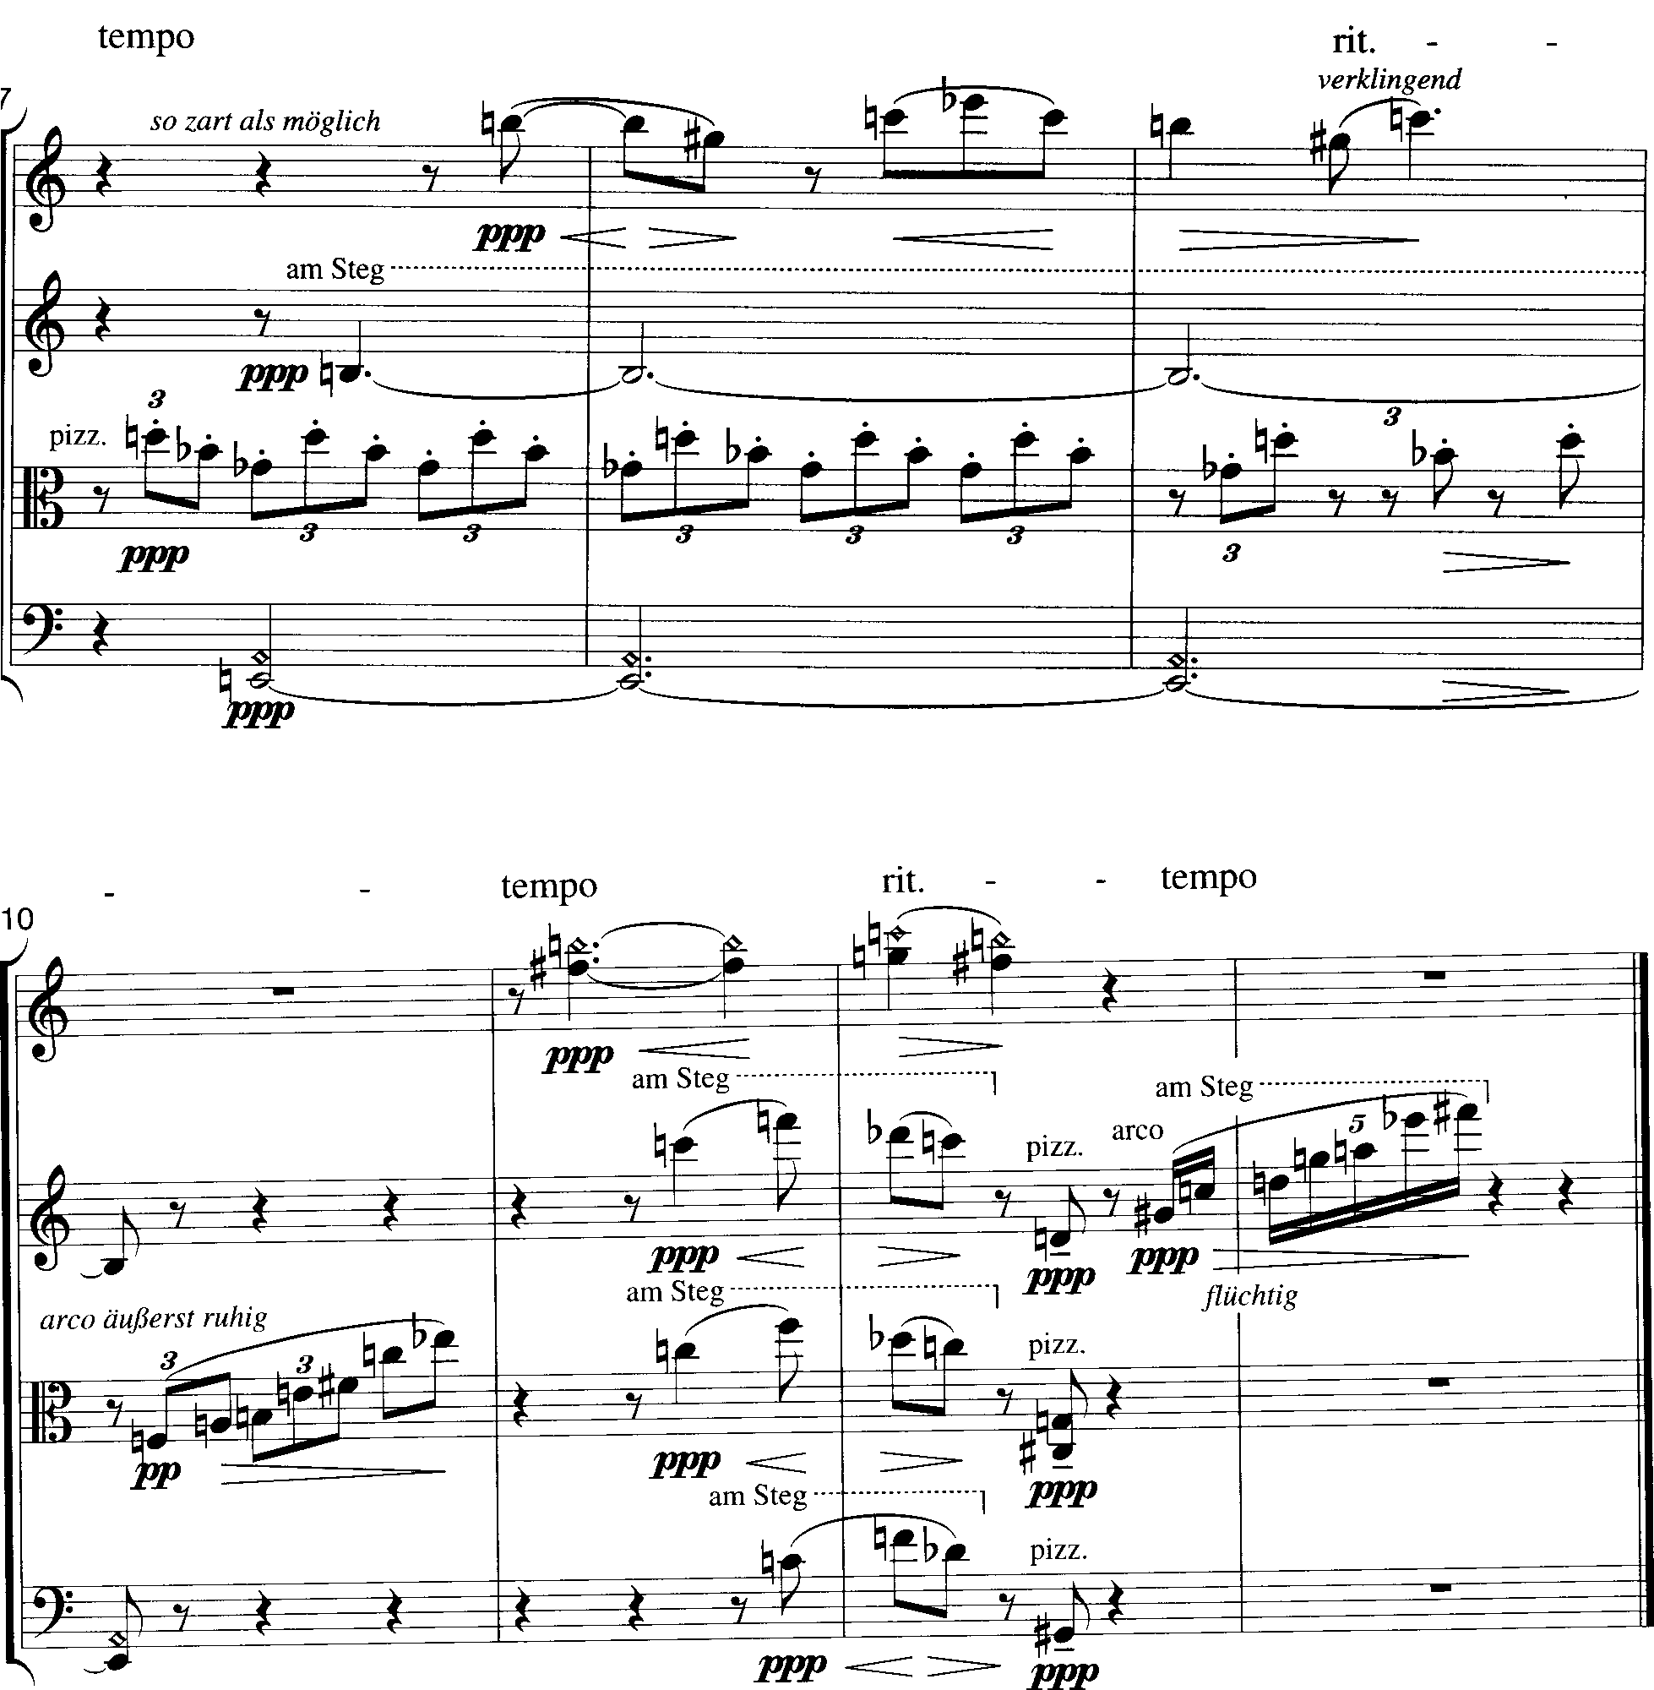
upper neighbor motive
Five Pieces for String Quartet, Op. 5, IV
A
B
A

Slide 6
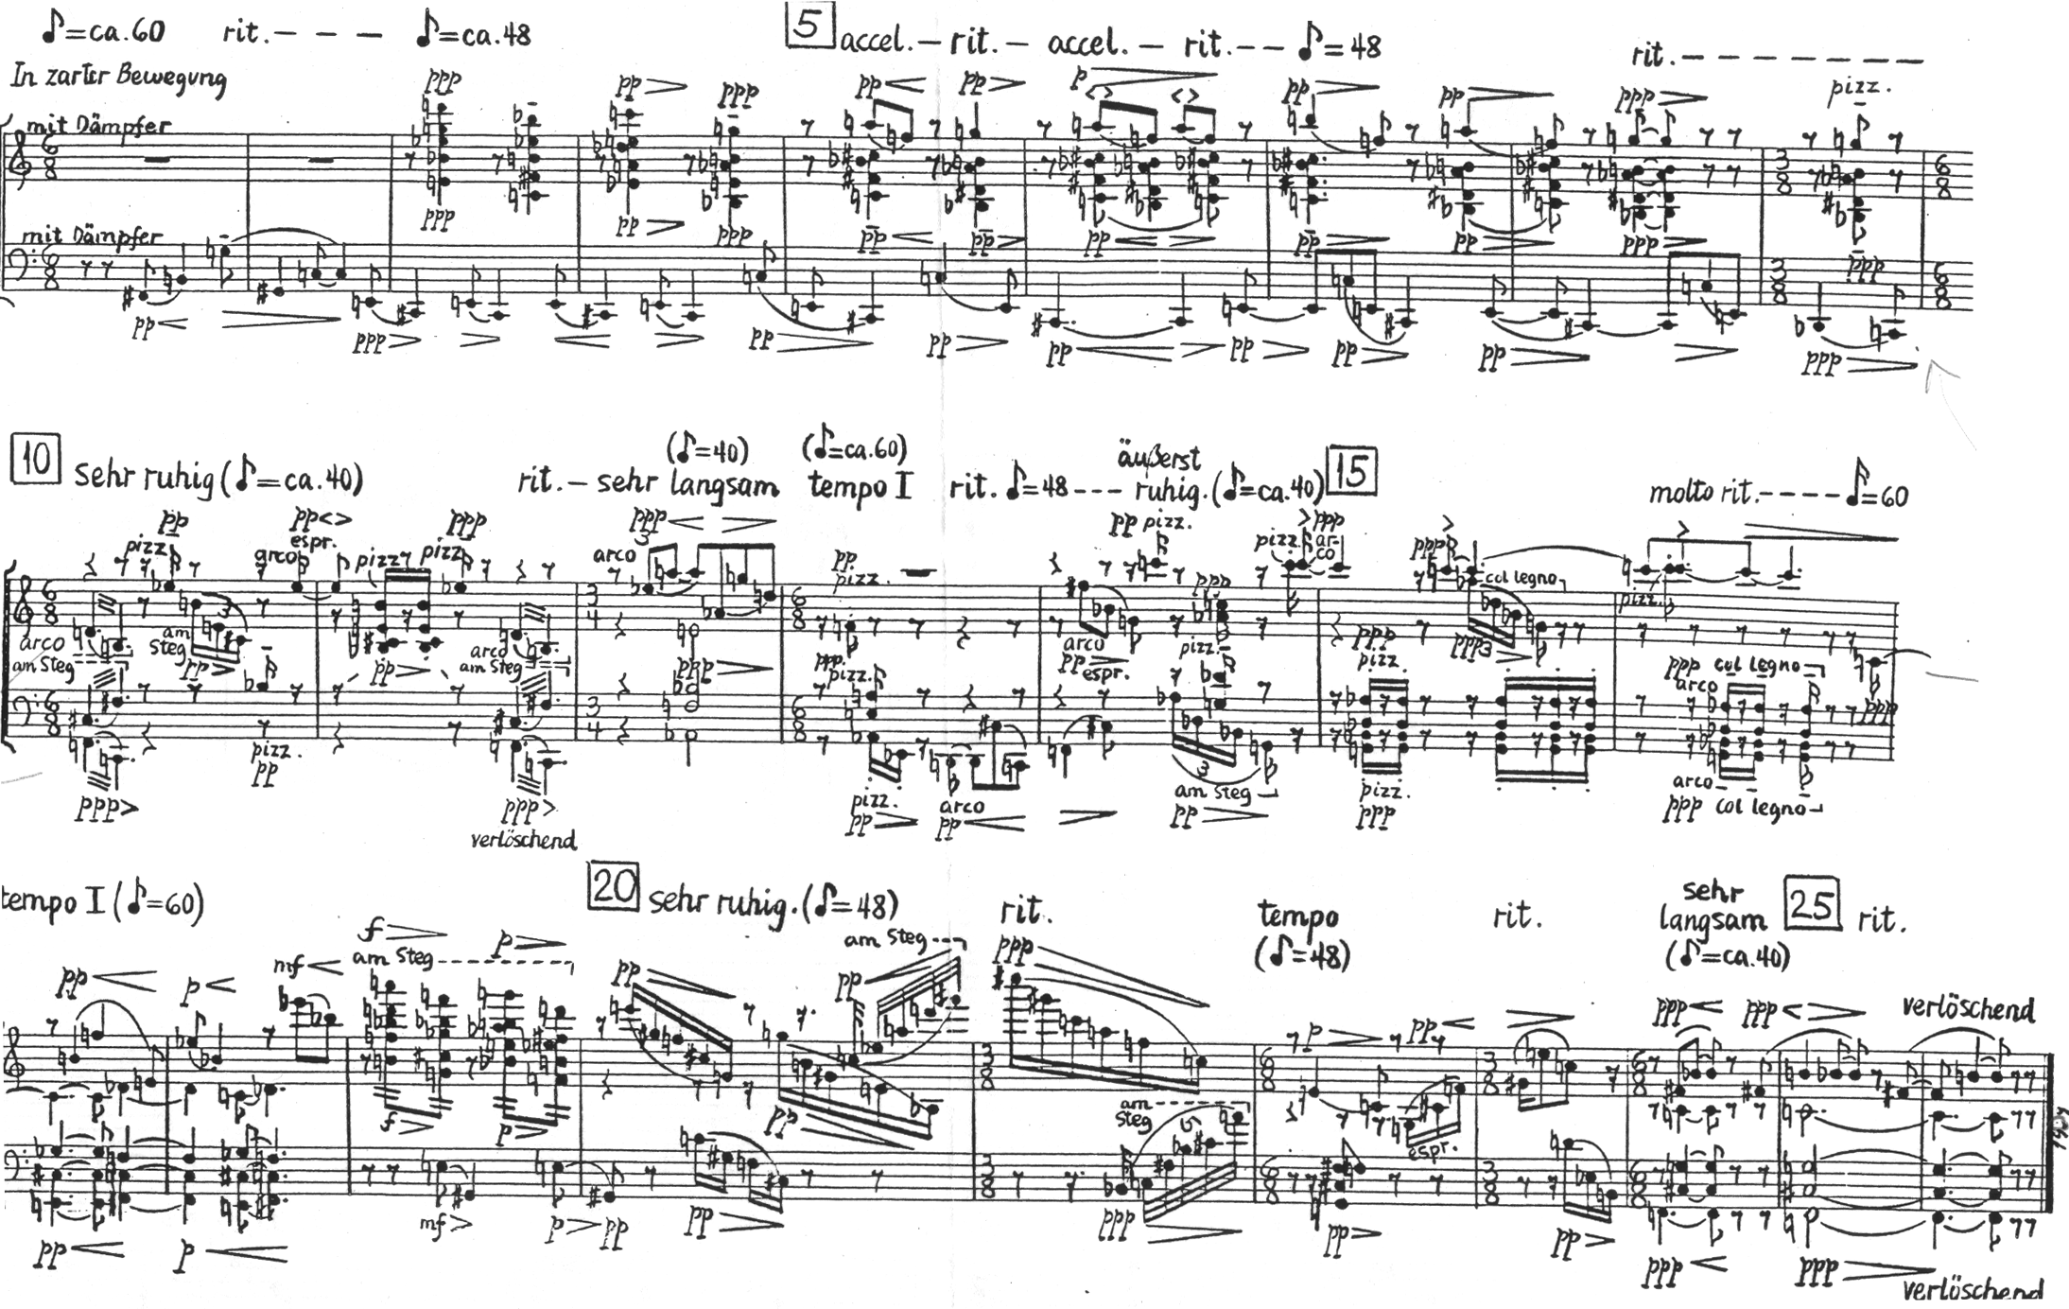
Five Pieces for String Quartet, Op. 5, V
inversionally symmetrical
final chord
B-C-C#-F-F#-G
tritone
tritone

Slide 7
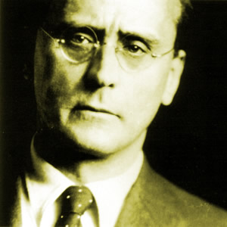
Five Pieces for Orchestra, Op. 10
“I can tell you something from my own experience: about 1911 I wrote the Bagatelles for string quartet, Op. 9, all very short pieces, lasting two minutes; perhaps the shortest there have been in music up to now. Here I had the feeling that when the twelve notes have all been played the piece is over.
Much later I realized that all this was a part of necessary development. In my sketchbook I wrote out the chromatic scale and crossed off individual notes. Why? Because I had convinced myself that the note was already there. ...In short, a law came into being. Until all twelve notes have appeared none of them must appear again…”

Slide 8
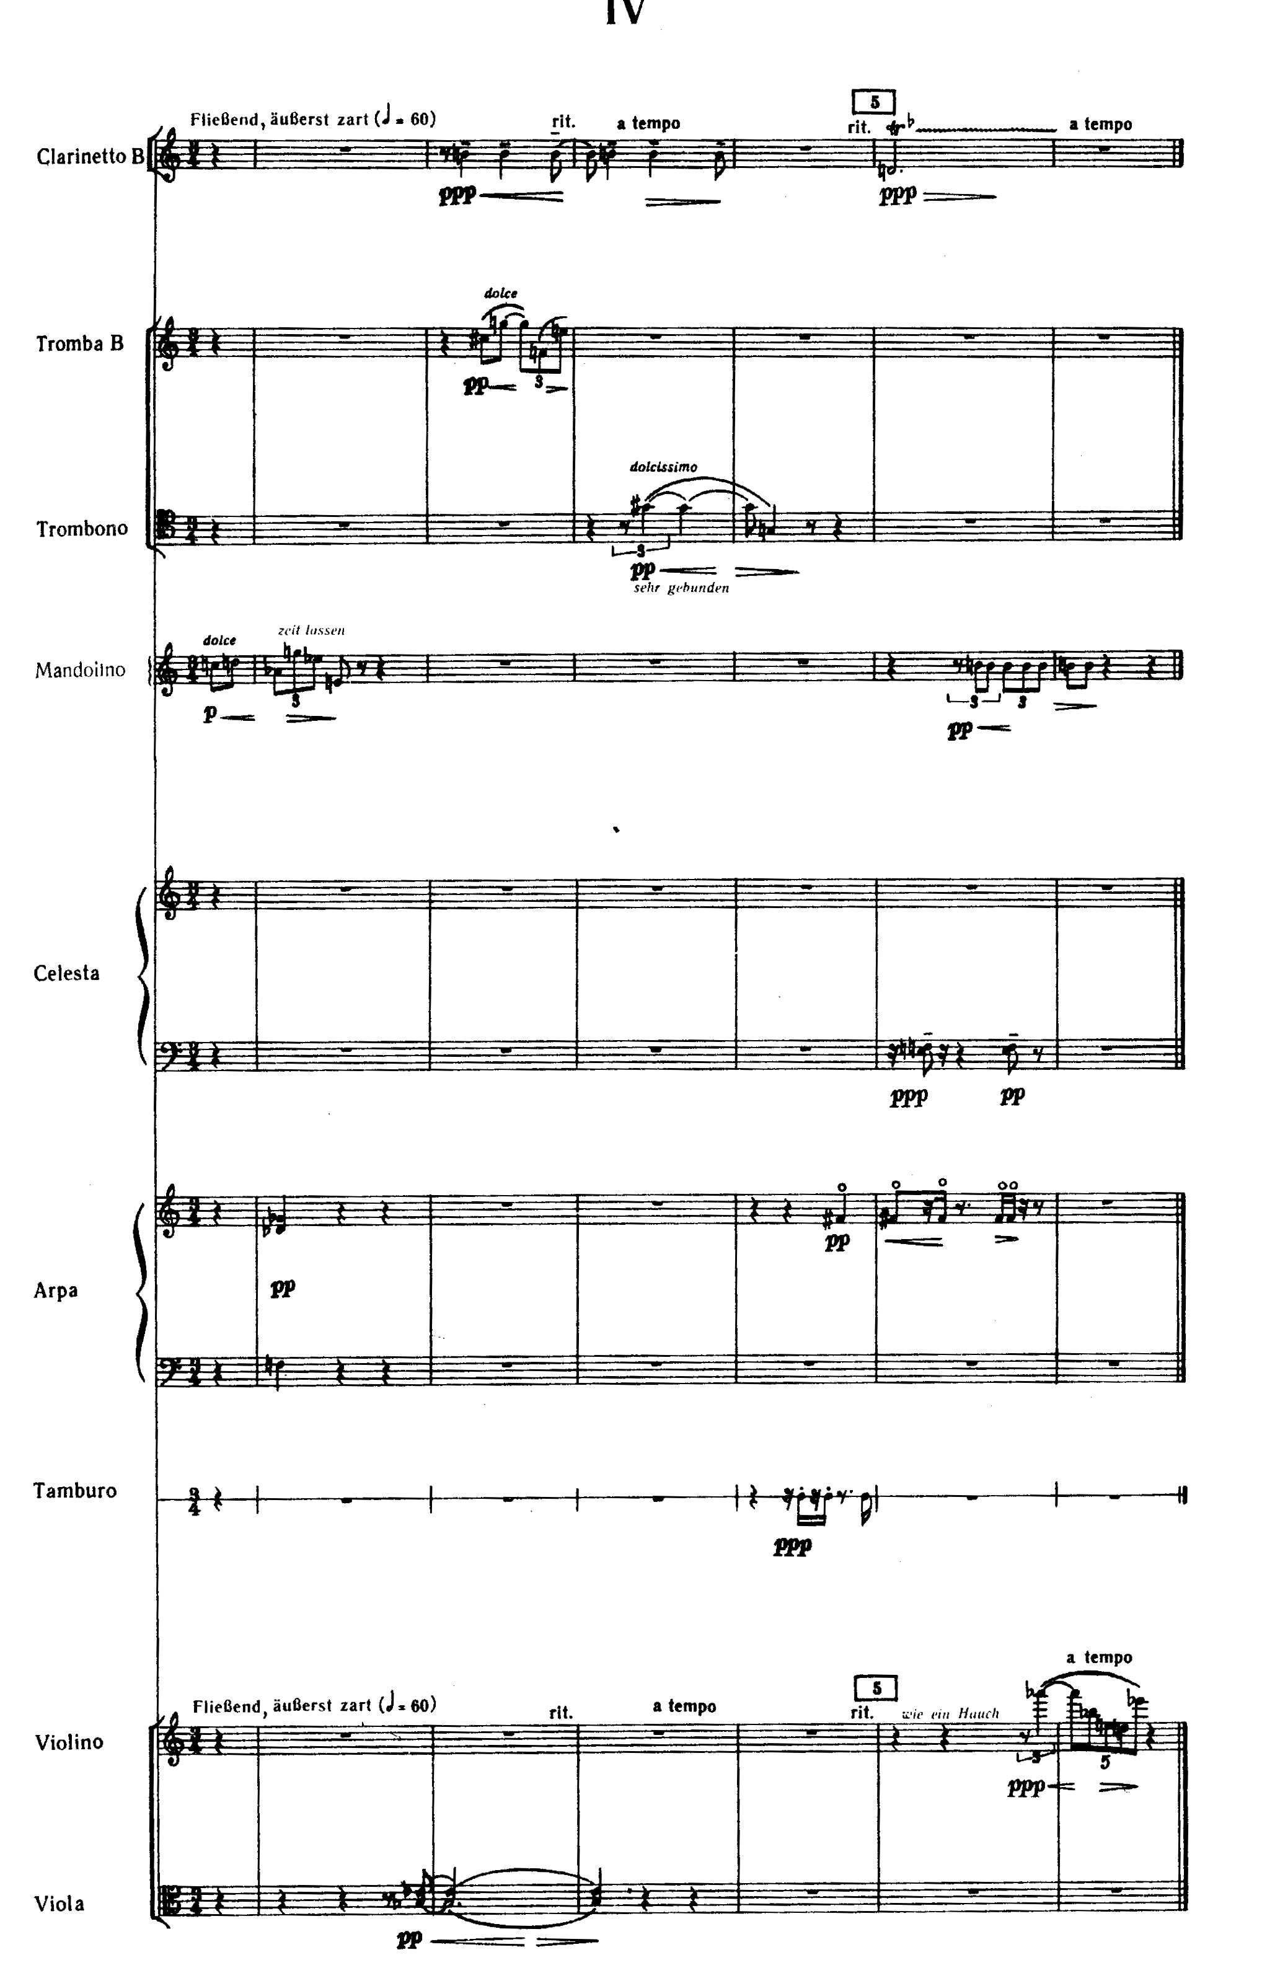
Movement 4. Fließend, äußerst zart (flowing, exceedingly delicate)
A
G
C
10
odd orchestration
B-F-Eb-D
11
flute, oboe, E-flat clarinet (double on clarinet), clarinet (doubles on bass clarinet), horn, trumpet, trombone, percussion, mandolin, guitar, celesta, harmonium, harp, violin, viola, cello, and bass
C-D-Ab-G-Eb-E
A
G#-G
1 2 3 4 5 6
12
E/F
F/Db/Gb
F#
7 8 9
transposition
Ab-Bb-E-D-Eb
Bb

