Slide 1
Igor Stravinsky (1888–1971)
The Early Period

Slide 2
Debussy and Stravinsky, 1910
(3 yrs before The Rite of Spring)
taken by Satie

Slide 3
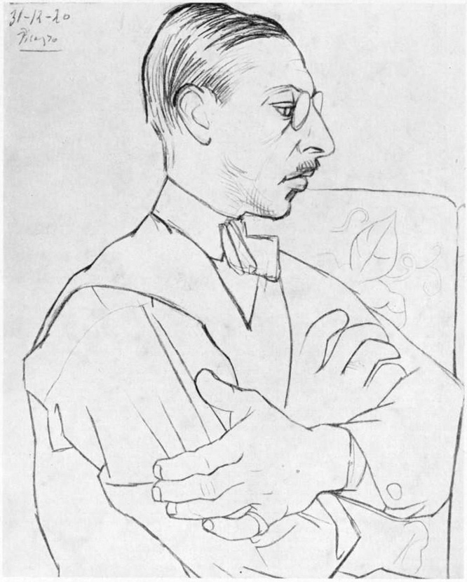
Early (Modernist) Stravinsky
First two periods
modernist-primitivist (1910-1918)
neoclassical (1918-1951)
Theodor W. Adorno (1949), who was an advocate of Schoenberg, equiated modernism = progress; neoclassicism = regression
1920 by Pablo Picasso

Slide 4
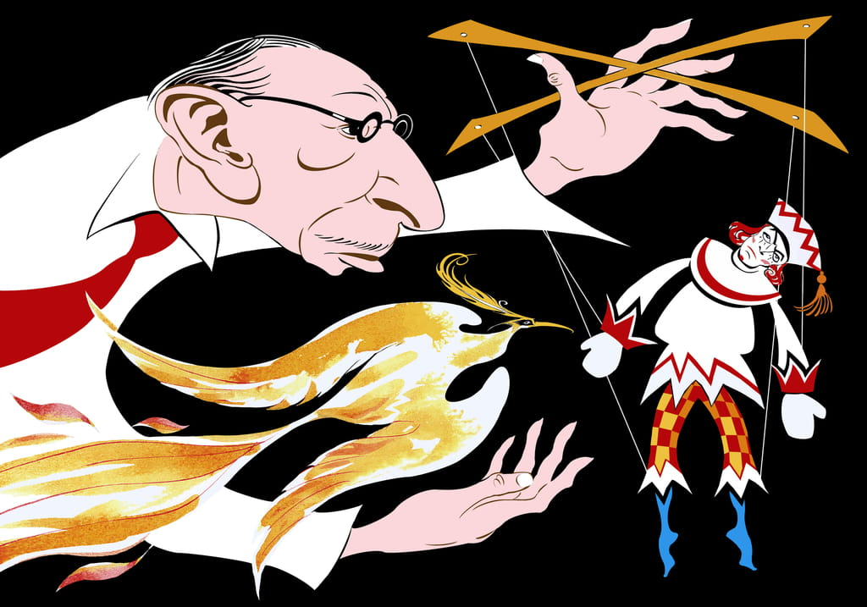
The Firebird (L’Oiseau de feu)
written for the 1910 Paris season of Sergei Diaghilev’s Ballets Russes company
Léon Bakst drawings
Nigel Osborne

Slide 5
Petrushka (1911)
Russian Shrovetide fair
Nijinsky as Petrushka

Slide 6
Fokine’s choreo, Benois’ set design
The story of the loves and jealousies of three puppets brought to life by the Charlatan during the 1830 Shrovetide Fair in St. Petersburg: Petrushka, the Ballerina and the Moor

Slide 7
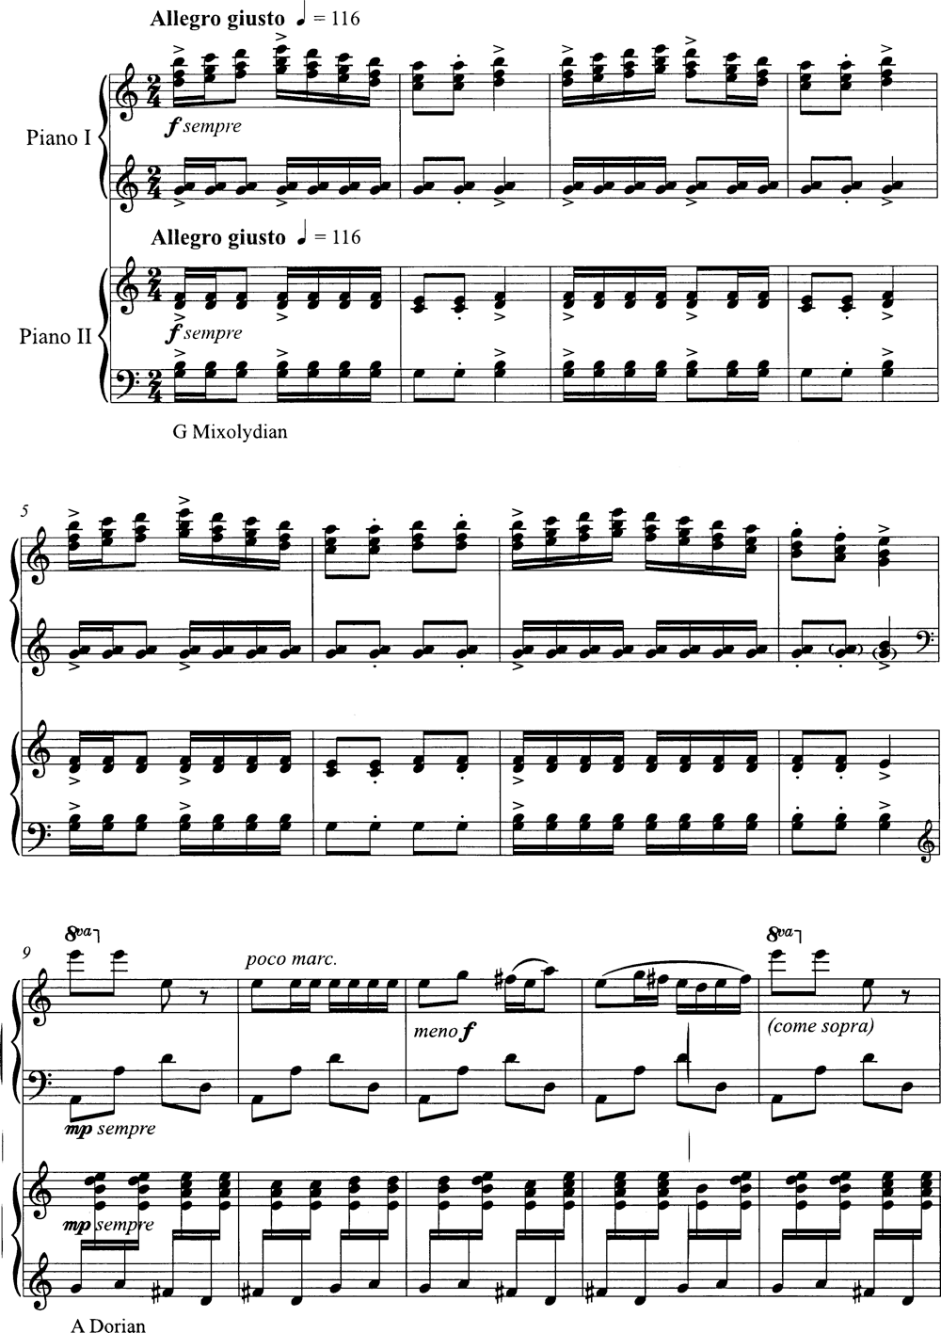
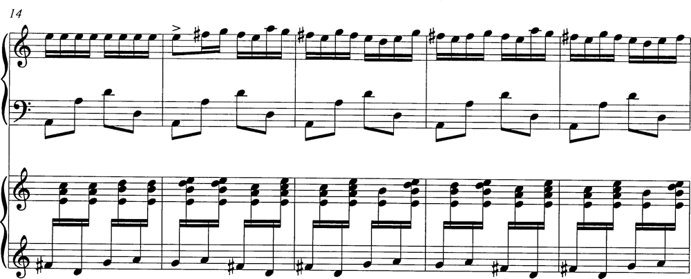
Petrushka is diatonic but modal,
not functionally tonal

Slide 8
Hexatonic:
triads on top, part of a
larger symmetric collection
*The “Petrushka Chord”:
C major over F# major

Slide 9
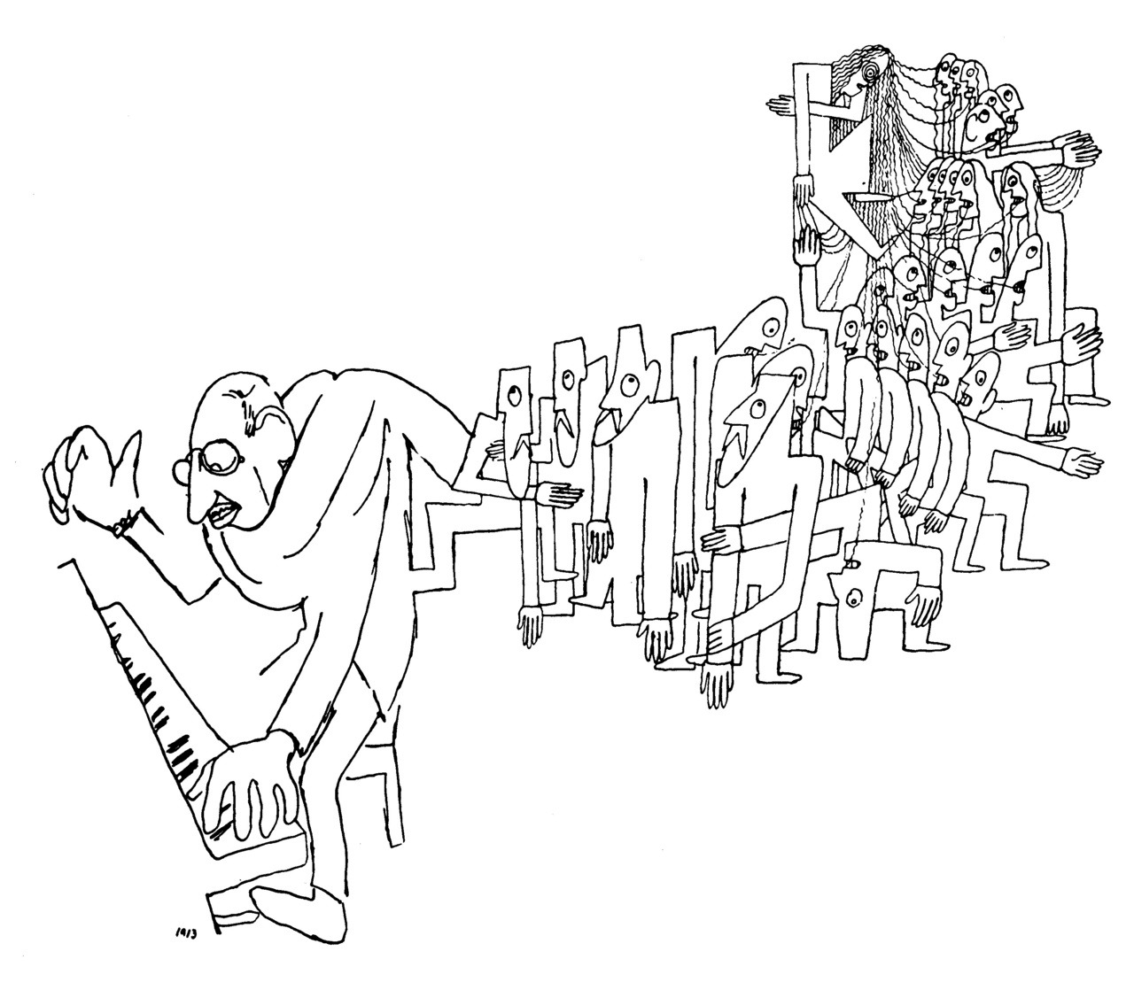
The Rite of Spring
Le Sacre du Printemps (1911-13)
The Rite of Spring was one of the first musical examples of primitivism: the practice of, or emphasis on, simplicity and irrationalism
Stage and costume designer Nicholas Roerich studied prehistoric Russian cultures; he was connected to Stravinsky by Serge Diaghilev, leader of the Ballets Russes
Likewise, Stravinsky came to use many Russian and East European folk melodies in the Rite
Jean Cocteau’s impression of Stravinsky playing for rehearsals of the Rite

Slide 10
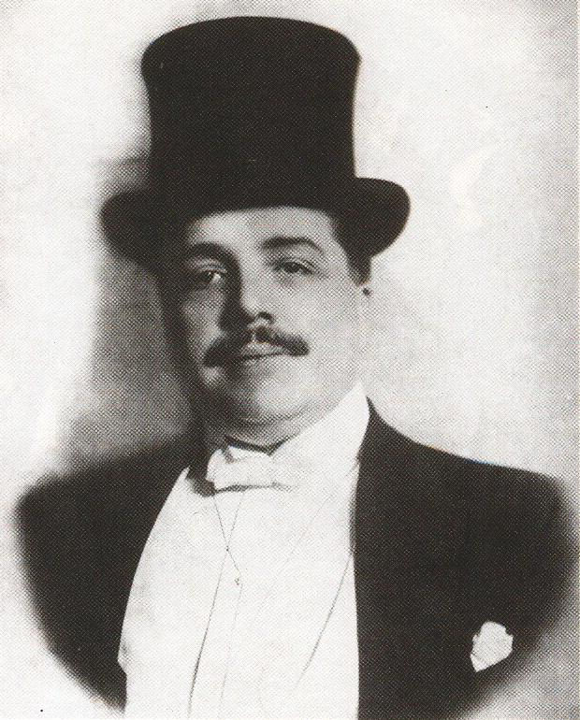
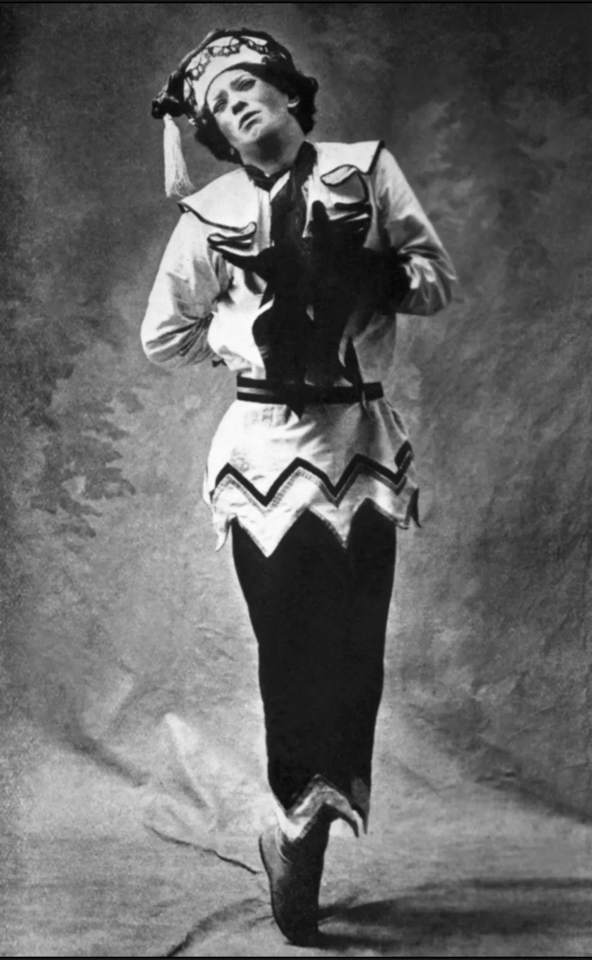
Serge Diaghilev (1874-1929)
Leader of the Ballets Russes in Paris, impresario who gave Stravinsky his first “break” by commissioning The Firebird
Diaghilev brought together Roerich, Nijinsky, & Stravinsky for The Rite of Spring, and premiered the ballet
Primitivism also characterized Vaslav Nijinsky’s choreography for the Rite of Spring, which contrasted shockingly with classical ballet style
Stravinsky and Nijinsky

Slide 11
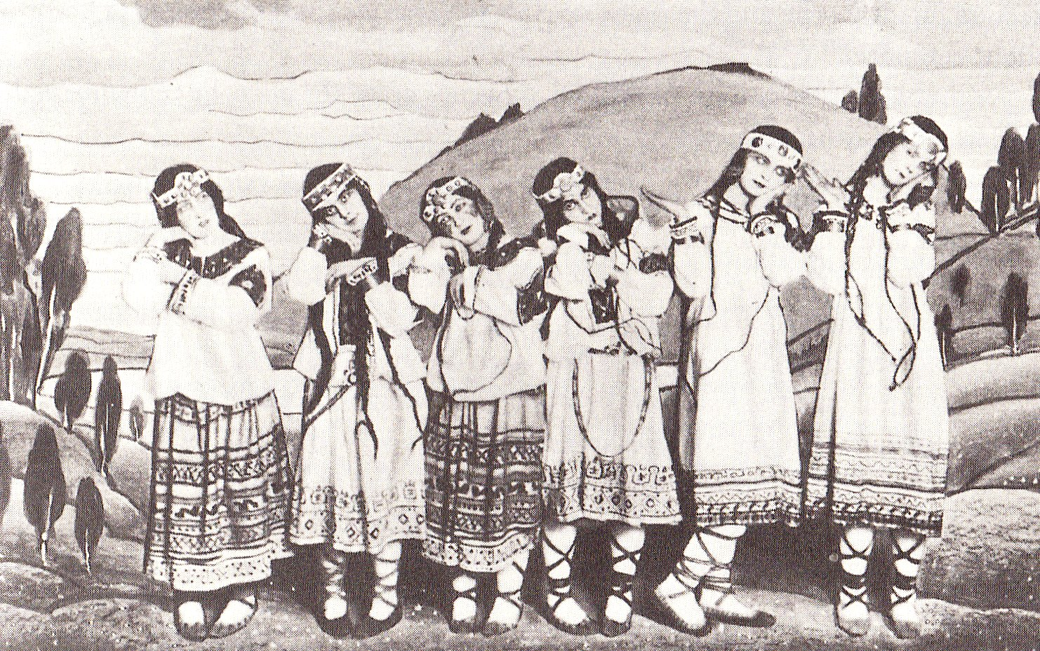
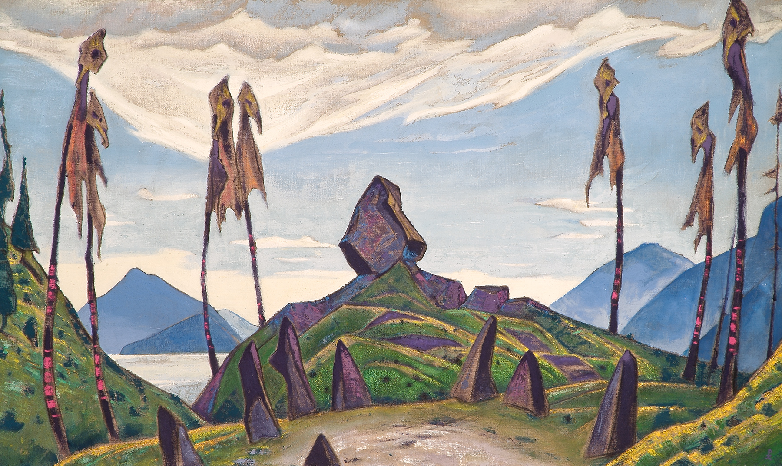
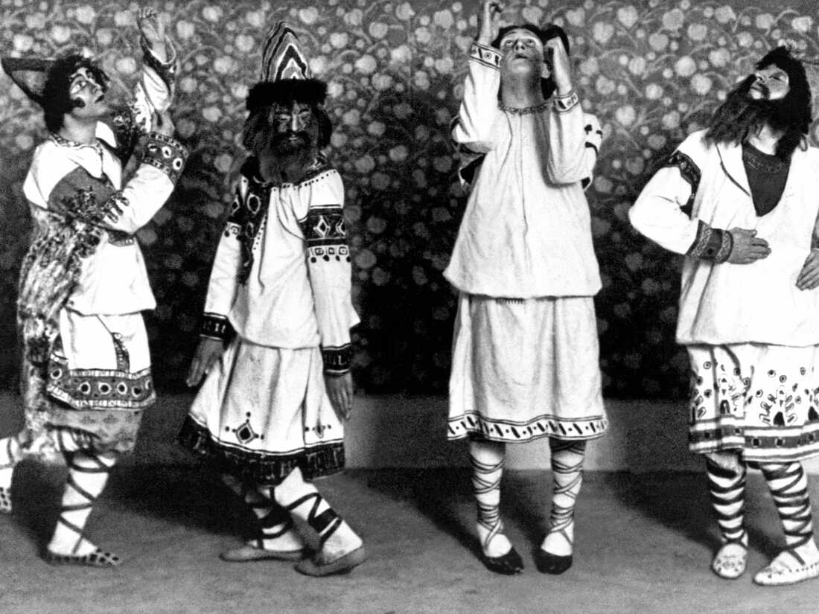
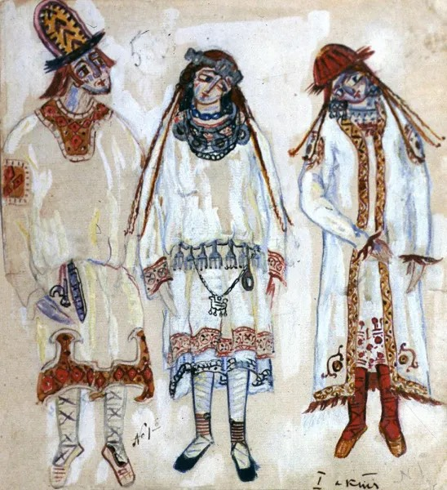

Slide 12
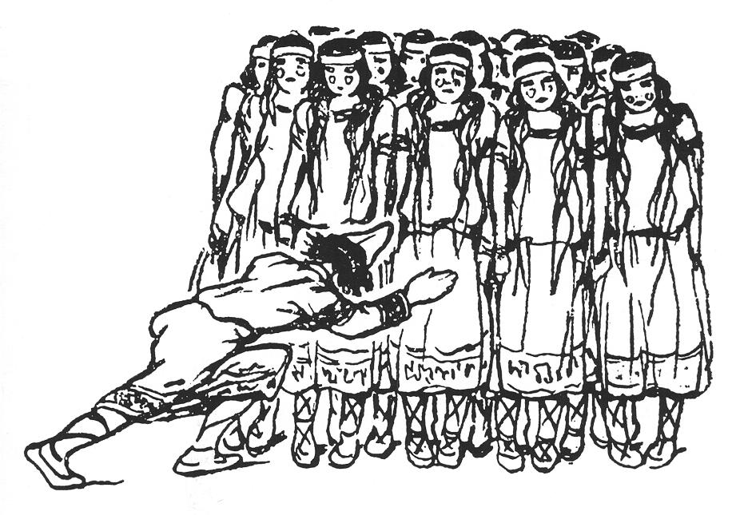
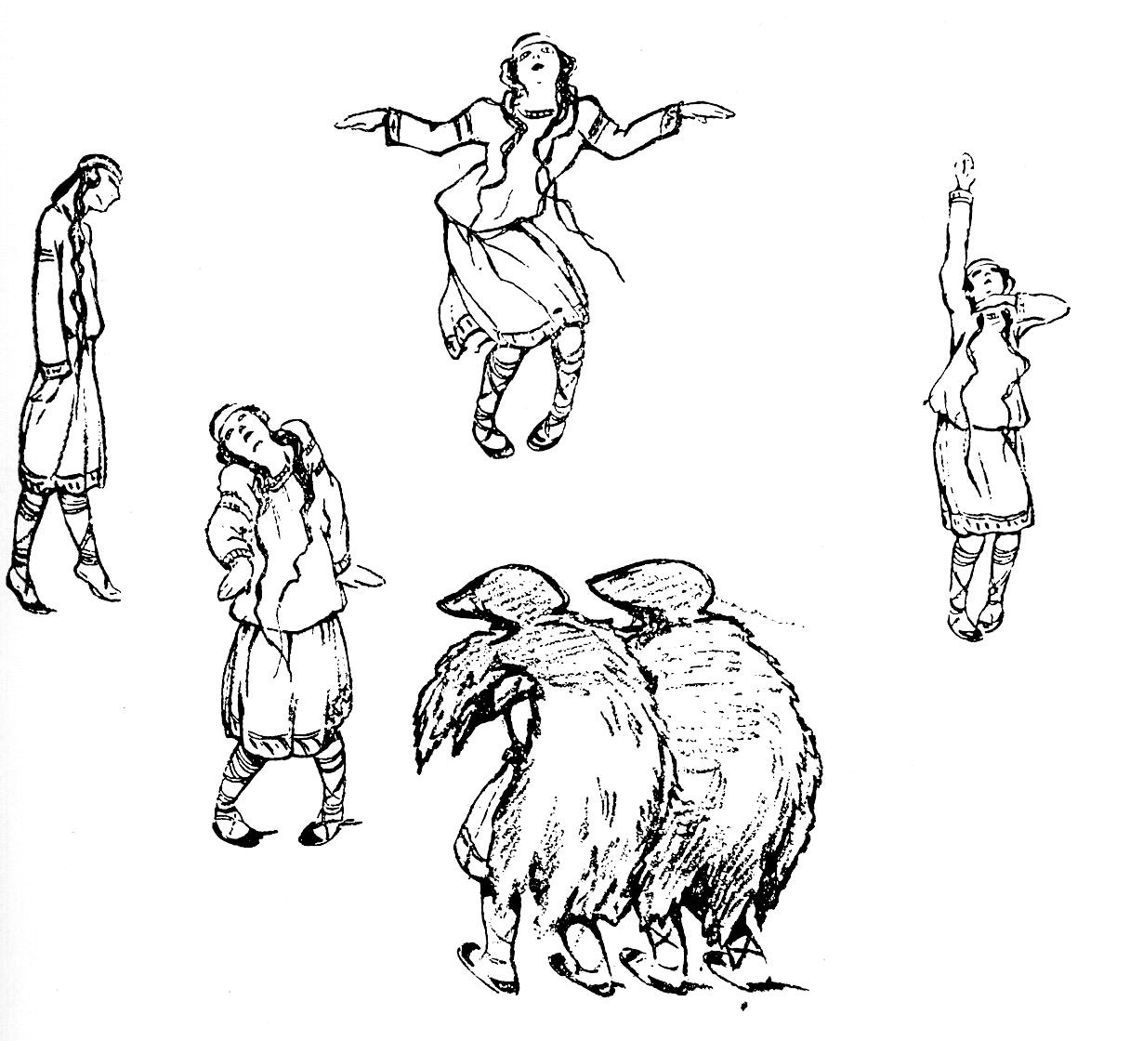
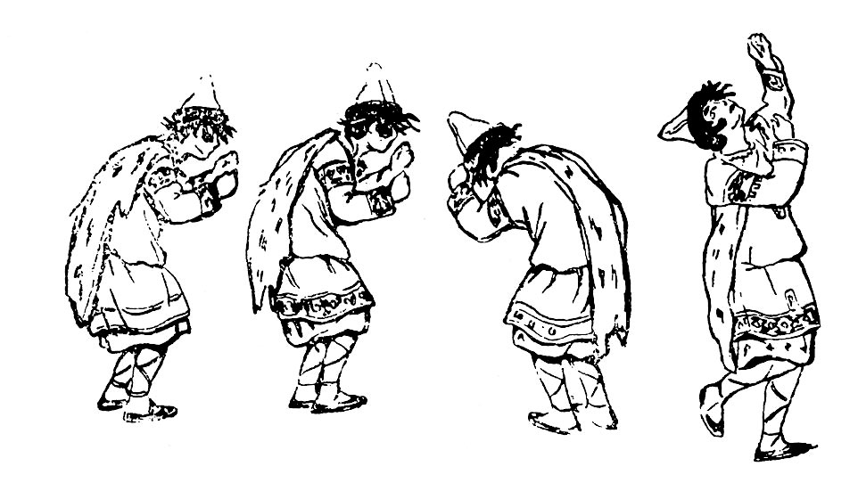
Eyewitness drawings of Nijinsky’s choreography in rehearsal

Slide 13
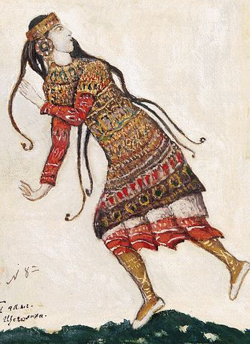
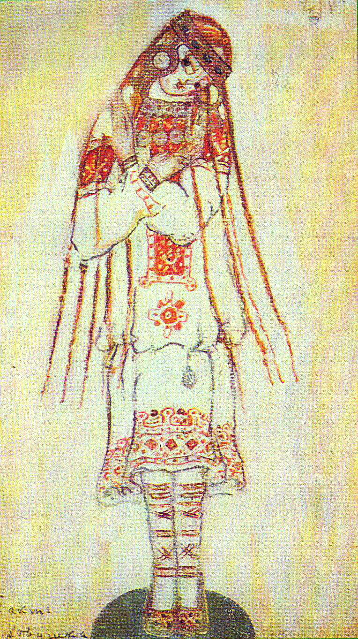
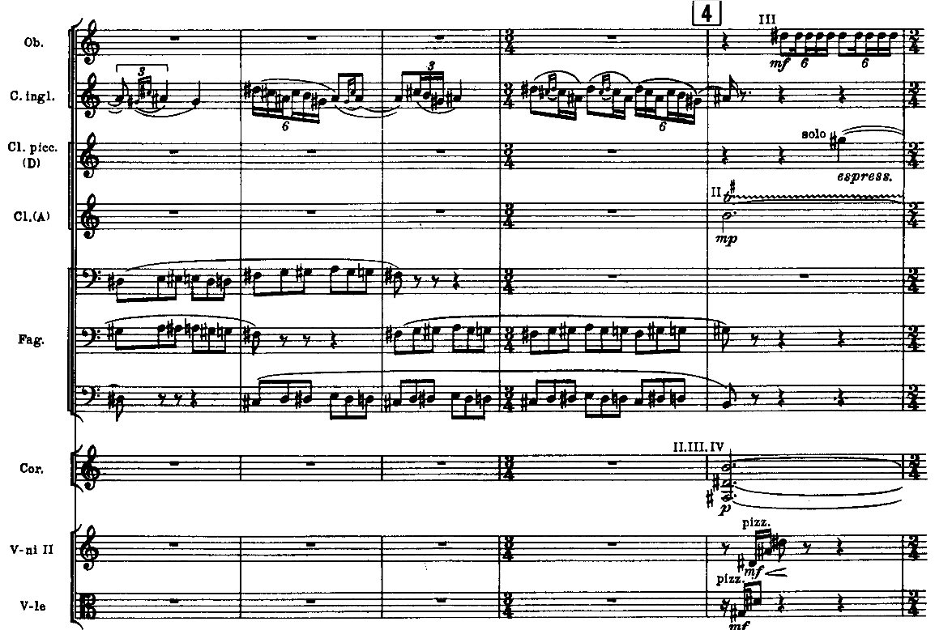
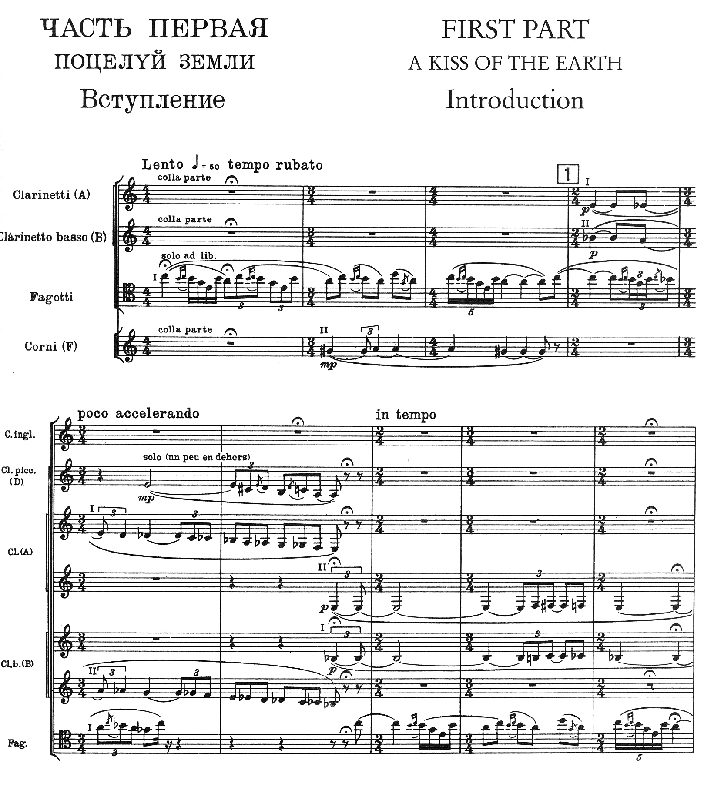
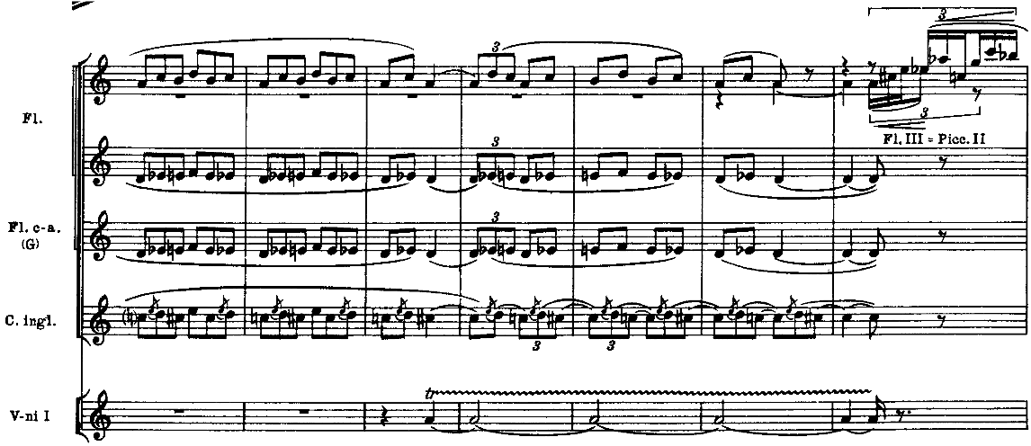
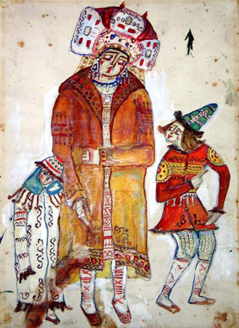
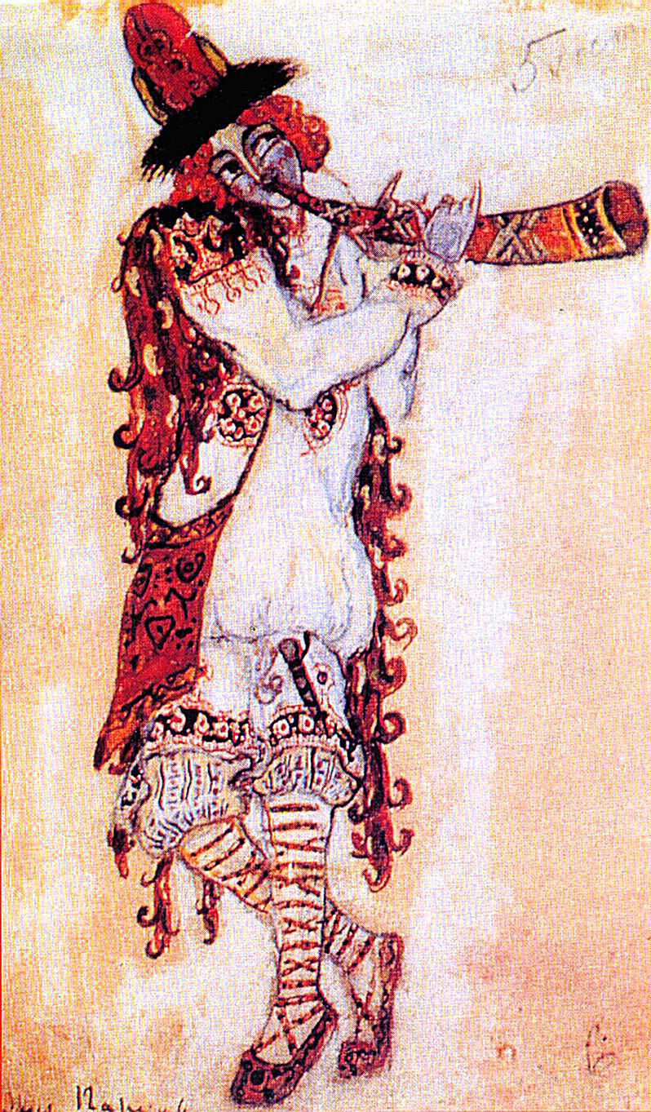
Roerich’s dramatic design for The Rite of Spring
Part One: the kiss of the Earth
C
C
C
B2
clarinets
bass clarinet
A
bassoon
B2
horns
B1
English horn
piccolo clarinet
A
clarinets
bass clarinets
A
bassoon
B2

Slide 14
Recreation of the original choreography, sets and costumes, Mariinsky Ballet

Slide 15
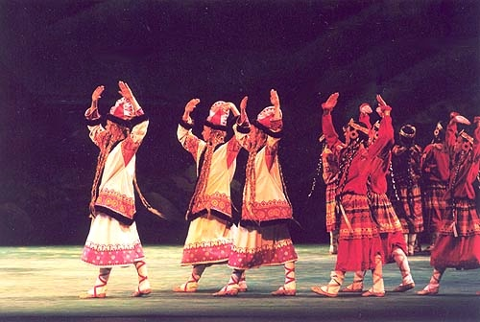
The Rite of Spring emphasizes & “liberates” rhythm & accent from their traditional melodic & harmonic roles in functional tonality: Stravinsky’s music often reduces itself to “pure” rhythm
The finale “Sacrificial Dance” begins with the same chord repeated 11 times!
Instead of fluidity of rhythm, music of the Rite changes through insistent shifts of accent; ideas take on large-scale importance through repetition, collision, juxtaposition, addition of units; melodic units (not really melodies) are short, rarely longer than a measure or two

Slide 16
“misplaced” accents on chords at “Dance of the Adolescents”
Written accents, most of them on weak beats
Strong beats you would expect to be accented

Slide 17
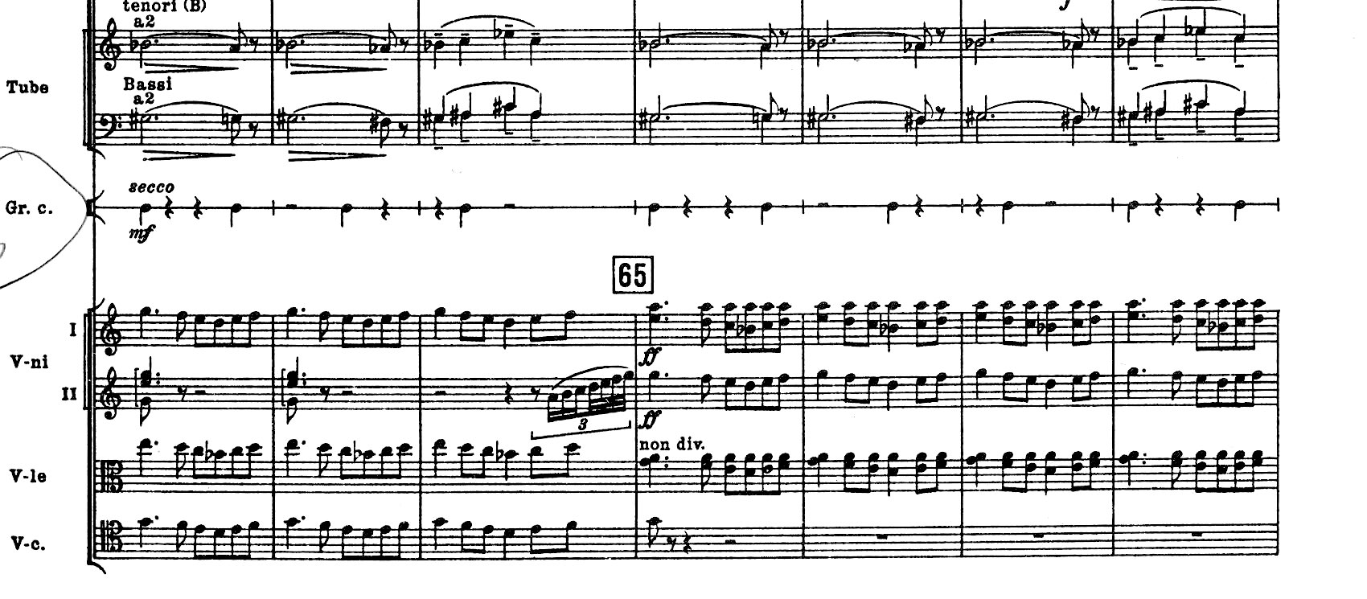
Polymeter in “Games of the Rival Tribes”
Bass drum in 3/4 time, everyone else in 4/4
tubas
bass drum
violins
violas
cellos

Slide 18
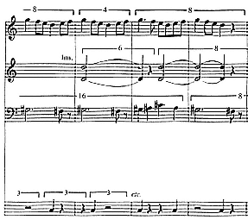
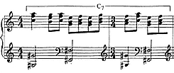
Rhythm and meter in the Rite
Meter change/mixed meter
Repetition of melodic cells associated with different rhythms
Repetition of melodic cells alters metric placement
Repeated rhythmic cells in various voices create different simultaneities and polyrhythm
Polymeter when simultaneous presentation of more than one meter

Slide 19
Above is the folk tune which serves as the basis to the opening theme
Melodic relationships:
stasis,
short and narrow range motives and
ostinati: naígrïsh
Russian folk music
motivic construction
additive process of cell repetition

Slide 20
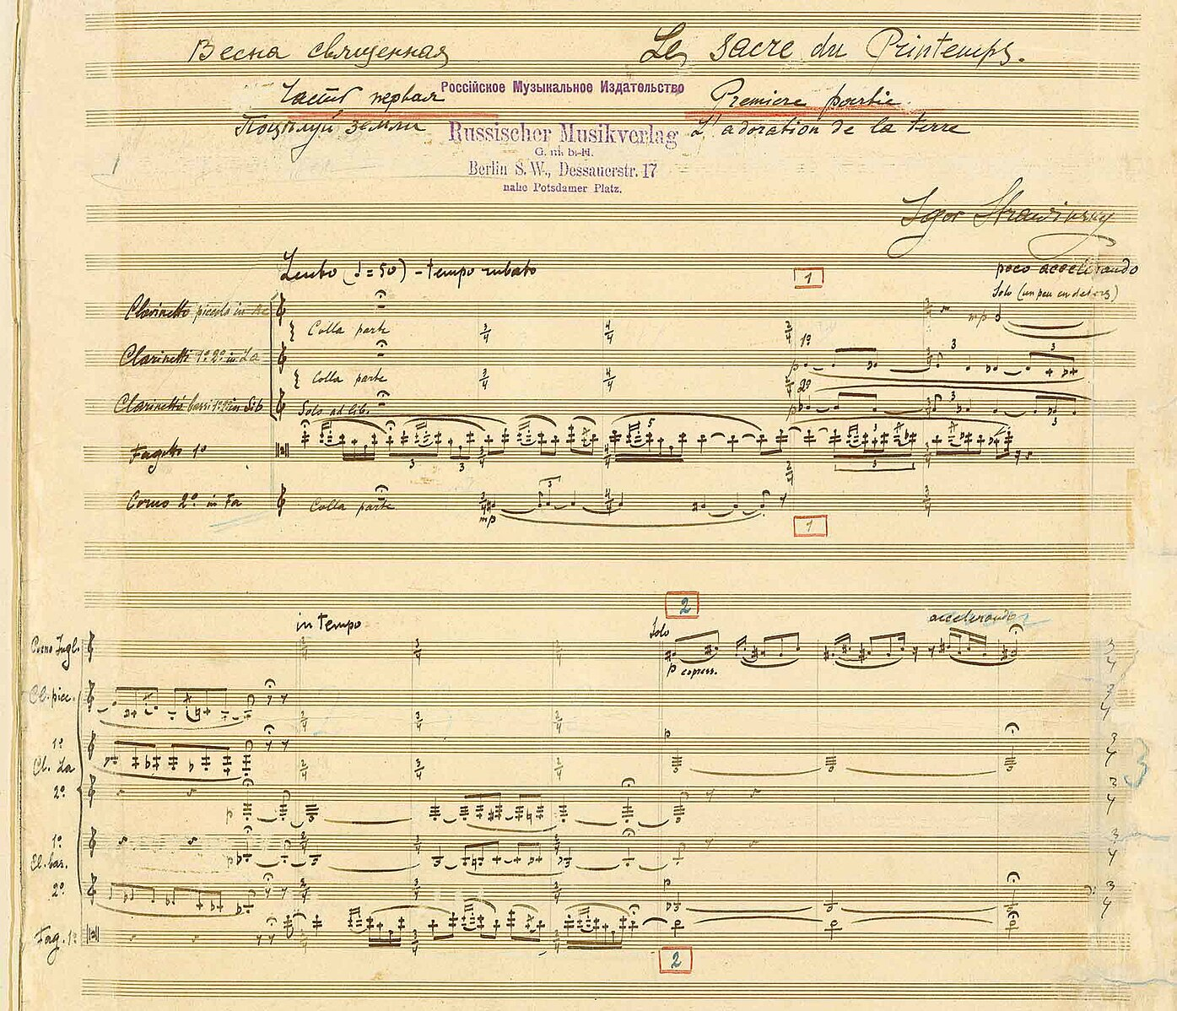
Formal processes
in the Rite
Nondevelopmental, repetitions at same tonal level
Block structures:
stratification,
juxtaposition,
interruption
synthesis.

Slide 21
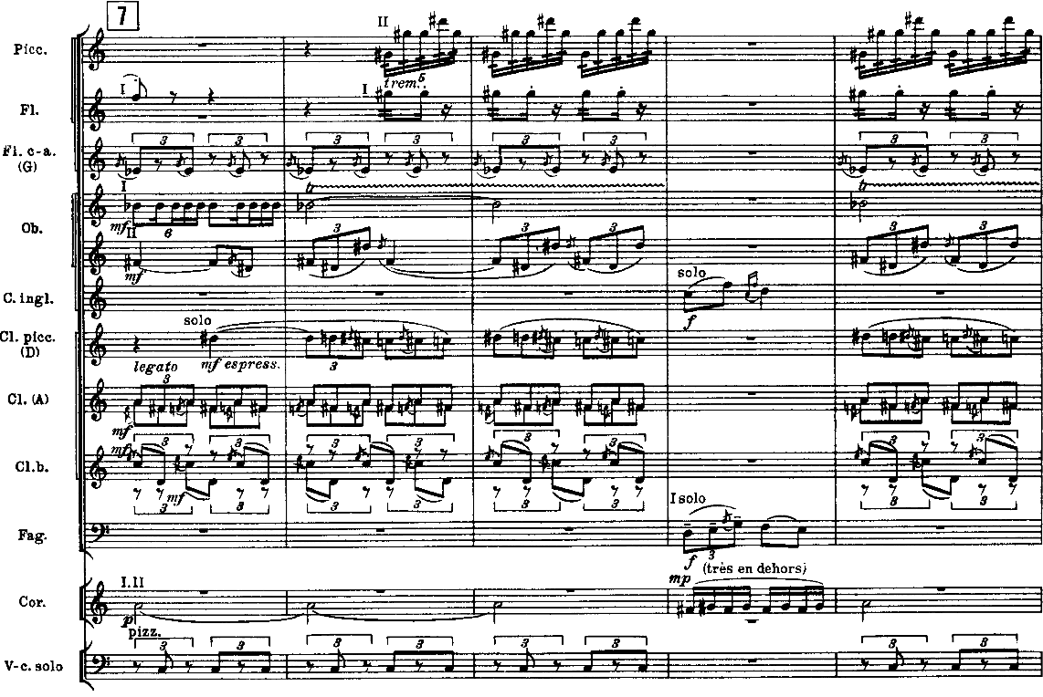
12 Layers

Slide 22
Stravinsky also reconceives harmony: harmonies tend to be dense, dissonant, opaque; but dissonant chords arrived at tas indivisible “blocks” of sound; this gives Stravinsky’s harmonies a kind of monumental & arbitrary quality
As we saw in Pettrushka, Stravinsky uses a variety of non-diatonic scales: whole-tone, pentatonic, octatonic (alternating whole & half steps)

Slide 23
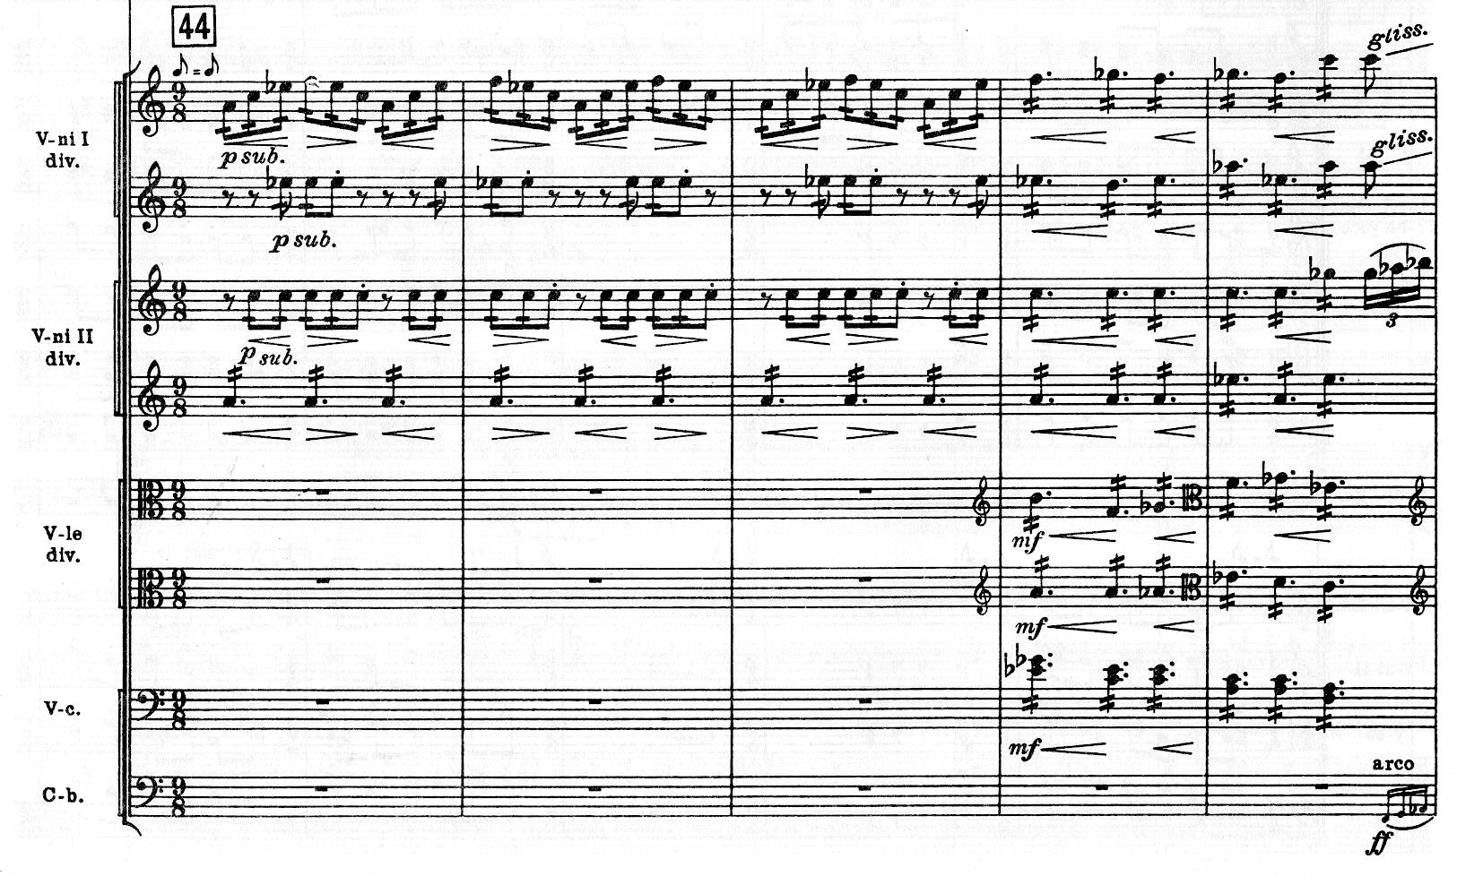
Stravinsky also reconceives the orchestra, using lots of winds and drums (more than in a traditional orchestra), and writing for strings in non-traditional ways

Slide 24
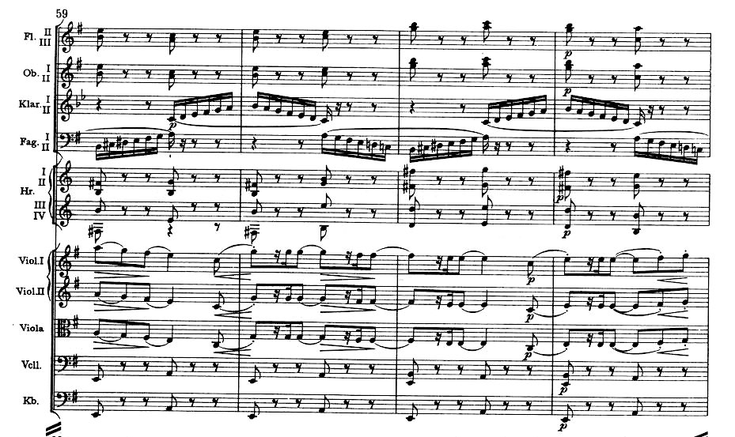
For comparison, some typical string parts in a Tchaikovsky symphony, with the melody in doubled violins & violas:

Slide 25
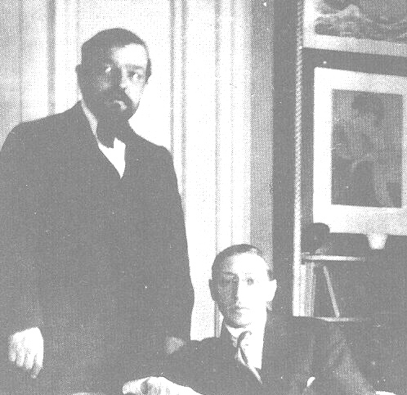
How is Stravinsky’s Rite different from Debussy’s brand of “impressionism”?
Debussy often elusive elusive and ambiguous, while Stravinsky is emphatic, barbaric, shocking
Debussy avoids clear repetition; Stravinsky repeats a dissonant chord 32 times; Stravinsky treats musical ideas as “objects,” to be repeated, dismembered, & overlaid without apology
Debussy avoids continuous and strictly defined rhythms, Stravinsky glorifies in these (uses many ostinatos — short musical patterns that are repeated insistently
Debussy hides & varies the pulse; Stravinsky’s main structural agent in Sacre is pulse, not harmonic motion & modulation

Slide 26
Characteristic conflicts of meter (march from The Soldier’s Tale, L’Histoire du soldat, 1918)
soldier’s theme on E: 2
A
Intro
NN: 2.5
G Lydian? prominent tritone G-C#
B-C#-D-E
always 3/8

