Slide 1
European Nationalism
Leoš Janáček

Slide 2
Leos Janácek (1854-1928)

Slide 3
Janácek born in a small Moravian village, later a provincial music teacher for years

Slide 4
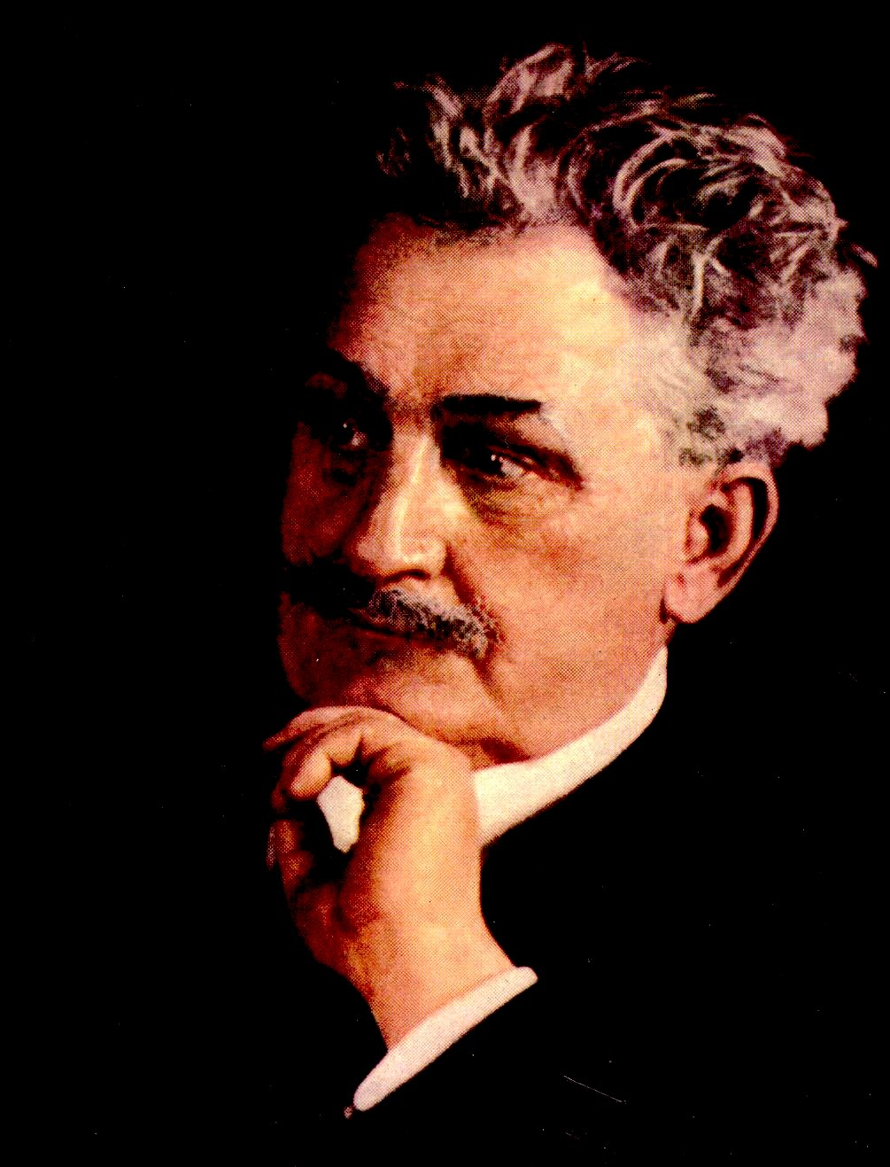
Unlike Dvorák, who was 13 years older, Janacek had an angular, hard-edged, non-lyrical, repetitious style
He quoted no folk tunes, but created his own folk-like elements and had a style that was basically tonal (emphasis on 2nds, 4ths, 5ths)
Examples in two late works: the Sinfonietta (1926) and Glagolitic Mass (1926-27)
Very interested in using elements of Czech speech: devised “speech melodies” from spoken language
Best known for his operas: The Cunning Little Vixen (1921-23), The Makropulos Affair (1923-25), From the House of the Dead (1927-28)

Slide 5
The Sinfonietta (1926)

Slide 6
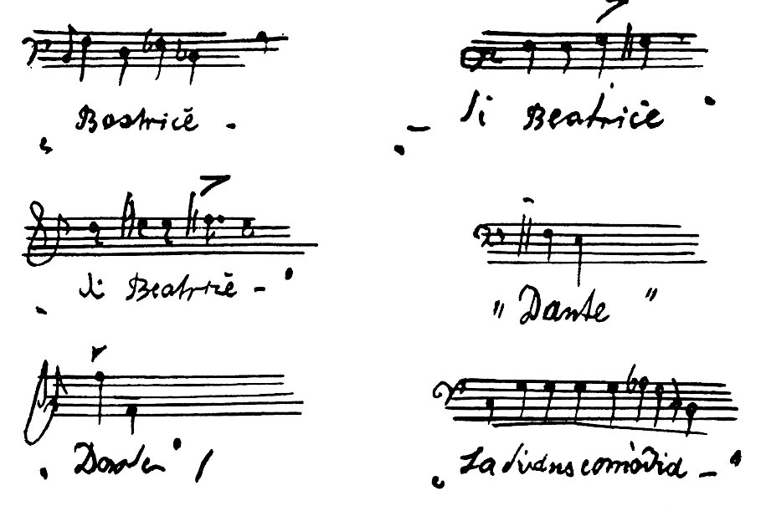
Some “speech melodies” taken down by Janácek in 1921

Slide 7
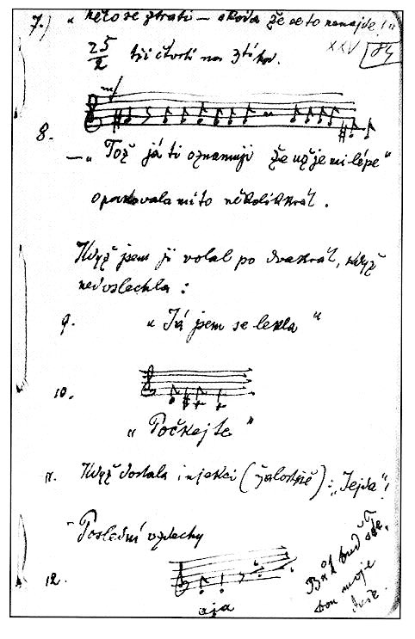
Janacek even wrote down the speech melodies he heard in his daughter’s dying words

Slide 8
Janácek’s operas
In 1920, Leos Janacek turned to science fiction for his opera The Excursions of Mr. Broucek, setting one of its scenes on the moon, where the local residents turn out to be fussy, art aficionados.
The Makropulos Affair (1923-25) includes a magic formula that lets the main character live for hundreds of years.
The Cunning Little Vixen (1921-23) was based on what was essentially a comic strip.
From the House of the Dead (1927-28) based on the Dostoyevsky novel (1862)

Slide 9
Excerpts from the animated opera film The Cunning Little Vixen, the European opera center

Slide 10
A late bloomer: fascination with the young Kamila Stösslová inspired Janácek to write his greatest music in his 60s

Slide 11
Nursery Rhymes (1925-26): 18 songs in folk style for chamber choir & ten instruments, on children’s texts in Czech, a Moravian dialect, and Ruthenian
Janacek frequently employs the intervals so characteristic of him (seconds, fourths and fifths) but his use of downward thirds sometimes pinpoints the mocking style of the rhyme (numbers 5, 13 and 14).
Piano style is chordal, percussive
vocal line of the rhymes often deliberately imitates a children's style of reciting, with intentional mis-stressing (numbers 6, 9 and 11);

Slide 17
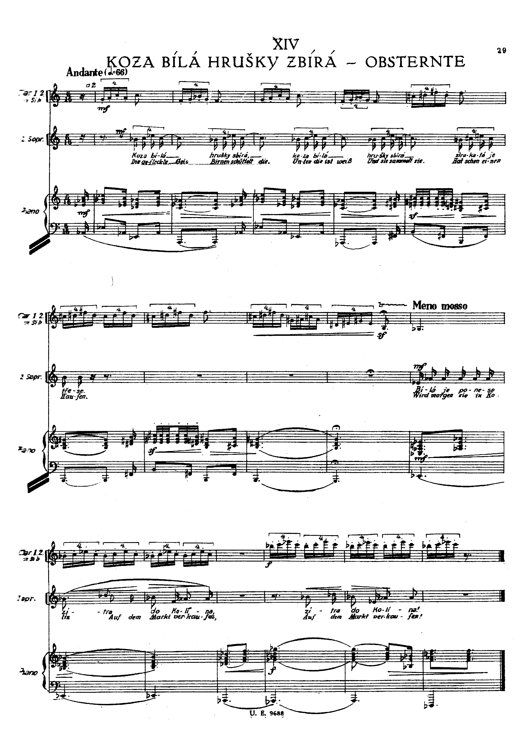
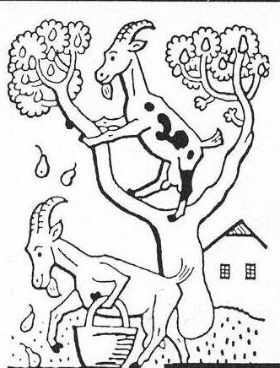
A white goat’s picking pears, a spotted one’s shaking them down. The white one, she’ll take them tomorrow to Kokín.

Slide 18
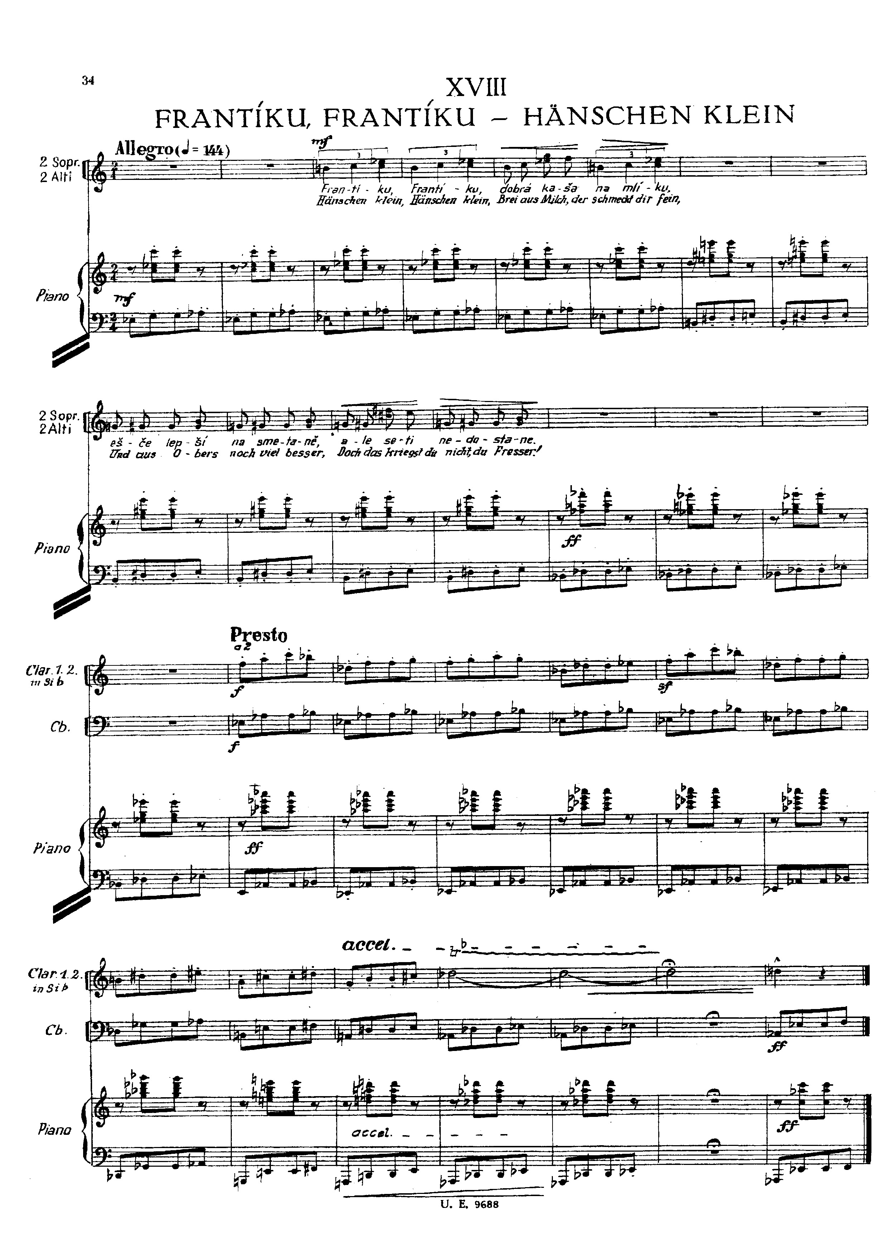
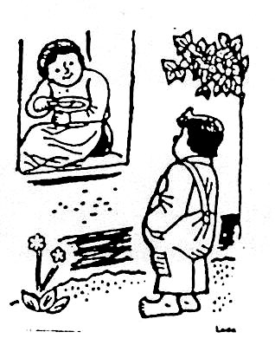
Frantík, Frantík, nice semolina with mild, even better with cream, but it won’t get around to you!

