Slide 1
Revolution
Debussy
Claude Debussy
(1862–1918)
Ernest Giraud: I am not saying that what you do isn’t beautiful, but it‘s theoretically absurd. Debussy: There is no theory. You have merely to listen. Pleasure is the law.

Slide 2
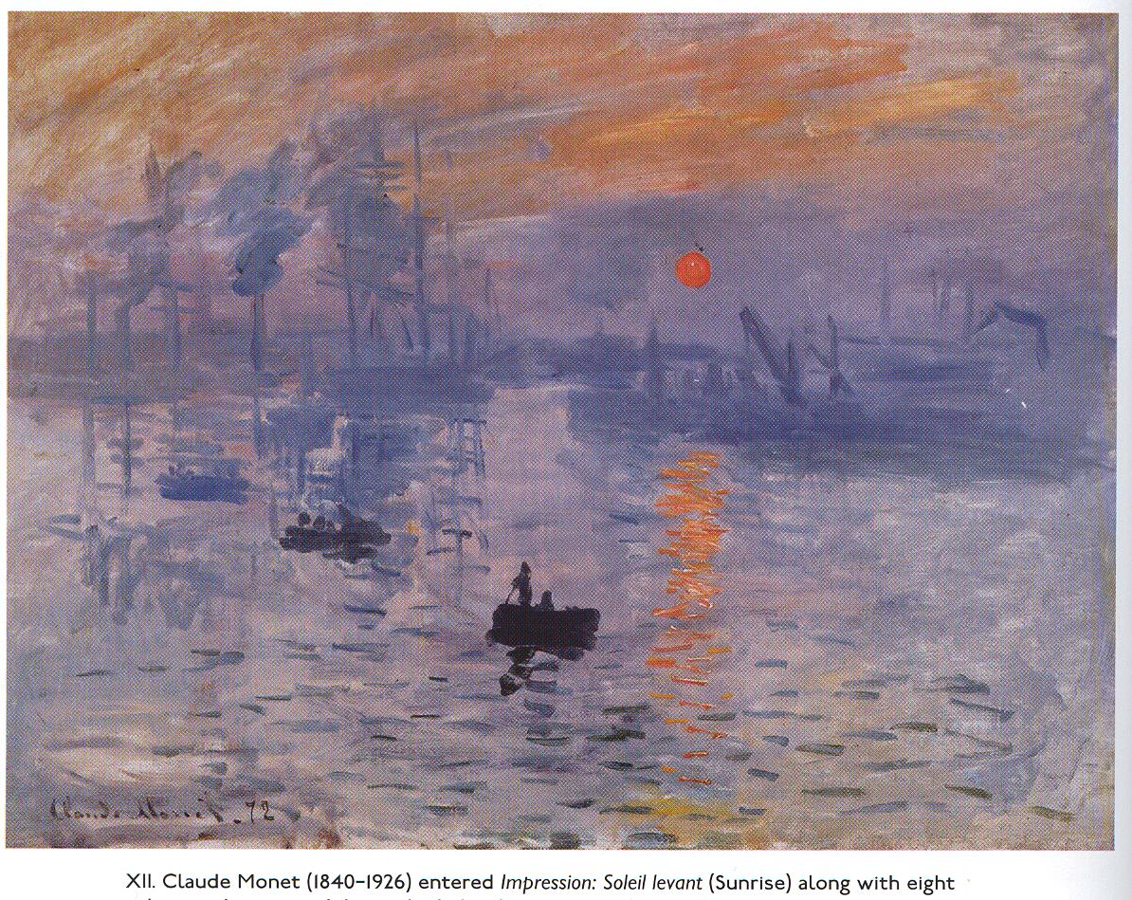
The French sound
French composers adept at developing “fluid” & less directional, more coloristic & improvisationalforms
Debussy did not feel heir to German traditions: far from sonata traditions and sonata ideas of balance, symmetry, contrast, clear architecture
Impressionism: Tone-color & quality of sound an important part of formal thinking
Claude Monet, Impression, Sunrise (1872)

Slide 3
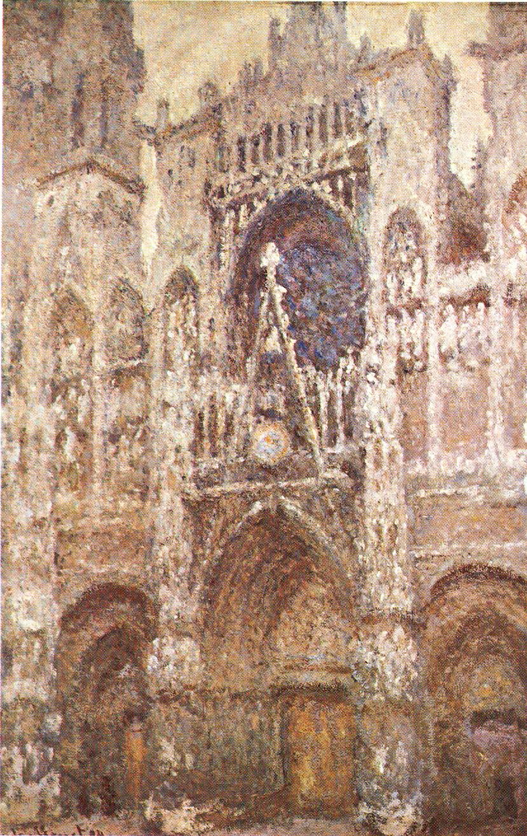
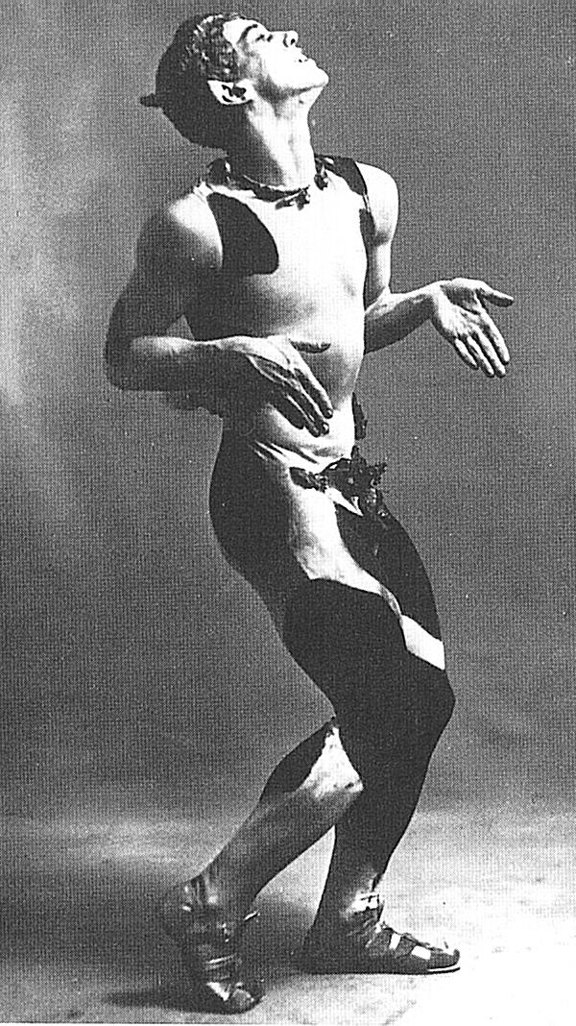
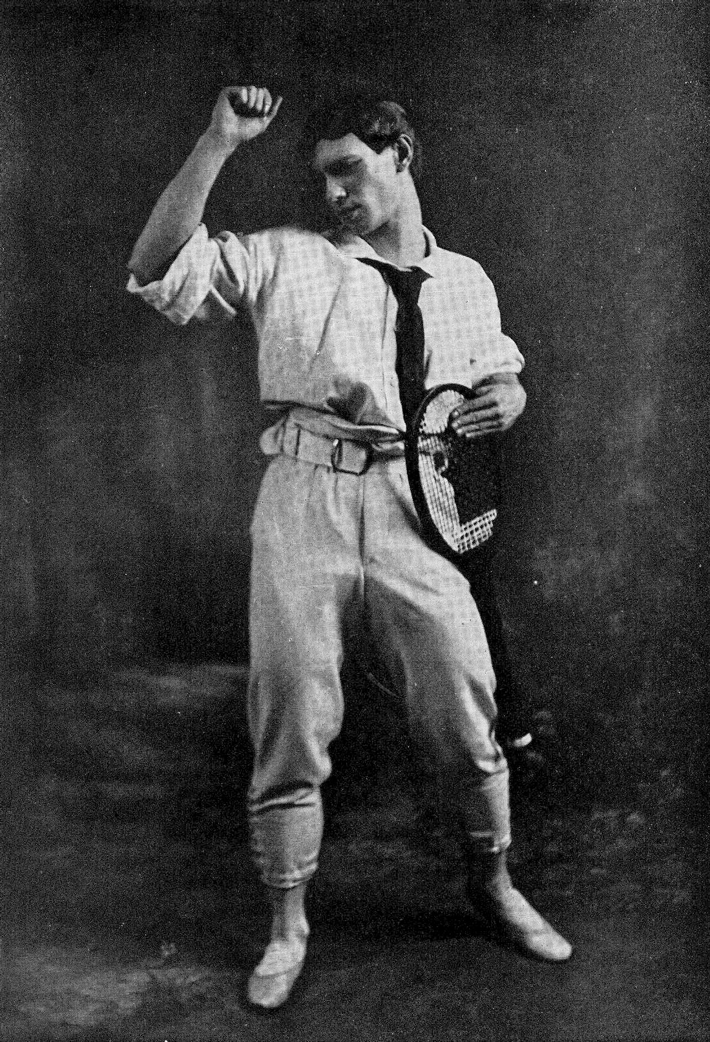
Debussy’s non-directional, non-cyclic structures were revolutionary.
Russian superstar Vaslav Nijinsky, in the premiere of Prelude to the Afternoon of a Faune (completed 1894) and Debussy’s late ballet Jeux (“games,” 1912)
Claude Monet, Rouen Cathedral: The Portal in Bleak Weather (1894)

Slide 4
Symbolists
Consciously unrealistic
Wanted language to be free from exact definitions, traditional sentence structure
Admired Wagner’s music dramas
Debussy—valued suggestion over outright statement
Henri Rousseau

Slide 5
Mark DeVoto, “The Debussy sound: colour, texture, gesture”
Elements as melody, rhythm, and microform
Repetition a fundamental aspect of Debussy’s sense of form.
La damoiselle élue, completed in 1889
and the Fantaisie for piano and orchestra
Nocturnes (1892–1899), Images pour orchestre (1905–1912)

Slide 6
The heterophonic orchestra
soft dynamics, wide range, preference for upper register of strings in soft textures
divided strings in multiple doublings, parallel or different rhythms, based and plucked simultaneously, embellished arpeggiation of one harmony
Woodwinds and brass in harmonic doublings, simultaneous patterns or figurations
Principal melodic line doubles within or between instrumental choirs; woodwind solos in melody
Varied orchestral emphasis of harmonic background, less often of contrapuntal line

Slide 7
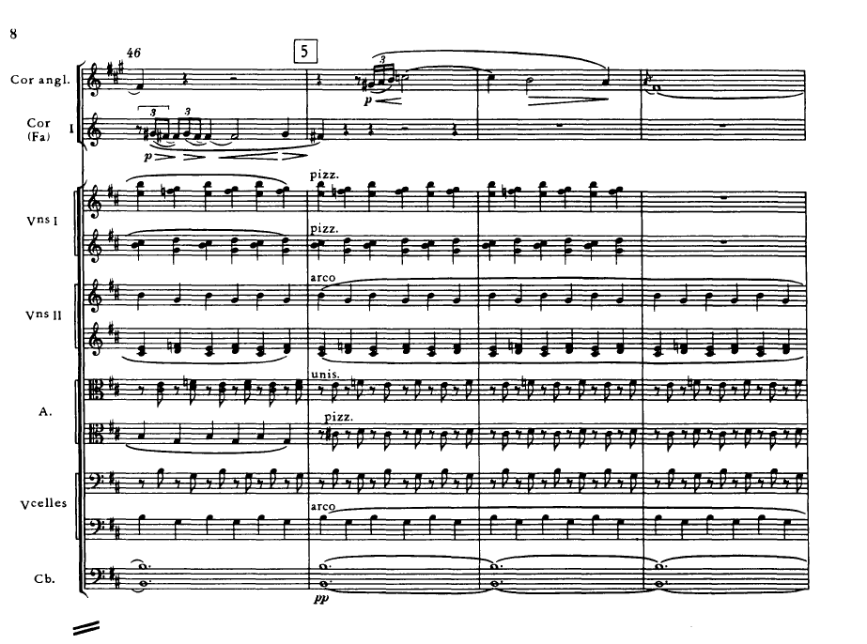
Nocturnes, “Nuages” (1892–99)
Tonality based on diminished triad, melodic line in background
muted horns, “a minimum of gestural events”
“A study in grey in painting”
each register marked by a characteristic string texture, such as simultaneous pizz. and arco
divided muted strings over wide span

Slide 8
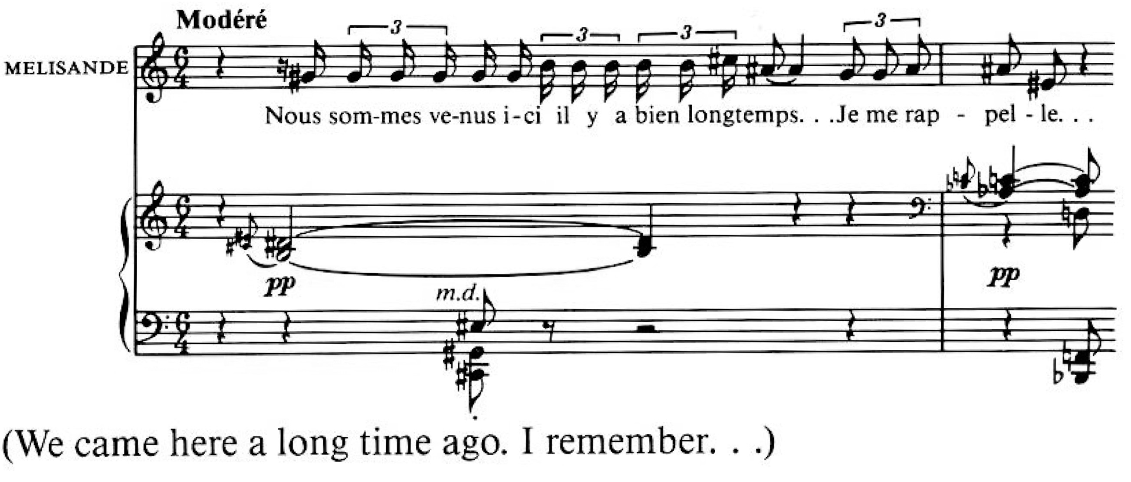
Pelléas et Mélisande (1902)
Its style deeply rooted in characteristics of the French language; Debussy’s vocal style designed as text setting.
Debussy’s breakthrough work, a shadowy, elusive piece wherein Strauss “heard no music”
A milestone in the history of operatic sound as well as dramatic treatment

Slide 9
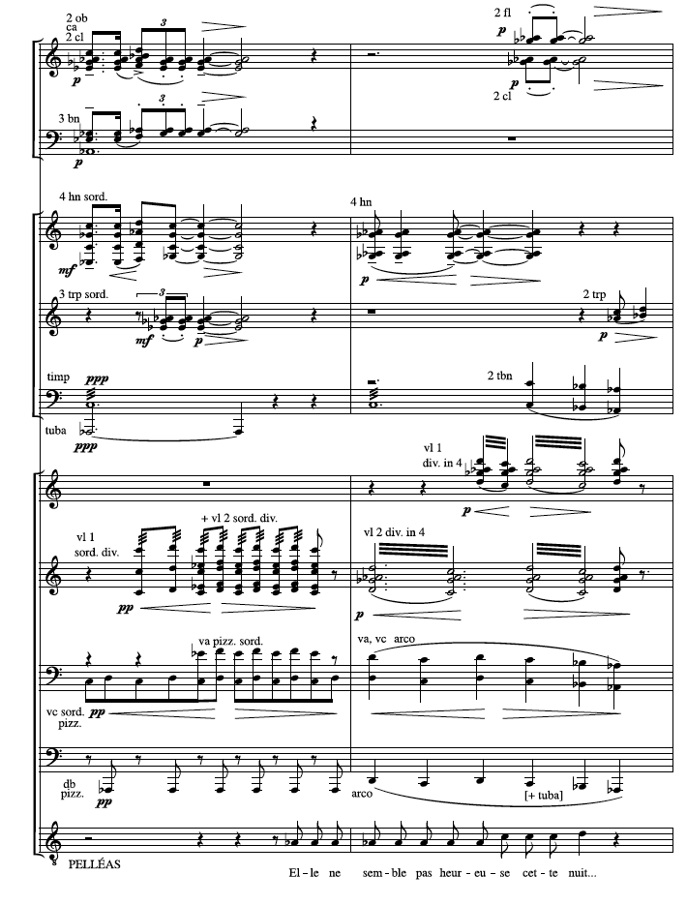
Contrast between
winds and strings
The Grotto scene at the end of act II shows color, subtle changes of doubling, textural rhythm, only slight harmonic movement
only one slight harmonic change
Pelléas et Mélisande, act II, scene 3

Slide 10
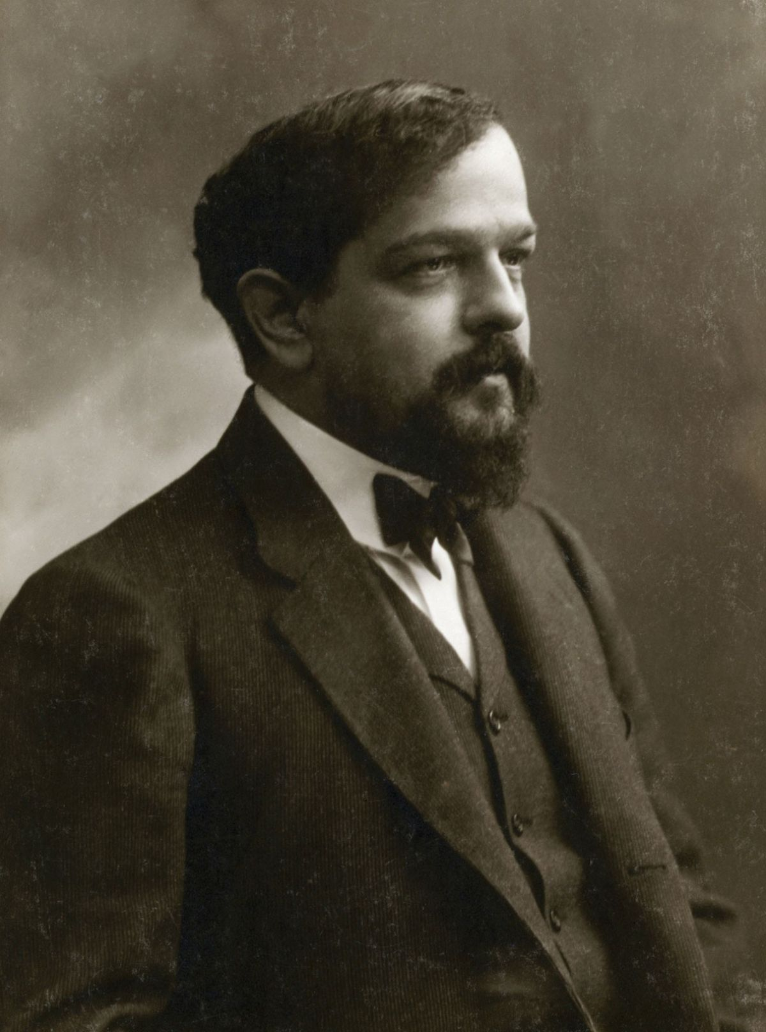
Debussy and the piano
During the 1890s parallel harmony “at its most crystalline”
1901 a pivotal year:
Pagodes (1903) and
Reflets dans l’eau (1905) more impressionistic

Slide 11
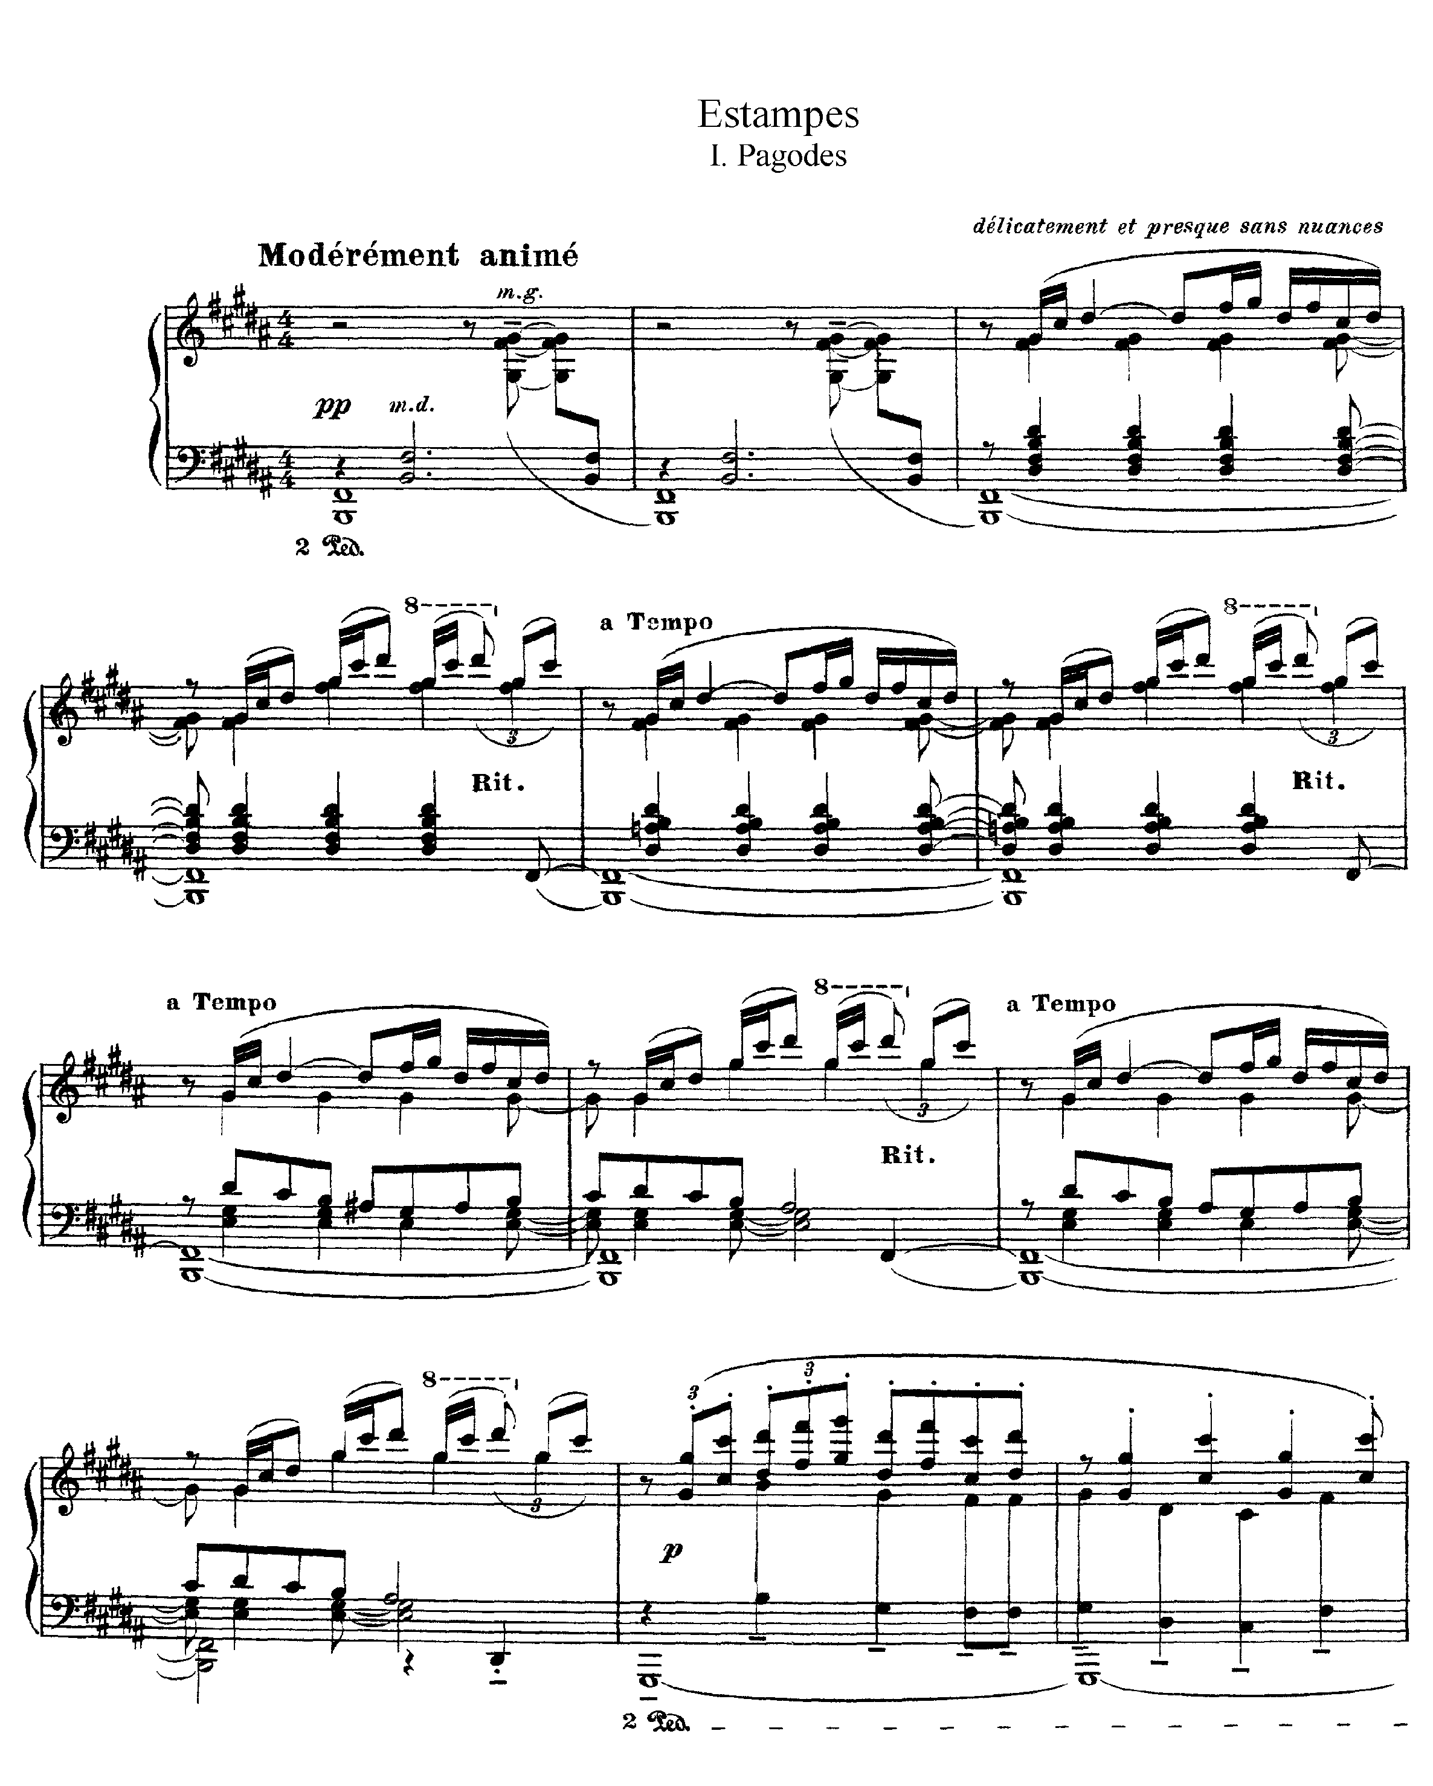

Slide 12
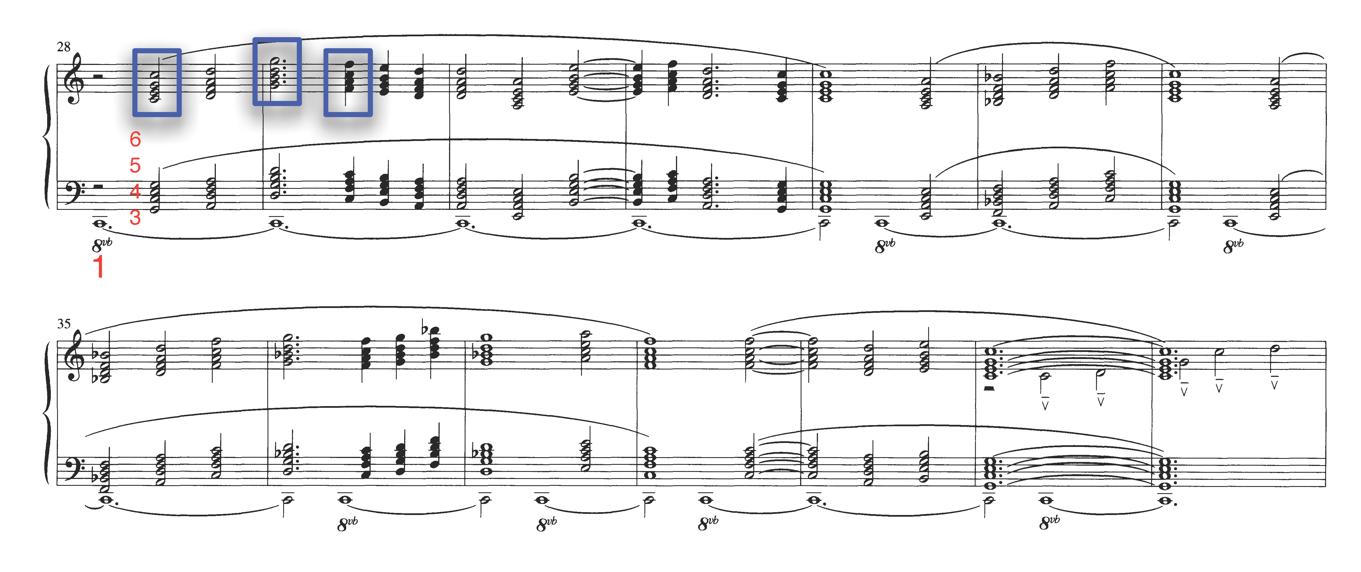
Harmonic language
Aspects of Debussy’s language that traditional diatonic tonality ambiguous in his music
Diatonic modes (Lydian, Dorian)
Strict parallel motion between lines in the musical texture (eliminating any sense of counterpoint)
Preludes, Book 1: La Cathedrale Engloutie

Slide 13
Harmonic language
Aspects of Debussy’s language that traditional diatonic tonality ambiguous in his music
Preludes, Book 1: Danseuses de Delphes

Slide 14
Non-diatonic scales: whole-tone, chromatic, pentatonic, acoustic, octatonic
whole-tone: only whole steps
C, D, E, F#, G#, A# and C#, D#, F, G, A, B
pentatonic: w-w-wm3-w-m3
C, D, E, G, A, etc.
acoustic: major with #ˆ4, bˆ7
C, D, E, F#, G, A, B^{b}
octatonic: alternating whole and half-steps
C, C#, D#, E, F#, G, A, B^{b}

Slide 15
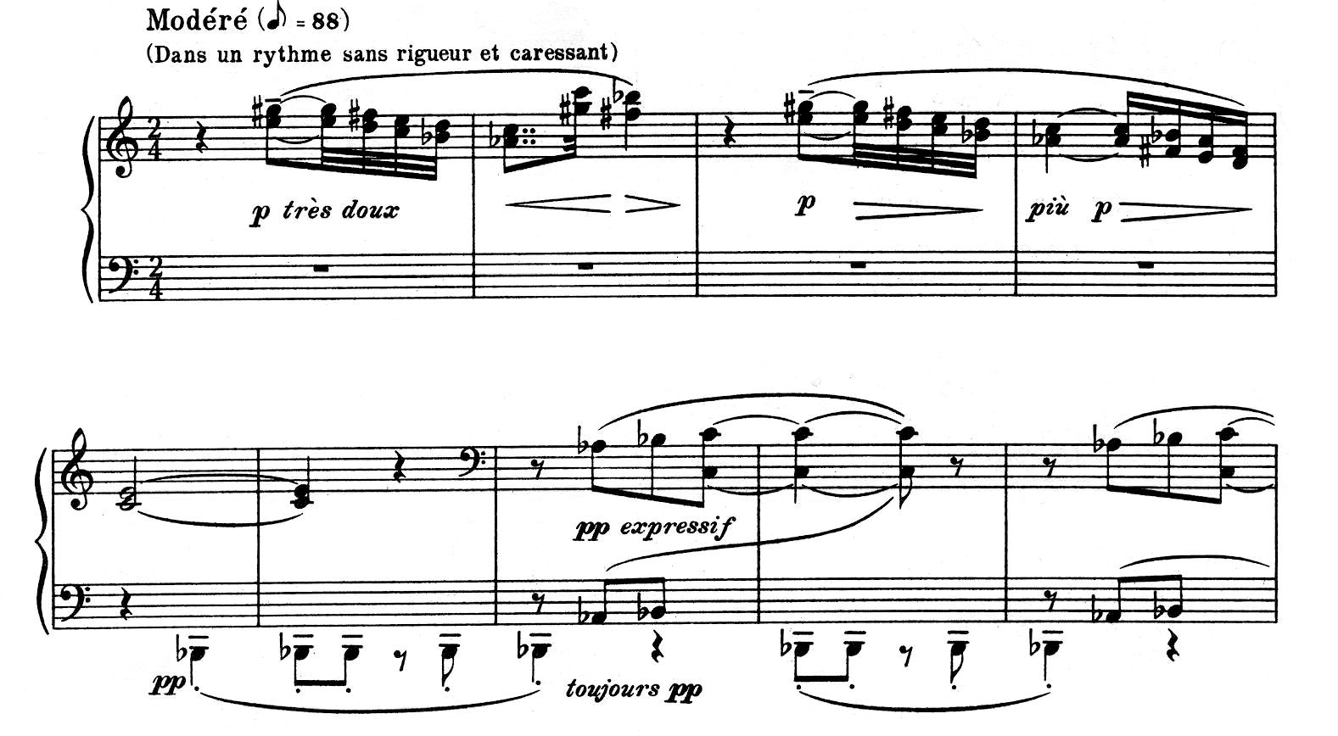
A whole-tone passage in Debussy’s Preludes, Book 1: “Voiles”

Slide 16
L'isle joyeuse

Slide 17
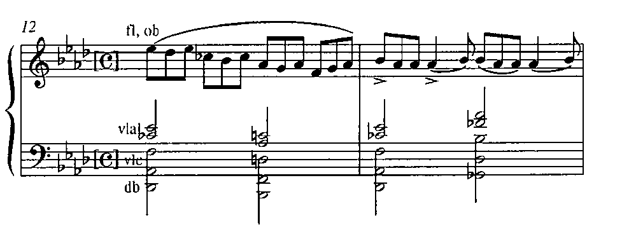
Chords “over-stacked” (9ths, 11ths, 13ths)
Nocturnes, “Fêtes,” mm. 12–13
La Soirée dans Grenade

Slide 18
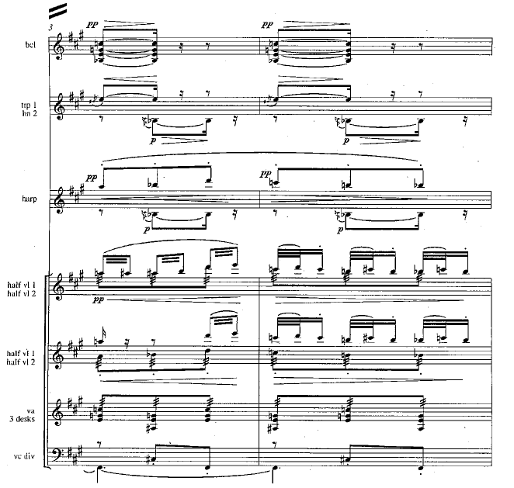
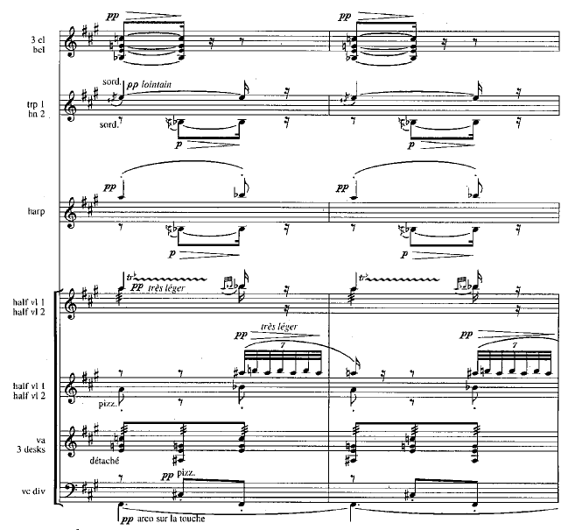
The later heterophony
Heterophony of timbre through the use of rapid ornaments on weak beats in string music: La mer (1905), Jeux (1912), En blanc et noir (1905)
Jeux featured Debussy’s largest orchestra (outside of Le martyrs de Saint-Sébastien), and was revolutionary for its formal freedom
Jeux, R10

Slide 19
La mer, trois esquisses symphoniques pour orchestre (The sea, three symphonic sketches for orchestra), or simply La mer (The Sea)
"De l'aube à midi sur la mer" – très lent – animez peu à peu
(From dawn to noon on the sea)
"Jeux de vagues" – allegro (dans un rythme très souple) – animé
(Play of the Waves)
"Dialogue du vent et de la mer" – animé et tumultueux – cédez très légèrement
(Dialogue of the wind and the sea)
The great wave of Kanaga from Hokusai

Slide 20
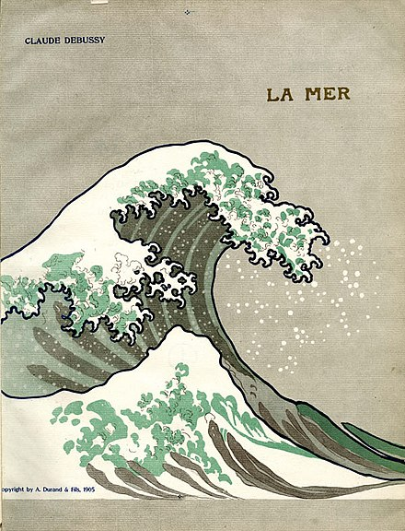
La mer: form, structure and motivic interpenetration
A mainstream view of form
What does “three symphonic sketches” mean?
De l‘aube à midi sur la mer seems to have two parts framed by an intro and coda that ends in Db major
Jeux de vagues like a scherzo (continuous or 3 parts?), where a dissonant tonic evolves to consonant E Lydian
Dialogue du vent et de la mer
Ergo, some argue that La mer is a symphony (even Debussy called it that sometimes)

Slide 21
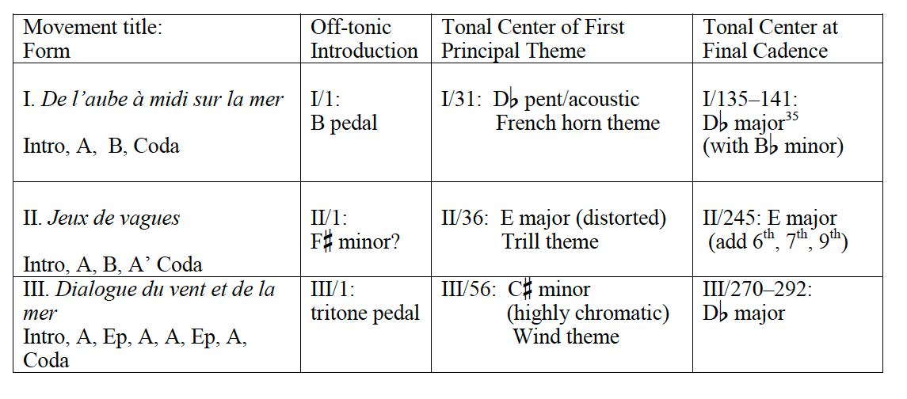
La mer as symphony; almost Romantic!
same tonic
all movements go I–bIII—I
four returns of main wind theme

Slide 22
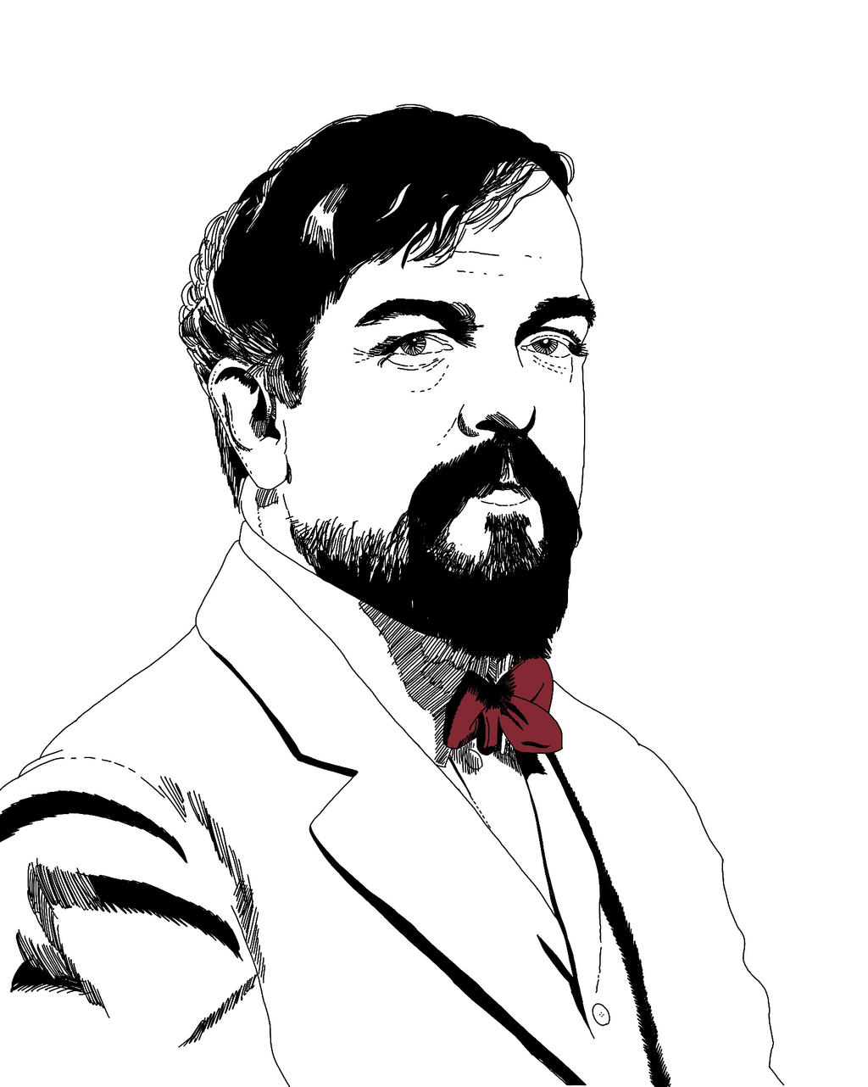
La mer is in many ways Debussy‟s most tightly organized multi-movement orchestral piece.
It is composed of metamorphosizing, genetically related melodies, which recycle and embed elements from a small pool of intervals, contours, and rhythms.

Slide 23
De l‘aube à midi sur la mer form

Slide 24
Motives: the dotted rhythm or appogiatura motive

Slide 25
Motives: the head motive

Slide 26
Motives: the step motive

Slide 27
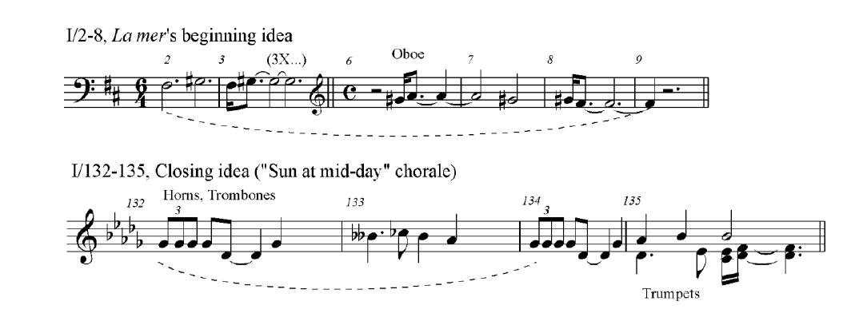
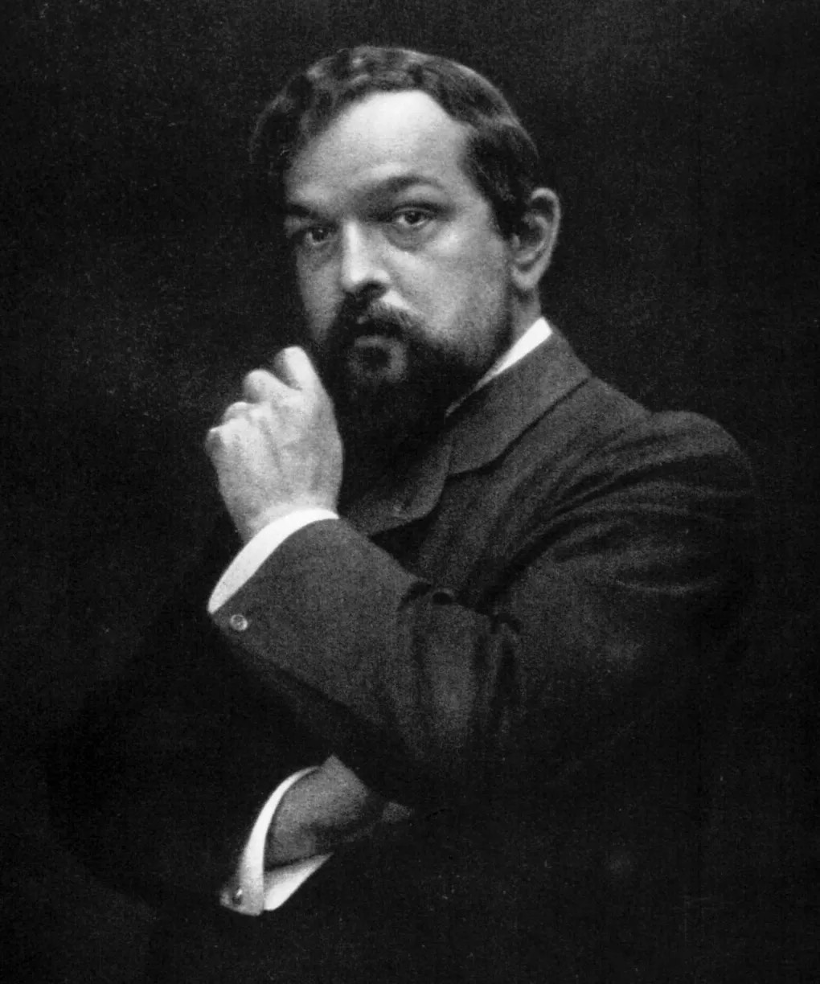
Compare the opening and closing themes

