Slide 1
Ruth Crawford Seeger (1901–1953)

Slide 2
Crawford Seeger and the Ultra-Modernists
The American composer Ruth Crawford Seeger developed techniques for structuring pitch, rhythm, dynamics, and texture that anticipated both Integral Serialism and process-based Minimalism
Born in Florida, she studied at the American Conservatory in Chicago before moving to New York in the mid-1920s and establishing herself as a composer in what became the Ultra-Modernist group that included Carl Ruggles,Varèse, Cowell, and Charles Seeger, whom she married in 1932.
Crawford Seeger composed her String Quartet (1931) while in Berlin on a Guggenheim Fellowship, the first to be awarded to a woman. Each of the four movements explores different innovative possibilities for systematically organizing the elements of music.

Slide 3
String Quartet
She described the third movement as “a heterophony of dynamics—a sort of counterpoint of crescendo and diminuendi.”
The final movement was a struggle between two voices in which the idea of dissonance is applied to dynamics and rhythm: “There is therefore a sort of dissonance within each voice between volume, in dynamics and number of tones, and also a sort of dissonance between the voices, in volume and number.”

Slide 4
At the start of the fourth movement, the first violin plays a single note that grows, one note at a time, into a melody 20 notes long:
The other three instruments reverse the pattern, starting with a muted 20-note melody played in unison that with each statement becomes one note shorter until it is reduced to a single note.

Slide 5
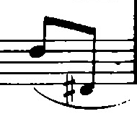
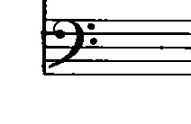
The lower voice is a 10-note row rotated with each statement to start on a new pitch.

Slide 6
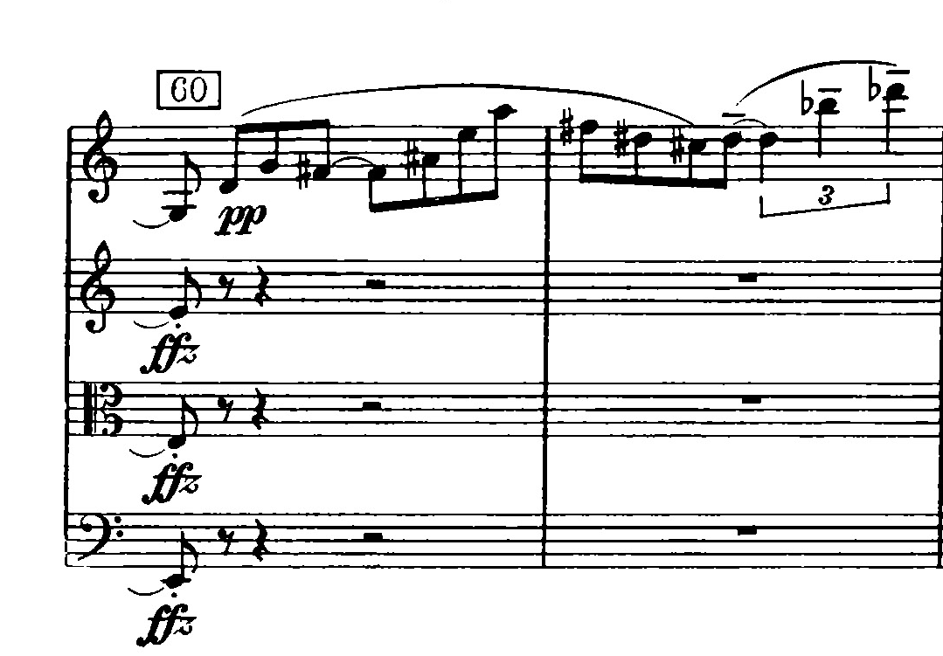
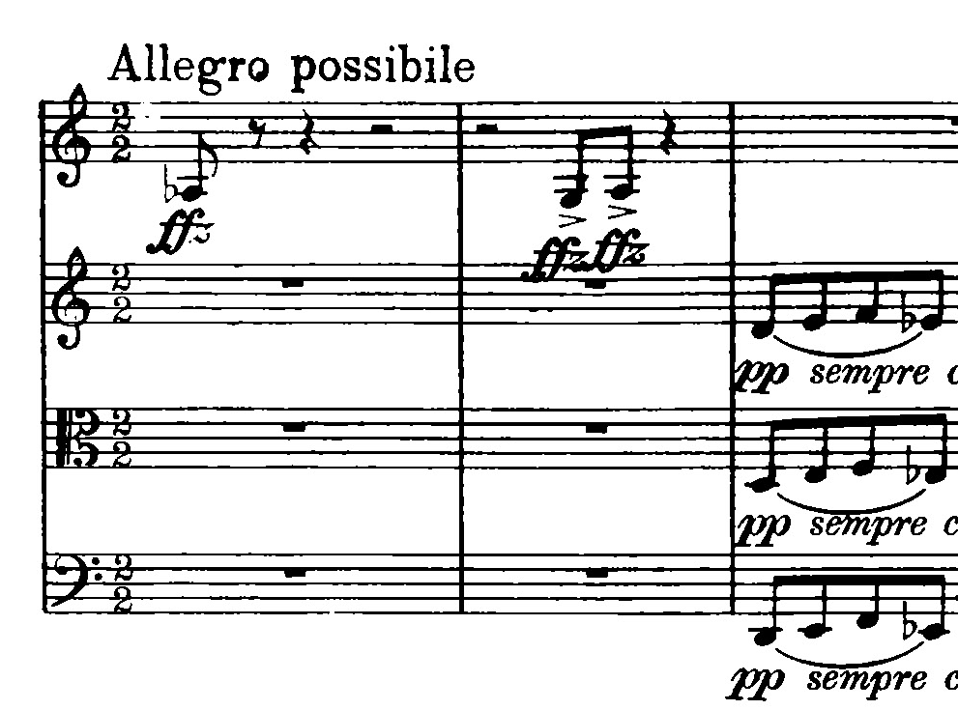
Meanwhile the two voices exchange their dynamic character .

Slide 7
In the second half of the movement all these processes are reversed, with both voices transposed up a half step, resulting in a large-scale palindrome .

