Slide 1
Alban Berg (1885–1935)

Slide 2
Musical dramatist, and heir to Mahler’s passionate post-Romantic style
Like Mahler, Berg never entirely abandoned tonality
Berg was intensely fascinated by the intricacies of musical structure
Like Schoenberg, he draws inspiration from the past;
unlike Schoenberg, that alludes to a richer harmonic language reminiscent of late chromatic music
Berg painting by Schoenberg

Slide 3
A page from Berg’s exhaustive counterpoint & composition lessons with Schoenberg

Slide 4
Piano Sonata, Op.1 (1906-1908)
Berg’s first substantial piece written under Schoenberg, classical phrase structure
cadential phrase: moves to point of rest

Slide 5
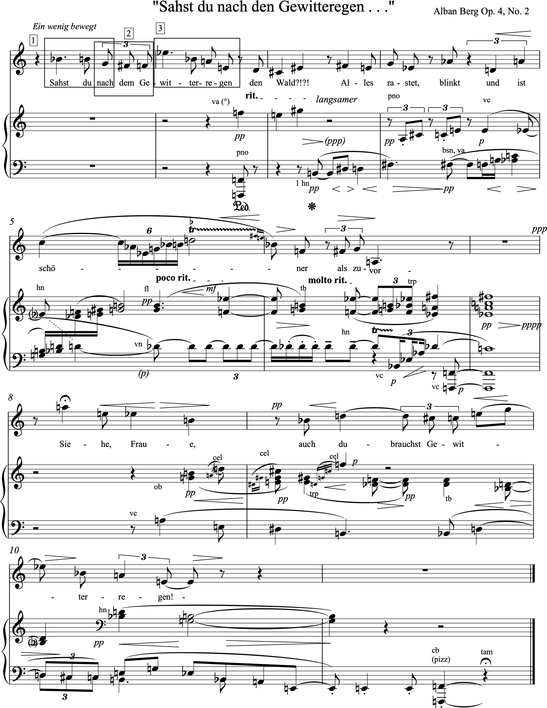
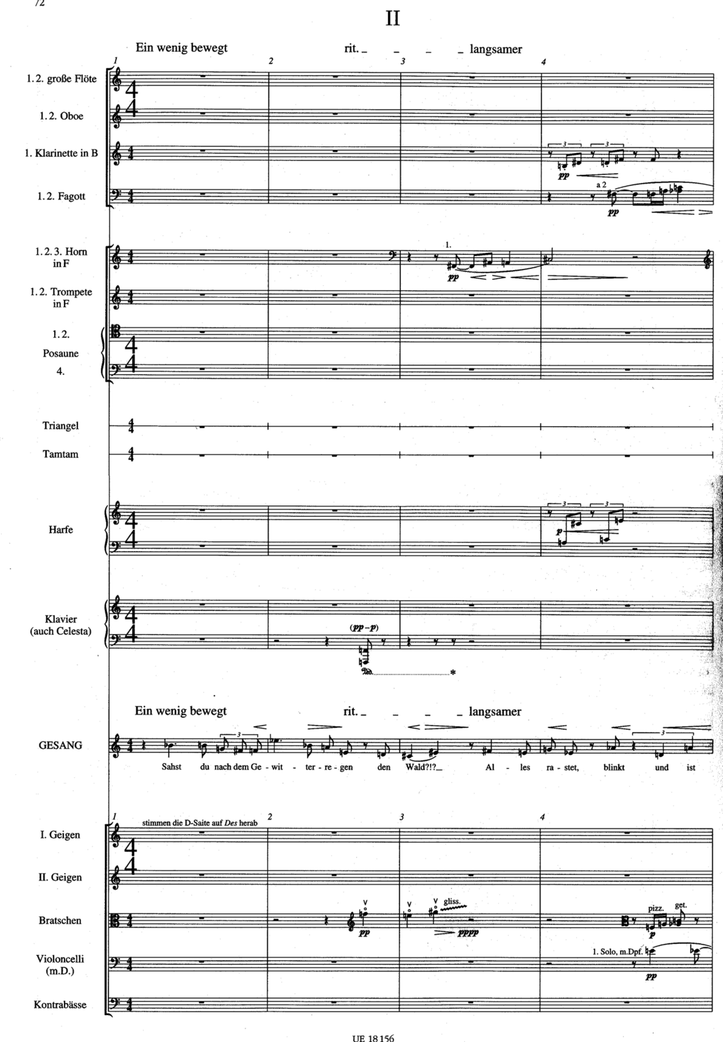
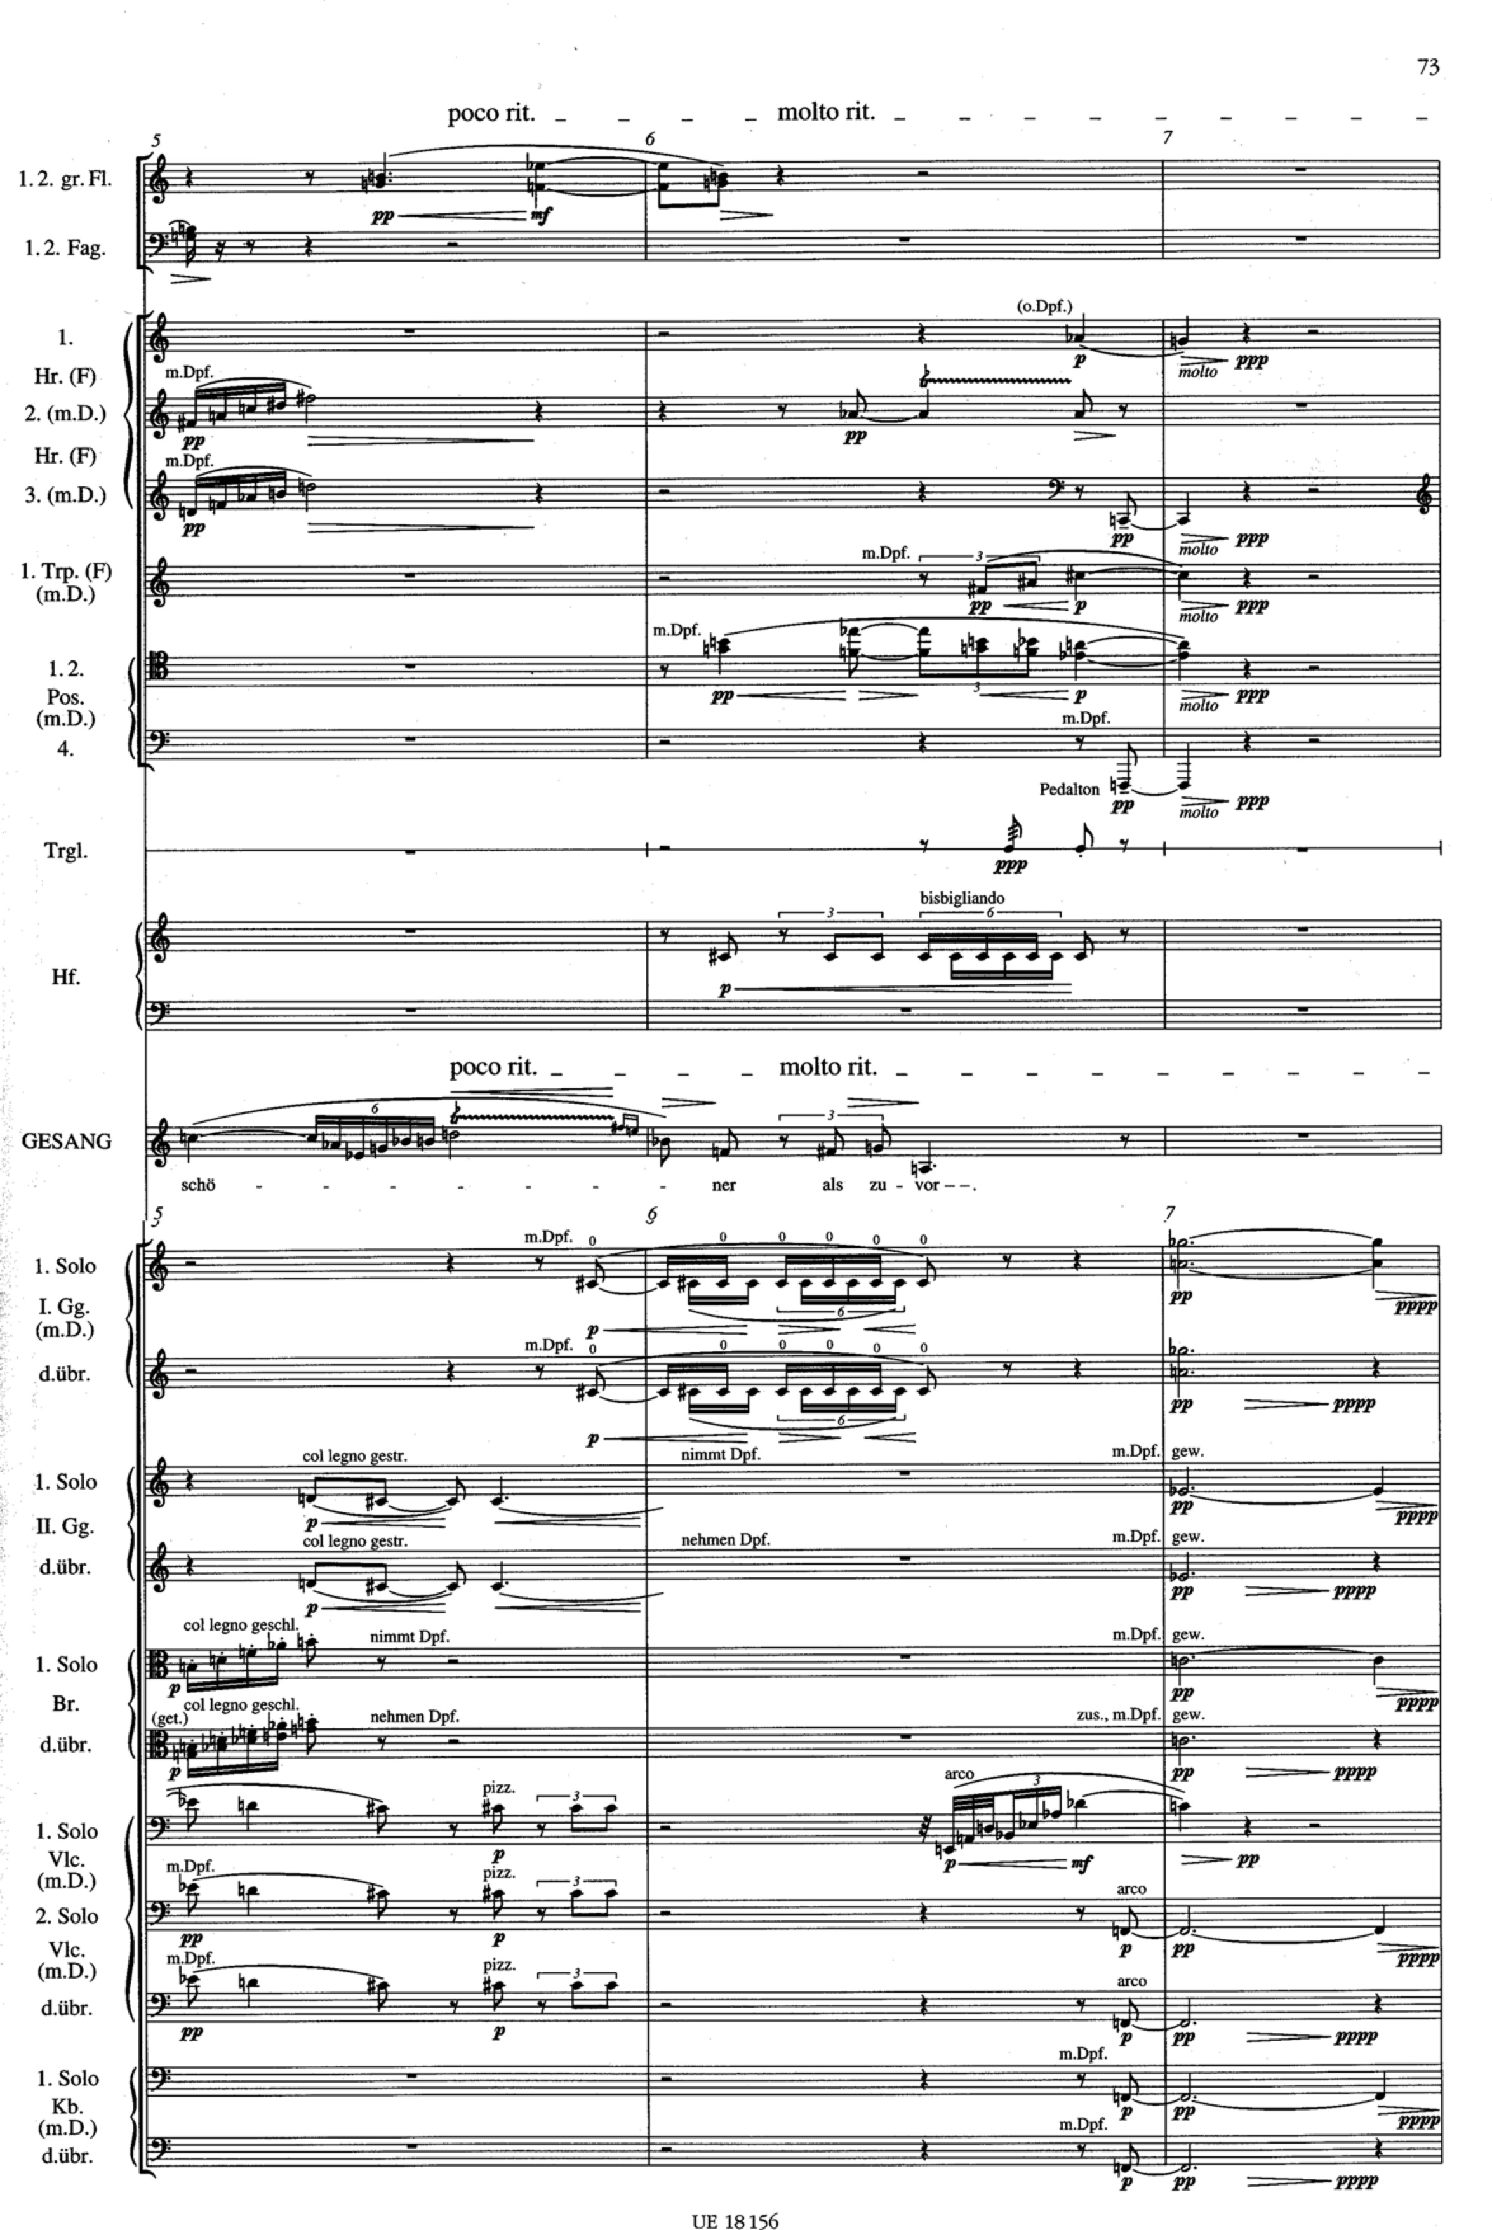
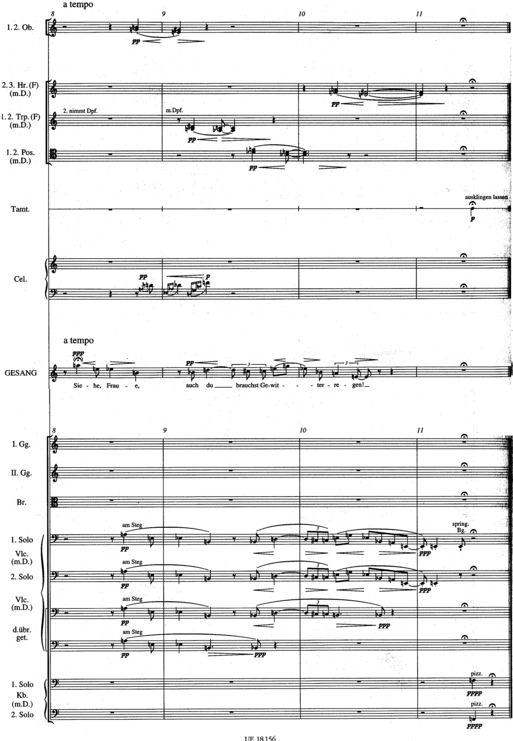
The Second of the Altenberglieder Op.4, orchestral songs written 1912 to postcard texts by Peter Altenberg for mezzo-soprano and orchestra
Did you see the forest after the thundershowers?
All is calm, glistens, and is more beautiful than before.
See, woman, you too need thundershowers!

Slide 6
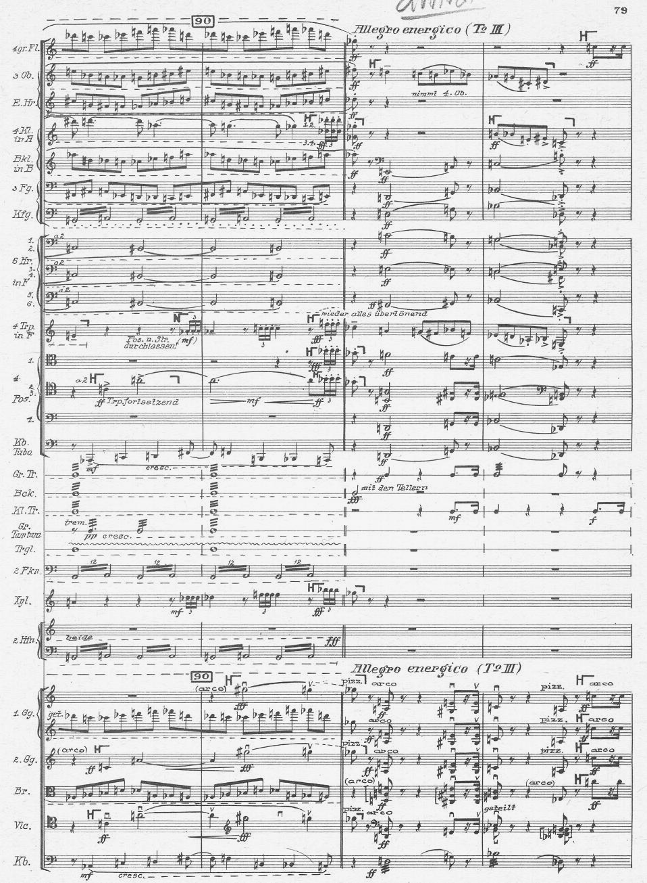
The gargantuan Three Orchestral Pieces Op.6, written 1914-15 under the influence of Berg’s beloved Mahler

Slide 7
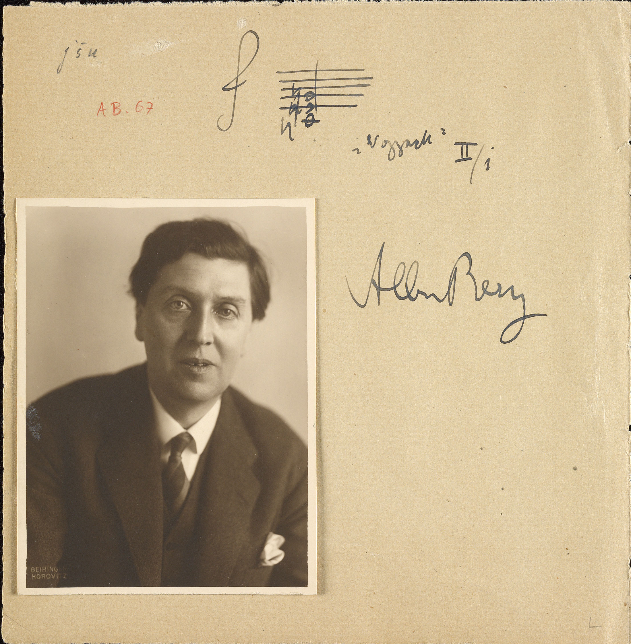
For his first opera, Berg chose the drama Woyzeck by Georg Büchner (1813-1837), based on the true story of a common soldier (exploited by everyone around him) who stabbed his faithless mistress to death and was executed
Wozzeck — the soldier
Marie — his common-law wife
The Doctor — exploits & experiments on Wozzeck
The Captain — obsessed with time & death, also torments Wozzeck

Slide 8
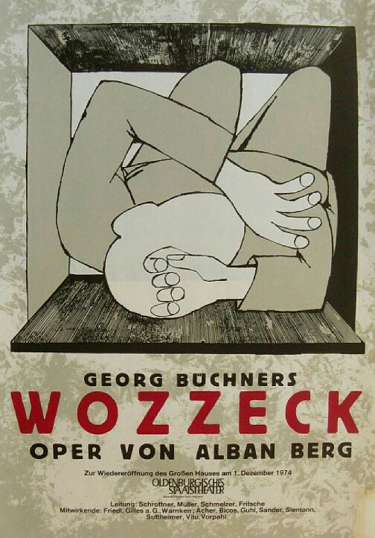
The musical language of Wozzeck
“Berg confidently displays his own mastery by overpowering Büchner's text to the point where - as is nowadays surely the common perception - Woyzeck the play is unthinkable without Wozzeck the opera.”
Anthony Pople
Three acts each having 5 scenes.
The play a kind of dramatic mobile, its very formlessness an essential characteristic.
This often works poorly in the theatre, but not in Berg. Music gives Berg the capacity for continual cross-references that counterpoint the chronological trajectory of the narrative, making a dramatic virtue of its “inevitability.”

Slide 9
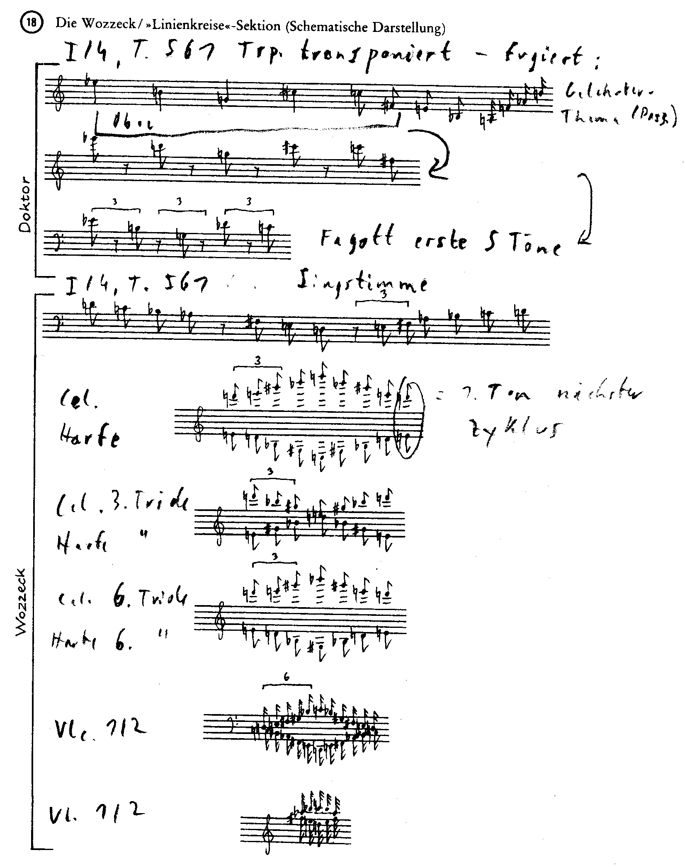
“ [the final scene] ... clearly moves to cadence on to the closing chord, it almost appears as if it carries on. And it does carry on! In fact, the opening bar of the opera could link up with this final bar and in so doing close the whole circle.”
Berg (1929)

Slide 10
Berg also aligned his opera with the Wagnerian music-drama project
drama |  | music
expositions | Act I | five character pieces
Wozzeck and the Captain | scene 1 | Suite
Wozzeck and Andres | scene 2 | Rhapsody
Marie and Wozzeck | scene 3 | Military march and lullaby
Wozzeck and the Doctor | scene 4 | Passacaglia
Marie and the Drum Major | scene 5 | Andante affetuoso (quasi Rondo)
dramatic development | Act II | Symphony in five movements
Marie and her child, later Wozzeck | scene 1 | Sonata movement
the Captain and the Doctor, later Wozzeck | scene 2 | Fantasia and Fugue
Marie and Wozzeck | scene 3 | Largo
garden of a tavern | scene 4 | Scherzo
guard room in the barracks | scene 5 | Rondo con introduzione
catastrophe and epilogue | Act III | six inventions
Marie and the child | scene I | invention on a theme
Marie and Wozzeck | scene 2 | invention on a note
tavern | scene 3 | invention on a rhythm
death ofWozzeck | scene4 | invention on a hexachord
 | interlude | invention on a tonality
children playing | scene 5 | invention on a regular quaver movement

Slide 11
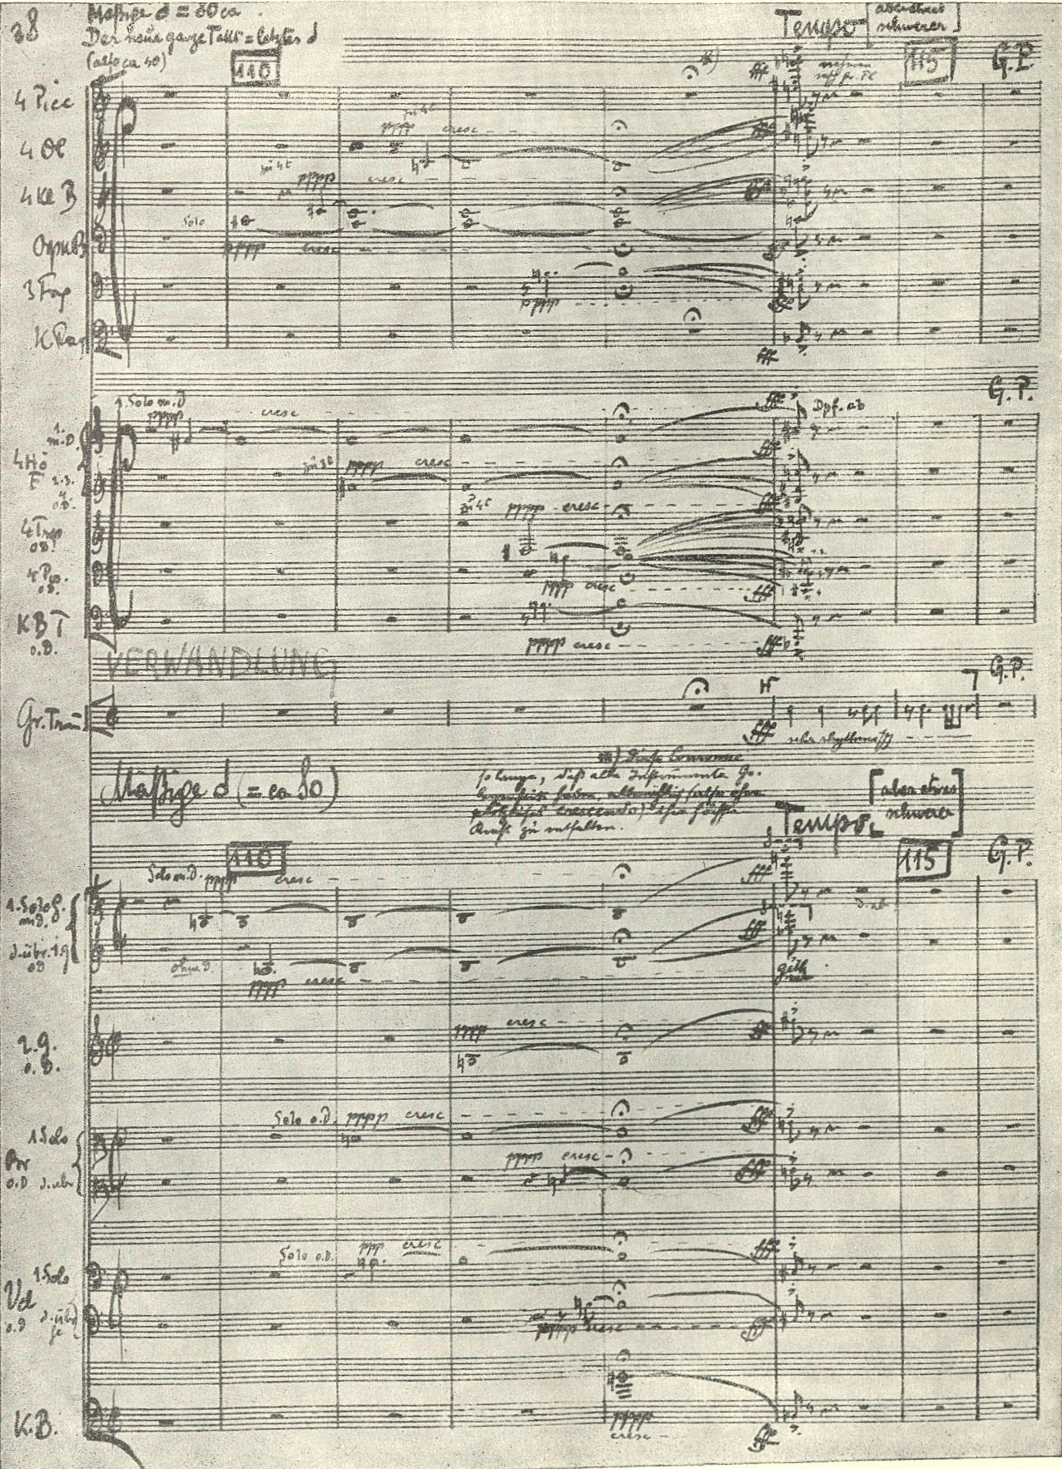
“ [The second act ... has, as its first musical form, a sonata movement. It is not, perhaps, an accident that the three figures appearing in this scene, Marie, her child and Wozzeck, form the basis of the three thematic groups of the musical exposition - the first subject, second subject and coda - of a strict sonata structure.”
Berg (1929)

Slide 12
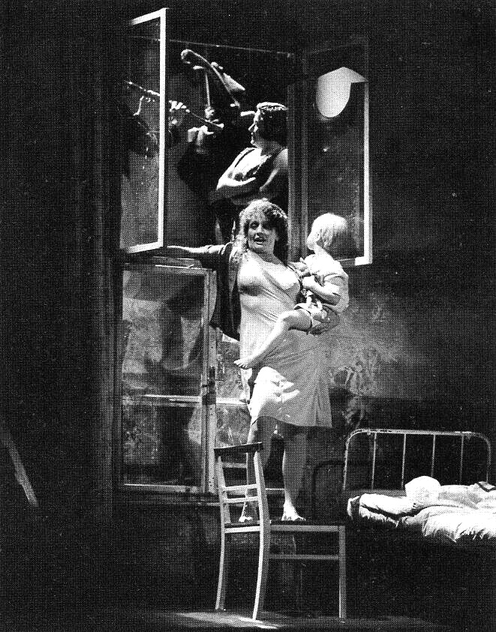
“ The function of a composer is to solve the problems of an ideal stage director. On the other hand this objective should not prejudice the development of the music as an entity, absolute, and purely musical. … It was imperative to use everything essential for the creation of individualizing characteristics on the one hand, and coherence on the other. Hence the much discussed utilization of both old and new musical forms .”
Berg “A Word about Wozzeck

Slide 13
Collages of motivic materials are characteristic of Wozzeck, and Berg's mature music in general.
The classic instance is at the moment of Marie's death, when “all the important musical configurations associated with her are played very rapidly ... at lightning speed.” (Berg)

Slide 14
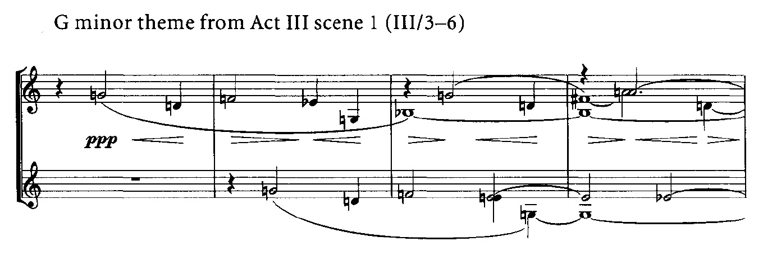
Atonal motives but also a sense of tonality that can be very focused
Marie's Bible scene at the beginning of Act III: a barely-disguised G minor followed by a twelve-note sequence.

Slide 15
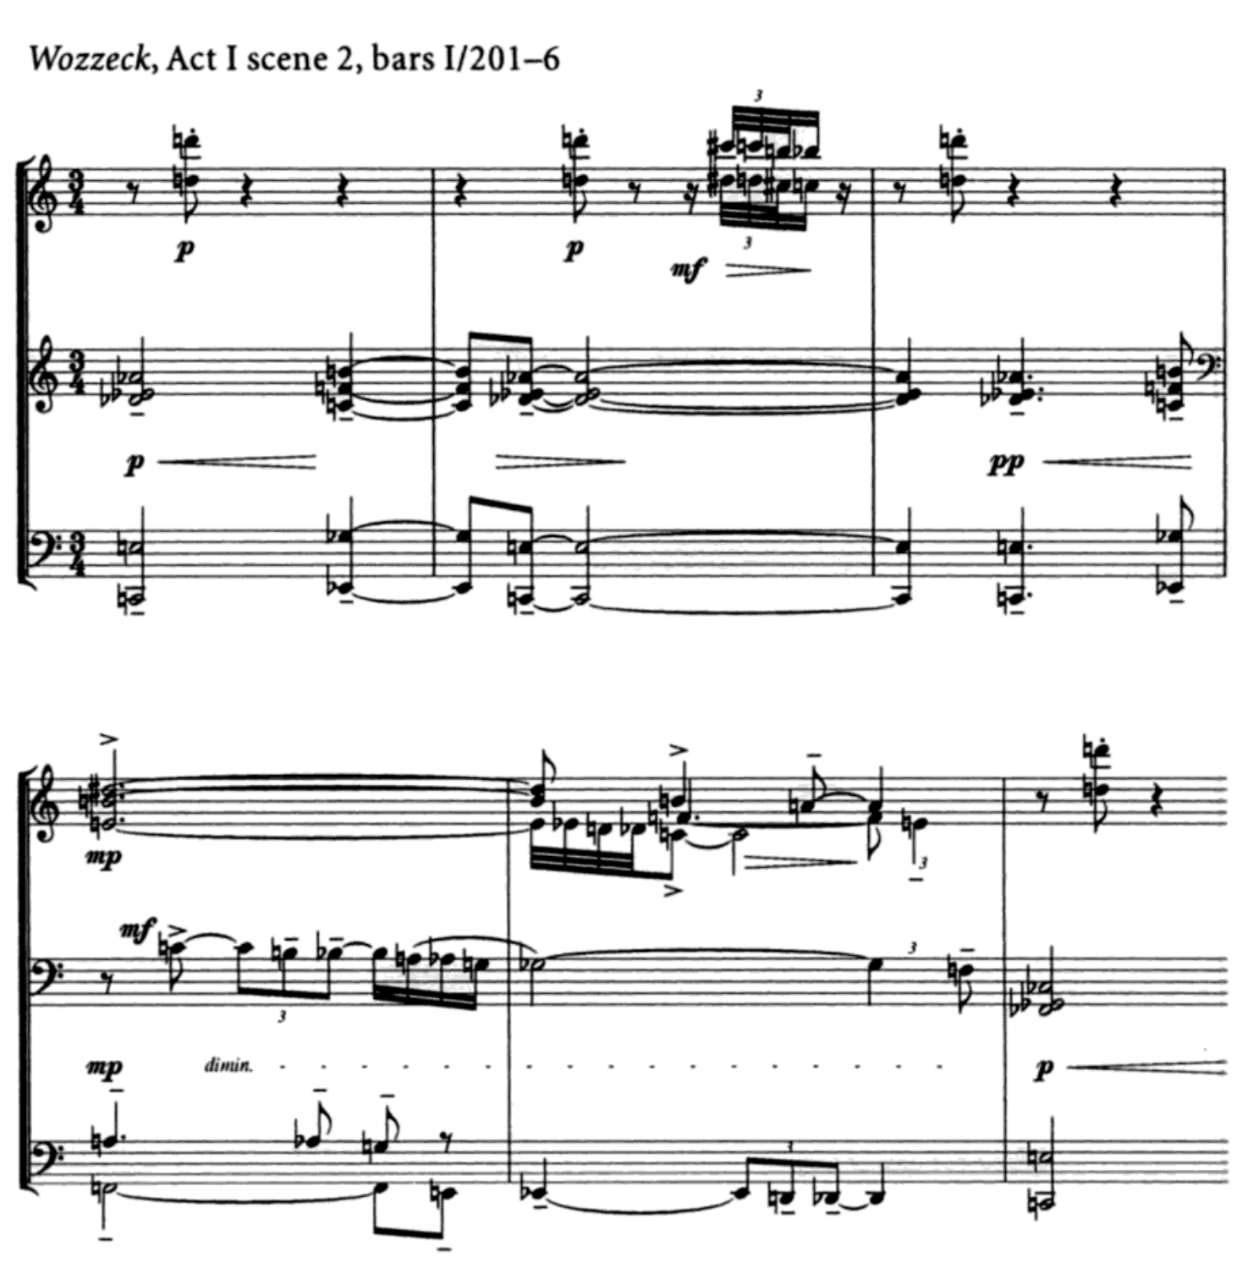
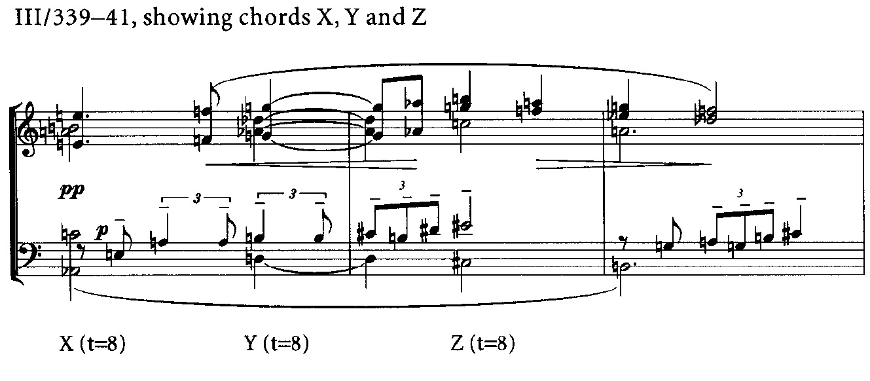
Atonal motives but also a sense of tonality that can be very focused
One of the most emblematic passages in Wozzeck is the opening of Act I scene 2
The three chords on which this is based are labelled X, Y and Z
Berg described these three chords as having tonic, dominant and subdominant functions.The appearance of chord X at bar III/331 is interpretable in as a C^{13b} chord.
This prepares for the complete statement of the tonal analogue X-Y-Z six bars later.

Slide 16
