Slide 1
Twelve-tone music

Slide 2
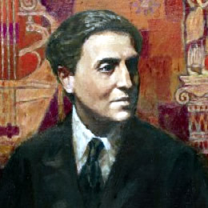
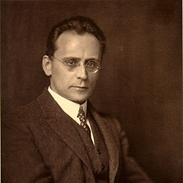
12-tone composition after Schoenberg
Vienna: Schoenberg’s prize students
Alban Berg (1885-1935)
Anton Webern (1883-1945)
Princeton: followers of Schoenberg
Roger Sessions (American, 1896-1985)
Milton Babbitt (American, b.1916; a pupil of Sessions)
Paris, Darmstadt: followers of Webern
Pierre Boulez (French, b.1926)
Karlheinz Stockhausen (German, b.1928)

Slide 3
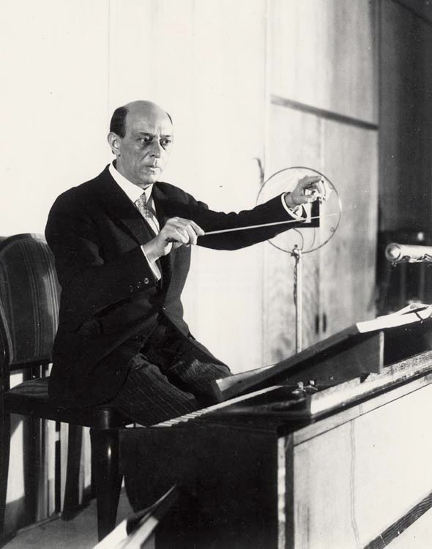
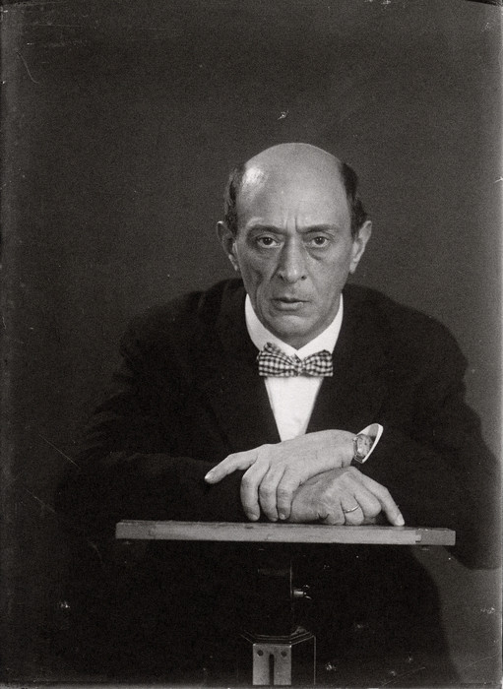
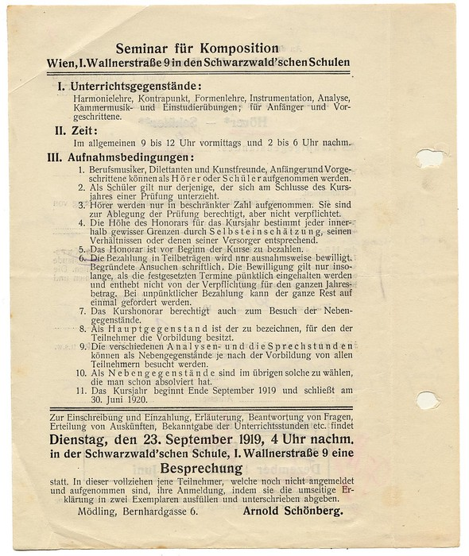
Schoenberg at outset of WWI (1914-): looking for a way to bring complete chromaticism (“atonality”) under some kind of control

Slide 4
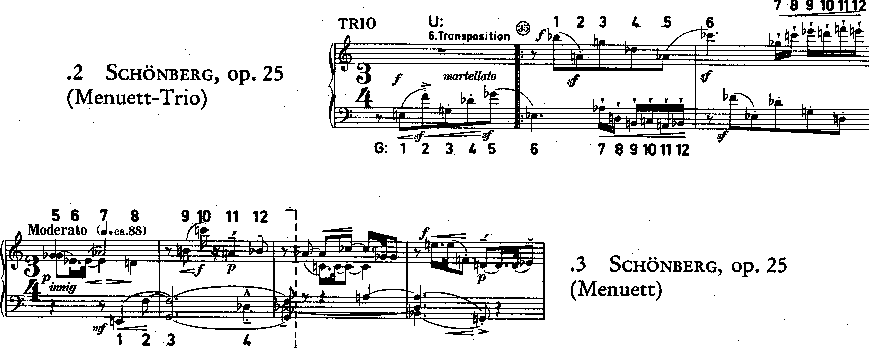
Gradually working his way toward “mature” twelve-tone music: (1) consistent “rotation” of the 12 chromatic pitches (i.e., consistent atonality); (2) writing around a strict and deterministic ordering of pitches
Schoenberg’s “transitional” works: Piano Pieces, Op. 23; Serenade, Op. 24 (all 1920-23)
“mature” twelve-tone works: Piano Suite, Op. 25 (1921-23); Wind Quintet, Op. 26 (1923-24)

Slide 5
 | I4 | I5 | I7 | I1 | I6 | I3 | I8 | I2 | I11 | I0 | I9 | I10
P4 | E | F | G | C# | F# | D# | G# | D | B | C | A | B^{b} | R4
P3 | D# | E | F# | C | F | D | G | C# | B^{b} | B | G# | A | R3
P1 | C# | D | E | B^{b} | D# | C | F | B | G# | A | F# | G | R1
P7 | G | G# | B^{b} | E | A | F# | B | F | D | D# | C | C# | R7
P2 | D | D# | F | B | E | C# | F# | C | A | B^{b} | G | G# | R2
P5 | F | F# | G# | D | G | E | A | D# | C | C# | B^{b} | B | R5
P0 | C | C# | D# | A | D | B | E | B^{b} | G | G# | F | F# | R0
P6 | F# | G | A | D# | G# | F | B^{b} | E | C# | D | B | C | R6
P9 | A | B^{b} | C | F# | B | G# | C# | G | E | F | D | D# | R9
P8 | G# | A | B | F | B^{b} | G | C | F# | D# | E | C# | D | R8
P11 | B | C | D | G# | C# | B^{b} | D# | A | F# | G | E | F | R11
P10 | B^{b} | B | C# | G | C | A | D | G# | F | F# | D# | E | R10
RI4 | RI5 | RI7 | RI1 | RI6 | RI3 | RI8 | RI2 | RI11 | RI0 | RI9 | RI10

Slide 6
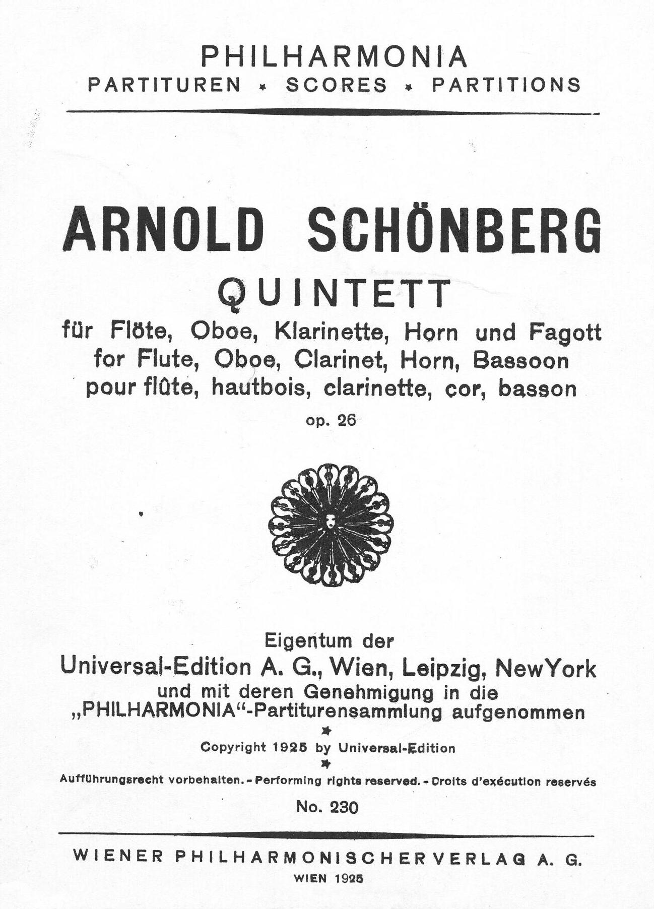
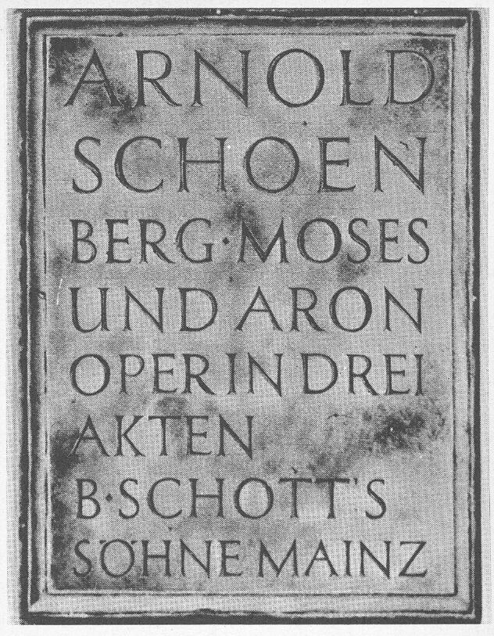
After devising 12-tone (he called it a “method” rather than a “system”), Schoenberg was able to return to large-scale composition

Slide 7
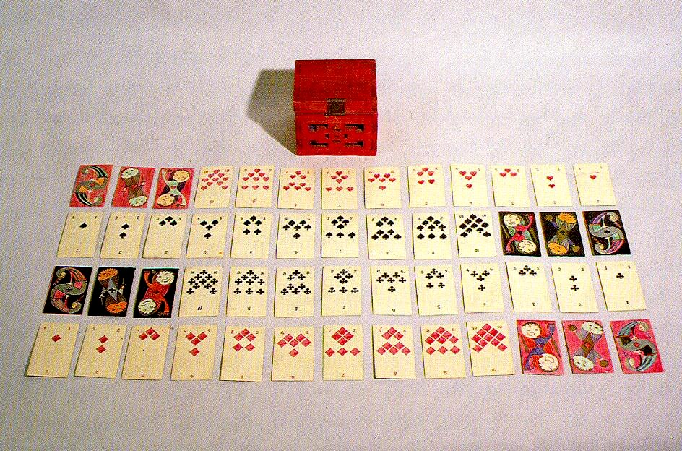
Composer as craftsman, designer, & inventor: a set of playing cards & box designed by Schoenberg

Slide 8
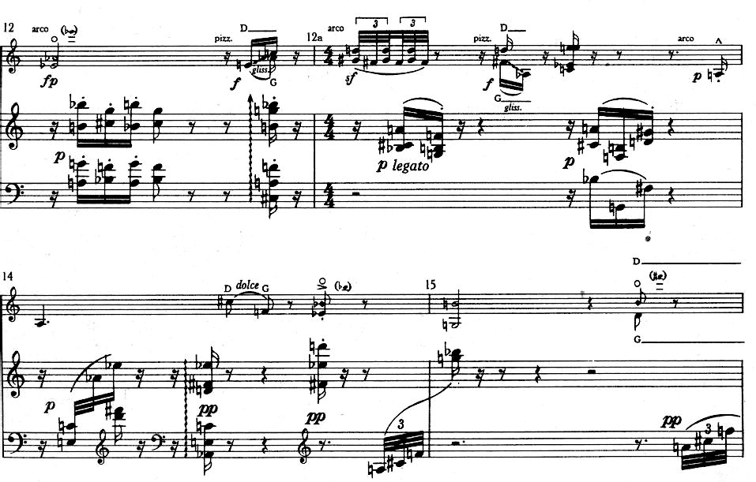
Schoenberg had numerical superstitions, as shown by this passage from his Violin Fantasy, Op.47 (1949):

Slide 9
Composer as scientist
12-tone techniques moved composition closer to fulfilling “the law of unity of musical space”
Godowsky, Einstein and Schoenberg (NY, 1934)

Slide 10
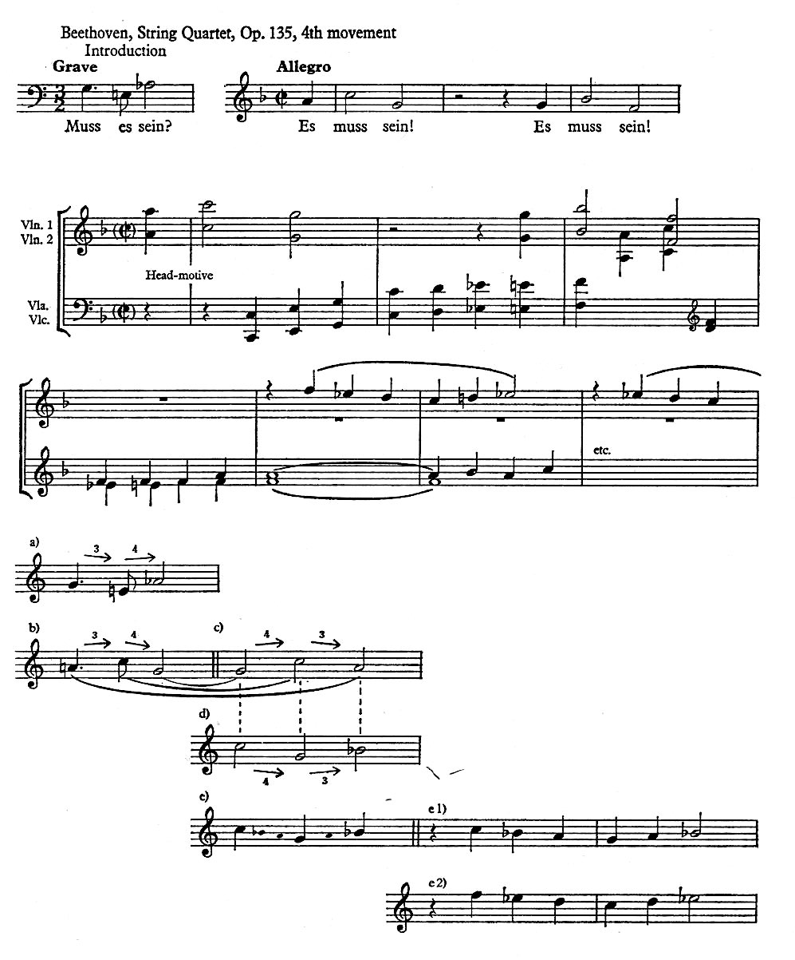
Schoenberg conceived the 12-tone row as an extension of the motive as developed by Beethoven and Brahms
As Beethoven’s and Brahms’s motives determined their music, 12-tone music realizes the musical possibilities latent in the 12-tone row:
the row functions as both structure and content

Slide 11
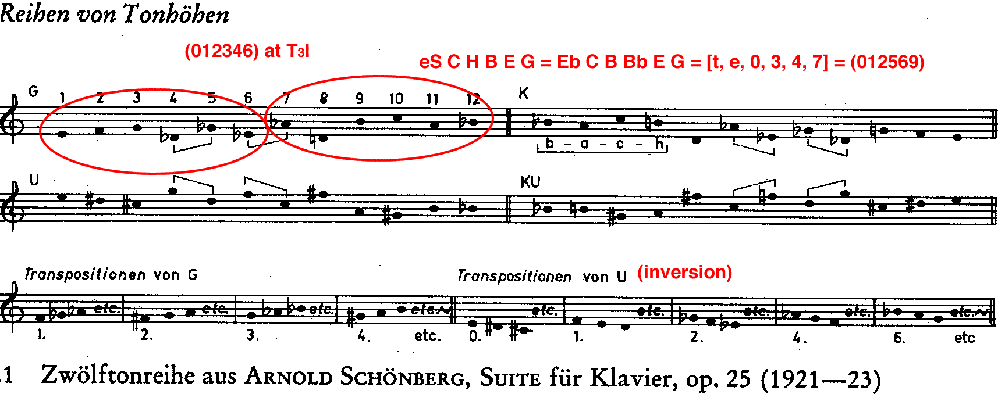
The Row in the second Viennese School

Slide 12
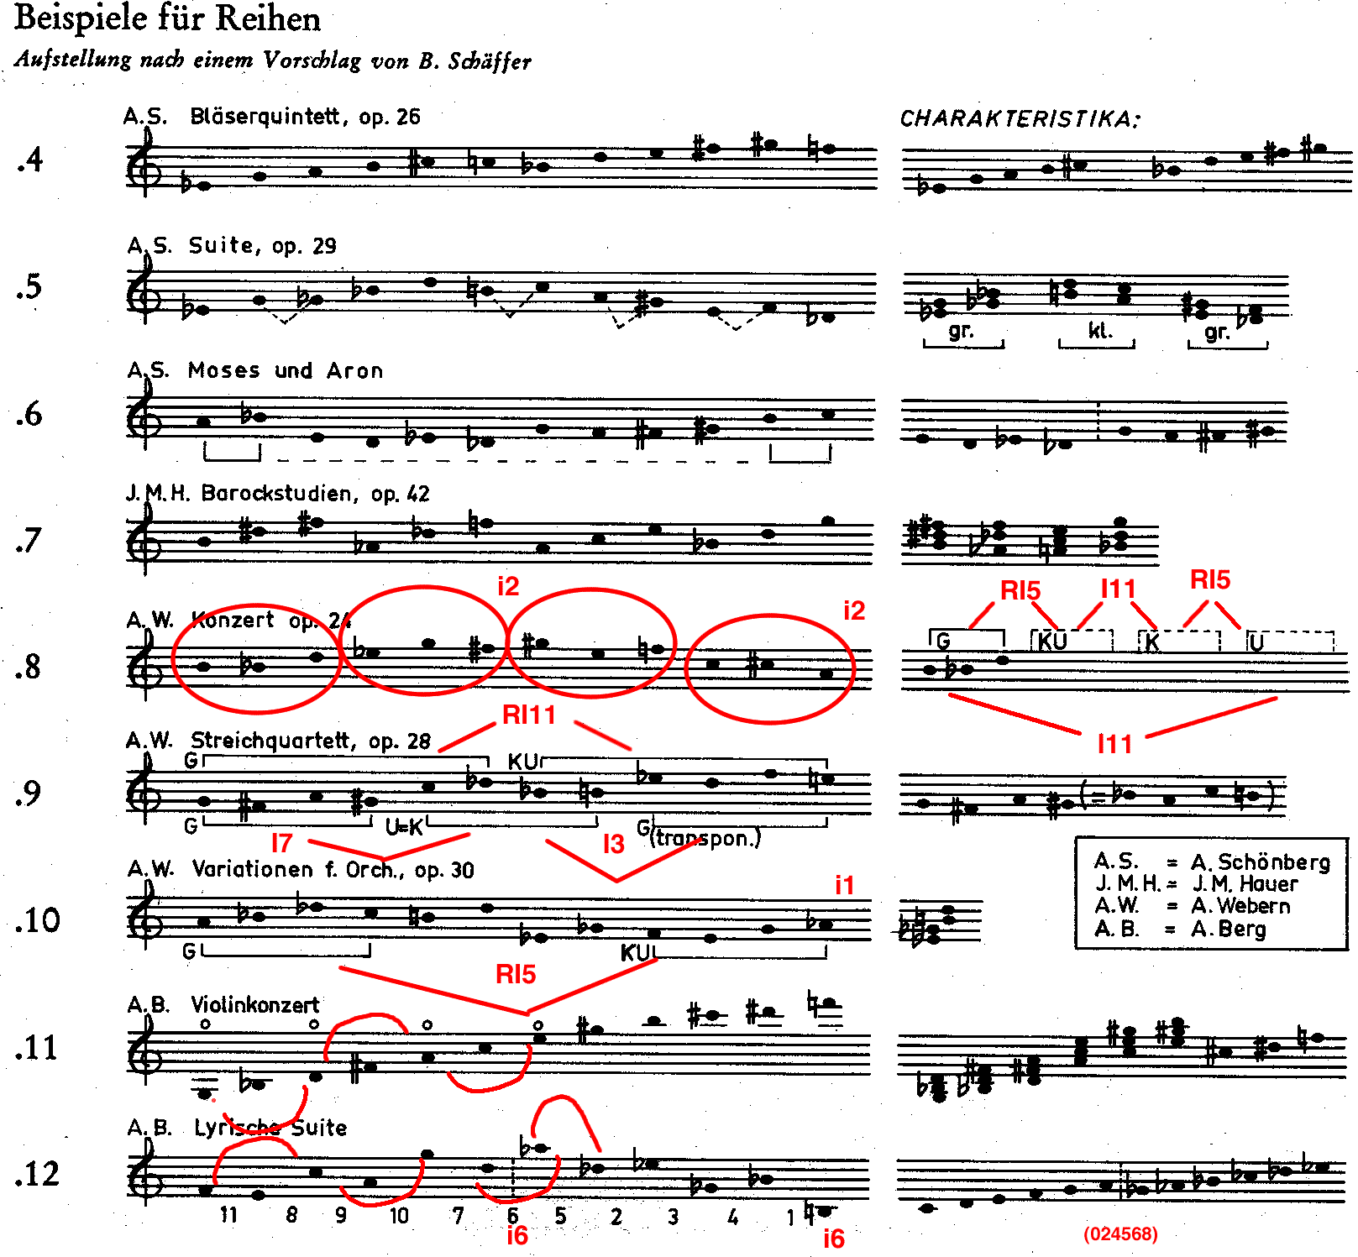
Schoenberg
Webern
Berg

Slide 13
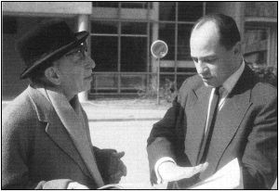
Webern, Concerto for Nine Instruments, op. 24
P₀: 0 E 3 4 8 7 9 5 6 1 2 T
P₀: 0 E 3 4 8 7 9 5 6 1 2 T
Interval series: <11,4,1,4,11,2,8,1,7,1,8,6,8,1,7,1,8,2,11,4,1,4,11>

Slide 14
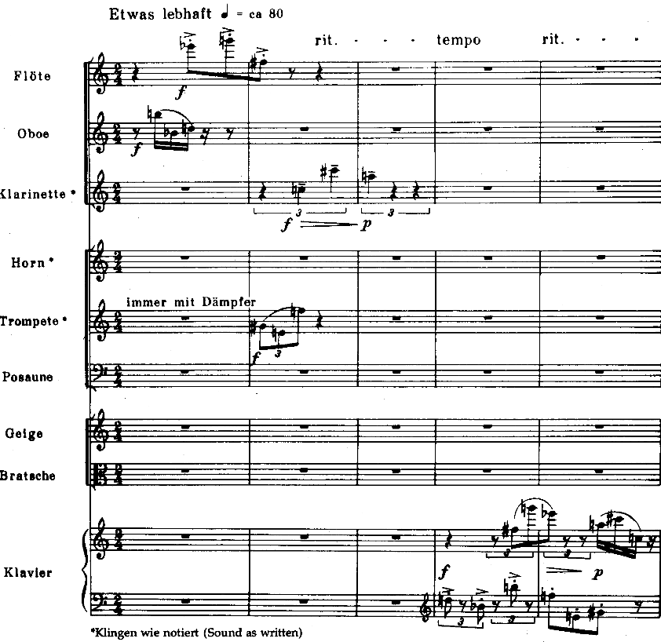
P₁₁
RI₁₁
RI₀
P₀

Slide 16
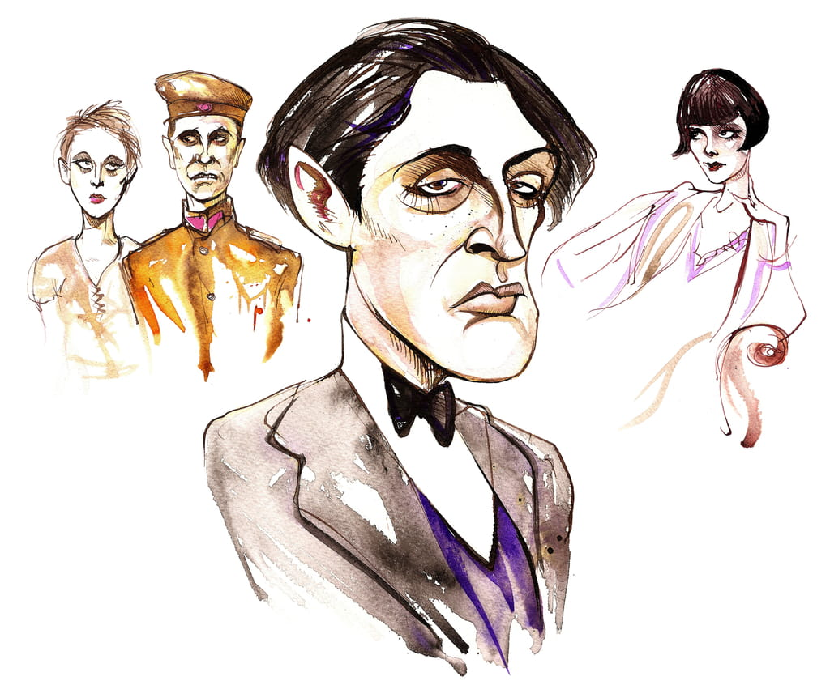
Alban Berg was the last of the three Viennese composers to take up the 12-tone method, and he turned it to his own stylistic and expressive ends
He was interested in basic 12-tone concept of order rather than circulating the complete chromatic
Chamber Concerto for Violin, Piano, 13 winds (1925)
Lyric Suite for string quartet (1926)
Der Wein - concert aria to words by Baudelaire (1929)
Lulu - 3-act opera (left unfinished on his death)
Violin Concerto (1935)

Slide 17
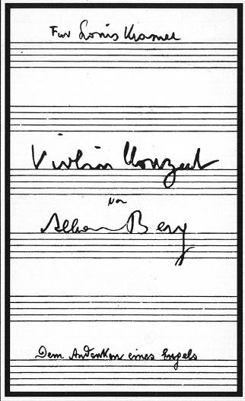
Violin Concerto by Alban Berg — In Memory of an Angel
Did Berg also write the concerto as a requiem for himself? he died soon after finishing it
Manon Gropius (1917-35)

Slide 18
Berg: characteristic 12-writing in the Violin Concerto
• Row idiosyncratically designed, in 3rds!
• Opening of 1st movement: skipping every other pitch in two rows a minor 3rd apart in transposition, creating 5ths
P-3
P-0
8
6
5
7
2
4
P-0
3
1
9
10
10? 12?
7
8
6
5
4
(4)
3
1
(11)
P-3
2
(9)

Slide 19
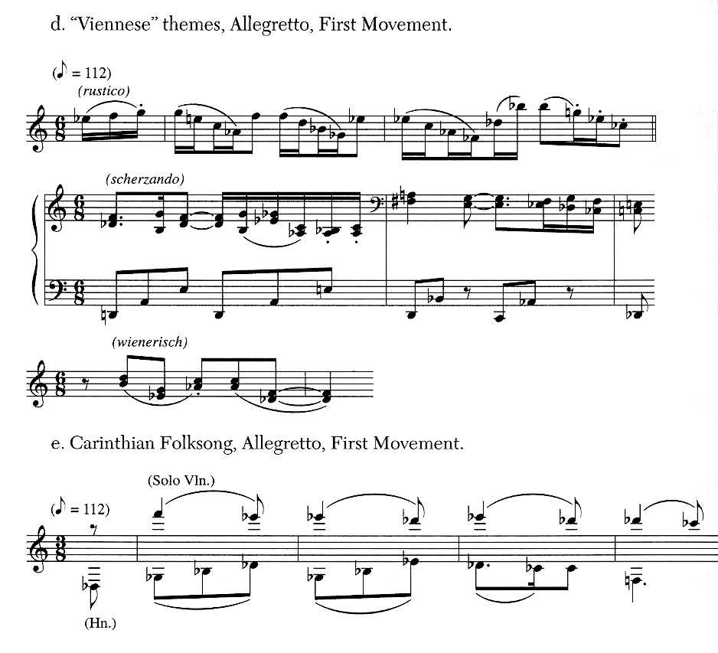
B’s 12-tone techniques allowed him to incorporate tonal & folk melodies into the Violin Concerto

Slide 20
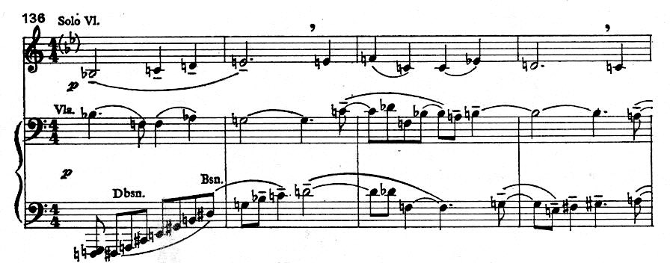
Opening of 4th movement: incorporates tonal chorale tune “Es ist genug” (in solo violin) into 12-tone writing
P-11
P-3
Herr, wenn es dir ge - fällt
Es ist ge - nug!

Slide 21
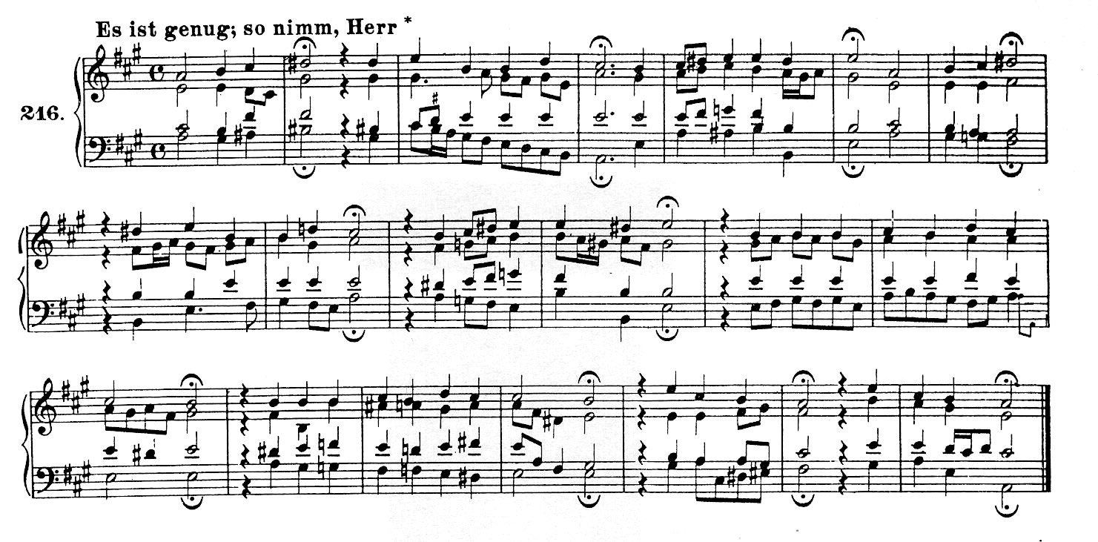
Protestant chorale “Es ist genug!” in J.S. Bach’s harmonization
Es ist genug! Herr, wenn es Dir gefällt, so spanne mich doch aus! Mein Jesus kommt: nun gute Nacht, 0 Welt! Ich fahr' in's Himmelhaus. Ich fahre sicher hin mit Frieden, mein großer Jaammer bleibt darnieden. Es ist genug.
(It is enough; Lord, when it pleases Thee do Thou unshackle me. My Jesus comes; I bid the world farewell, and go, in peace to dwell. In Heaven's house I then will find me, my cares and troubles all behind me. It is enough.)

Slide 22
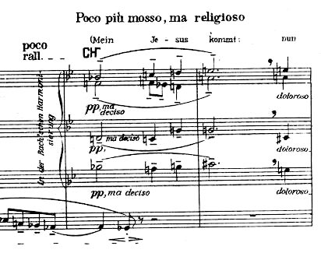
clarinets

Slide 23
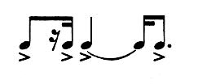
Violin Concerto in 4 movements, with a break only between 2nd and 3rd:
(1) Andante; (2) Allegretto; (3) Allegro; (4) Adagio
Portrait of Manon in life
Her death-struggle: the fateful rhythm
Her transcendance beyond earthly life: the chorale “Es ist genug!”
(3) Allegro
(4) Adagio
A1 B A2
(harp)
(1-42) (43-95) (96-135)
Chorale (136-57)
Var.1 (158-77)
Var.2 (178-97)
Carinthian folktune (198-213)
Coda (214-30)

Slide 24
Movement 1a (Andante)
mm. 1-10 Introduction
11-37 A (aaba)
38-76 B (abab)
77-83 Retransition (using material from A)
84-93 A’ (also uses material from intro)
94-103 Codetta/Transition (using material from intro)

