Slide 1
Schoenberg’s Op. 19, No. 4
beginning the
pc set analysis

Slide 2
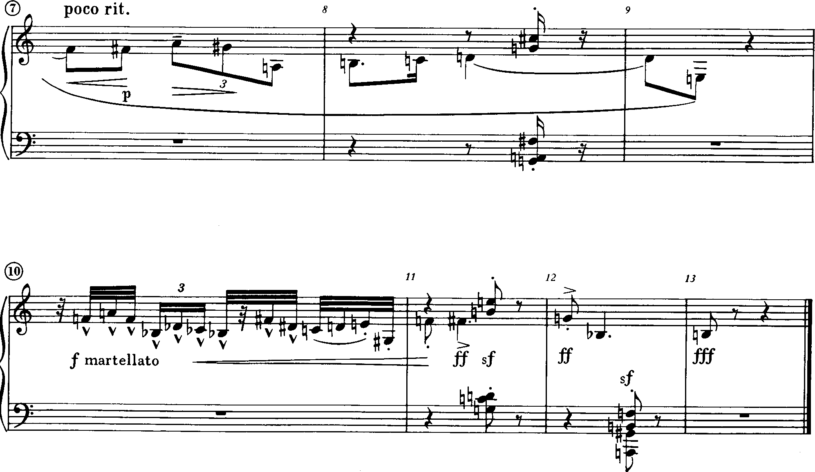

Slide 3
Form
The three phrases of this miniature constitute the sections of its overall form.
Describe the formal division using letters, i.e. A, B, etc.
Which surface features (motive, contour, amount of rhythmic activity, dynamics, register, texture, etc.) reinforce these formal divisions?

Slide 4
The opening 5 measures provide most of the motivic, rhythmic, and set-class content for the piece.
Four sets are bracketed in the score. Decide how you will segment the remaining pitches in mm. 1-5 (pcs in one set may overlap with those in another).

Slide 5
Work out the normal form, prime form, and interval vector for each set.
Can you find 3 motivic sets?
Can you find traditional motives?
4

Slide 6
[9T15]
[59E0]
[1346]
[0257]
(0137)
(0235)
(0148)
(0257)
4-19
4-z29
4-10
4-23
m7 chord
subset of eschbeg
all-interval
includes triad
minor tetrachord
symmetrical
pentatonic
“rhythm” tet
[68T]
WT0
(024)
3-6

Slide 7
[T0257]
[E237]
[7TE23]
[T01246]
(02479)
(023468)
(0148)
(01458)
5-35
6-21
5-21
wt0 with an extra note
hexatonic
same chord
as m. 3.2
pentatonic!
4-19 again (first motive)
[0257]
(0257)

Slide 8
[9T15]
(0148)
[E02467]
[46E]
[027]
same motive from beginning - recap!
(013578)
(027)
6z26 ??
3-9: diatonic trichord; 5ths
[5789TE]
[57TE]
6-2: superchromatic ??
[012346]
[89E]
(013) 3-2
(0146)
all-interval

