Slide 1
Today:
Post-mortem on analysis
Quiz on ICV and symmetry
Review of inversion by letter name
Introduction to complementarity
Some analyses!

Slide 2
I7
T0
I10
I10
T3
I10
NB: all transpositions/inversions
based on opening 4-note motive

Slide 3
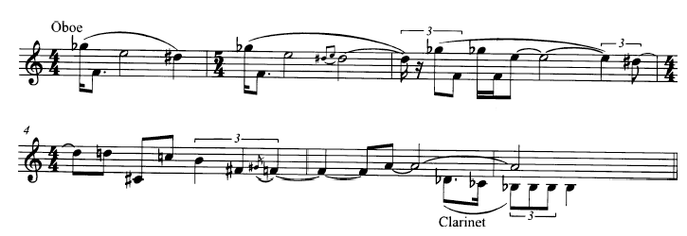
4-note chromatic motive

Slide 4
3-note (013) motive and inversion

Slide 5
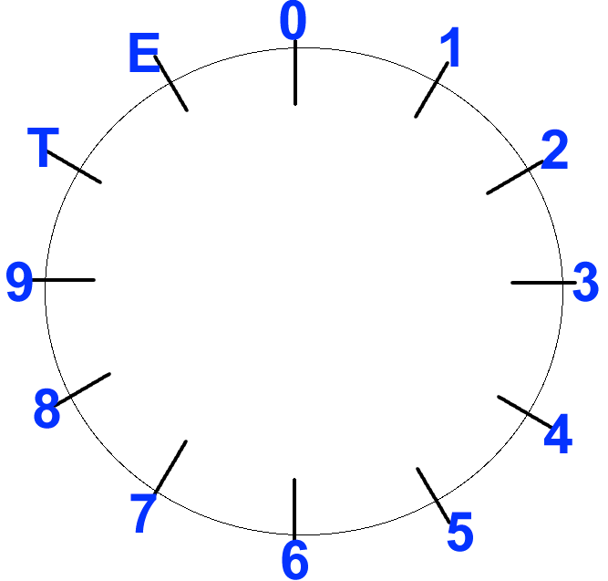
Another way to represent Inversion: I^{x}y
This notation represents the case where X and Y are pcs that invert onto each other
I^{G}B maps G and B onto each other in the circle

Slide 6
Another way to represent Inversion: I^{x}y
This inversion also maps:
C# onto F: I^{C#}F
D onto E: I^{D}E
Bb onto G#: I^{Bb}G#
and D# onto A: I^{D#}A

Slide 7
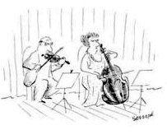
Set Complementarity
Set Complement: the set formed by all pcs not included in original set
Union of set and its complement = collection fo all 12 pcs, or aggregate
[0123] and [456789TE]

Slide 8
Set Complementarity
Literal Complement: the set of actual pcs not included in original set
[0123] and [456789TE]
[02468T] and [13579E]
[0369] and [124578TE]

Slide 9
Set Complementarity
Abstract Complement: any member of the set class that includes the literal complement
(0123) and (01234567)
(02468T) and (02468T)
(0369) and (0134679T)

Slide 10
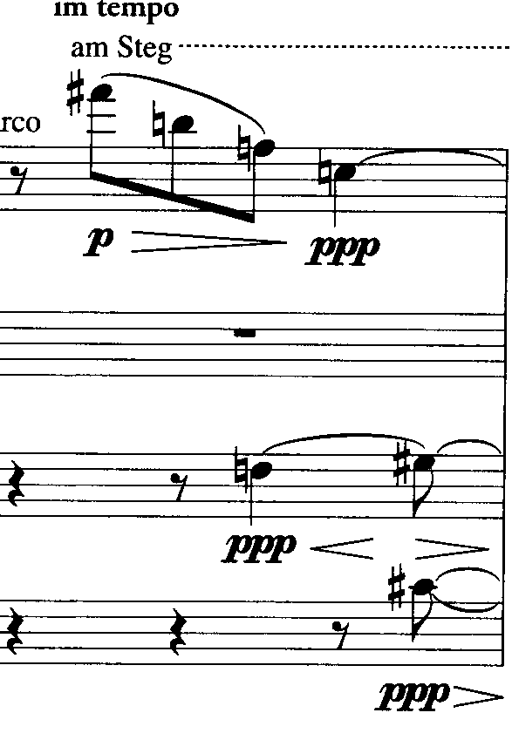
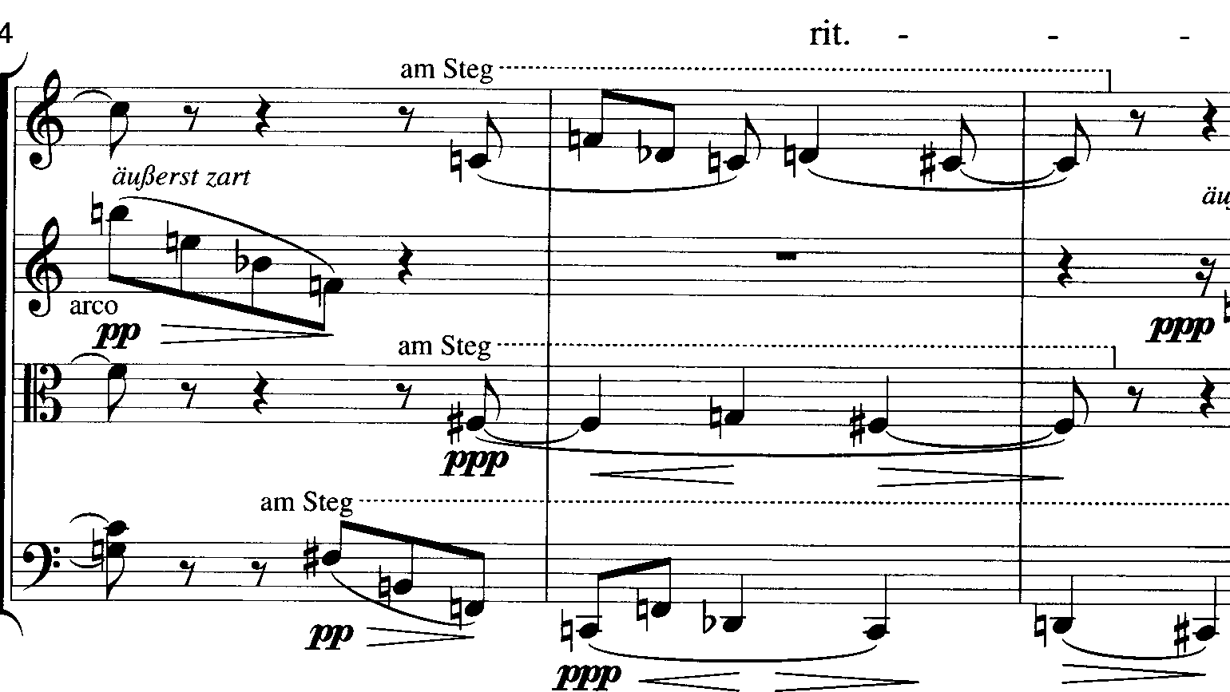
Webern Op. 5, IV, mm. 3-6
5-7 (01267)
5-7
5-7
5-7
7-7 (0123678)
7-7

Slide 11
Hexachordal Complementarity
Some 6-note sets are self-complements, such at the WT hexachord
All hexachords that are not self-complements are Z-related chords
That is, a 6-note set must evenly-divide all possible intervals

Slide 12
Inclusion: Supersets & subsets
All sets x include themselves as well as smaller sets
A literal subset is a subset of the actual pcs in a given superset
Given the tetrachord [2345], [234], [235], [245], [345], [23], [24], [25], [34], [35], [45], [2], [3], [4], [5], ø are all subsets

Slide 13
Inclusion: Supersets & subsets
An abstract subset is any member of the set class that includes a literal subset (the prime form of any subset)
Given the tetrachord [2345] = (0123), (012), (013), (01), (02), (03), (0) and ø are all abstract subsets, as are any representations of those sets

Slide 14
[2,3,5,6,9]
Find all literal and abstract tetrachordal subsets
[2356] = (0134)
[2359] = (0137)
[2369] = (0147)
[2569] = (0347)
[3569] = (0236)

Slide 15
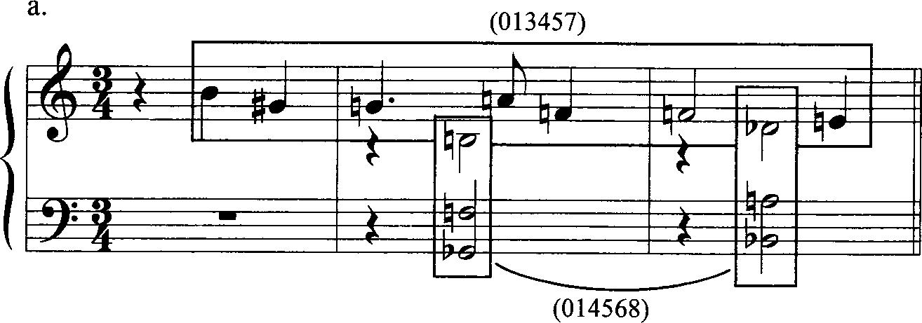
Schoenberg, Drei Klavierstücke, Op. 11, no. 1, mm. 1-3
Two different hexachords

Slide 16
Schoenberg, Drei Klavierstücke, Op. 11, no. 1, mm. 1-3
Each hexachord shares the
trichordal subsets (014), (015) and (016)

Slide 17
Schoenberg, Drei Klavierstücke, Op. 11, no. 1, mm. 1-3
Each hexachord shares the
tetrachordal subset (0124)

Slide 18
Review: Degrees of Symmetry
Sets that map onto themselves
Defines the number of unique versions; a non-symmetrical set has 24 distinct forms
Transpositional symmetry: can the set transpose into itself?
Inversional symmetry: can the set invert into itself?

Slide 19
Look at the interval-class vector
A set is transpositionally equivalent if the vector contains an entry equal to the number of pcs in the set (or half that number in the case of ic6)
(0369) = <004002>
(0369) maps onto itself at T_{3/9} and T₆

Slide 20
A set that is inversionally symmetrical can be ordered so that its interval series is its own retrograde
(0167) = 1-5-1
(0167) can be inverted onto itself at T₇I

Slide 21
Degrees of Symmetry
 | 0 | 1 | 6 | 7
0 | 0 | 1 | 6 | 7
1 | 1 | 2 | 7 | 8
6 | 6 | 7 | 0 | 1
7 | 7 | 8 | 1 | 2

Slide 22
(0, 3, 6, 9)
Maps into itself at T₀, T₃, T₆, T₉, T₀I, T₃I, T₆I, T₉I
Can you think of a set that is MORE redundant?
(02468T) can be mapped into itself at 6 levels of transposition and 6 levels of inversion

Slide 23
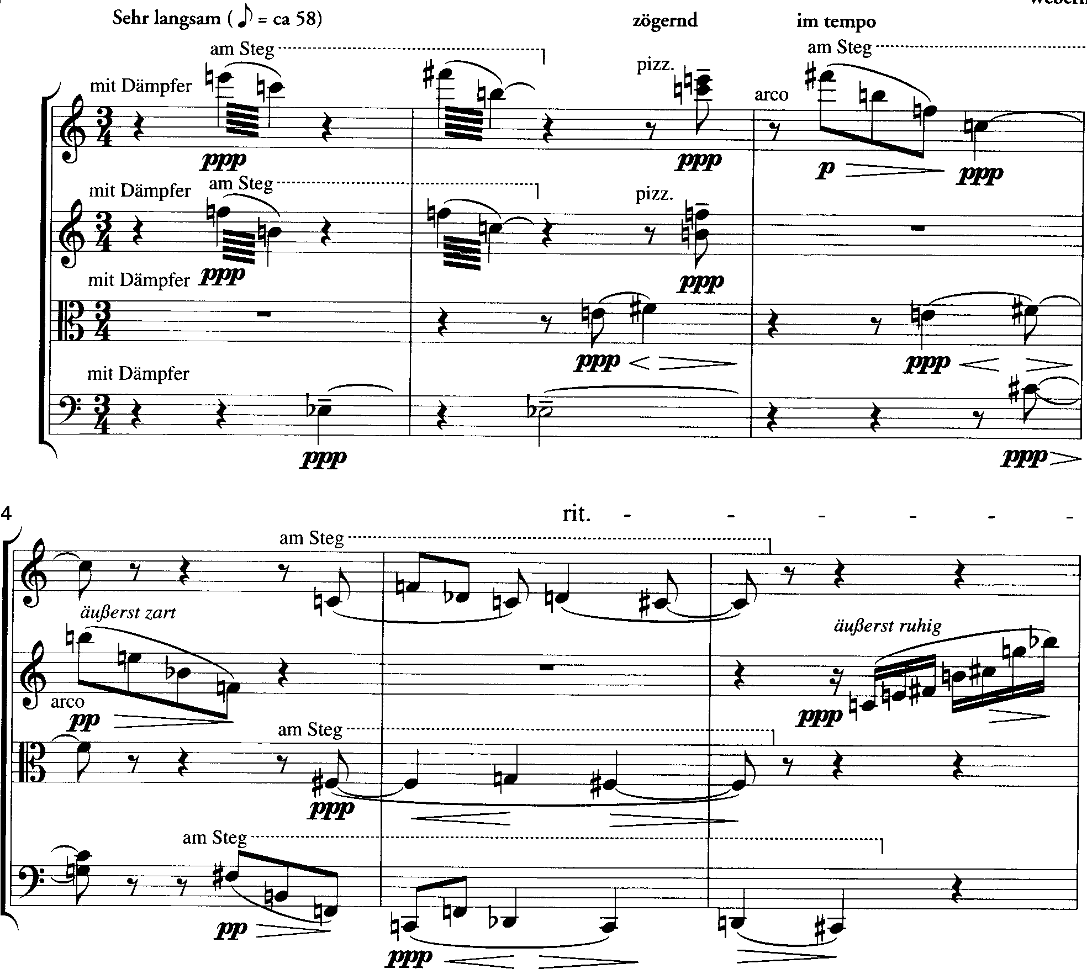

Slide 24
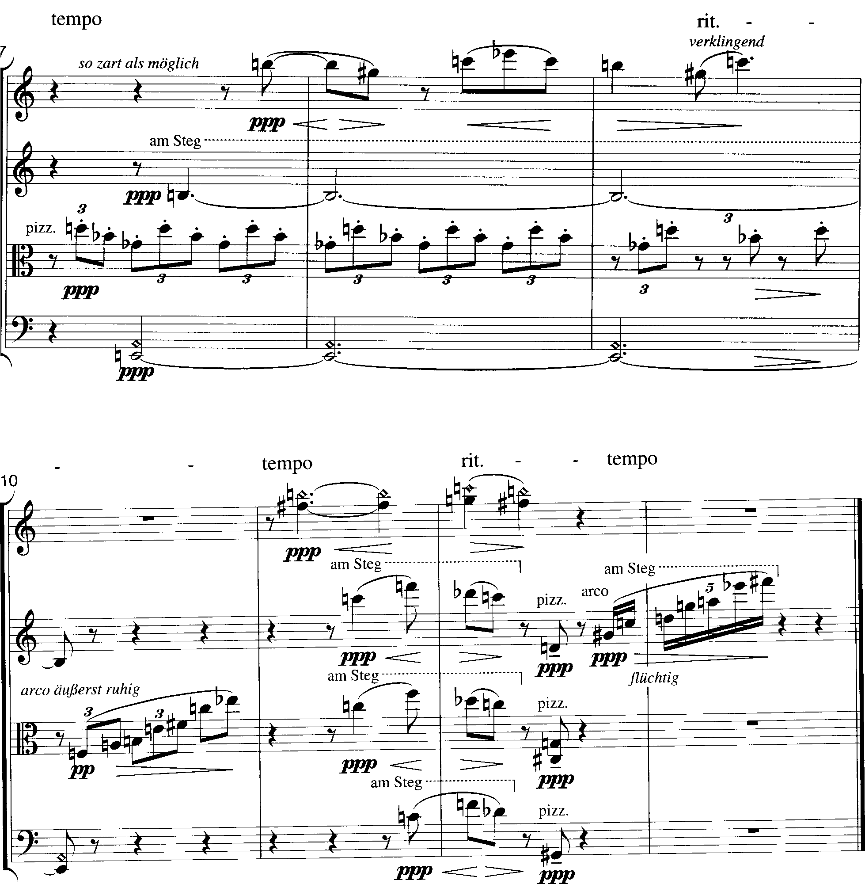

Slide 25
Analysis of Webern, Op. 5, IV
The primary tetrachords are 4-8 (0, 1, 5, 6) and 4-9 (0, 1, 6, 7)
both are symmetrical at Tn, TnI, as well as self-symmetrical.
In the first two mm., [E, 0, 5] 3-5 (0, 1, 6) is held invariant between 4-8 and 4-9 in vns 1 & 2, while pcs 4 and 6 are the variant pcs.
The whole step from E-F# becomes an important pitch-specific motive in the movement.

Slide 26
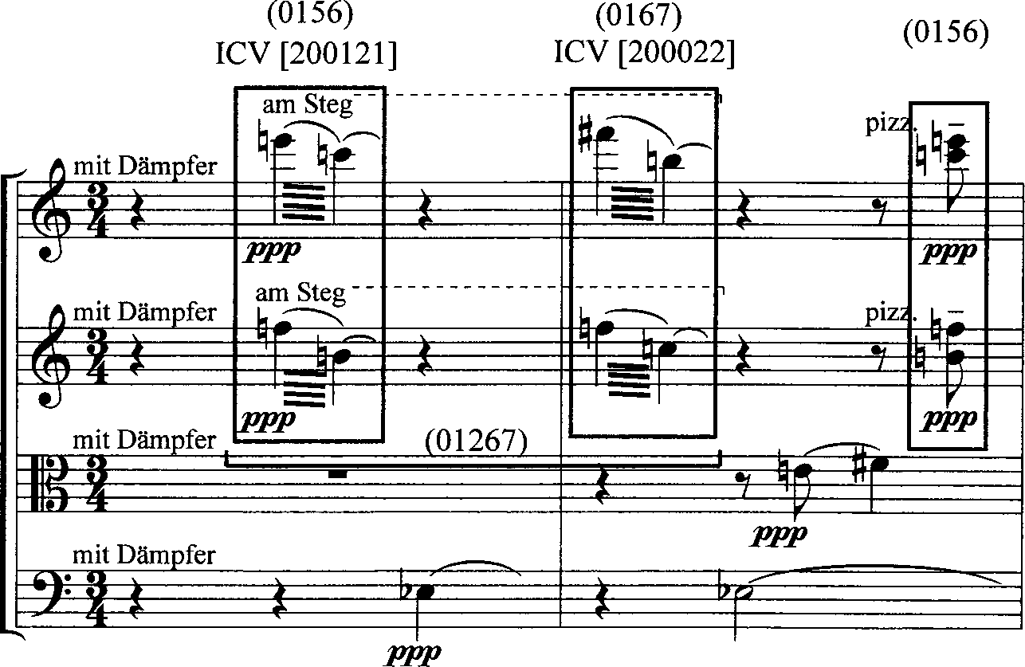
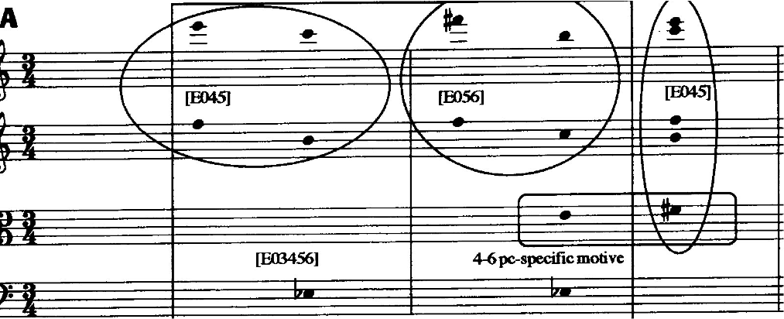

Slide 27
larger sets in the A section
The larger set 5-7 (0, 1, 2, 6, 7) is formed in vns & va mm. 1-3 [E, 0, 4, 5, 6], and again in the second half the first beat of m. 4 to the third beat [E, 0, 5, 6, 7] and in m. 4 [E, 0, 1, 5, 6]
6-5 is the sum of all pcs found in mm. 1-3 (0, 1, 2, 3, 6, 7).

Slide 28
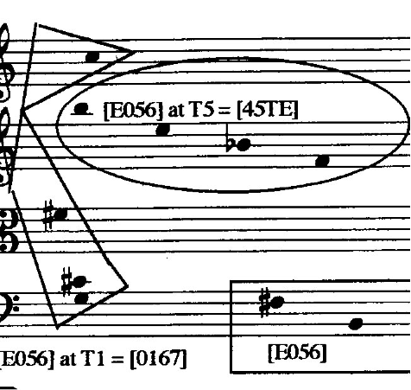
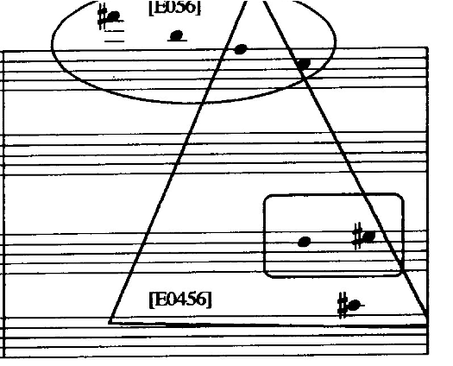
3

Slide 29
motives
The descending motive in vn 1, m. 3 repeats the pitches of the initial 4-8, and appears at T₅ in vn 2 (holding two pcs invariant in outer voices with the first statement: B and F), and back at T0 in vc in m. 3.

Slide 30
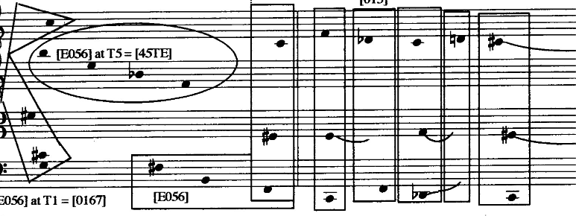
motives
This melodic 4-9 in imitation is punctuated by a harmonic 4-9 on the downbeat of m. 5 [0, 1, 6, 7], forming a 6-7 in mm. 1-4 (0, 1, 2, 6, 7, 8): a symmetrical set that includes both 4-8 and 4-9 [5, 6, 7, E, 0, 1].

Slide 31
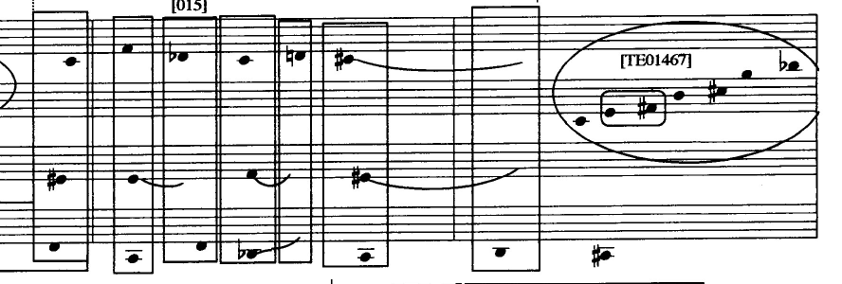
A section canon
Set-class 3-4 (0, 1, 5) begins a melodic canon in mm. 4-6 in vn 1 and vc;
vertical trichords 3-4 and 3-5 "fall out" of the conjunction of the canon and the second important pitch specific motive: the rising semitone F#-G-F# in va, mm. 4-6.

Slide 32
A section canon
Set-class 3-4 is a subset of 4-8, and 3-5 is a subset of 4-9;
indeed, if you add 3-4 to its inversion at T₆I, you get 4-8: (0, 1, 5) & (1, 5, 6) = (0, 1, 5, 6),
and if you add 3-5 to its inversion at T₇I you get 4-9): (0, 1, 6) & (1, 6, 7) = (0, 1, 6, 7).

Slide 33
A section transition
The "A" section of the movement is brought to an end by a rising figure in vn2, m. 6 that forms sc 7-19 (0, 1, 2, 3, 6, 7, 9): [T, E, 0, 1, 4, 6, 7].

Slide 34
A section transition
This set includes one occurrence of 4-8, one of 4-9, four of 3-4, and six of 3-5 (!): [T, E, 4], [1, 6, 7], [6, 7, 0], [0, 1, 6], [6, E, 0] and [7, 0, 1].

Slide 35
The B section
The B section contrasts greatly with the A:
in A, all sets include at least one semitone/M7 (ic 1) and one P4/P5 (ic 5),
10 pcs of the total chromatic are used: TE01234567.
But the 3-12 that rotates in va in mm. 7-9 contains only M3s (ic 4);
the E harmonic in vc combines with it to form set 4-24 (0, 2, 6, 8) as [2, 4, 6, T], a set with exclusively even-numbered ics.

Slide 36
The B section
Neither whole-tone set is a subset of any of the tetrachords, pentachords, hexachords or septachords heard in the A section.
Altogether there are but 4 pcs in mm. 7-9.

Slide 37
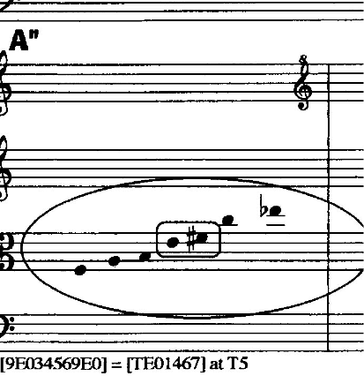
The closing section
The 7-19 motive returns--like the 4-9 in m. 3 did in m. 4--at T₅ to herald the ‘closing section’ of the movement
This motive holds 4 pcs invariant with its first statement in m. 6: the central four [E, 0, 4, 6], heard in vns, m. 1, and features the E-F# motive.

Slide 38
The closing section
The F#-G-F# neighbor motion returns in the tempo rit. mm. 11-12 in harmonics, vn 1, over a 3-4 in lower voices [0, 1, 5]

Slide 39
The closing section
this again produces sc 5-7, the union of the prime forms of 4-8 and 4-9: [0, 1, 5, 6, 7]

Slide 40
The closing section
[0, 1, 5, 6, 7] pauses before a final 4-9 (T₇I in relation to the first 4-9 [E, 0, 5, 6]) and the last statement of the rising 7-19 at T₈

Slide 41
The closing section
The final rising figure holds three pcs invariant with its first appearance: 3-5 [0, 6, 7] and four invariant pcs with the 7-19 in m. 10: [0, 3, 6, 9]
This 4-28 joins with the [2, 7, 8] of the previous 4-9).

Slide 42
The closing section
Altogether the vertical 4-9 and rising motive 7-19 create sc 8-9, the abstract complement of 4-9.

Slide 43
Symmetry in op. 5, IV
Symmetrical sets and the symmetrical use of sets in registral spacings are very important in this movement.
For example, the vertical 4-9 in m. 2, vn 1 & 2, is horizontalized in m. 3, v 1, arpeggiated downward by i7, i6 and i5: 6-E-5-0.
The 7-19 motive is consistently divided in the middle by a pitch axis at pc E, 4 or 7

Slide 44
Set-class inventory

Slide 45
