Slide 1
Voice-Leading Parsimony in the Music of Alexander Scriabin
Clifton Callendar

Slide 2
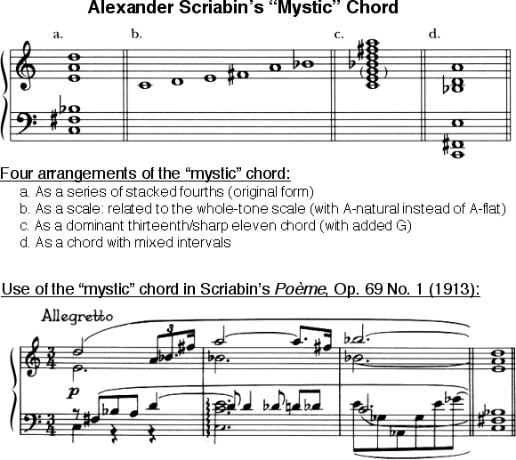
Mystic chord 6-34 (013579)
Dahlhaus: dominant ninth with a flat fifth and an added sixth
others: generated by the harmonic series (7th—13th partials omitting12th)
stacked 4ths
“almost” whole-tone scale
V13(#11)
6-10-6-4-7

Slide 3
Poème, Op. 69, No. 1 (1913)

Slide 4
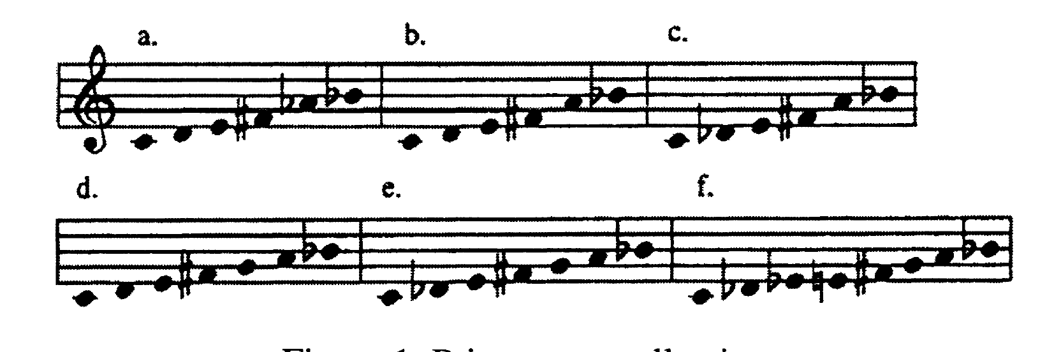
related collections used by scriabin
a) 6-35 (02468T), whole-tone; b) 6-34 (013579), mystic; c) 6-Z49 (013479)
d) 7-34 (013468T), acoustic; e) 7-31 (0134679); and f) 8-28 (0134679T), octatonic
WT0: 8—>9 = 6-34;
6-34: 2—>1 = 6z49;
6-34 + 7 = 7-34;
6z49 + 7 = 7-31;
7-31 + 3 = 8-28
Common tones 0, 4, 6, T (0268), Fr+6

Slide 5
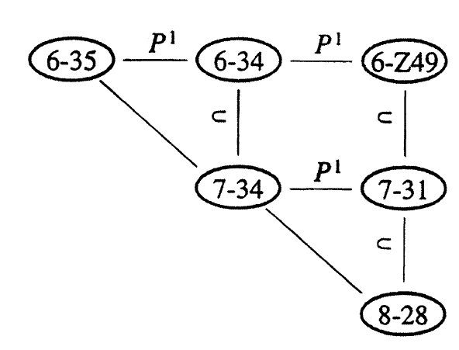
incomplete relational network
Horizontal connections between set classes = PI-relations (altering one pitch "up" or "down")
Vertical connections = addition or subtraction of a one pitch class (inclusion-relation)

Slide 6
incomplete relational network
Motion from the upper l.h. to the lower r.h. = whole-tone, to whole-tone influenced, to increasing octatonic, to the octatonic collection.
The acoustic collection in a central position

Slide 7
b
Sc 6-34 (013579), sc 3-11 (037) = consonant triad. and sc 4-27 (0258), dominant and Ø seventh chords = a minimal perturbation of an equal division of the octave: here the whole-tone collection.
3-11: C, E, G-> C, E, G#
4-27: C, E, G, Bb -> C, E, G#, Bb

Slide 8
Parsinomious voice-leading
Some definitions require common tones to be fixed:
{023} {034} 2 moves by WS
But what if only one is fixed, and two pcs move by S?
Callendar limits all motion to S

Slide 9
If more than one voice moves by step, we do it in sequence
prefer shortest distance
one voice move per sequence; total number of moves one less than members of sequence (no circular moves)

Slide 10
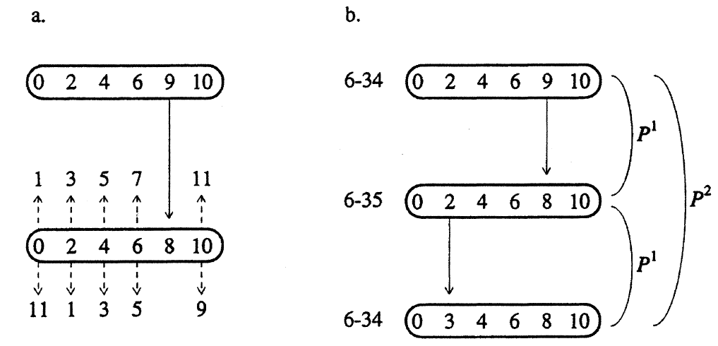
p² relations between mystic chords (1 voice moves by 1 step 2x)
mystic chord to whole-tone; 10 possible motions away from whole-tone
sustained tones - Fr+6 = 4-25 {46T0} = (0268)

Slide 11
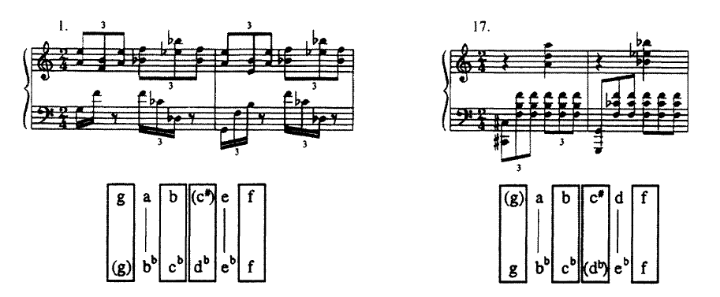
p² relations between mystic chords (1 voice moves by 1 step 2x)
1–2 Common tones 4-25: C#, G, F, B LH, E–>Eb and A->Bb RH
17–18 Two voices move by contrary motion -> inversionally-related members of 6-34

Slide 12
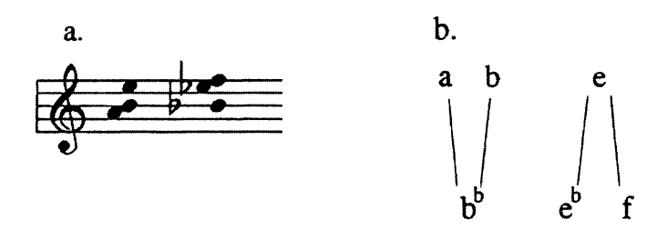
p^{n} relations about 1–1 mapping in register
Other models possible: splitting and fusion of voices in registral proximity
Voices can be conceived as existing in either a fused or split state

Slide 13
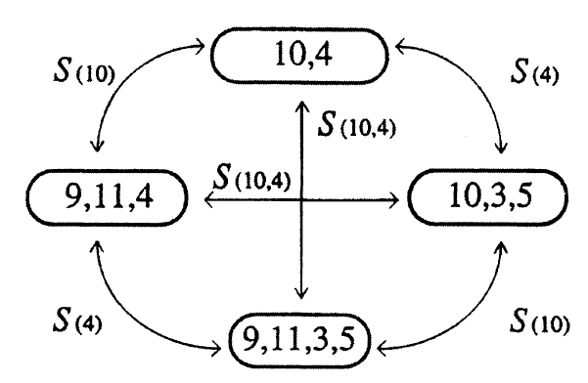
lower voice
split 1st
upper voice
split 1st
lower voice
upper voice
(0268)
Four possible combos of voices and positions
Both voices fused (10,4), both voices split (9,11,3,5), one voice in each state (9,11,4) and (10,3,5)
Neighbors S related about one voice; opposed elements S related about both voices
Motion between trichords must “pass through” the top or bottom

Slide 14
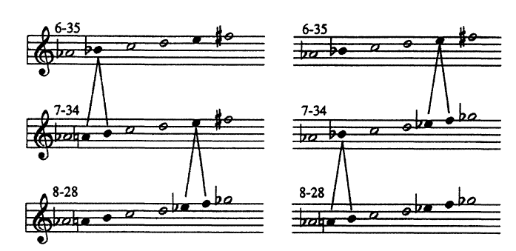
(0268) common tones
Split Bb for acoustic
Split E for octatonic 2,3
Split E for acoustic (T6 of set on right)
Split Bb for octatonic 2,3

Slide 15
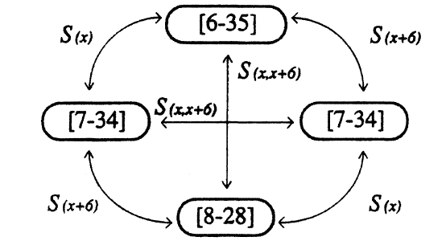
network of split relations between 6-35 (whole-tone), 7-34 (acoustic) and 8-28 (octatonic)
Any whole-tone collection is in an S-relation to any two T6-related acoustic collections, each of which is S related to the same octatonic collection

Slide 16
Op. 65, No. 3
From the beginning, Acoustic and S relations: (027) at T6 in RH, (0258) LH

Slide 17
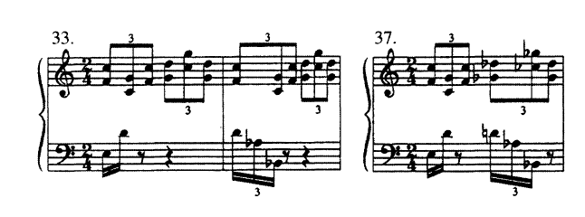
Op. 65, No. 3
In m. 33–34, the union of subsets forms 7-34, without split voice-leading
But in m. 37,, Ab, Bb and D held as common tones while F and G->Gb,
and C->Cb and Db

Slide 18
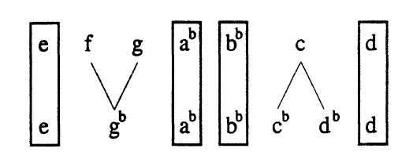
m. 37
In m. 33–34, the union of subsets forms 7-34, without split voice-leading
But in m. 37,, Ab, Bb and D held as common tones while F and G->Gb,
and C->Cb and Db

Slide 19
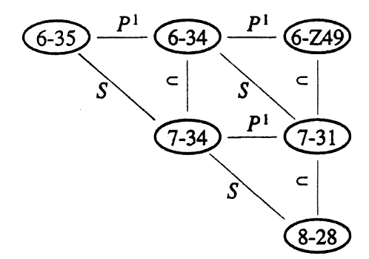
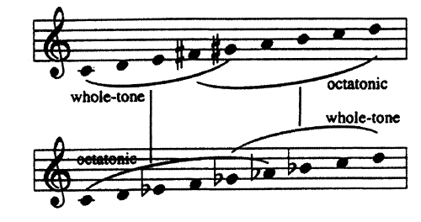
full relational network of Scriabin’s faves
The S relation transforms the whole-tone segment of the acoustic collection into its octatonic segment, and v.v.

Slide 20
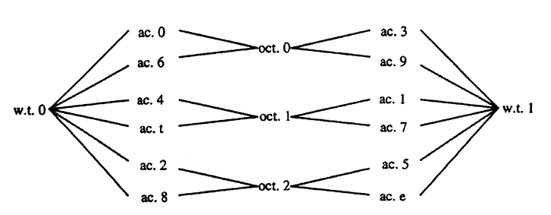
relational network of Split relations between WT, AC and OCT
  Listed as transpositions of the prime form (in modern terminology):
  WT0 [02468T] WT1 [13579E]
AC [013468T] [4578T02] [23568T0] [34679E1] [124579E] [5689E13]
[679T024] [TE12468] [89E0246] [9T01357] [78TE135] [E023579]
OCT0,1 [0134679T] OCT1,2 [124578TE] OCT2,3 [235689E0]

Slide 21
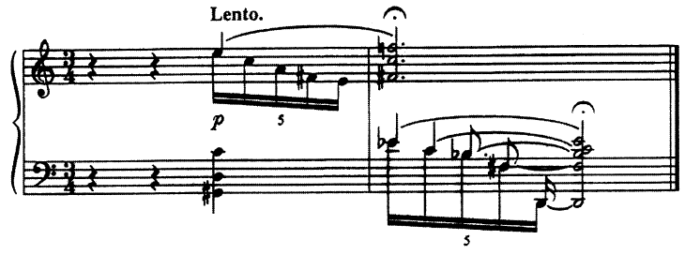
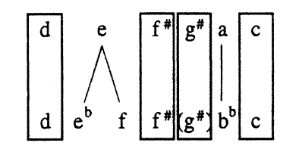
Final two bars
combo of P¹ and S(e) relations

