Slide 1
Centricity

Slide 2
Inversional Axis
Centricity in post-tonal music can be established by direct emphasis and reinforcement and on inversional symmetry.
An inversionally symmetrical set has an axis of symmetry, a midpoint around which all of the notes balance. A pitch or pitch-class center may function as an axis of symmetry.

Slide 3
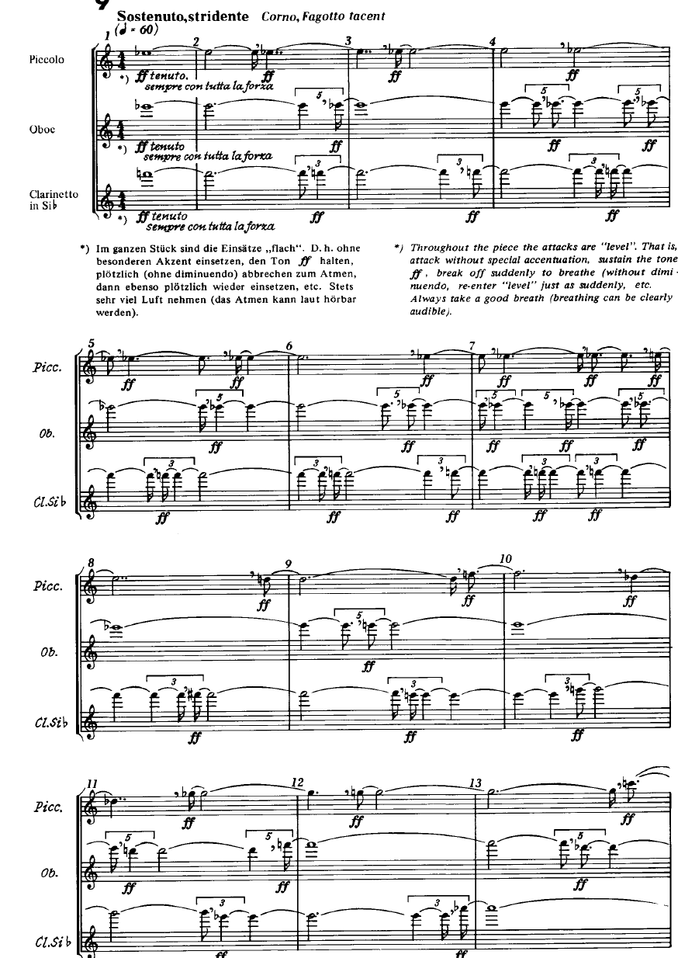
Ligeti's Ten Pieces for Wind Quintet, No. 9
features notes radiate outward
from a central tone in an expanding wedge.

Slide 4
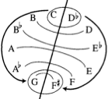
A contracting wedge, as at the end of the first movement of Bartok's String Quartet No. 5. The lines begin on E in four different octaves, and then converge on the cadential B.

Slide 5
Contracting wedge (Bartok, String Quartet No. 5, first movement).

Slide 6
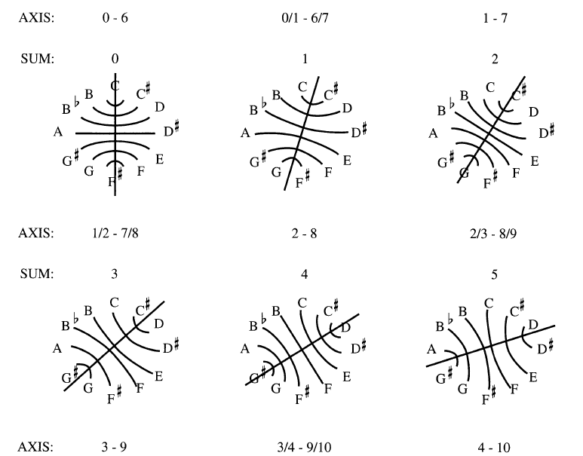
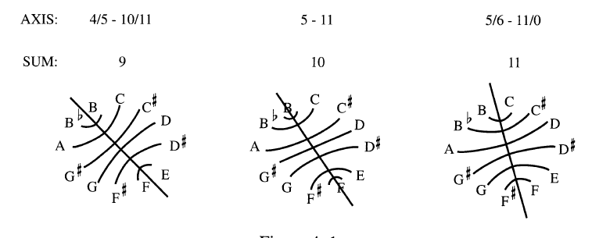
There are twelve axes of inversion. For each sum n, the inversional axis will pass through n/2 and n/2 + 6. Even one note, odd, the axis will pass between two pairs of notes. Music might "modulate" from one axis to another.

Slide 7
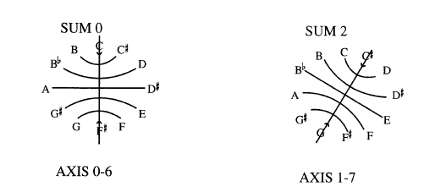
Sonata for Two Pianos & Percussion

Slide 8
The Diatonic Collection
The diatonic collection is set class 7-35 (013568T).
The opening of Stravinsky's Petrushka moves from G-Mixolydian (G-A-B-C-D-E-F-G) to A-Dorian (A-B-C-D-E-FI-G-A).
In analyzing post-tonal diatonic music, we will usually want to know both the centric tone and the scalar ordering.
Terminology for Collections: 0-sharp, 1-sharp, 2-sharp, 3-sharp, 4-sharp, 5-sharp, 6-sharp or 6-flat, 5-flat, 4-flat, 3-flat, 2-flat, and 1-flat.
C-Lydian, G-Ionian, E-Aeolian, and F#-Locrian represent different scalar orderings of the 1-sharp collection.

Slide 9
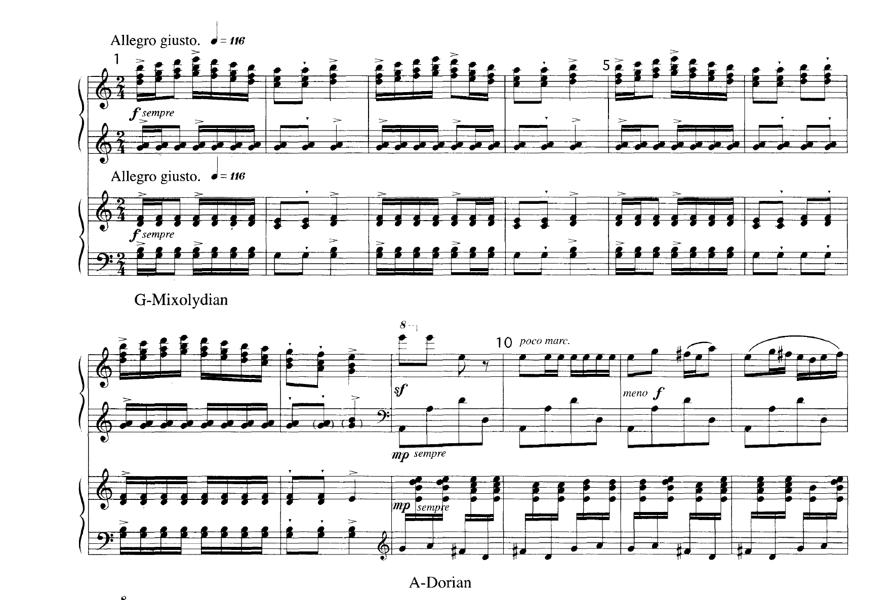
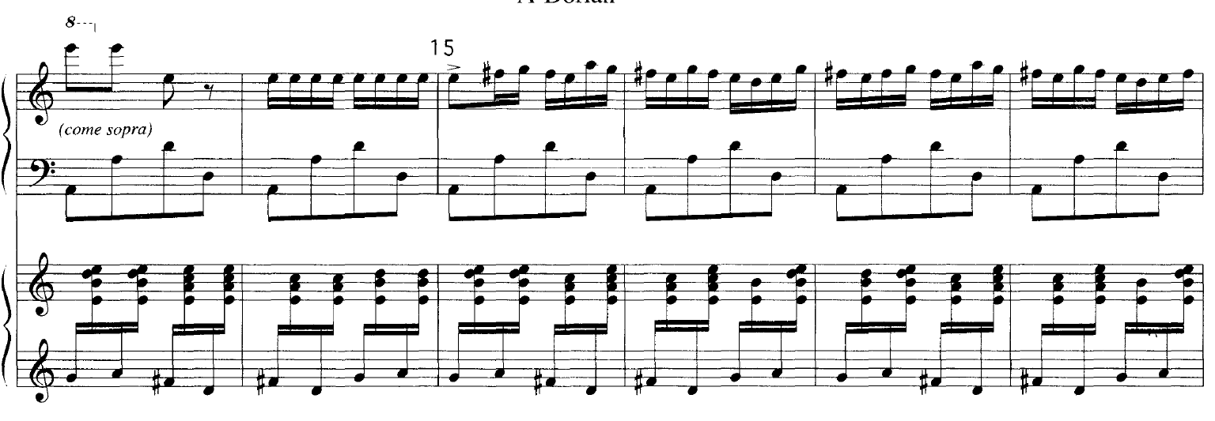
Post-tonal diatonic tri- and tetrachords 4-23 (0257) and 3-9 (027) occur often in Stravinsky and Minimalism

Slide 10
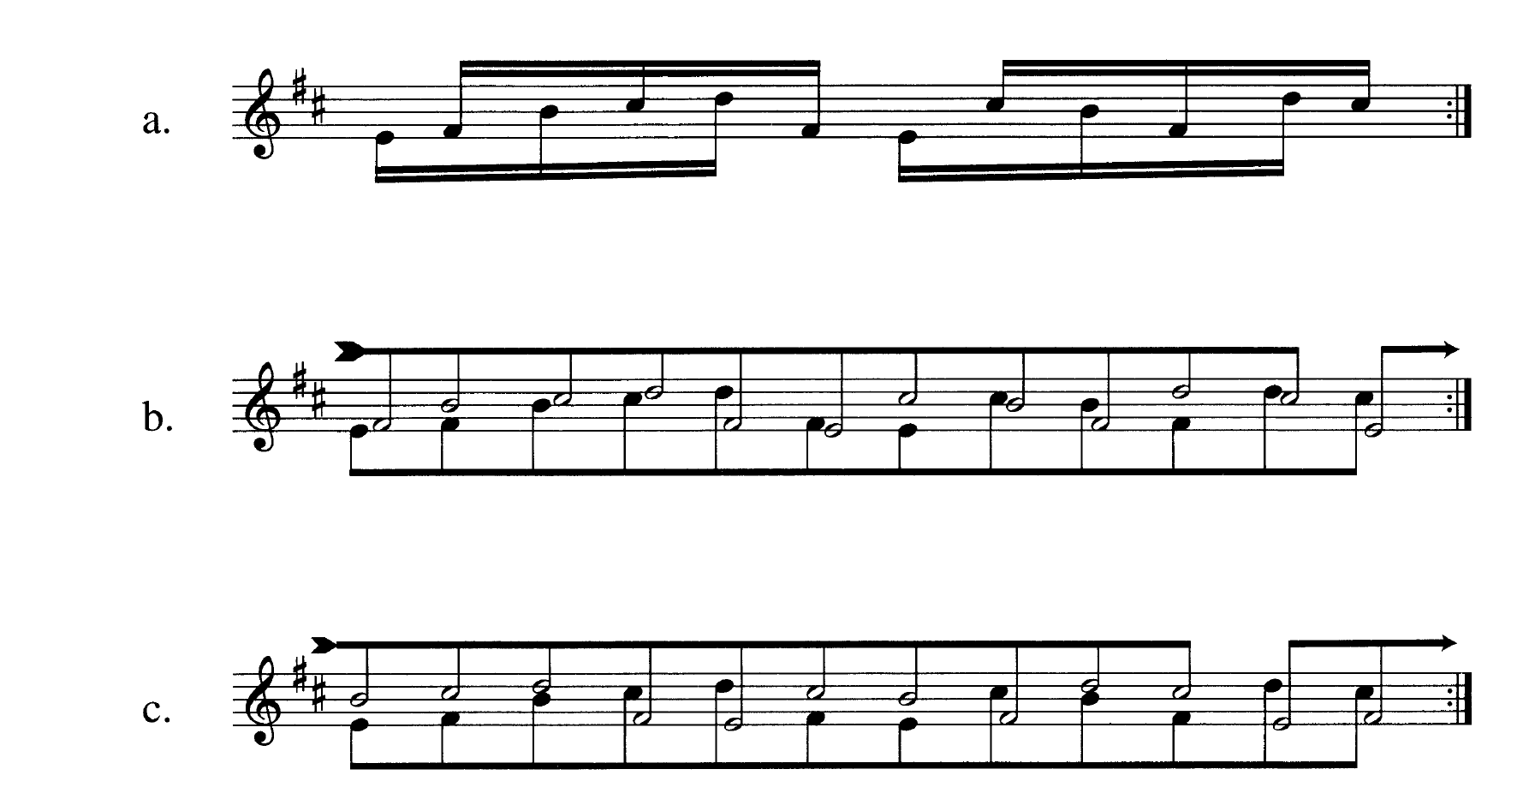
5 notes of the “2-sharp” collection; rhythm of 3:2 comes out of the interlocking of E-B-C and F#-C#

Slide 11
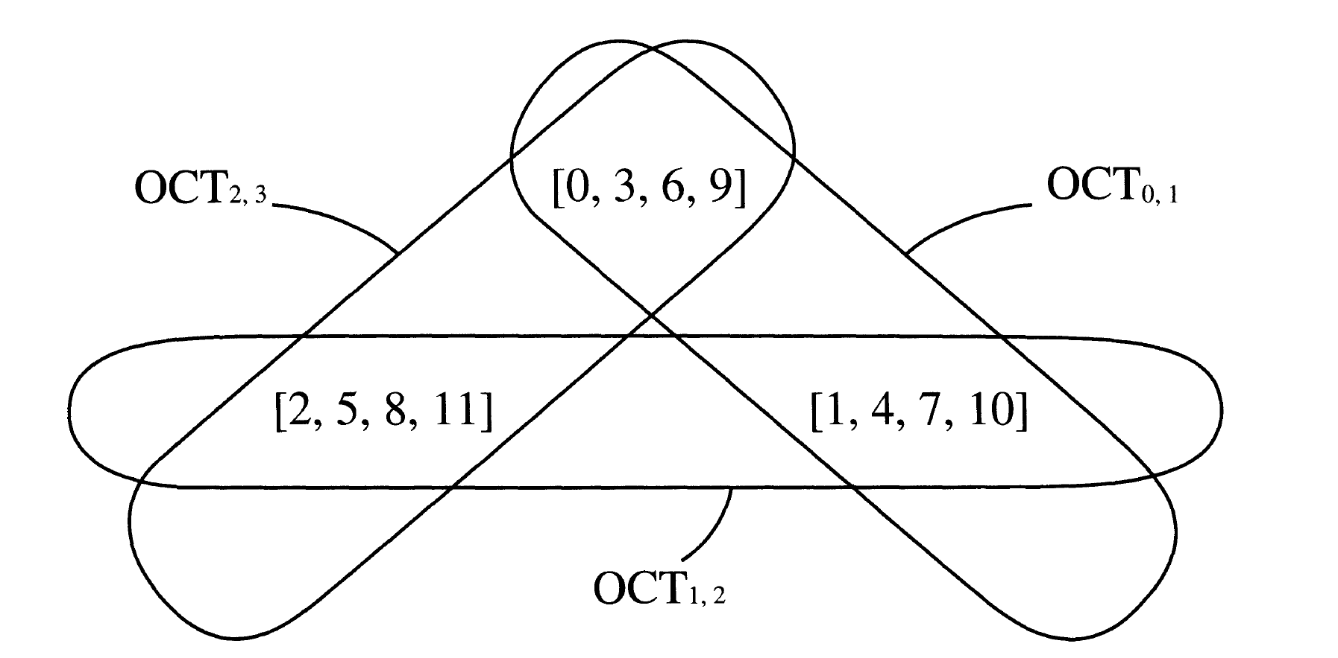
C D#/Eb F#/Gb A
C#/Db E G A#/Bb
C#/Db E G A#/Bb
C D#/Eb F#/Gb A
C D#/Eb F#/Gb A
D F G#/Ab B
D F G#/Ab B
The octatonic collection 8-28 (0134679T) is highly symmetrical; i.e.,
it maps onto itself at 4 levels of T and TnI
Its subset structure is restricted and redundant.

Slide 12
3-11 (037) (major or minor triad)
4-3 (0134) (semitone-whole tone-semitone)
4-10 (0235) (minor or dorian tetrachord)
4-26 (0358) (minor seventh chord)
4-27 (0258) (dominant or half-diminished seventh chord)
4-28 (0369) (diminished seventh chord)
C-Eb-G/C-E-G
C-C#/Db-D#/Eb-E
C-D-D#/Eb-F
C-D#/Eb-F-G#/Ab
C-D-F-G#/Ab
C-D#/Eb-F#/Gb-A

Slide 13
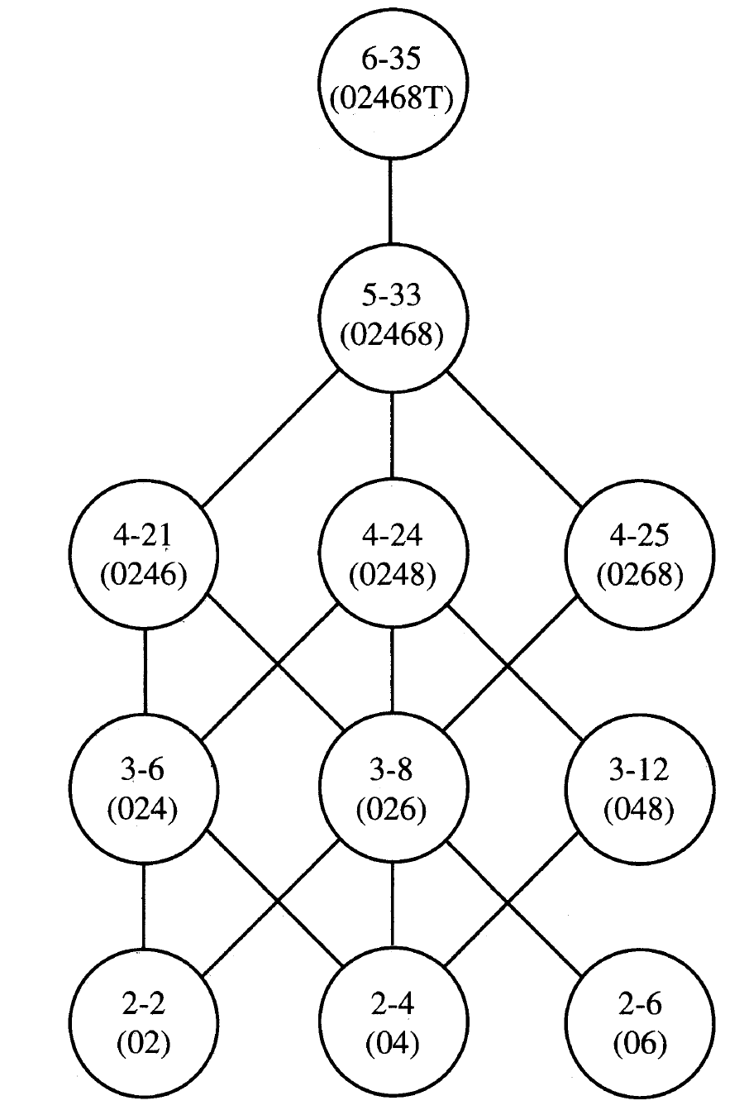
The Whole-tone Collection 6-35 (02468t) is both transpositionally and inversionally symmetrical at six different levels

Slide 14
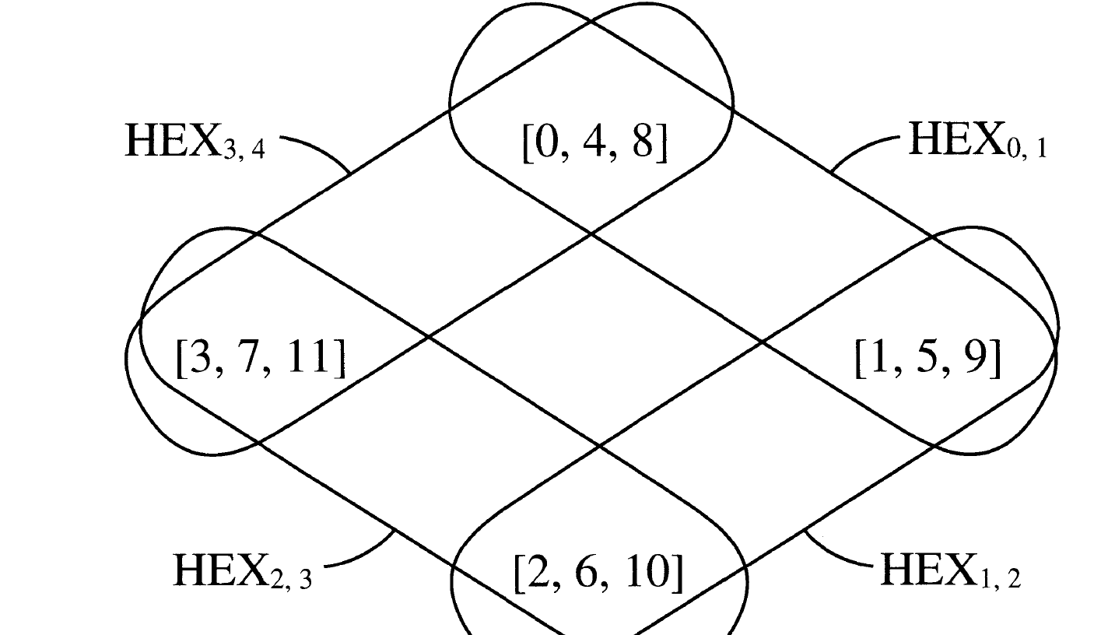
C E G#/Ab
C#/Db F A
C#/Db F A
D#/Eb G B
D#/Eb G B
D F#/Gb A#/Bb
D F#/Gb A#/Bb
The Hexatonic Collection 6-20 (014589) is both transpositionally and inversionally symmetrical at three different levels.

Slide 15
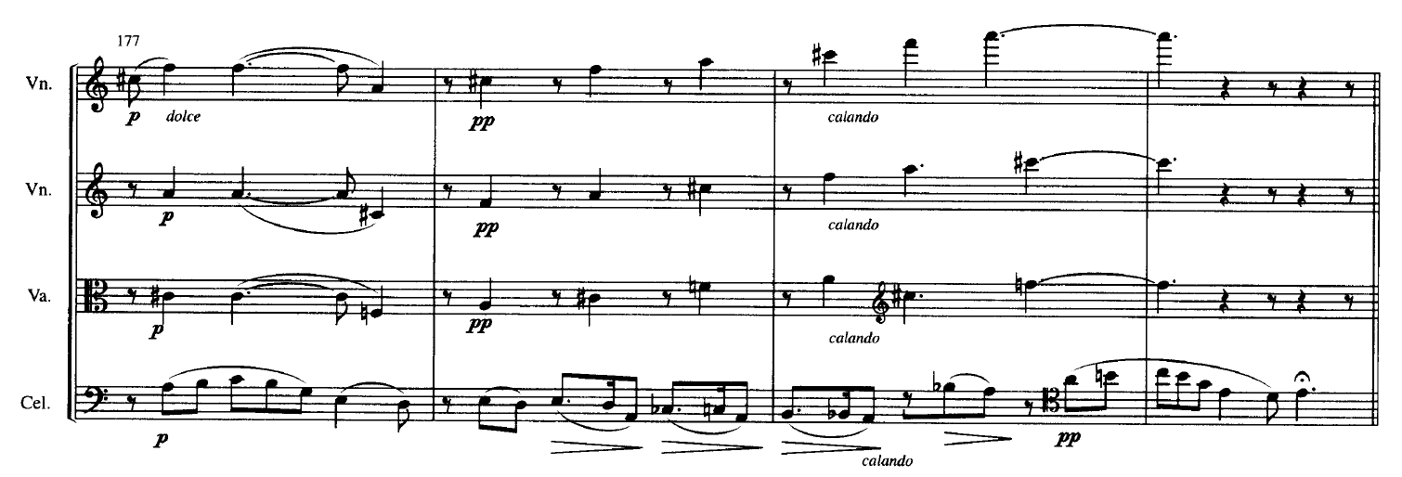
[159]
(048)
hex
&
wt
[9e15]
(0258)
not hex
[579e1]
(02469)
not hex
[1259]
(0148)
hex
Bartók String Quartet No, 2, I, hexatonic

Slide 16
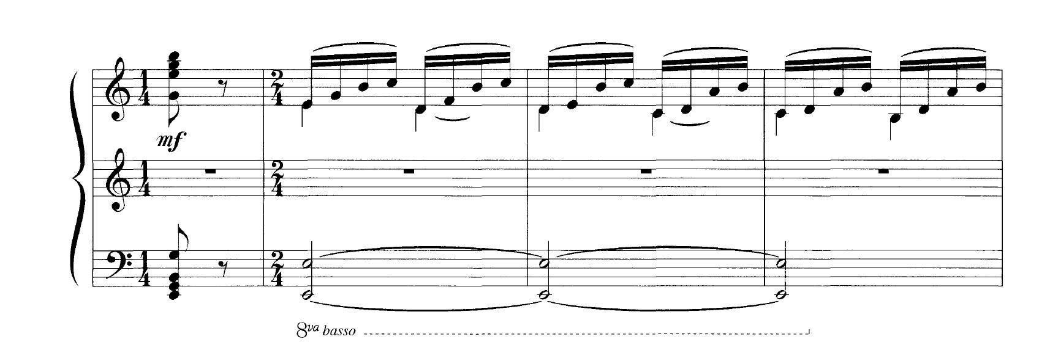
Psalms chord as subset of E Phrygian (Diatonic C collection [e024579] with emphasis on E)
Psalms chord as subset of Octatonic on E [235689e0]

Slide 17
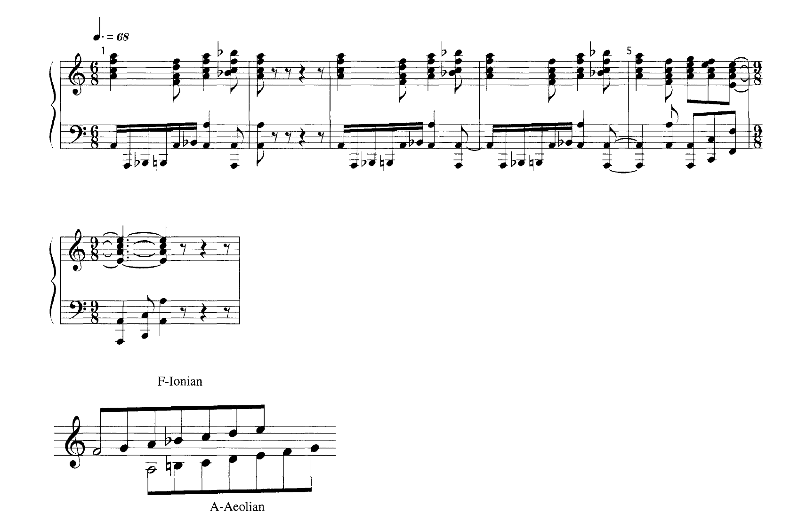
[59t0] = Oct 0,1
Stravinsky’s Serenade en la as union of two diatonic modes
(Diatonic Octad?)

Slide 18
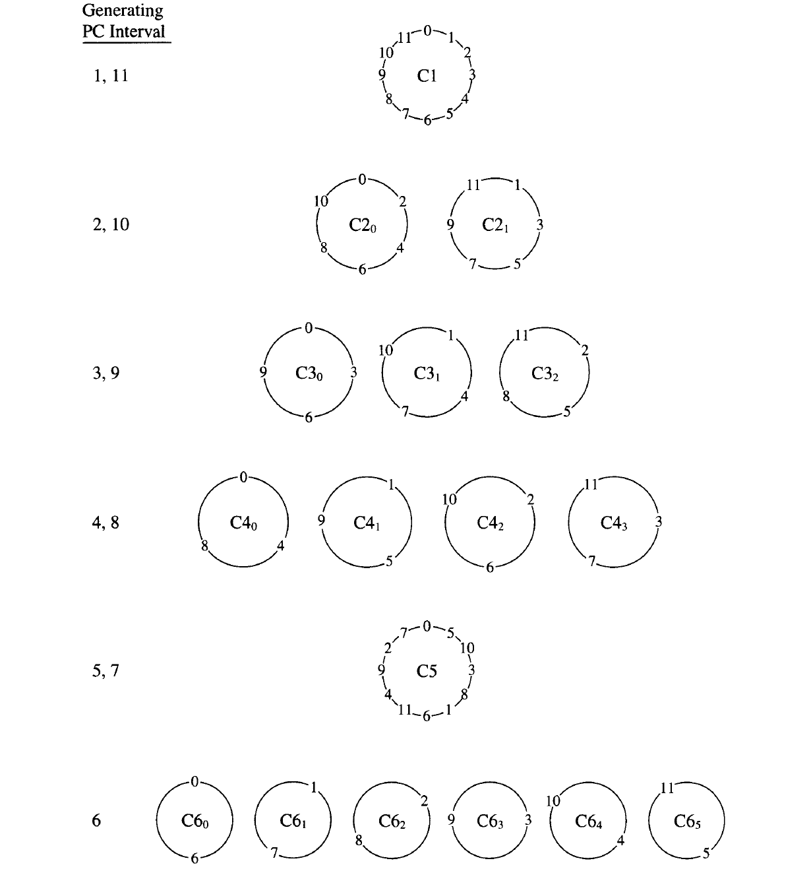
Interval Cycles

Slide 19
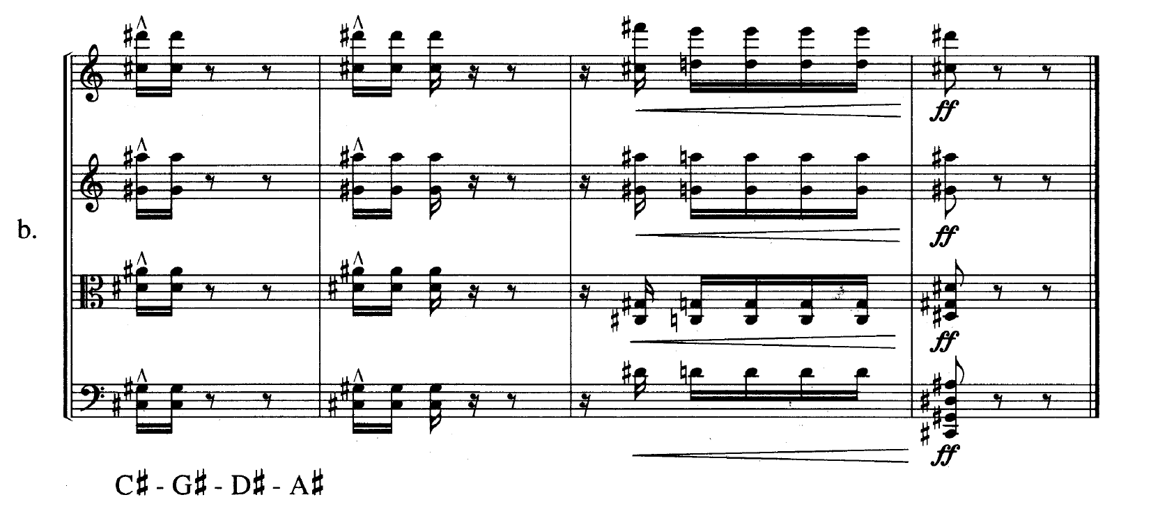
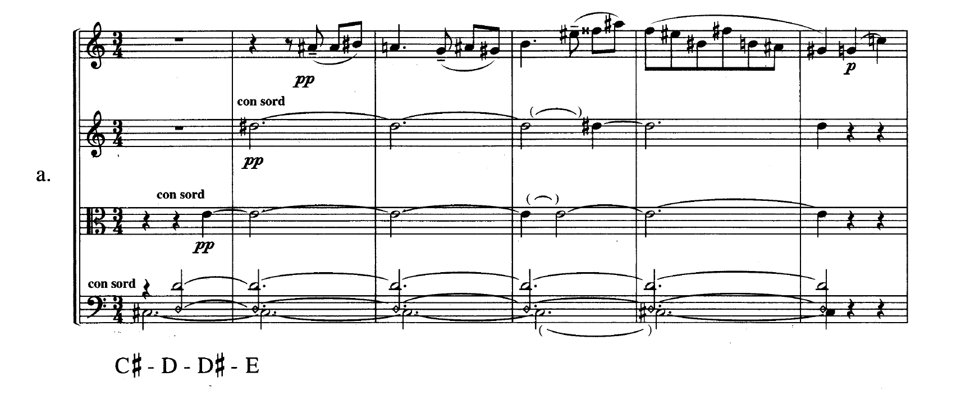
Interval Cycles: Bartók, Quartet No. 3, I intro and finale

Slide 20
whole-tone
circle of 5ths
Interval Cycles: Ives, The Cage

Slide 21
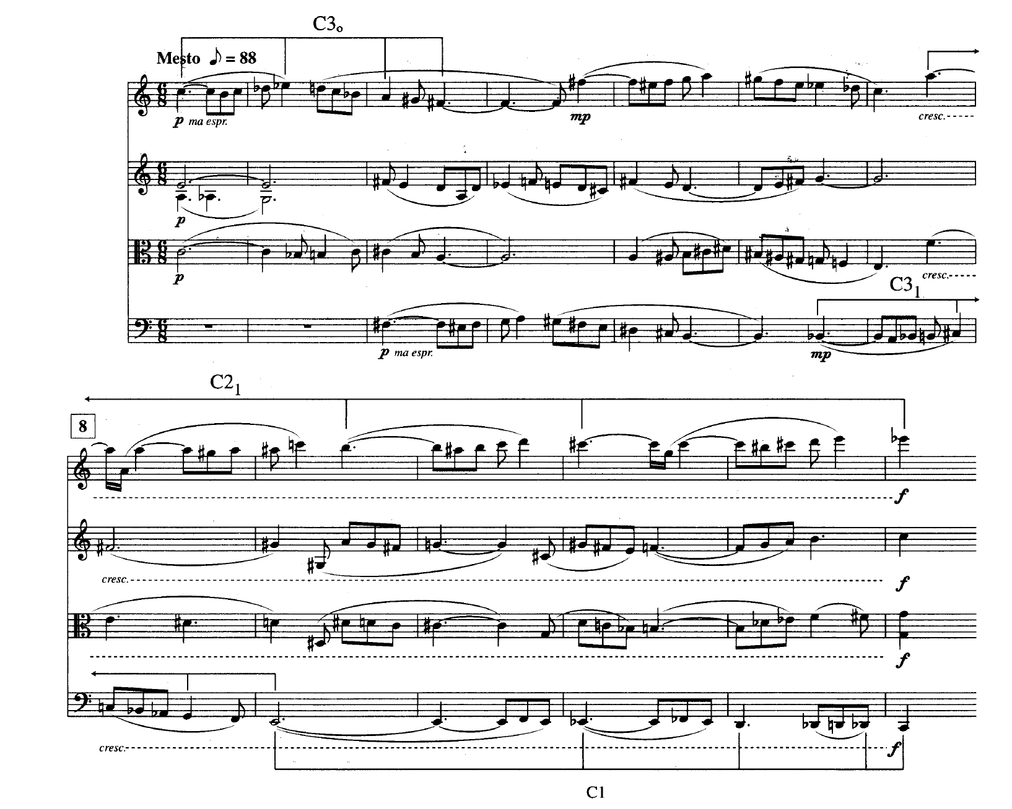
Interval Cycles: Bartók, Quartet No. 6

