Slide 1
Collections

Slide 2
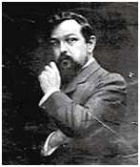
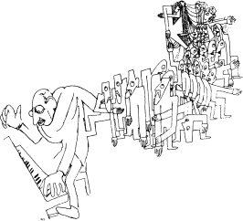
Diatonic/Modal Collections
The major scale in successive rotations, therefore still diatonic;
C major=C Ionian; beginning on
D, Dorian; on E, Phrygian; on
F Lydian; on G Mixolydian; on
A, Aeolian; on
B, Locrian.
As with the major and minor scales, there are twelve forms (twelve distinct collections) of each mode.

Slide 3
Diatonic/Modal Collections
Ionian 2-2-1-2-2-2-1 (Major Scale)
Dorian 2-1-2-2-2-1-2 (symmetrical; associated with mm7 chord)
Phrygian 1-2-2-2-1-2-2 (begins with 1, flat 7th)
Lydian 2-2-2-1-2-2-1 (major with #4)
Mixolydian 2-2-1-2-2-1-2 (major with flat 7th; associated with Mm7 chord)
Aeolian 2-1-2-2-1-2-2 (Natural minor)
Locrian 1-2-2-1-2-2-2 (begins with 1; flat 5th and flat 7th)

Slide 4
Anhemitonic Pentatonic Collections
No half steps, two non-consecutive thirds: 2-2-3-2-3.
Rotations of standard C anhemitonic pentatonic

Slide 5
More modal IDs
This is the acoustic scale - not covered in your text
C-D-E-F#-G-A-Bb-C
2-2-2-2-1-2-1-2
What two scales seem to combine here?

Slide 6
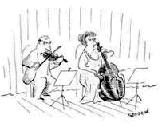
Symmetrical Scales
Even and Odd Whole Tone

Slide 7
The Octatonic Scale
OCT (0,1) =
Octatonic collection with pc 0 & pc 1

Slide 8
Model A = S-T, model B = T-S

Slide 9
Octatonic as transpositional combo

Slide 10
The hexatonic scale S-m3-S-m3-S-m3

Slide 11
The hexatonic scale transpositional combination

