Slide 1
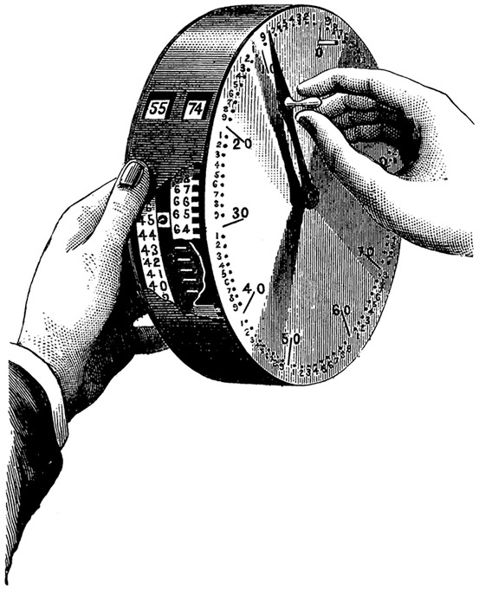
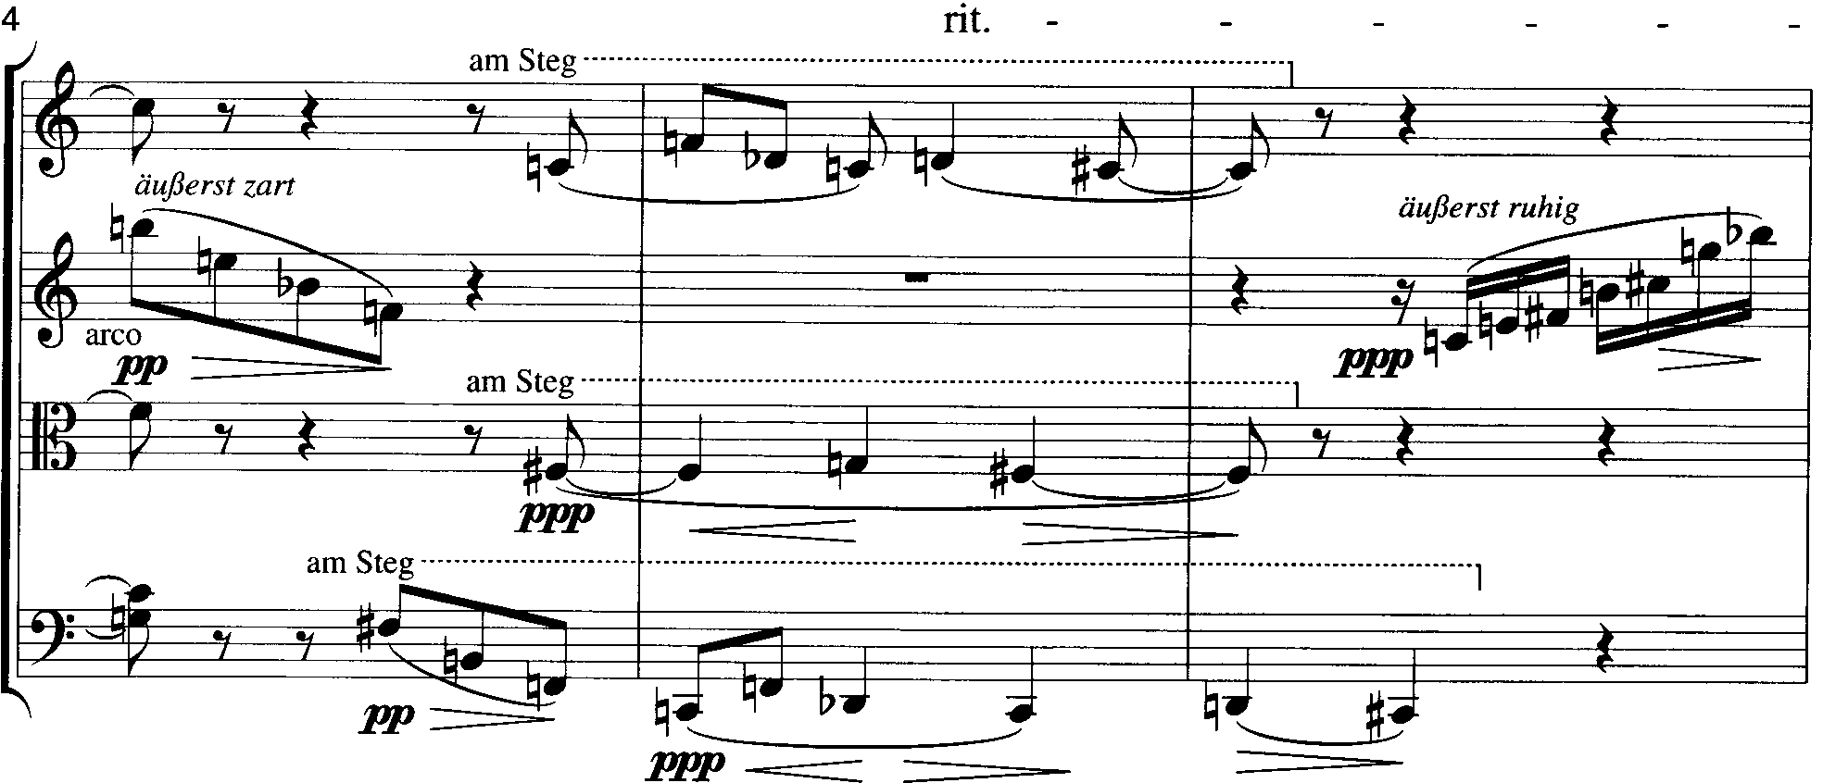
Final review

Slide 2
Contents of theory portion
Interval cycles
two questions on single-interval cycles
one on combo cycles
Transformational voice-leading: given a series of pc sets in NF, describe a network in T and/or I
Contextual Inversion: given a tetrachord and two trichords X and Y, invert around each trichord to produce a new tetrachord
Triadic transformation:
apply P, L, R or SLIDE to a given triad
Starting with a given triad and cycle, list the chords that form the cycle
Referential collections and symmetry: write out scales identify collections, reorder a collection to reveal its inherent symmetry
12-tone theory:
given a P row, write out three forms beginning on a given pc
Given a row and an invariant trichord, list a P, R, I or RI that will map that chord into a second trichord

Slide 3
Transformational voice-leading
Write out the transformational network that connects the following series of pc set-classes (ie. Tn–>In-> …). For a., relate every set back to the first set. For b., relate every new set only to the set that proceeds it.
[B, C, D, E], [F, G, A, B^{b}], [E^{b}, F, G, A^{b}], [C, D^{b}, E^{b}, F]
a. I9, I7, T1
b. I9, T10, I8

Slide 4
Contextual Inversion
Given the contextual inversion (014) X, and the contextual inversion (025) Y, what are X and Y inversions for the following sets (i.e. invert around these trichords to produce a new tetrachord)?
a. [C, D^{b}, E, F#] [0146]
b, [B, D^{b}, E, F] [E145]
a. X: [B^{b}, C, Db, E] or [T014]
a. Y: [D^{b}, E, F#, G] or [1467]
b. X: [D^{b}, E, F, G] or [1457]
b. Y: [A#, B, D^{b}, E] or [TE14]

Slide 5
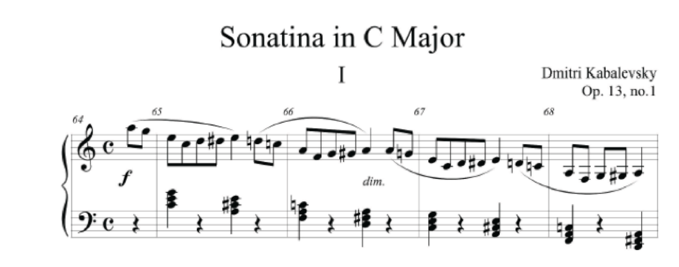
NRT analysis
C⁺ A⁺ F⁺ D⁺
RP RL RP

Slide 6
Triadic transformation: Gavin Bryars, “A Man In A Room, Gambling”
A⁺ C^{#-}
L
F⁻ A^{b+}
R
B⁻ D⁺
R
PL
PRP

Slide 7
Triadic transformation, mm. 12–14
E^{b-} C^{b+} G^{b+} A^{b-} D^{b+}
E^{b-} C^{b+} G^{b+} A^{b-} D^{b+}
L
E^{b-} C^{b+} G^{b+} A^{b-} D^{b+}
L LR
E^{b-} C^{b+} G^{b+} A^{b-} D^{b+}
L LR SLIDEPSLIDE
E^{b-} C^{b+} G^{b+} A^{b-} D^{b+}
L LR SLIDEPSLIDE R’*
*root of - becomes 5th of + and v.v.

Slide 8
Triadic transformation
F#-+ –P– F#-+
F#- –R– A+
F#- –L– D+
F#- –SLIDE– F+
Triadic transformation:
apply P, L, R or SLIDE to a given triad: F#-, C#+
Starting with a given triad and cycle, list the chords that form the cycle:
P->L->R->P->L->R on F+
C#+ –P– C#-
C#+ –R– B^{b}-
C#+ –L– F-
C#+ –SLIDE– D-
F+ F- Db+ Bb- Bb+ D- F+
-P- -L- -R- -P- -L- -R-

Slide 9
NRT relations extended

Slide 10
12-tone theory
given a P row, write out three forms beginning on a given pc (e.g., Pn, Rn, In, RIn)
Given a row and an invariant trichord, list a P, R, I or RI that will map that chord into a second trichord ORDER MATTERS
P9: 9 10 2 5 7 1 0 4 6 11 8 3
Map 571 into 397
397 is R2 of 571
EXTRA CREDIT:
Which row form begins at T2?
R11 5 10 1 8 6 2 3 9 7 4 0 11

Slide 11
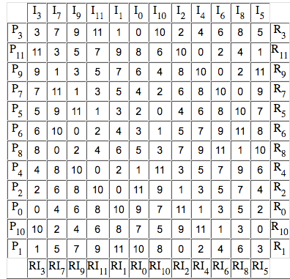
Under which operations will the segment 3, 7, 9, 11 map onto itself?
Series: 3, 7, 9, 11, 1, 0, 10, 2, 4, 6, 8, 5
I3 = I6

Slide 12
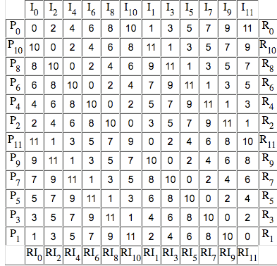
The first 6 pcs of P0 are in the same order as
the last pcs of which two row forms?
Series: 0, 2, 4, 6, 8, 10, 1, 3, 5, 7, 9, 11
P11
RI10

