Slide 1
Tonal structure

Slide 2
Beethoven, Variations WoO 75, Theme

Slide 3
Review of Graphic Notation
Open noteheads on highest level of structure
Beams and slurs group related tones: arpeggiations, linear progressions, neighbors; beams at a higher structural level
dotted slurs indicate retention of pitch over broader span

Slide 4
Review of Graphic Notation
Lines connect notes separated in time, but structurally together
Roman Numerals indicate only primary structural harmonies
Nested harmonies show middleground action

Slide 5
Beethoven, Variations WoO 75, Theme
Get it in your head
Imaginary Continuo
Stemless noteheads (one place to start)!

Slide 6
Beethoven, Variations WoO 75, Theme
Primary tonic triads get open noteheads
4-prg indicated not with beam but slur; dotted lines show persistence of C and G
Alto voice articulated with slurs and stems (to show subsidary linear progression); CS shows prolongations of C and G

Slide 7
The consequent outlines a 5-prg, complementing the 4-prg in the antecedent; tonic prolonged into m. 6
The alto analysis matches the antecedent, while the flag on ii⁶ marks its connection to V⁷
Harmonic prolongation of F
The alto no longer creates a linear progression, because it breaks for the predominant
The final E in treble is graphed as an inner voice, as a CS from G (ˆ2)
C a “dividing dominant” (part of the overall tonic prolongation)

Slide 8
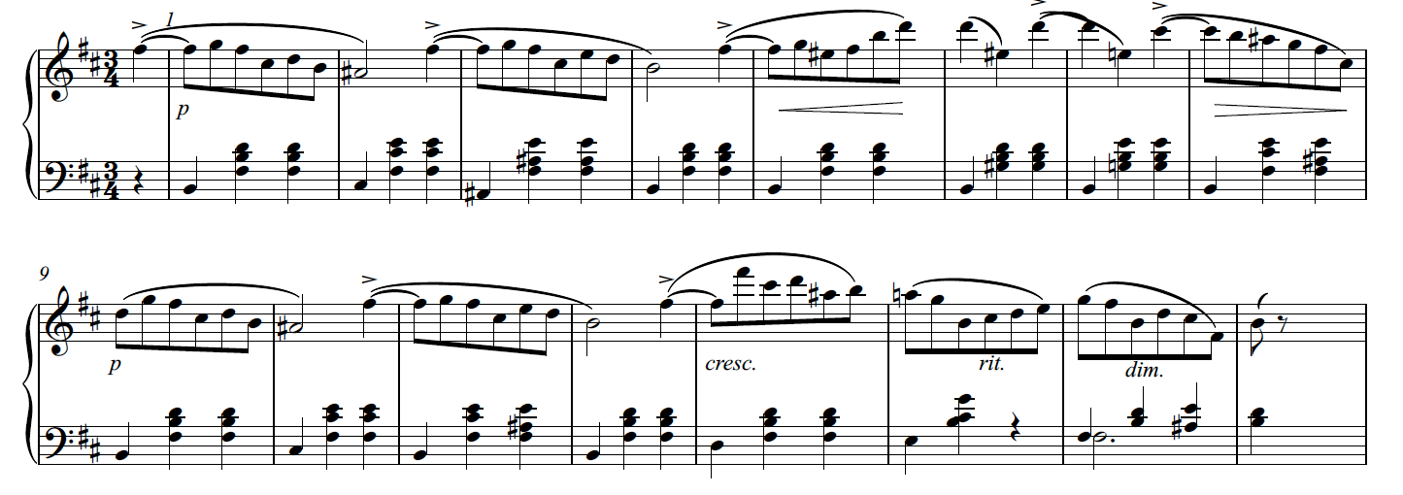
Chopin Waltz in b, Op. 69, No. 2

Slide 10
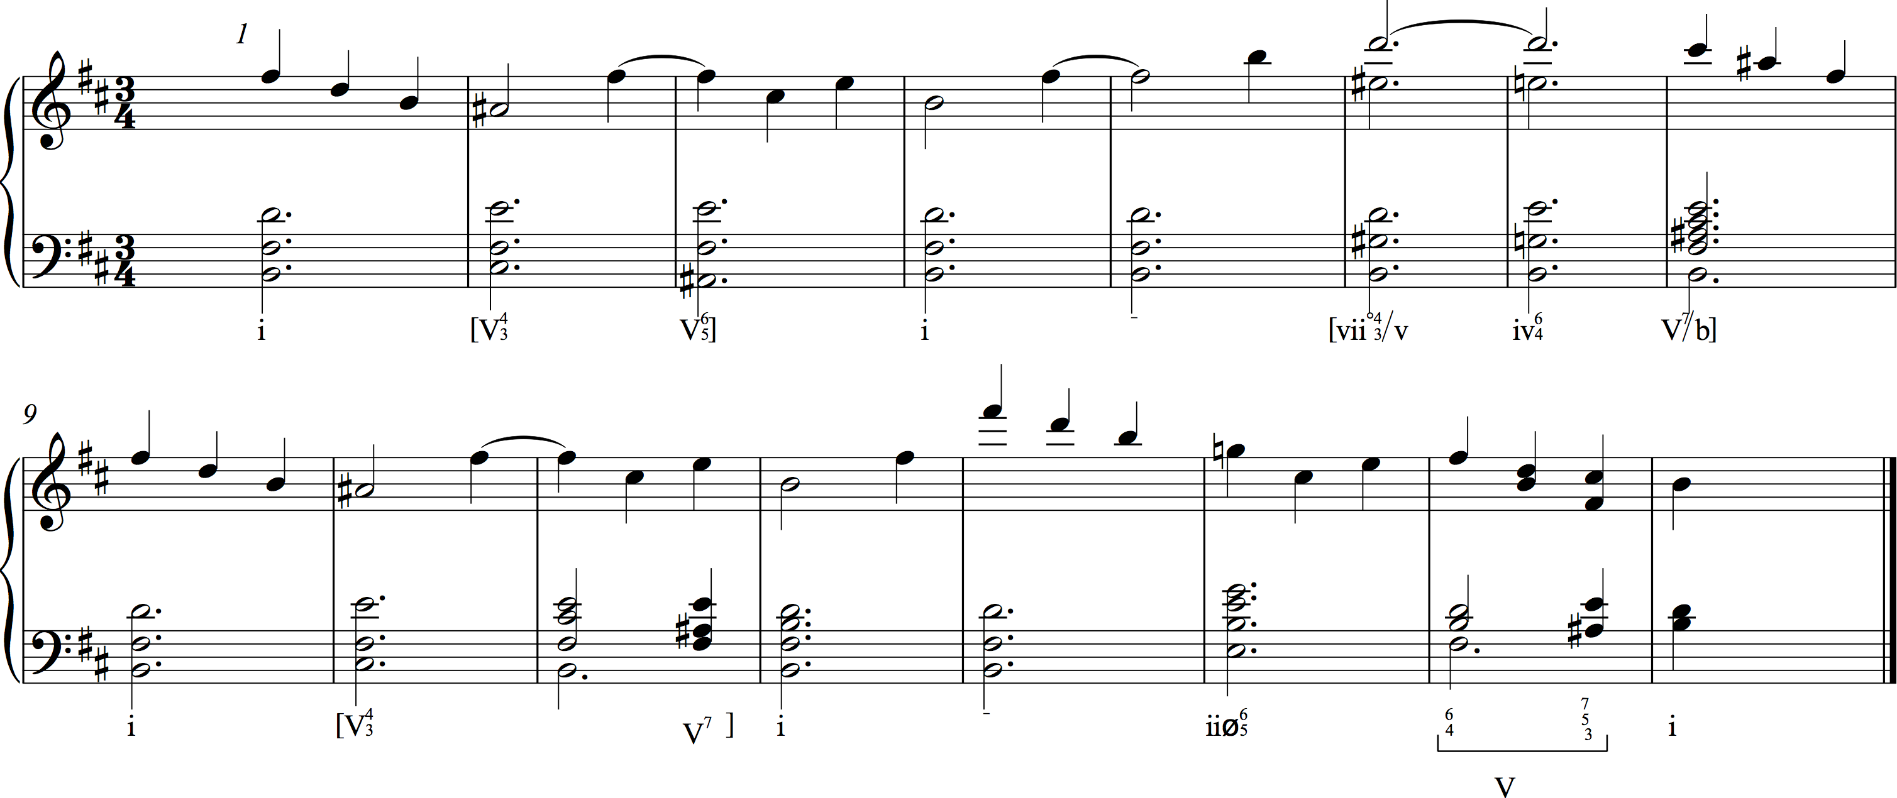

Slide 12
repeat

Slide 14
Beethoven, Sonata No. 6, Op. 10, No. 2, I

